Slide 1
Chapter 3: An Introduction to Portfolio Management

Slide 2
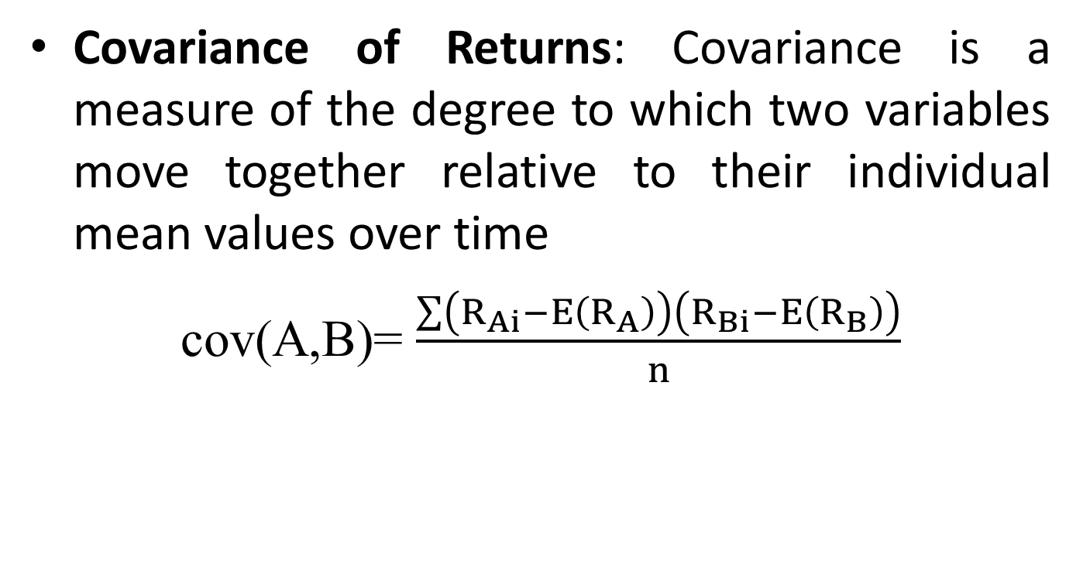
Covariance and Correlation
Covariance of Returns: Covariance is a measure of the degree to which two variables move together relative to their individual mean values over time
cov(A,B)= $\frac{\sum{\left(R_{Ai}−E\left(R_{A}\right)\right)}\left(R_{Bi}−E\left(R_{B}\right)\right)}{n}$

Slide 3
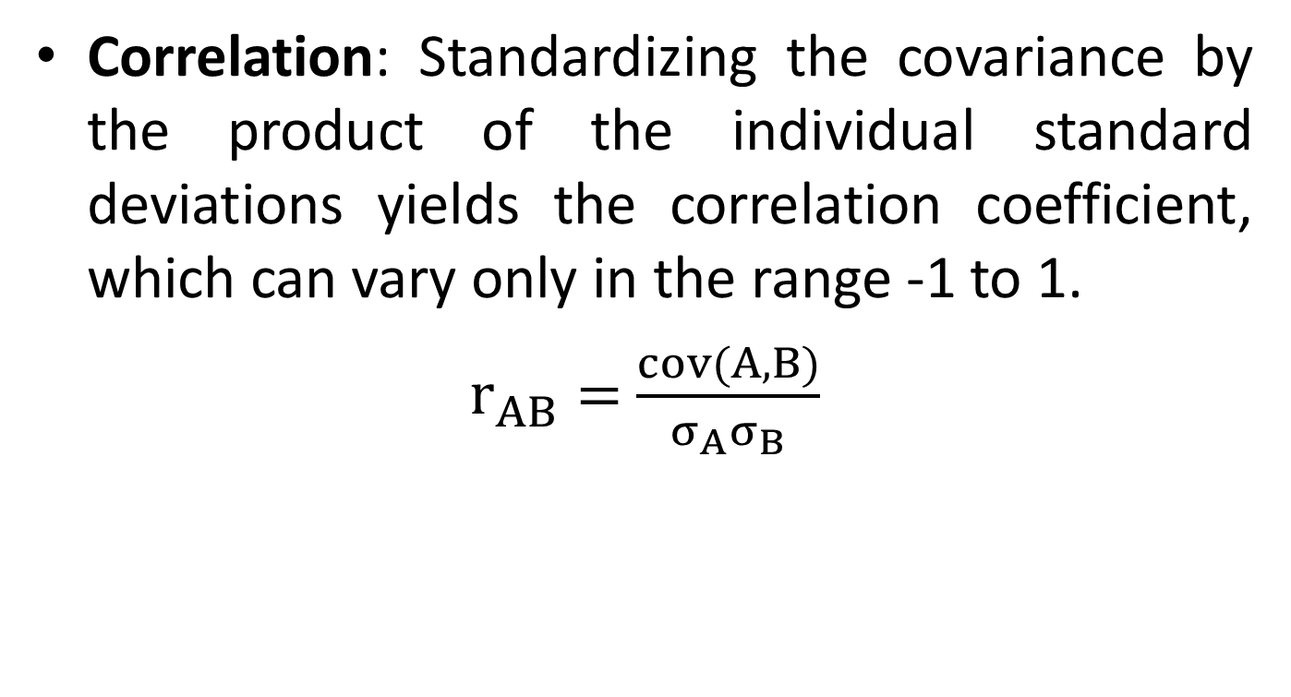
Covariance and Correlation
Correlation: Standardizing the covariance by the product of the individual standard deviations yields the correlation coefficient, which can vary only in the range -1 to 1.
$r_{AB}=$ $\frac{cov(A,B)}{σ_{A}σ_{B}}$

Slide 4
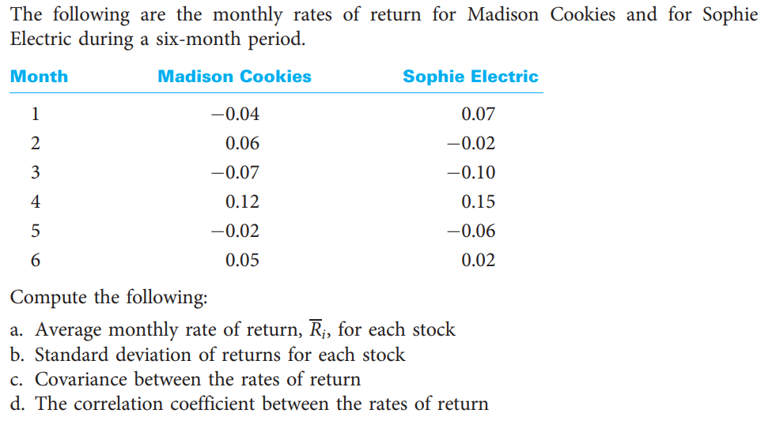
Covariance and Correlation
Problem 3

Slide 5
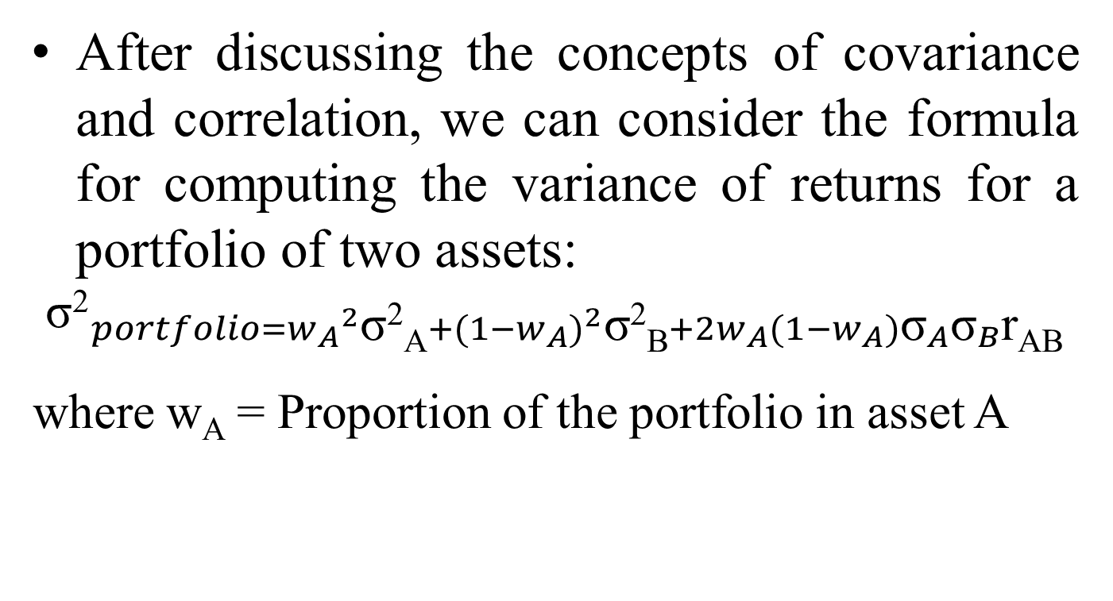
Variance of a Portfolio
After discussing the concepts of covariance and correlation, we can consider the formula for computing the variance of returns for a portfolio of two assets:
$${\text{σ}\text{2}}_{\begin{aligned}portfolio={w_{A}}^{2}\text{σ}\text{2}\text{A}+{(1−w_{A})}^{2}\text{σ}\text{2}\text{B}+2w_{A}(1−w_{A}){\text{σ}}_{A}{\text{σ}}_{B}\text{r}\text{AB} \\ \end{aligned}}$$
where w_{A} = Proportion of the portfolio in asset A

Slide 6
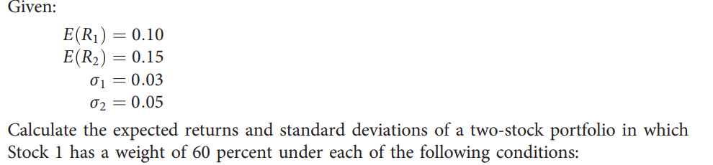
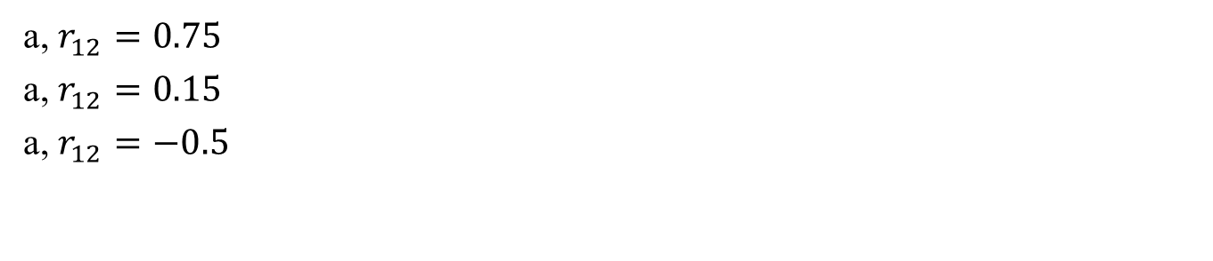
Variance of a Portfolio
a, $r_{12}=0.75$
a, $r_{12}=0.15$
a, $r_{12}=−0.5$

Slide 7
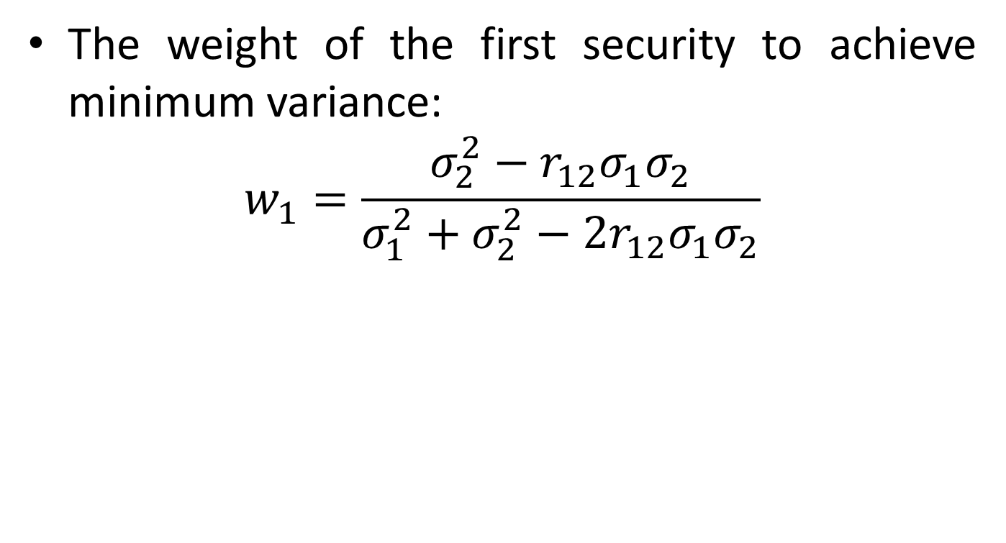
The minimum-variance portfolio
The weight of the first security to achieve minimum variance:
$$w_{1}=\frac{σ_{2}^{2}−r_{12}σ_{1}σ_{2}}{{σ_{1}^{2}+σ}_{2}^{2}−{2r}_{12}σ_{1}σ_{2}}$$

Slide 8
The minimum-variance portfolio
Assume that we have two risky assets. The first is a stock fund, the second is a long-term bond fund. Their correlation coefficient is 0.3.
What are the investment proportions in the minimum-variance portfolio of the two risky funds, and what are the expected value and standard deviation of its rate of return?
 | Expected Return | Standard Deviation
Stock fund (S) | 13% | 20%
Bond fund (B) | 8% | 12%

Slide 9
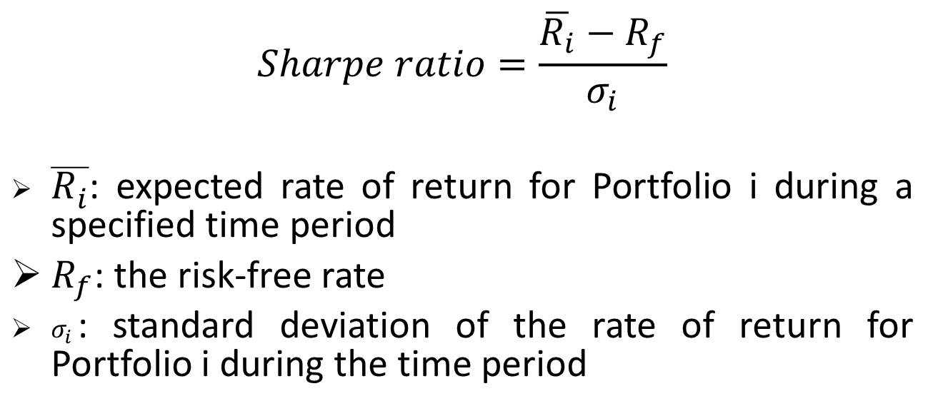
Sharpe Portfolio Performance Measure
$$Sharpe ratio=\frac{\overline{R_{i}}−R_{f}}{σ_{i}}$$
$\overline{R_{i}}$: expected rate of return for Portfolio i during a specified time period
$R_{f}$: the risk-free rate
$σ_{i}$: standard deviation of the rate of return for Portfolio i during the time period

Slide 10
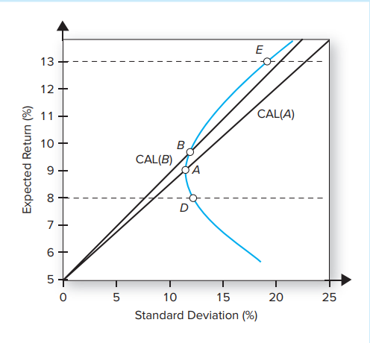
Asset Allocation with Stocks, Bonds, and Cash equivalent
If our risky assets are still confined to the bond and stock funds, as in the last section, but we can now also invest in risk-free T-bills yielding 5%.
Two possible capital allocation lines (CALs) are drawn from the risk-free rate (rf = 5%)
to two feasible portfolios. The first possible CAL is drawn through the minimum-variance
portfolio A, which is invested 82% in bonds and 18% in stocks.

Slide 11
Asset Allocation with Stocks, Bonds, and Cash equivalent
Now consider the CAL that uses portfolio B
instead of A. Portfolio B invests 70% in bonds and
30% in stocks.
We can continue
to ratchet the CAL upward to the greatest extent
possible, which is where it ultimately reaches the point of tangency with the investment opportunity set. This yields the CAL with the highest feasible Sharpe ratio

Slide 12
The optimal portfolio
The weights of the optimal risky portfolio
$$w_{1}=\frac{(E\left(r_{1}\right)−r_{f})σ_{2}^{2}−{(E\left(r_{2}\right)−r_{f})r}_{12}σ_{1}σ_{2}}{\left(E\left(r_{1}\right)−r_{f}\right)σ_{2}^{2}+\left(E\left(r_{2}\right)−r_{f}\right)σ_{1}^{2}−{(E\left(r_{1}\right)+E\left(r_{2}\right)−{2r}_{f})r}_{12}σ_{1}σ_{2}}$$

Slide 13
The Efficient Frontier
The Efficient Frontier:
The efficient frontier represents that set of portfolios that has the maximum rate of return for every given level of risk or the minimum risk for every level of return.
No portfolio on the efficient frontier can dominate any other portfolio on the efficient frontier. All of these portfolios have different return and risk measures, with expected rates of return that increase with higher risk.
According to mean–variance theory, in determining a strategic asset allocation an investor should choose from among the efficient portfolios consistent with that investor’s risk tolerance

Slide 14
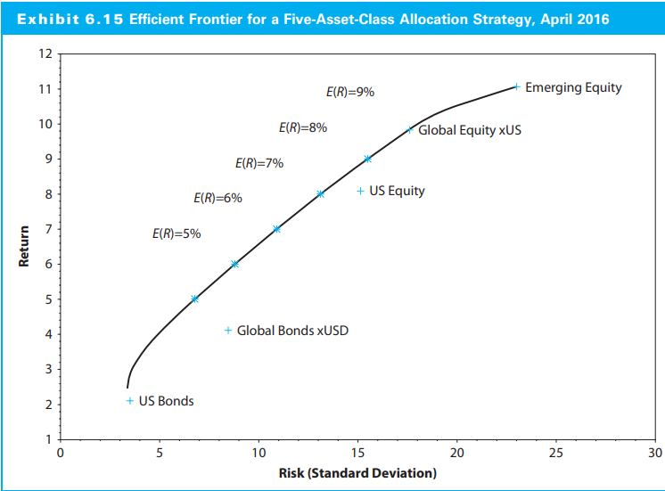
The Efficient Frontier

Slide 15
The Efficient Frontier
A corner portfolios define a segment of the efficient frontier within which (1) portfolios hold identical assets and (2) the rate of change of asset weights in moving from one portfolio to another is constant.
As the minimum-variance frontier passes through a corner portfolio, an asset weight either changes from zero to positive or from positive to zero

Slide 16
The Efficient Frontier
Asset class | Expected return (%) | Standard deviation (%)
Vietnamese Stocks (1) | 10 | 15
Chinese Stocks (2) | 8 | 12
Vietnamese government 1Y bond (3) | 4 | 7
Vietnamese government 10Y bond (4) | 4.5 | 8
Chinese government 15Y bond (5) | 5 | 9
Vietnamese corporate 10Y bond (6) | 7 | 10

Slide 17
The Efficient Frontier
 |  |  | Weights of asset classes
Corner portfolios | Expected returns (%) | Standard deviations (%) | 1 | 2 | 3 | 4 | 5 | 6
1 | 10 | 15 | 100 | 0 | 0 | 0 | 0 | 0
2 | 8.86 | 11.04 | 61.9 | 0 | 0 | 0 | 0 | 38.1
3 | 8.35 | 9.8 | 40.31 | 13.85 | 0 | 0 | 0 | 45.83
4 | 7.94 | 8.99 | 32.53 | 14.3 | 0 | 0 | 8.74 | 44.44
5 | 7.3 | 7.82 | 19.93 | 21.09 | 16.85 | 0 | 0 | 42.13
6 | 6.13 | 5.94 | 0 | 26.61 | 37.81 | 0 | 0 | 35.58
7 | 5.33 | 5.37 | 0 | 13.01 | 59.94 | 0 | 0 | 27.06

Slide 18
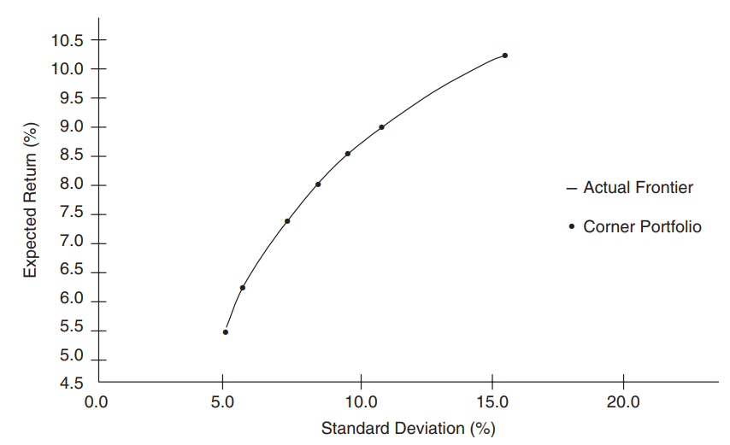
The Efficient Frontier

Slide 19
The Efficient Frontier
Corner portfolios allow us to create other minimum-variance portfolios
Suppose we want to find the composition of the efficient portfolio with an 8 percent expected return.

Slide 20
The Efficient Frontier
As chief investment officer of a small endowment fund, you are considering expanding the fund’s strategic asset allocation from just common stock (CS) and fixed-income (FI) to include private real estate partnerships (PR) as well:
Current Allocation: 60 percent of Asset CS, 40 percent of Asset FI
Proposed Allocation: 50 percent of Asset CS, 30 percent of Asset FI, 20 percent of Asset PR
You also consider the following historical data for the three risky asset classes (CS, FI, and PR) and the risk-free rate (RFR) over a recent investment period

Slide 21
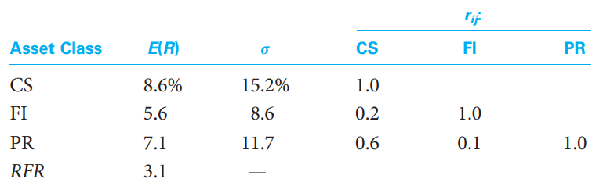
The Efficient Frontier
a. Calculate the expected return for the Current and Proposed Allocations.
b. Calculate the standard deviation for the Current and Proposed Allocations.
c. For both the Current and Proposed Allocations, calculate the expected risk premium per unit of risk

Slide 22
EQUITY valuation
  Share of common stock is more difficult to value in practice than a bond for at least three reasons:
  With common stock, not even the promised cash flows are known in advance
  Life of the investment is essentially forever because common stock has no maturity
  No way to easily observe the rate of return that the market requires
  There are two ways to evaluate equity: discounted cash flow analysis and relative valuation
Notes:
Section 8.1

Slide 23

discounted cash flow
Imagine you are considering buying a share of stock today. You plan to sell the stock in one year. You somehow know that the stock will be worth $70 at that time. You predict the stock will also pay a $10 per share dividend at the end of the year. If you require a 25% return on your investment, what is the most you would pay for the stock? In other words, what is the present value of the $10 dividend along with the $70 ending value at 25%?
  Present value = ($10 + 70)/1.25 = $64
Let P₀ be the current price of the stock, and assign P₁ to be the price in one period. If D₁ is the cash dividend paid at the end of the period and R is the required return in the market on this investment , then:
Notes:
Section 8.1
$64 is the value you would assign to the stock today.

Slide 24

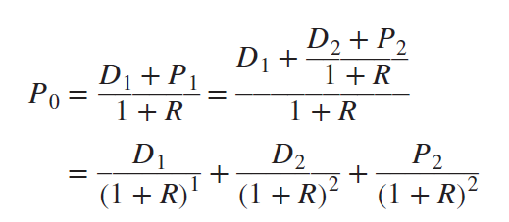
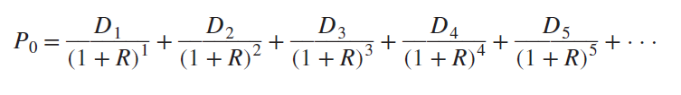
discounted cash flow
(continued)
Suppose we somehow knew the price in two periods, P₂. Given a predicted dividend in two periods, D₂, the stock price in one period would be:
Substitute this expression for P₁ into our expression for P₀
The price of the stock today is equal to the present value of all of the future dividends
Notes:
We can push the problem of coming up with the stock price off into the future forever. Note that no matter what the stock price is, the present value is essentially zero if we push the sale of the stock far enough away. What we are eventually left with is the result that the current price of the stock can be written as the present value of the dividends beginning in one period and extending out forever.

Slide 25



Zero growth
A share of common stock in a company with a constant dividend is much like a share of preferred stock
Dividend on a share of preferred stock has zero growth and is constant through time; for a zero-growth share of common stock, this implies that:
Value of the stock is:
Stock may be viewed as ordinary perpetuity with cash flow equal to D every period, with the per-share value given by:
  Where R is the required return

Slide 26
Constant growth
Suppose we know that the dividend for some company always grows at a steady rate. Call this growth rate g. If we let D₀ be the dividend just paid, then the next dividend, D₁, is:
    D₁ = D₀ × (1 + g)
The dividend in two periods is:
    D₂ = D₁ × (1 + g)
    = [D₀ × (1 + g )] × (1 + g)
    = D₀ × ( 1 + g )²
We could repeat this process to come up with the dividend at any point in the future
The dividend t periods into the future, D_{t}, is given by:
    D_{t} = D₀ × (1 + g)^{t}
Notes:
The assumption of steady dividend growth might strike you as peculiar. Why would the dividend grow at a constant rate? The reason is that, for many companies, steady growth in dividends is an explicit goal.

Slide 27


Constant growth
(continued)
The dividend growth model determines the current price of a stock as its dividend next period divided by the discount rate less the dividend growth rate, and can be written as follows, so long as the growth rate, g, is less than the discount rate, r:
We can use the dividend growth model to get the stock price at any point in time; in general, the price of the stock as of Time t is:

Slide 28

Constant growth
(concluded)
Suppose D₀ is $2.30, R is 13%, and g is 5%. The price per share in this case is:
    P₀ = D₀ × (1 + g)/(R − g)
    = $2.30 × 1.05/(. 13 − . 05 )
    = $2.415 / .08
    = $30.19
Suppose we are interested in the price of the stock in five years, P₅. We first need the dividend at Time 5, D₅. Because the dividend just paid is $2.30 and the growth rate is 5% per year, D₅ is:
    D₅ = $2.30 × 1.05⁵ = $2.30 × 1.2763 = $2.935
The price of the stock in five years is:

Slide 29
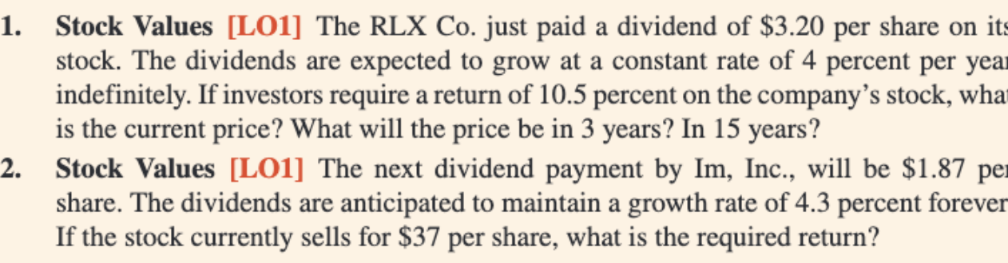

Slide 30
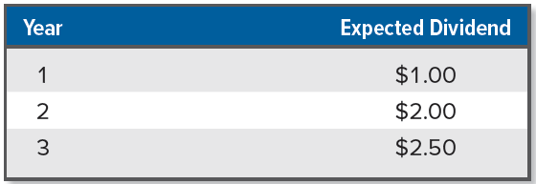
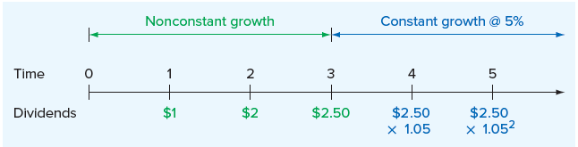
Nonconstant GROWTH
(continued)
Suppose you have come up with the following dividend forecasts for the next three years. After the third year, the dividend will grow at a constant rate of 5% per year. The required return is 10%. What is the value of the stock today?
In dealing with nonconstant growth, a time line can be helpful
Notes:
The problem of nonconstant growth is only slightly more complicated if the dividends are not zero for the first several years.
The important thing to notice is when constant growth starts. As we’ve shown, for this problem, constant growth starts at Time 3. By far the most common mistake in this situation is to incorrectly identify the start of the constant growth phase and, as a result, calculate the future stock price at the wrong time.

Slide 31
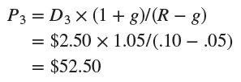
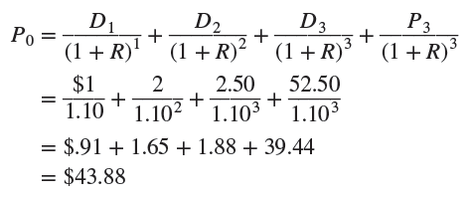
Nonconstant GROWTH
(Concluded)
Value of the stock is the present value of all the future dividends:
  Compute the PV of the stock price three years down the road
  Add in the PV of dividends that will be paid between now and then
Notes:
The value of the stock today is thus $43.88.

Slide 33
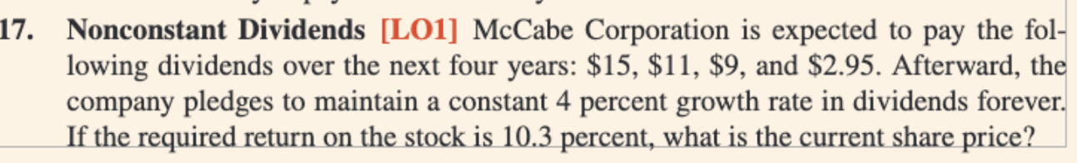

Slide 34
RELATIVE VALUATION
While discounted cash flow analysis attempts to calculate the intrinsic value of a company, relative valuation attempts to value a company by comparing it to similar companies or the overall market or the stock’s own trading history. DCF is often described as the best way to determine absolute value while relative valuation describes what others seem willing to pay.
When analysts use multiples, they are typically used in one of the following ways:
1. Comparing multiples to comparable companies.
2. Comparing a stock multiple to the market multiple.
3. Comparing a stock’s multiple to its historic multiple.
4. Comparing a stock’s multiple to recent transactions
Notes:
As with any ratio, all three valuation ratios vary based on company age and industry.

Slide 35
RELATIVE VALUATION
If the company is profitable (i.e., has positive earnings), use the PE ratio, calculated as the ratio of a stock’s price per share to its earnings per share (EPS) over the previous year
  Idea is to have some sort of benchmark PE ratio, which we then multiply by earnings to come up with a price:
  Benchmark PE ratio could come from a variety of sources (e.g., based on similar companies, based on a company’s own historical values)
  PE ratio based on estimated future earnings is a forward PE ratio
Some companies do not pay dividends nor are they profitable
  In this case, use the price-sales ratio, calculated as the price per share on the stock divided by sales per share, or the EV/EBITDA ratio
Notes:
As with any ratio, all three valuation ratios vary based on company age and industry.

