Slide 1
Portfolio Management
Dr. Le Quy Duong
Email: duonglq@neu.edu.vn
Phone: 0966973642
Research Interests: efficient stock markets, asset pricing models

Slide 2
Chapter 1: The Investment Setting

Slide 3
1.1 What is an Investment?
For most of your life, you will be earning and spending money.
When current income exceeds current consumption desires, people tend to save the excess. They can give up the immediate possession of these savings for a future larger amount of money that will be available for future consumption
What you do with the savings to make them increase over time is investment

Slide 4
1.1.1 Investment Defined
An investment is the current commitment of dollars for a period of time in order to derive future payments that will compensate the investor for (1) the time the funds are committed, (2) the expected rate of inflation during this time period, and (3) the uncertainty of the future payments.

Slide 5
1.1.1 Investment Defined
The “investor” can be an individual, a government, a pension fund, or a corporation. Similarly, this definition includes all types of investments, including investments by corporations in plant and equipment and investments by individuals in stocks, bonds, commodities, or real estate

Slide 6
1.1.1 Investment Defined
In all cases, the investor is trading a known dollar amount today for some expected future stream of payments that will be greater than the current dollar amount today. At this point, we have answered the questions about why people invest and what they want from their investments

Slide 7
1.1.1 Investment Defined
Investors want a rate of return that compensates them for the time period of the investment, the expected rate of inflation, and the uncertainty of the future cash flows. This return is the investor’s required rate of return. A central question is how investors select investments that will give them their required rates of return

Slide 8
1.2 Measures of Return and Risk
Return quantifies gains or losses on investments.
Risk measures the uncertainty of these returns using variance and standard deviation.
Following the presentation of measures of historical rates of return and risk, we turn to estimating the expected rate of return for an investment. Obviously, such an estimate contains a great deal of uncertainty, and we present measures of this uncertainty or risk

Slide 9
1.2.1 Measures of Historical Rates of Return
Historical return reflects asset performance over a holding period.
Holding period yield (HPY) = (Ending Value of Investment + Income - Beginning Value of Investment)/ Beginning Value of Investment.

Slide 10
1.2.1 Measures of Historical Rates of Return
If you commit $200 to an investment at the beginning of the year and you get back $220 at the end of the year
Consider an investment that cost $250 and is worth $350 after being held for two years

Slide 11

1.2.2 Computing Mean Historical Returns
Single investment:
Arithmetic Mean: Simple average of returns.
Geometric Mean: Compounded annual rate of return.

Slide 12
1.2.2 Computing Mean Historical Returns
A Portfolio of Investments: Weighted average based on investment values. The weights used in computing the averages are the relative beginning market values for each investment.

Slide 13
1.2.2 Computing Mean Historical Returns
 | Stock price at 31 Dec, 2023($) | Stock price at 31 Dec, 2024 ($) | Market values for each investment ($)
DTT | 8.89 | 12.7 | 889
HAX | 15.7 | 18.8 | 785
BMI | 20.7 | 26.7 | 621

Slide 14
1.2.3 Expected Rates of Return
Risk is the uncertainty that an investment will earn its expected rate of return. In the examples in the prior section, we examined realized historical rates of return. In contrast, an investor who is evaluating a future investment alternative expects or anticipates a certain rate of return.

Slide 15

1.2.3 Expected Rates of Return
The investor might estimate probabilities for each of these economic scenarios based on past experience and the current outlook as follows:

Slide 16
1.2.4 Risk of Expected Returns
Most investors want to quantify Risk of Expected Returns using statistical techniques. These statistical measures allow you to compare the return and risk measures for alternative investments directly. Two possible measures of risk (uncertainty) have received support in theoretical work on portfolio theory: the variance and the standard deviation of the estimated distribution of expected returns.

Slide 17
1.2.5 Historical Return Risk
To measure the risk for a series of historical rates of returns, we use the same measures as for expected returns (variance and standard deviation) except that we consider the historical holding period yields
Problem 5

Slide 18
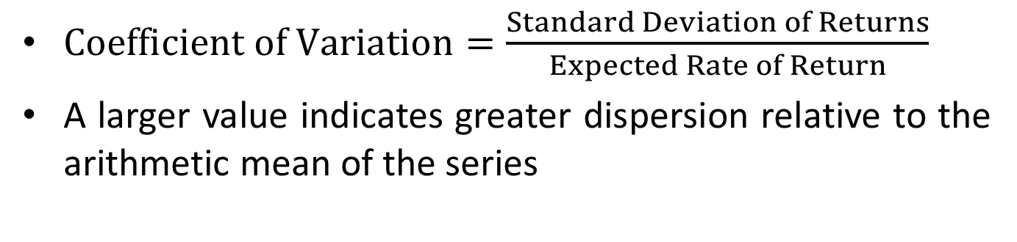
1.2.6 Coefficient of variation
$Coefficient of Variation=\frac{Standard Deviation of Returns}{Expected Rate of Return}$
A larger value indicates greater dispersion relative to the arithmetic mean of the series

Slide 19
1.3 Determinants of Required Rates of Return
Securities provide a rate of return that compensates you for: (1) the time value of money during the period of investment, (2) the expected rate of inflation during the period, and (3) the risk involved.
The summation of these three components is called the required rate of return. This is the minimum rate of return that you should accept from an investment to compensate you for deferring consumption

Slide 20
1.3 Determinants of Required Rates of Return
The analysis and estimation of the required rate of return are complicated by the behavior of market rates over time. First, a wide range of rates is available for alternative investments at any time. Second, the rates of return on specific assets change dramatically over time. Third, the difference between the rates available (that is, the spread) on different assets changes over time

Slide 21
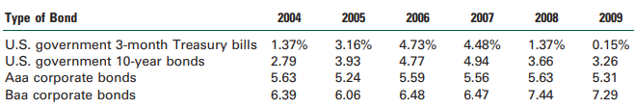
1.3 Determinants of Required Rates of Return

Slide 22
1.3.1 Real Risk-Free Rate
The real risk-free rate (RRFR) is the basic interest rate, assuming no inflation and no uncertainty about future flows. An investor in an inflation-free economy who knew with certainty what cash flows he or she would receive at what time would demand the RRFR on an investment.

Slide 23
1.3.2 Nominal Risk-Free Rate
Nominal rates of interest are determined by real rates of interest, plus factors that will affect the nominal rate of interest, such as conditions in the Capital Market and the expected rate of inflation.

Slide 24
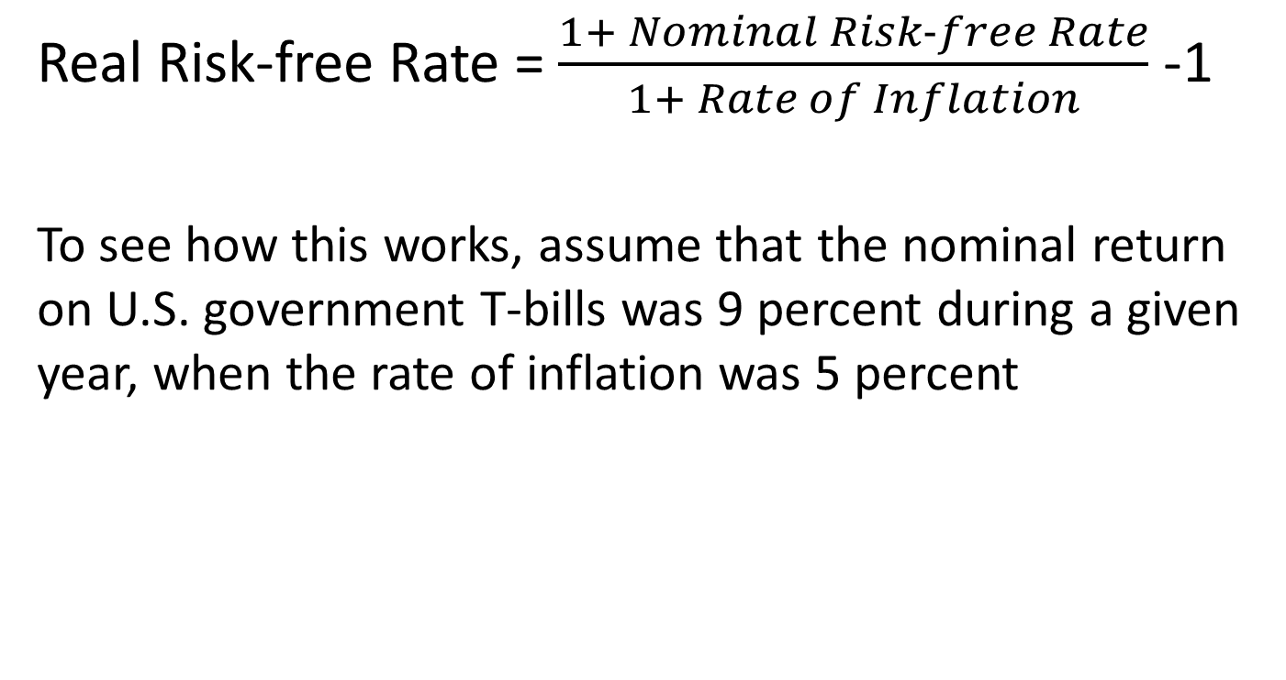
1.3.2 Nominal Risk-Free Rate
Real Risk-free Rate = $\frac{1+ Nominal Risk−free Rate}{1+ Rate of Inflation}$ -1
To see how this works, assume that the nominal return on U.S. government T-bills was 9 percent during a given year, when the rate of inflation was 5 percent

Slide 25
1.3.3 Risk Premium
Investments can range in uncertainty from basically risk-free securities, such as T-bills, to highly speculative investments, such as the common stock of small companies engaged in high-risk enterprises.
Most investors require higher rates of return on investments if they perceive that there is any uncertainty about the expected rate of return. This increase in the required rate of return over the Nominal Risk-Free Rate is the risk premium

Slide 26
1.3.3 Risk Premium
The major sources of uncertainty include: (1) business risk, (2) financial risk (leverage), (3) liquidity risk, (4) exchange rate risk, and (5) country (political) risk
Business risk is the uncertainty of income flows caused by the nature of a firm’s business. The less certain the income flows of the firm, the less certain the income flows to the investor. Therefore, the investor will demand a risk premium that is based on the uncertainty caused by the basic business of the firm

Slide 27
1.3.3 Risk Premium
Financial risk is the uncertainty introduced by the method by which the firm finances its investments. If a firm uses only common stock to finance investments, it incurs only business risk. If a firm borrows money to finance investments, it must pay fixed financing charges (in the form of interest to creditors) prior to providing income to the common stockholders, so the uncertainty of returns to the equity investor increases

Slide 28
1.3.3 Risk Premium
Liquidity risk is the uncertainty introduced by the secondary market for an investment. When an investor acquires an asset, he or she expects that the investment will mature (as with a bond) or that it will be salable to someone else. In either case, the investor expects to be able to convert the security into cash and use the proceeds for current consumption or other investments. The more difficult it is to make this conversion to cash, the greater the liquidity risk

Slide 29
1.3.3 Risk Premium
Exchange rate risk is the uncertainty of returns to an investor who acquires securities denominated in a currency different from his or her own. The likelihood of incurring this risk is becoming greater as investors buy and sell assets around the world, as opposed to only assets within their own countries.
Country risk, also called political risk, is the uncertainty of returns caused by the possibility of a major change in the political or economic environment of a country

Slide 30
1.3.4 Risk Premium and Portfolio Theory
An alternative view of risk has been derived from extensive work in portfolio theory and capital market theory.
Under a specified set of assumptions, all rational, profit-maximizing investors want to hold a completely diversified market portfolio of risky assets, and they borrow or lend to arrive at a risk level that is consistent with their risk preferences. Under these conditions, they showed that the relevant risk measure for an individual asset is its comovement with the market portfolio. This comovement, which is measured by an asset’s covariance with the market portfolio, is referred to as an asset’s systematic risk

Slide 31
1.4 Relationship Between Risk and Return
Investors increase their required rates of return as perceived risk (uncertainty) increases. The line that reflects the combination of risk and returns available on alternative investments is referred to as the security market line (SML). The SML reflects the risk-return combinations available for all risky assets in the capital market at a given time. Investors would select investments that are consistent with their risk preferences; some would consider only low-risk investments, whereas others welcome high-risk investments.

Slide 32
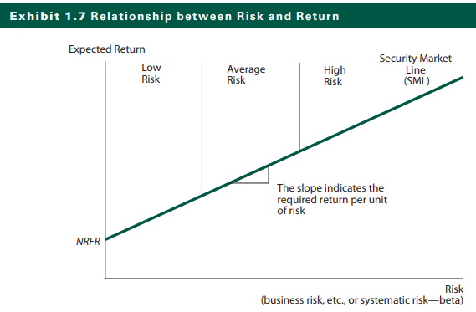
1.4 Relationship Between Risk and Return

