Slide 1
Agentic Teaching & Admin Workflow Skills
Addressing Hallucinations, Confidentiality, and Memory Management
Andreas Henschel · Khalifa University

Slide 2
Outline
Intro LLMs
Rant 1 – Hallucinations and Context Rot
  Kool Aid 1: Witchcraft - prompt engineering
  Kool Aid 2: More Witchcraft – hierarchical instructions
Rant 2 – confidentiality breaches.
  Issues with Server side processing
  Trackers in web sites
  Mitigation: Local LLMs
Practical part
  Claude Code (optional, but highly recommended)
  Application:
    large scale document (internship reports) analysis with skills
    Grade scope + Claude + Chrome
  Optional: MCP project

Slide 3
What This Workshop Covers
How LLMs actually work, and where that leads to hallucinations in admin contexts
Making instructions persistent — 🧩 Skills and layered 📄 CLAUDE.md files, not chat memory
Local data, local agents, and deterministic tool calls (function calling, MCP, UTCP)
A full worked example: grading 150+ internship reports end-to-end, skillified for reuse
🤖 Agent resilience, sub-agents, and why unattended “auto-mode” agents need guardrails
Local LLMs (Ollama) as the concrete confidentiality mechanism, vs. cloud alternatives
How it all addresses confidentiality, objectivity, and transparency throughout

Slide 4
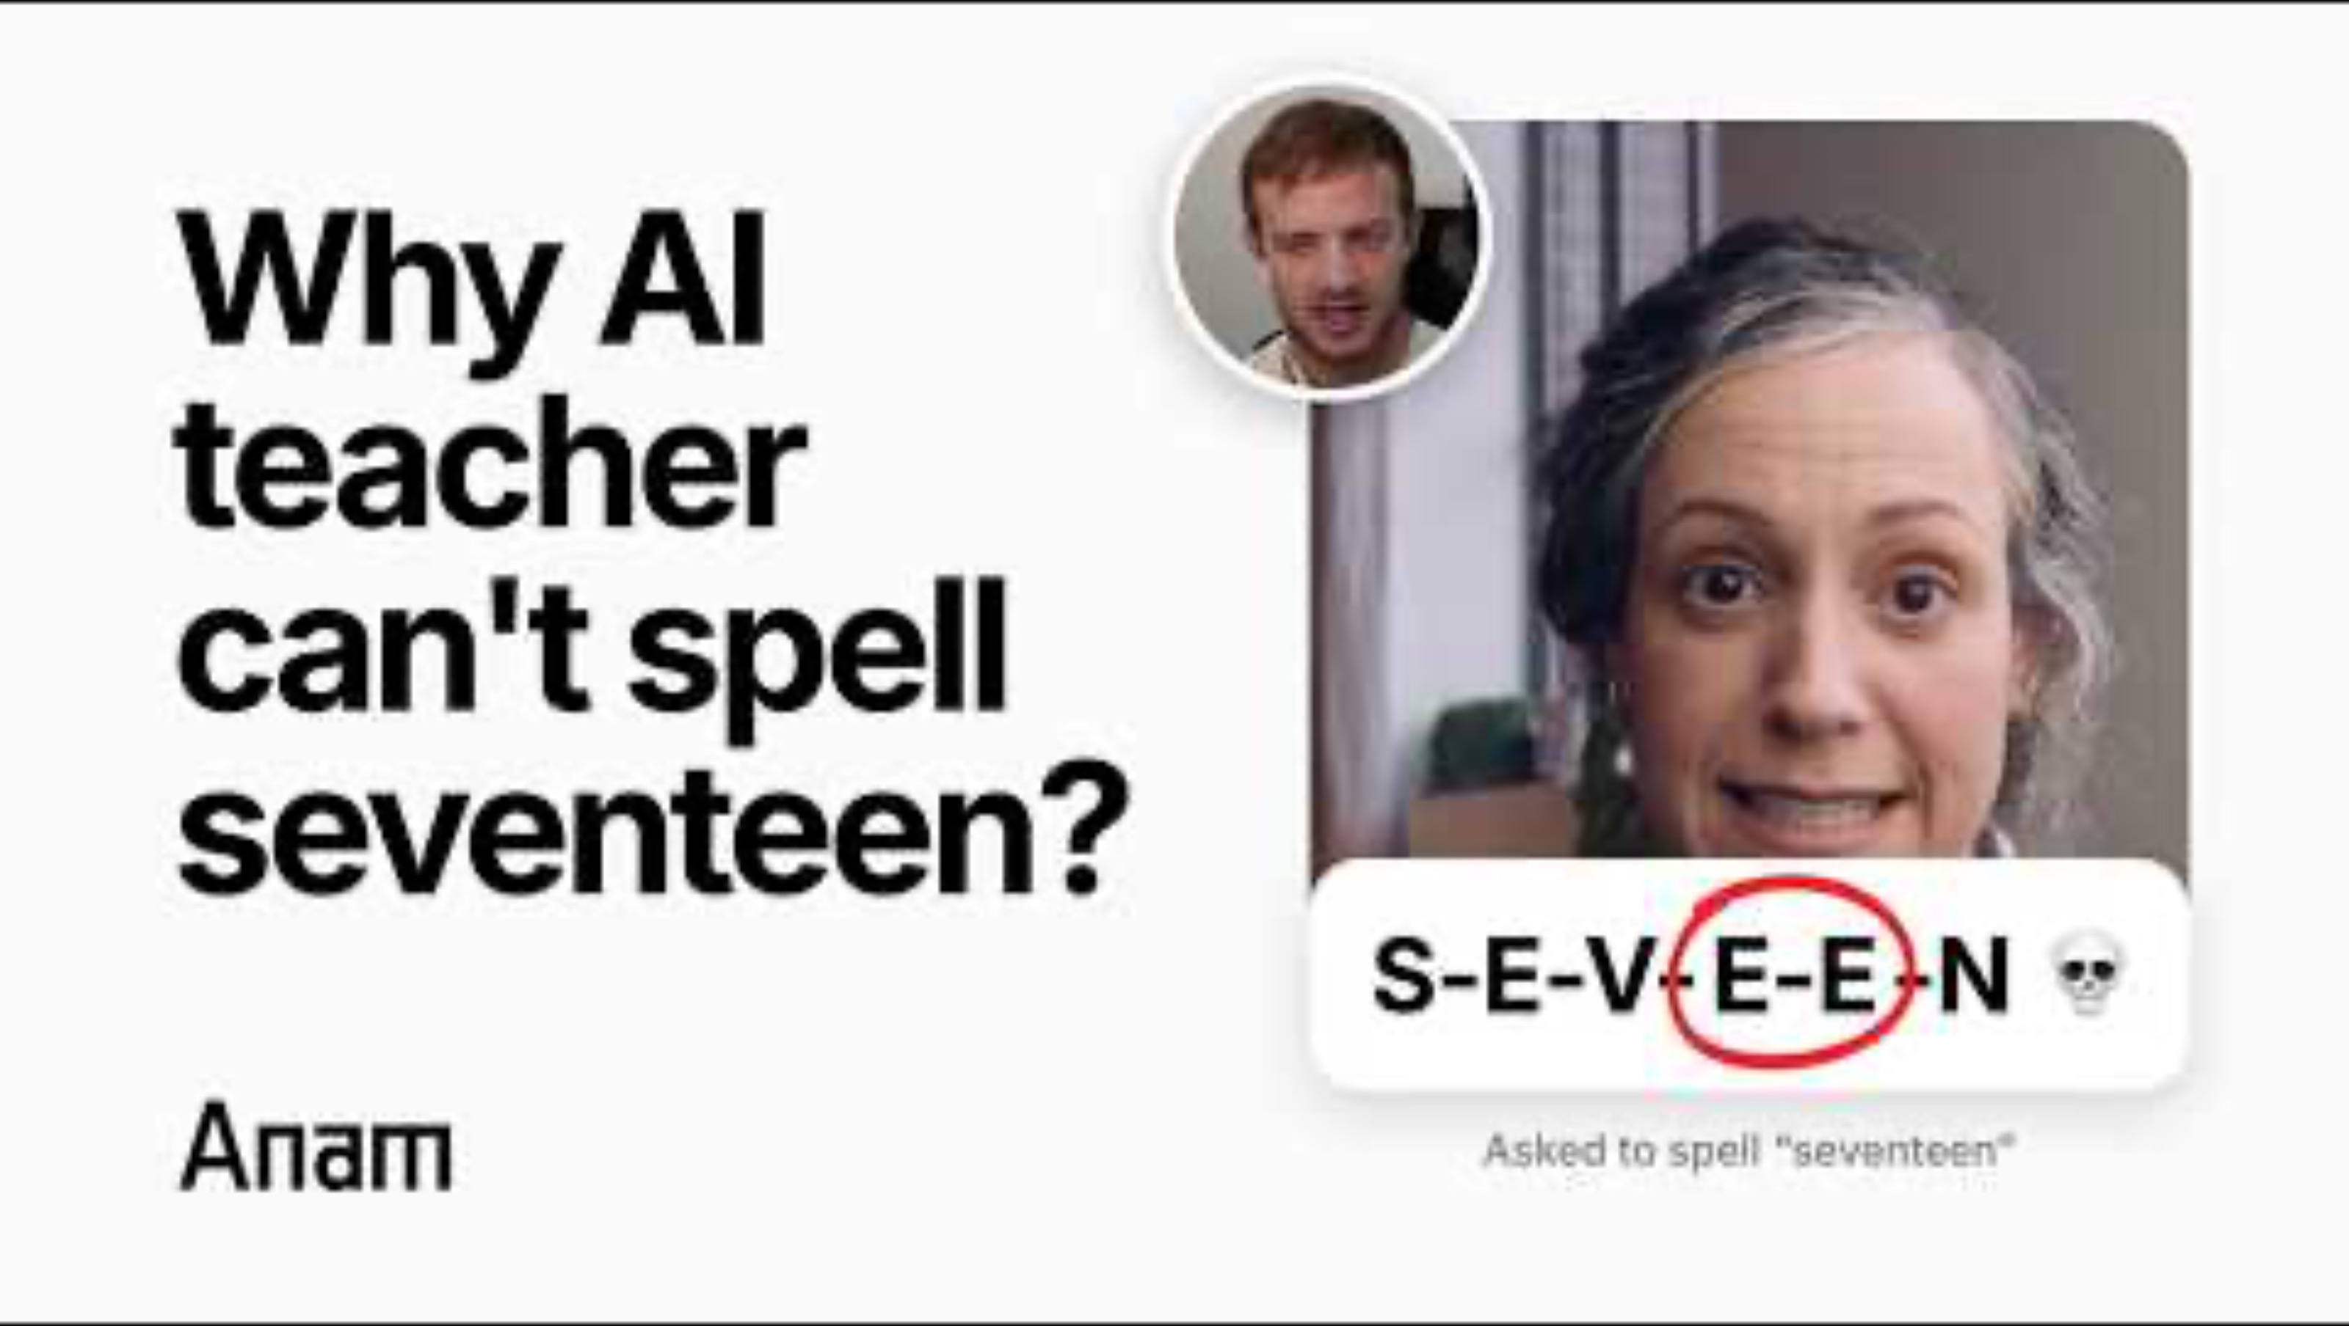
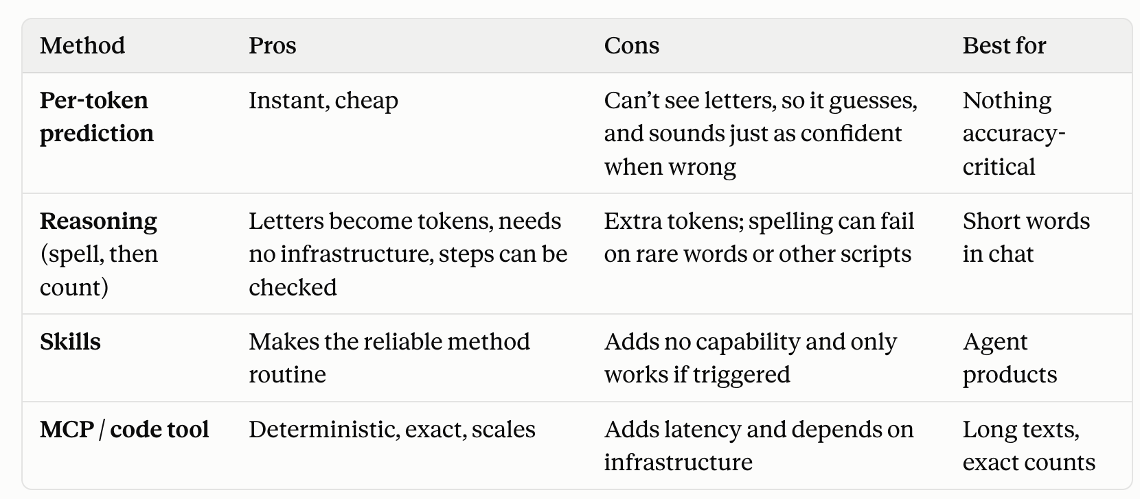
Husk.IRL vs Sam Altman
Watch on YouTube

Slide 5
Inner working of LLMs: Per-Token Prediction
An LLM generates text one token at a time, each drawn from a probability distribution conditioned on everything written so far — it is not looking up stored facts
→ same prompt can produce different wording each time
→ plausible, not necessarily correct
Practical implication for admin work:
  treat any generated claim about a date, policy, or institutional fact as a draft to verify
  never as a lookup

Slide 6
Prompt Engineering – aka Witchcraft
Unprovable claims, only empirical findings
Sensitive to tokenization, model change etc
Even at temperature 0 (e.g. slight reformulations)
No formal specs like for compilers or (internal state: billions/trillions of weights)

Slide 7
Hallucinations That Matter for Admin Work
Dynamic / real-time: facts that changed after training (this semester's dates, the latest policy revision) — the model cannot know these unless it is told
Personal: a specific person's role, history, or preferences — an ungrounded model will confidently invent plausible-sounding specifics
Institution-specific: KU's own rubrics, committee rules, and templates — generic knowledge of “an internship report” is not the same as KU's actual Handbook wording
Countermeasure used throughout this workshop's example: read the rubric from 📄 CLAUDE.md fresh every run, never from the model's memory of a prior conversation

Slide 8
Beyond Prompting: Persisting Skills, Plan and Memory
Ordinary prompt engineering resets every conversation — the same instructions get retyped or re-explained each time
🧩 Skills and layered 📄 CLAUDE.md files make instructions persistent and inheritable across a folder hierarchy, instead of living only in a chat transcript
This is this workshop's throughline: the grading pipeline's rubric, safeguards, and output format are “memory” that outlives any single conversation

Slide 9
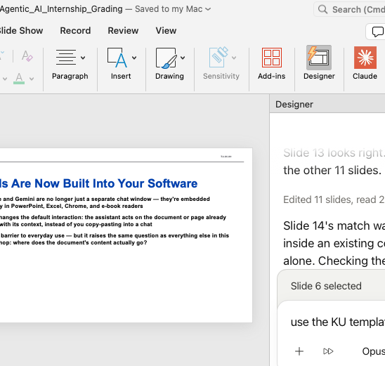
LLMs Built Into Software: PowerPoint etc
Claude & Co embedded in PowerPoint, Excel, Chrome, and e-book readers
This changes the default interaction: the assistant acts on open document/page
Lower barrier to everyday use — but again: where does the document's content actually go?

Slide 10
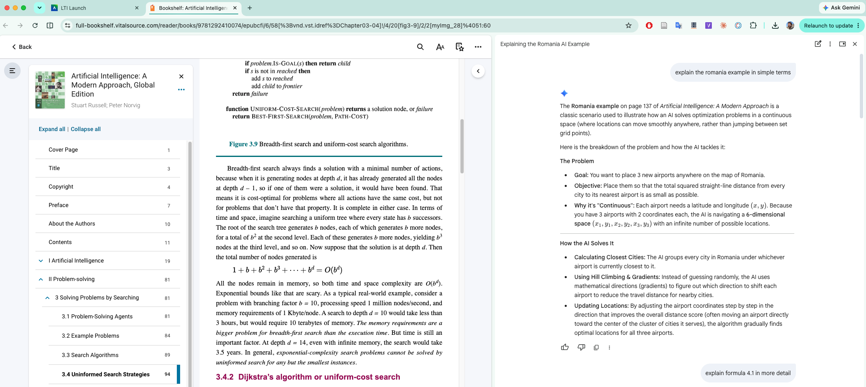
LLMs Built Into Software: Chrome+VitalSource

Slide 11
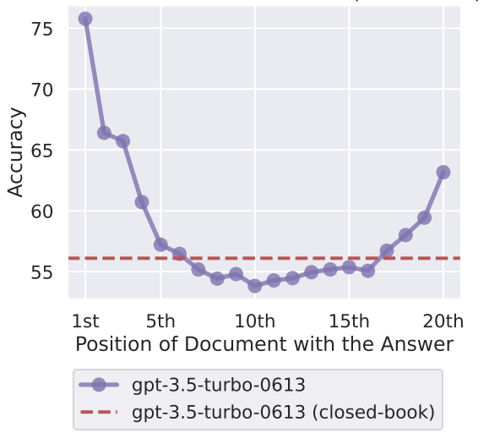
Context rot
Primacy
bias
Recency
bias
Uploading 50 page documents
“Lost in the middle” – Stanford study says: information in the middle is less often paid attention too
Attention dilution: caveat of larger models
Mitigation Approaches:
  Smaller contexts through house-holding
  Summarizing context in smaller model
  Sub-agents
  Skills
  RAGs
Lost in the Middle: How Language Models Use
Long Contexts, Liu et al, 2023, Stanford
Positional bias, Context Dilution

Slide 12

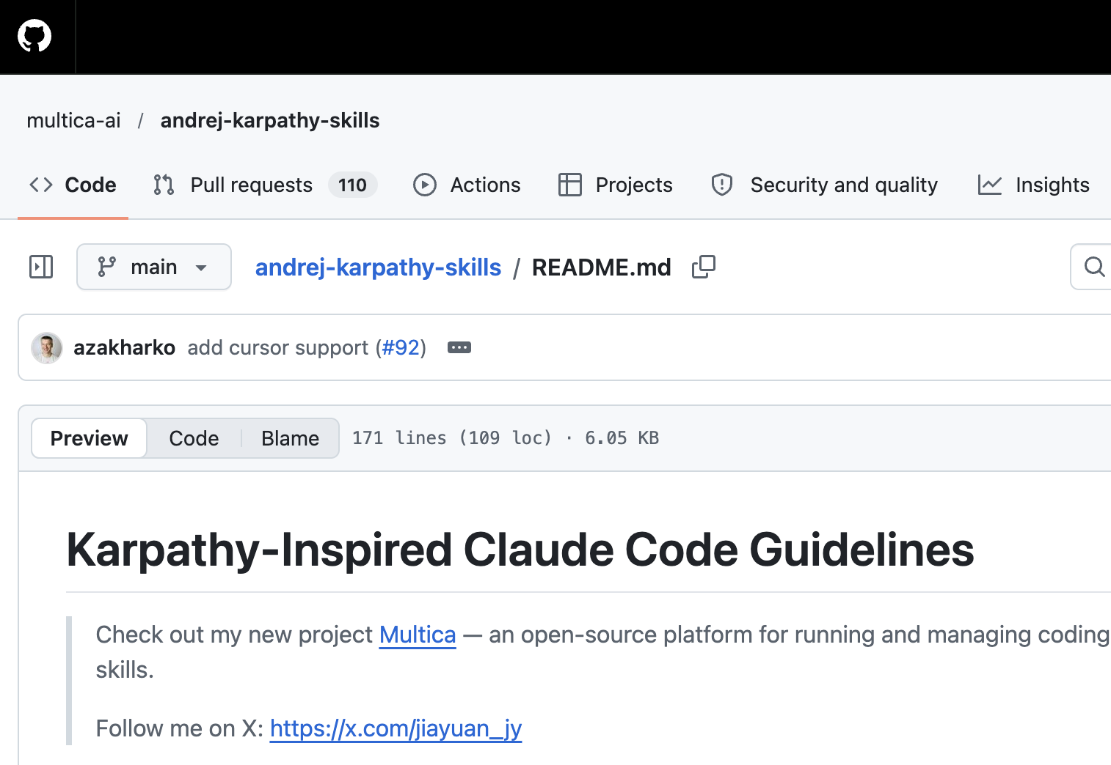
Problems with LLMs for coding:
Andrej Karpathy, founding member of OpenAI
models make wrong assumptions on your behalf
run along with them without checking.
They don't manage their confusion, don't seek clarifications, don't surface inconsistencies, don't present tradeoffs, don't push back when they should."
overcomplicate code and APIs, bloat abstractions, don't clean up
Principle | Addresses
Think Before Coding | Wrong assumptions, hidden confusion, missing tradeoffs
Simplicity First | Overcomplication, bloated abstractions
Surgical Changes | Orthogonal edits, touching code you shouldn't
Goal-Driven Execution | Leverage through tests-first, verifiable success criteria

Slide 13
Beyond Grading: Adapting Community Patterns to Admin Work
Source: Karpathy's 4-principle 📄 CLAUDE.md for coding 🤖 agents (github.com/multica-ai/andrej-karpathy-skills) — Think Before Coding, Simplicity First, Surgical Changes, Goal-Driven Execution
Adapted into a parallel 4-section 📄 CLAUDE.md for academic admin work (~/Dropbox/Administrativa/CLAUDE.md): Compliance & Accreditation Protocol, Document Structure & Formatting, Committee & Stakeholder Coordination, Operational Guardrails & Multi-Folder Scoping
Same instinct, different domain: “don’t assume, flag it” becomes “no speculation — flag [MISSING COMPLIANCE EVIDENCE] rather than guess”
Two additions the coding version didn’t need: explicit confidentiality rules (anonymized student/faculty identifiers) and per-sub-folder priorities (Accreditation / Committee_Internships / EventPlanning each inherit the same root file)
A direct illustration of this workshop’s three themes: objectivity (enforced rubrics, institutional tone), transparency (flag missing evidence, show step-by-step reasoning), confidentiality (anonymized identifiers by default)

Slide 14
Grounding in Local Files, Not Memory
📄 CLAUDE.md in each folder carries the verbatim rubric from the Internship Handbook (pp. 17–18) — read fresh every run, never from a remembered summary
The Blackboard gradebook export, downloaded by the instructor, is the source of truth and the join key (Student ID) for every merge
Submission filenames themselves encode Student ID, timestamp, and attempt — parsed directly, never guessed
Every grading decision is written back to disk (JSON + CSV) so it can be inspected, audited, or re-merged later

Slide 15
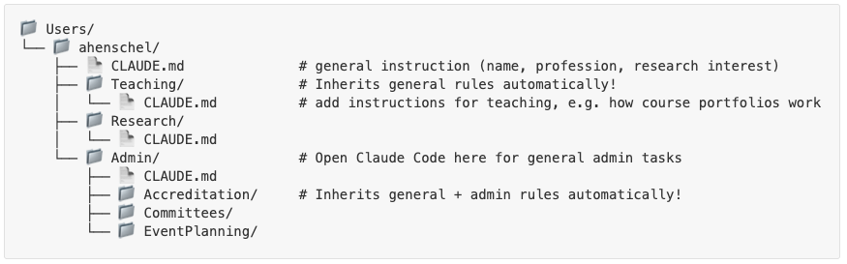
Hierarchy of instructions
HPC (ssh) information for remote compute

Slide 16
Three layers: rules, procedure, code
CLAUDE.md
The rules
What a portfolio must contain, the CLO standards (73% per student, 70% class bar), and the guardrails
SKILL.md
The procedure
Which steps to run, in what order, which script each step uses, and when to stop and ask
scripts/ and reference/
The code and the test
clo_attainment.py, max_points.py, redact_scans.py, plus the COSC620 golden outputs
Claude follows all three when it runs the workflow; each layer changes for a different reason.

Slide 17
What a SKILL.md file is
---
name: course-portfolio
description: Build or update a course
portfolio for a Teaching course: checklist,
CLO attainment, redaction, forms
---
# Course portfolio
## Workflow
1. Checklist ...
3. Max points: run scripts/max_points.py
exit 2 -> ask the instructor
1 Always listed
Only the name and description. Claude uses them to decide when the skill applies.
2 Loaded on invoke
The body of SKILL.md enters the conversation and sets the steps to follow.
3 Read or run as needed
Scripts run and reference files are opened only when a step needs them.

Slide 18
Does SKILL.md stay in memory?
Short answer: the file stays on disk, but the loaded text does not stay in every session.
This session
Skill invoked; its body is in context while the steps run.
Context cleared or compacted
The loaded body may be dropped. Invoke the skill again to reload it.
A new session
Only the name and description are listed. Invoke the skill to get the steps back.
Not the memory folder
The memory folder (under ~/.claude/projects) stores facts about you and your feedback. The procedure belongs in SKILL.md, so it is versioned with the course files and survives every session.

Slide 19
Sub-agents with Focus
Mitigate Context Rot: e.g. Cap context to e.g. 2000 tokens
Physically prevent “lost in the middle”
Embarassingly parallel
Orchestrator needed to synthesize final result

Slide 20
Agents: Resilience — and Failure Modes
Goal-driven resilience: a well-built agent keeps working toward the stated goal across setbacks, rather than stopping at the first obstacle
That same persistence is a risk without guardrails — “auto-mode” agent incidents (Huggingface etc) are a reminder that unattended, goal-driven agents can take unintended, hard-to-reverse actions
A small-scale example from this workshop's own preparation: a broad “close every open presentation” automation command had a blast radius wider than intended, and closed an unrelated, unsaved file
🤖 Sub-agents are a practical mitigation: isolate a heavy or risky sub-task in its own focused context, instead of letting the main agent's context — and judgment — get diluted

Slide 21
Skills vs. Sub-Agents: Two Different Tools
🧩 Skills encode the recipe — the rubric, the safeguards, the output format — as instructions that persist across semesters and don’t need to be re-explained
🤖 Sub-agents are an execution tool — isolating or parallelizing the heavy work (e.g. 150+ individual Ollama calls) inside a run, without filling up the main conversation
A 🧩 Skill can use a 🤖 sub-agent internally; a sub-agent on its own has no memory of the rubric or safeguards once that run ends
Rule of thumb: if it should be the same next semester, it belongs in a 🧩 Skill; if it’s just about running faster or in isolation this run, it’s a 🤖 sub-agent’s job

Slide 22
Confidentiality
Ways to give an assistant your own data:
  upload files into a cloud based chat
      Differentiate between standard usage and
      Organizational encapsulation (Co-Pilot, runs OpenAI servers + secure remote calls on Anthropic servers)
  run an agent locally against files that never leave the machine
Local/specialized agents:
  🤖 Codex, Claude Code for software; local work
  🤖 Dedicated tools Claude Design; Claude Science for research — tool-calls into scientific databases (e.g. flagging an abnormal SMN1 copy number in Genome in a Bottle data) and retrieves literature from repositories like PubMed, rather than answering from memory
Confidentiality issue: uploading to a cloud chat means the data leaves the institution's control; a local agent reading local files does not – remember the CLOUD Act
Transparency: a local agent's actions are traceable on disk (what it read, wrote, ran, ) still requires inspection

Slide 23
Local LLMs: the Ollama Platform
Ollama runs open-weight models (this pipeline uses gemma4) entirely on local hardware, served over a local HTTP API
No API key, no per-call cost, no network call to a third party — the tradeoff is local compute/GPU capacity and a smaller model than the largest cloud offerings
This is the concrete mechanism behind every “no student data leaves the machine” claim earlier in this workshop — it's not a policy promise, it's where the inference actually runs

Slide 24
Complete Confidentiality: Local vs. Cloud
A cloud assistant's confidentiality is a matter of contract and configuration — e.g. Microsoft Copilot's organizational encapsulation keeps data inside a tenant boundary, but that boundary is still cloud infrastructure subject to the provider's jurisdiction
The U.S. CLOUD Act lets U.S. authorities compel a U.S. provider to produce data it stores or controls, regardless of where it is physically hosted — a real consideration for non-U.S. institutions
A local model (Ollama + gemma4, this workshop's own example) sidesteps that question: the data never leaves a machine the institution controls, so there is no provider, no tenant, and no jurisdiction to reason about
The tradeoff is capability, not confidentiality — local models are smaller; this pipeline treats that as acceptable for rubric-scoring tasks with cited evidence, not as a universal substitute for frontier cloud models

Slide 25
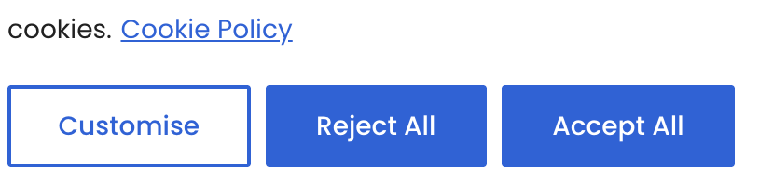
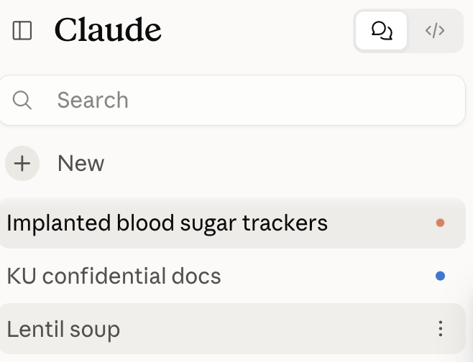
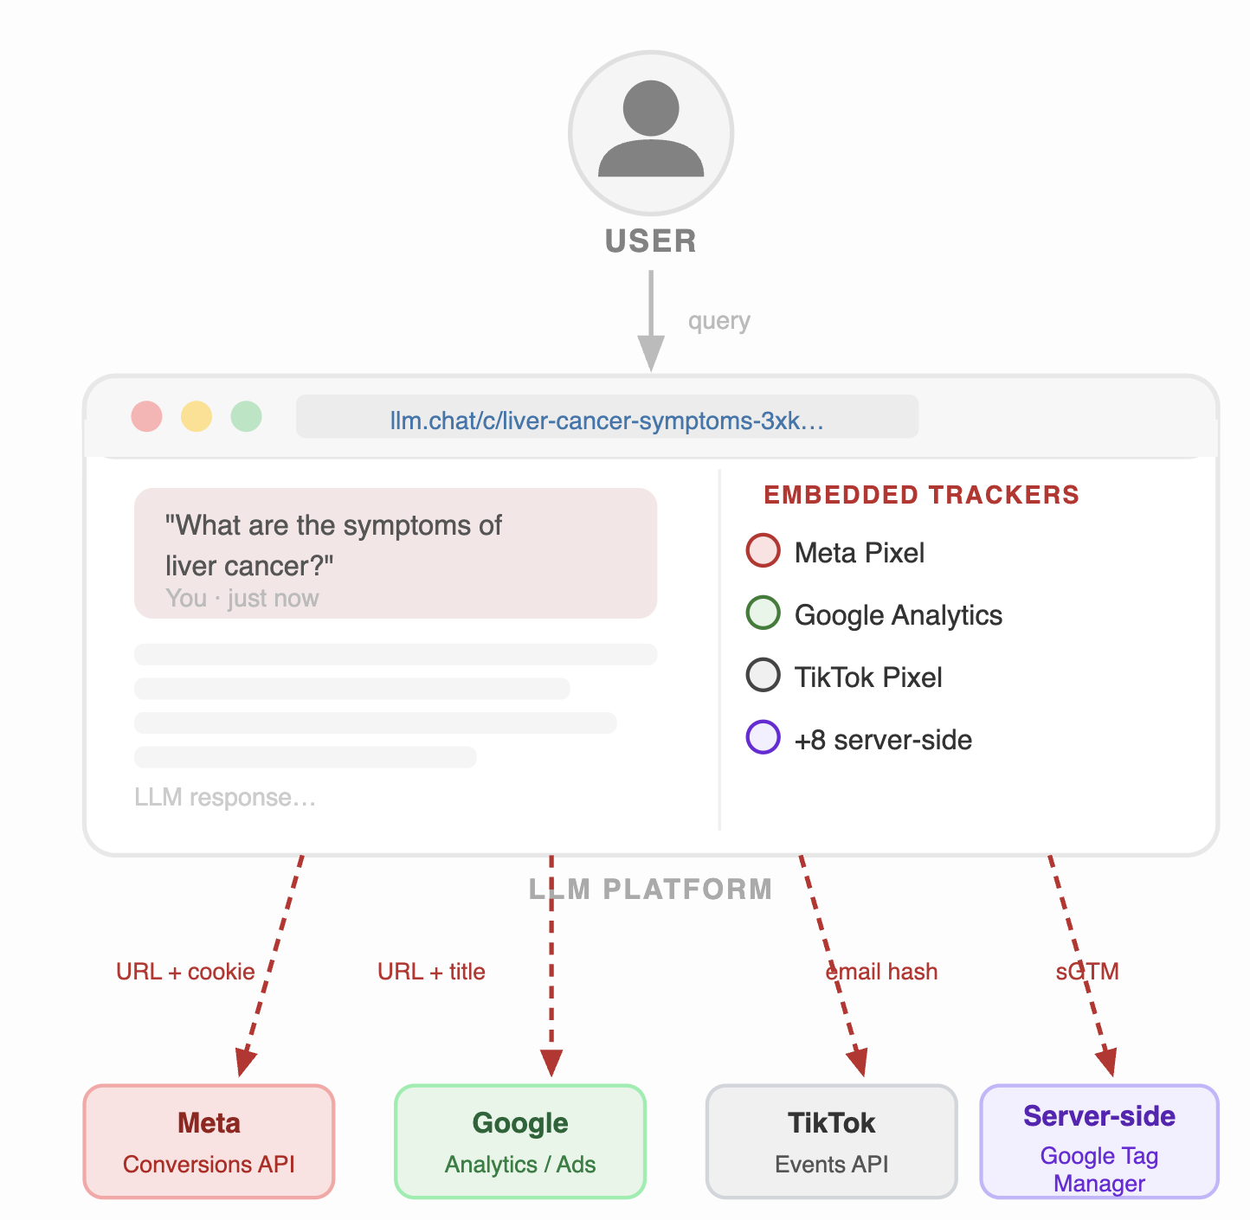
More Confidentiality issues
LeakyLM: Web based AI leaks your info 😱
Study by IMDEA
prominent GenAI services leak user conversations, identities, and sensitive metadata
Third-Party Trackers: Platforms like ChatGPT, Claude, Grok, and Perplexity embed third-party tracking services
Leaked Data: User activity, chat titles, tracking cookies etcsent to advertising networks
Grok : Guest chats public by default
Open Graph metadata has exposed content to TikTok
ChatGPT & Claude: transmit conversation URLs and cookies to Meta and Google servers
Hidden Practices: platforms didn’t disclose these data-sharing practices

Slide 26
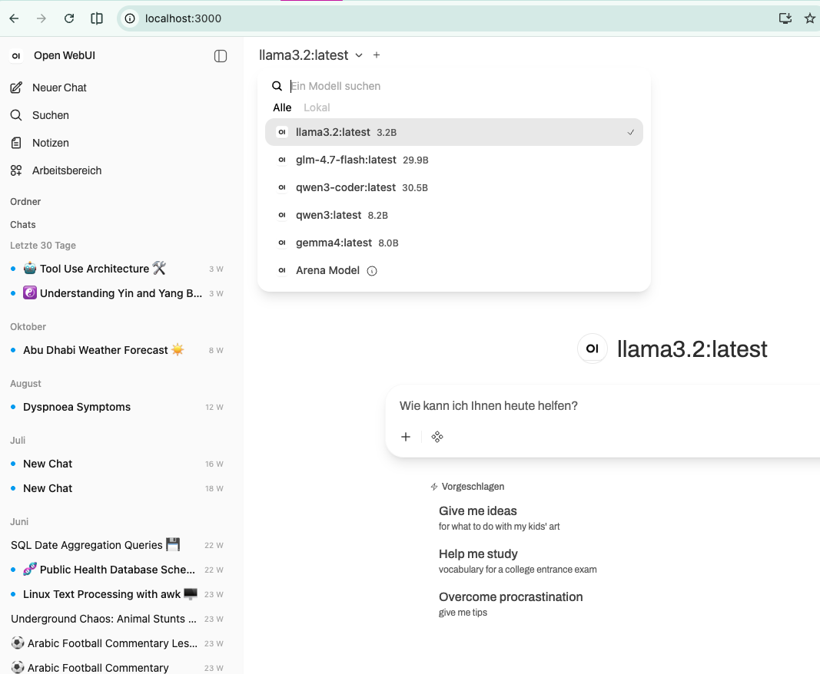
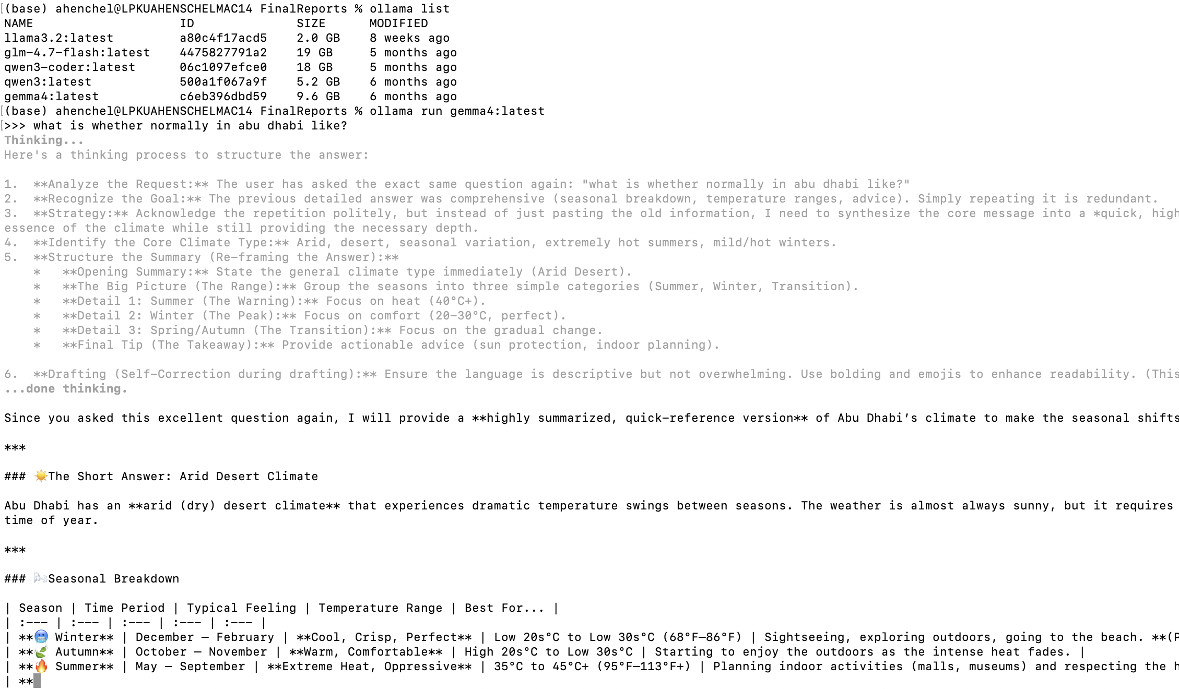
Local LLMs

Slide 27
Application: Document Analysis
Two courses, 150+ Final Reports and Logbooks each semester, 10–50+ pages apiece
One consistent rubric (Internship Handbook, pp. 17–18) applied by hand, every time
Mismatched files, scanned PDFs, and duplicate submissions slip through manual review
Grades still have to land correctly in the official Blackboard gradebook
Goal: an agent that reads, scores, and merges — without losing rigor or an audit trail

Slide 28
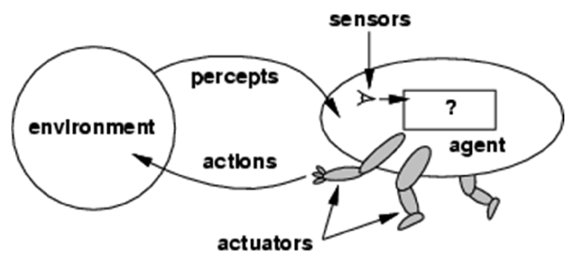
What Makes This “Agentic AI”
Not a single prompt-and-response: a multi-step, tool-using agent
Plans a pipeline, executes it with real tools (shell, file system, browser), and checks its own output
Decides what to do next based on what it finds — e.g. a 0-word extraction takes a different path than a normal one
Corrects course when reality disagrees with its own assumptions (see “bugs caught,” later)
A human stays in the loop for judgment calls and anything irreversible

Slide 29
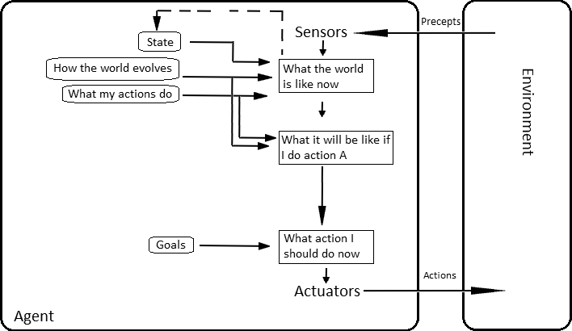
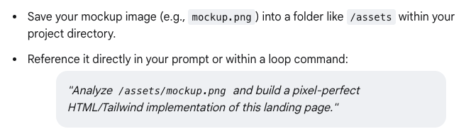
AGENT ARCHITECTURES
Model-based, goal-based agent
Keeping state information, goal in mind
Roughly similar in Claude code
Program 4 · Day 1 - The agent, the router, and the week ahead
14
Notes:
Source: introCOSC604.pdf, slide 37. A. Henschel, Techniques in AI Introduction, September 2nd, 2015.
Model based goal based agent
Keeping state information, goal in mind
A. Henschel (Masdar) Techniques in AI Introduction September 2nd, 2015 37 / 39

Slide 30
ZOOMING IN
Inside "decide" - what an agent actually is
Context / Memory
What the model already knows this step
p
a
Observation +
Instruction
LLM
Action
reads
emits
User input (prompt)
Reads input + context, decides the next action
What goes out this step
consults
options
Tools
Named functions available this step
f (decide)
An agent, this week, is always this: f implemented as an LLM call, reading a percept p (observation + instruction) and a percept history (context/memory), optionally calling a named tool, and returning one a ∈ A. Everything from here is this box, drawn larger.
Program 4 · Day 1 - The agent, the router, and the week ahead
16
Notes:
This is the "how these agents work" diagram - spend real time on it. The tools box is the one to dwell on: today the only tool is "emit a function call"; by Friday the tool is "run a shell command". The shape of the box never changes.

Slide 31
Internship grading: End-to-End Workflow
1. Submission
Uploaded to Blackboard by students
2. Bulk Download
Instructor exports all files as one ZIP
3. Local Files
Organized by course & assignment
4. Agent Processing
Extracts text, scores vs. CLAUDE.md rubric
5. Structured Output
Per-student JSON + one summary.csv
6. Gradebook Merge
Joined in by Student ID

Slide 32
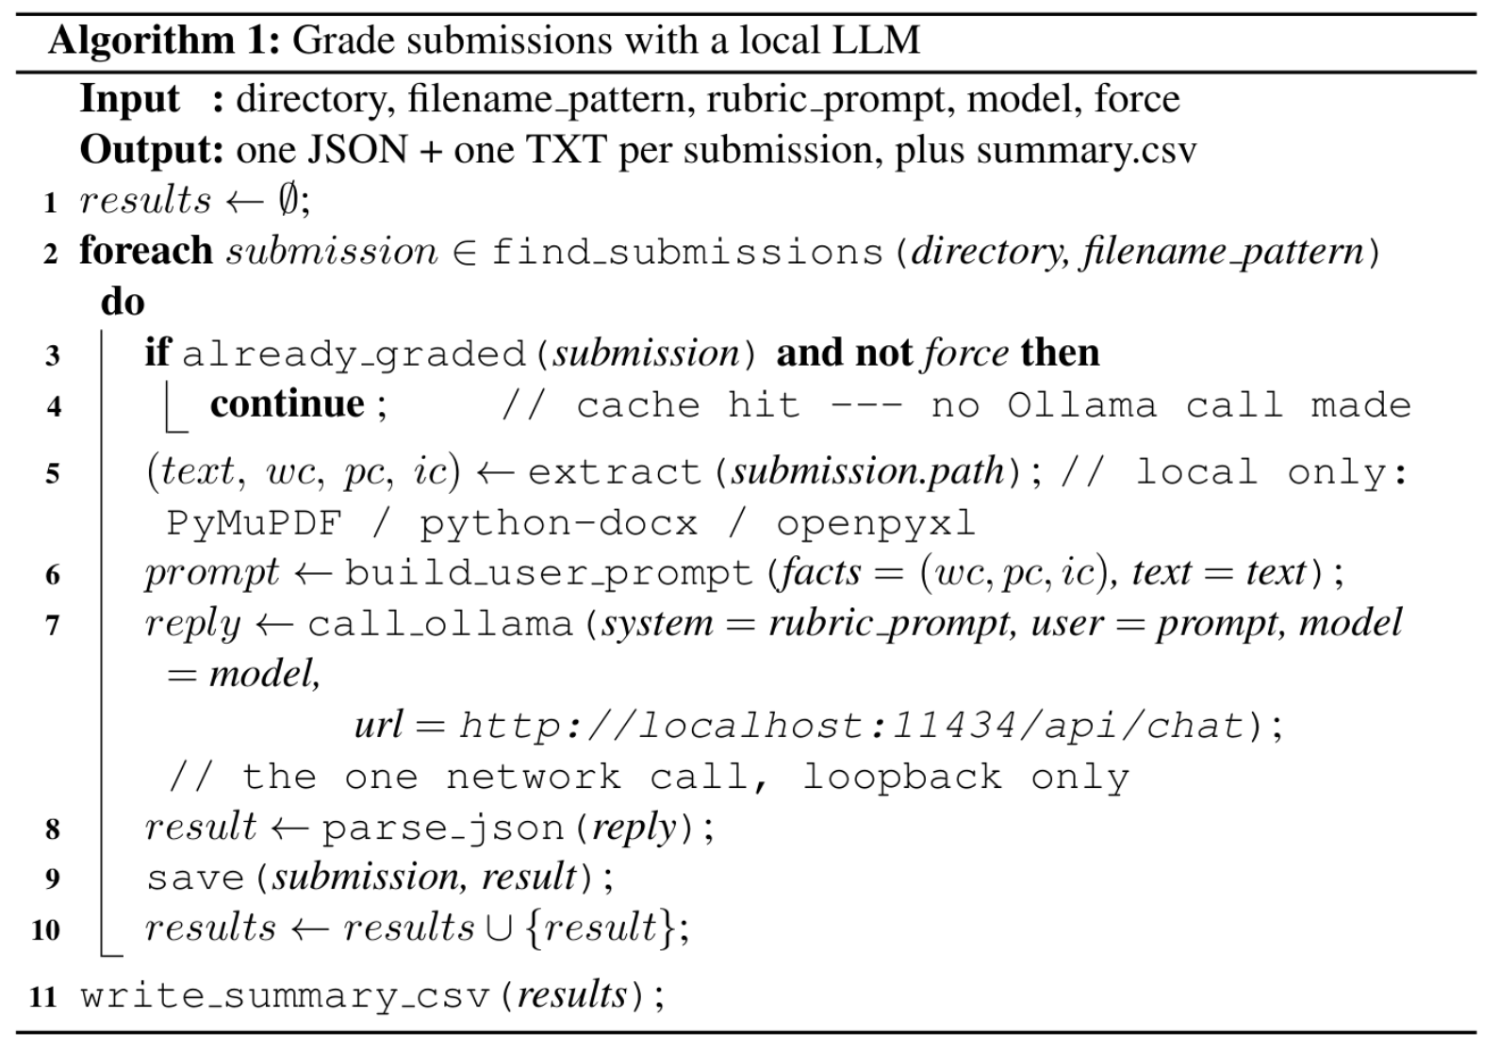
The algorithm

Slide 33

The Grading Pipeline
Extract text from PDF / DOCX / XLSX submissions (PyMuPDF, python-docx, openpyxl)
Score against the rubric with a local LLM (Ollama, gemma4) — fully offline, no student data leaves the machine
Rubric weighting is tuned from real feedback — e.g. circuit-diagram scoring was relaxed after review, since most interns are CS students in non-hardware roles
Every result is structured JSON (pass/fail per criterion + evidence) rolled into one summary.csv per course

Slide 34

Code Spotlight: The Three Scripts
📄 grading_common.py — shared plumbing: finds submissions by the Blackboard filename pattern, extracts text via PyMuPDF / python-docx / openpyxl, calls Ollama, parses its JSON reply, writes the summary CSV
📄 grade_submissions.py — the driver, run as --assignment-type report or logbook: builds each prompt, calls Ollama once per submission, writes one JSON + one .txt per student, then rewrites summary.csv from every cached result
Results are cached by filename — a rerun only re-grades submissions that don't already have a JSON file, unless --force is passed
📄 merge_grades_into_gradebook.py (downstream, not grading itself) — joins summary.csv into the Blackboard export by Student ID, filling a cell only if it's still blank

Slide 35
Code Spotlight: Calling Ollama Locally
OLLAMA_URL = "http://localhost:11434/api/chat"
DEFAULT_MODEL = "gemma4"
def call_ollama(system_prompt, user_prompt,
model=DEFAULT_MODEL, url=OLLAMA_URL,
temperature=0.2):
payload = {
"model": model,
"messages": [
{"role": "system", "content": system_prompt},
{"role": "user", "content": user_prompt},
],
"format": "json",
"stream": False,
}
resp = requests.post(url, json=payload, timeout=600)
return resp.json()["message"]["content"]
▸ url defaults to localhost:11434 — Ollama's own local server, not a cloud endpoint
▸ format: "json" forces a structured, parseable reply instead of free text
▸ temperature 0.2 — low, because this is rubric grading, not creative writing
▸ This is the only network call anywhere in the grading pipeline

Slide 36
Code Spotlight: Where call_ollama() Gets Called
# main(): the loop over every submission in the directory
for i, sf in enumerate(submissions, 1):
result = process_submission(cfg, sf, output_dir,
args.model, args.url,
args.force)
results.append(result)
write_summary_csv(cfg, results, output_dir)
# process_submission(): the actual call site, once per submission
user_prompt = build_user_prompt(sf, doc)
try:
raw = gc.call_ollama(cfg.system_prompt, user_prompt,
model=model, url=url)
result = gc.parse_model_json(raw)
except Exception as e:
return None
▸ One call per submission — process_submission() (and call_ollama() inside it) runs once per file in this loop, no batching
▸ cfg.system_prompt is the rubric — whichever AssignmentConfig matched --assignment-type (report/logbook/practice)
▸ model and url come from the CLI, never hardcoded at the call site
▸ try/except matters at scale — one bad file returns None and moves on, it doesn't abort the other 149

Slide 37
From Handbook to JSON: the Rubric Prompt
Each course folder's 📄 CLAUDE.md carries the Handbook rubric verbatim (reports: pp. 17–18; logbooks: p. 17) — the one authoritative source, never a remembered summary of “what reports usually need”
That rubric becomes a rubric_fields list — one key per criterion (cover_page, abstract, table_of_contents, organization_brief_section, … , conclusion) — plus a system_prompt that restates it for the model
The system prompt demands one exact JSON shape back, one object per criterion with a present/absent flag and a cited comment — never just a bare score
One committee rule is written directly into the logbook prompt: circuit/technical-sketch evidence is graded leniently, with zero weight on the score, for the many CS/software-track students whose work never touches literal circuits

Slide 38
Why No Document Ever Leaves the Machine
Download and extraction happen entirely on local disk, in-process — PyMuPDF, python-docx, and openpyxl make no network calls of any kind
The only network call anywhere in the pipeline is inside call_ollama() — and its url defaults to localhost, the loopback address, which never reaches a network card, router, or ISP
The one model-weight download (ollama pull gemma4) happens once, before any student has submitted anything — it moves a public model in, never a document out
Caveat worth stating plainly: the guarantee holds only as long as --url stays pointed at localhost — a one-line, auditable setting, not a hidden risk
Second caveat: the course folder lives inside Dropbox, whose sync client does upload file contents for storage — a different channel than AI processing, but still worth flagging to the committee

Slide 39
Safeguards Built Into the Pipeline
Never overwrite a grade already in the gradebook — flag it for manual review instead
Multiple files for one student (duplicate upload, wrong format) are flagged, never silently picked
Submissions that are the wrong document entirely (e.g. a supervisor form, not a report) are caught and excluded
Scanned, unreadable PDFs are detected (0 extracted words) and routed to a human, not scored as “empty”

Slide 40
Scaling to Two Courses — and the Bugs That Surfaced
Extended from 37 reports in one course to 150+ reports across two, same pipeline
A filename-caching bug (same report, two file extensions) risked silently re-grading everything — caught and fixed before it burned a full re-run
A gradebook-merge bug that could have overwritten manually entered grades was found and replaced with a “never overwrite” rule
Each fix came from checking real output, not from re-reading the code

Slide 41
From Ad-Hoc Scripts to Reusable Skills
Every semester, the same pipeline was being re-explained from scratch instead of re-run
Repackaged as three Claude Code 🧩 Skills, saved as files in the course folder: 🧩 grade-submissions, 🧩 write-grading-csv, 🧩 merge-gradebook
Each Skill is scoped to one stage only — extraction+scoring, CSV rollup, or gradebook merge — so one stage can be fixed or re-run without touching the others
The 150+ submission-grading loop itself collapsed from four duplicated scripts into one parameterized 📄 grade_submissions.py (--assignment-type report|logbook)
Next semester: invoke the Skills on a new course folder — no re-deriving the rubric, the safeguards, or the CSV format from memory

Slide 42
Back of the Envelope: What Skills Save in Tokens
Illustrative example (order-of-magnitude numbers)
Per-submission cost is unavoidable either way: ~900 tokens of rubric + up to ~11,000 tokens of extracted text + ~500 of response, local or remote, Skill or not
What a 🧩 Skill actually saves: a remote LLM resends its whole context, 📄 CLAUDE.md included, on every turn of every session in that folder — grading-related or not
Bake that ~900-token rubric into an always-loaded 📄 CLAUDE.md instead of an on-demand 🧩 Skill, across ~30 sessions a semester at ~40 turns each, and it gets resent roughly 30 × 40 × 900 ≈ 1.1M tokens — most of those turns never touch grading at all
As a 🧩 Skill, that content only enters context on the fraction of turns that actually invoke 🧩 grade-submissions — illustratively cutting that resend cost by 80–90%
At a mid-tier remote price (~$3 per million input tokens), that's only a few dollars a semester — the real saving is a cleaner context, not a smaller bill

Slide 43
Extending the Pattern: Supervisor Evaluations
Same rubric-to-structured-data idea, applied to the paper “Organization Supervisor’s Report” form
Rebuilt as one Google Form with personalized, pre-filled links — one per student, confidential by construction
The agent drove a real browser to build the form, test it, and catch a subtle bug no code review would have found
Responses land in a spreadsheet keyed by Student ID, ready to merge the same way

Slide 44
Confidentiality, Objectivity, Transparency — by Design
Confidentiality
Objectivity
Transparency
• Local Ollama inference — no student data ever leaves the machine
• One shared Google Form, personalized links: a supervisor only ever sees their own students
• Example reports anonymized (names/IDs redacted) before being shared for review
• The same verbatim Handbook rubric is applied to every submission, every course
• The model must cite evidence for each verdict, not just assert “pass”
• Standing leniency rules (e.g. CS circuit-sketch grading) are written into the prompt, not left to ad-hoc per-grader judgment
• Every score is backed by a per-student JSON + human-readable .txt file
• Ambiguous or low-confidence cases are flagged for manual review, never silently decided
• The gradebook merge never overwrites an existing grade — what was auto-filled vs. flagged is always visible

Slide 45
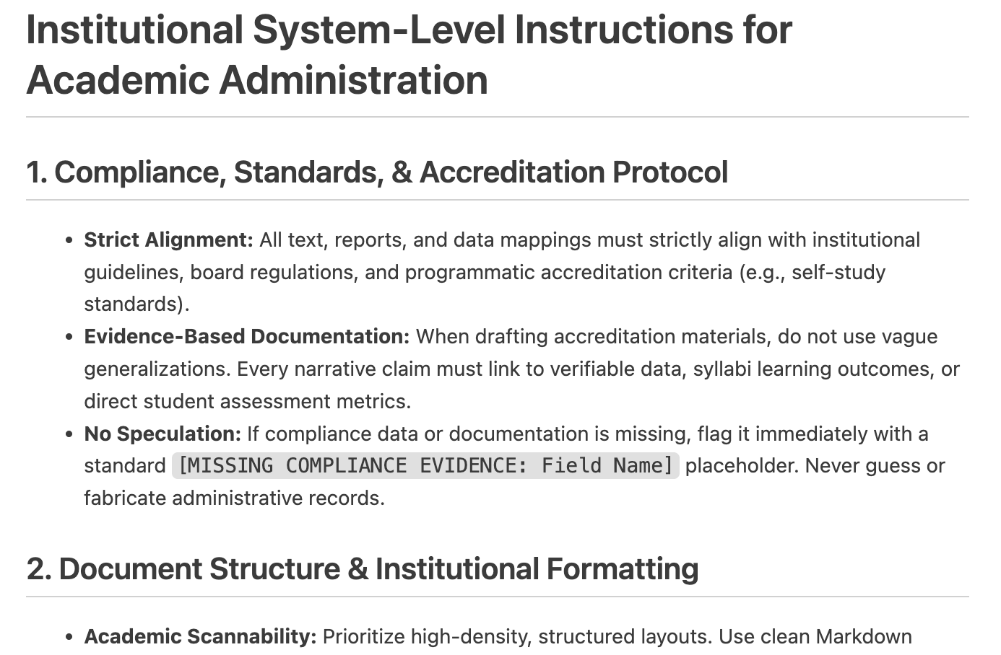

Slide 46
Deterministic Logic via Function Calls
An LLM is a probabilistic text predictor, not a calculator — for math, dates, or anything that must be exactly right, the agent should call a deterministic function rather than let the model pattern-match an answer
YouTuber Husk.IRL went viral calling out exactly this gap: ChatGPT's app doesn't reliably call a tool for deterministic things like timing or spelling — it pattern-matches an answer instead; Sam Altman's response was that this kind of tool-calling may land natively in the chat app within about a year
Recent progress: agent setups now chain function calls through long, multi-step problems (e.g. hundreds of pages of proof work) instead of stalling after one step
Getting it right is its own pipeline: triage (does this need a tool at all?), selection (which tool?), parameter construction, and validation of the result
Quality is measured, not assumed — benchmarks such as the Berkeley Function-Calling Leaderboard (BFCL) and agentic-task arenas (e.g. WebArena-style evaluations) exist to score exactly this
▶ Clip: AI model failing to spell “seventeen” (YouTube Shorts)

Slide 47
MCP and UTCP: the Dominant Tool-Handling Layer
MCP (Model Context Protocol) and UTCP (Universal Tool Calling Protocol) standardize how an agent discovers and calls external tools, instead of every integration being bespoke
Architecture: a client (the agent) talks to one or more servers, each exposing a set of tools/resources over a common protocol
Docker is a common way to package and run an MCP server in isolation, with its own dependencies
Example: a small client/server pair where the server does deterministic math and the agent just calls it
The same client can invoke its own tools, a local third-party server, and a remote third-party server side by side — the protocol doesn't care which

Slide 48
MCP Architecture
Host · host.py
Model service
Ollama HTTP API
gemma4:latest
Decision loop
Triage · Select · Bind
Validate · Answer
HTTP (chat)
tools/call, …
MCP client
one connection per server
MCP server · server.py
subprocess, stdio
tools · resource · prompt
JSON-RPC over stdio
Ollama is a separate HTTP service, not an MCP server.

Slide 49
Claude Code: It's Still a Shell
Pipe real output straight in — cat error.log | claude -p "what's going on here?" — Claude Code composes with the rest of the shell, it doesn't replace it
Everything a shell can already do, an agent can wire up: redirects, command substitution, cron — and tmux keeps a long remote job alive across a disconnect, one place the CLI beats a GUI
Reverse prompt search (Ctrl+R) — search back through what you've already typed this session, the same muscle memory as bash history
Resuming a session — claude --resume / claude --continue — pick up exactly where a long-running task left off instead of re-explaining it

Slide 50
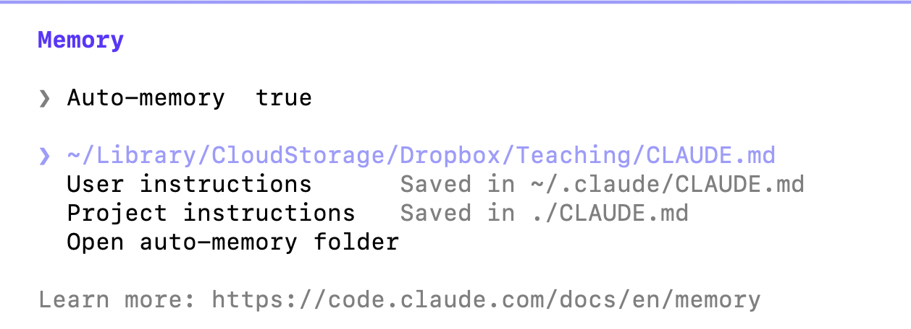
Claude Code: Slash Commands Worth Knowing
/memory — open and edit the layered CLAUDE.md files in effect right now — user-level (~/.claude/CLAUDE.md) and project-level (./CLAUDE.md) — see the screenshot
/compact — summarize the conversation to free up context without losing the thread, instead of starting a new session over
/agents — see and manage the sub-agent types available in this session
/usage — check token/usage consumption so far — useful before, not just after, a long run
/model — switch models mid-session, e.g. drop to a faster/cheaper one for a simple follow-up task
/memory's own output, run in this project's folder

Slide 51
Claude Code: Plan Before You Code
/plan switches the session read-only: exploration and design happen, but no file edit, commit, or destructive command runs until a plan is explicitly approved
The plan isn't just a chat reply — it's written to a real file (a PLAN.md-style markdown document) that persists, so it can be read carefully, not just skimmed as it scrolls by
This workshop's own tutorial repo was built this way: explore the existing code → design the approach → an explicit question back on the open decisions (license, verbatim-vs-paraphrased rubric, scope) → a written plan → approval — only then did any file get touched
The same human-in-the-loop principle as the grading pipeline's own safeguards, just applied one level up: to the agent's own actions, not only to its grading verdicts

Slide 52
Claude + Chrome: Example — Gradescope Automation
🤖 Claude in Chrome lets an agent act inside a real browser session — Gradescope, Blackboard, any web tool — using the instructor's own already-logged-in session
This workshop's own supervisor-evaluation work did exactly this pattern: drove a real browser to build and test a Google Form, catching a bug no code review would have found
Gradescope is where the same approach actually ran next — browser automation over a real grading UI, with the same safeguard as everywhere else in this pipeline: never submit or finalize without a human check

Slide 53
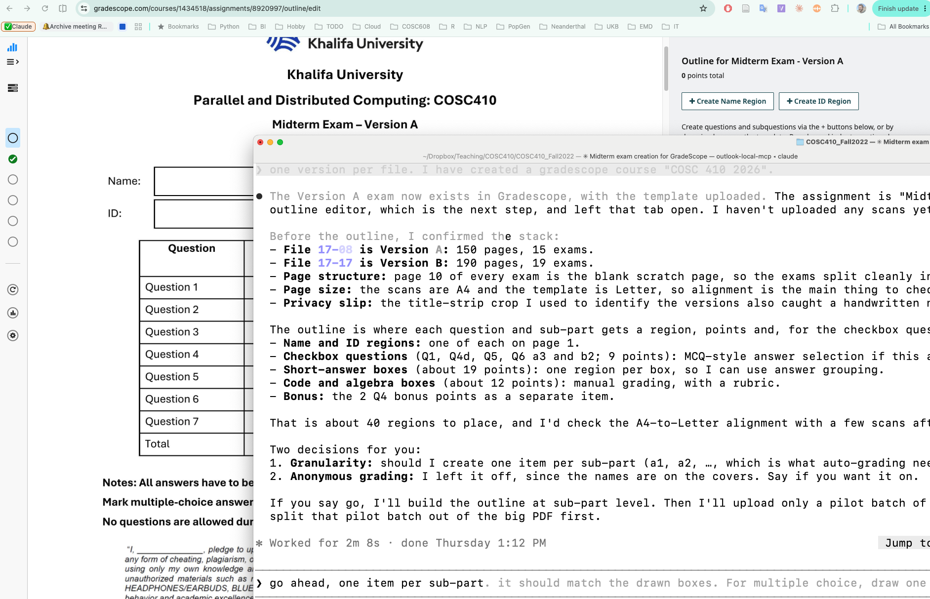
Gradescope in Practice: Setting Up the Exam
▸ Claude + Chrome, live in a terminal pane, setting up a real Gradescope outline for a COSC410 midterm — one region per question/sub-part, from a 40-item list
▸ Before touching the outline, it confirmed the stack itself: which scanned file was Version A vs. B, page counts, and where the blank scratch page splits exams apart
▸ It caught something nobody asked it to look for: a handwritten note on the title-strip crop used to identify versions — a privacy concern, flagged on its own
▸ Two judgment calls were handed back to the instructor before proceeding: sub-part granularity, and whether to anonymize grading

Slide 54
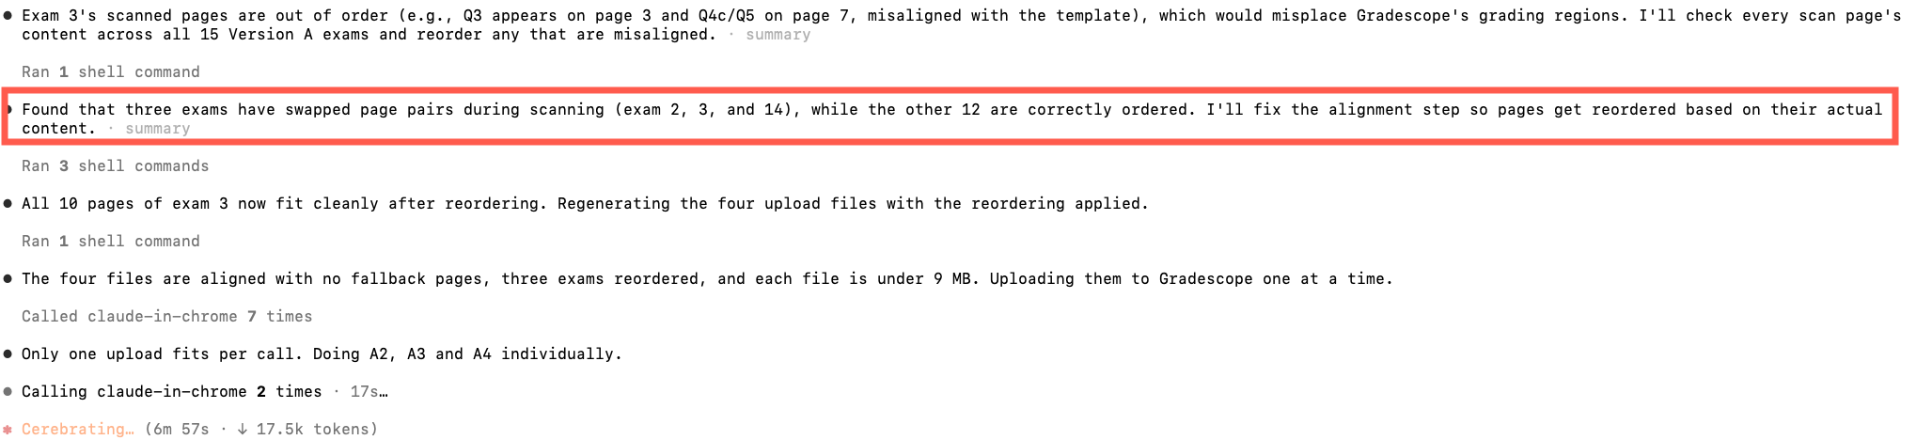
Gradescope in Practice: Catching a Real Bug
Exam 3's scanned pages were out of order — Q3 lands on the wrong page relative to the template, which would misplace Gradescope's grading regions
It checked every page of all 15 Version A exams against the template, not just the one exam someone happened to notice
Found 3 of 15 with swapped page pairs (exams 2, 3, 14) — reordered them based on actual page content, then re-verified before uploading, no fallback pages left over
Same pattern as the internship-grading pipeline's own bugs-caught story: checking real output surfaces problems a human skim wouldn't — just running on exam scans here instead of report PDFs

Slide 55
Killer Application: Gradescope & Course Management
The highest-leverage use case isn't just grading one assignment — it's the whole course-management surface: rosters, course files, repeated semester-to-semester paperwork
Course files (syllabi, assessment mappings, accreditation evidence) are exactly the kind of “repeats every semester, rubric-governed, confidentiality-sensitive” work this pipeline already handles for internship reports
The same three-skill pattern — extract/score, roll up, merge without overwriting — generalizes directly to that surface

Slide 56
Outcomes & Takeaways
150+ reports and logbooks graded against one consistent, documented rubric across two courses
Every score is traceable: per-student JSON with cited evidence, not a black-box number
Ambiguous or risky cases are surfaced to the committee instead of guessed
Confidentiality, objectivity, and transparency were addressed by specific design choices, not assumed by default
The pipeline is now three reusable Skills, not four scripts — next semester starts by invoking them, not rebuilding them

Slide 57
Agentic AI Principles, Illustrated
Plan → Act → Verify: every claim of success was checked against real output, not assumed from the code
Tool diversity: shell, file system, a local LLM, and browser automation, all in service of one task
Self-correction from evidence: a live test surfaced the Google Forms field-ID bug; it was fixed and re-verified, not argued around
Human-in-the-loop: destructive or ambiguous steps (overwriting grades, sending emails, architecture choices) stopped for a decision

Slide 58
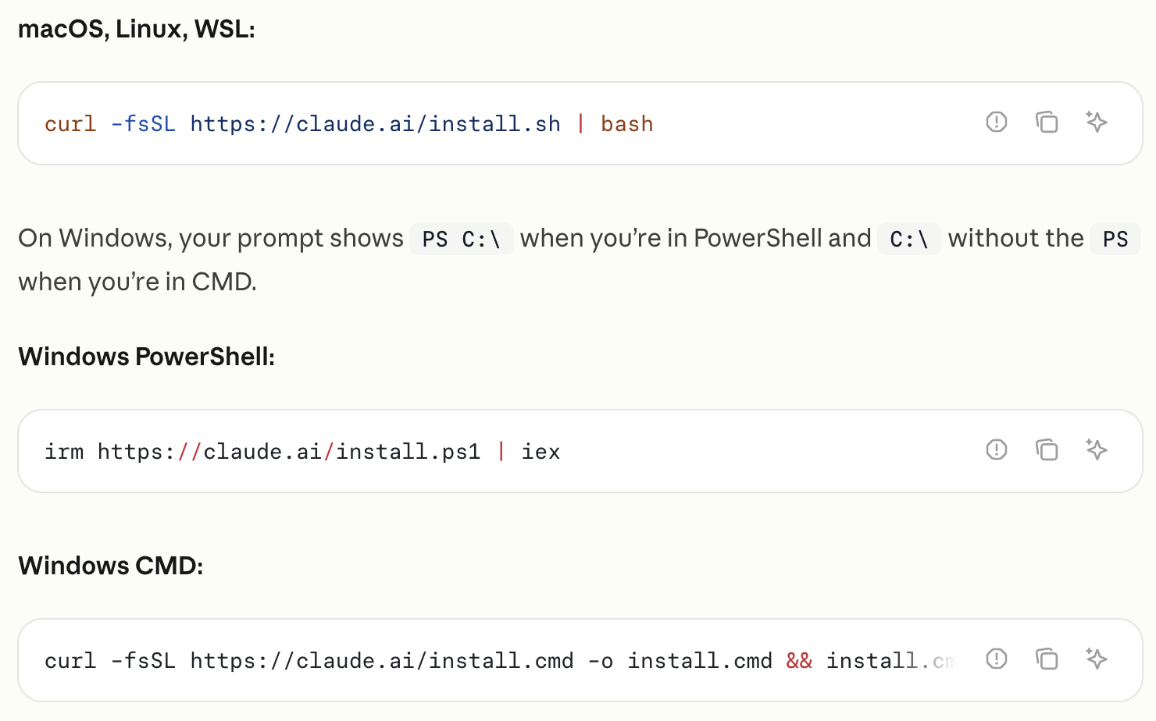
Claude Code – Getting started
Claude Code is an agentic coding tool in the terminal,
understands your codebase
helps you code faster through natural language commands
https://code.claude.com/docs/en/overview

