Slide 1

Let’s Save Whales
Guanlin Guo, Shiheng Huang, Hanwen Ju

Slide 2
Introduction
Ship Strike is one of the main causes of death of whales.
Solution No. 1: Lethal Collision Probability Risk Model
Solution No. 2: Additional Slow Zones

Slide 3
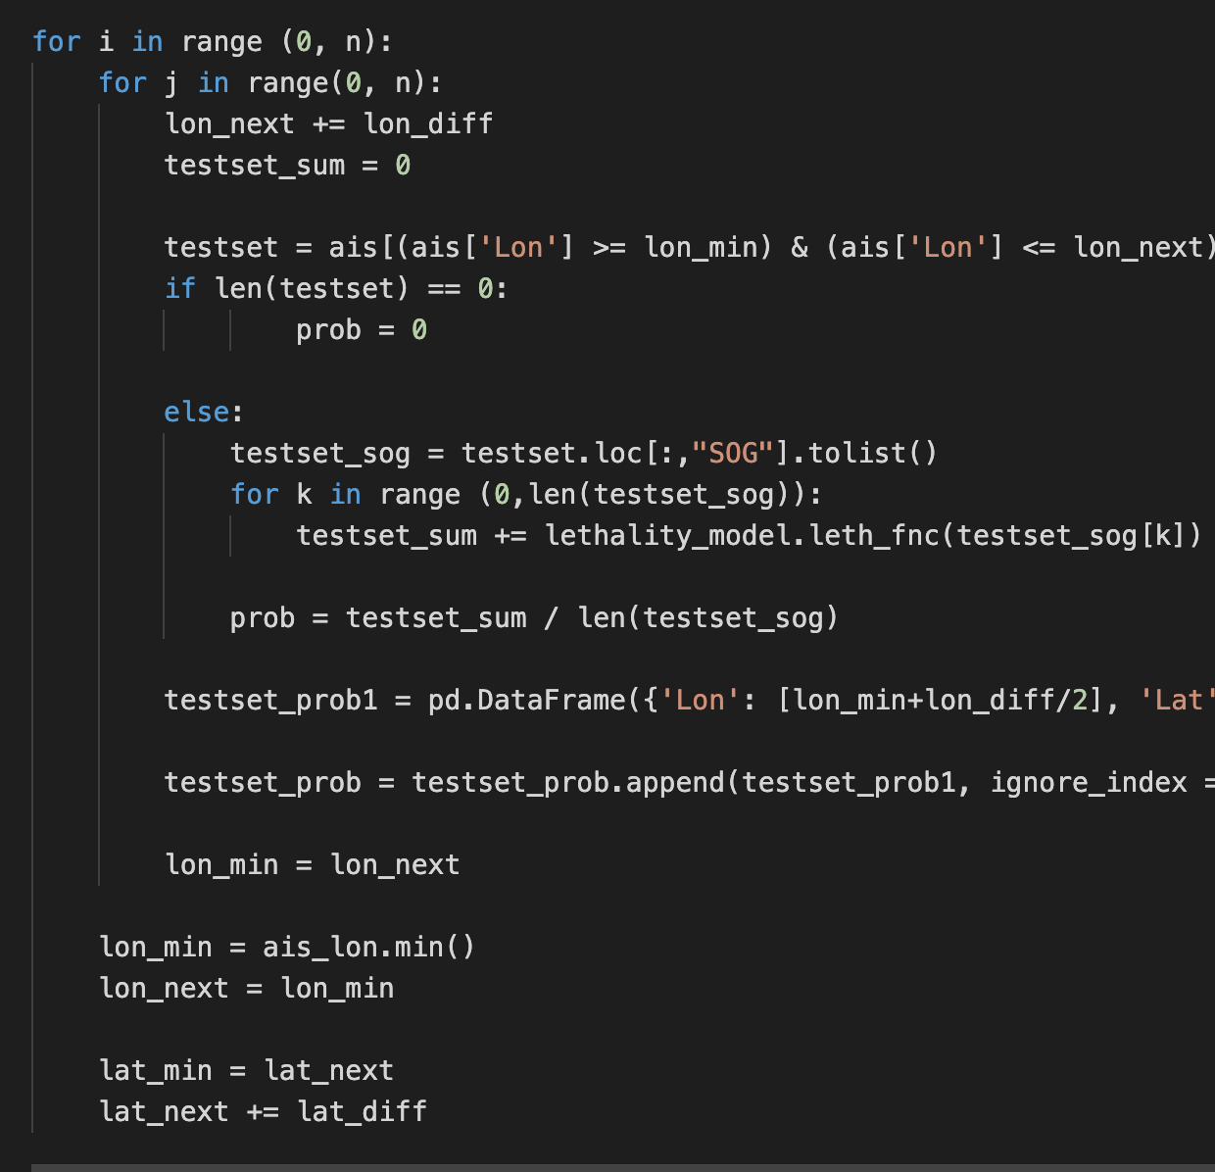
Solutions No. 1
Lethal Collision Probability Risk Model
Evenly distribute the Atlanta Coast to 1957 regions (with the land)
Make subsets of transmissions within each region and find the probability of lethal probability from speed for each transmissions point
Compute the average lethal probability in each region, and visualized with different colours

Slide 4
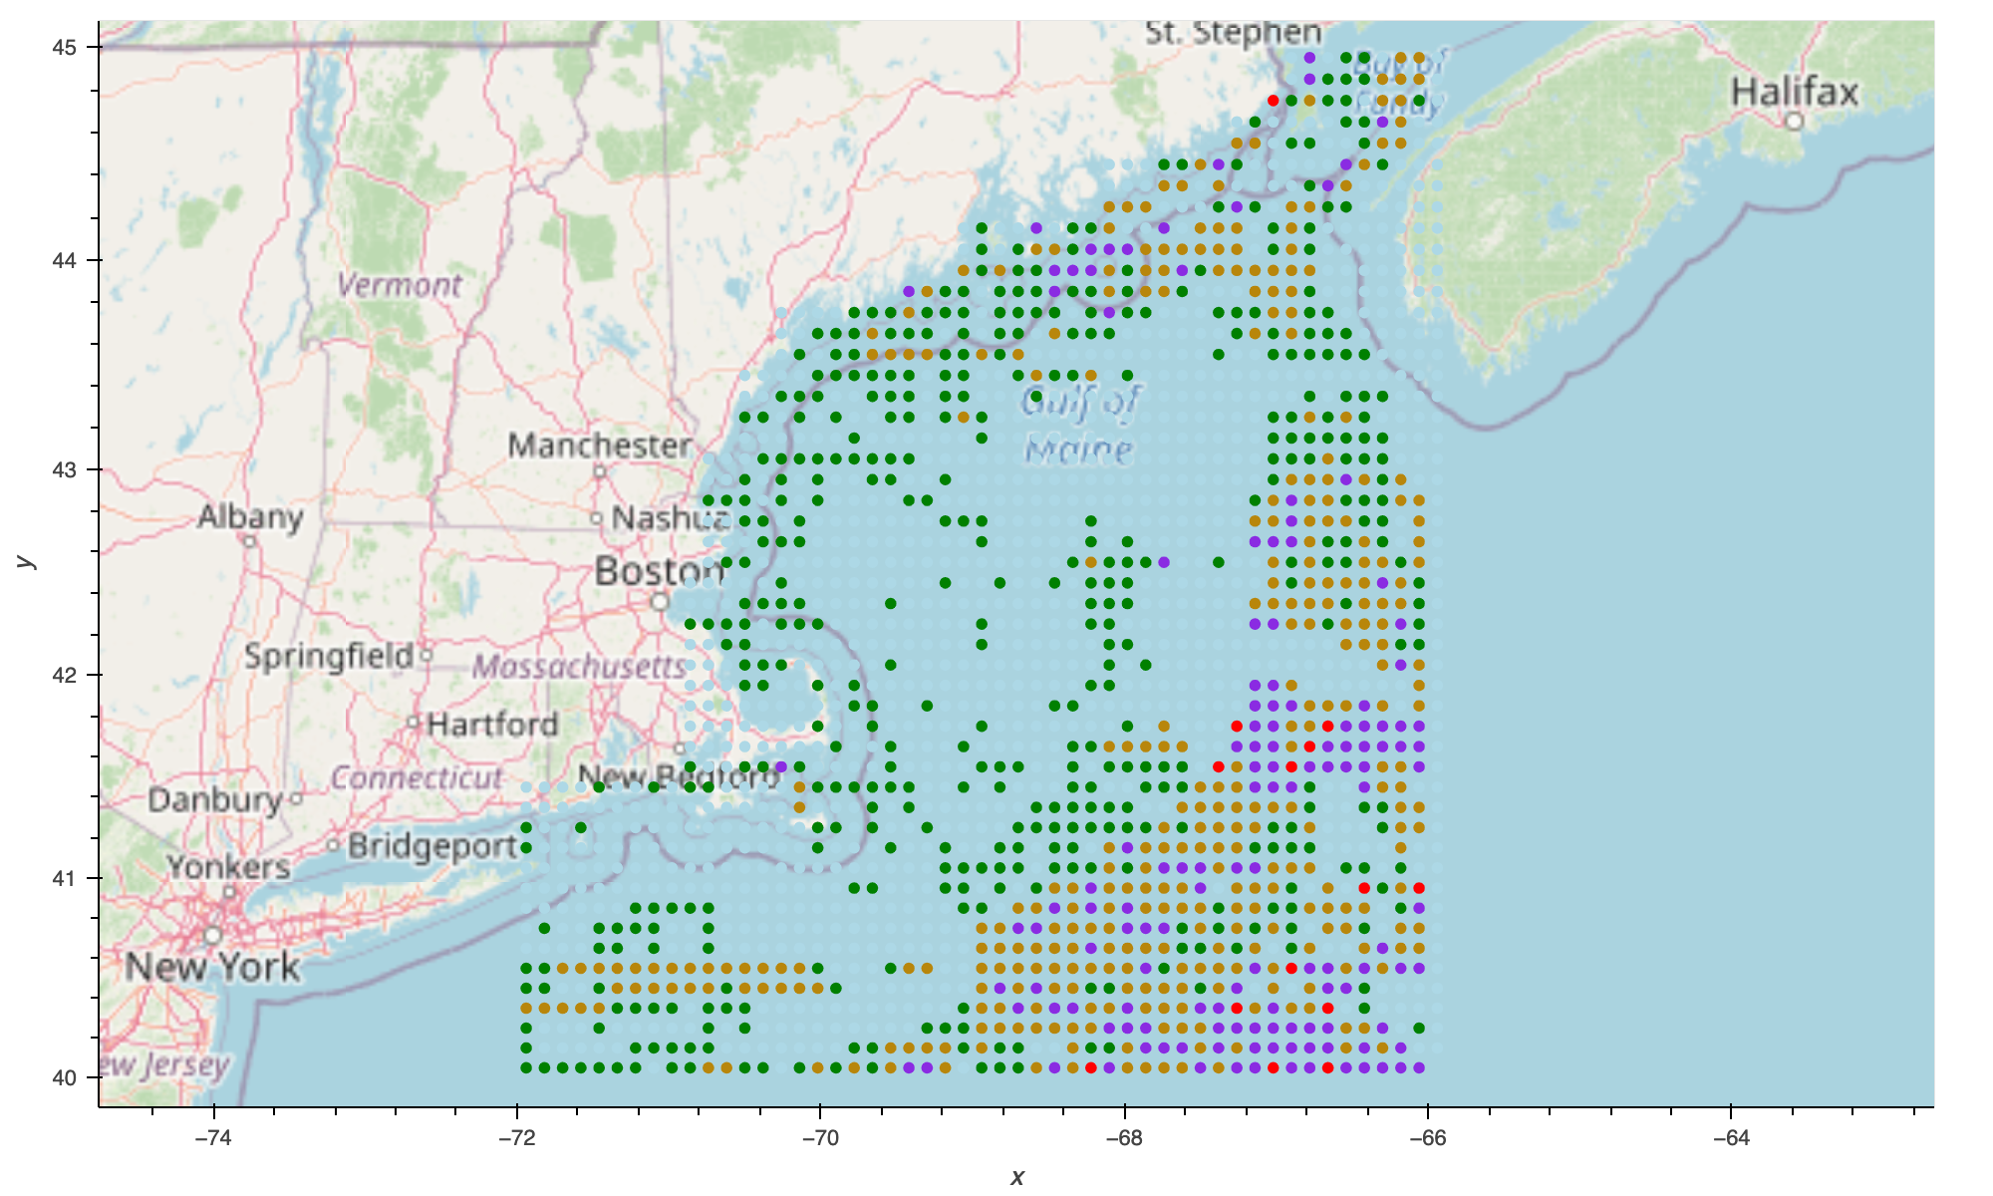
May Risk of Collision Image
Color | Lethal Prob
Lightblue | 0%-20%
Green | 20%-40%
Darkgoldenrod | 40%-60%
Blueviolet | 60%-80%
Red | 80%-100%

Slide 5
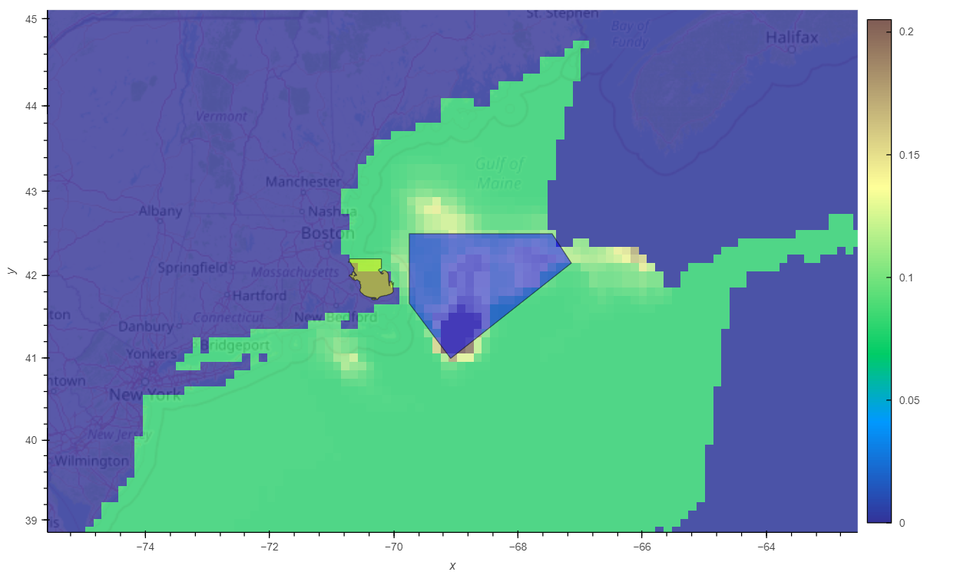
May
Zone overlaps with saving the whales
Collision lethality Habitat and effective slow zone

Slide 6
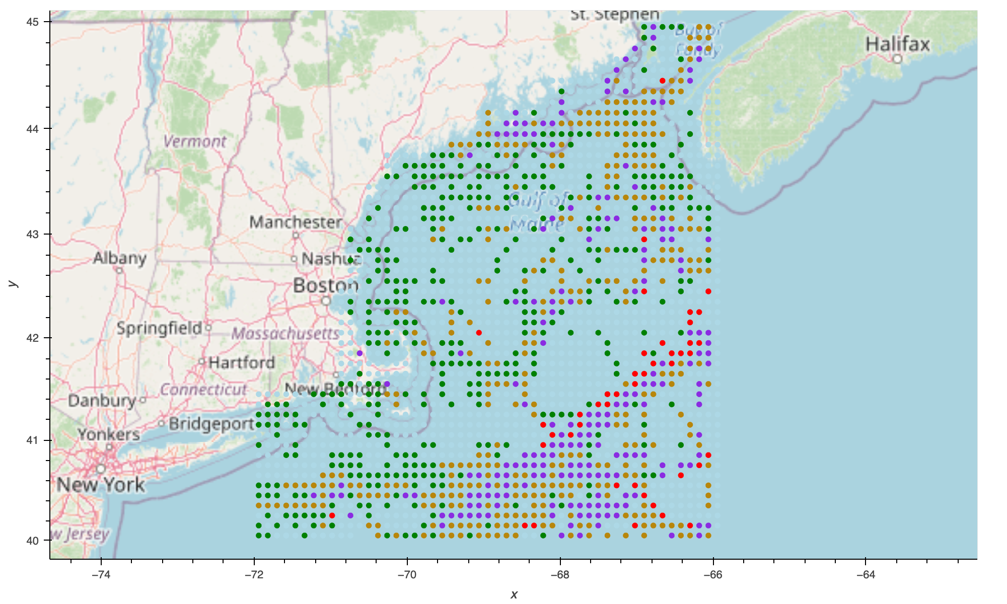
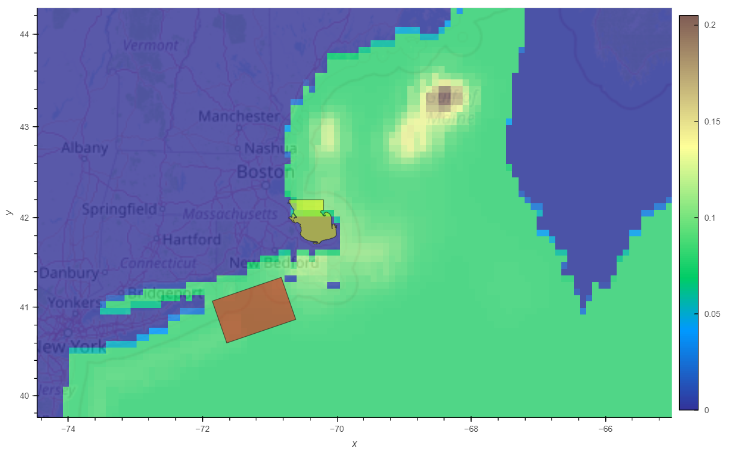
Collision lethality Habitat and effective slow zone
January
However, the slow zones do not cover the Habitat at all.

Slide 7
Future Expansion
Lethality model with distribution of Whale Habitat
Design slow zones to fit with the Whale Habitat
More discussion

