Slide 1
NP-PROBLEM RESEARCH
PHAN BA DUC

Slide 2
Problem Statement
The subset sum problem (SSP) is a decision problem in computer science. In its most general formulation, there is a set of integers and a target-sum T, and the question is to decide whether any subset of the integers sum to precisely T.

Slide 3
Some Analysis
The run-time complexity of SSP depends on two parameters:
n - the number of input integers. If n is a small fixed number, then an exhaustive search for the solution is practical.
L - the precision of the problem, stated as the number of binary place values that it takes to state the problem. If L is a small fixed number, then there are dynamic programming algorithms that can solve it exactly.
As both n and L grow large, SSP is NP-hard. The complexity of the best known algorithms is exponential in the smaller of the two parameters n and L. The problem is NP-hard even when all input integers are positive (and the target-sum T is a part of the input).

Slide 4
Algorithms
Brute-Force
Approximation
Memoization(Dynamic Programming)
Reverse Approach for Approximation
Greedy

Slide 5
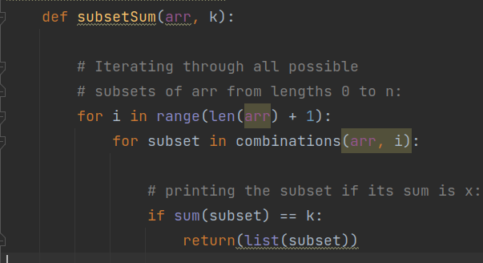
Brute-Force
Find all possible subset sums of the given list and check if the sum is equal to the value we want
O(N^2)

Slide 6
Greedy Algorithm
Given a set, a number k, we sort the elements in set in descending order
For each element in sorted list, we take the largest element which is smaller than from set and decrease k by that element
Do until k becomes 0
If k becomes zero, we find a subset we need
If not, refresh k do step 2 again, but take firstly next largest element that is smaller than k from set
Do step 5 until k becomes 0

Slide 7
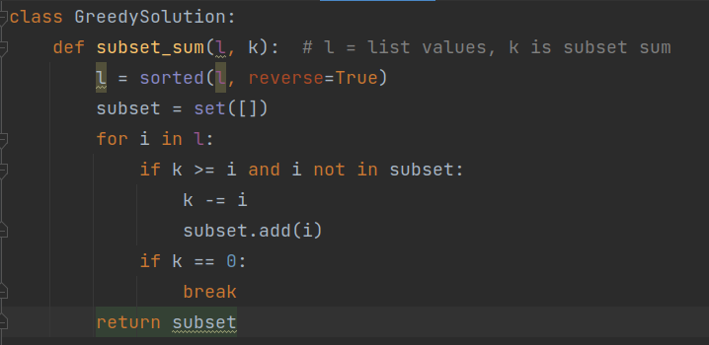
Code Sample
O(N^2)

Slide 8
Memoization
Code a function subsetsum function that return the numbers of subsets in our list that sum to k
To solve it recursively, first we have to analyze the base (i.e.: arr[i:] is empty):
K == 0: The only subset of [] has sum 0, so it is a valid subset. Because of this, the function should return 1.
K != 0: As the only subset of [] has sum 0, there is not a valid subset. Because of this, the function should return 0.
Then, let's analyze the recursive case (i.e.: arr[i:] is not empty). There are two choices: include the number arr[i] in the current subset, or not include it. If we include arr[i], then we are looking subsets that have sum S - arr[i], otherwise, we are still looking for subsets with sum S.
By checking the function subsetsum > 0, we know there is a solution to our problem.
Now we need a function getsubset to find the subset we need

Slide 9
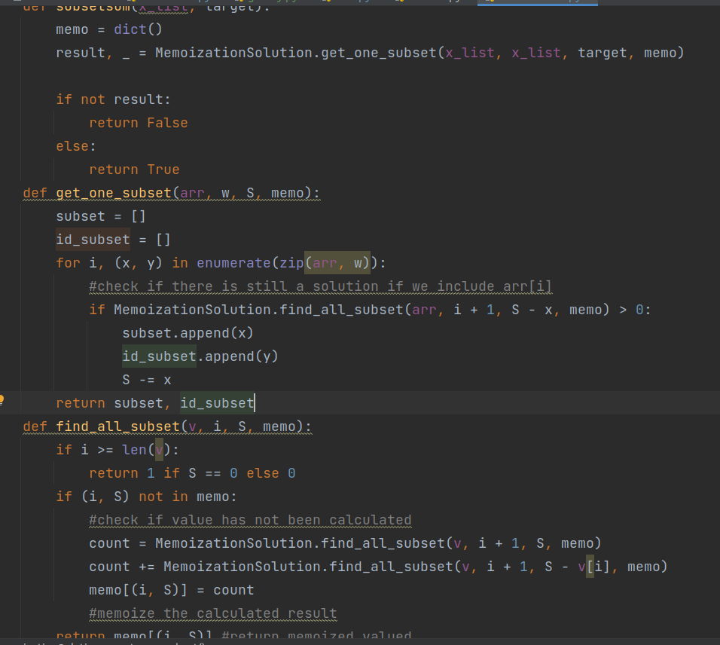
Code Sample
O(N*k)

Slide 10
Approximation Solution
Idea: Suppose all inputs are positive. The Algorithm to SSP aims to find a subset of S with a sum of at most T and at least r times the optimal sum, where r is a number in (0,1) called the approximation ratio. initialize a list L to contain one element 0.
for each i from 1 to n do let U_{i} be a list containing all elements y in L, and all sums x_{i} + y for all y in L. sort U_{i} in ascending order make L empty let y be the smallest element of U_{i} add y to L for each element z of U_{i} in increasing order do // Trim the list by eliminating numbers close to one another // and throw out elements greater than the target sum T. if y + ε T/n < z ≤ T then y = z add z to L return the largest element in L.
The algorithm attains, for every epsilon > 0, an approximation ratio of 1 - epsilon}. Its run time is polynomial in n and 1/epsilon. Recall that n is the number of inputs and T is the upper bound to the subset sum.

Slide 11
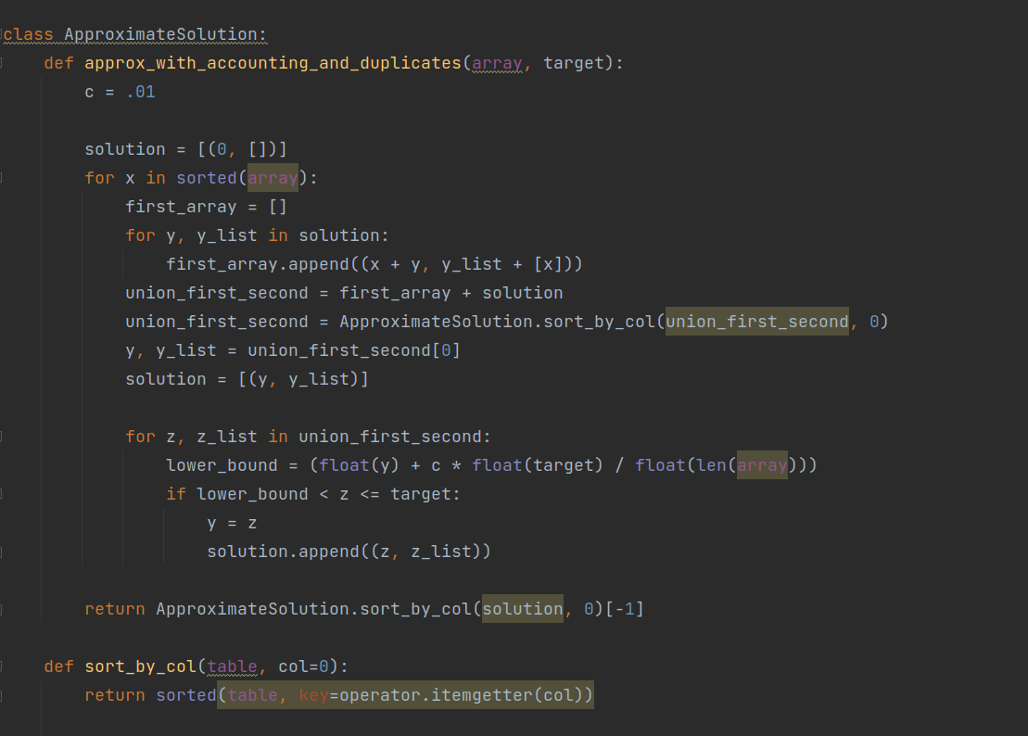
Code Sample

Slide 12
Reverse Method Approximation
Instead of find the exact subset sum, we will do the following. If we can’t find the exact subset sum, we will find the nearest biggest that smaller than k
This one is the best solution so far, which can work with big size input (EX: 100k, 1m)

Slide 13
Compare running time
 | 20 | 100 | 1000 | 10000 | 100000 | 1000000
Brute Force | 2,1s | Error | Error | Error | Error | Error
Memoization | 0,025 | 9,1s | Memmory Error | Memmory Error | Memmory Error | Memmory Error
Approximation | 0,00964 | 0,481855 | 262,5024 | Error | Error | Error
Reverse | 0,16749 | 0,04 | 0.0847 | 2.8 | 36.44 | 52

Slide 14
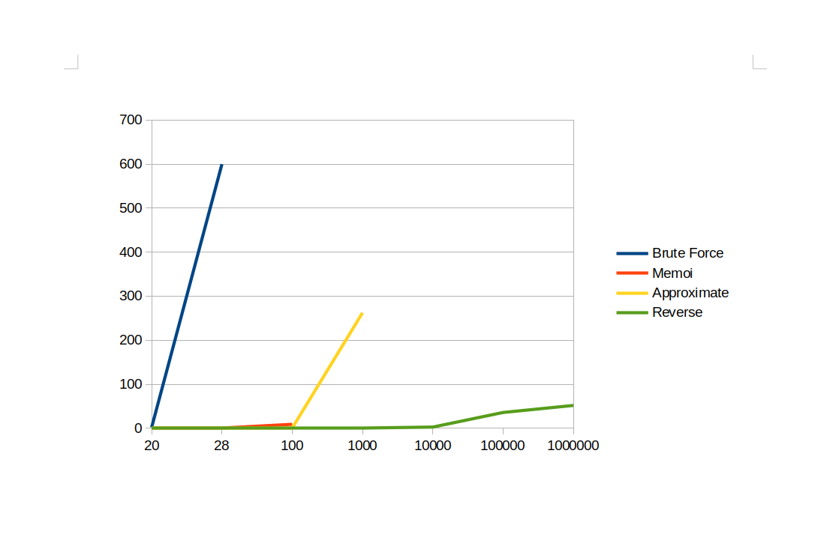
Graph

Slide 15
Thank you for your attention

