Slide 1


HACKATHON ‘21

Slide 2
PROBLEM STATEMENT
There is no proper communications and connections between suppliers(Voltic, Adonko etc.), wholesalers and retailers.
A Lots of goods which costs thousands of cedis goes to waste because they cannot connect with the right customers(Eg. Asapreko produces variaties of drinks and if the unpopular ones do not sell, the company ran at a loss).

Slide 3
PROBLEM STATEMENT
Most (gaint) wholesalers exploits the small wholesalers(I know this because I am manager in a small wholesale shop)
and the smaller ones also exploits on retailers.
This causes unevenness of prices and commodities in a city and this sometimes lead to inflation.

Slide 4
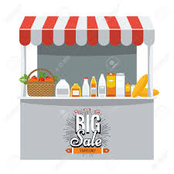
CONCEPT
A distributor of goods(suppliers, wholesales, and retailers) and customers can are on a platform(vision it like a booth(s) in a virtual form) where consumers, window shoppers and even distributors can meet and view a distributor’s page on prices of goods and purchase goods.

Slide 5
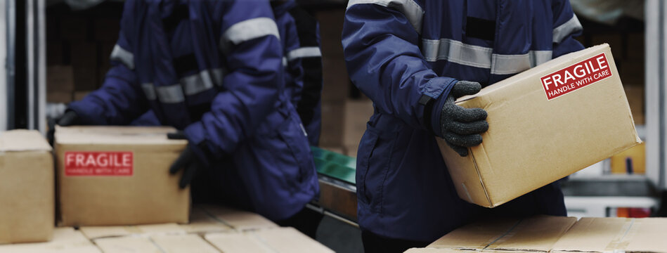
HOW THE SOLUTION WORKS
Anyone can join however they will have to decide a category you fall in(supplier, wholesales or a customer) on the database.
A page(booth) is given to the supplier and the wholesalers to showcase their products(at a cost because they are been exposed to more customers on ayoba).
A retailer and a consumer has the ability to view which booth they want to go and visit and make purchases.
Wholesalers also have this privileges.

Slide 6
TECHNOLOGY APPLIED
Nodejs, Express, MongoDB

Slide 7
DEMO
https://drive.google.com/file/d/19VA2qJhlosEoNi_JIeXswcF9DTEUZnj7/view?usp=sharing

Slide 8
THANK YOU
ANY QUESTIONS?

