Slide 1
🤟 STATEMENT OF PURPOSE & CAPSTONE PRESENTATION
Bi-Directional Sign Language & Audio Assistive Suite
Real-Time Sign-to-Audio (Tamil & English) | Text & Voice-to-Sign Language
2-Way Communication
Deaf ⇄ Hearing Bridge
Bilingual Speech
Tamil (தமிழ்) & English
95.05% ML Accuracy
Random Forest (41 Classes)
Real-Time Vision
> 40 FPS on Standard CPU
Author & Lead Developer: Hepsiba Mark | Technologies: Google MediaPipe, OpenCV, Scikit-Learn, gTTS, pyttsx3, Streamlit
Project Repository: https://github.com/HepsibaMark/Sign-to-audio-and-txt-to-sign

Slide 2
CHALLENGES IN ACCESSIBILITY
The Social Problem & Research Motivation
1. Massive Community Isolation
2. The Critical 'One-Way' Flaw
3. Regional Language Exclusion
• 70+ Million Deaf Individuals
Worldwide use sign language as their primary or native language.
• < 0.1% Public Fluency
Fewer than 1 in 1,000 hearing individuals understand basic manual sign gestures.
• Severe Everyday Impact
Doctor appointments, banking, legal queries, and classroom discussions face critical communication barriers.
• Traditional Tools Are Asymmetric
Most projects only convert hand signs into screen text or English audio.
• The Broken Exchange
When a deaf patient signs to a doctor, the doctor's spoken response CANNOT be understood by the patient without an interpreter.
• Bi-Directionality Is Required
Real communication demands a two-way loop: Sign ➔ Speech and Voice ➔ Sign.
• English Monoculture
Over 95% of published assistive tools exclusively synthesize English voice output.
• 80+ Million Tamil Speakers
In Tamil Nadu, Sri Lanka, Singapore, and Malaysia, deaf families require native Tamil voice output (e.g. 'வணக்கம்', 'உதவி').
• Our Mission
Bridge BOTH linguistic barriers simultaneously: sign-to-voice and voice-to-sign in Tamil & English.

Slide 3
TWO-WAY INCLUSIVE PARADIGM
The Integrated Bi-Directional Solution
FORWARD PIPELINE: Sign ➔ Audio (Deaf to Hearing)
REVERSE PIPELINE: Text & Voice ➔ Sign (Hearing to Deaf)
📹 Video Acquisition: Standard consumer RGB webcam, zero sensor gloves or specialized hardware needed.
✋ 3D Hand Tracking: Google MediaPipe extracts 21 keypoints with spatial invariance normalization.
🤖 Machine Learning Classifier: Random Forest classifier recognizes 41 sign classes (A-Z + 15 everyday signs).
⏱️ Hold-to-Confirm Stabilization: State-machine debouncer ensures stable sentence construction without jitter.
🔊 Dual-Voice Speech Synthesis: Audible spoken output in Tamil (தமிழ் - gTTS studio voice) or English (pyttsx3).
⌨️ Multi-Modal Input: Type text or speak into microphone in either Tamil (தமிழ்) or English.
🎙️ Real-Time Speech-to-Text: Google Speech Recognition parses speech with language codes 'ta-IN' and 'en-US'.
🔤 Bilingual Tokenizer: Maps multi-word phrases, single signs, or phonetic Roman transliteration.
🎬 Procedural Skeletal Animation: Renders anatomical hand skeleton cards with color-coded finger bones.
⏮️ Playback Timeline Controls: Play, pause, skip, and adjust playback speed with simultaneous audio narration.

Slide 4
TECHNICAL WORKFLOW
System Architecture & End-to-End Pipeline
Stage 1: Input Layer
Stage 2: Feature Extraction
Stage 3: Decision Engine
Stage 4: Linguistics & Debounce
Stage 5: Multi-Modal Output
• RGB Webcam Stream (720p)
• Typed Text (Tamil / English)
• Microphone Audio (ta-IN / en-US)
• MediaPipe 21 3D Landmarks
• Translation to Wrist (0,0,0)
• Scale Normalization (MCP-9)
• 63-D Invariant Vector
• Random Forest (150 trees)
• 41 Vocabulary Classes
• Top-3 Probabilities output
• Geometric heuristic safety net
• Tamil Audio (gTTS Studio)
• English Audio (pyttsx3 SAPI5)
• Visual 3D Skeleton Cards
• Animated Sign Timeline
• Hold-to-Confirm (0.8s timer)
• Tamil-English Lexical Mapper
• Phonetic Transliteration
• Sentence Buffer Manager

Slide 5
SUPERVISED CLASSIFICATION
Machine Learning Classifier & Training Evaluation
Random Forest Classifier Architecture
Empirical Test Benchmark (95.05% Accuracy)
• Ensemble Strategy: 150 Decision Trees with bootstrap aggregation (Bagging).
• Max Tree Depth: 24 levels to prevent overfitting while capturing non-linear angles.
• Input Features: 63 continuous features (normalized 3D coordinates).
• Multi-Class Scope: 41 Classes (26 ASL alphabet letters + 15 conversational words).
• Inference Latency: < 2 milliseconds per frame on standard laptop CPU (> 500 FPS).
• Probability Distribution: Predicts exact Top-3 class confidences for visual transparency.
✓ Total Dataset Samples: 7,380 samples across 41 classes
✓ Training Set (80%): 5,904 stratified samples
✓ Test / Validation Set (20%): 1,476 unseen test samples
✓ Overall Test Accuracy: 95.05% (1,403 / 1,476 correctly classified)
✓ Macro Precision: 0.95
✓ Macro Recall: 0.95
✓ Macro F1-Score: 0.95
✓ Per-Class Accuracies: 100% precision on A, B, C, D, HELLO, WATER, OK, PEACE, Y, I LOVE YOU

Slide 6
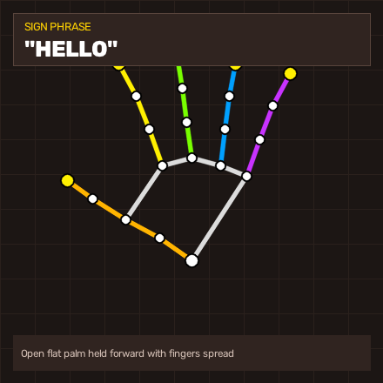
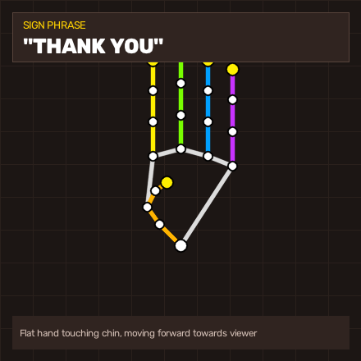
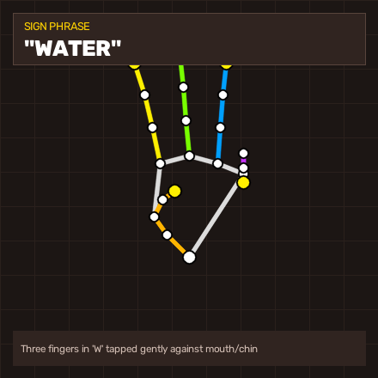
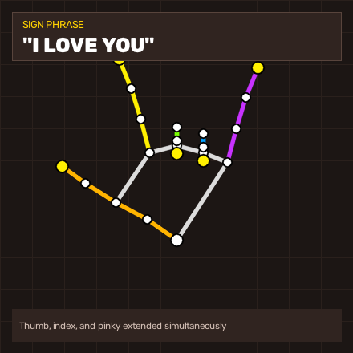
HIGH-CLARITY DIAGRAMS
Visual Sign Generator & Anatomical Gallery
HELLO
THANK YOU
WATER
I LOVE YOU
வணக்கம் (Vanakkam)
Open Palm Greeting
நன்றி (Nandri)
Chin Forward Motion
தண்ணீர் (Thanneer)
'W' Sign Survival
நான் உன்னை நேசிக்கிறேன்
Universal ASL Affection

Slide 7
EXPERIMENTAL EVALUATION
Empirical Benchmarks & Execution Latency
End-to-End Pipeline Latency (CPU Only)
System Resource Footprint & Accuracy
Video Frame Grab (OpenCV): 4.2 ms (240 FPS max)
MediaPipe Landmark Tracking: 18.5 ms (54 FPS throughput)
Spatial Invariance Normalization: 0.3 ms (> 3000 FPS)
Random Forest ML Inference: 1.8 ms (> 500 FPS)
Hold Debounce State Machine: < 0.1 ms (Negligible)
TOTAL VISION PIPELINE: 24.8 ms (> 40.3 FPS (Real-Time))
Local Audio Playback (Cache): 12.1 ms (Instant)
pyttsx3 Offline Audio: 45.0 ms (Near-Instant)
• Test Accuracy on 41 Classes:
95.05% on 1,476 unseen test samples
• GPU Requirement:
0 GB (Runs 100% on standard laptop CPU)
• RAM Consumption:
~ 320 MB at full runtime
• Disk Footprint:
~ 85 MB (including models, cache, assets)
• Hardware Compatibility:
Standard 720p/1080p USB or built-in webcam
• OS Support:
Windows 10/11, Ubuntu Linux, macOS
• Speech Locales:
Tamil ('ta-IN' & 'ta') and English ('en-US' & 'en')

Slide 8
SUMMARY & NEXT STEPS
Conclusion & Future Roadmap
Key Technical Achievements
Future Roadmap & Project Inquiries
✓ Complete Bi-Directional Bridge:
Successfully bridged both directions (Sign ➔ Audio and Text/Voice ➔ Sign) in a single platform.
✓ First-Class Tamil Language Support:
Solved regional language exclusion with native Tamil voice synthesis and script transliteration.
✓ High-Performance Machine Learning:
Trained on 7,380 samples across 41 classes with 95.05% benchmark accuracy.
✓ Zero-Cost Consumer Accessibility:
Requires only a standard laptop webcam. Zero specialized sensors or paid APIs required.
✓ Full Fault Isolation:
Robust software architecture ensuring partial mission failures never corrupt existing outputs.
🚀 Two-Handed Sign Tracking:
Expand MediaPipe dual-hand pipeline for complex two-handed phrases and continuous sentence grammar.
🚀 Indian Sign Language (ISL) Integration:
Incorporate the full two-handed ISL manual alphabet alongside ASL.
🚀 Mobile Edge Deployment:
Convert Random Forest model to ONNX / TFLite for native Android & iOS mobile apps.
🚀 Repository & Open Source:
Complete codebase and documentation published at:
https://github.com/HepsibaMark/Sign-to-audio-and-txt-to-sign

