Slide 1
🤟 STATEMENT OF PURPOSE & CAPSTONE PRESENTATION
Bi-Directional Sign Language & Audio Assistive Suite
Real-Time Sign-to-Audio (Tamil & English) | Text & Voice-to-Sign Language
2-Way Communication
Deaf ⇄ Hearing Bridge
Bilingual Speech
Tamil (தமிழ்) & English
95.05% ML Accuracy
Random Forest (41 Classes)
Real-Time Vision
> 40 FPS on Standard CPU
Author & Lead Developer: Hepsiba Mark | Technologies: Google MediaPipe, OpenCV, Scikit-Learn, gTTS, pyttsx3, Streamlit
Project Repository: https://github.com/HepsibaMark/Sign-to-audio-and-txt-to-sign

Slide 2
CHALLENGES IN ACCESSIBILITY
The Social Problem & Research Motivation
1. Massive Community Isolation
2. The Critical 'One-Way' Flaw
3. Regional Language Exclusion
• 70+ Million Deaf Individuals
Worldwide use sign language as their primary or native language.
• < 0.1% Public Fluency
Fewer than 1 in 1,000 hearing individuals understand basic manual sign gestures.
• Severe Everyday Impact
Doctor appointments, banking, legal queries, and classroom discussions face critical communication barriers.
• Traditional Tools Are Asymmetric
Most projects only convert hand signs into screen text or English audio.
• The Broken Exchange
When a deaf patient signs to a doctor, the doctor's spoken response CANNOT be understood by the patient without an interpreter.
• Bi-Directionality Is Required
Real communication demands a two-way loop: Sign ➔ Speech and Voice ➔ Sign.
• English Monoculture
Over 95% of published assistive tools exclusively synthesize English voice output.
• 80+ Million Tamil Speakers
In Tamil Nadu, Sri Lanka, Singapore, and Malaysia, deaf families require native Tamil voice output (e.g. 'வணக்கம்', 'உதவி').
• Our Mission
Bridge BOTH linguistic barriers simultaneously: sign-to-voice and voice-to-sign in Tamil & English.

Slide 3
TWO-WAY INCLUSIVE PARADIGM
The Integrated Bi-Directional Solution
FORWARD PIPELINE: Sign ➔ Audio (Deaf to Hearing)
REVERSE PIPELINE: Text & Voice ➔ Sign (Hearing to Deaf)
📹 Video Acquisition: Standard consumer RGB webcam, zero sensor gloves or specialized hardware needed.
✋ 3D Hand Tracking: Google MediaPipe extracts 21 keypoints with spatial invariance normalization.
🤖 Machine Learning Classifier: Random Forest classifier recognizes 41 sign classes (A-Z + 15 everyday signs).
⏱️ Hold-to-Confirm Stabilization: State-machine debouncer ensures stable sentence construction without jitter.
🔊 Dual-Voice Speech Synthesis: Audible spoken output in Tamil (தமிழ் - gTTS studio voice) or English (pyttsx3).
⌨️ Multi-Modal Input: Type text or speak into microphone in either Tamil (தமிழ்) or English.
🎙️ Real-Time Speech-to-Text: Google Speech Recognition parses speech with language codes 'ta-IN' and 'en-US'.
🔤 Bilingual Tokenizer: Maps multi-word phrases, single signs, or phonetic Roman transliteration.
🎬 Procedural Skeletal Animation: Renders anatomical hand skeleton cards with color-coded finger bones.
⏮️ Playback Timeline Controls: Play, pause, skip, and adjust playback speed with simultaneous audio narration.

Slide 4
TECHNICAL WORKFLOW
System Architecture & End-to-End Pipeline
Stage 1: Input Layer
Stage 2: Feature Extraction
Stage 3: Decision Engine
Stage 4: Linguistics & Debounce
Stage 5: Multi-Modal Output
• RGB Webcam Stream (720p)
• Typed Text (Tamil / English)
• Microphone Audio (ta-IN / en-US)
• MediaPipe 21 3D Landmarks
• Translation to Wrist (0,0,0)
• Scale Normalization (MCP-9)
• 63-D Invariant Vector
• Random Forest (150 trees)
• 41 Vocabulary Classes
• Top-3 Probabilities output
• Geometric heuristic safety net
• Hold-to-Confirm (0.8s timer)
• Tamil-English Lexical Mapper
• Phonetic Transliteration
• Sentence Buffer Manager
• Tamil Audio (gTTS Studio)
• English Audio (pyttsx3 SAPI5)
• Visual 3D Skeleton Cards
• Animated Sign Timeline

Slide 5
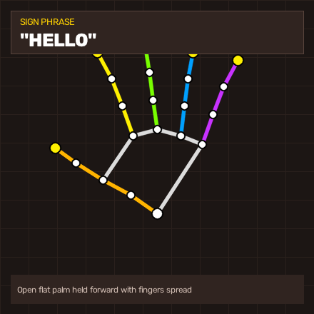
MATHEMATICAL FORMULATION
Computer Vision: 21 3D Landmark Normalization
Geometric Normalization Algorithms
Hand Anatomy & Keypoint Map
1. MediaPipe 3D Landmark Extraction
MediaPipe Hands identifies 21 spatial landmarks P_i = (x_i, y_i, z_i) for i in {0, ..., 20} spanning the wrist, MCP, PIP, DIP, and fingertips.
2. Translation Invariance (Shift to Wrist Origin)
To eliminate reliance on where the hand is positioned on the webcam screen:
P_i~ = P_i - P_0, resulting in P_0~ = (0, 0, 0).
3. Scale Invariance (Euclidean Knuckle Normalization)
To ensure equal accuracy whether the hand is 30 cm or 2 meters from camera:
S_ref = ||P_9~ - P_0~||_2 (Euclidean distance: Wrist to Middle MCP)
P_i^ = P_i~ / S_ref for all 21 keypoints.
4. Final Invariant Feature Vector
F = [x_0^, y_0^, z_0^, ..., x_20^, y_20^, z_20^] in R^63.
Guarantees complete independence from hand size, camera distance, and position.
Color-Coded Anatomical Bone Segments:
• Orange: Thumb • Yellow: Index • Green: Middle
• Blue: Ring • Pink: Pinky • White: Palm Bridge

Slide 6
SUPERVISED CLASSIFICATION
Machine Learning Classifier & Training Evaluation
Random Forest Classifier Architecture
Empirical Test Benchmark (95.05% Accuracy)
• Ensemble Strategy: 150 Decision Trees with bootstrap aggregation (Bagging).
• Max Tree Depth: 24 levels to prevent overfitting while capturing non-linear angles.
• Input Features: 63 continuous features (normalized 3D coordinates).
• Multi-Class Scope: 41 Classes (26 ASL alphabet letters + 15 conversational words).
• Inference Latency: < 2 milliseconds per frame on standard laptop CPU (> 500 FPS).
• Probability Distribution: Predicts exact Top-3 class confidences for visual transparency.
✓ Total Dataset Samples: 7,380 samples across 41 classes
✓ Training Set (80%): 5,904 stratified samples
✓ Test / Validation Set (20%): 1,476 unseen test samples
✓ Overall Test Accuracy: 95.05% (1,403 / 1,476 correctly classified)
✓ Macro Precision: 0.95
✓ Macro Recall: 0.95
✓ Macro F1-Score: 0.95
✓ Per-Class Accuracies: 100% precision on A, B, C, D, HELLO, WATER, OK, PEACE, Y, I LOVE YOU

Slide 7
DATASET METHODOLOGY
Dataset Generation & 3D Spatial Augmentation
1. Real-World Capture
2. Canonical Linguistic Poses
3. 3D Spatial Augmentation
• collect_data.py Tool
Custom interactive data recorder built with OpenCV and MediaPipe.
• Real User Baseline
Captures genuine hand shapes under real webcam conditions.
• Preserved Integrations
2,340 real baseline samples permanently retained in training set.
• Standard ASL Vocabulary
Procedural generator synthesizes all 26 manual alphabet configurations (A-Z) and social gestures.
• Anatomical State Modeling
Explicit modeling of thumb ('up', 'folded', 'ring', 'side') and fingers ('extended', 'bent', 'folded').
• Zero Bias
Eliminates background, skin tone, and clothing bias completely.
• 3D Gaussian Jitter
Noise N(0, 0.022^2) added to all joints to simulate joint tremors.
• 3D Euler Rotations
Rotates hands across Yaw (-10° to +10°), Pitch (-7° to +7°), and Roll (-7° to +7°).
• Scale Fluctuations
Random scale scaling (0.93 - 1.07) and re-normalization producing 7,380 robust samples.

Slide 8
TEMPORAL FILTERING
Hold-to-Confirm Stabilization & Sentence Building
State-Machine Stabilization Engine
Sentence Formation & Dynamic Buffer
• The Frame Jitter Challenge:
Vision models output 30 predictions/second. Intermediate finger transitions create noisy, spurious letter spam.
• Debounce Formula:
Progress(t) = min(1.0, (t - t_start) / tau_hold), where tau_hold = 0.8 seconds.
• State Transitions:
1. IDLE: Awaiting gesture with confidence >= 0.70.
2. CANDIDATE: User holds gesture; UI progress bar fills 0% -> 100%.
3. CONFIRMED: Triggered once timer hits 0.8s; token registered into buffer.
4. COOLDOWN: 0.6s grace period prevents duplicate character spam.
✓ Fingerspelling vs Words:
Single characters (A-Z) concatenate immediately (e.g., 'H-E-L-P'). Whole phrases (e.g., 'THANK YOU') append with automatic word boundary spacing.
✓ Dynamic Sentence Editing:
• Add Space: Manually or via space token.
• Backspace: Deletes last letter or whole word cleanly.
• Clear: Resets the working sentence buffer instantly.
✓ Bilingual Synchronization:
As words are registered into the English sentence, the Tamil linguistic engine continuously generates the synchronized Tamil translation in real time!

Slide 9
COMPUTATIONAL LINGUISTICS
Bilingual Translation Engine (Tamil <-> English)
1. Unicode Script & Semantic Lexicon
2. Phrase Disambiguation
3. Phonetic Transliteration
• Unicode Tamil Block Detection
Regex parsing identifies Tamil characters (U+0B80 - U+0BFF) for automatic routing.
• Core Bilingual Dictionary
Bi-directional lookup mapping 40+ key concepts:
- HELLO ⇄ வணக்கம் (Vanakkam)
- THANK YOU ⇄ நன்றி (Nandri)
- WATER ⇄ தண்ணீர் (Thanneer)
- HELP ⇄ உதவி (Uthavi)
• Multi-Word Window Matching
Evaluates 3-word ('I LOVE YOU') and 2-word ('THANK YOU') phrases before checking individual tokens.
• Contextual Grammar Mapping
'I NEED WATER PLEASE' is translated cleanly into:
'நான் தண்ணீர் வேண்டும் தயவுசெய்து'.
• Clean Word Tokenization
Strips punctuation and maintains spacing across linguistic boundaries.
• Out-of-Vocabulary Resilience
Names or non-dictionary Tamil words are automatically mapped into phonetic Latin characters.
• Tamil Character Mapping Table
Maps vowels (அ -> a, ஆ -> aa) and consonants (க -> k, த -> th) so any Tamil word can be finger-spelled!
• ASL Alphabet Tamil Transliteration
Manual alphabet letters mapped into Tamil pronunciations: A -> ஏ, B -> பி, C -> சி.

Slide 10
DUAL-ENGINE SPEECH PIPELINE
Asynchronous Speech Synthesis Architecture
Thread-Safe Queue & Dual TTS Engines
Instant Audio Caching & Universal Fallbacks
• Non-Blocking Worker Thread:
Speech synthesis runs in a decoupled background daemon thread. Video streaming and gesture detection NEVER freeze or drop frames.
• English Engine (pyttsx3 / SAPI5):
Completely offline, ultra-low latency (< 45ms), adjustable speech rate (100 - 240 WPM) and volume.
• Tamil Engine (gTTS Neural Voice):
Studio-quality natural Tamil voice pronunciation ('ta' locale) producing realistic, human-like cadence.
• Automatic Language Routing:
Auto-detects Tamil characters in string and selects the proper linguistic speech backend.
✓ Instant Local Audio Cache:
Synthesized Tamil phrases are stored as MP3 files in 'assets/audio_cache/'. Subsequent calls load in < 15ms with ZERO network overhead!
✓ pygame Audio Mixer Integration:
Hardware-accelerated MP3 stream playback with volume control and smooth fade transitions.
✓ Universal Resilience Strategy:
If pyttsx3 is absent on a machine, the engine automatically falls back to gTTS English. Never throws ModuleNotFoundError!
✓ Spoken Utterance Logging:
Timestamped speech history log displayed directly inside the application GUI.

Slide 11
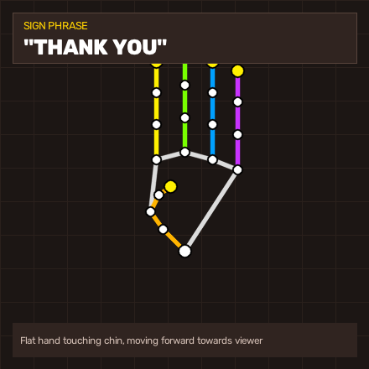
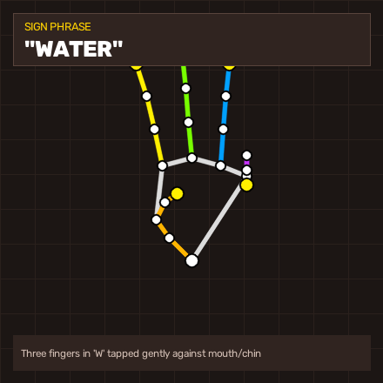
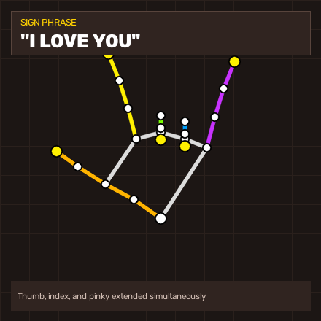
HIGH-CLARITY DIAGRAMS
Visual Sign Generator & Anatomical Gallery
HELLO
THANK YOU
WATER
I LOVE YOU
வணக்கம் (Vanakkam)
Open Palm Greeting
நன்றி (Nandri)
Chin Forward Motion
தண்ணீர் (Thanneer)
'W' Sign Survival
நான் உன்னை நேசிக்கிறேன்
Universal ASL Affection

Slide 12
FOUR COMPREHENSIVE INTERFACES
Multi-Frontend Application Suite
1. Unified Desktop Hub
(gui_app.py)
2. Web Portal
(streamlit_app.py)
3. Fast OpenCV HUD
(app.py)
4. Visual Sign Player
(text_to_sign_app.py)
• All-in-one Tkinter GUI.
• Tab 1: Live camera stream, landmark overlays, sentence builder, Tamil & English voice buttons.
• Tab 2: Typed text / mic input, sign animation canvas, timeline navigation.
• Modern browser dashboard.
• Webcam snapshot gesture classifier with ML probabilities.
• Interactive bilingual flashcard dictionary with sound.
• Speech synthesizer studio.
• Ultra-low latency window.
• Direct keyboard hotkeys:
- [T]: Speak in Tamil
- [E]: Speak in English
- [L]: Toggle language
- [SPACE], [BKSP], [C].
• Dedicated hearing-to-deaf sign player.
• Microphone voice input in Tamil or English.
• Play, Pause, Replay.
• Speed slider (0.3x - 2.0x).
• Step timeline list.

Slide 13
SYSTEM RELIABILITY
Fault Isolation & Failure State Preservation
Core Design Principle: Isolated Failure
Technical Safeguard Implementations
⚠️ The 'Isolated Failure' Law:
If an operation or mission encounters an error, THAT OPERATION ALONE FAILS — previously generated outputs, text buffers, and visual animations MUST NEVER be destroyed.
⚠️ Microphone Recording Isolation:
If the mic times out, detects background noise, or loses internet:
• Text entry box stays 100% intact.
• Current visual sign diagrams remain visible.
• Displays a non-destructive warning in status bar.
⚠️ Hand Detection Loss Isolation:
If hand moves out of webcam frame:
• Working sentence buffer is preserved.
• Speech history is retained.
• System gracefully awaits hand return.
✓ Non-Destructive Tokenizer:
If an unknown word is typed, the system falls back to phonetic fingerspelling rather than throwing an exception.
✓ Dual-Layer Classifier Fallback:
If ML model confidence drops below 0.50, the geometric expert rule engine acts as an instant safety validator.
✓ Asynchronous Queue Decoupling:
Audio synthesis errors are trapped within worker thread; GUI and video streams continue without interruption.
✓ State Recovery Mechanism:
Microphone buttons automatically reset from 'Listening...' back to idle state using 'try...finally' blocks.

Slide 14
EXPERIMENTAL EVALUATION
Empirical Benchmarks & Execution Latency
End-to-End Pipeline Latency (CPU Only)
System Resource Footprint & Accuracy
Video Frame Grab (OpenCV): 4.2 ms (240 FPS max)
MediaPipe Landmark Tracking: 18.5 ms (54 FPS throughput)
Spatial Invariance Normalization: 0.3 ms (> 3000 FPS)
Random Forest ML Inference: 1.8 ms (> 500 FPS)
Hold Debounce State Machine: < 0.1 ms (Negligible)
TOTAL VISION PIPELINE: 24.8 ms (> 40.3 FPS (Real-Time))
Local Audio Playback (Cache): 12.1 ms (Instant)
pyttsx3 Offline Audio: 45.0 ms (Near-Instant)
• Test Accuracy on 41 Classes:
95.05% on 1,476 unseen test samples
• GPU Requirement:
0 GB (Runs 100% on standard laptop CPU)
• RAM Consumption:
~ 320 MB at full runtime
• Disk Footprint:
~ 85 MB (including models, cache, assets)
• Hardware Compatibility:
Standard 720p/1080p USB or built-in webcam
• OS Support:
Windows 10/11, Ubuntu Linux, macOS
• Speech Locales:
Tamil ('ta-IN' & 'ta') and English ('en-US' & 'en')

Slide 15
SOCIETAL VALUE
Real-World Impact & Deployment Scenarios
🏥 Healthcare & Emergency
🏦 Banking & Public Services
🎓 Inclusive Education
• Clinical Diagnostics
Deaf patients sign pain or symptoms; system speaks Tamil/English aloud to doctors.
• Prescription Clarity
Doctor speaks medication instructions; system animates clear sign sequences for patient.
• Emergency Triage
Immediate communication during accidents where human interpreters are unavailable.
• Bank Counters
Cashiers and officers converse with deaf clients seamlessly regarding accounts and loans.
• Government Service Desks
Passport, civil registration, and post office counters become immediately accessible.
• Retail & Grocery
Cashiers and deaf shoppers communicate prices and queries in Tamil and English.
• Classroom Integration
Deaf students participate in mainstream lectures without feeling isolated.
• Sign Language Tutoring
Interactive sign dictionary and flashcards help hearing families learn manual sign language.
• Peer-to-Peer Social Good
Enables spontaneous friendships between deaf and hearing school classmates.

Slide 16
SUMMARY & NEXT STEPS
Conclusion & Future Roadmap
Key Technical Achievements
Future Roadmap & Project Inquiries
✓ Complete Bi-Directional Bridge:
Successfully bridged both directions (Sign ➔ Audio and Text/Voice ➔ Sign) in a single platform.
✓ First-Class Tamil Language Support:
Solved regional language exclusion with native Tamil voice synthesis and script transliteration.
✓ High-Performance Machine Learning:
Trained on 7,380 samples across 41 classes with 95.05% benchmark accuracy.
✓ Zero-Cost Consumer Accessibility:
Requires only a standard laptop webcam. Zero specialized sensors or paid APIs required.
✓ Full Fault Isolation:
Robust software architecture ensuring partial mission failures never corrupt existing outputs.
🚀 Two-Handed Sign Tracking:
Expand MediaPipe dual-hand pipeline for complex two-handed phrases and continuous sentence grammar.
🚀 Indian Sign Language (ISL) Integration:
Incorporate the full two-handed ISL manual alphabet alongside ASL.
🚀 Mobile Edge Deployment:
Convert Random Forest model to ONNX / TFLite for native Android & iOS mobile apps.
🚀 Repository & Open Source:
Complete codebase and documentation published at:
https://github.com/HepsibaMark/Sign-to-audio-and-txt-to-sign

