Slide 1
Predicting financial index movement using trend indicators and machine learning
Domain: Machine Learning
Presented by: Sooraj V S (31165)
Seminar Guide : Prof. P.R. Rajmane

Slide 2
Index
Problem Definition
Introduction
Motivation
Literature Survey
Block Diagram
Data Description
Prediction Models & Observations
Conclusion
References

Slide 3
Problem Definition
Scope:
To compare the accuracy of well known machine learning algorithms,extracted from literature survey when used with trend indicators as inputs to predict financial indices.
This study focuses on comparing prediction performance of Naive-Bayes, Logistic regression, Random forest, SVM and ANN models for the task of predicting index price movement. Twelve technical parameters computed at different intervals are used as the inputs to these (wiz. SMA, WMA, EMA, Momentum, Stochastic K%, Stochastic D%, RSI, MACD and Commodity Channel Index).

Slide 4
Introduction
Prediction of future movement of index prices has been the subject matter of many research work.
There are work that have shown, if correctly modeled, stock prices can be predicted with a fairly reasonable degree of accuracy. Focused on choice of variables, appropriate functional forms and techniques of forecasting
There is also an extent of literature on technical analysis of index prices where the objective is to identify patterns in movements. various indicators like Bollinger Band, Moving Average Convergence Divergence (MACD), Relative Strength Index (RSI), Moving Average, Momentum Stochastics, Meta Sine Wave etc., have been devised towards this end.

Slide 5
Motivation
Financial Index price prediction is a classic and important problem. With a successful model for index prediction, we can gain insight about market behavior over time, spotting trends that would otherwise not have been noticed. With the increasing computational power, machine learning will be an efficient method to solve this problem.
Many people are interested in the financial markets, need guidance and accurate predictions to invest wisely. The ability to uncover a mathematical model that can consistently predict the direction of the future index prices would make the owner of the model maximize the gains from the same. Thus, researchers, investors and investment professionals are always attempting to find a market model that would yield them higher returns than their counterparts.

Slide 6
Literature Survey
Model/Algorithm | Overview | Positive Aspects | Limitations
Naive Bayes Classifier [4] (2020) | Previous interval Close, Low and High price are taken as input, Output predicts the direction of movement in next interval. | This approach can be used for making real time predictions as it doesn’t require as much training data making it ideal for short term predictions. | This assumes that all predictors are independent, this limits the applicability of this algorithm in predicting index movements which are continuous and highly correlated to each other.
Logistic Regression [4] (2020) | This model uses technical indicators calculated from the previous rates and predicts output class corresponding to upward or downward movement for future interval. | It can interpret model coefficients as indicators of feature importance. Good accuracy for many simple data sets and it performs well when the dataset is linearly separable. | Exact value of the movement can't be predicted using logistic regression as the output has to be in form of classes.
Random Forest Classifier [5] (2018) | Continuous Close, Low and High price are taken as input to predict the direction of the movement. | It works well with both categorical and continuous values thus becomes flexible to both classification and regression problem. | Due to the ensemble of decision trees, it also suffers interpretability and fails to determine the significance of each variable.
Neural Network [2] (2020) | Trend indicators are used as inputs along with fear/greed index estimated using sentiment analysis on social media platforms. | Investor’s emotions derived from Twitter have impacts on stock indicators which is considered while making prediction. | Taking twitter posts into accord compromise the ability of the model in predicting real-time results.

Slide 7
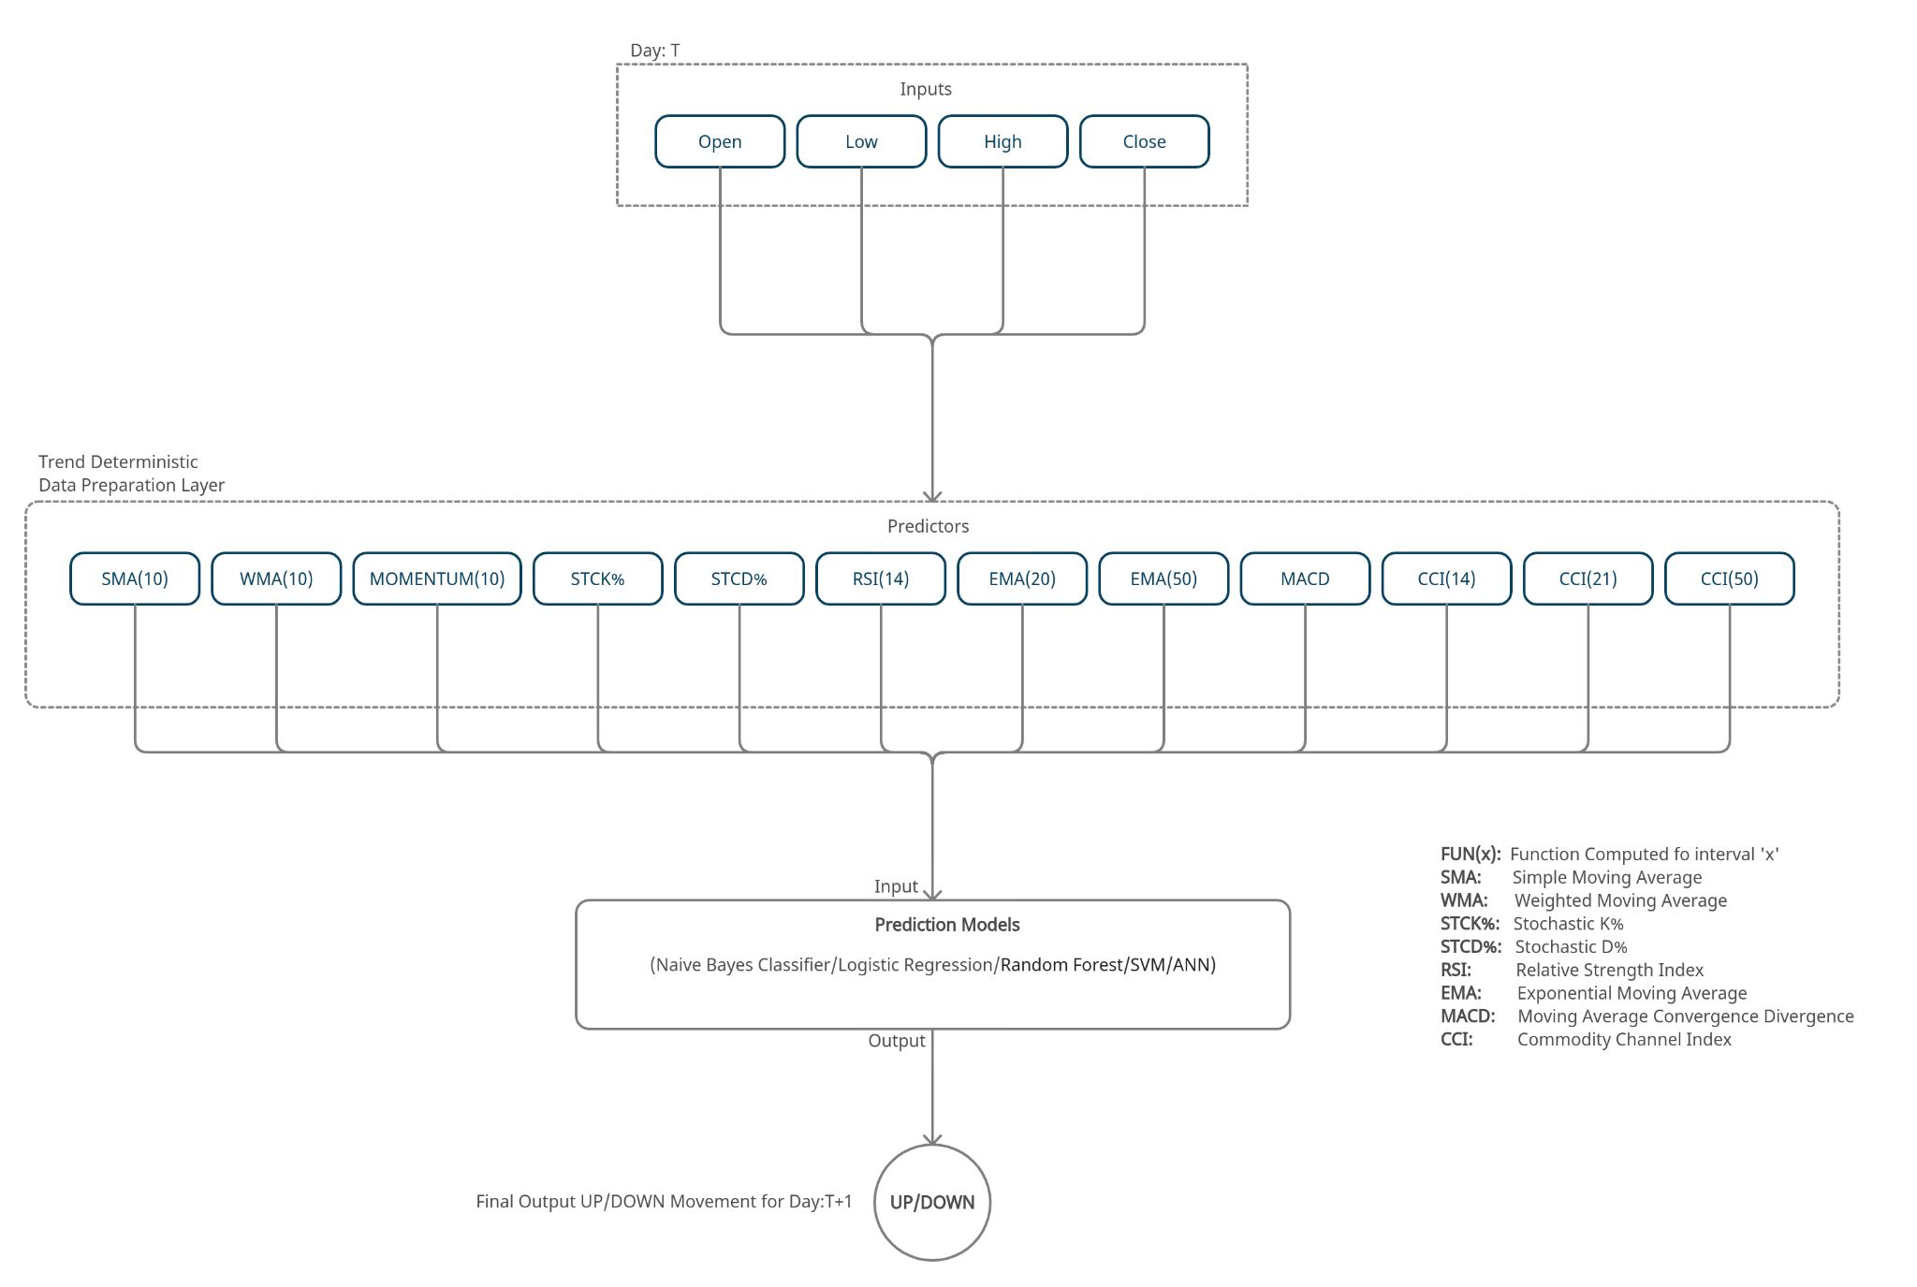
Block Diagram

Slide 8
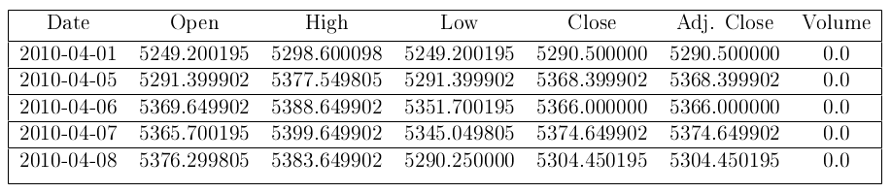
Data Description
The datasets used in this project include NIFTY50, ONGC, HDFC BANK, and BOSCH LTD of National Stock Exchange India historical data obtained from Yahoo Finance. The data contain open price, close price, daily high price, daily low price, adjusted close price and the volume of trades for these indices from April 1st, 2010 until March 31st, 2020.
Table: Unprocessed Data NIFTY 50

Slide 9
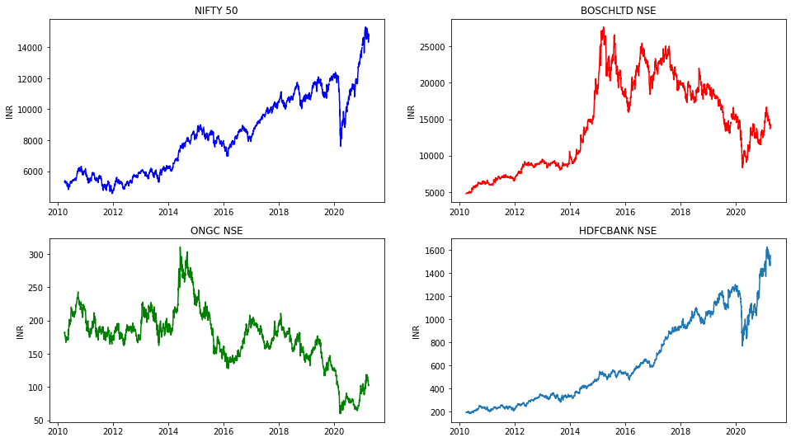
Figure: Line plots: Date vs Close Price (Raw Data)

Slide 10

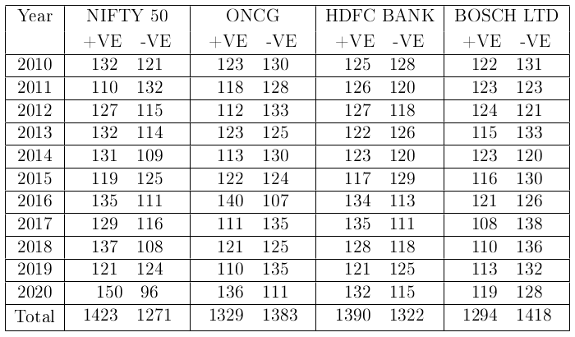
Trend
Table: Trend frequency for NIFTY 50

Slide 11
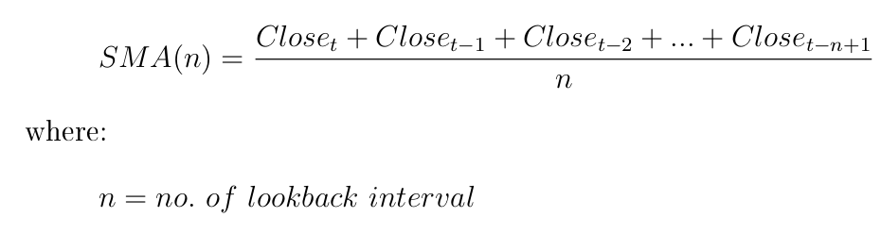
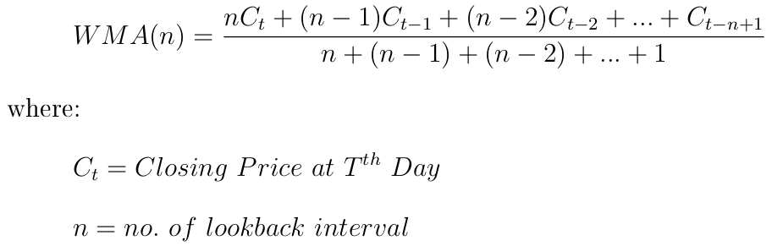
Simple Moving Average (SMA)
Weighted Moving Average (WMA)

Slide 12
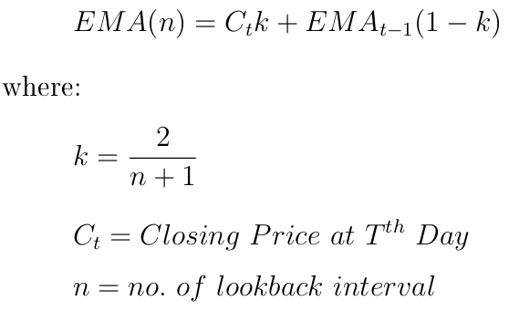
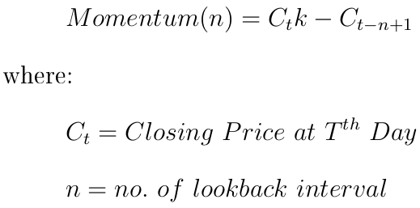
Exponential Moving Average (EMA)
Momentum

Slide 13
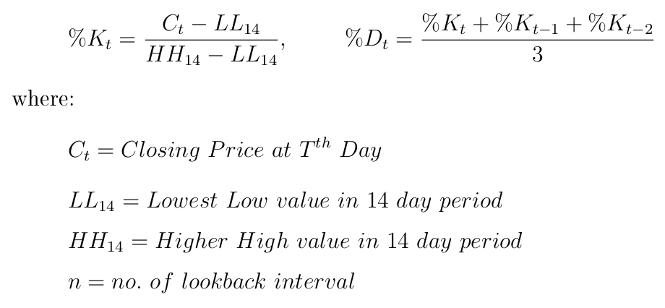
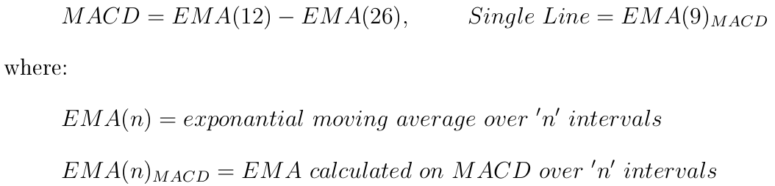
Stochastic Oscillator
Moving Average Convergence Divergence (MACD)

Slide 14
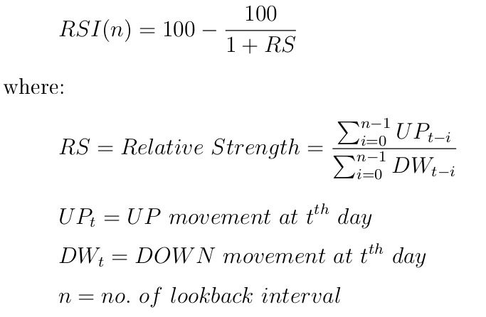
Relative Strength Index(RSI)

Slide 15
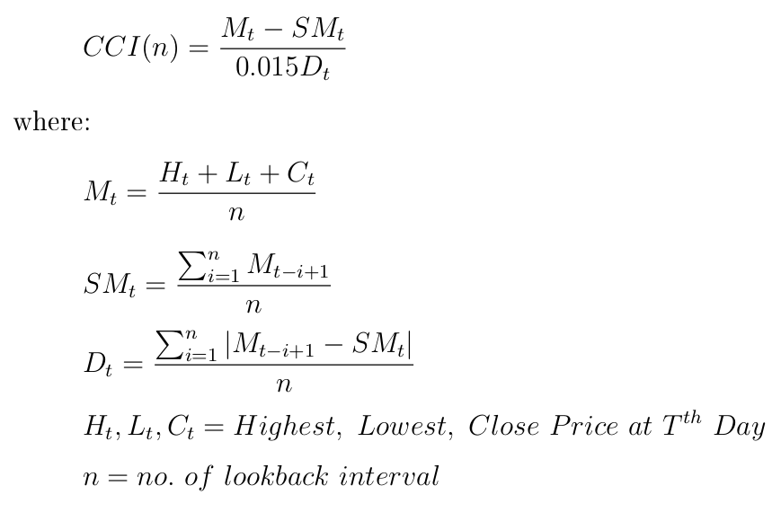
Commodity Channel Index (CCI)

Slide 16
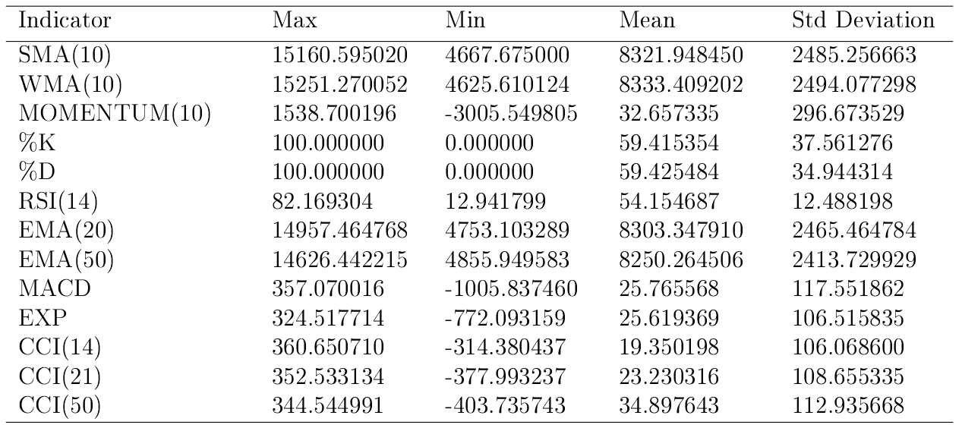
Table: Summary statistics for the selected indicators: NIFTY 50

Slide 17
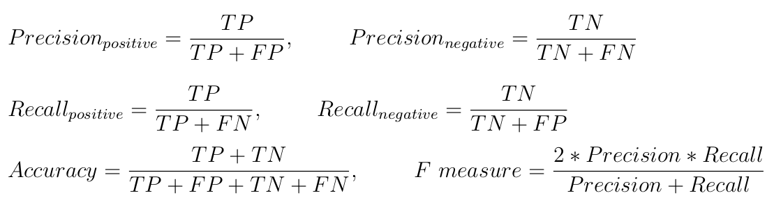
Prediction Models & Observations
Accuracy and f-measure are used to evaluate the performance of proposed models. Computation of these evaluation measures requires estimating Precision and Recall which are evaluated from True Positive (TP), False Positive (FP), True Negative (TN) and False Negative(FN).

Slide 18
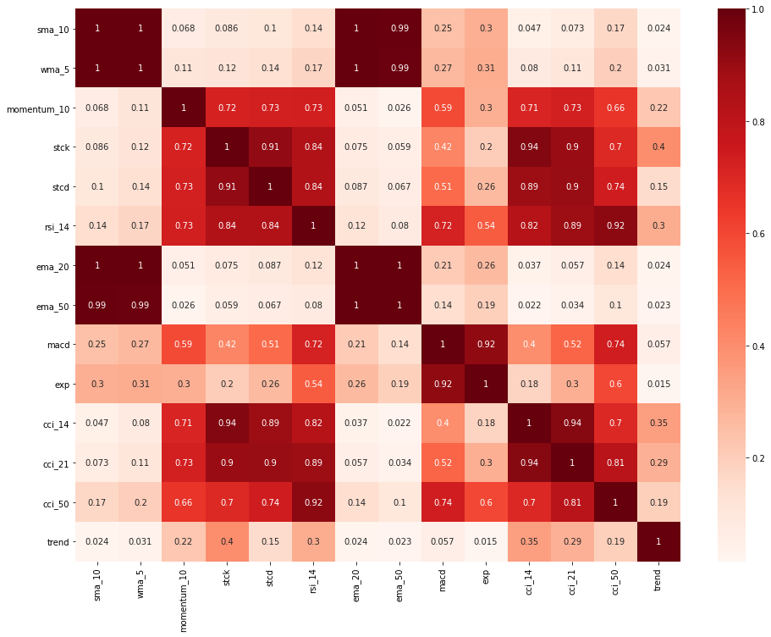
Figure: Correlation Heat-Map of technical indicators

Slide 19
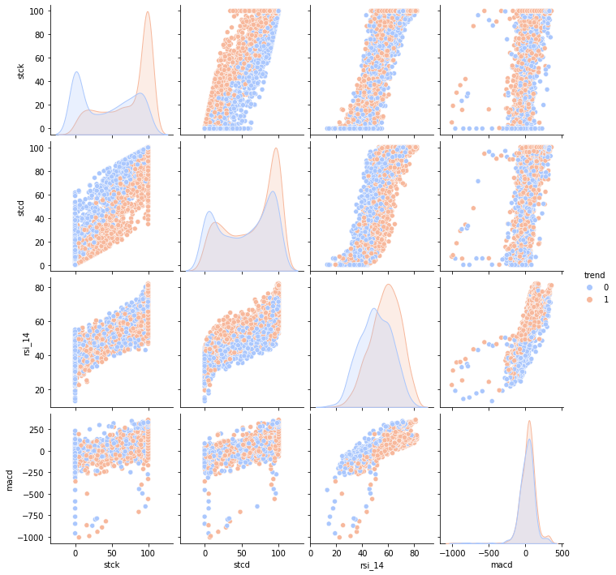
Figure: Pairplot of technical indicators with Trend distribution

Slide 20
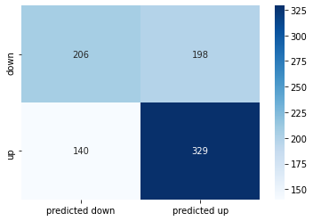
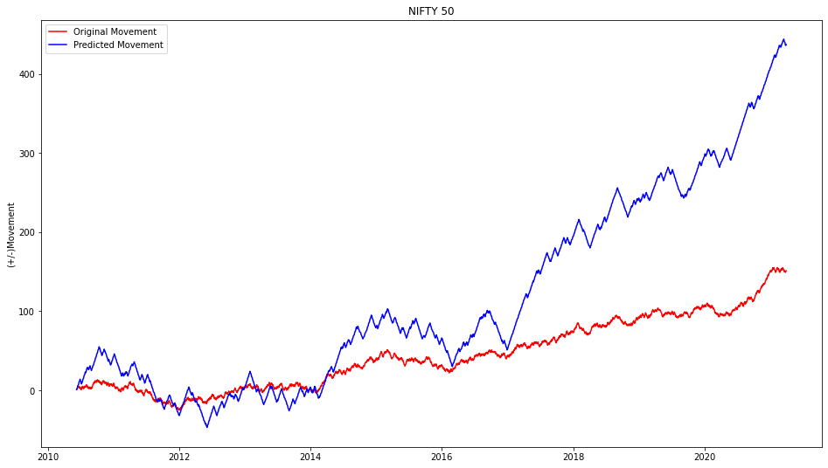
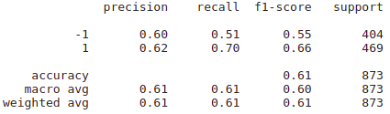
Naive Bayes Classifier
Figure: Confusion Matrix
Figure: Classification Report
Figure: Line Plot Comparison

Slide 21
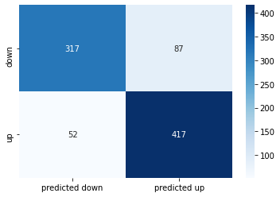
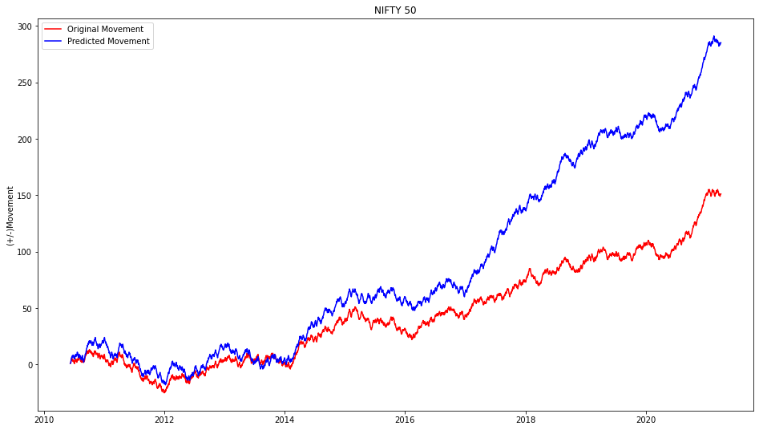
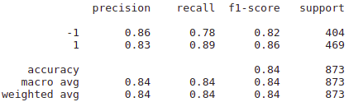
Logistic Regression
Figure: Confusion Matrix
Figure: Classification Report
Figure: Line Plot Comparison

Slide 22
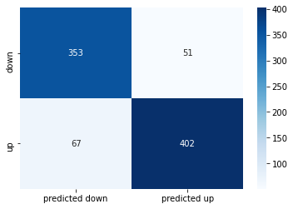
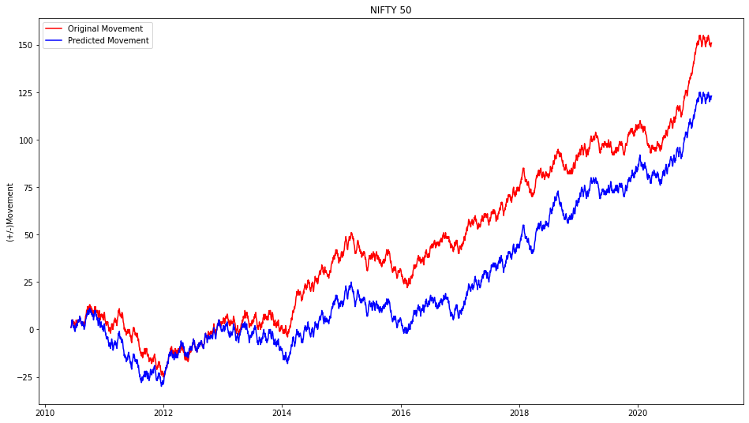
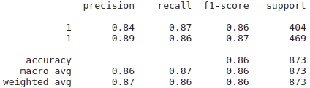
Random Forest Classifier
Figure: Confusion Matrix
Figure: Classification Report
Figure: Line Plot Comparison

Slide 23

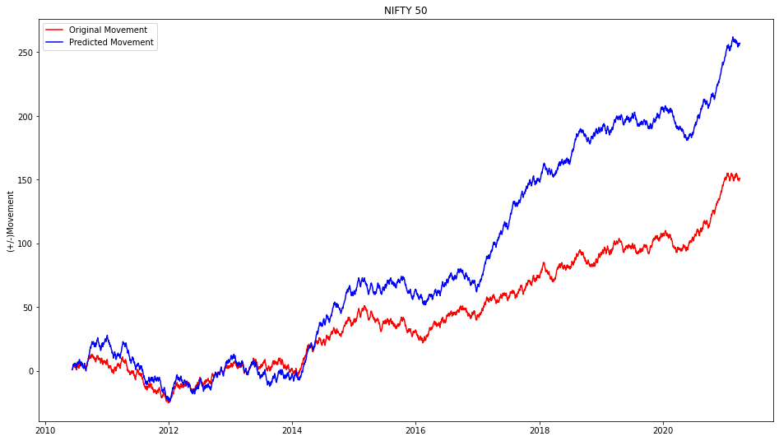
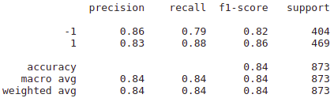
Support Vector Machine
Figure: Confusion Matrix
Figure: Classification Report
Figure: Line Plot Comparison

Slide 24
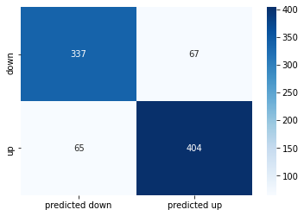
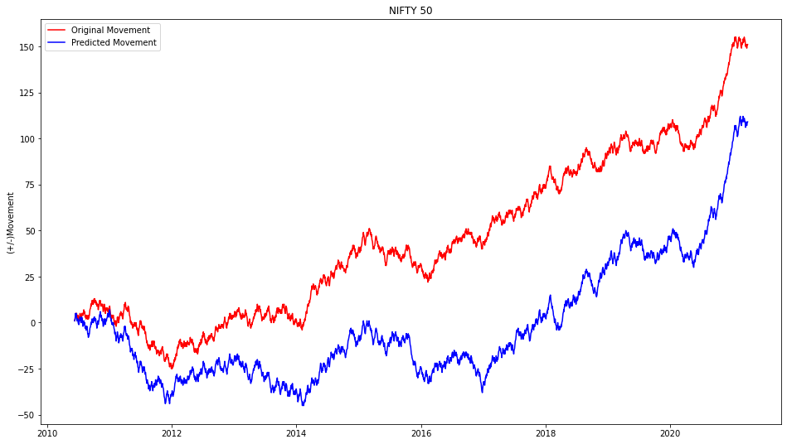
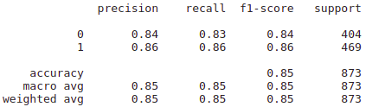
Neural Networks
Figure: Confusion Matrix
Figure: Classification Report
Figure: Line Plot Comparison

Slide 25
Conclusion
In this survey paper we conclude that though various methods and approaches can be used for predicting the stock price, every method has its limitations and advantages.
By considering both technical indicators and fundamental analysis the accuracy of the predictions can be made more accurate and reliable. Despite many such algorithms available, there is always room for improvement.
It is observed that use of different parameters of the data set in different algorithms results in various accuracy rates.
We conclude that the use of Trend deterministic forecasting with the Neural Networks and Random Forest Classifier yield in more accurate prediction.

Slide 26
References
A. Elliot, C. Hsu, "Time Series Prediction : Predicting Stock Price, 2017 " (arXiv: Machine Learning, 2017).
Li-Pang Chen, “Using Machine Learning Algorithms on Prediction of Stock Price” Journal of Modeling and Optimization , vol. 12, no. 2 (2020), ISSN: 1759-7676
Yaping Hao * and Qiang Gao, “Predicting the Trend of Stock Market Index Using the Hybrid Neural Network Based on Multiple Time Scale Feature Learning” MPDI: Applied Science Vol. 10, issue. 11, 2020, April 2020.
Prerana C , Pratheeksha Mahishi J. "Stock market prediction using machine learning and deep learning techniques" International Research Journal of Engineering and Technology (IRJET), vol. 07, issue 04, April 2020
Jaydip Sen, “Stock Price Prediction Using Machine Learning and Deep Learning Frameworks,” 6th International Conference on Business Analytics and Intelligence (ICBAI), at Indian Institute of Science, Bangalore, INDIA, December 2018.
Yahoo Finance Website (Dataset):https://in.finance.yahoo.com
Investopedia Website: https://www.investopedia.com/technical-analysis-4689657
Implementation: https://github.com/HeptaDecane/IndexPrediction

