Slide 1
National University of Science and Technology
Land Cover Classification using Deep Learning
Presented by
Sania Arif
Shazia Sifat
Behram Khan
Data Science and AI
Nov-2024

Slide 2
Contents
Introduction
Problem
Objectives
Implementation
Nov-2024
<number>

Slide 3

Introduction
Land cover classification is a critical task in remote sensing that involves identifying and categorizing the physical surface of the earth.
A deep learning (neural network) based land cover classification project using RGB satellite images across 10 classes.
Land Cover Classifier
Nov-2024
<number>

Slide 4

Problem
Monitoring Land Cover Changes
In order to help the relevant authorities find where to focus their efforts, we want to build Land Cover Classifier so that they can monitor deforestation using satellite images to observe if land starts changing from forest or vegetation to another class.
Land Cover Classifier
Nov-2024
<number>

Slide 5
Objectives
Develop a Deep Learning Model for Land Cover Classification
Preprocess and Augment the EuroSAT Dataset
Classify Land Cover Types Using RGB Imagery
Land Cover Classifier
Nov-2024
<number>

Slide 6
Implementation
Data Preprocessing
The Eurosat dataset was first downloaded which consists of 27,000 images across 10 classes.
The dataset is then split into 80% test and 20% train data.
Model Development
Transfer learning vgg16 model with additional dense and dropout layers for 10 classes classification task.
Data Augmentation and Fine Tuning vgg16
Vgg16 model was fine tuned on our custom dataset at layer 15.
Data augmentation techniques were utilized for training purposes.
Land Cover Classifier
Nov-2024
<number>

Slide 7
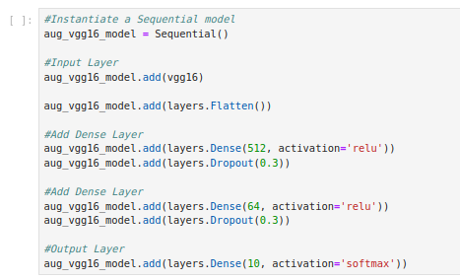
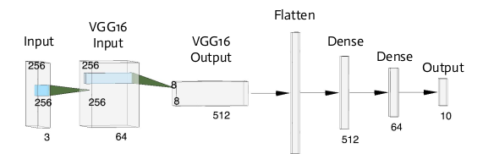
Sequential model with vgg16 layers
Land Cover Classifier
Nov-2024
<number>

Slide 8
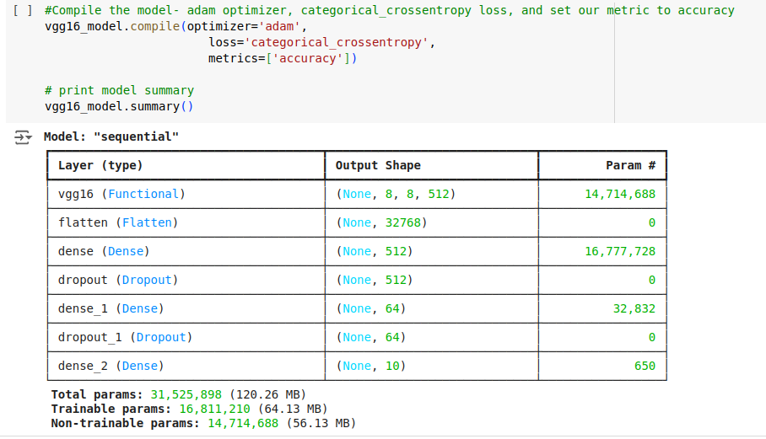
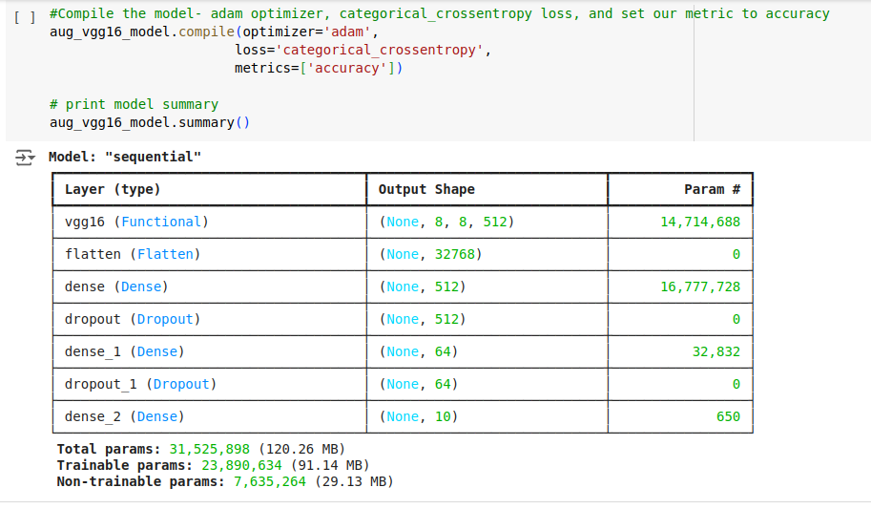
Transfer Learning and Fine Tuning
Land Cover Classifier
Nov-2024
<number>

Slide 9
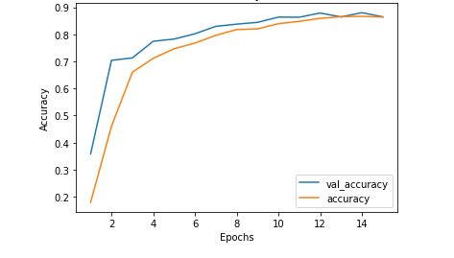
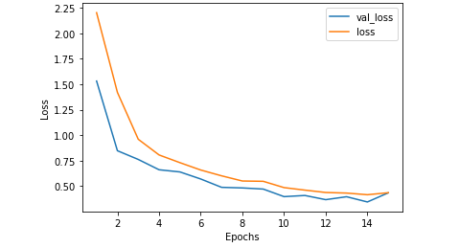
Evaluation
Land Cover Classifier
Nov-2024
<number>

Slide 10
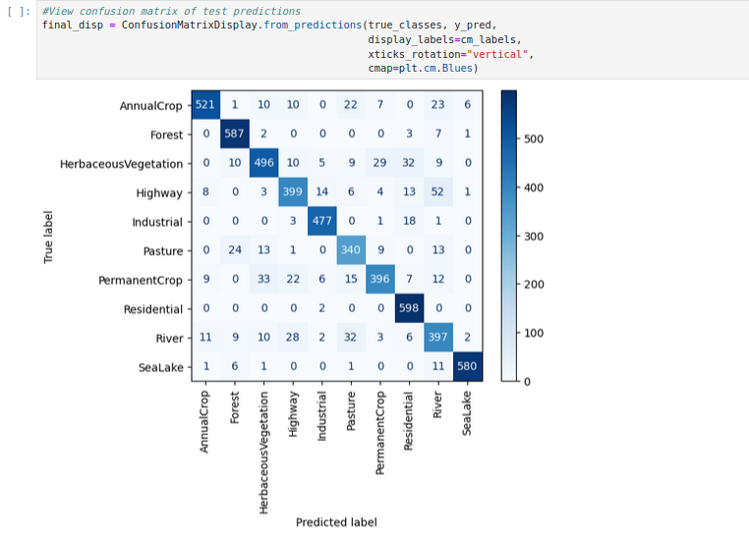
Confusion Matrix
Land Cover Classifier
Nov-2024
<number>

Slide 11
Conclusion and Further Steps
Vgg16 with dense and dropout layers
The vgg16 model with additional dense and dropout layer showed accuracy 86.1%
Data Augmentation and Fine Tuning vgg16
The data augmented and fine tuned model at layer 15 showed an accuracy of 88.6% on the test data.
Reﬁne model on confused classes (i.e. river and highway) possibly through preprocessing.
Create object detection to help classify multiple areas of land cover within an image.
Land Cover Classifier
Nov-2024
<number>

Slide 12
THANK YOU
For Your
ATTENTION!!!

