Slide 1
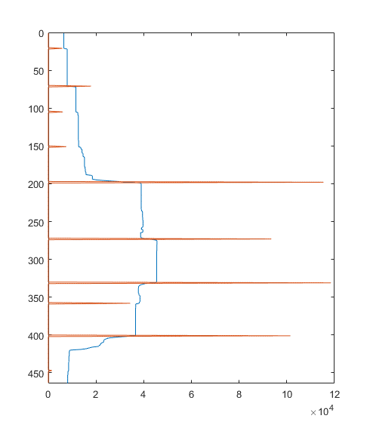

3
2
2
4
1
6
5
7

Slide 2
1
1

Slide 3
3
2
4
6
1
5
7

Slide 4
3
2
4
6
1
5
7

Slide 5
198
3
273
2
4
331
6
1
358
5
7
401

Slide 6














$$0_{px}$$
$${198}_{px}$$
$${ N}_{3}$$
$${ N}_{2}$$
$${273}_{px}$$
$${ N}_{4}$$
$${ N}_{1}$$
$${331}_{px}$$
$${ N}_{6}$$
$${358}_{px}$$
$${ N}_{5}$$
$${ N}_{7}$$
$${401}_{px}$$
$${464}_{px}$$

Slide 8
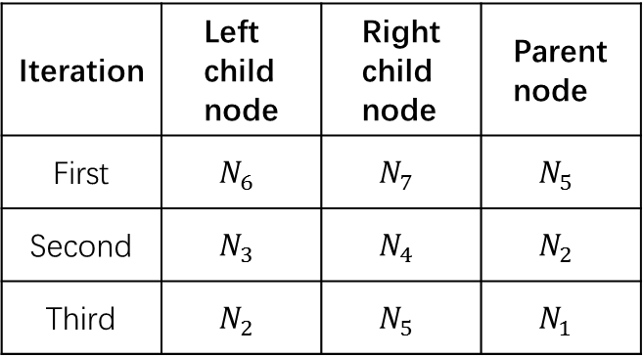
Iteration | Left child node | Right child node | Parent node
First | $$N_{6}$$ | $$N_{7}$$ | $$N_{5}$$
Second | $$N_{3}$$ | $$N_{4}$$ | $$N_{2}$$
Third | $$N_{2}$$ | $$N_{5}$$ | $$N_{1}$$

Slide 9
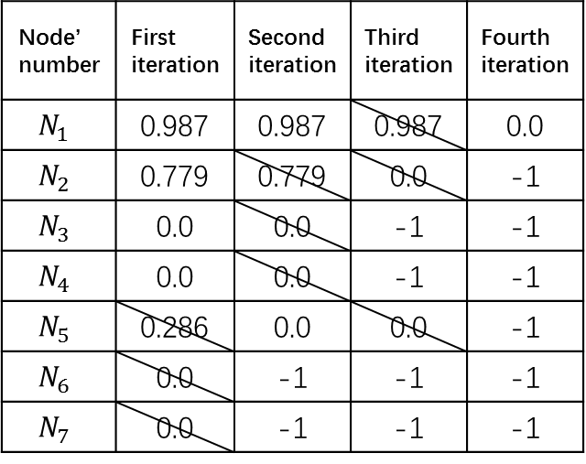
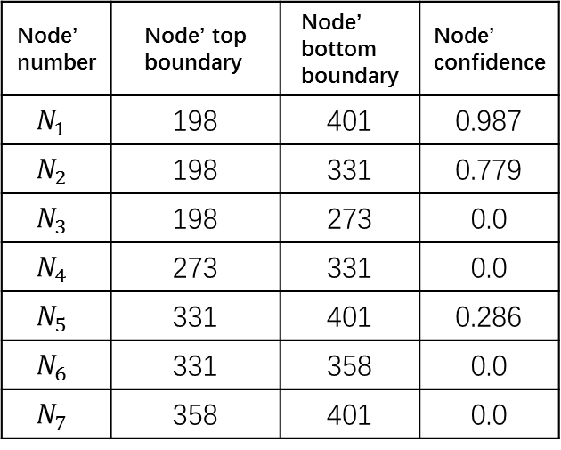
Node’ number | Node’ top boundary | Node’ bottom boundary | Node’ confidence
$$N_{1}$$ | 198 | 401 | 0.987
$$N_{2}$$ | 198 | 331 | 0.779
$$N_{3}$$ | 198 | 273 | 0.0
$$N_{4}$$ | 273 | 331 | 0.0
$$N_{5}$$ | 331 | 401 | 0.286
$$N_{6}$$ | 331 | 358 | 0.0
$$N_{7}$$ | 358 | 401 | 0.0
Node’ number | First iteration | Second iteration | Third iteration | Fourth iteration
$$N_{1}$$ | 0.987 | 0.987 | 0.987 | 0.0
$$N_{2}$$ | 0.779 | 0.779 | 0.0 | -1
$$N_{3}$$ | 0.0 | 0.0 | -1 | -1
$$N_{4}$$ | 0.0 | 0.0 | -1 | -1
$$N_{5}$$ | 0.286 | 0.0 | 0.0 | -1
$$N_{6}$$ | 0.0 | -1 | -1 | -1
$$N_{7}$$ | 0.0 | -1 | -1 | -1

Slide 10
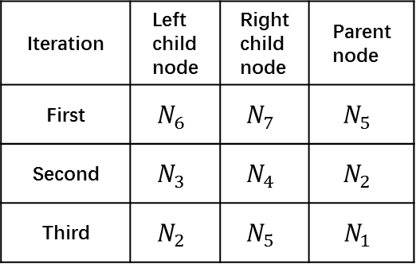
Node’ number | Node’ top boundary | Node’ bottom boundary | Node’ confidence
$$N_{1}$$ | 198 | 401 | 0.987
$$N_{2}$$ | 198 | 331 | 0.779
$$N_{3}$$ | 198 | 273 | 0.0
$$N_{4}$$ | 273 | 331 | 0.0
$$N_{5}$$ | 331 | 401 | 0.286
$$N_{6}$$ | 331 | 358 | 0.0
$$N_{7}$$ | 358 | 401 | 0.0
First iteration | Second iteration | Third iteration | End
0.987 | 0.987 | 0.987 | 0.0
0.779 | 0.779 | 0.0 | -1
0.0 | 0.0 | -1 | -1
0.0 | 0.0 | -1 | -1
0.286 | 0.0 | 0.0 | -1
0.0 | -1 | -1 | -1
0.0 | -1 | -1 | -1
Iteration | Left child node | Right child node | Parent node
First | $$N_{6}$$ | $$N_{7}$$ | $$N_{5}$$
Second | $$N_{3}$$ | $$N_{4}$$ | $$N_{2}$$
Third | $$N_{2}$$ | $$N_{5}$$ | $$N_{1}$$

Slide 11
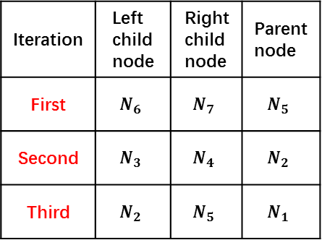
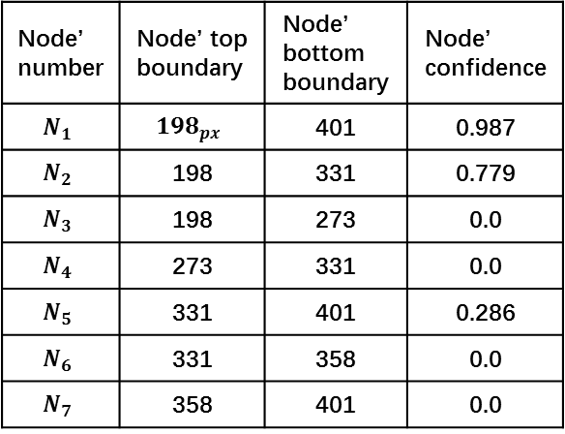
Node’ number | Node’ top boundary | Node’ bottom boundary | Node’ confidence
$$N_{1}$$ | $${198}_{px}$$ | 401 | 0.987
$$N_{2}$$ | 198 | 331 | 0.779
$$N_{3}$$ | 198 | 273 | 0.0
$$N_{4}$$ | 273 | 331 | 0.0
$$N_{5}$$ | 331 | 401 | 0.286
$$N_{6}$$ | 331 | 358 | 0.0
$$N_{7}$$ | 358 | 401 | 0.0
First iteration | Second iteration | Third iteration | End
0.987 | 0.987 | 0.987 | 0.0
0.779 | 0.779 | 0.0 | -1
0.0 | 0.0 | -1 | -1
0.0 | 0.0 | -1 | -1
0.286 | 0.0 | 0.0 | -1
0.0 | -1 | -1 | -1
0.0 | -1 | -1 | -1
Iteration | Left child node | Right child node | Parent node
First | $$N_{6}$$ | $$N_{7}$$ | $$N_{5}$$
Second | $$N_{3}$$ | $$N_{4}$$ | $$N_{2}$$
Third | $$N_{2}$$ | $$N_{5}$$ | $$N_{1}$$

Slide 12
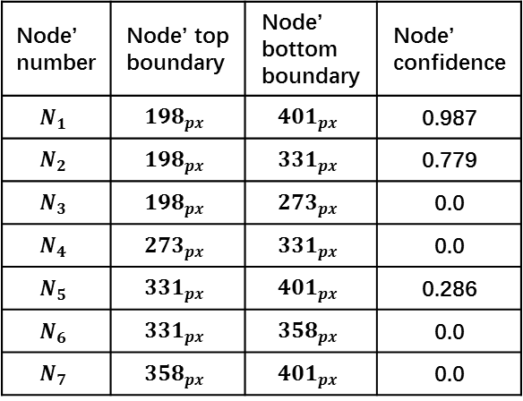
Node’ number | Node’ top boundary | Node’ bottom boundary | Node’ confidence
$$N_{1}$$ | $${198}_{px}$$ | $${401}_{px}$$ | 0.987
$$N_{2}$$ | $${198}_{px}$$ | $${331}_{px}$$ | 0.779
$$N_{3}$$ | $${198}_{px}$$ | $${273}_{px}$$ | 0.0
$$N_{4}$$ | $${273}_{px}$$ | $${331}_{px}$$ | 0.0
$$N_{5}$$ | $${331}_{px}$$ | $${401}_{px}$$ | 0.286
$$N_{6}$$ | $${331}_{px}$$ | $${358}_{px}$$ | 0.0
$$N_{7}$$ | $${358}_{px}$$ | $${401}_{px}$$ | 0.0
First iteration | Second iteration | Third iteration | End
0.987 | 0.987 | 0.987 | 0.0
0.779 | 0.779 | 0.0 | -1
0.0 | 0.0 | -1 | -1
0.0 | 0.0 | -1 | -1
0.286 | 0.0 | 0.0 | -1
0.0 | -1 | -1 | -1
0.0 | -1 | -1 | -1
Iteration | Left child node | Right child node | Parent node
First | $$N_{6}$$ | $$N_{7}$$ | $$N_{5}$$
Second | $$N_{3}$$ | $$N_{4}$$ | $$N_{2}$$
Third | $$N_{2}$$ | $$N_{5}$$ | $$N_{1}$$

Slide 14
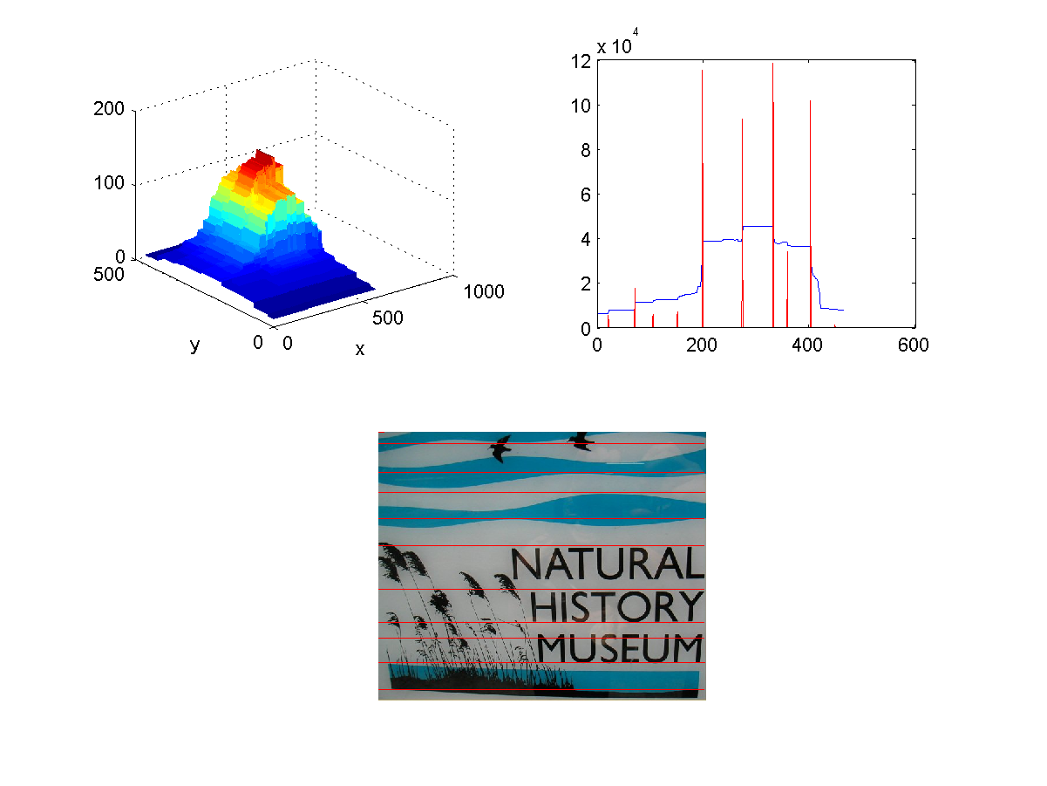
5
7
6

Slide 15



$${ N}_{5}$$
$${ N}_{6}$$
$${ N}_{7}$$

Slide 17
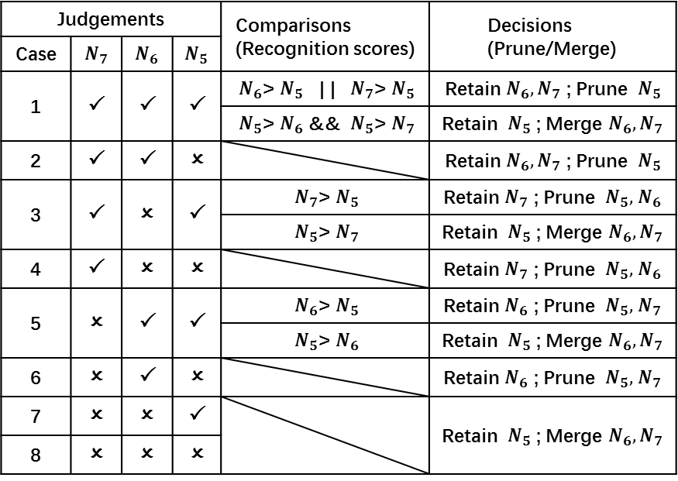
Judgements |  |  |  | Comparisons (Recognition scores) | Decisions (Prune/Merge)
Case | $${ N}_{7}$$ | $${ N}_{6}$$ | $${ N}_{5}$$
1 |  |  |  | ${ N}_{6}$>${ N}_{5}$ | | ${ N}_{7}$>${ N}_{5}$ | Retain $N_{6}{, N}_{7}$ ; Prune ${ N}_{5}$
 |  |  |  | ${ N}_{5}$>${ N}_{6}$ && ${ N}_{5}$>${ N}_{7}$ | Retain ${ N}_{5}$ ; Merge $N_{6}{, N}_{7}$
2 |  |  |  |  | Retain $N_{6}{, N}_{7}$ ; Prune ${ N}_{5}$
3 |  |  |  | ${ N}_{7}$>${ N}_{5}$ | Retain $N_{7}$ ; Prune ${ N}_{5},$ $N_{6}$
 |  |  |  | ${ N}_{5}$>${ N}_{7}$ | Retain ${ N}_{5}$ ; Merge $N_{6}{, N}_{7}$
4 |  |  |  |  | Retain $N_{7}$ ; Prune ${ N}_{5},$ $N_{6}$
5 |  |  |  | ${ N}_{6}$>${ N}_{5}$ | Retain $N_{6}$ ; Prune ${ N}_{5},$ $N_{7}$
 |  |  |  | ${ N}_{5}$>${ N}_{6}$ | Retain ${ N}_{5}$ ; Merge $N_{6}{, N}_{7}$
6 |  |  |  |  | Retain $N_{6}$ ; Prune ${ N}_{5},$ $N_{7}$
7 |  |  |  |  | Retain ${ N}_{5}$ ; Merge $N_{6}{, N}_{7}$
8 |  |  | 

Slide 18
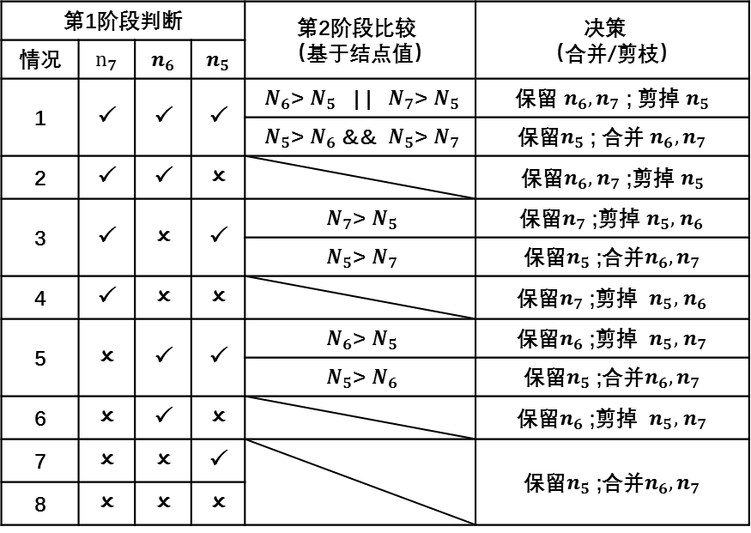
第1阶段判断 |  |  |  | 第2阶段比较 （基于结点值） | 决策 （合并/剪枝）
情况 | $${ n}_{7}$$ | $${ n}_{6}$$ | $${ n}_{5}$$
1 |  |  |  | ${ N}_{6}$>${ N}_{5}$ | | ${ N}_{7}$>${ N}_{5}$ | 保留 $n_{6}{,n}_{7}$ ; 剪掉 $n_{5}$
 |  |  |  | ${ N}_{5}$>${ N}_{6}$ && ${ N}_{5}$>${ N}_{7}$ | 保留$n_{5}$ ; 合并 $n_{6}{,n}_{7}$
2 |  |  |  |  | 保留$n_{6}{,n}_{7}$ ;剪掉 $n_{5}$
3 |  |  |  | ${ N}_{7}$>${ N}_{5}$ | 保留$n_{7}$ ;剪掉 $n_{5},$ $n_{6}$
 |  |  |  | ${ N}_{5}$>${ N}_{7}$ | 保留$n_{5}$ ;合并$n_{6}{,n}_{7}$
4 |  |  |  |  | 保留$n_{7}$ ;剪掉 $n_{5},$ $n_{6}$
5 |  |  |  | ${ N}_{6}$>${ N}_{5}$ | 保留$n_{6}$ ;剪掉 $n_{5},$ $n_{7}$
 |  |  |  | ${ N}_{5}$>${ N}_{6}$ | 保留$n_{5}$ ;合并$n_{6}{,n}_{7}$
6 |  |  |  |  | 保留$n_{6}$ ;剪掉 $n_{5},$ $n_{7}$
7 |  |  |  |  | 保留$n_{5}$ ;合并$n_{6}{,n}_{7}$
8 |  |  | 

Slide 19
第1阶段判断 |  |  |  | 第2阶段比较 （基于结点值） | 决策 （合并/剪枝）
情况 | $${ n}_{7}$$ | $${ n}_{6}$$ | $${ n}_{5}$$
1 |  |  |  | ${ N}_{6}$>${ N}_{5}$ | | ${ N}_{7}$>${ N}_{5}$ | 保留 $n_{6}{,n}_{7}$ ; 剪掉 $n_{5}$
 |  |  |  | ${ N}_{5}$>${ N}_{6}$ && ${ N}_{5}$>${ N}_{7}$ | 保留$n_{5}$ ; 合并 $n_{6}{,n}_{7}$
2 |  |  |  |  | 保留$n_{6}{,n}_{7}$ ;剪掉 $n_{5}$
3 |  |  |  | ${ N}_{7}$>${ N}_{5}$ | 保留$n_{7}$ ;剪掉 $n_{5},$ $n_{6}$
 |  |  |  | ${ N}_{5}$>${ N}_{7}$ | 保留$n_{5}$ ;合并$n_{6}{,n}_{7}$
4 |  |  |  |  | 保留$n_{7}$ ;剪掉 $n_{5},$ $n_{6}$
5 |  |  |  | ${ N}_{6}$>${ N}_{5}$ | 保留$n_{6}$ ;剪掉 $n_{5},$ $n_{7}$
 |  |  |  | ${ N}_{5}$>${ N}_{6}$ | 保留$n_{5}$ ;合并$n_{6}{,n}_{7}$
6 |  |  |  |  | 保留$n_{6}$ ;剪掉 $n_{5},$ $n_{7}$
7 |  |  |  |  | 保留$n_{5}$ ;合并$n_{6}{,n}_{7}$
8 |  |  | 

Slide 21
