Slide 1
INFOSYS VIRTUAL INTERNSHIP 6.0
ElectViz: Election Data Visualization for Media
BATCH-11
TEAM-D
Mentor : Mrs Nithyasri S J
Presented by : Neelapu Herambudu

Slide 2
INTRODUCTION
Elections generate large volumes of complex data that can be difficult to interpret in raw form. Effective data visualization helps transform this data into clear insights that support transparency, media reporting, and public understanding.
ElectViz – Election Data-Based Dashboard is a data visualization project that analyzes historical U.S. House election data to present voting trends, party performance, and state-wise outcomes through interactive dashboards. By enabling filters for year, state, party, and election type, the project supports intuitive exploration and data-driven storytelling.
Overall, ElectViz demonstrates how visual analytics can simplify election data and make democratic processes more accessible and understandable for media and the public.

Slide 3
Workflow & system design
CSV Dataset (Raw Election Data)
Power BI Data Model
• Tables & Relationships
Interactive Dashboard
• Charts & Maps
• KPI Cards
• Filters & Slicers
Power Query (ETL Layer)
• Data Cleaning
• Data Transformation • Normalization
DAX Measures & KPIs
• Vote Share Calculations
• Seats Won Metrics
• Aggregations & Trends
User Insights & Analysis
• Trends Identification
• Comparative Analysis

Slide 4
milestones
Milestone 1:
This phase focused on understanding project objectives and preparing the election dataset for analysis. Data cleaning and preprocessing were performed to ensure accuracy, consistency, and reliability across all election years and states.
Milestone 2:
This milestone involved building the first set of dashboard pages, including Election Overview, Special Elections and Fusion Ticket Analysis, and State-wise Candidate Vote Distribution. These pages provide high-level trends and regional insights into voting patterns and electoral behavior.
Milestone3:
In this phase, advanced analytical pages were developed to evaluate party dominance, candidate performance, and seat distribution across states. The visuals enable deeper insights into political control and shifts in power over time.
Milestone 4:
The final milestone completed the dashboard with voter participation analysis and a consolidated results overview. This phase focused on summarizing insights and enhancing storytelling for quick interpretation and presentation.

Slide 5
Future enhance
Integrate real-time election data to provide live updates during ongoing elections.
Apply predictive analytics and machine learning to forecast election outcomes and voter trends.
Include demographic data (age, gender, urban–rural) for deeper voter behavior analysis.
Add AI-generated insights and automated headlines to support media reporting.
Improve interactivity and drill-down capabilities for constituency-level analysis.

Slide 6




outputs

Slide 7

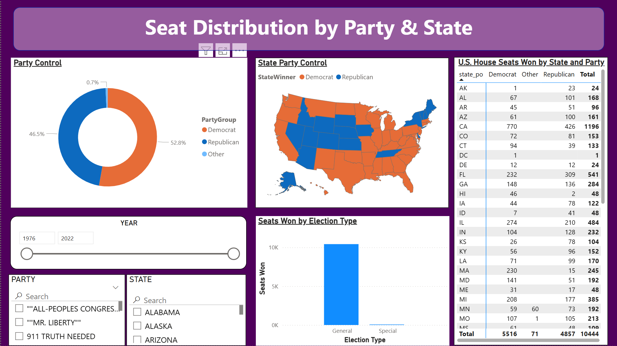



Slide 8
conclusion
The ElectViz – Election Data Visualization for Media project successfully transforms complex election data into clear, interactive, and media-friendly dashboards. By analyzing historical U.S. House election data, the system highlights voting trends, party performance, state-wise outcomes, and electoral competitiveness. The project demonstrates how data visualization and storytelling can improve transparency, support data-driven journalism, and enhance public understanding of democratic processes.

Slide 9
Acknowledgement & reference
We would like to express our heartfelt gratitude to:
Infosys Springboard Team – for organizing this valuable internship opportunity.
Our Mentor – for her continuous support and feedback.
My Teammates – for collaboration, encouragement, and insights
This internship has been a significant step in our professional growth and technical journey.
References:
US_Election_Data(Kaggle source)
Microsoft Power BI Documentation
Infosys Springboard Virtual Internship course materials

Slide 10
Thank you

