Slide 1
ElectViz: Election Data Visualization for Media
Batch-11
Group D
Neelapu Herambudu
Francis Daniel
Swathika Murugan
Shaik Shabeena Praveen
Gopi Krishna
Tanmay Parulkar

Slide 2
PROJECT OVERVIEW
Project Name: ElectViz – Election Data Analytics Dashboard
Domain: Data Analytics & Visualization
Tool Used: Microsoft Power BI
Dataset: U.S. House of Representatives Elections (1976–2022)
Objective:
  Analyze long-term election trends
  Understand party dominance and power shifts
  Compare state-wise and candidate-wise performance
Outcome:
An interactive dashboard enabling data-driven exploration of election data

Slide 3
PROJECT FILES
Raw Dataset:
  Historical U.S. House election data (CSV format)
  Processed using Power Query
  Standardized state and party names
Power BI File (.pbix):
  Contains data model, DAX measures, and dashboards
Documentation:
  Project report
  Dashboard explanation
  PPT for final submission

Slide 4
KEY FEATURES
Interactive dashboards with multi-page navigation
Dynamic filters: Year, State, Party
Election Type
KPI cards for: Total votes, Total candidates, Average vote share
State-wise and party-wise comparison
Trend analysis across multiple election cycles
User-friendly and visually consistent design

Slide 5
TOOLS
&
TECHNOLOGIES
Microsoft Power BI Desktop – Data modeling and dashboard development
Power Query (M Language) – ETL, data cleaning, and transformation
DAX (Data Analysis Expressions) – Advanced calculations and KPIs
Interactive Slicers – Dynamic filtering by year, state, and party

Slide 6
WORKFLOW
Step 1 – Understanding the Raw Dataset
The team first analyzed the structure to identify all cleaning and transformation steps needed.
Step 2 – Data Cleaning & Preparation (Power Query)
This step ensured that the dashboard visuals produced correct insights.
Step 3 – Data Modeling & Measure Creation (DAX)
DAX also fixed logical issues created by the raw dataset (e.g., recalculating correct percentages)
Step 4 – Designing Visual Pages
The dashboard pages were built with a clear structure:
  Page 1 – Election Overview & Trends
  Page 2 – Special Elections & Fusion Ticket Analysis
  Page 3 – State-wise Candidate Vote Distribution
  Page 4 – Party & Candidate Performance
  Page 5 – Seat Distribution by Party and State
  Page 6 – State Wise Election Participation
  Page 7 –Election Results-Final Overview
Step 5 – Usability & Visual Refinements
Map color contrast, Data label visibility, Slicer interactivity, Clean layout spacing, Improved title clarity & page names

Slide 7
SYSTEM DESIGN
CSV Dataset
↓
Power Query (Cleaning & Transformation)
↓
Power BI Data Model (Tables + Relationships)
↓
DAX Measures & KPIs
↓
Interactive Dashboard Visuals
↓
User Insights & Analysis

Slide 8
MILESTONES
Weekly Activities | Milestones | Date
Week 1 | Milestone 1: Project Initialization, Dataset Setup, Data cleaning and preprocessing | January 16,2026
Week 2 | Milestone 2: Dashboard development: Page1:Election Overview and Trends Page2: Special Elections and Fusion Ticket Analysis Page3: State-wise Candidate Vote Distribution | January 23,2026
Week 3 | Optimization and documentation
Week 4 | Milestone3: Dashboard development: Page4: Party and Candidate Performance Page5: Seat Distribution by Party and State | January 30,2026
Week 5 | Optimization and documentation
Week 6 | Milestone4: Dashboard development: Page6: State-wise Election Participation and Comparison Page7: Election results – Final Overview | February 6,2026
Week 7 | Optimization and documentation
Week 8 | Documentation and Final Presentation

Slide 9
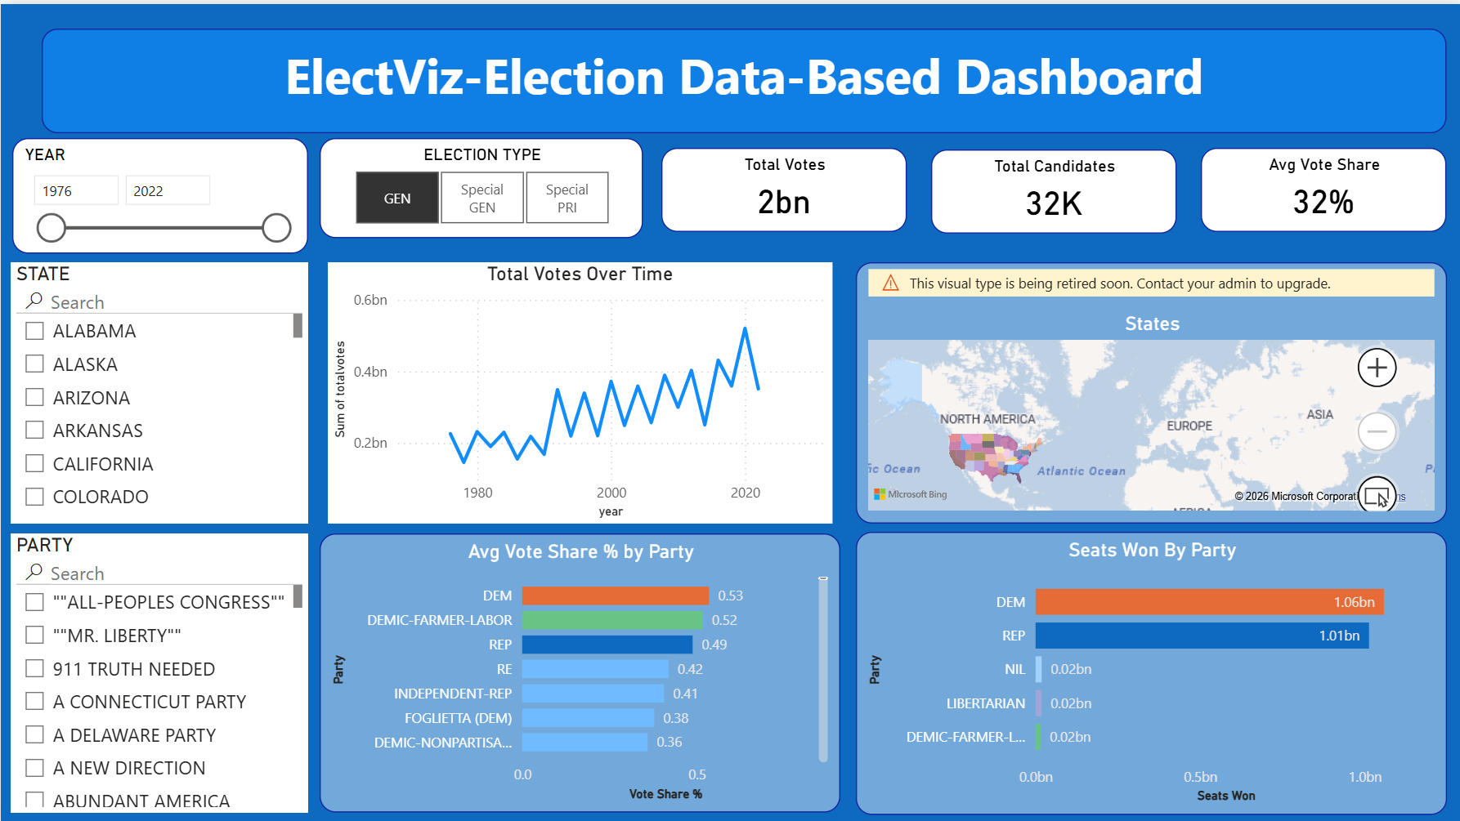
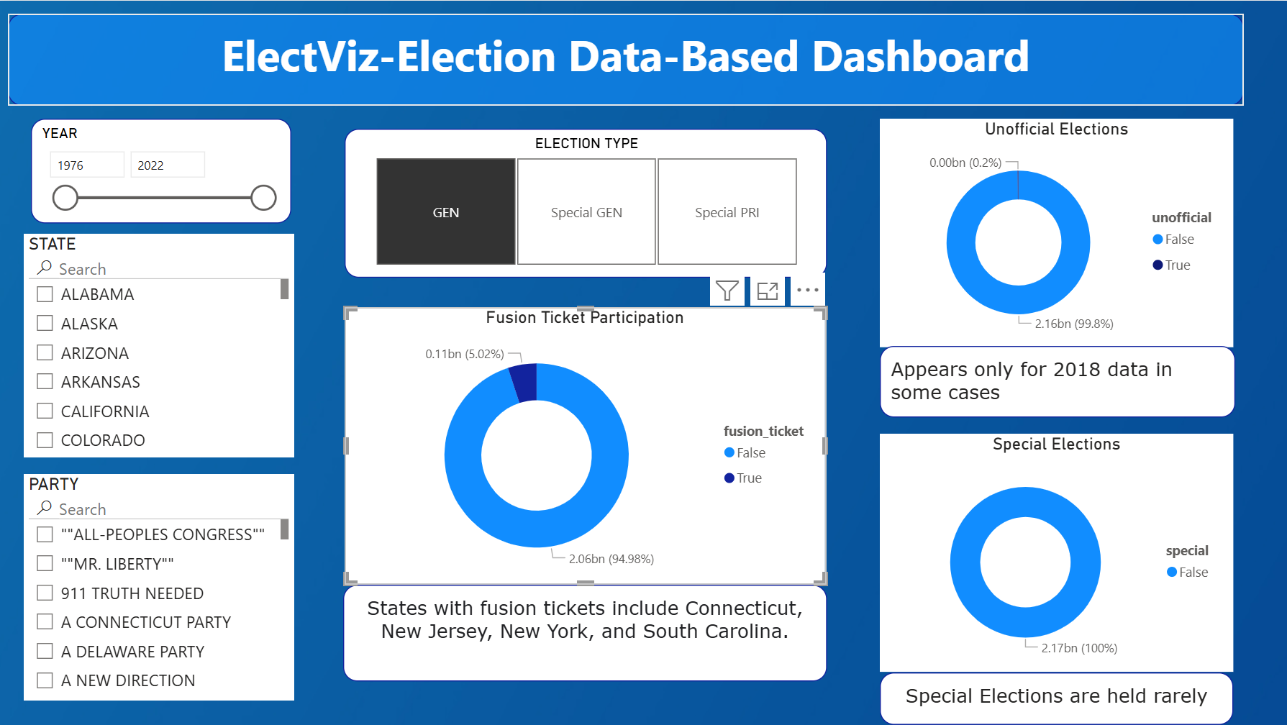
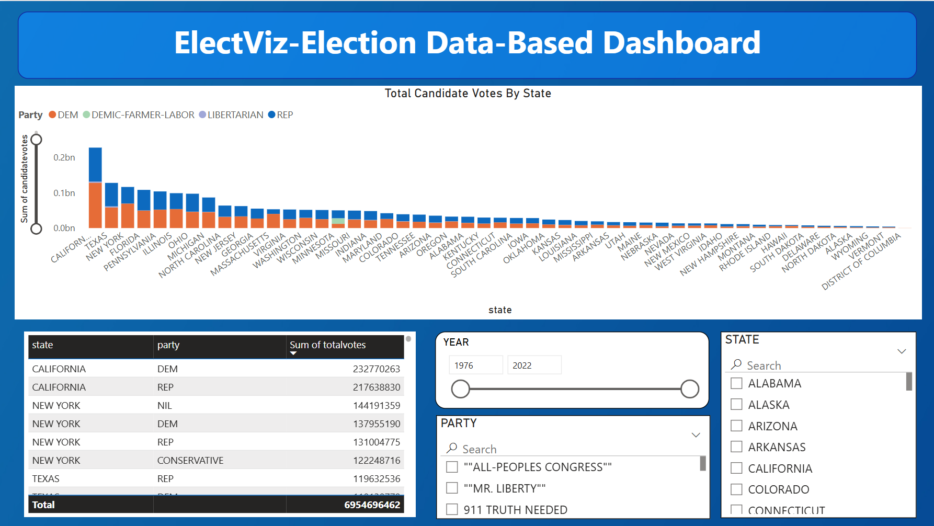
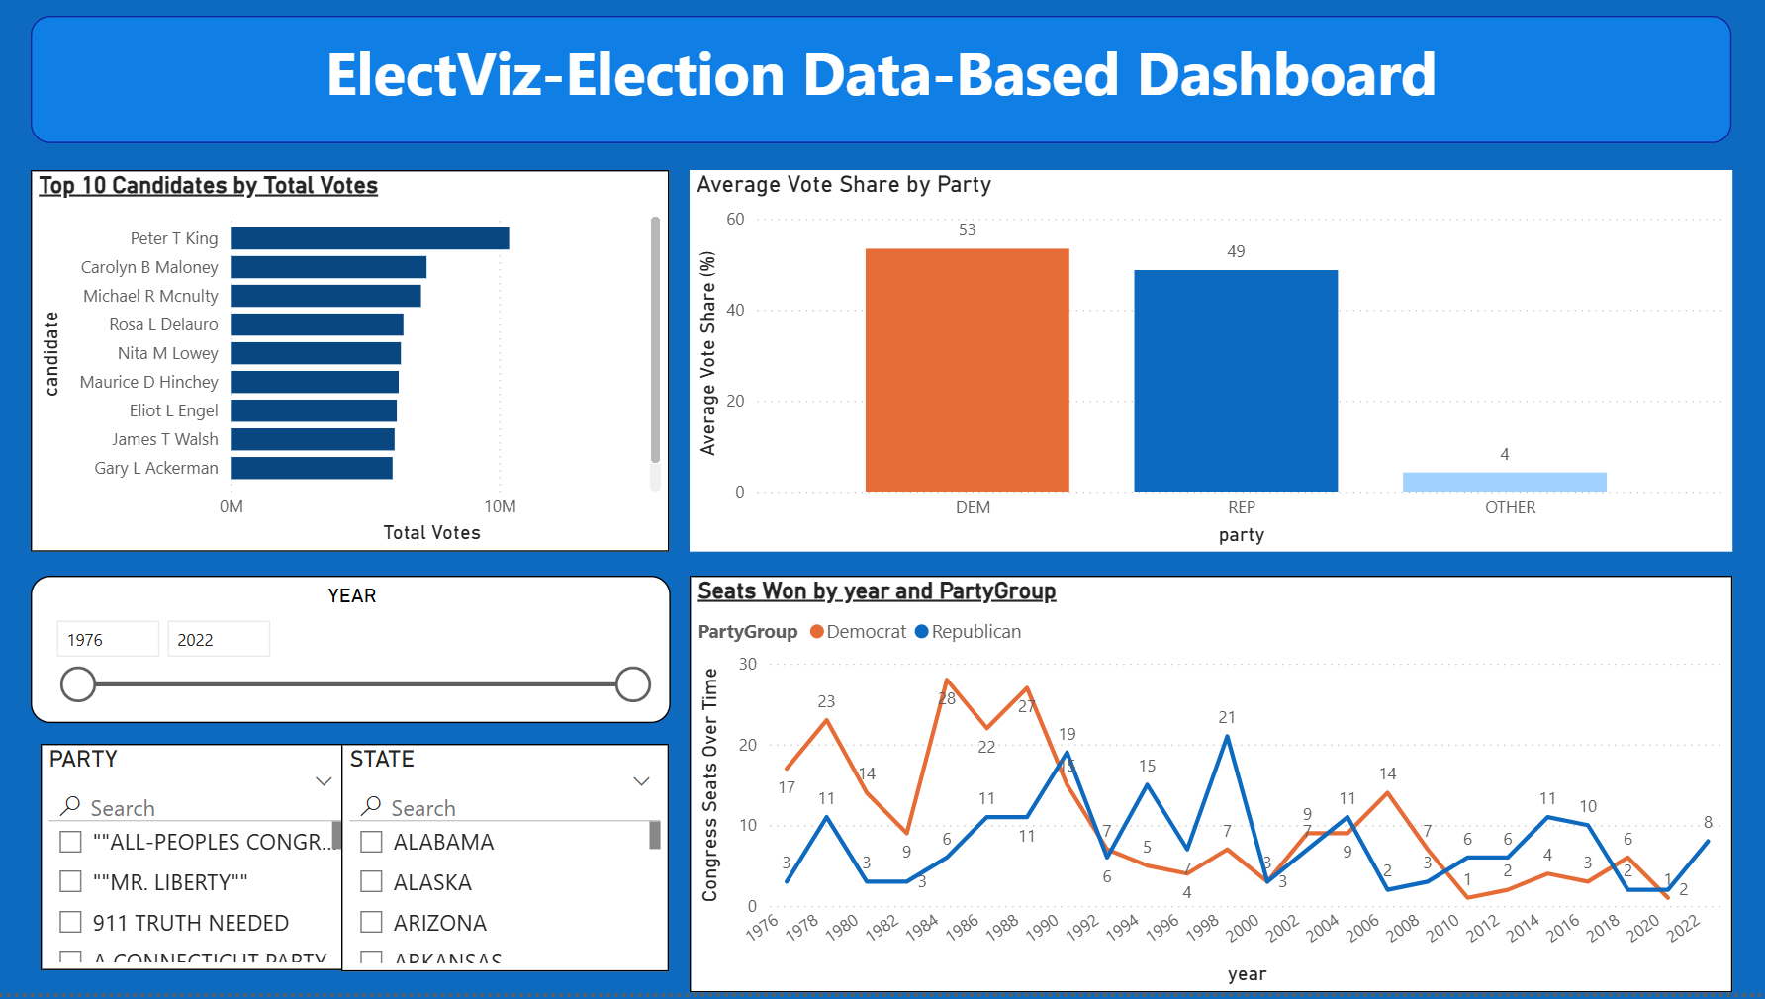
OUTCOMES

Slide 10
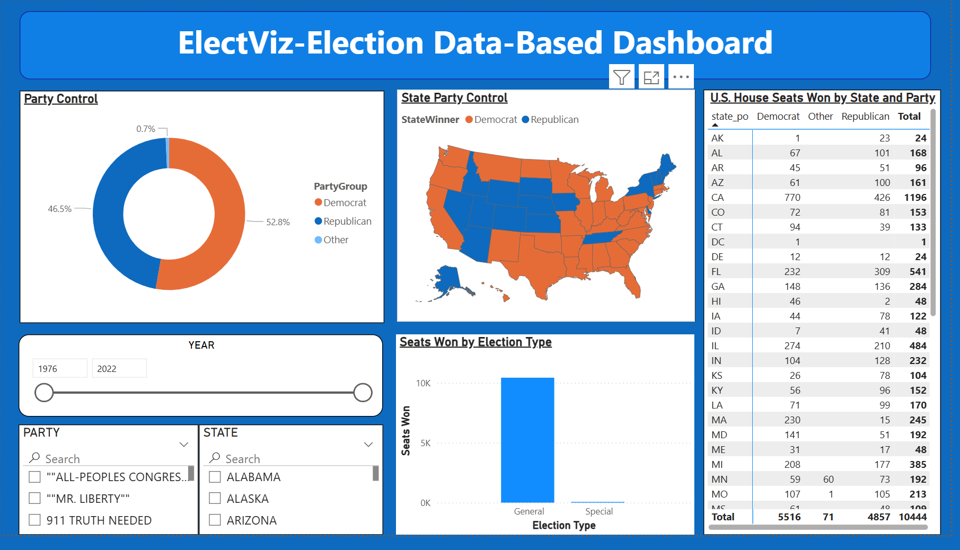
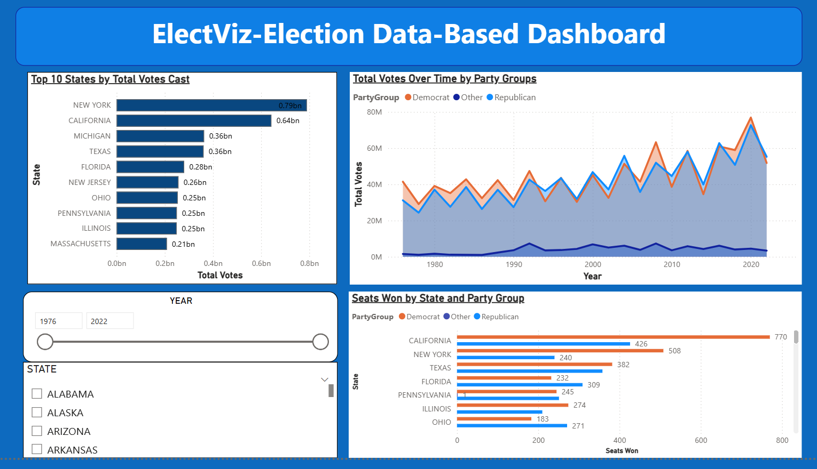
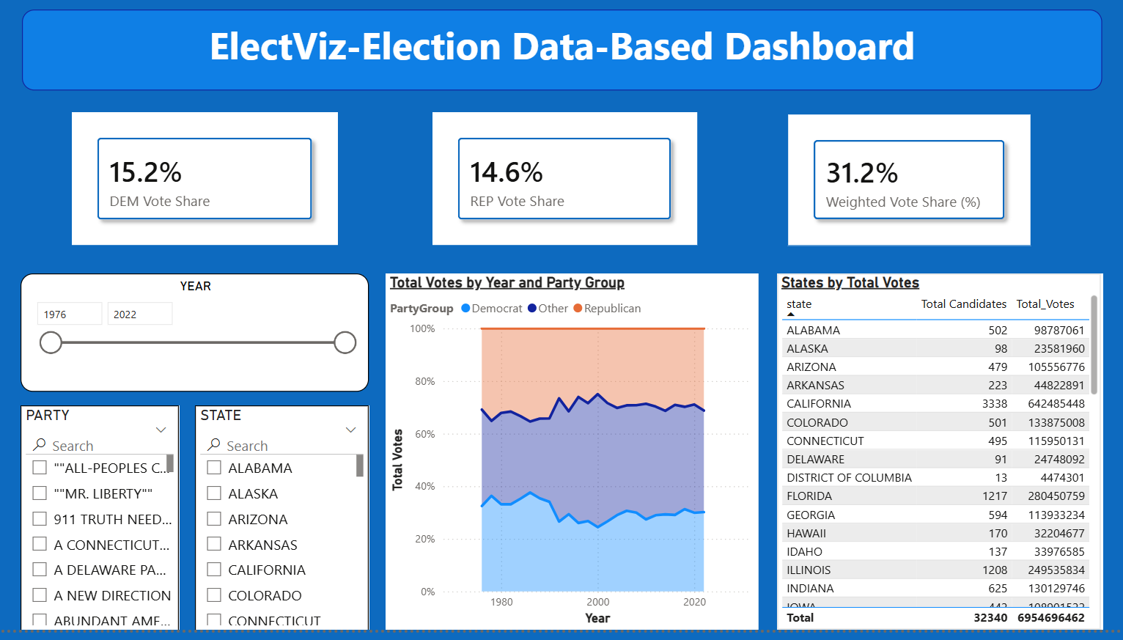
OUTCOMES

Slide 11
FUTURE ENHANCEMENTS
Predictive AI Integration: Incorporating machine learning models to project "Likely Winners" in real-time based on early partial returns.
Predictive "What-If" Modeling: Enabling a feature (similar to major news networks) to estimate final outcomes as soon as key precincts report.
Demographic Overlay: Integrating US Census data to visualize how factors like income, education, and age influenced the voting shifts seen in your current charts.
Live API Connectivity: Transitioning from static datasets to live Web API feeds (such as the Associated Press) for automated updates during election nights.

Slide 12
CONCLUSION
The project successfully transformed raw election data into meaningful insights
Demonstrated the power of data visualization in understanding political trends
Enabled comprehensive analysis of party performance and voter behavior
Served as a valuable learning experience in data analytics and visualization
Established a strong foundation for advanced analytical projects

Slide 13
ACKNOWLEDGEMENT
AND
REFERENCE
Team:
Neelapu Herambudu,
Francis Daniel,
Swathika Murugan,
Shaik Shabeena Praveen,
Gopi Krishna,
Tanmay Parulkar
Data : US Election Data set 1976-22 (Kaggle).
Notes:
Dashboard insights vary based on selected filters
Data accuracy depends on source dataset completeness
Visuals are designed for analytical interpretation
Project developed as part of Infosys Springboard Virtual Internship 6.0

