Slide 1


INFOSYS VIRTUAL-INTERNSHIP
ELECTVIZ: ELECTION DATA VISUALIZATION FOR MEDIA
Mentor - Mrs.Nithyasri S J
Presented by-Gopi Krishna

Slide 2
INTRODUCTION
  Elections generate massive volumes of structured and unstructured data including votes, candidates, parties, constituencies, and voter statistics. Analyzing this data manually is complex and time-consuming.
  ElectViz Dashboard is a Power BI-based interactive data visualization system designed to transform raw election datasets into meaningful insights.
  It enables:
  Easy comparison of party performance
  Constituency-level analysis
  Vote share and winning margin insights
  Trend-based interpretation
  The goal of this project is to help media analysts, researchers, and citizens understand election outcomes through intuitive and interactive visual analytics.
01

Slide 3
WORK FLOW&SYSTEM DESIGN
  Data Collection
    Raw election data collected from structured sources (Excel/CSV).
  Data Preprocessing (Excel + Power Query)
    Removing null/duplicate values
    Standardizing party and state names
    Creating calculated columns
    Formatting data types
    Data cleaning and transformation
  Data Modeling (Power BI)
    Establishing relationships between tables
    Creating measures using DAX
    Designing KPIs (Total Votes, Seats Won, Vote Share, etc.)
  Dashboard Development
    Visuals: Bar charts, Pie charts, Maps, Cards
    Filters/Slicers for state, party, year
    Interactive drill-down analysis
  Insight Generation
    Party dominance analysis
    Regional voting patterns
    Winning margin comparison
ARCHITECTURE FLOW:
RAW DATA (EXCEL)
⬇
DATA CLEANING (POWER QUERY)
⬇
DATA MODELING (POWER BI RELATIONSHIPS + DAX)
⬇
VISUALIZATION LAYER (INTERACTIVE DASHBOARD)
⬇
USER INTERACTION (FILTERS, SLICERS, DRILL-DOWN)
THE SYSTEM FOLLOWS A DATA → TRANSFORMATION → MODELING → VISUALIZATION → INSIGHT PIPELINE.
02

Slide 4
FUTURE ENHANCEMENTS
  Integration with real-time election APIs
  Predictive analytics using Machine Learning
  Trend analysis across multiple election years
  Sentiment analysis from social media
  Mobile-optimized dashboard version
  Deployment to Power BI Service for public access
  Advanced drill-through reports for constituency-level deep analysis
03

Slide 5
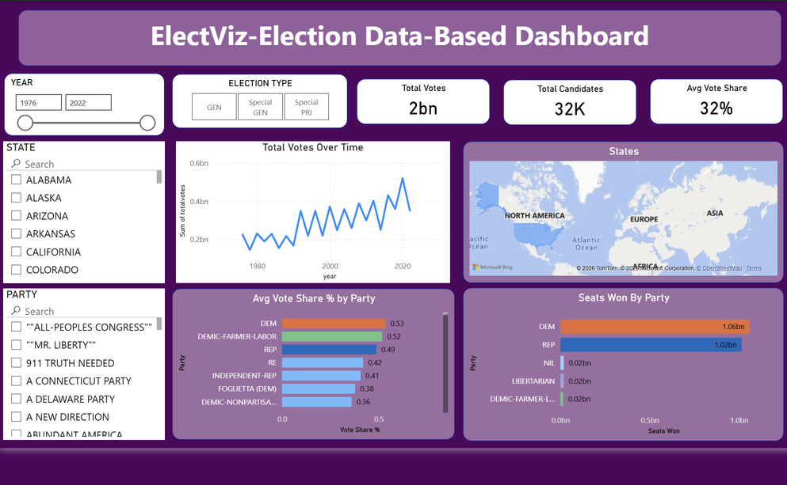
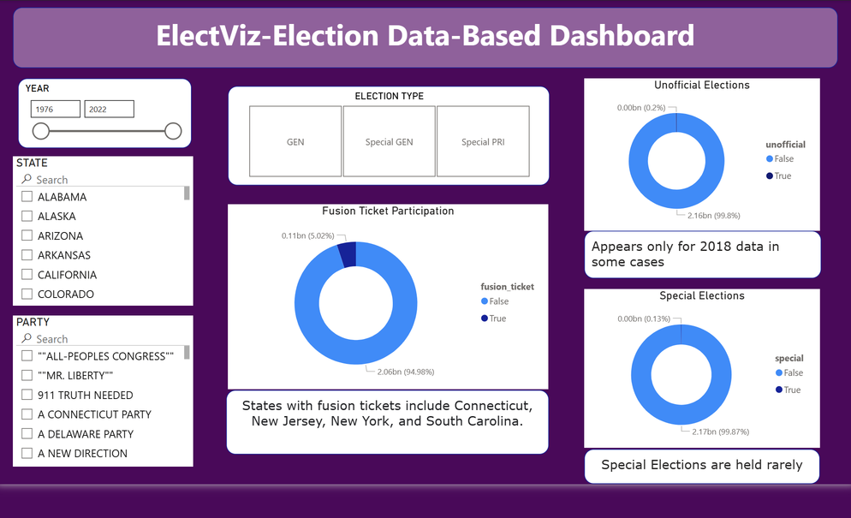
RESULT
  Overview Page – Provides a summary of overall election results including total seats, total votes, and major party performance.
  Party Analysis Page – Displays party-wise seat distribution, vote share percentage, and comparative performance.
  State/Region Analysis Page – Shows state-wise election results and regional voting patterns.
  Constituency Analysis Page – Provides detailed constituency-level insights including winning candidate and vote margin.
  Vote Share Analysis Page – Compares vote percentage distribution among different political parties.
  Winning Margin Page – Highlights the difference in votes between winning and runner-up candidates.
  Trend/Comparative Analysis Page – Analyzes performance trends across multiple elections or regions.
04

Slide 6
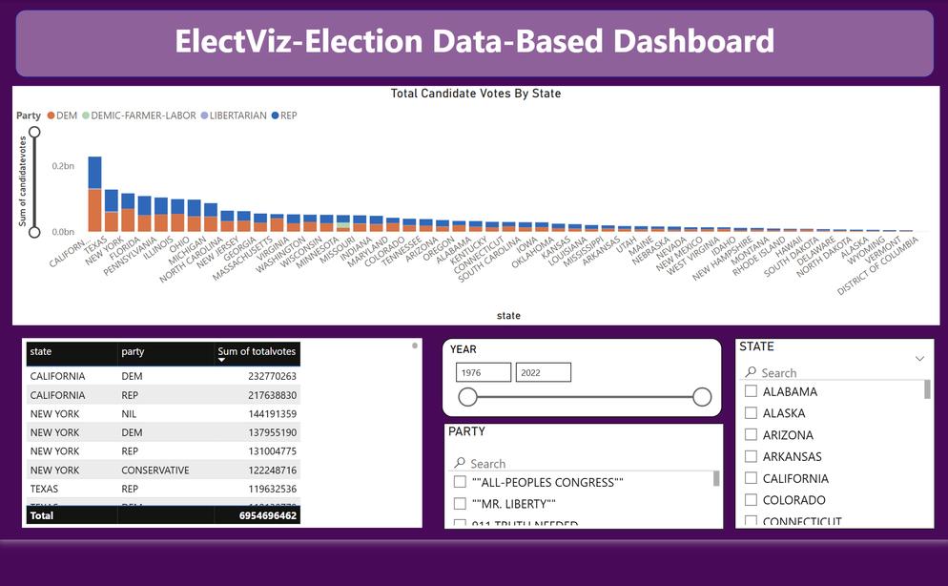
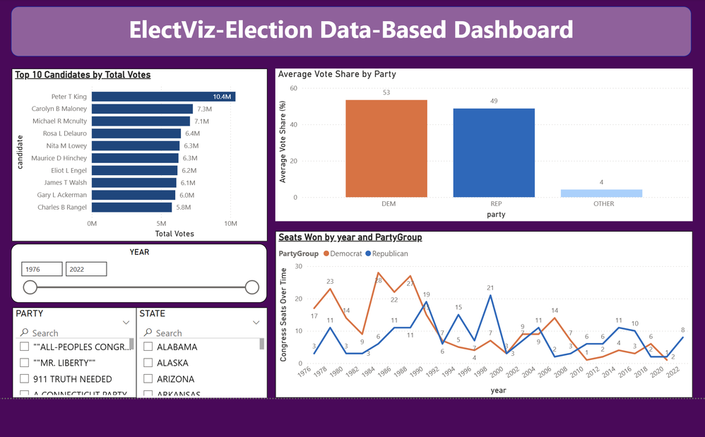
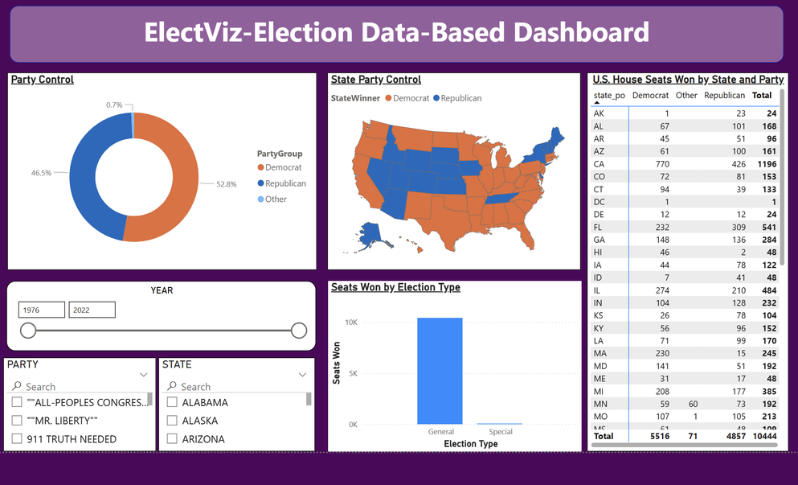
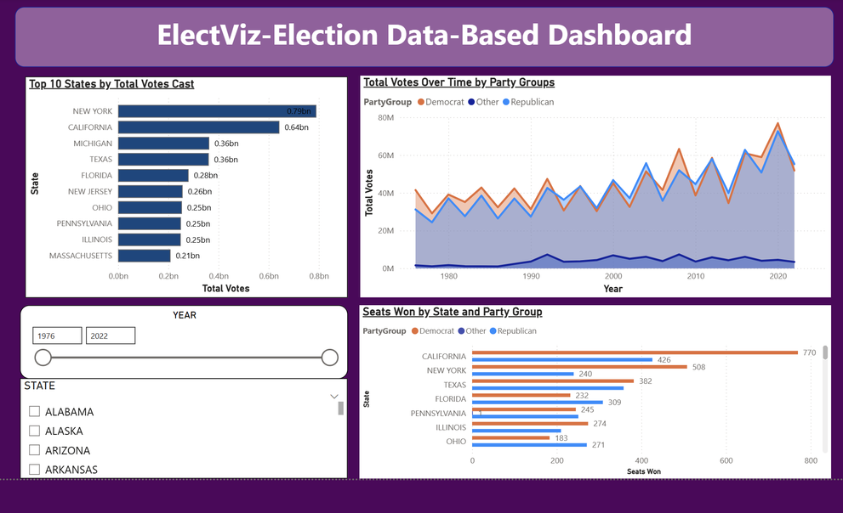
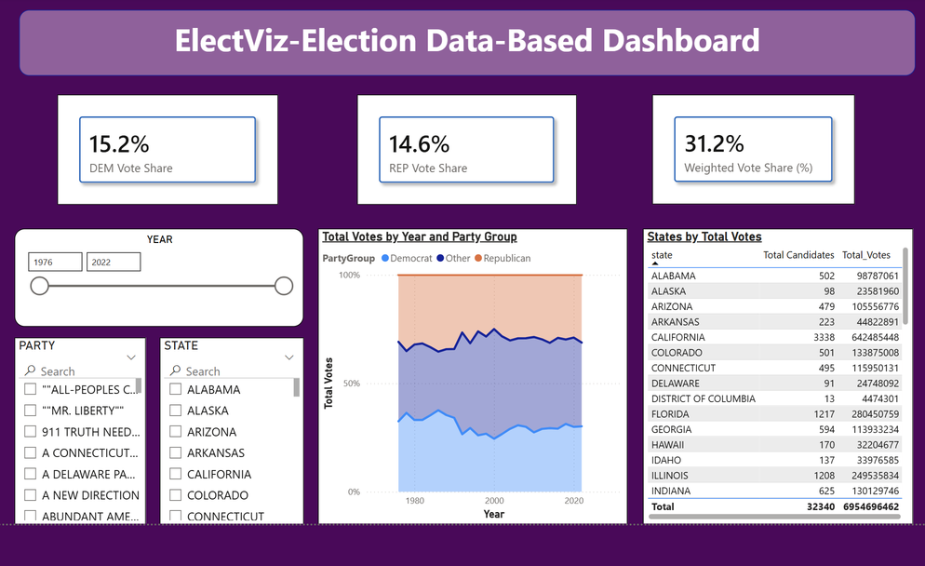
08

Slide 7
ACKNOWLEDGEMENT
I would like to express my sincere gratitude to:
  My mentor for guidance and continuous support
  Faculty members for their valuable suggestions
  Open data sources used for election datasets
  Microsoft Power BI platform for enabling advanced analytics
Their support and resources helped in the successful completion of this project.
08

Slide 8
REFERENCES
  Official Election Commission Data Sources
  Microsoft Power BI Documentation
  Microsoft Learn – DAX and Power Query
  Online tutorials and documentation for data visualization best practices
  Publicly available election datasets
08

Slide 9
CONTRIBUTORS
  Neelapu Herambudu,
  Francis Daniel,
  Swathika Murugan,
  Shaik Shabeena Praveen,
  Gopi Krishna,
  Tanmay Parulkar
08

Slide 10
CONCLUSION
The ElectViz Dashboard successfully transforms complex election data into clear, interactive, and insightful visual representations.
It demonstrates:
  Effective data preprocessing
  Strong data modeling using DAX
  Insightful visualization design
  Practical application of Business Intelligence concepts
This project highlights how data visualization tools like Power BI can simplify complex political datasets and support data-driven decision-making.
09

Slide 11
THANK YOU
10

