Slide 1
INFOSYS VIRTUAL INTERNSHIP 6.0
Elect Viz -Election Data Visualization for Media Batch-11
Mentor : Mrs Nithyasri S J Made by: SHAIK SHABEENA

Slide 2
Project Overview
Project Name: ElectViz – Election Data Analytics Dashboard
Domain: Data Analytics & Visualization
Tool Used: Microsoft Power BI
Dataset: U.S. House of Representatives Elections (1976–2022)
Objective:
  Analyze long-term election trends
  Understand party dominance and power shifts
  Compare state-wise and candidate-wise performance
Outcome:
An interactive dashboard enabling data-driven exploration of election data

Slide 3
Interactive dashboards with multi-page navigation:
Interactive dashboards: Easy navigation to explore election data across multiple pages.
Dynamic filters: Quickly filter data by year, state, party, or election type.
KPI cards: Show key metrics like total votes, candidates, and average vote share
.
State & party comparison: Compare performance across regions and parties.
Trend analysis: Shows voting and party trends over different election years.
User-friendly design: Simple, clear, and consistent dashboard layout.

Slide 4
WORKFLOW AND SYSTEM DESIGN
Power BI Data Model
• Tables & Relationships
Interactive Dashboard
• Charts & Maps
• KPI Cards
• Filters & Slicers
CSV Dataset (Raw Election Data)
Power Query (ETL Layer)
• Data Cleaning
• Data Transformation • Normalization
DAX Measures & KPIs
• Vote Share Calculations
• Seats Won Metrics
• Aggregations & Trends
User Insights & Analysis
• Trends Identification
• Comparative Analysis

Slide 5
MILESTONES
Milestone 1:
This phase concentrated on defining project goals and preparing the election dataset for analysis. Data cleaning and preprocessing were carried out to maintain accuracy, uniformity, and reliability across all states and election years.
Milestone 2:
This milestone focused on developing the initial dashboard pages, including Election Overview, Special Elections and Fusion Ticket Analysis, and State-wise Candidate Vote Distribution. These pages highlight major trends and provide regional insights into voting patterns and electoral behavior.
Milestone 3:
During this phase, advanced analytical dashboards were created to assess party dominance, candidate performance, and seat distribution across states. These visuals offer deeper understanding of political control and shifts in power over time.
Milestone 4:
The final milestone completed the dashboard by adding voter participation analysis along with a consolidated results overview. This stage emphasized summarizing insights and improving storytelling for quick understanding and effective presentation.

Slide 6




MILESTONE Outcomes

Slide 7
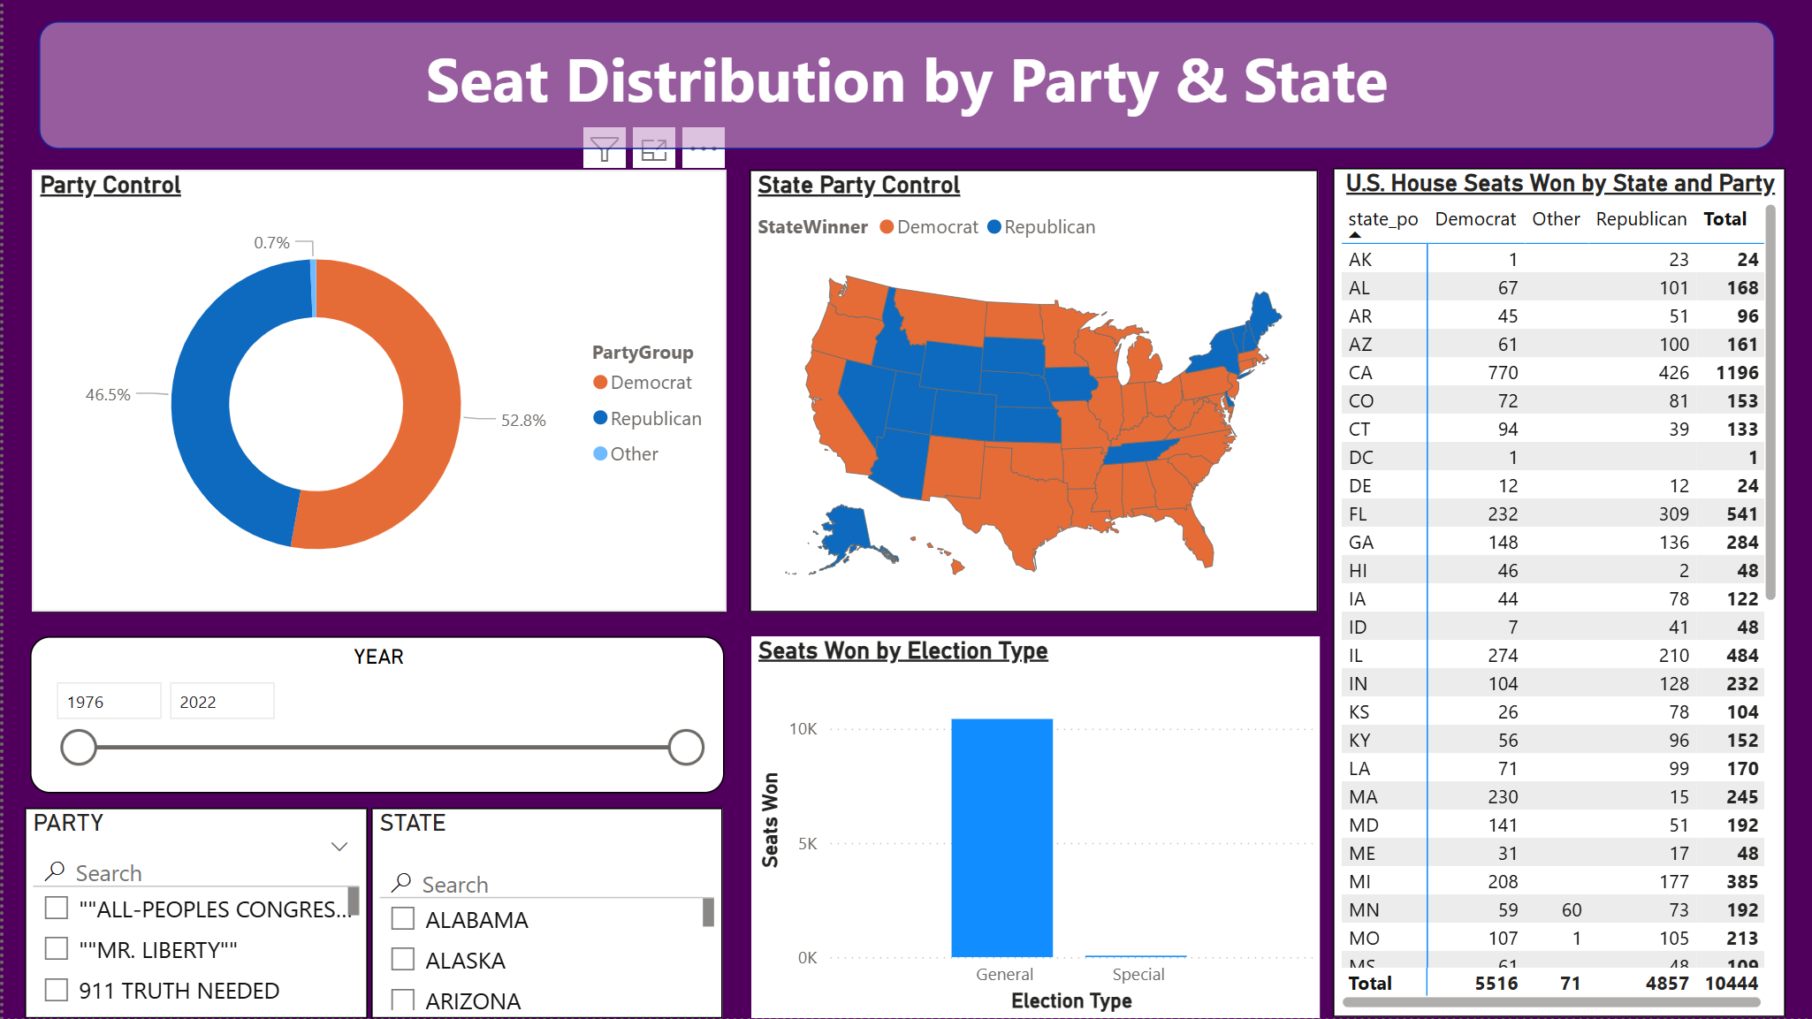


MILESTONE Outcomes

Slide 8
Future Enhancements
Predictive AI Integration: Incorporating machine learning models to project "Likely Winners" in real-time based on early partial returns.
Predictive "What-If" Modeling: Enabling a feature (similar to major news networks) to estimate final outcomes as soon as key precincts report.
Demographic Overlay: Integrating US Census data to visualize how factors like income, education, and age influenced the voting shifts seen in your current charts.
Live API Connectivity: Transitioning from static datasets to live Web API feeds (such as the Associated Press) for automated updates during election nights.

Slide 9
Conclusion
The project successfully transformed raw and complex election datasets into structured, accurate, and visually intuitive insights, enabling users to quickly interpret large volumes of electoral information that would otherwise be difficult to analyze in tabular form.
By leveraging modern data visualization techniques, the project clearly demonstrated how interactive dashboards can enhance the understanding of political trends, voting patterns, and long-term shifts in party dominance across multiple election cycles.
The dashboard enabled comprehensive and multi-dimensional analysis of party performance, voter behavior, seat distribution, and regional influence, allowing users to explore data at national, state, and candidate levels through dynamic filtering and drill-down capabilities.
Finally, the project established a strong and scalable foundation for advanced analytical work, making it well-suited for future enhancements such as real-time data integration, predictive analytics, demographic analysis, and more sophisticated decision-support systems.

Slide 10
ACKNOWLEDGMENT & Reference
We would like to express our heartfelt gratitude to:
Infosys Springboard Team – for organizing this valuable internship opportunity.
Our Mentor – for her continuous support and feedback.
My Teammates – for collaboration, encouragement, and insights
This internship has been a significant step in our professional growth and technical journey.
References:
US_Election_Data(Kaggle source)
Microsoft Power BI Documentation
Infosys Springboard Virtual Internship course materials

Slide 11
THANK YOU

