Slide 1
ElectViz: Election Data Visualization for Media
Batch-11
Mentor : Mrs. Nithyasri S J
Interns
Neelapu Herambudu
Francis Daniel
Swathika Murugan
Shaik Shabeena Praveen
Gopi Krishna
Tanmay Parulkar
Presented by Tanmay Parulkar

Slide 2
Introduction
(Project Overview)
The Mission: To create an election analytics dashboard that does more than show numbers — it reveals the story behind the results, highlighting trends, shifts, and patterns hidden within the data.
The Information Gap: US Elections are uniquely complex, the public
needs a clear guide to navigate the "Red Mirages" and shifting data of
election night.
Media Value: Specialized for newsrooms to transform high-volume data
(like AP feeds) into broadcast-ready stories instantly.
The Human Connection: We bridge the gap between cold statistics and
the real-world concerns of voters, making the democratic process
accessible to everyone.

Slide 3
Workflow(Project Milestones
Data Collection
Data Preprocessing
Data Modeling
Gathered dataset from Kaggle covering 25 year span of data from US Elections
Removed,
Cleaned & Imputated Values for uniformity
Created relations between candidates,parties,
states,election year for analysis
Dashboard Creation
Insight Generation
Testing &
Presentation
Designed interactive visuals with slicers and filters
Identified major trend and patterns
Tested each test case for final accuracy and dashboard

Slide 4



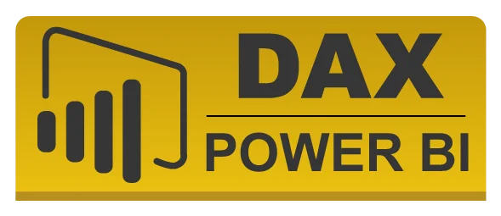
System Design
(Project Files)
Power BI Extended File (.pbix): The central Power BI project file that contains the entire data model, visual reports, and interactive dashboard layout.
Cleaned Source Dataset (.csv / .xlsx): The "source of truth" containing historical US Election records (1976–2022) after the data cleaning process was completed.
DAX Measure Repository: A collection of custom formulas created within the file to calculate complex metrics like "Weighted Vote Share %" and "Seats Won by Party".
Power Query Logic (M Language): The internal transformation scripts used to clean, filter, and format the raw election data before it entered the dashboard.

Slide 5




Tools and
Technology
Primary Platform: Microsoft Power BI Desktop – core environment for building full analytical pipeline — from data modeling and DAX calculations to crafting interactive dashboards.
Data Engine: Power Query (M Language) – Leveraged for the ETL process: cleaning raw US Election datasets, handling missing values, and normalizing state/county naming conventions.
Analytical Logic: DAX (Data Analysis Expressions) – Created custom measures to calculate complex metrics like Weighted Vote Share %, Electoral Thresholds, and Year-over-Year Participation Trends
Visualization Suite:
Native AI Visuals: Used for identifying key influencers & performance trends.
Geospatial Mapping: Integrated Bing Maps for state-wise votes and dominance

Slide 6


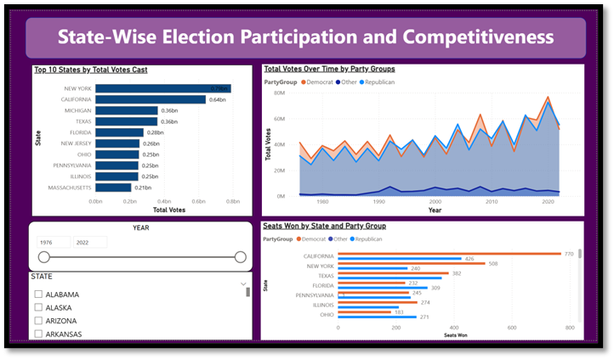

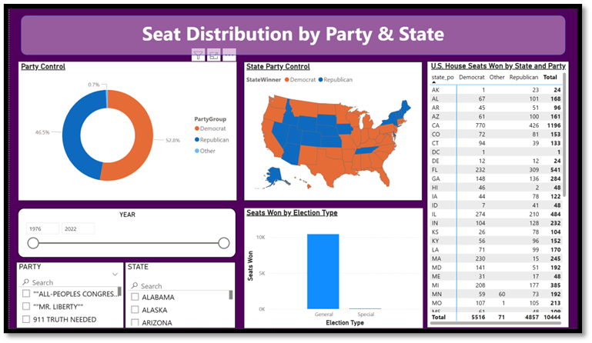
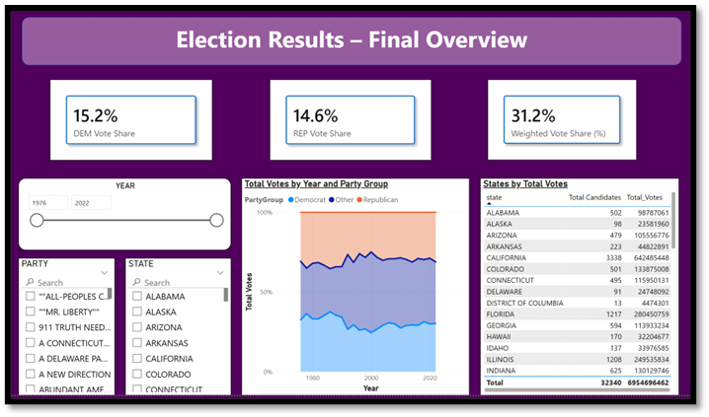

Milestones
Milestone 1:
Milestone 2:
Milestone 2:

Slide 7




Future Enhancements
Predictive Forecasting
"What-If" Modeling
Demographic Overlay
Live API Connectivity
Live API Connectivity: Transitioning from static datasets to live Web API feeds (such as the Associated Press) for automated updates during election nights.
Enabling a "The Needle" feature (similar to major news networks) to estimate final outcomes as soon as key precincts report.
Our dataset lacks key demographic fields like
Gender
Education
Age group the voting shifts seen in your current charts
Future versions can integrate the same
We can apply machine learning models to decades of election data (1976–2022) to forecast probable winners, turnout shifts, and party performance based on early trends or past patterns.

Slide 8
Conclusion
Every Vote, Every Dataset, A Story: Throughout this project, we learned that elections aren’t just numbers. ElectViz makes the American democratic experiment visible to everyone.
Clarity in Chaos: We provide the "Eye of the Storm" for journalists during the most chaotic nights in media.
Final Quote: “In democracy, transparency isn’t optional. ElectViz makes it visual, simple, and accessible.”

Slide 9
Thank You

Slide 10
License
Open Access (MIT): We believe the math behind American democracy should be open.
Non-Partisan Commitment: Our code is designed to be a "neutral mirror," reflecting data without algorithmic bias.

Slide 11
Team Learning
Data Empathy: We learned that cleaning a "US Election" dataset is an ethical duty; behind every row is a voter whose intent must be accurately represented.
The Power of Clarity: We realized quickly that complicated structures like Fusion Ticket, Special Elections & multiple vote columns can confuse users. Transforming them into simple visuals (like donut charts) made the insights much clearer.
Technical Agility: We mastered DAX to handle "Weighted Vote Share" and Power Query to merge fragmented state records into a unified national narrative.
User-Centric Design: By testing our "Year Sliders," we learned how to design for a high-pressure newsroom where a journalist needs historical context in under three seconds.
Integrity over Aesthetics: We prioritized data validation over "flashy" visuals, ensuring that every seat count and percentage on the dashboard is bulletproof and auditable.

Slide 12
Key Features
Key Features
Multivariate Trend Analysis: Interactive line and area charts that visualize voting patterns and seat distributions from 1976 to 2022.
Dynamic Geographic
Insights: A state-wise breakdown of candidate performance and participation, allowing for hyper-local reporting
Path to Victory Tracker: Real time calculation of “Seats won” and “Vote Share %” to help media houses identify 270 threshold
Candidate and Party Benchmarking: Comparative analysis of Top 10 candidates and party-wise dominance to identify political shifts.
Deep Dive Filtering: Synchronized "Year," "State," and "Party" slicers that allow journalists to isolate specific election stories instantly.
.
Special Election Analytics: Unique tracking of Fusion Tickets and Special Elections to provide context beyond standard general races.

Slide 13
Contributors
&
Notes
Team: Neelapu Herambudu, Francis Daniel, Swathika Murugan, Shaik Shabeena Praveen, Gopi Krishna, Tanmay Parulkar
Special Note: The dataset includes historical US Census data to provide deeper context into "The American Voter."
The “Anxiety-Free” UI: Election nightmare chaotic and stressful. We deliberately chose a “Calm UI” to give journalists a sense of stability when reporting live.
The Three-Second Rule: In a fast-placed newsroom, clarity is king. We designed our visualizations so that a viewer can understand the state of a race in under three seconds.
Data with a Pulse: We didn't just build a dashboard; we built a storyteller. Our "Trend Arrows" and "Swing Analysis" explain the movement of the American people, not just the final score.

Slide 14
Future Enhancements
Predictive Forecasting using historical data: We can apply machine learning models to decades of election data (1976–2022) to forecast probable winners, turnout shifts, and party performance based on early trends or past patterns.
Advanced “What-If” Simulations: A dynamic scenario engine could allow users to simulate: Changes in vote share, Swing state behavior, Effects of third-party performance, Similar to newsroom “Needle” models, this would estimate likely outcomes even before full results are available.
Demographic Overlay: Integrating US Census data to visualize how factors like income, education, and age influenced the voting shifts seen in your current charts.
Social Layering: Our dataset lacks key demographic fields. Future versions can integrate:
Age Groups
Gender
Income levels
Live API Connectivity: Transitioning from static datasets to live Web API feeds (such as the Associated Press) for automated updates during election nights.

Slide 15


Outcomes

