Slide 1
Customer Churn Prediction using PySpark
Herambeshwar Pendyala | 01130541

Slide 2
Goal
The primary objective of the project is to build a scalable model to predict the customer churn for a music streaming service, given features such as user activity on the website, events, user history and other user related data.

Slide 3
Data
The data given is that of user events. Every interaction of every user with the application is provided.
Each record in our data represents an event by a user. This makes the data huge as the application grows and makes tedious to process it.
Root |-- artist: string (nullable = true) |-- auth: string (nullable = true) |-- firstName: string (nullable = true) |-- gender: string (nullable = true) |-- itemInSession: long (nullable = true) |-- lastName: string (nullable = true) |-- length: double (nullable = true) |-- level: string (nullable = true) |-- location: string (nullable = true) |-- method: string (nullable = true) |-- page: string (nullable = true) |-- registration: long (nullable = true) |-- sessionId: long (nullable = true) |-- song: string (nullable = true) |-- status: long (nullable = true) |-- ts: long (nullable = true) |-- userAgent: string (nullable = true) |-- userId: string (nullable = true)

Slide 4
Implementation Design
Data PreProcessing using pyspark sql dataframe.
Labelling Churn
Feature engineering to generate user stats from event data
Machine Learning modelling using pyspark rdd
Building a logistic regression model for binary Classification
Evaluating model using metrics

Slide 5
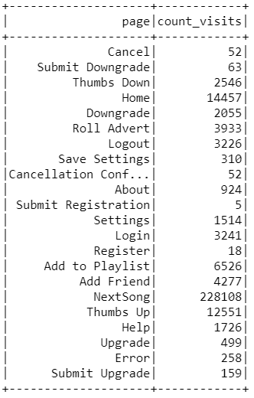
Preprocessing using spark SQL
Labelling churn
Generating user stats from the events data by aggregating over time and session data.
Using functions like UDF, window for data preprocessing to get insights from the events data.

Slide 6
Preprocessing using spark SQL
Data
Name | DataSize | DataSize Rows | Rows Retrieved
Set1 | 128 mb | 286500 | 225
Set2 | 250 mb | 543705 | 448
Set3 | 490 mb | 1087410 | 8279
set4 | 980 mb | 2174820 | 10620
set5 | 1.9 gb | 4349640 | 12679
set6 | 3.9 gb | 8699280 | 14142
Set7 | 7.9 gb | 17398560 | 21069
Set8 | 12 gb | 25259199 | 22216
Final feature set includes one record per user and user stats engineered in the previous stage.
Final Features –
Stats from time spent on application: consecutive_listening_days, days_since_last_listen, total_listens, total_thumbs_up, total_thumbs_down, total_errors, total_add_to_playlists, total_add_friends.
Stats from session data: avg_sess_listens, avg_sess_thU, avg_sess_thD, avg_sess_err, avg_sess_addP, avg_sess_addF.

Slide 7
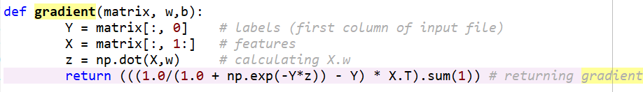
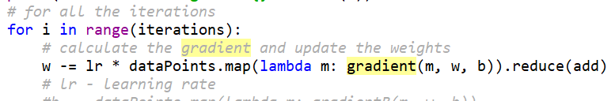
Modelling using Logistic Regression
RDD based implementation of gradient descent optimization

Slide 8
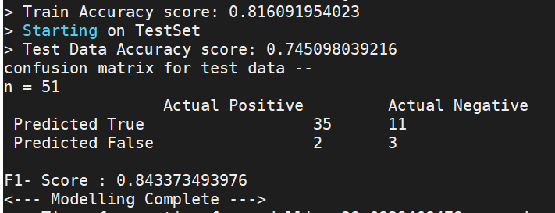
Metrics
Confusion Matrix
Accuracy
F1-Score

Slide 9
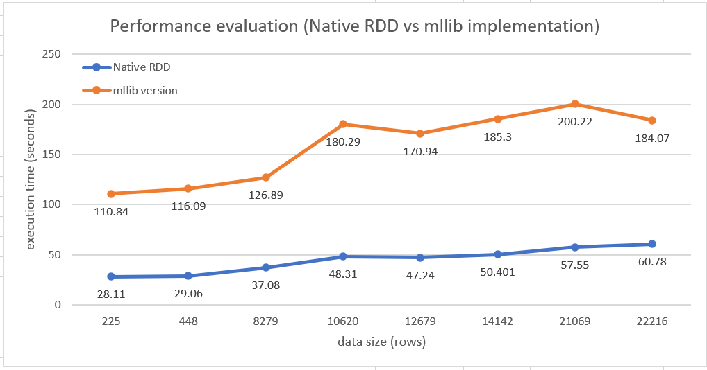
Comparing with mllib library version
MLLIB vs native rdd | Execution Time(Seconds)
Rows | Native | mllib
225 | 28.11 | 110.84
448 | 29.06 | 116.09
8279 | 37.08 | 126.89
10620 | 48.31 | 180.29
12679 | 47.24 | 170.94
14142 | 50.401 | 185.3
21069 | 57.55 | 200.22
22216 | 60.78 | 184.07

Slide 10


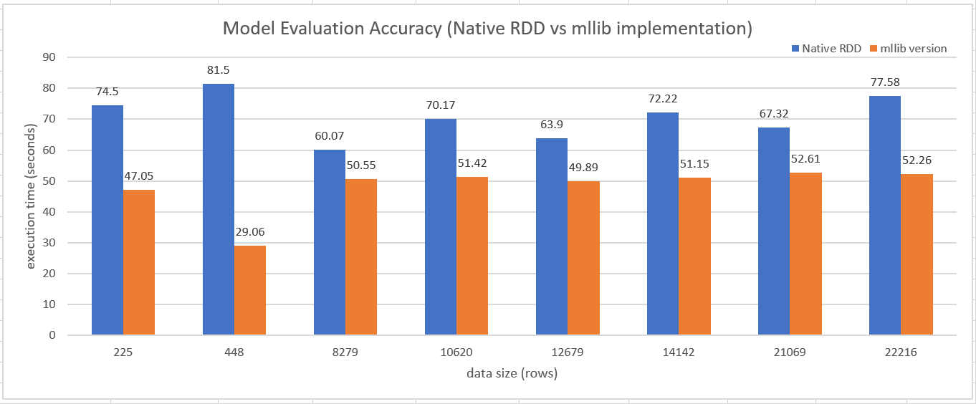


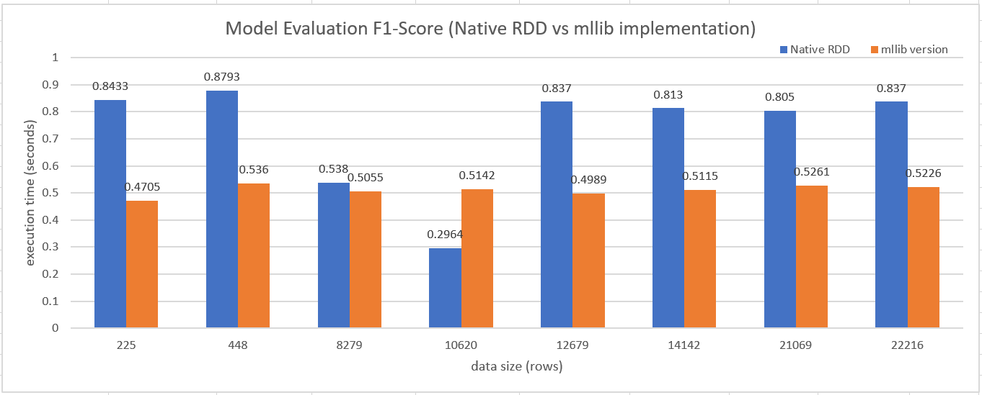

Accuracy and F1-Score

Slide 11
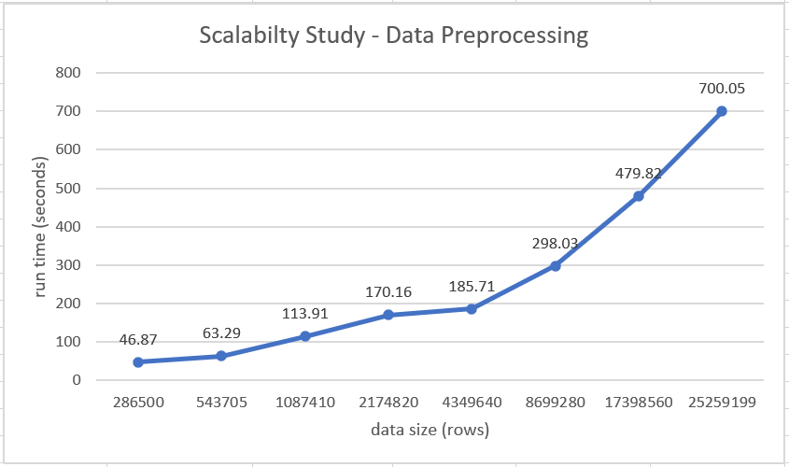
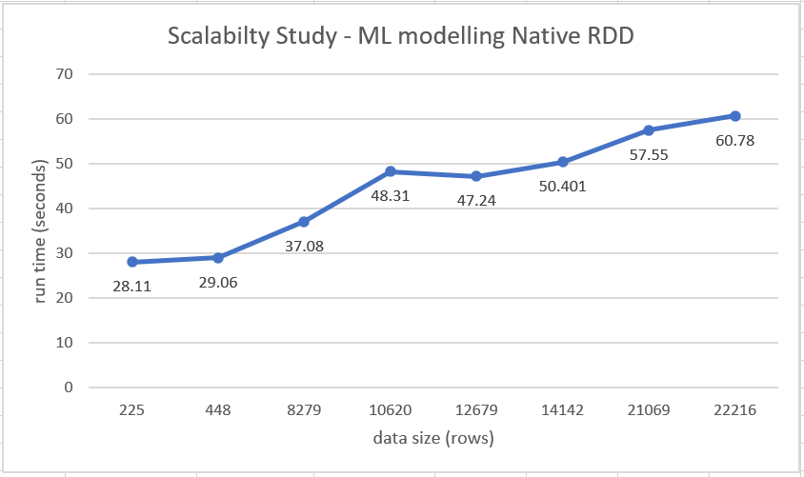
Scalability

Slide 12
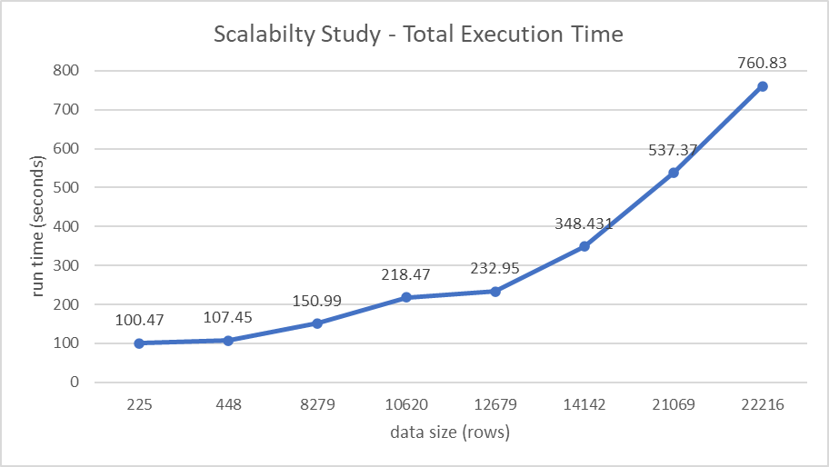
Total Execution time
Data |  | Time for 100 iterations
DataSize Rows | Rows Retrieved | PreProcess | Modelling | Total
286500 | 225 | 72.36 | 28.11 | 100.47
543705 | 448 | 78.39 | 29.06 | 107.45
1087410 | 8279 | 113.91 | 37.08 | 150.99
2174820 | 10620 | 170.16 | 48.31 | 218.47
4349640 | 12679 | 185.71 | 47.24 | 232.95
8699280 | 14142 | 298.03 | 50.401 | 348.431
17398560 | 21069 | 479.82 | 57.55 | 537.37
25259199 | 22216 | 700.05 | 60.78 | 760.83

Slide 13
Lessons Learned
Learned how we can use spark in big data analysis in preprocessing phase.
As I have tested the same code on different sizes of data (128 mb to 12 gb), I got to know how useful and powerful distributed computing techniques can be.
Initially testing on 128mb executed without any errors, but as I increased the size of the data, there were lot many errors and by resolving those errors I got to learn more about how spark works in background.

Slide 14
Demo

Slide 15
Thank you

