Slide 2
The Problem With Fast Food:
Low quality
Unhealthy
Lack of variety
The Problem With Asian Restaurants:
Unpredictable quality
Greasy
Poor ambience
Source: Survey of MSB students & faculty

Slide 3
Business Plan Presentation
October 19, 2001

Slide 4

The Xasia Concept
The Menu
  Portable pan-Asian food (wraps, rolls, soups)
  Made to order in front of the customer
  Imported & domestic beers
  High standard of quality
The Restaurant
  Clean and stylish
  Fast, efficient service
Average Check: ~ $8.00

Slide 5
Restaurants: A Tough Industry
High failure rate
Very competitive
Low margins
Staff turnover

Slide 6
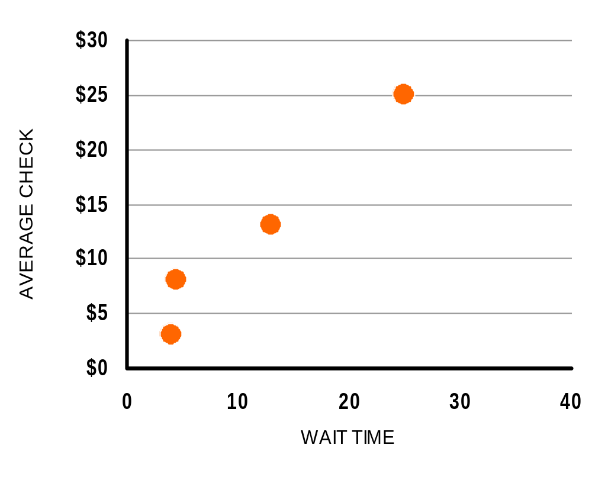
Segments of the Restaurant Industry
Fine Dining
Casual Dining (Bennigan’s)
Fast-Casual
Quick-Serve (McDonald’s)

Slide 7
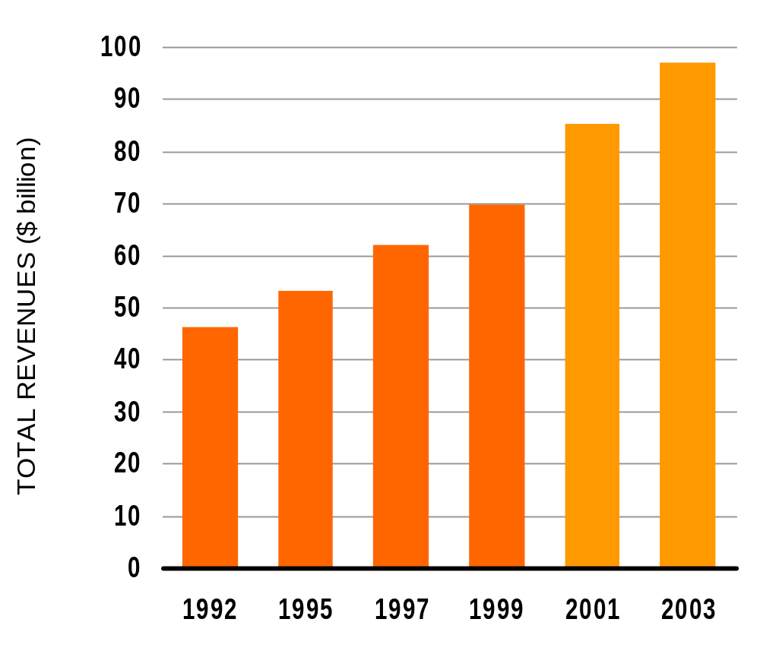
Demand for Ethnic Food is Growing
(Projected)
Source: SBI Market Profile: Foodservice Industry

Slide 8
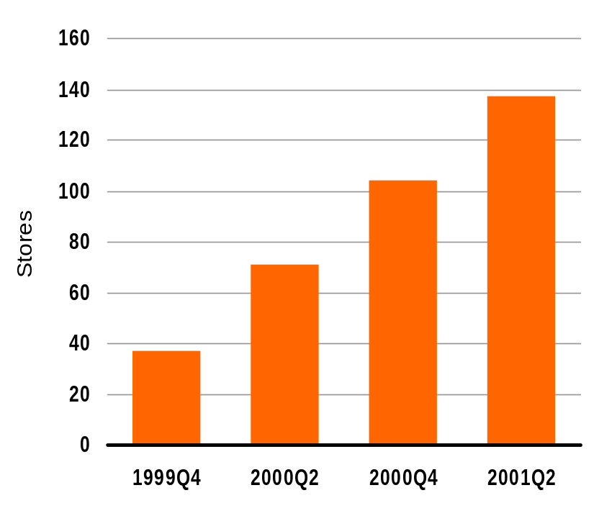
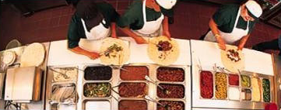
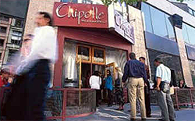
Example: Chipotle Mexican Grill
McDonalds owns majority stake
Revenues per unit: $1.4 million
Source: McDonald’s Corp.

Slide 9
Demand & Market Segments
Target demographic
  Young
  Professional/Students
  Urban
Choice of geographical area
  Eastern U.S.
  Large metropolitan areas
  Mixed neighborhoods (target both lunch & dinner)
  First market: Columbus, Ohio

Slide 10
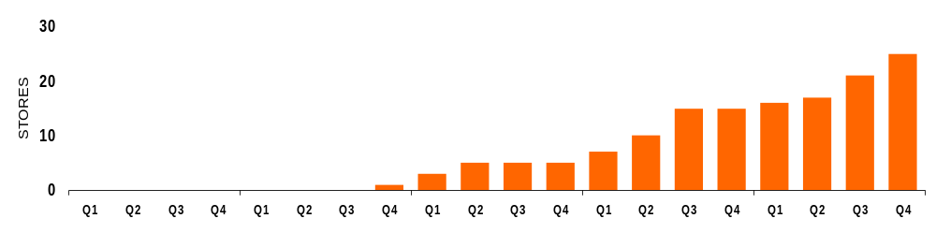
Milestones
2001 Q4 Planning
& concept design
2002 Q4 Opening
of first store in Columbus, followed by four more
2004 Q2 Opening of five stores each in Washington, DC and Atlanta, GA
2005 Q3 Expansion to three more markets
2001
2002
2003
2004
2005

Slide 11
The Xasia Grill Board
Lana Whatley, VP for Human Resources, Jack-in-the-Box
Kym Arnone, Senior Managing Director, Bear Stearns
Al Dietzel, Vice President, The Limited
John Kasich, Lehman Bros.
James Turner, Vice President, Cinergy Corporation

Slide 12
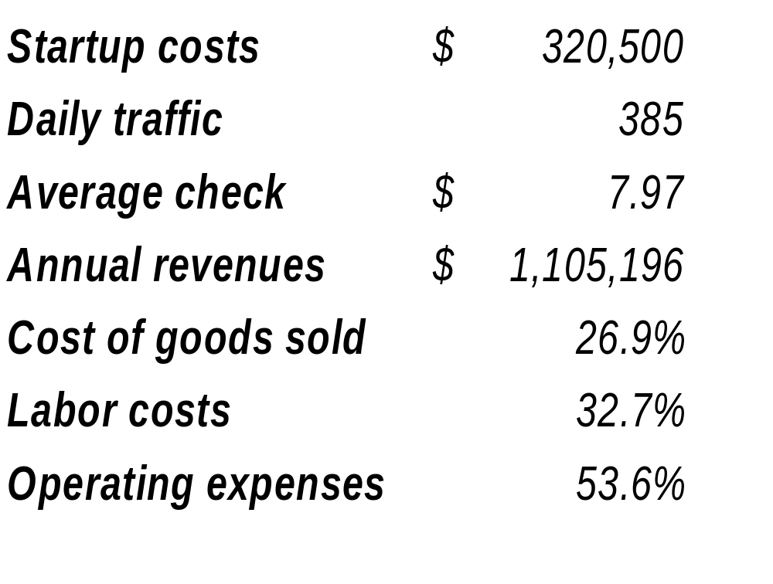
Projections: Per Restaurant

Slide 13
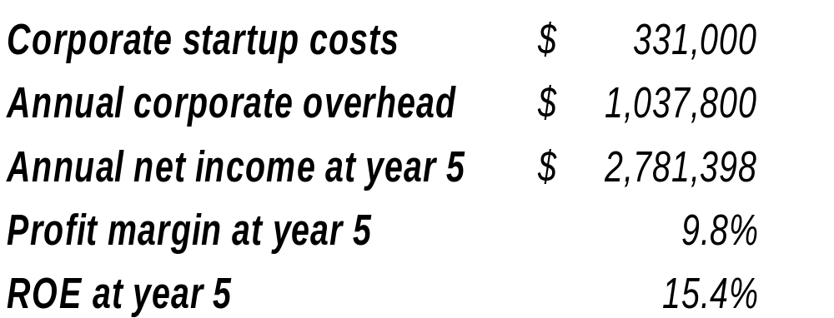
Projections: Corporate

Slide 14
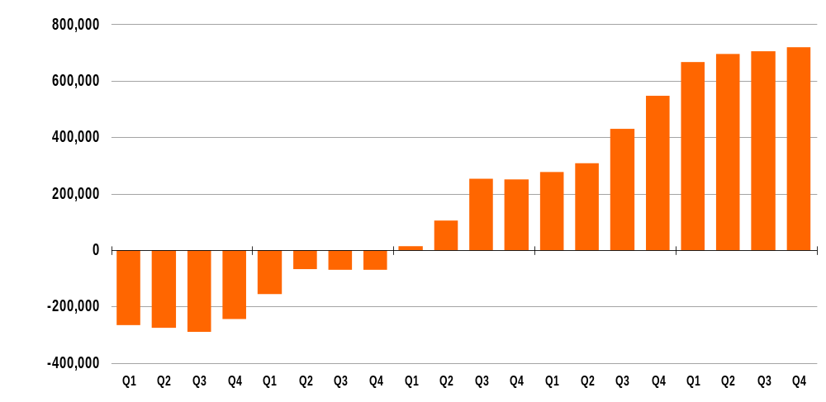
Projected Net Income
2002
2003
2004
2005
2006

Slide 15
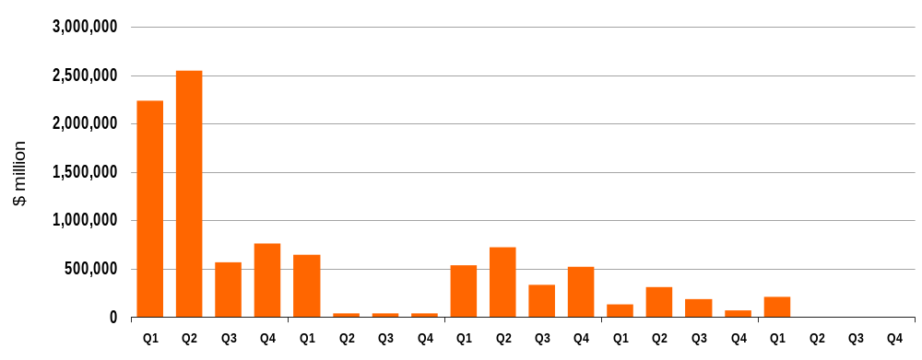
Capital Requirements
2002
2003
2004
2005
2006
Initial investment required: $5.5 million
Total capital requirements (first 5 years): $10.8 million

Slide 16
http://ibamba.net/xasia

