Slide 1
Introduction
Chapter 1

Slide 2
Risk vs Return
There is a trade off between risk and expected return
The higher the risk, the higher the expected return

Slide 3
Example (Table 1.1, page 2)
Suppose Treasuries yield 5% and the returns for an equity investment are:
Probability | Return
0.05 | +50%
0.25 | +30%
0.40 | +10%
0.25 | –10%
0.05 | –30%

Slide 4
Example continued
We can characterize investments by their expected return and standard deviation of return
For the equity investment:
  Expected return =10%
  Standard deviation of return =18.97%

Slide 5
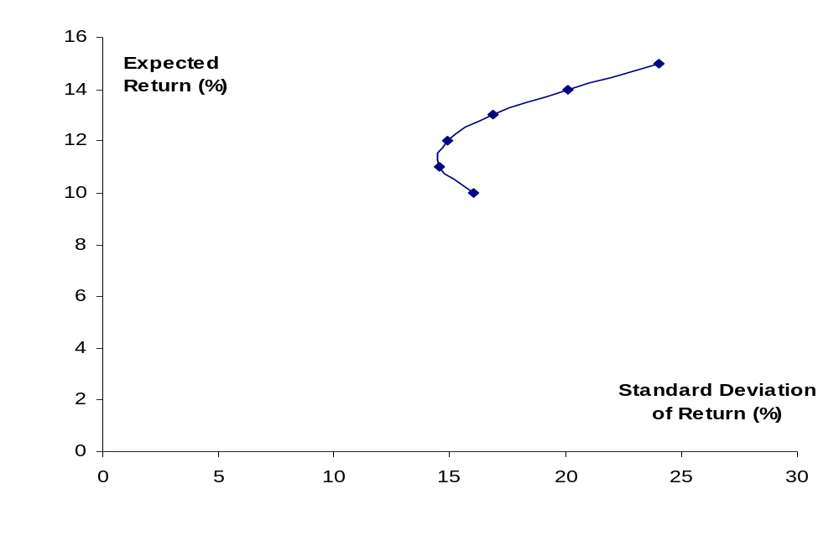
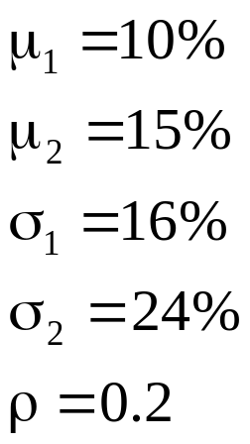
Combining Risky Investments (page 5)

Slide 6
Efficient Frontier of Risky Investments (Figure 1.3, page 6)
Efficient Frontier
Expected Return
Investments
S.D. of Return

Slide 7
Efficient Frontier of All Investments (Figure 1.4, page 7)
J
Expected Return
M
E(R_{M})
I
Previous Efficient Frontier
F
R_{F}
New Efficient Frontier
S.D. of Return
σ_{M}

Slide 8
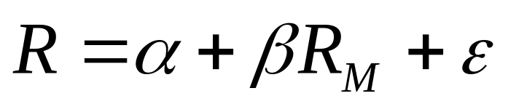
Systematic vs Non-Systematic Risk (equation 1.3, page 9)
We can calculate the best fit linear relationship between return from investment and return from market
Systematic Risk (non-diversifiable)
Non-systematic risk (diversifiable)

Slide 9

The Capital Asset Pricing Model (Figure 1.5, page 10)
Expected Return E(R)
E(R_{M})
R_{F}
Beta
1.0

Slide 10
Arbitrage Pricing Theory
Returns depend on several factors
We can form portfolios to eliminate the dependence on the factors
Leads to result that expected return is linearly dependent on the realization of the factors

Slide 11
Risk vs Return for Companies
If shareholders care only about systematic risk should the same be true of company managers?
In practice companies are concerned about total risk
Earnings stability and company survival are important managerial objectives
“Bankruptcy costs” arguments show that that managers are acting in the the best interests of shareholders when they consider total risk

Slide 12
What Are Bankruptcy Costs? (Business Snapshot 1.1, page 14)
Lost sales (There is a reluctance to buy from a bankrupt company.)
Key employees leave
Legal and accounting costs

Slide 13
Capital
Capital is designed to provide protection against extreme events that have a very low (e.g. 0.1%) chance of occurring

Slide 14
Example of Simple Bank Balance Sheet: End 2006 (Table 1.3, page 15)
Assets
Cash 5
Marketable Securities 10
Loans 80
Fixed Assets 5
Total 100
Liabilities
Deposits 90
Subord L.T. Debt 5
Equity Capital 5
Total 100

Slide 15
Income Statement: 2006 (Table 1.4, page 16)
Net Interest Income 3.00
Provision for Loan Losses (0.80)
Non-Interest Income 0.90
Non-Interest Expense (2.50)
Pre-Tax Operating Income 0.60

Slide 16
Year 2007
What happens in year 2007 if it is the same as year 2006 except that provision for loan losses is 4.0 instead of 0.8?

Slide 17
What if Balance Sheet Had Been More Aggressive?
Assets
Cash 5
Marketable Securities 10
Loans 80
Fixed Assets 5
Total 100
Liabilities
Deposits 94
Subord L.T. Debt 5
Equity Capital 1
Total 100

Slide 18
Regulation
Regulators set minimum levels for the capital a bank is required to keep
Equity is an example of Tier I capital
Subordinated long term debt is an example of Tier II capital

Slide 19
Categories of Risk
Market Risk
Credit Risk
Operational Risk

Slide 20
Approaches to Bank Risk Management
Risk aggregation: aims to get rid of non-systematic risks with diversification
Risk decomposition: tackles risks one by one
In practice banks use both approaches

Slide 21
Management of Net Interest Income (Table 1.6, page 20)
Suppose that the market’s best guess is that future short term rates will equal today’s rates
What would happen if a bank posted the following rates?
How can the bank manage its risks?
Maturity (yrs) | Deposit Rate | Mortgage Rate
1 | 3% | 6%
5 | 3% | 6%

Slide 22
Expensive Failures of U.S. Financial Institutions (Business Snapshot 1.2, page 22)
Savings and Loans
Continental Illinois

