Slide 1
How Traders Manage Their Exposures
Chapter 3

Slide 2
A Trader’s Gold Portfolio. How Should Risks Be Hedged? (Table 3.1, page 56)
Position | Value ($)
Spot Gold | 180,000
Forward Contracts | – 60,000
Futures Contracts | 2,000
Swaps | 80,000
Options | –110,000
Exotics | 25,000
Total | 117,000

Slide 3
Delta
Delta of a portfolio is the partial derivative of a portfolio with respect to the price of the underlying asset (gold in this case)
Suppose that a $0.1 increase in the price of gold leads to the gold portfolio increasing in value by $100
The delta of the portfolio is 1000
The portfolio could be hedged against short-term changes in the price of gold by selling 1000 ounces of gold. This is known as making the portfolio delta neutral

Slide 4
Linear vs Nonlinear Products
When the price of a product is linearly dependent on the price of an underlying asset a ``hedge and forget’’ strategy can be used
Non-linear products require the hedge to be rebalanced to preserve delta neutrality

Slide 5
Example (page 59)
A bank has sold for $300,000 a European call option on 100,000 shares of a nondividend paying stock
S₀ = 49, K = 50, r = 5%, σ = 20%,
T = 20 weeks, μ = 13%
The Black-Scholes value of the option is $240,000
How does the bank hedge its risk to lock in a $60,000 profit?

Slide 6
Delta of the Option
Option
price
Slope = Δ
B
A
Stock price

Slide 7
Delta Hedging
Initially the delta of the option is 0.522
This means that 52,200 shares are purchased to create a delta neutral position
But, if a week later delta falls to 0.458, 6,400 shares must be sold to maintain delta neutrality
Tables 3.2 and 3.3 (pages 61 and 62) provide examples of how delta hedging might work for the option.

Slide 8
Gamma
Gamma (Γ) is the rate of change of delta (Δ) with respect to the price of the underlying asset
Gamma is greatest for options that are close to the money

Slide 9
Gamma Measures the Delta Hedging Errors Caused By Curvature (Figure 3.4, page 64)
Call
price
C''
C'
C
Stock price
S
S'

Slide 10
Vega
Vega (ν) is the rate of change of the value of a derivatives portfolio with respect to volatility
Vega tends to be greatest for options that are close to the money

Slide 11
Gamma and Vega Limits
In practice a trader responsible for all trading involving a particular asset must keep gamma and vega within limits set by risk management

Slide 12
Theta
Theta (Θ) of a derivative (or portfolio of derivatives) is the rate of change of the value with respect to the passage of time
The theta of a call or put is usually negative. This means that, if time passes with the price of the underlying asset and its volatility remaining the same, the value of the option declines

Slide 13
Rho
Rho is the partial derivative with respect to to a parallel shift in all interest rates in a particular country

Slide 14
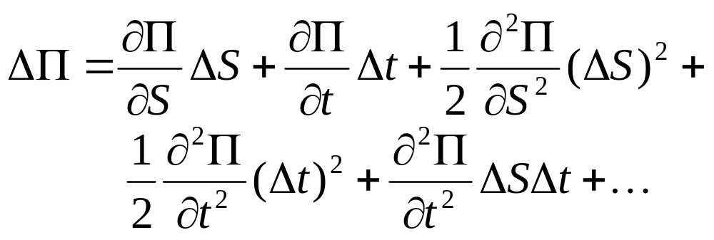
Taylor Series Expansion (Equation 3.1, page 70)

Slide 15
Interpretation of Gamma
(Equation 3.2, page 70)
For a delta neutral portfolio,
ΔΠ ≈ Θ Δt + ½ΓΔS ²
ΔΠ
ΔΠ
ΔS
ΔS
Positive Gamma
Negative Gamma

Slide 16
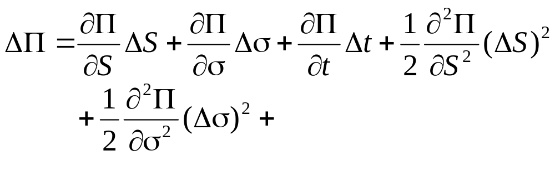
Taylor Series Expansion when Volatility is Uncertain

Slide 17
Managing Delta, Gamma, & Vega
Δ can be changed by taking a position in the underlying
To adjust Γ & ν it is necessary to take a position in an option or other derivative

Slide 18
Hedging in Practice
Traders usually ensure that their portfolios are delta-neutral at least once a day
Whenever the opportunity arises, they improve gamma and vega
As portfolio becomes larger hedging becomes less expensive

Slide 19
Static Options Replication
(page 74)
This involves approximately replicating an exotic option with a portfolio of vanilla options
Underlying principle: if we match the value of an exotic option on some boundary, we have matched it at all interior points of the boundary
Static options replication can be contrasted with dynamic options replication where we have to trade continuously to match the option

Slide 20
Scenario Analysis
A scenario analysis involves testing the effect on the value of a portfolio of different assumptions concerning asset prices and their volatilities

