Slide 1
Interest Rate Risk
Chapter 4

Slide 2
Measuring Interest Rates
The compounding frequency used for an interest rate is the unit of measurement
The difference between quarterly and annual compounding is analogous to the difference between miles and kilometers

Slide 3
Continuous Compounding
(Page 81)
In the limit as we compound more and more frequently we obtain continuously compounded interest rates
$100 grows to $100e^{RT} when invested at a continuously compounded rate R for time T
$100 received at time T discounts to $100e^{-RT} at time zero when the continuously compounded discount rate is R

Slide 4
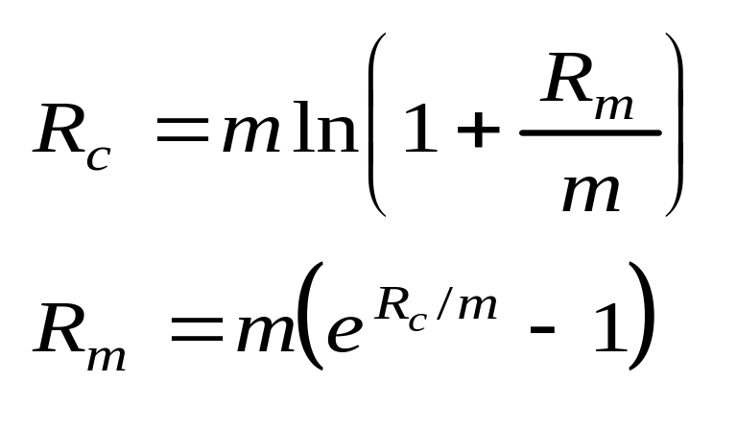
Conversion Formulas
(Page 82)
Define
R_{c} : continuously compounded rate
R_{m}: same rate with compounding m times per year

Slide 5
Zero Rates
A zero rate (or spot rate), for maturity T is the rate of interest earned on an investment that provides a payoff only at time T

Slide 6
Forward Rates
The forward rate is the future zero rate implied by today’s term structure of interest rates

Slide 7
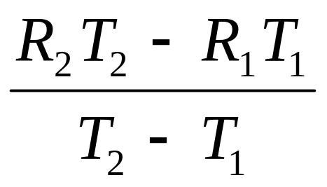
Formula for Forward Rates
(Equation 4.5 , page 84)
Suppose that the zero rates for time periods T₁ and T₂ are R₁ and R₂ with both rates continuously compounded.
The forward rate for the period between times T₁ and T₂ is

Slide 8
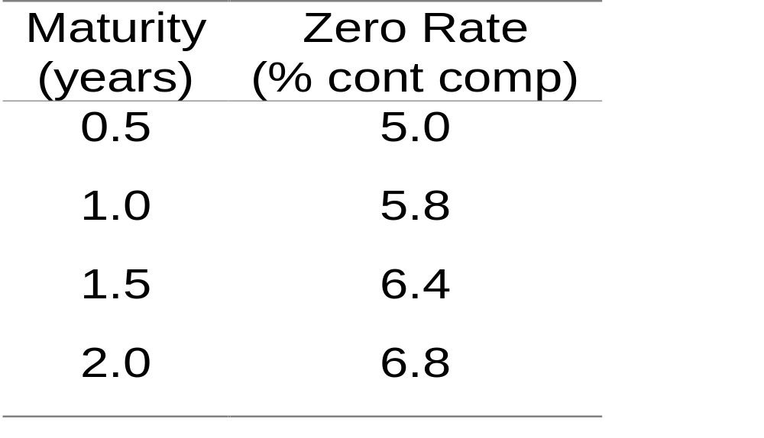
Example (Table 4.2, page 83)

Slide 9
Forward Rates (Table 4.3, page 84)
Period (years) | Forward Rate (% cont comp)
0.5 to 1.0 | 6.6
1.0 to 1.5 | 7.6
1.5 to 2.0 | 8.0

Slide 10
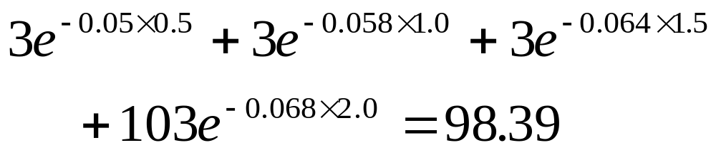
Bond Pricing
To calculate the cash price of a bond we discount each cash flow at the appropriate zero rate
In our example, the theoretical price of a two-year bond providing a 6% coupon semiannually is

Slide 11
Bond Yield
The bond yield is the discount rate that makes the present value of the cash flows on the bond equal to the market price of the bond
Suppose that the market price of the bond in our example equals its theoretical price of 98.39
The bond yield (continuously compounded) is given by solving
to get y=0.0676 or 6.76%.

Slide 12
Determining the Zero Curve: The Bootstrap Method
We work forward to successively longer maturities.
Suppose that the zero curve determined for zero to two years is as in our example and that the price of a 2.5-year bond paying a coupon of 8% is 102
If R is the 2.5-year rate we must have
4e^{-0.05×0.5}+ 4e^{-0.058×1.0+} 4e^{-0.064×1.5}+ 4e^{-0.68×2.0}+104e^{-R×2.5}=102
This can be solved to give R=7.05%

Slide 13
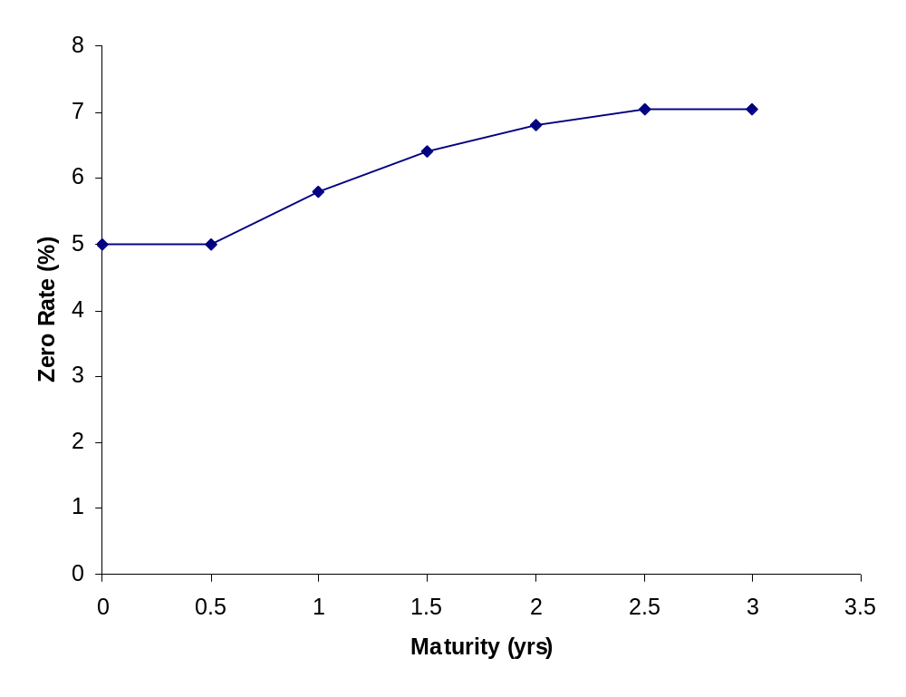
The Zero Curve (Figure 4.1, page 87)

Slide 14
LIBOR Rates
LIBOR rates are 1-, 3-, 6-, and 12-month borrowing rates for companies that have a AA-rating
To extend the LIBOR zero curve we can
  Create a zero curve to represent the rate sat which AA-rates companies can borrow for longer periods of time
  Create a zero curve to represent the future short term borrowing rates for AA-rated companies
In practice we do the second

Slide 15
Swap Rates
A bank can
  Lend to a series AA-rated borrowers for ten successive six month periods
  Swap the LIBOR interest received to the five-year swap rate
This shows that swap rates can be used to extend the LIBOR zero curve. To avoid ambiguity we refer to it as the LIBOR/swap zero curve

Slide 16
Risk-Free Rate (Page 89)
In practice traders and risk managers assume that the LIBOR/swap zero curve is the risk-free zero curve
The Treasury curve is about 50 basis points below the LIBOR/swap zero curve
Treasury rates are considered to be artificially low for a variety of regulatory and tax reasons

Slide 17
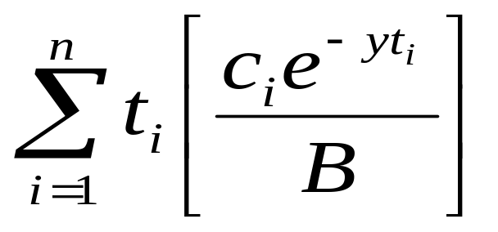
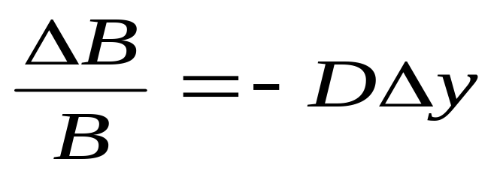
Duration (page 90)
Duration of a bond that provides cash flow c _{i} at time t _{i} is
where B is its price and y is its yield (continuously compounded)
This leads to

Slide 18
Calculation of Duration for a 3-year bond paying a coupon 10%. Bond yield=12%. (Table 4.5, page 91)
Time (yrs) | Cash Flow ($) | PV ($) | Weight | Time× Weight
0.5 | 5 | 4.709 | 0.050 | 0.025
1.0 | 5 | 4.435 | 0.047 | 0.047
1.5 | 5 | 4.176 | 0.044 | 0.066
2.0 | 5 | 3.933 | 0.042 | 0.083
2.5 | 5 | 3.704 | 0.039 | 0.098
3.0 | 105 | 73.256 | 0.778 | 2.333
Total | 130 | 94.213 | 1.000 | 2.653

Slide 19
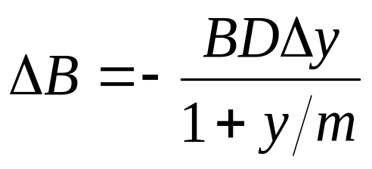
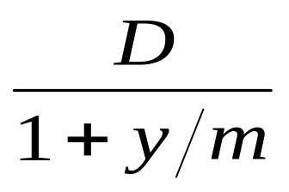
Duration Continued
When the yield y is expressed with compounding m times per year
The expression
is referred to as the “modified duration”

Slide 20
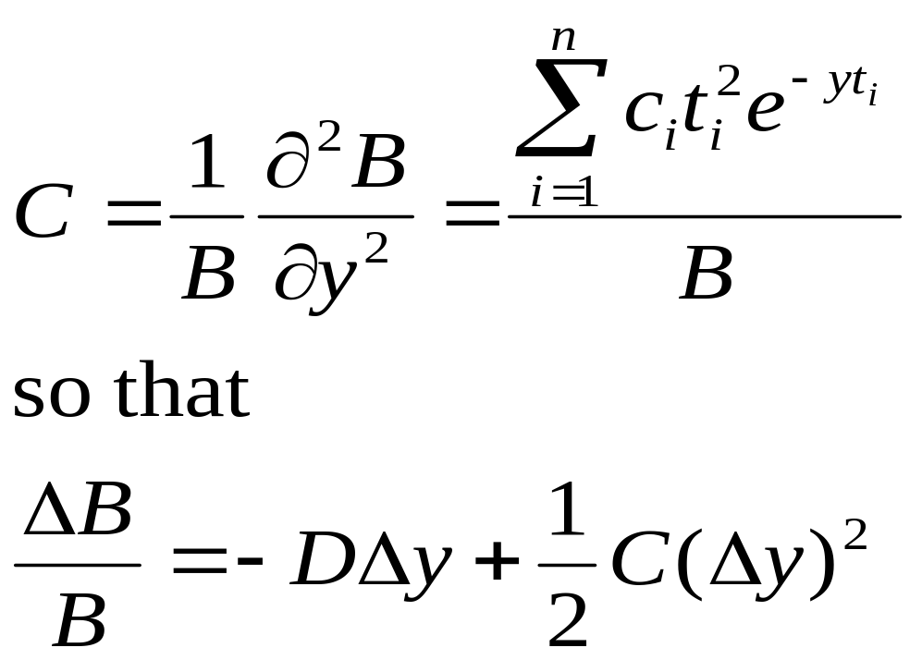
Convexity (Page 94)
The convexity of a bond is defined as

Slide 21
Portfolios
Duration and convexity can be defined similarly for portfolios of bonds and other interest-rate dependent securities
The duration of a portfolio is the weighted average of the durations of the components of the portfolio. Similarly for convexity.

Slide 22
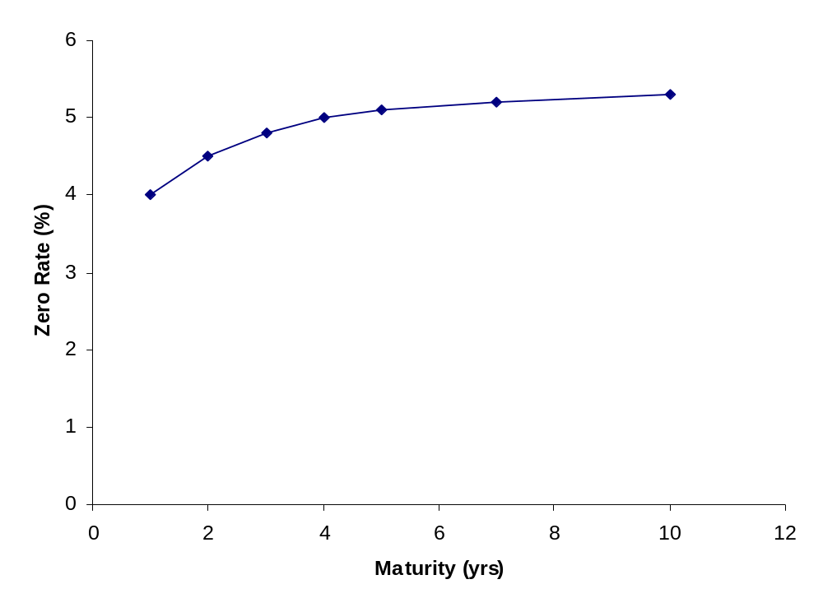
Starting Zero Curve (Figure 4.3, page 97)

Slide 23
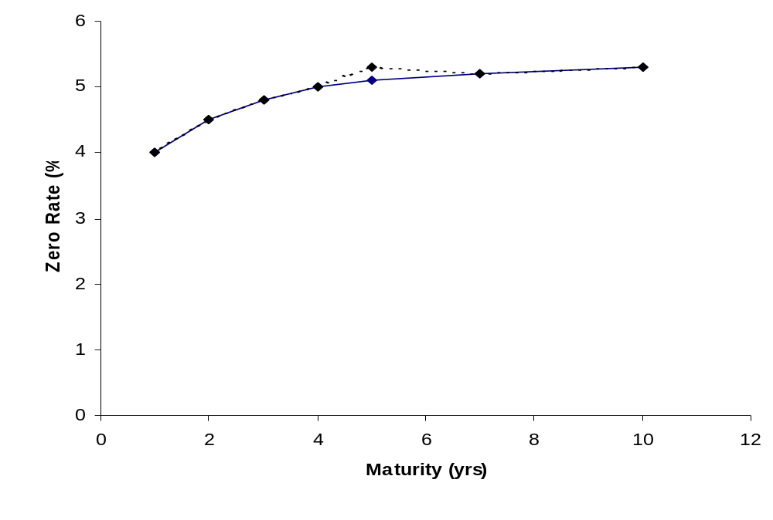
Calculating a Partial Duration
(Figure 4.4, page 97)

Slide 24
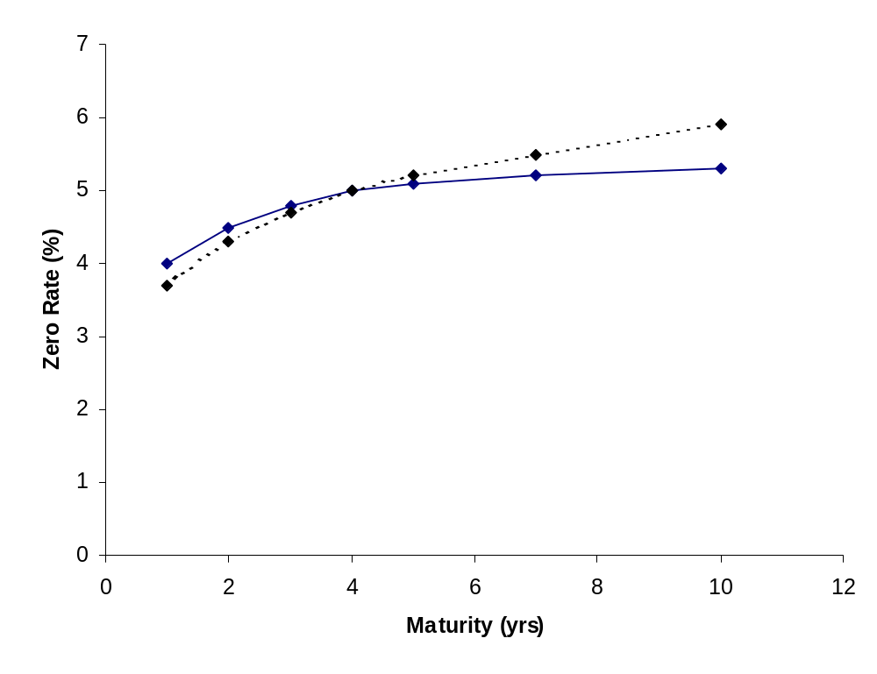
Combining Partial Durations to Create Rotation in the Yield Curve
(Figure 4.5, page 98)

Slide 25
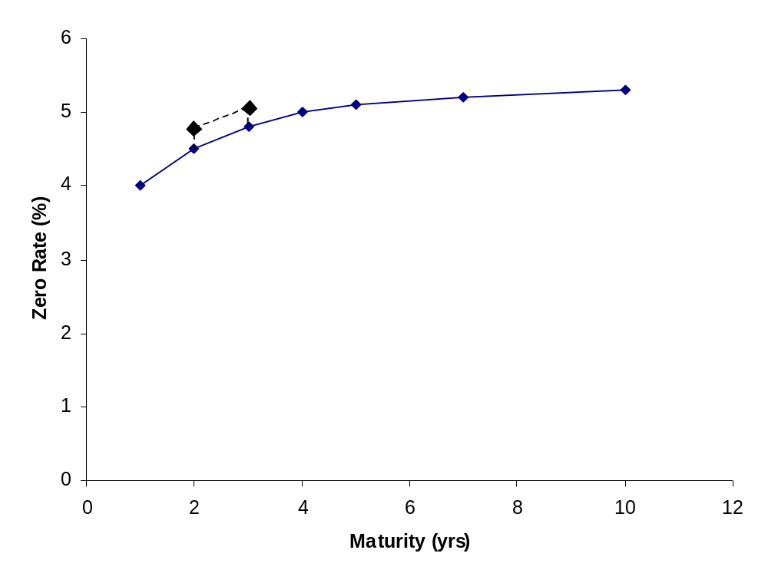
Change When One Bucket Is Shifted (Figure 4.6, page 99)

Slide 26
Principal Components Analysis
Attempts to identify standard shifts (or factors) for the yield curve so that most of the movements that are observed in practice are combinations of the standard shifts

Slide 27
Results (Tables 4.9 and 4.10 on page 101)
The first factor is a roughly parallel shift (83.1% of variation explained)
The second factor is a twist (10% of variation explained)
The third factor is a bowing (2.8% of variation explained)

Slide 28
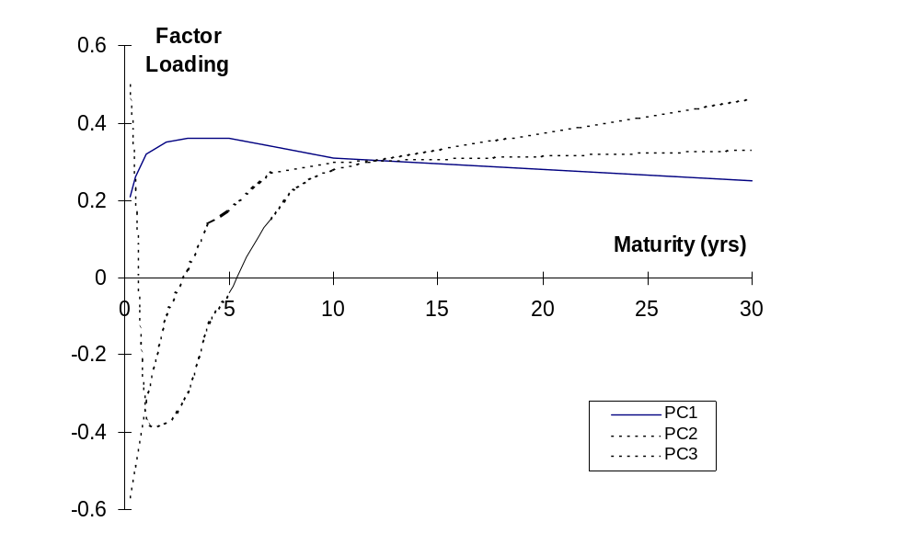
Results (continued) Figure 4.7 page 103

Slide 29
Alternatives for Calculating Multiple Deltas to Reflect Non-Parallel Shifts in Yield Curve
Shift individual points on the yield curve by one basis point
Shift segments of the yield curve by one basis point
Shift quotes on instruments used to calculate the yield curve
Calculate deltas with respect to the shifts given by a principal components analysis.

Slide 30
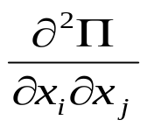
Gamma for Interest Rates
Gamma has the form
where x_{i} and x_{j} are yield curve shifts considered for delta
To avoid too many numbers being produced one possibility is consider only i = j
Another is to consider only parallel shifts in the yield curve
Another is to consider the first two or three types of shift given by a principal components analysis

Slide 31
Vega for Interest Rates
One possibility is to make the same change to all interest rate implied volatilities. (However implied volatilities for long-dated options change by less than those for short-dated options.)
Another is to do a principal components analysis on implied volatility changes

