Slide 1
Volatility
Chapter 5

Slide 2
Background
The volatility of a variable is the standard deviation of its return with the return being expressed with continuous compounding
The variance rate is the square of volatility
Implied volatilities are the volatilities implied from option prices
Normally days when markets are closed are ignored in volatility calculations (252 days per year; see Business Snapshot 5.1, page113)

Slide 3
Implied Volatilities
Of the variables needed to price an option the one that cannot be observed directly is
volatility
We can therefore imply a volatilities from market prices and vice versa

Slide 4
Are Daily Changes in Exchange Rates Normally Distributed? Table 5.2, page 118
 | Real World (%) | Normal Model (%)
>1 SD | 25.04 | 31.73
>2SD | 5.27 | 4.55
>3SD | 1.34 | 0.27
>4SD | 0.29 | 0.01
>5SD | 0.08 | 0.00
>6SD | 0.03 | 0.00

Slide 5
Alternatives to Normal Distributions: The Power Law (See page 120)
Prob(v > x) = Kx^{-α}
This seems to fit the behavior of the returns on many market variables better than the normal distribution

Slide 6
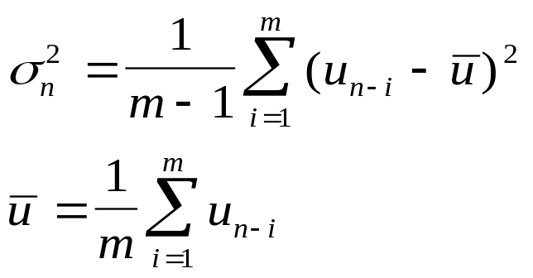
Standard Approach to
Estimating Volatility
Define σ_{n} as the volatility per day between day n-1 and day n, as estimated at end of day n-1
Define S_{i} as the value of market variable at end of day i
Define u_{i}= ln(S_{i}/S_{i-1})

Slide 7
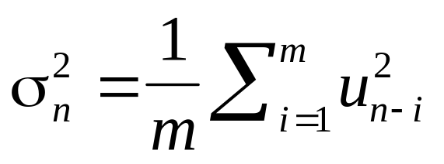
Simplifications Usually Made in
Risk Management
Define u_{i} as (S_{i}-S_{i-1})/S_{i-1}
Assume that the mean value of u_{i} is zero
Replace m-1 by m
This gives

Slide 8
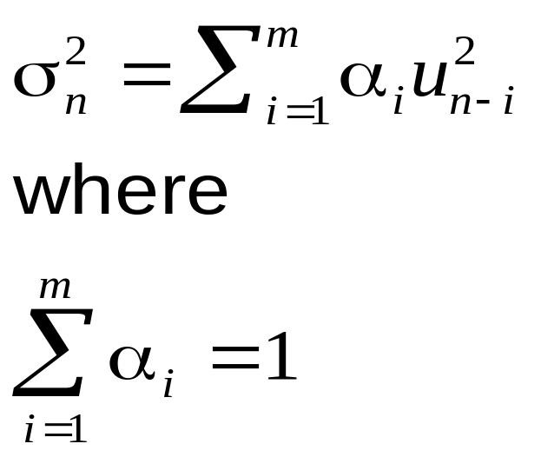
Weighting Scheme
Instead of assigning equal weights to the observations we can set

Slide 9
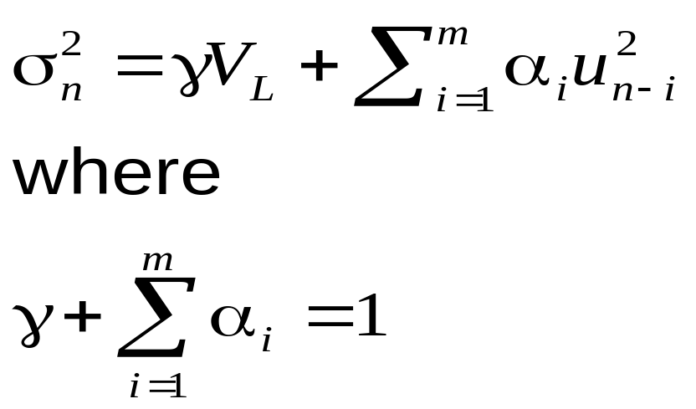
ARCH(m) Model
In an ARCH(m) model we also assign some weight to the long-run variance rate, V_{L}:

Slide 10
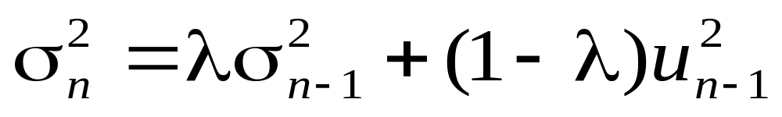
EWMA Model (page 123)
In an exponentially weighted moving average model, the weights assigned to the u² decline exponentially as we move back through time
This leads to

Slide 11
Attractions of EWMA
Relatively little data needs to be stored
We need only remember the current estimate of the variance rate and the most recent observation on the market variable
Tracks volatility changes
RiskMetrics uses λ = 0.94 for daily volatility forecasting

Slide 12
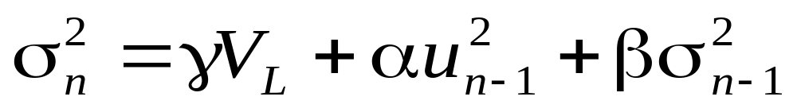
GARCH (1,1), page 125
In GARCH (1,1) we assign some weight to the long-run average variance rate
Since weights must sum to 1
γ + α + β =1

Slide 13
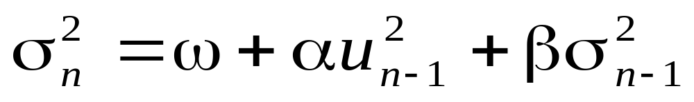
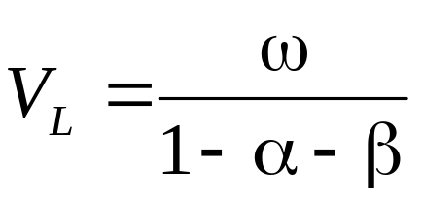
GARCH (1,1) continued
Setting ω = γV the GARCH (1,1) model is
and

Slide 14
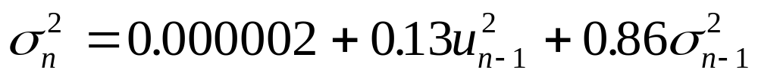
Example
Suppose
The long-run variance rate is 0.0002 so that the long-run volatility per day is 1.4%

Slide 15
Example continued
Suppose that the current estimate of the volatility is 1.6% per day and the most recent percentage change in the market variable is 1%.
The new variance rate is
The new volatility is 1.53% per day

Slide 16
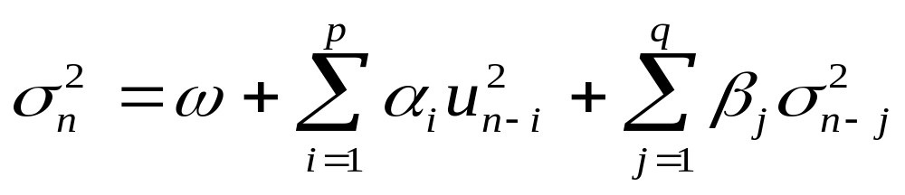
GARCH (p,q)

Slide 17
Other Models
We can design GARCH models so that the weight given to u_{i}² depends on whether u_{i} is positive or negative
We do not have to assume that the conditional distribution is normal

Slide 18
Variance Targeting
One way of implementing GARCH(1,1) that increases stability is by using variance targeting
We set the long-run average volatility equal to the sample variance
Only two other parameters then have to be estimated

Slide 19
Maximum Likelihood Methods
In maximum likelihood methods we choose parameters that maximize the likelihood of the observations occurring

Slide 20
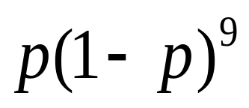
Example 1 (page 127)
We observe that a certain event happens one time in ten trials. What is our estimate of the proportion of the time, p, that it happens?
The probability of the outcome is
We maximize this to obtain a maximum likelihood estimate: p=0.1

Slide 21
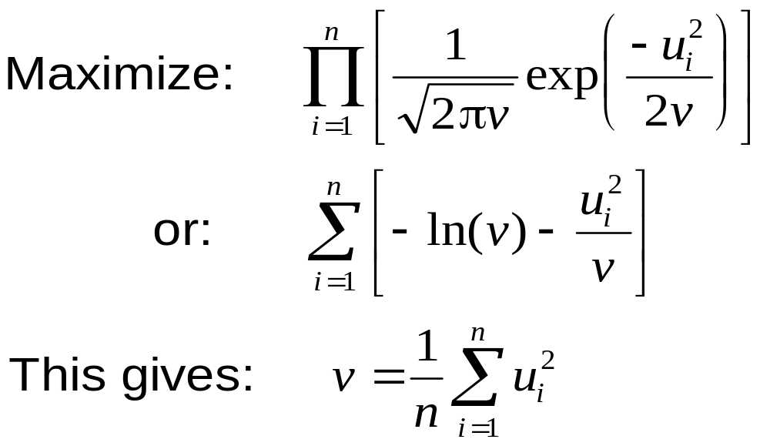
Example 2 (page 127-8)
Estimate the variance of observations from a normal distribution with mean zero

Slide 22
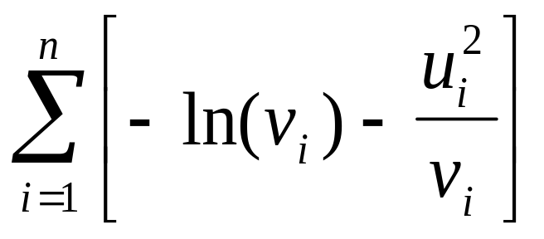
Application to GARCH (1,1)
We choose parameters that maximize

Slide 23
How Good is the Model?
The Ljung-Box statistic tests for autocorrelation
We compare the autocorrelation of the
u_{i}² with the autocorrelation of the u_{i}²/σ_{i}²

Slide 24
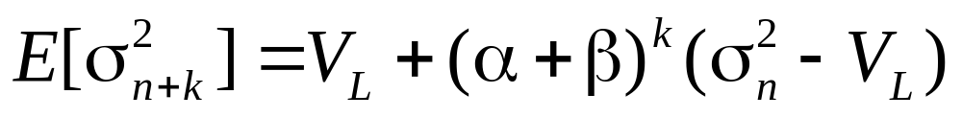
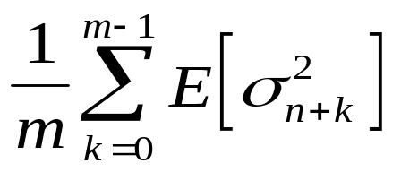
Forecasting Future Volatility
(Equation 5.14, page 134)
A few lines of algebra shows that
The variance rate per day for an option expiring on day m is

Slide 25
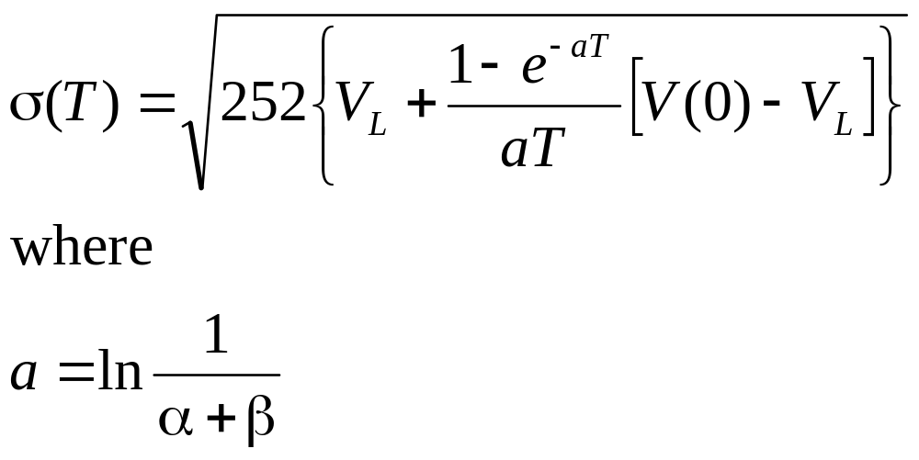
Forecasting Future Volatility continued (Equation 5.15, page 135)
The volatility per year for an option lasting T days is

Slide 26
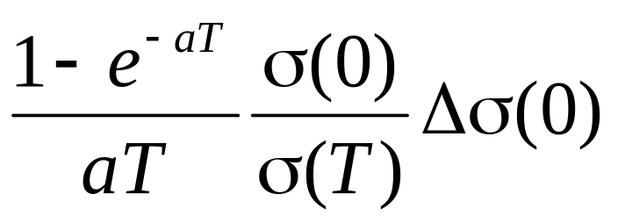
Volatility Term Structures
(Equation 5.16, page 136)
The GARCH (1,1) model allows us to predict volatility term structures changes
When σ(0) changes by Δσ(0), GARCH (1,1) predicts that σ(T) changes by

