Slide 1
Correlations and Copulas
Chapter 6

Slide 2
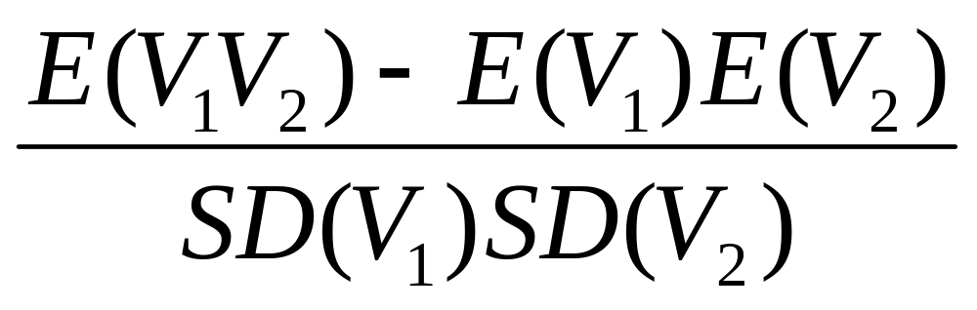
Coefficient of Correlation
The coefficient of correlation between two variables V₁ and V₂ is defined as

Slide 3
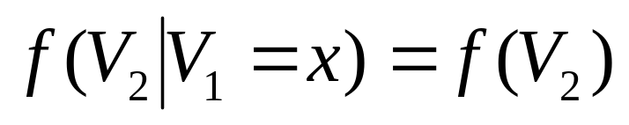
Independence
V₁ and V₂ are independent if the knowledge of one does not affect the probability distribution for the other
where f(.) denotes the probability density function

Slide 4
Independence is Not the Same as Zero Correlation
Suppose V₁ = –1, 0, or +1 (equally likely)
If V₁ = -1 or V₁ = +1 then V₂ = 1
If V₁ = 0 then V₂ = 0
V₂ is clearly dependent on V₁ (and vice versa) but the coefficient of correlation is zero

Slide 5
Types of Dependence
E(Y)
E(Y)
X
X
(a)
(b)
E(Y)
X
(c)

Slide 6
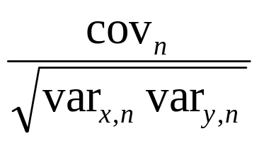
Monitoring Correlation Between Two Variables X and Y
Define x_{i}=(X_{i}-X_{i-1})/X_{i-1} and y_{i}=(Y_{i}-Y_{i-1})/Y_{i-1}
Also
var_{x,n}: daily variance of X calculated on day n-1
var_{y,n}: daily variance of Y calculated on day n-1
cov_{n}: covariance calculated on day n-1
The correlation is

Slide 7

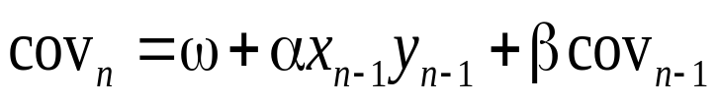
Monitoring Correlation continued
EWMA:
GARCH(1,1)

Slide 8
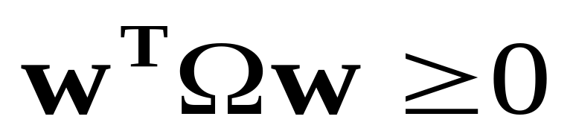
Positive Finite Definite Condition
A variance-covariance matrix, Ω, is internally consistent if the positive semi-definite condition
holds for all vectors w

Slide 9
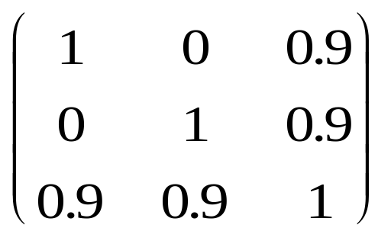
Example
The variance covariance matrix
is not internally consistent

Slide 10
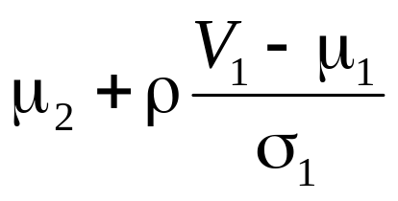
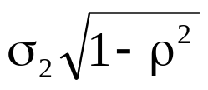
V₁ and V₂ Bivariate Normal
Conditional on the value of V₁, V₂ is normal with mean
and standard deviation where μ_{1,}, μ₂, σ₁, and σ₂ are the unconditional means and SDs of V₁ and V₂ and ρ is the coefficient of correlation between V₁ and V₂

Slide 11
Multivariate Normal
Many variables can be handled
A variance-covariance matrix defines the variances of and correlations between variables
To be internally consistent a variance-covariance matrix must be positive semidefinite

Slide 12
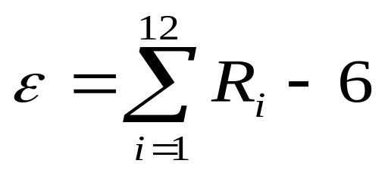
Generating Random Samples for Monte Carlo Simulation
An approximate sample from a standard normal distribution is
where the R_{i} are random numbers between 0 and 1
For a multivariate normal distribution a method known as Cholesky’s decomposition can be used to generate random samples

Slide 13
Factor Models
When there are N variables, V_{i} (i=1,2,..N), in a multivariate normal distribution there are N(N-1)/2 correlations
We can reduce the number of correlation parameters that have to be estimated with a factor model

Slide 14
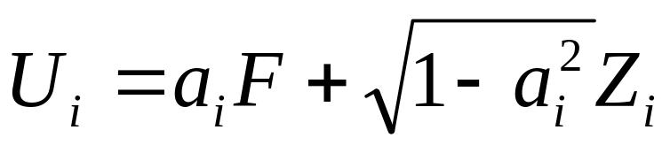
Factor Models continued
If U_{i} have standard normal distributions we can set
where the common factor F and the idiosyncratic component Z_{i} have independent standard normal distributions
In a multifactor model this becomes

Slide 15
Gaussian Copula Models:
Creating a correlation structure for variables that are not normally distributed
Suppose we wish to define a correlation structure between two variable V₁ and V₂ that do not have normal distributions
We transform the variable V₁ to a new variable U₁ that has a standard normal distribution on a “percentile-to-percentile” basis.
We transform the variable V₂ to a new variable U₂ that has a standard normal distribution on a “percentile-to-percentile” basis.
U₁ and U₂ are assumed to have a bivariate normal distribution

Slide 16
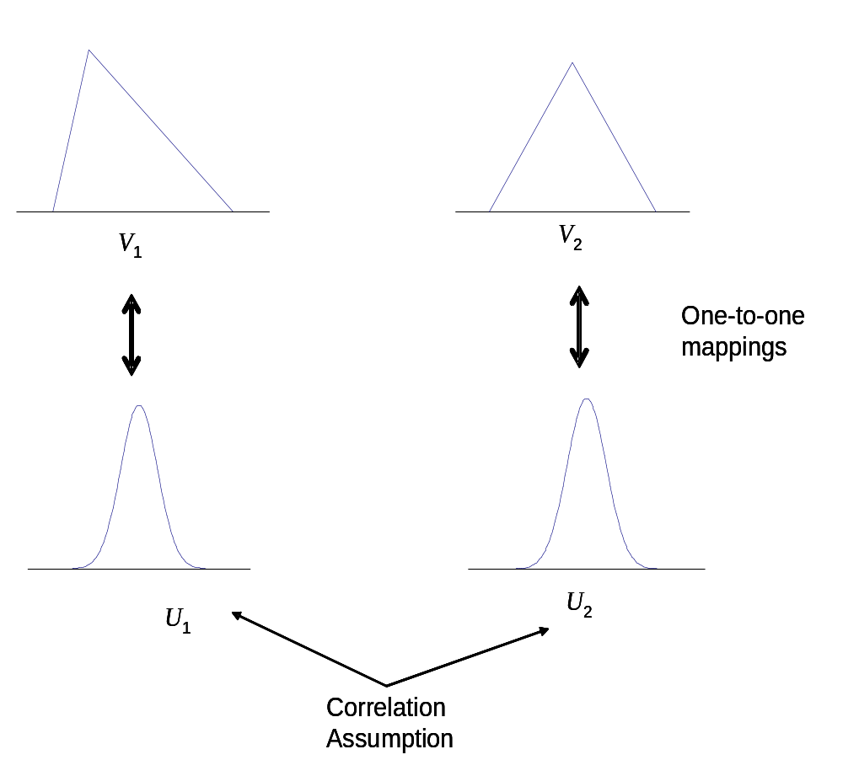
The Correlation structure between the V’s is define by that between the U’s

Slide 17
Other Copulas
Instead of a bivariate normal distribution for U₁ and U₂ we can assume any other joint distribution
One possibility is the bivariate Student t distribution

Slide 18
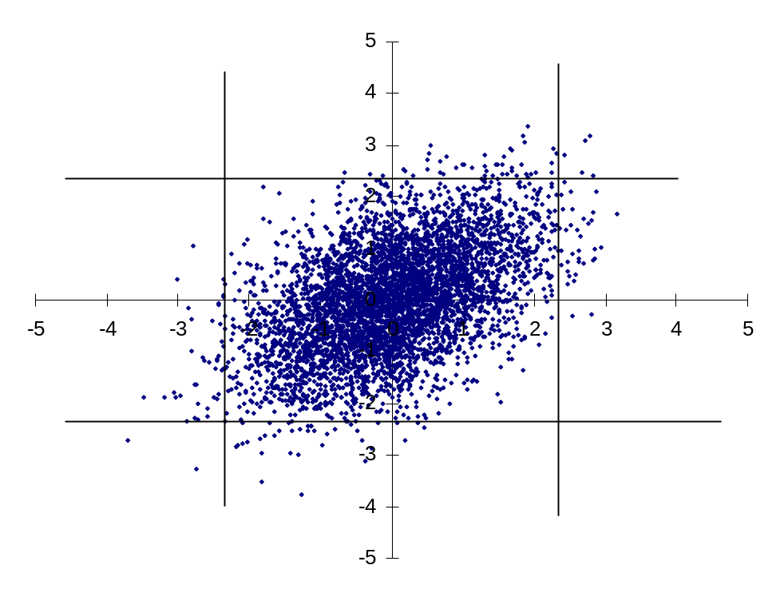
5000 Random Samples from the Bivariate Normal

Slide 19
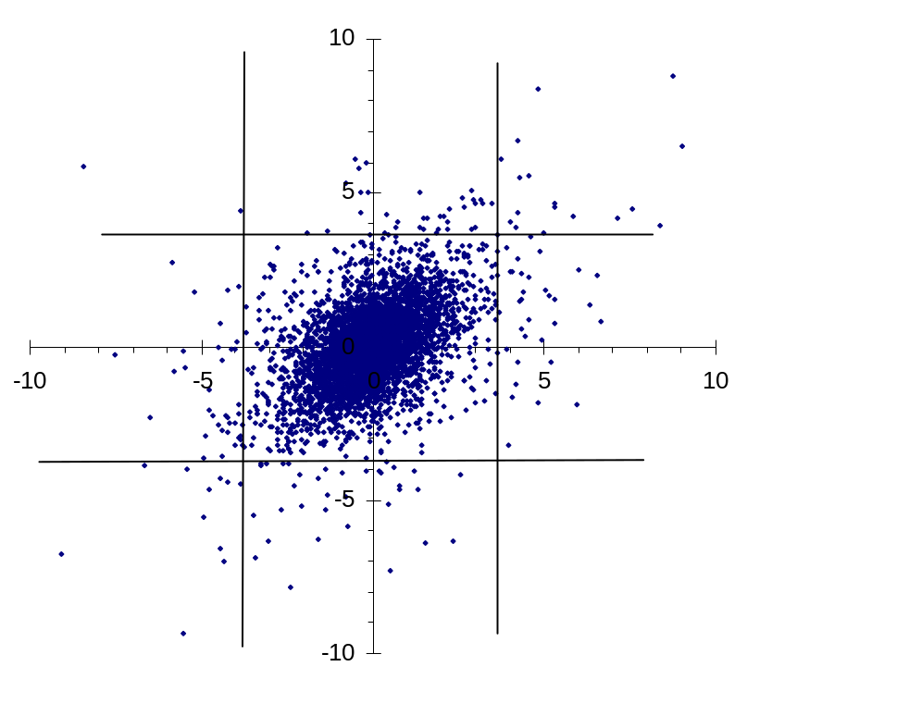
5000 Random Samples from the Bivariate Student t

Slide 20
Multivariate Gaussian Copula
We can similarly define a correlation structure between V₁, V₂,…V_{n}
We transform each variable V_{i} to a new variable U_{i} that has a standard normal distribution on a “percentile-to-percentile” basis.
The U’s are assumed to have a multivariate normal distribution

Slide 21
Factor Copula Model
In a factor copula model the correlation structure between the U’s is generated by assuming one or more factors.

Slide 22
Credit Default Correlation
The credit default correlation between two companies is a measure of their tendency to default at about the same time
Default correlation is important in risk management when analyzing the benefits of credit risk diversification
It is also important in the valuation of some credit derivatives

Slide 23

The Model
We map the time to default for company i, T_{i}, to a new variable U_{i} and assume
where F and the Z_{i} have independent standard normal distributions
Define Q_{i} as the cumulative probability distribution of T_{i}
Prob(U_{i}<U) = Prob(T_{i}<T) when N(U) = Q_{i}(T)

Slide 24
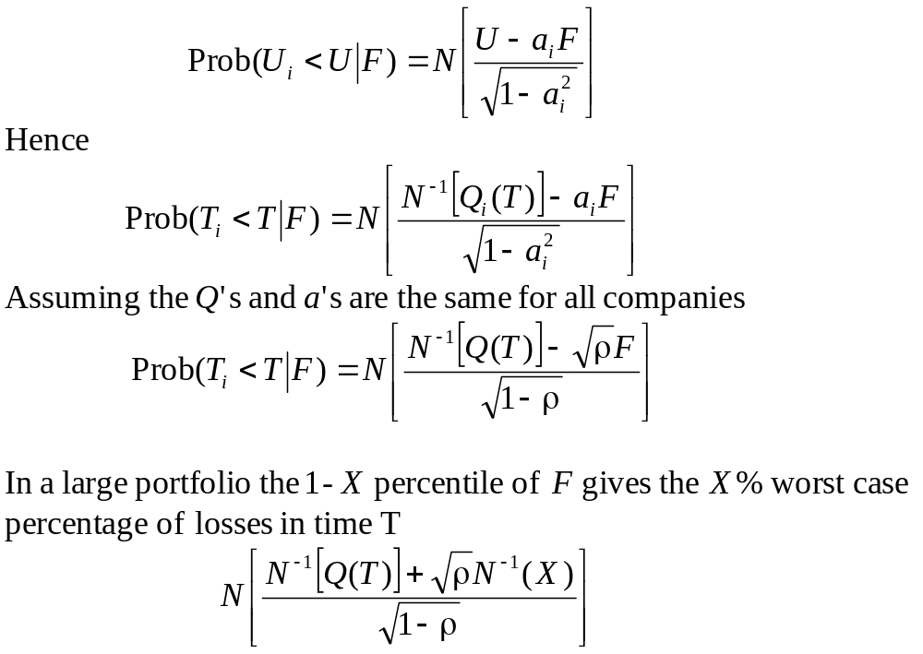
The Model continued

