Slide 1
Bank Regulation and Basel II
Chapter 7

Slide 2
History of Bank Regulation
Pre-1988
1988: BIS Accord (Basel I)
1996: Amendment to BIS Accord
1999: Basel II first proposed

Slide 3
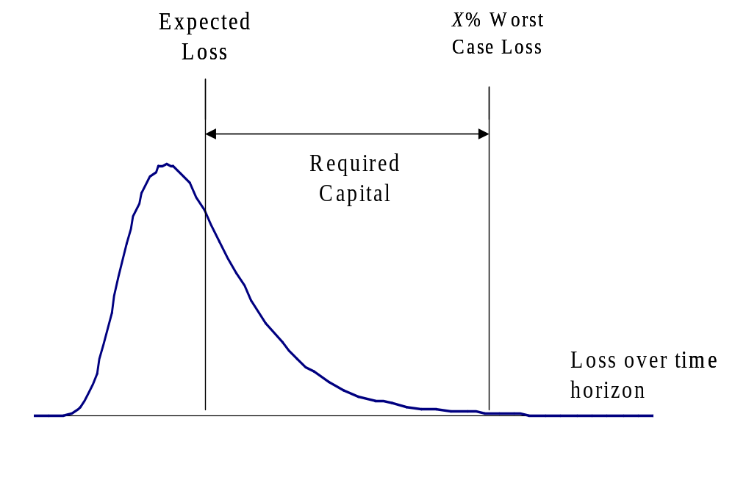
The Model used by Regulators (Figure 7.1, page 166)

Slide 4
Pre-1988
Banks were regulated using balance sheet measures such as capital:assets
Definitions and required ratios varied from country to country
Enforcement of regulations varied from country to country
Bank leverage increased in 1980s
Off-balance sheet derivatives trading increased
Third world debt was a major problem
Basel Committee on Bank Supervision set up

Slide 5
1988: BIS Accord (page 169)
Assets:Capital must be less than 20. Assets includes off-balance sheet items that are direct credit substitutes such as letters of credit and guarantees
Cooke Ratio: Capital must be 8% of risk weighted amount. At least 50% of capital must be Tier 1.

Slide 6
Types of Capital (page 172)
Tier 1 Capital: common equity, non-cumulative perpetual preferred shares, minority interests in consolidated subsidiaries less goodwill
Tier 2 Capital: cumulative preferred stock, certain types of 99-year debentures, subordinated debt with an original life of more than 5 years

Slide 7
Risk-Weighted Capital
A risk weight is applied to each on-balance- sheet asset according to its risk (e.g. 0% to cash and govt bonds; 20% to claims on OECD banks; 50% to residential mortgages; 100% to corporate loans, corporate bonds, etc.)
For each off-balance-sheet item we first calculate a credit equivalent amount and then apply a risk weight
Risk weighted amount (RWA) consists of
  sum of risk weight times asset amount for on-balance sheet items
  Sum of risk weight times credit equivalent amount for off-balance sheet items

Slide 8
Credit Equivalent Amount
The credit equivalent amount is calculated as the current replacement cost (if positive) plus an add on factor
The add on amount varies from instrument to instrument (e.g. 0.5% for a 1-5 year swap; 5.0% for a 1-5 year foreign currency swap)

Slide 9
Add-on Factors (% of Principal) Table 7.2, page171
Remaining Maturity (yrs) | Interest rate | Exch Rate and Gold | Equity | Precious Metals except gold | Other Commodities
<1 | 0.0 | 1.0 | 6.0 | 7.0 | 10.0
1 to 5 | 0.5 | 5.0 | 8.0 | 7.0 | 12.0
>5 | 1.5 | 7.5 | 10.0 | 6.0 | 15.0
Example: A $100 million swap with 3 years to maturity worth $5 million would have a credit equivalent amount of $5.5 million

Slide 10
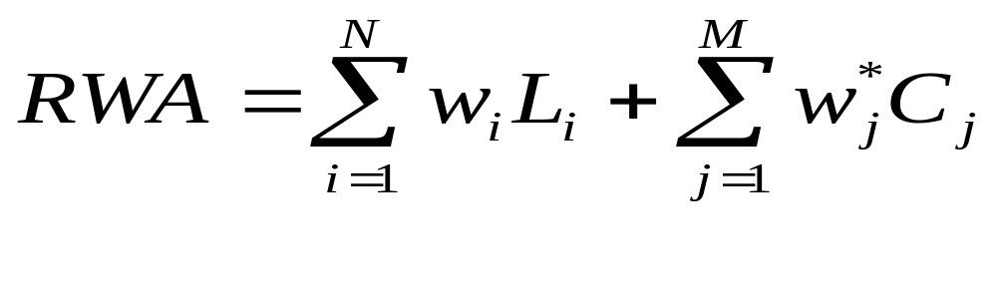
The Math
On-balance sheet items: principal times risk weight
Off-balance sheet items: credit equivalent amount times risk weight
For a derivative C_{j} = max(V_{j},0)+a_{j}L_{j} where V_{j} is value, L_{j} is principal and a_{j} is add-on factor

Slide 11
G-30 Policy Recommendations
(page 172-3)
Influential publication from derivatives dealers, end users, academics, accountants, and lawyers
20 recommendations published in 1993

Slide 12
Netting (page 174-5)
Netting refers to a clause in derivatives contracts that states that if a company defaults on one contract it must default on all contracts
In 1995 the 1988 accord was modified to allow banks to reduce their credit equivalent totals when bilateral netting agreements were in place

Slide 13


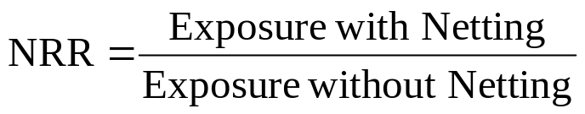
Netting Calculations
Without netting exposure is
With netting exposure is

Slide 14


Netting Calculations continued
Credit equivalent amount modified from
To

Slide 15
1996 Amendment (page 176)
Implemented in 1998
Requires banks to measure and hold capital for market risk for all instruments in the trading book including those off balance sheet (This is in addition to the BIS Accord credit risk capital)

Slide 16

The Market Risk Capital
The capital requirement is
Where k is a multiplicative factor chosen by regulators (at least 3), VaR is the 99% 10-day value at risk, and SRC is the specific risk charge (primarily for debt securities held in trading book)

Slide 17
Basel II
Expected to be implemented in 2007
Three pillars
  New minimum capital requirements for credit and operational risk
  Supervisory review: more thorough and uniform
  Market discipline: more disclosure

Slide 18
New Capital Requirements
Risk weights will be based on on either external credit rating (standardized approach) or a bank’s own internal credit ratings (IRB approach)
Recognition of credit risk mitigants
Separate capital charge for operational risk

Slide 19
USA vs European Implementation
In US Basel II will apply only to large international banks
Small regional banks required to implement “Basel 1A’’ (similar to Basel I), rather than Basel II
European Union requires Basel II to be implemented by securities companies as well as banks

Slide 20
New Capital Requirements
Standardized Approach, Table 7.4, page 180
Banks counterparties are treated similarly to corporations. Under Basel I corporations are assumed to be substantially less creditworthy
Rating | AAA to AA- | A+ to A- | BBB+ to BBB- | BB+ to BB- | B+ to B- | Below B- | Unrated
Country | 0% | 20% | 50% | 100% | 100% | 150% | 100%
Banks | 20% | 50% | 50% | 100% | 100% | 150% | 50%
Corporates | 20% | 50% | 50% | 100% | 150% | 150% | 100%

Slide 21
New Capital Requirements
IRB Approach for corporate, banks and sovereign exposures
Basel II provides a formula for translating PD (probability of default), LGD (loss given default), EAD (exposure at default), and M (effective maturity) into a risk weight
Under the Advanced IRB approach banks estimate PD, LGD, EAD, and M
Under the Foundation IRB approach banks estimate only PD and the Basel II guidelines determine the other variables for the formula

Slide 22
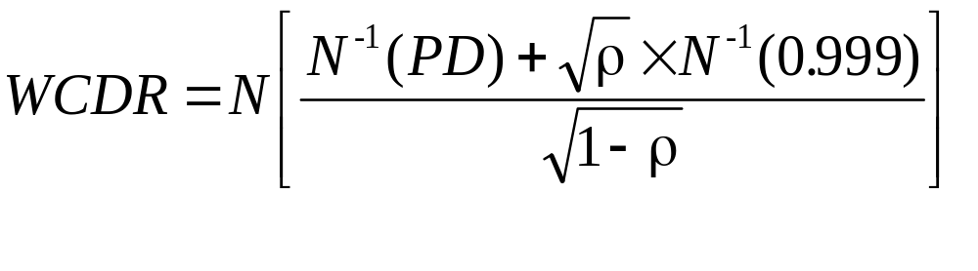
Key Model (Gaussian Copula)
The 99.9% worst case default rate is

Slide 23
Numerical Results for WCDR
Table 7.5, page 183
 | PD=0.1% | PD=0.5% | PD=1% | PD=1.5% | PD=2%
ρ=0.0 | 0.1% | 0.5% | 1.0% | 1.5% | 2.0%
ρ=0.2 | 2.8% | 9.1% | 14.6% | 18.9% | 22.6%
ρ=0.4 | 7.1% | 21.1% | 31.6% | 39.0% | 44.9%
ρ=0.6 | 13.5% | 38.7% | 54.2% | 63.8% | 70.5%
ρ=0.8 | 23.3% | 66.3% | 83.6% | 90.8% | 94.4%

Slide 24
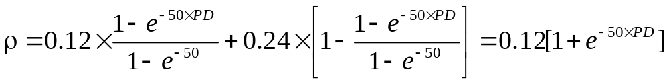
Dependence of ρ on PD
For corporate, sovereign and bank exposure
  (For small firms ρ is reduced)
PD | 0.1% | 0.5% | 1.0% | 1.5% | 2.0%
WCDR | 3.4% | 9.8% | 14.0% | 16.9% | 19.0%

Slide 25
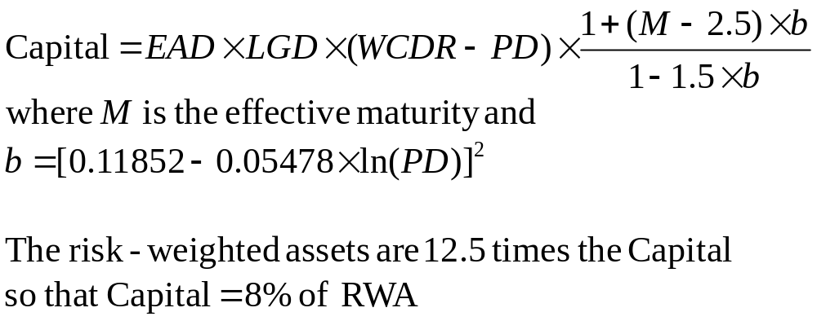
Capital Requirements

Slide 26
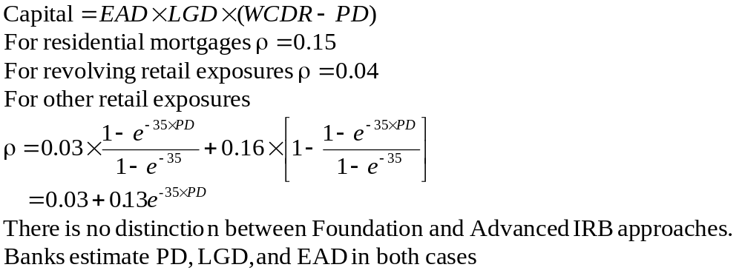
Retail Exposures

Slide 27
Credit Risk Mitigants
Credit risk mitigants (CRMs) include collateral, guarantees, netting, the use of credit derivatives, etc
The benefits of CRMs increase as a bank moves from the standardized approach to the foundation IRB approach to the advanced IRB approach

Slide 28
Adjustments for Collateral
Two approaches
  Simple approach: risk weight of counterparty replaced by risk weight of collateral
  Comprehensive approach: exposure adjusted upwards to allow to possible increases; value of collateral adjusted downward to allow for possible decreases; new exposure equals excess of adjusted exposure over adjusted collateral; counterparty risk weight applied to the new exposure

Slide 29
Guarantees
Traditionally the Basel Committee has used the credit substitution approach (where the credit rating of the guarantor is substituted for that of the borrower)
However this overstates the credit risk because both the guarantor and the borrower must default for money to be lost
Alternative proposed by Basel Committee: capital equals the capital required without the guarantee multiplied by 0.15+160×PD_{g} where PD_{g} is probability of default of guarantor

Slide 30
Operational Risk Capital
Basic Indicator Approach: 15% of gross income
Standardized Approach: different multiplicative factor for gross income arising from each business line
Internal Measurement Approach: assess 99.9% worst case loss over one year.

Slide 31
Supervisory Review Changes
(page 189-90)
Similar amount of thoroughness in different countries
Local regulators can adjust parameters to suit local conditions
Importance of early intervention stressed

Slide 32
Market Discipline (page 190-91)
Banks will be required to disclose
  Scope and application of Basel framework
  Nature and components of capital
  Nature of institution’s risk exposures
  Capital adequacy: both regulatory and economic

