Slide 1
The VaR Measure
Chapter 8

Slide 2
The Question Being Asked in VaR
“What loss level is such that we are X% confident it will not be exceeded in N business days?”

Slide 3
VaR and Regulatory Capital
Regulators base the capital they require banks to keep on VaR
The market-risk capital is k times the 10-day 99% VaR where k is at least 3.0
Under Basel II capital for credit risk and operational risk is based on a one-year 99.9% VaR

Slide 4
Advantages of VaR
It captures an important aspect of risk
in a single number
It is easy to understand
It asks the simple question: “How bad can things get?”

Slide 5
VaR vs. Expected Shortfall
VaR is the loss level that will not be exceeded with a specified probability
Expected shortfall is the expected loss given that the loss is greater than the VaR level (also called C-VaR and Tail Loss)
Two portfolios with the same VaR can have very different expected shortfalls

Slide 6
Distributions with the Same VaR but Different Expected Shortfalls
(Figures 8.1 and 8.2, page197-8)
VaR
VaR

Slide 7
Coherent Risk Measures (page 199)
Define a coherent risk measure as the amount of cash that has to be added to a portfolio to make its risk acceptable
Properties of coherent risk measure
  If one portfolio always produces a worse outcome than another its risk measure should be greater
  If we add an amount of cash K to a portfolio its risk measure should go down by K
  Changing the size of a portfolio by λ should result in the risk measure being multiplied by λ
  The risk measures for two portfolios after they have been merged should be no greater than the sum of their risk measures before they were merged

Slide 8
VaR vs Expected Shortfall
VaR satisfies the first three conditions but not the fourth one
Expected shortfall satisfies all four conditions.
Example 8.1 : Two $10 million one-year loans each of which has a 1.25% chance of defaulting. All recoveries between 0 and 100% are equally likely. If there is no default the loan leads to a profit of $0.2 million. If one loan defaults it is certain that the other one will not default.

Slide 9
Spectral Risk Measures
A spectral risk measure assigns weights to quantiles of the loss distribution
VaR assigns all weight to Xth quantile of the loss distribution
Expected shortfall assigns equal weight to all quantiles greater than the Xth quantile
For a coherent risk measure weights must be a non-decreasing function of the quantiles

Slide 10

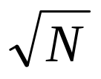
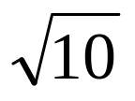
Normal Distribution Assumption
The simplest assumption is that daily gains/losses are normally distributed and independent
It is then easy to calculate VaR from the standard deviation (1-day VaR=2.33σ)
The N-day VaR equals times the one-day VaR
Regulators allow banks to calculate the 10 day VaR as times the one-day VaR

Slide 11
Independence Assumption in VaR Calculations (Equation 8.3, page 204)
When daily changes in a portfolio are identically distributed and independent the variance over N days is N times the variance over one day
When there is autocorrelation equal to ρ the multiplier is increased from N to

Slide 12
Impact of Autocorrelation: Ratio of N-day VaR to 1-day VaR (Table 8.1, page 204)
 | N=1 | N=2 | N=5 | N=10 | N=50 | N=250
ρ=0 | 1.0 | 1.41 | 2.24 | 3.16 | 7.07 | 15.81
ρ=0.05 | 1.0 | 1.45 | 2.33 | 3.31 | 7.43 | 16.62
ρ=0.1 | 1.0 | 1.48 | 2.42 | 3.46 | 7.80 | 17.47
ρ=0.2 | 1.0 | 1.55 | 2.62 | 3.79 | 8.62 | 19.35

Slide 13
Choice of VaR Parameters
Time horizon should depend on how quickly portfolio can be unwound. Regulators in effect use 1-day for bank market risk and 1-year for credit/operational risk. Fund managers often use one month
Confidence level depends on objectives. Regulators use 99% for market risk and 99.9% for credit/operational risk. A bank wanting to maintain a AA credit rating will often use 99.97% for internal calculations. (VaR for high confidence level cannot be observed directly from data and must be inferred in some way.)

Slide 14
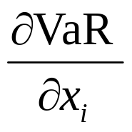
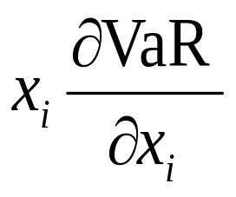
VaR Measures for a Portfolio where an amount x_{i} is invested in the ith component of the portfolio (page 206-7)
Marginal VaR:
Incremental VaR: Incremental effect of ith component on VaR
Component VaR

Slide 15
Properties of Component VaR
The component VaR is approximately the same as the incremental VaR
The total VaR is the sum of the component VaR (Euler’s theorem)
The component VaR therefore provides a sensible way of allocating VaR to different activities

Slide 16
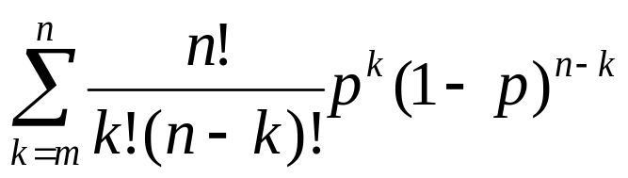
Backtesting (page 208)
Backtesting a VaR calculation methodology involves looking at how often exceptions (loss>VaR) occur
Alternatives: a) compare VaR with actual change in portfolio value and b) compare VaR with change in portfolio value assuming no change in portfolio composition
Suppose that the theoretical probability of an exception is p (=1-X). The probability of m or more exceptions in n days is

Slide 17
Basel Committee Rules for Market Risk VaR (page 210)
If number of exceptions in previous 250 days is less than 5 the regulatory multiplier, k, is set at 3
If number of exceptions is 5, 6, 7, 8 and 9 supervisors may set k equal to 3.4, 3.5, 3.65, 3.75, and 3.85, respectively
If number of exceptions is 10 or more k is set equal to 4

Slide 18
Bunching
Bunching occurs when exceptions are not evenly spread throughout the backtesting period
Statistical tests for bunching have been developed (See page 211)

Slide 19
Stress Testing (page 212-3)
Considers how portfolio would perform under extreme market moves
Scenarios can be taken from historical data (e.g. assume all market variable move by the same percentage as they did on some day in the past)
Alternatively they can be generated by senior management

