Slide 1
Market Risk VaR: Historical Simulation Approach
Chapter 9

Slide 2
Historical Simulation
(See Table 9.1 and 9.2)
Collect data on the daily movements in all market variables.
The first simulation trial assumes that the percentage changes in all market variables are as on the first day
The second simulation trial assumes that the percentage changes in all market variables are as on the second day
and so on

Slide 3
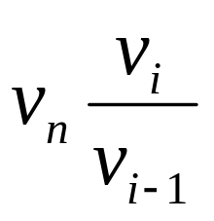
Historical Simulation continued
Suppose we use n days of historical data with today being day n
Let v_{i} be the value of a variable on day i
There are n-1 simulation trials
The ith trial assumes that the value of the market variable tomorrow (i.e., on day n+1) is

Slide 4
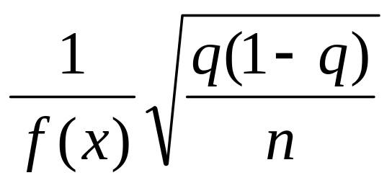
Accuracy (page 220)
Suppose that x is the qth quantile of the loss distribution when it is estimated from n observations. The standard error of x is
where f(x) is an estimate of the probability density of the loss at the qth quantile calculated by assuming a probability distribution for the loss

Slide 5
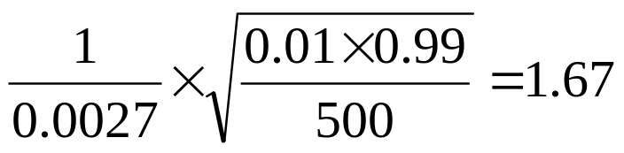
Example 9.1 (page 220)
We estimate the 0.01-quantile from 500 observations as $25 million
We estimate f(x) by approximating the actual empirical distribution with a normal distribution mean zero and standard deviation $10 million
The 0.01 quantile of the approximating distribution is NORMINV(0.01,0,10) = 23.26 and the value of f(x) is NORMDIST(23.26,0,10,FALSE)=0.0027
The estimate of the standard error is therefore

Slide 6
Extension 1
Let weights assigned to observations decline exponentially as we go back in time
Rank observations from worst to best
Starting at worst observation sum weights until the required quantile is reached

Slide 7
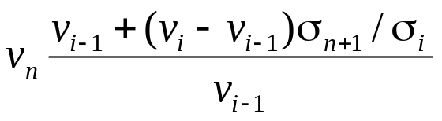
Extension 2
Use a volatility updating scheme and adjust the percentage change observed on day i for a market variable for the differences between volatility on day i and current volatility
Value of market variable under ith scenario becomes

Slide 8
Extension 3
Calculate a 95% confidence interval for VaR by sampling with replacement from daily changes to obtain many different sets of changes over n days
This is known as the bootstrap method

Slide 9
Extreme Value Theory (page 224)
Extreme value theory can be used to investigate the properties of the right tail of the empirical distribution of a variable x. If we interested in the left tail we consider the variable –x.
We first choose a level u somewhat in the right tail of the distribution
We then use Gnedenko’s result which shows that for a wide class of distributions as u increases the probability distribution that x lies between u and u+y conditional that it is greater than u tends to a generalized Pareto distribution

Slide 10

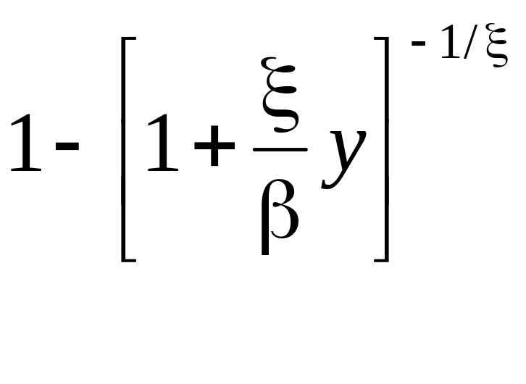
Generalized Pareto Distribution
This has two parameters ξ (the shape parameter) and β (the scale parameter)
The cumulative distribution is

Slide 11
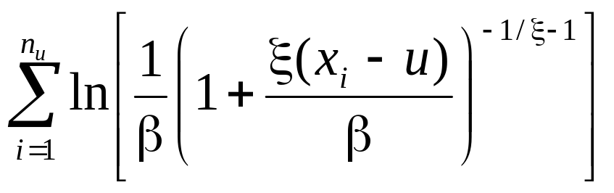
Maximum Likelihood Estimator (Equation 9.4, page 225)
The observations, x_{i}, are sorted in descending order. Suppose that there are n_{u} observations greater than u
We choose ξ and β to maximize

Slide 12
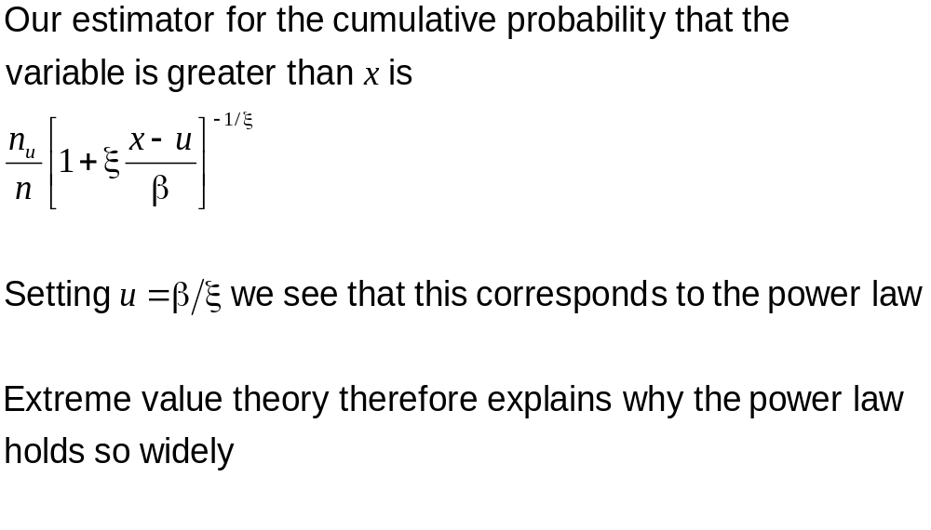
Tail Probabilities and VaR

Slide 13
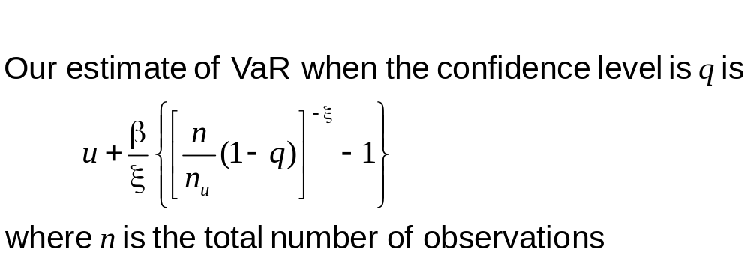
Estimating VaR Using Extreme Value Theory

