Slide 1
Market Risk VaR: Model-Building Approach
Chapter 10

Slide 2
The Model-Building Approach
The main alternative to historical simulation is to make assumptions about the probability distributions of the returns on the market variables and calculate the probability distribution of the change in the value of the portfolio analytically
This is known as the model building approach or the variance-covariance approach

Slide 3
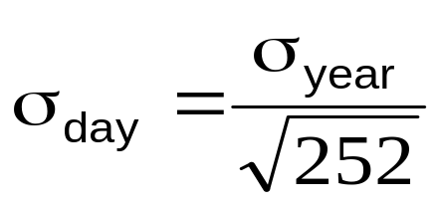
Daily Volatilities (page 234)
In option pricing we express volatility as volatility per year
In VaR calculations we express volatility as volatility per day

Slide 4
Daily Volatility continued
Strictly speaking we should define σ_{day} as the standard deviation of the continuously compounded return in one day
In practice we assume that it is the standard deviation of the percentage change in one day

Slide 5
Microsoft Example (page 234-5)
We have a position worth $10 million in Microsoft shares
The volatility of Microsoft is 2% per day (about 32% per year)
We use N=10 and X=99

Slide 6
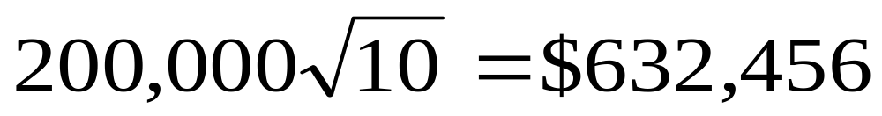
Microsoft Example continued
The standard deviation of the change in the portfolio in 1 day is $200,000
The standard deviation of the change in 10 days is

Slide 7
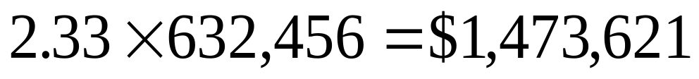
Microsoft Example continued
We assume that the expected change in the value of the portfolio is zero (This is OK for short time periods)
We assume that the change in the value of the portfolio is normally distributed
Since N(–2.33)=0.01, the VaR is

Slide 8
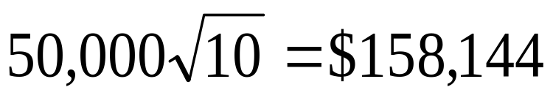
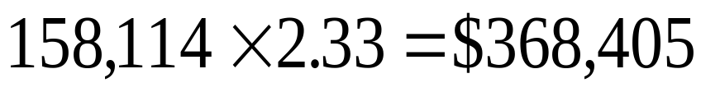
AT&T Example
Consider a position of $5 million in AT&T
The daily volatility of AT&T is 1% (approx 16% per year)
The SD per 10 days is
The VaR is

Slide 9
Portfolio (page 235)
Now consider a portfolio consisting of both Microsoft and AT&T
Suppose that the correlation between the returns is 0.3

Slide 10
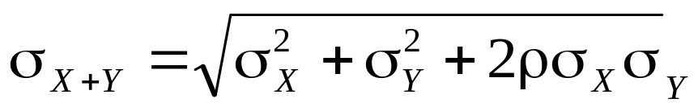
S.D. of Portfolio
A standard result in statistics states that
In this case σ_{X} = 200,000 and σ_{Y} = 50,000 and ρ = 0.3. The standard deviation of the change in the portfolio value in one day is therefore 220,227

Slide 11
VaR for Portfolio
The 10-day 99% VaR for the portfolio is
The benefits of diversification are
(1,473,621+368,405)–1,622,657=$219,369
What is the incremental effect of the AT&T holding on VaR?

Slide 12
The Linear Model
We assume
The daily change in the value of a portfolio is linearly related to the daily returns from market variables
The returns from the market variables are normally distributed

Slide 13
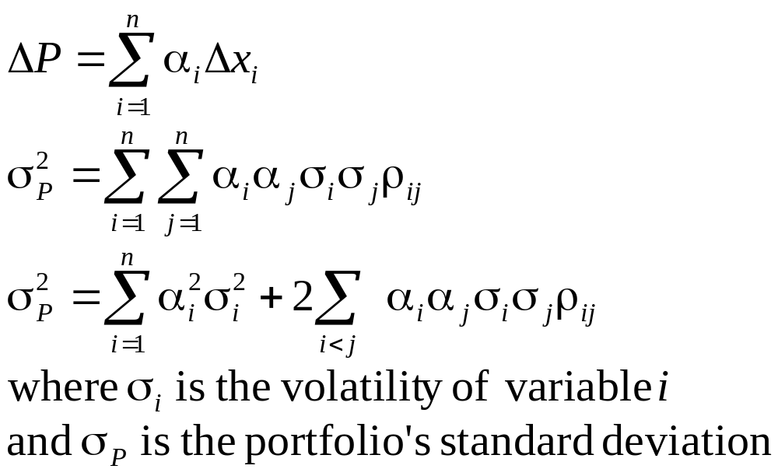
The General Linear Model continued (equations 10.1 and 10.2, page 237)

Slide 14
Alternatives for Handling Interest Rates
Duration approach: Linear relation between ΔP and Δy but assumes parallel shifts)
Cash flow mapping: Variables are zero-coupon bond prices with about 10 different maturities
Principal components analysis: 2 or 3 independent shifts with their own volatilities

Slide 15
Handling Interest Rates: Cash Flow Mapping (page 239)
We choose as market variables zero-coupon bond prices with standard maturities (1mm, 3mm, 6mm, 1yr, 2yr, 5yr, 7yr, 10yr, 30yr)
Suppose that the 5yr rate is 6% and the 7yr rate is 7% and we will receive a cash flow of $10,000 in 6.5 years.
The volatilities per day of the 5yr and 7yr bonds are 0.50% and 0.58% respectively

Slide 16
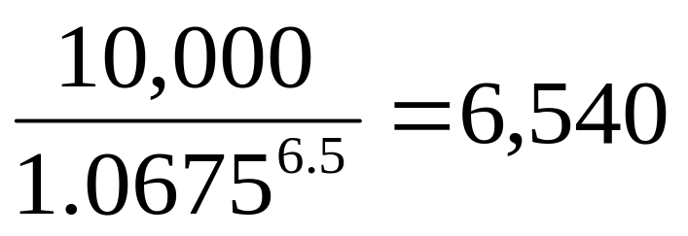
Example continued
We interpolate between the 5yr rate of 6% and the 7yr rate of 7% to get a 6.5yr rate of 6.75%
The PV of the $10,000 cash flow is

Slide 17
Example continued
We interpolate between the 0.5% volatility for the 5yr bond price and the 0.58% volatility for the 7yr bond price to get 0.56% as the volatility for the 6.5yr bond
We allocate α of the PV to the 5yr bond and (1- α) of the PV to the 7yr bond

Slide 18
Example continued
Suppose that the correlation between movement in the 5yr and 7yr bond prices is 0.6
To match variances
This gives α=0.074

Slide 19
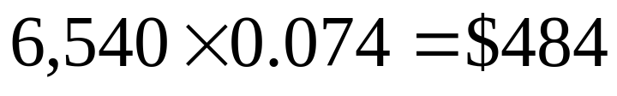
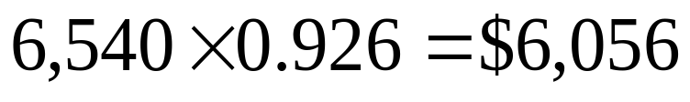
Example continued
The value of 6,540 received in 6.5 years
in 5 years and by
in 7 years.
This cash flow mapping preserves value and variance

Slide 20
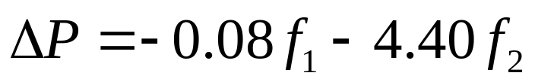
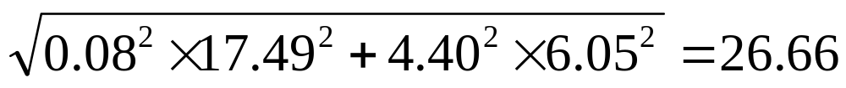
Principal Components Analysis (page 241)
Suppose we calculate
where f₁ is the first factor and f₂ is the second factor
If the SD of the factor scores are 17.49 and 6.05 the SD of ΔP is

Slide 21
When Linear Model Can be Used
Portfolio of stocks
Portfolio of bonds
Forward contract on foreign currency
Interest-rate swap

Slide 22
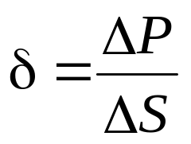
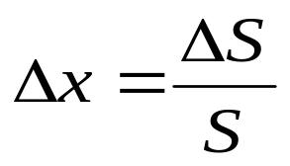
The Linear Model and Options
Consider a portfolio of options dependent on a single stock price, S. Define
and

Slide 23
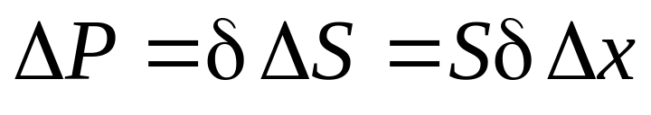
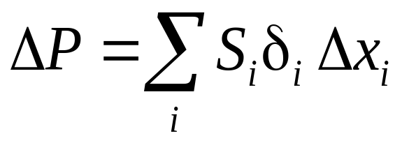
Linear Model and Options continued
As an approximation
Similarly when there are many underlying market variables
where δ_{i} is the delta of the portfolio with respect to the ith asset

Slide 24
Example
Consider an investment in options on Microsoft and AT&T. Suppose the stock prices are 120 and 30 respectively and the deltas of the portfolio with respect to the two stock prices are 1,000 and 20,000 respectively
As an approximation
where Δx₁ and Δx₂ are the percentage changes in the two stock prices

Slide 25
Skewness
(See Figures 10.1, 10.2, and 10.3)
The linear model fails to capture skewness in the probability distribution of the portfolio value.

Slide 26
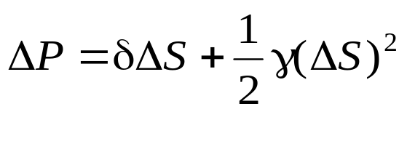
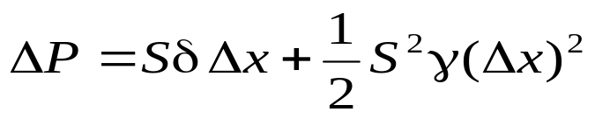
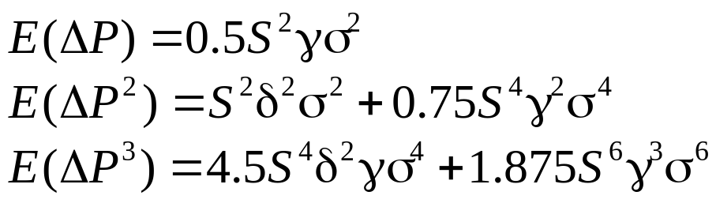
Quadratic Model
(page 246-7)
For a portfolio dependent on a single stock price it is approximately true that
so that
Moments are

Slide 27
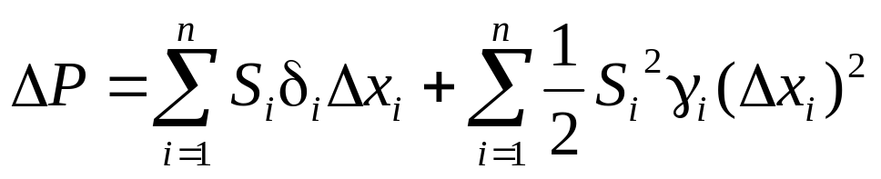
Quadratic Model continued
With many market variables and each instrument dependent on only one
where δ_{i} and γ_{i} are the delta and gamma of the portfolio with respect to the ith variable
Formulas for calculating moments exist but are fairly complicated
What happens when each instrument can be dependent on several market variables?

Slide 28
Cornish Fisher Expansion (page 247)
Cornish Fisher expansion can be used to calculate fractiles of the distribution of ΔP from the moments of the distribution

Slide 29
Monte Carlo Simulation (page 248)
To calculate VaR using MC simulation we
Value portfolio today
Sample once from the multivariate distributions of the Δx_{i}
Use the Δx_{i} to determine market variables at end of one day
Revalue the portfolio at the end of day

Slide 30
Monte Carlo Simulation continued
Calculate ΔP
Repeat many times to build up a probability distribution for ΔP
VaR is the appropriate fractile of the distribution times square root of N
For example, with 1,000 trial the 1 percentile is the 10th worst case.

Slide 31
Speeding up Calculations with the Partial Simulation Approach
Use the approximate delta/gamma relationship between ΔP and the Δx_{i} to calculate the change in value of the portfolio
This can also be used to speed up the historical simulation approach

Slide 32
Alternative to Normal Distribution Assumption in Monte Carlo
In a Monte Carlo simulation we can assume non-normal distributions for the x_{i} (e.g., a multivariate t-distribution)
Can also use a Gaussian or other copula model

Slide 33
Model Building vs Historical Simulation
Model building approach is used for investment portfolios, but it does not usually work well for portfolios involving options that are close to delta neutral

