Slide 1
Credit Risk: Estimating Default Probabilities
Chapter 11

Slide 2
Credit Ratings (page 255-7)
In the S&P rating system, AAA is the best rating. After that comes AA, A, BBB, BB, B, and CCC
The corresponding Moody’s ratings are Aaa, Aa, A, Baa, Ba, B, and Caa
Bonds with ratings of BBB (or Baa) and above are considered to be “investment grade”
Most banks have their own internal ratings systems for borrowers

Slide 3
Altman’s Z-score (Manufacturing companies) page 257
X₁=Working Capital/Sales
X₂=Retained Earnings/Total Assets
X₃=EBIT/Total Assets
X₄=Market Value of Equity/Book Value of Liabilities
X₅=Sales/Total Assets
Z=1.2X₁+1.4X₂+3.3X₃+0.6X₄+0.99X₅
If the Z>3.0 default is unlikely; if 2.7<Z<3.0 we should be on alert. If 1.8<Z<2.7 there is a moderate chance of default; if Z<1.8 there is a high chance of default

Slide 4
Estimating Default Probabilities
Alternatives:
  Use Historical Data
  Use Bond Prices
  Use CDS spreads (to be covered later)
  Use Merton’s Model

Slide 5
Historical Data
Historical data provided by rating agencies can be used to estimate the probability of default

Slide 6
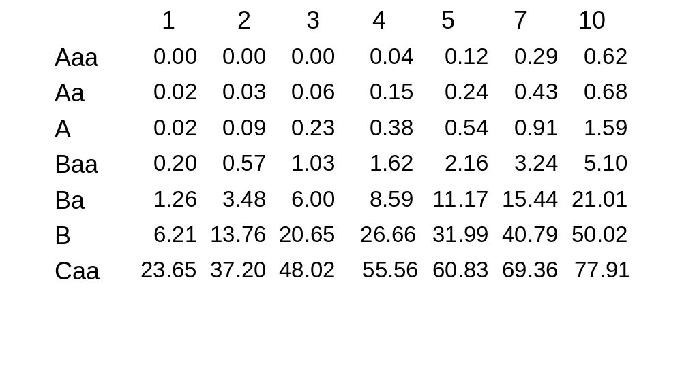
Cumulative Average Default Rates
(%) (1970-2003, Moody’s) Table 11.1, page 258

Slide 7
Interpretation
The table shows the probability of default for companies starting with a particular credit rating
A company with an initial credit rating of Baa has a probability of 0.20% of defaulting by the end of the first year, 0.57% by the end of the second year, and so on

Slide 8
Do Default Probabilities Increase with Time?
For a company that starts with a good credit rating default probabilities tend to increase with time
For a company that starts with a poor credit rating default probabilities tend to decrease with time

Slide 9
Default Intensity vs Unconditional Default Probability
The default intensity or hazard rate is the probability of default conditional on no earlier default
The unconditional default probability is the probability of default as seen at time zero
What are the default intensities and unconditional default probabilities from the Moody’s table for a Caa rate company in the third year?

Slide 10
Recovery Rate
The recovery rate for a bond is usually defined as the price of the bond immediately after default as a percent of its face value

Slide 11
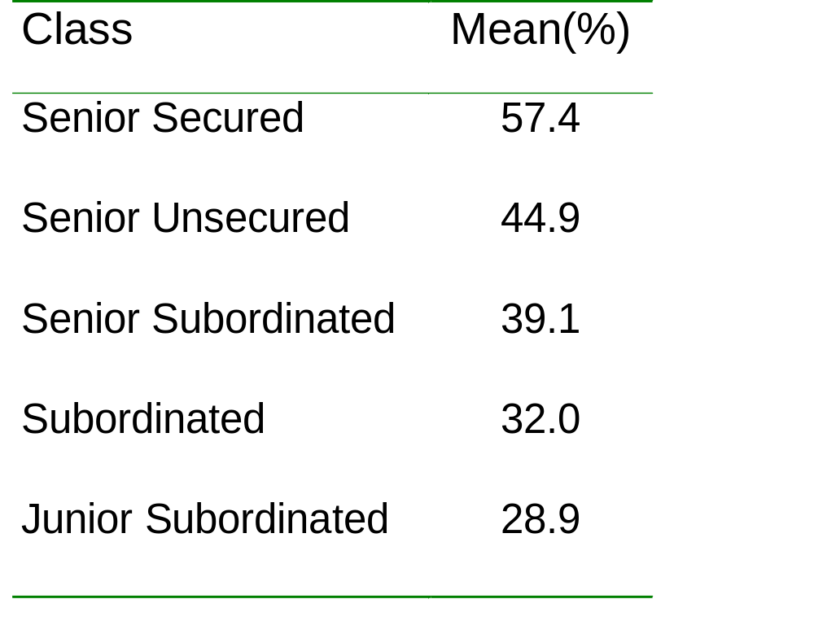
Recovery Rates; Moody’s: 1982 to 2004
(Table 11.2, page 260)

Slide 12
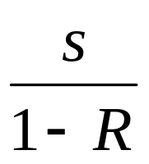
Using Bond Prices to Predict Default Probabilities
Average default intensity over life of bond is
approximately
where s is the spread of the bond’s yield over the risk-free rate and R is the recovery rate

Slide 13
More Exact Calculation (page 262)
Suppose that a five year corporate bond pays a coupon of 6% per annum (semiannually). The yield is 7% with continuous compounding and the yield on a similar risk-free bond is 5% (with continuous compounding)
Price of risk-free bond is 104.09; price of corporate bond is 95.34; expected loss from defaults is 8.75
Suppose that the unconditional probability of default is Q per year and that defaults always happen half way through a year (immediately before a coupon payment).

Slide 14
Calculations
Time (yrs) | Def Prob | Recovery Amount | Risk-free Value | Loss | Discount Factor | PV of Exp Loss
0.5 | Q | 40 | 106.73 | 66.73 | 0.9753 | 65.08Q
1.5 | Q | 40 | 105.97 | 65.97 | 0.9277 | 61.20Q
2.5 | Q | 40 | 105.17 | 65.17 | 0.8825 | 57.52Q
3.5 | Q | 40 | 104.34 | 64.34 | 0.8395 | 54.01Q
4.5 | Q | 40 | 103.46 | 63.46 | 0.7985 | 50.67Q
Total |  |  |  |  |  | 288.48Q

Slide 15
Calculations continued
We set 288.48Q = 8.75 to get Q = 3.03%
This analysis can be extended to allow defaults to take place more frequently
With several bonds we can use more parameters to describe the default probability distribution

Slide 16
The Risk-Free Rate (page 263)
The risk-free rate when default probabilities are estimated is usually assumed to be the LIBOR/swap zero rate
To get direct estimates of the PV of difference between corporate bond and a similar risk-free bond when the LIBOR/swap curve is assumed to be the risk-free curve we can use asset swaps

Slide 17
Asset Swaps (page 264)
Suppose asset swap spread for a particular corporate bond is 150 basis points
One side pays coupons on the bond; the other pays LIBOR+150 basis points
In addition there is an initial exchange of cash reflecting the difference between the bond price and $100
The PV of the asset swap spread is the amount by which the price of the corporate bond is exceeded by the price of a similar risk-free bond when the LIBOR/swap curve is used for discounting

Slide 18
Real World vs Risk-Neutral Default Probabilities
The default probabilities backed out of bond prices or credit default swap spreads are risk-neutral default probabilities
The default probabilities backed out of historical data are real-world default probabilities

Slide 19
A Comparison
Calculate 7-year default intensities from the Moody’s data (These are real world default probabilities)
Use Merrill Lynch data to estimate average 7-year default intensities from bond prices (these are risk-neutral default intensities)
Assume a risk-free rate equal to the 7-year swap rate minus 10 basis points

Slide 20
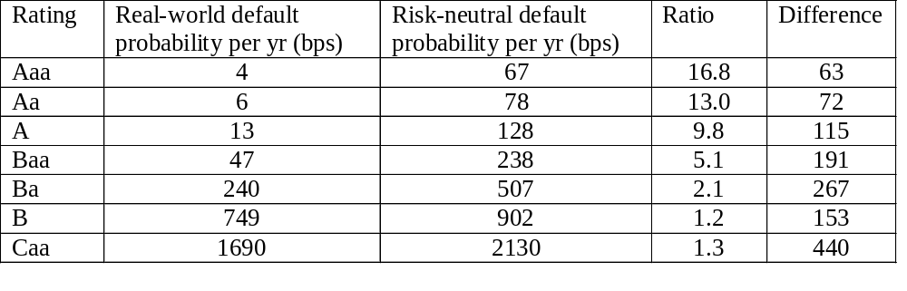
Real World vs Risk Neutral Default Probabilities (7 year averages) Table 11.4, page 265

Slide 21
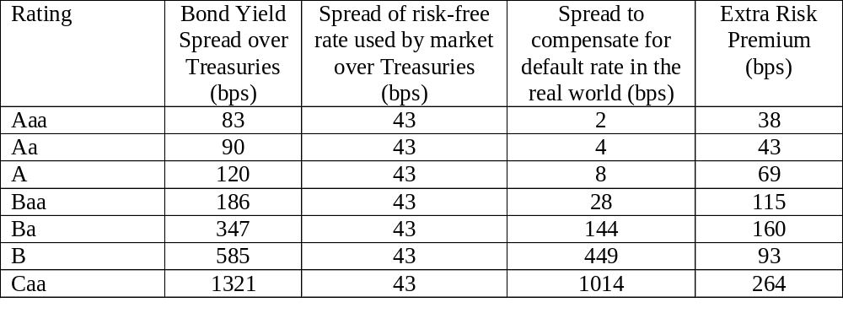
Risk Premiums Earned By Bond Traders (Table 11.5, page 266)

Slide 22
Possible Reasons for These Results
(The third reason is the most important)
Corporate bonds are relatively illiquid
The subjective default probabilities of bond traders may be much higher than the estimates from Moody’s historical data
Bonds do not default independently of each other. This leads to systematic risk that cannot be diversified away.
Bond returns are highly skewed with limited upside. The non-systematic risk is difficult to diversify away and may be priced by the market

Slide 23
Which World Should We Use?
We should use risk-neutral estimates for valuing credit derivatives and estimating the present value of the cost of default
We should use real world estimates for calculating credit VaR and scenario analysis

Slide 24
Merton’s Model (Section 11.6, pages 269-72)
Merton’s model regards the equity as an option on the assets of the firm
In a simple situation the equity value is
max(V_{T} –D, 0)
where V_{T} is the value of the firm and D is the debt repayment required

Slide 25
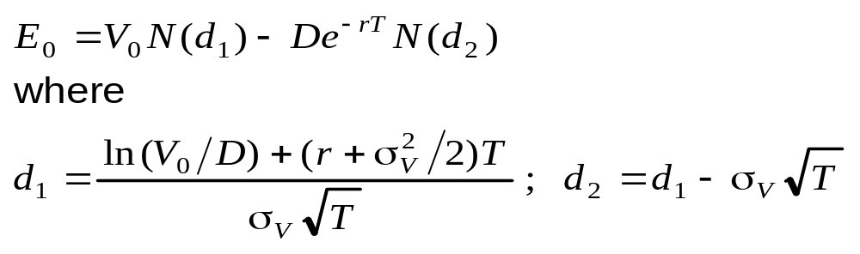
Equity vs. Assets
An option pricing model enables the value of the firm’s equity today, E₀, to be related to the value of its assets today, V₀, and the volatility of its assets, σ_{V}

Slide 26
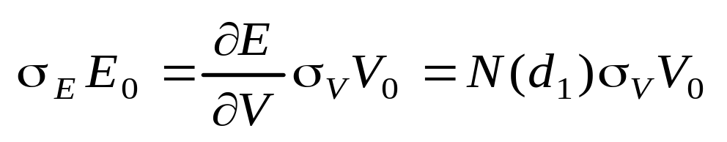
Volatilities
This equation together with the option pricing relationship enables V₀ and σ_{V} to be determined from E₀ and σ_{E}

Slide 27
Example
A company’s equity is $3 million and the volatility of the equity is 80%
The risk-free rate is 5%, the debt is $10 million and time to debt maturity is 1 year
Solving the two equations yields V₀=12.40 and σ_{v}=21.23%

Slide 28
Example continued
The probability of default is N(-d₂) or 12.7%
The market value of the debt is 9.40
The present value of the promised payment is 9.51
The expected loss is about 1.2%
The recovery rate is 91%

Slide 29
The Implementation of Merton’s Model by Moody’s KMV
Choose time horizon
Calculate cumulative obligations to time horizon. This is termed by KMV the “default point”. We denote it by D
Use Merton’s model to calculate a theoretical probability of default
Use historical data to develop a one-to-one mapping of theoretical probability into either real-world probability of default.

