Slide 1
Credit Risk Losses and Credit VaR
Chapter 12

Slide 2
Credit Risk in Derivatives Transactions (page 278)
Three cases
Contract always an asset
Contract always a liability
Contract can be an asset or a liability

Slide 3
General Result
Assume that default probability is independent of the value of the derivative
Define
  t₁, t₂,…t_{n}: times when default can occur
  q_{i}: default probability at time t_{i}.
  f_{i}: The value of the contract at time t_{i}
  R: Recovery rate

Slide 4
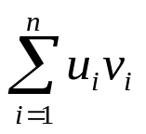
General Result continued
The expected loss from defaults at time t_{i} is
q_{i}(1-R)E[max(f_{i},0)].
Defining u_{i}=q_{i}(1-R) and v_{i} as the value of a derivative that provides a payoff of max(f_{i},0) at time t_{i}, the PV of the cost of defaults is

Slide 5
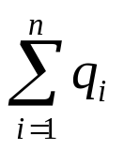
Applications
If contract is always an asset so that f_{i}>0 then v_{i} = f₀ and the cost of defaults is f₀ times the total default probability, times 1-R
If contract is always a liability then v_{i}= 0 and the cost of defaults is zero
In other cases we must value the derivative max(f_{i},0) for each value of i

Slide 6
Expected Exposure on Pair of Offsetting Interest Rate Swaps and a Pair of Offsetting Currency Swaps
(Figure 12.2, page 281)
Exposure
Currency swaps
Interest Rate Swaps
Maturity

Slide 7
Interest Rate vs Currency Swaps
The u_{i}’s are the same for both
The v_{i}’s for an interest rate swap are on average much less than the v_{i}’s for a currency swap
The expected cost of defaults on a currency swap is therefore greater.

Slide 8
Two-Sided Default Risk (page 282)
In theory a company should increase the value of a deal to allow for the chance that it will itself default as well as reducing the value of the deal to allow for the chance that the counterparty will default

Slide 9
Credit Risk Mitigation (page 283)
Netting
Collateralization
Downgrade triggers

Slide 10
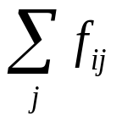
Netting
We replace f_{i} by in the definition of u_{i}
to calculate the expected cost of defaults by a counterparty where j counts the contracts outstanding with the counterparty
The incremental effect of a new deal on the exposure to a counterparty can be negative!

Slide 11
Collateralization
Contracts are marked to markets periodically (e.g. every day)
If total value of contracts Party A has with party B is above a specified threshold level it can ask Party B to post collateral equal to the excess of the value over the threshold level
After that collateral can be withdrawn or must be increased by Party B depending on whether value of contracts to Party A decreases or increases

Slide 12
Downgrade Triggers
A downgrade trigger is a clause stating that a contract can be closed out by Party A when the credit rating of the other side, Party B, falls below a certain level
In practice Party A will only close out contracts that have a negative value to Party B
When there are a large number of downgrade triggers they are counterproductive (See Business Snapshot 12.2)

Slide 13
Credit VaR (page 287)
Can be defined analogously to Market Risk VaR
A one year credit VaR with a 99.9% confidence is the loss level that we are 99.9% confident will not be exceeded over one year

Slide 14
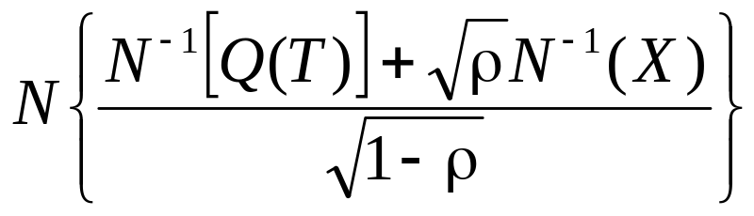
Vasicek’s Model (Section 12.4)
For a large portfolio of loans, each of which has a probability of Q(T) of defaulting by time T the default rate that will not be exceeded at the X% confidence level is
Where ρ is the Gaussian copula correlation

Slide 15
Credit Risk Plus (Section 12.5)
This calculates a loss probability distribution using a Monte Carlo simulation where the steps are:
Sample overall default rate
Sample number of defaults for portfolio under consideration
Sample size of loss for each default

Slide 16
CreditMetrics (Section 12.6)
Calculates credit VaR by considering possible rating transitions
A Gaussian copula model is used to define the correlation between the ratings transitions of different companies

