Slide 1
Operational Risk
Chapter 14

Slide 2
Definition of Operational Risk
“Operational risk is the risk of loss resulting from inadequate or failed internal processes, people, and systems, or from external events”
Basel Committee Jan 2001

Slide 3
What It Includes
The definition includes people risks, technology and processing risks, physical risks, legal risks, etc
The definition excludes reputation risk and strategic risk

Slide 4
Regulatory Capital (page 324)
In Basel II there will be a capital charge for Operational Risk
Three alternatives:
  Basic Indicator (15% of annual gross income)
  Standardized (different percentage for each business line)
  Advanced Measurement Approach (AMA)

Slide 5
Categorization of Business Lines
Corporate finance
Trading and sales
Retail banking
Commercial banking
Payment and settlement
Agency services
Asset management
Retail brokerage

Slide 6
Categorization of risks
Internal fraud
External fraud
Employment practices and workplace safety
Clients, products and business practices
Damage to physical assets
Business disruption and system failures
Execution, delivery and process management

Slide 7
The Task Under AMA
Banks need to estimate their exposure to each type of risk for each business line combination
Ideally this will lead to 7×8=56 VaR measures that can be combined into an overall VaR measure (See Chapter 16 for the way this is done)

Slide 8
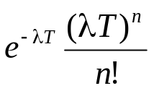
Loss Severity vs Loss Frequency (page 327)
Loss frequency should be estimated from the banks own data as far as possible. One possibility is to assume a Poisson distribution so that we need only estimate an average loss frequency. Probability of n events in time T is then
Loss severity can be based on internal and external historical data. (One possibility is to assume a lognormal distribution so that we need only estimate the mean and SD of losses)
Monte Carlo simulation can be used to combine the two distributions (see Figure 14.2)

Slide 9
Monte Carlo Simulation Trial
(page 328)
Sample from frequency distribution to determine the number of loss events (=n)
Sample n times from the loss severity distribution to determine the loss severity for each loss event
Sum loss severities to determine total loss

Slide 10
External Historical Loss Severity Data
Two possibilities
  data sharing
  data vendors
Data from vendors is based on publicly available information and therefore is biased towards large losses
Data from vendors can therefore only be used to estimate the relative size of the mean losses and SD of losses for different risk categories

Slide 11
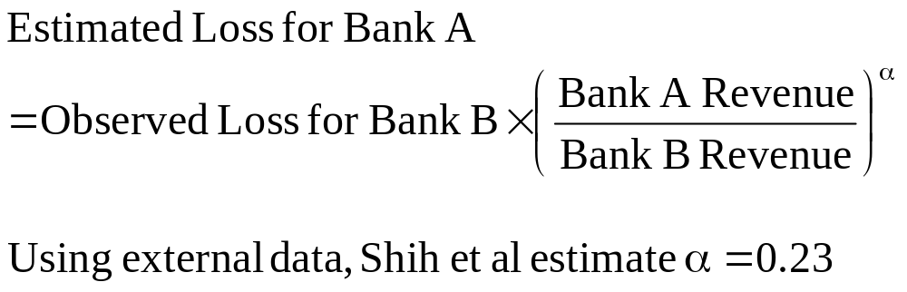
Scaling for Size (page 330)

Slide 12
Other Techniques
Scenario Analysis (page 331)
Identifying Causal Relationships (page 332)
RCSA (page 333)
KRI (page 333)
Scorecard approaches (page 334)
The power law (page 335)

Slide 13
Insurance (page 335-7)
Factors that affect the design of an insurance contract
  Moral hazard
  Adverse selection
To take account of these factors there are
  deductibles
  co-insurance provisions
  policy limits

Slide 14
Sarbanes-Oxley (page 337)
CEO and CFO are more accountable
SEC has more powers
Auditors are not allowed to carry out significant non-audit tasks
Audit committee of board must be made aware of alternative accounting treatments
CEO and CFO must return bonuses in the event financial statements are restated

