Slide 1
Model Risk and
Liquidity Risk
Chapter 15

Slide 2
Model Risk Can Lead To…
Incorrect price at time product is bought or sold
Incorrect hedging

Slide 3
Finance vs Physics (page 344)
The models of physics describe physical processes and are highly accurate. Their parameters do not change through time.
The models of finance describe human behavior. They are at best approximations. Parameters do change through time

Slide 4
Calibration
Models of finance are calibrated to market prices daily
As a result parameters change from day to day
For a particular option maturing in three months volatility might be 20% on Day 1, 22% on Day 2, and 19% on Day 3.

Slide 5
Linear Products
Very little uncertainty about the right model
But mistakes do happen. For example…
  Kidder Peabody (Business Snapshot 15.1, page 345)
  LIBOR-in Arrears Swaps (Business Snapshot 15.2, page 346)

Slide 6
Actively Traded Products (page 346)
We do not need a model to know the price of an actively traded product. The market tells us the price.
The model is a communication tool (e.g., implied volatilities are quoted for options)
It is also an interpolation tool (e.g., a tool for interpolating between strike prices and maturities.

Slide 7
Volatility Smiles
A volatility smile shows the variation of the implied volatility with the strike price
The volatility smile should be the same whether calculated from call options or put options

Slide 8
The Volatility Smile for Foreign Currency Options
(Figure 15.1, page 347)
Implied
Volatility
Strike
Price

Slide 9
The Volatility Smile for Equity Options (Figure 15.2, page 348)
Implied
Volatility
Strike
Price

Slide 10
Volatility Term Structure
In addition to calculating a volatility smile, traders also calculate a volatility term structure
This shows the variation of implied volatility with the time to maturity of the option

Slide 11
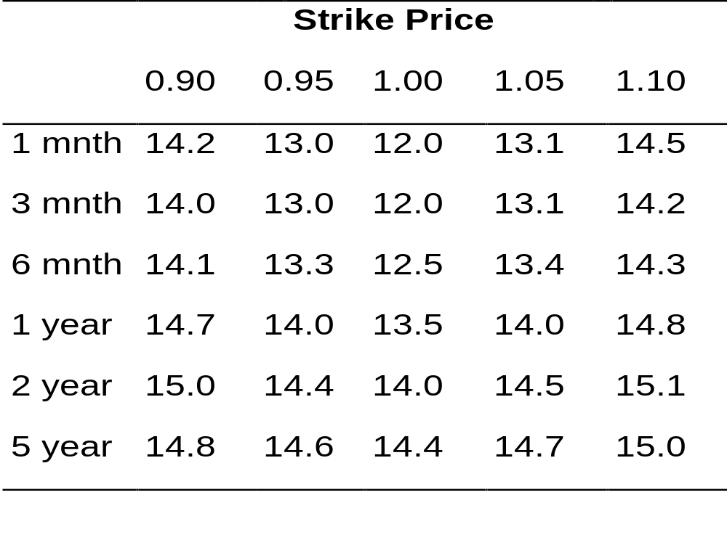
Example of a Volatility Surface
(Table 15.1, page 350)

Slide 12
Hedging Actively Traded Products
Models are used in a more significant way for hedging than for pricing
We can distinguish “within model” hedging from ”outside model” hedging

Slide 13
P&L Decomposition (page 351)
Distinguishes between:
P&L changes from risks that were unhedged
P&L changes from the hedging model being imperfect
P&L changes from new trades done during day

Slide 14
Models for Structured Products (page 351)
In the case of structured products models play a key role in both pricing and hedging
It is a good idea to use more that one model whenever possible

Slide 15
Dangers in Model Building (page 352)
Overfitting
Overparametrization

Slide 16
Detecting Model Problems (page 353)
Monitor types of trading a financial institution is doing with other financial institutions
Monitor profits being recorded from trading of different products

Slide 17
Liquidity Risk (Traditional View)
Bid offer spreads depend on the quantity traded
Time horizons in VaR should reflect the time it takes to unwind a position
Can calculate a liquidity-adjusted VaR that incorporates bid-offer spreads

Slide 18
A More Serious Aspect of Liquidity Risk: Liquidity Black Holes
A liquidity black hole occurs everyone wants to take one side of the market and liquidity dries up
Examples:
  Crash of 1987 (Business Snapshot 15.4, page 358)
  British Insurance Companies (Business Snapshot 15.5, page 359)
  LTCM (page 260-1)

Slide 19
Potential Causes of Liquidity Black Holes (page 357)
Everyone using the same computer models
All financial institutions being regulated in the same way
The herd mentality

Slide 20
Is Liquidity Improving?
Spreads are narrowing
But arguably the risks of liquidity black holes are now greater than they used to be
We need more diversity in financial markets where different groups of investors are acting independently of each other

