Slide 1
Economic Capital and RAROC
Chapter 16

Slide 2
Economic Capital
Bank’s own assessment of the capital it requires

Slide 3
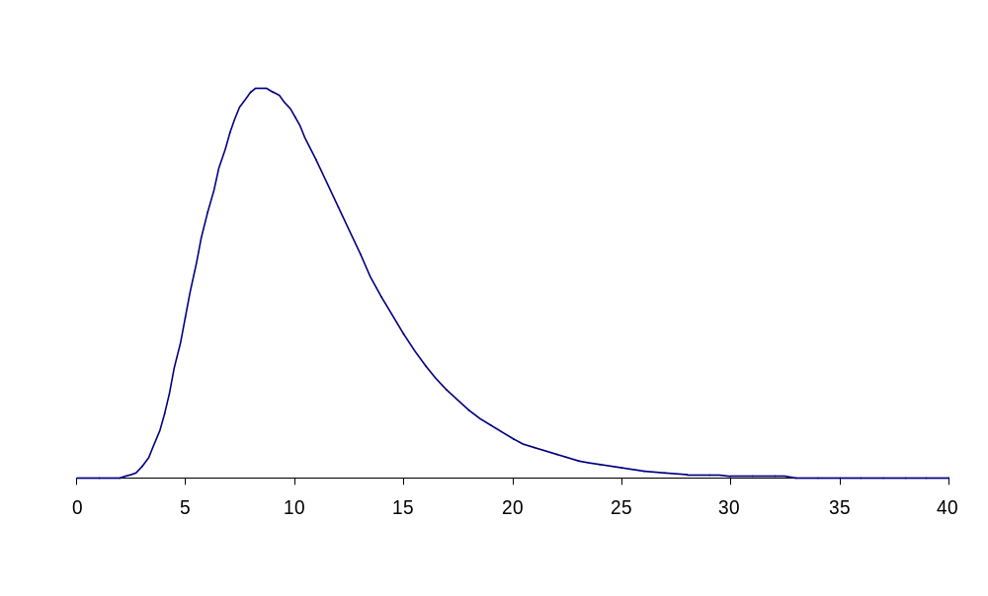
Model Used for Economic and Capital (Same as Regulatory Capital)
Figure 16.1, page 367
Expected
Loss
X% Worst
Case Loss
Capital
Loss over time horizon

Slide 4
Choice of Parameters
For a bank wishing to maintain a AA-rating, capital is chosen so that X = 99.97% and time horizon is one year
This is because statistics from rating agencies show that an AA-rated company should have a probability of only 0.03% of defaulting in one year

Slide 5
The Basel II Regulatory Environment (Figure 16.2, page 367)
Total Risk
Non-Business Risk
(regulatory capital):
Credit Risk
Market Risk
Operational Risk
Business Risk
(no regulatory capital):
Risk from Strategic Decisions
Reputation Risk

Slide 6
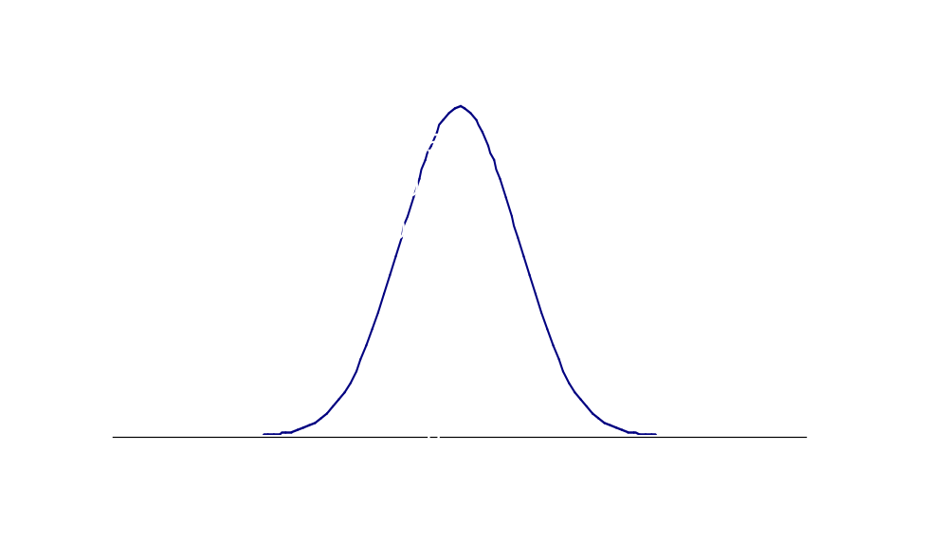
One-year Market Risk Gains/Loss Distribution (Figure 16.3, page 371)
Gain
Loss

Slide 7
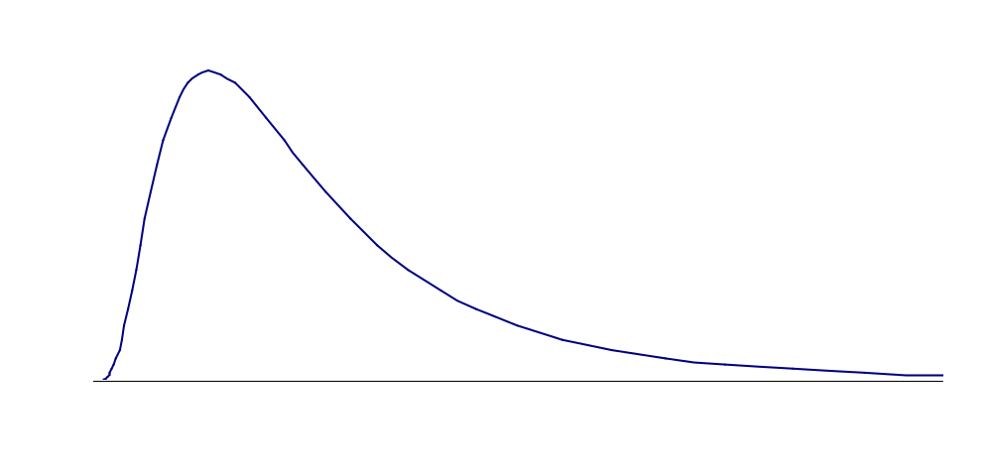
One-year Credit Risk Loss Distribution (Figure 16.4, page 371)
Loss

Slide 8
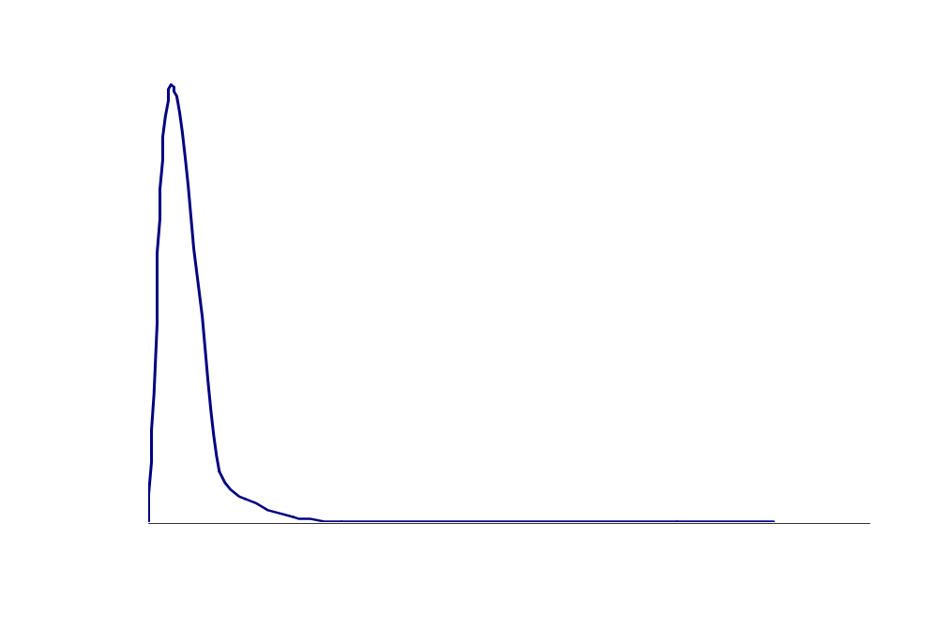
One Year Operational Risk Loss Distribution (Figure 16.5, page 372)
Loss

Slide 9
Characteristics of Distributions (Table 16.1, page 371)
 | Second Moment (Variance) | Third Moment (Skewness) | Fourth Moment (Kurtosis)
Credit Risk | Moderate | Moderate | Moderate
Market Risk | High | Zero | Low
Operational Risk | Low | High | High

Slide 10
Importance of Risks (page 372)
Type of Business | Most Important Risk
Commercial Banking | Credit Risk
Investment Banking & Trading | Market Risk and Credit Risk
Asset Management | Operational Risk

Slide 11
European Growth Trust (Example of Operational Risk in Asset Management)
See Business Snapshot 16.1
No more than 10% of EGT could be invested in unlisted securities
Peter Young the fund manager violated this rule
The cost to Deutsche Bank was about $200 million

Slide 12
Interactions of Risks
LGD and PD depend on market value
Credit
Risk
Market Risk
Operational risks can be contingent on market moves or credit events
Operational
Risk

Slide 13
Integrated Risk Management
Typically a bank calculates economic capital for different types of risk and different units
It is then faced with the problem of aggregating the risks

Slide 14
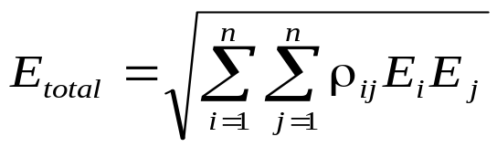
Combining the Distributions
Assume perfect correlation: overstates capital by about about 40%
Assume distributions are normal for the purposes of aggregation: understates capital by about 40%
Hybrid approach:
seems to work reasonable well

Slide 15
Example: Economic Capital Estimates (Table 16.2, page 376)
 | Business Unit 1 | Business Unit 2
Market Risk | 30 | 40
Credit Risk | 70 | 80
Operational Risk | 30 | 90

Slide 16
Correlations
Market and credit risk within the same business unit: 0.5
Market and operational risk or credit and operational risk within the same business unit: 0.2
Market risks across business units: 0.4
Credit risk across business units: 0.6
Operational risk across business units: 0.0

Slide 17
Total Economic Capital
Business Unit 1: 100.0
Business Unit 2: 153.7
Whole bank: 203.2
Diversification benefit is 253.7 – 203.2 = 50.5
How should this be allocated to the business units?
Equivalently how should the total economic capital of 203.2 be allocated?

Slide 18
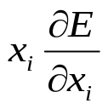
Alternatives
Allocate economic capital in proportion to the stand alone economic capitals
Allocate economic capital in proportion to marginal contribution of business units to total economic capital
Set economic capital for business unit i equal to where x_{i} is the size of business unit i

Slide 19
Deutsche Bank Economic Capital (millions of Euros) Table 16.4, page 379
Credit Risk | 5,971
Market Risk | 5,476
Diversification: Credit and Mkt Risk | -870
Operational Risk | 2,243
Business Risk | 381
Total | 13,201
Regulatory Capital | 17,300
Actual Capital | 28,600

Slide 20
RAROC (page 379)
RAROC is the return on economic capital for a business unit
The denominator is the economic capital allocated to the business unit
The numerator is the expected profit. This can be before or after tax and can include a interest at the risk-free rate on the economic capital
It is sometimes also referred to as RORAC

Slide 21
Example 16.5 (page 380)
When lending in a certain region of the world an AA-rated bank estimates its average losses from defaults as 1% of outstanding loans per year
The 99.97% worst case loss is 5% of outstanding loans
Economic capital per $100 of loans is therefore $4

Slide 22
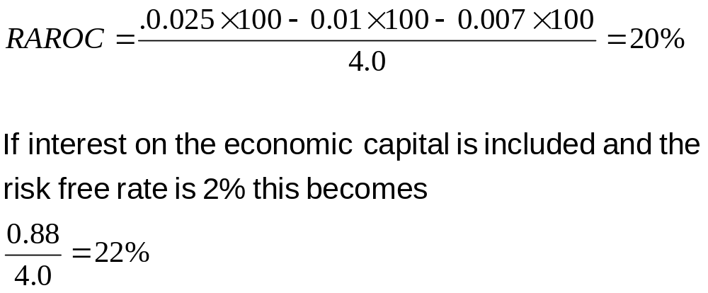
Example continued
The bank’s spread between cost of funds and interest charged is 2.5% and administrative costs are 0.7%

Slide 23
Ex-ante vs Ex-post
RAROC was originally suggested as a tool to be used on an ex-ante basis. This means that we have to forecast the expected loss
It is then used as a tool to allocate capital to the most profitable parts of the business
It is also sometimes used on an ex-post basis for performance evaluation. Realized loss then replaces expected loss

