Slide 2
Process Abstraction
STATE
ENVIRONMENT
ADDRESS
SPACE
REGISTERS
CPU
CONTROL

Slide 3
Kernel implements processes!
User Mode
P1
P2
P3
Supervisor Mode
OS KERNEL
Kernel is only part of the operating system

Slide 4
CPU runs each process directly
But somehow each process has its own
Registers
Memory
I/O resources
“thread of control”

Slide 5
Process Control Block
Process Identifier
Process arguments (for identification)
Process status (runnable, waiting, zombie, …)
User Identifier (for security)
beware: superuser ≠ supervisor
Registers
Interrupt Vector
Pending Interrupts
Base / Bound
Scheduling / accounting info
I/O resources
…

Slide 6
createProcess(initial state)
Allocate memory for address space
Initialize address space
program vs fork
program ≠ process
Allocate ProcessID
Allocate process control block
Put process control block on the run queue

Slide 7
Dispatch: kernel → process
Software:
CurProc := &PCB of current process
Set user base/bound register
Restore process registers
Execute ReturnFromInterrupt instruction
Hardware:
Sets user mode
Enables interrupts
Restores program counter

Slide 8
Trap process → kernel
Hardware:
Disables interrupts
Sets supervisor mode
Saves user PC and SP on kernel stack
why not on process stack?
Sets kernel stack pointer
Sets PC to kernel-configured position
Software:
Save process registers in PCB of CurProc
Back to kernel main loop

Slide 9
What is a program?
A program is a file containing executable code (machine instructions) and data (information manipulated by these instructions) that together describe a computation
Resides on disk
Obtained through compilation and linking

Slide 10
Preparing a Program
compiler/
assembler
Linker
Source
files
Object files
static
libraries
(libc)
Header
Code
Initialized data
PROGRAM
An executable file
in a standard format,
such as ELF on Linux,
Microsoft PE on Windows
BSS
Symbol table
Line numbers
Ext. refs

Slide 11
Running a program
Every OS provides a “loader” that is capable of converting a given program into an executing instance, a process
A program in execution is called a process
The loader:
reads and interprets the executable file
Allocates memory for the new process and sets process’s memory to contain code & data from executable
pushes “argc”, “argv”, “envp” on the stack
sets the CPU registers properly & jumps to the entry point

Slide 12
Process != Program
mapped segments
Header
DLL’s
Program is passive
Code + data
Process is running program
stack, regs, program counter
Example:
We both run IE:
Same program
Separate processes
Code
Stack
Initialized data
BSS
Symbol table
Line numbers
Heap
Ext. refs
BSS
Executable
Initialized data
Process
address space
Code

Slide 13
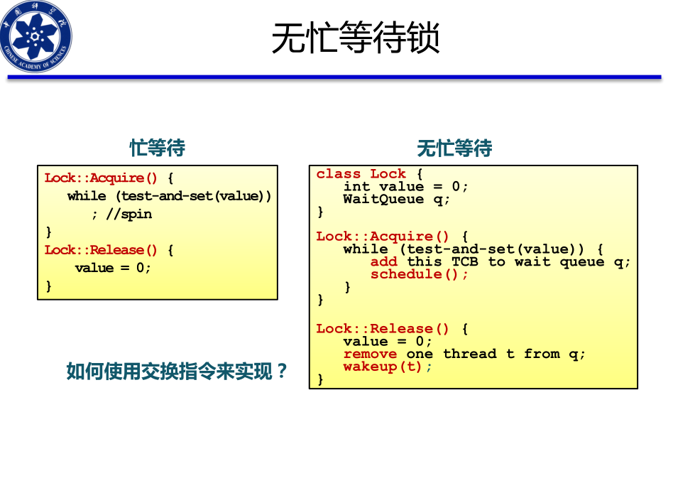
自旋锁和互斥锁的区别

