Slide 1
Lecture 2
Data management
Simple Regression Model

Slide 2
Management of Data
1. How/Where to collect data?
2. Macro-data, Micro-data, Mix-data
3. Cumulate public official statistical books/website
4. Questionnaire design

Slide 3
Commands for combining data in STATA
append
merge
joinby
A
A
+
B
=
B
A
B
A
B
+
=
A
B
A
B
☓
=

Slide 4
Some Note:
Using Stata Transfer to transfer different data format into Stata format.
For large data file, need to set memory first.
Checking the missing observations/variables, and tepo if you input by hand.
Data correction, like using price index as example.
Make variable description note no matter in original situation or changing situation.

Slide 5
Begin to collect the data for your report.
Some data set for public use，for example:
CHARLS: http://charls.pku.edu.cn/zh-CN
CHNS: https://www.cpc.unc.edu/projects/china

Slide 6
Part 1
Regression analysis with cross-section data
The simple regression model

Slide 7
The Simple Linear Regression Model
Correlation of two random variables
OLS Estimates
Fitted value, Residuals

Slide 8
Measures of association:
(Relationship between two random variables)
Covariance
Correlation
Pearson Correlation
Spearman Correlation

Slide 9
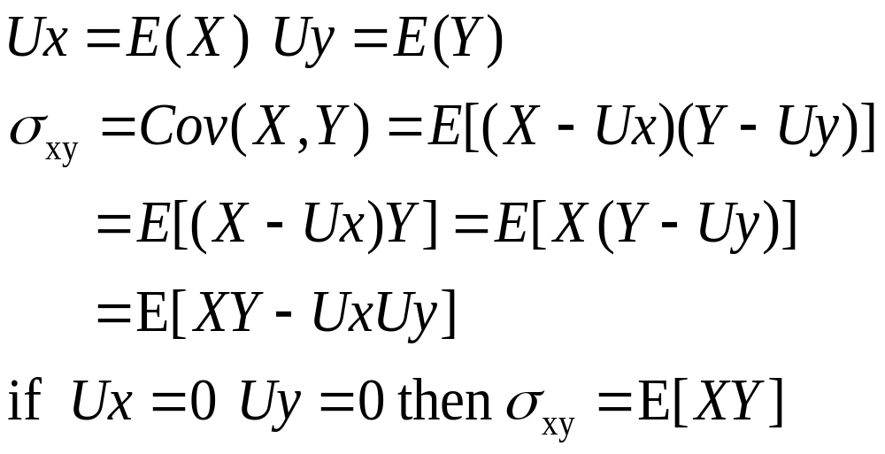
Covariance
The population covariance for two random variables X and Y.
Let

Slide 10
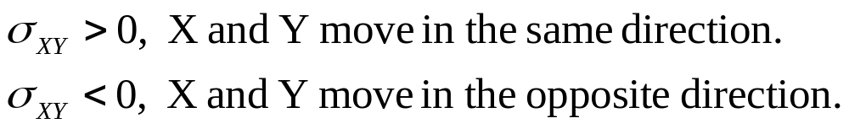
Properties of Covariance
Covariance measures the amount of linear dependence between two random variables.
Property 1: If X and Y are independent, the Cov(X,Y)=0, Converse is not true, it means, zero covariance between X and Y does not imply that X and Y are independent.
e.g. for any random variable X, E(X)=0, now, there is Y=X², then Cov(X,Y)=0, but the are not independent.
This reveals a weakness of Covariance as a general association between two variables.

Slide 11
Properties of Covariance
Property 2:For any constant a1,b1,a2 and b2
The covariance between two random variables can be altered simply by multiplying one or both of the random variables by a constant.
In economics, like monetary variables, inflation rates and so on, can be defined with different unit of measurement without changing their meaning.

Slide 12
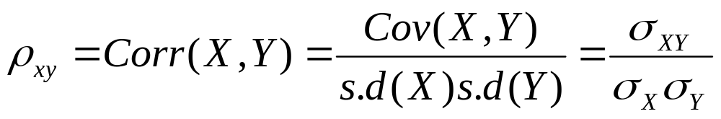
Correlation coefficient
The difference between correlation and covariance:
Covariance depends on the units of measurements;
Correlation does not.
If X and Y are independent, the Corr(X,Y)=0, Converse is not true.

Slide 13
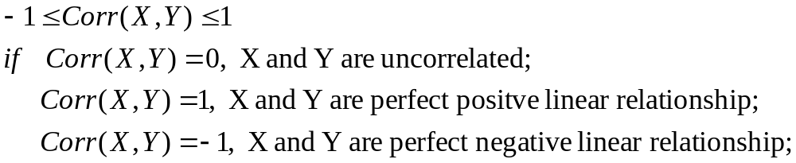
Properties of Correlation
Property 1:

Slide 14
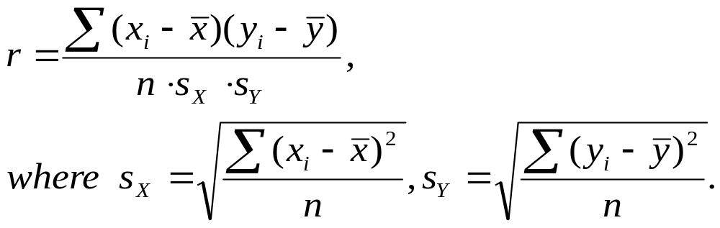
Two types of Correlation
Pearson Correlation
example: Lecture2.dta

Slide 15
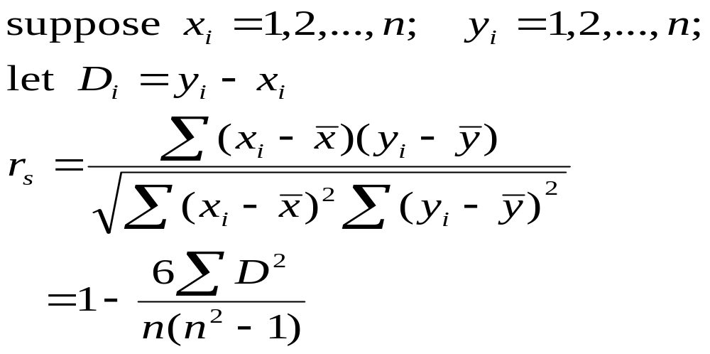
Two types of Correlation
Spearman correlation: Sample grade correlation
Note: Correlation does not mean really correlated in Economic world.

Slide 16
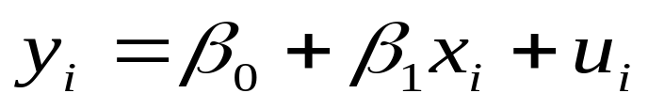
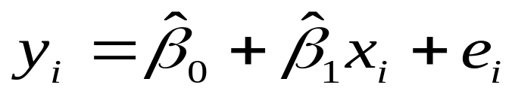
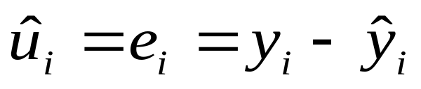
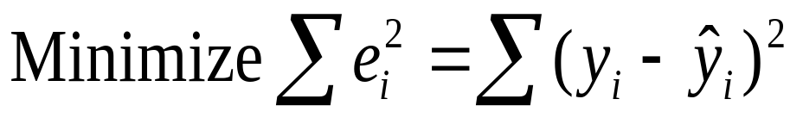
Simple Linear Regression Model
Population Regression Function(PRF)
Sample Regression Function(SRF)
Using SRF to estimate PRF

Slide 17
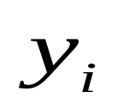




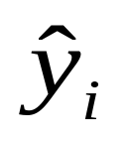
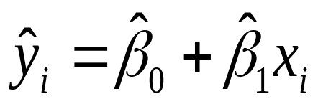
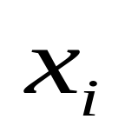
Using SRF to estimate PRF

Slide 18
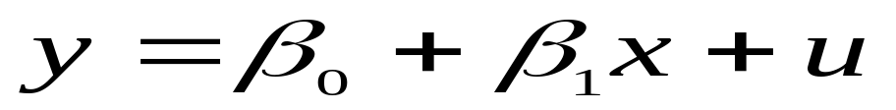
Definition of PRF
Slope parameter
Error term
Disturbance
Intercept parameter
Dependent Variable
Explained Variable
Controlled Variable
Predicted Variable
Regressand
Left-hand Side Variable
Endogenous
Outcome
Independent Variable
Explanatory Variable
Control Variable
Predictor Variable
Regressor
Right-hand Side Variable
Exogenous
Covariate

Slide 19
Population regression line, sample data points
and the associated error terms
y
E(y|x) = β₀ + β₁x
.
y₄
u₄
{
y₃
.
u₃
}
.
y₂
u₂
{
.
u₁
y₁
}
x₁
x₂
x₃
x₄
x

Slide 20
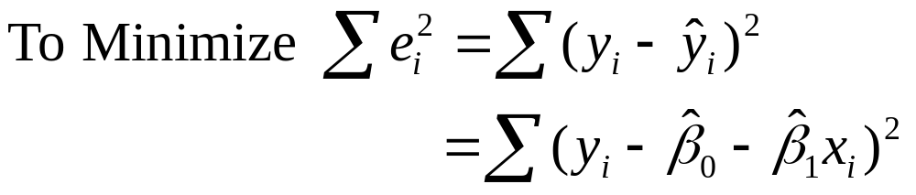
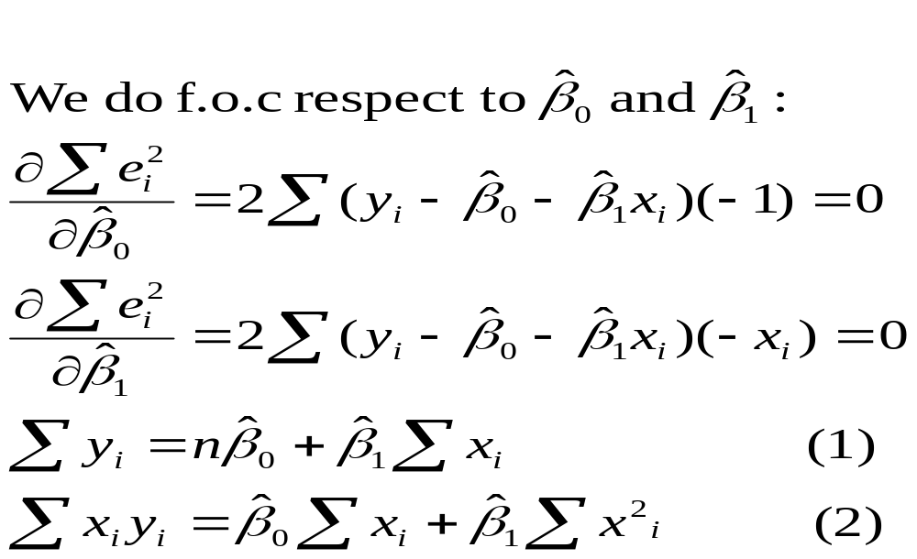
Deriving the OLS estimates

Slide 21
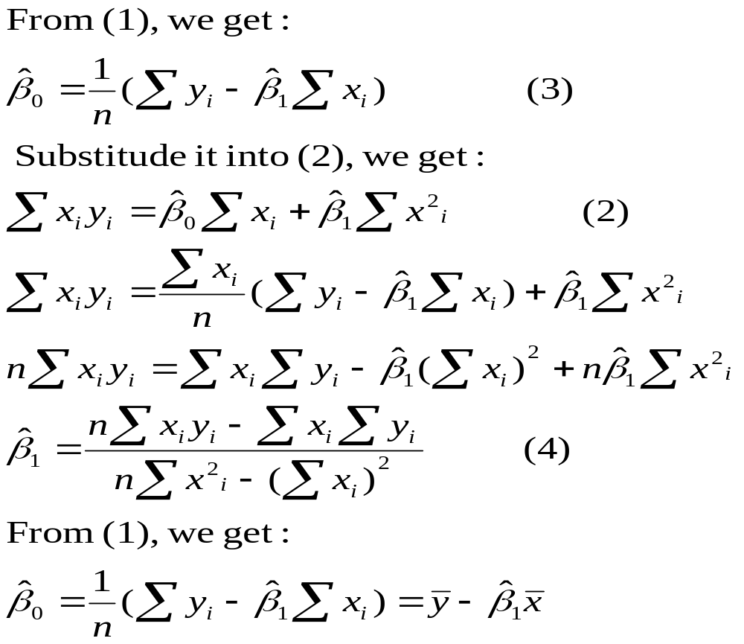

Slide 22
The Simple
Regression Model
CEO Salary and return on equity
Fitted regression
Causal interpretation?
Salary in thousands of dollars
Average return on equity of the CEO‘s firm
Intercept
If the return on equity increases by 1 percent,
then salary is predicted to change by $18,501

Slide 23
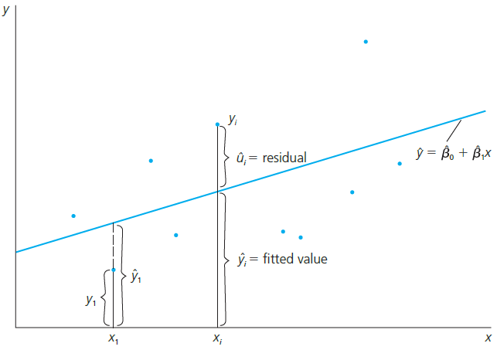

The Simple
Regression Model
Fit as good as possible a regression line through the data points:
Fitted regression line
For example, the i-th
data point

Slide 24

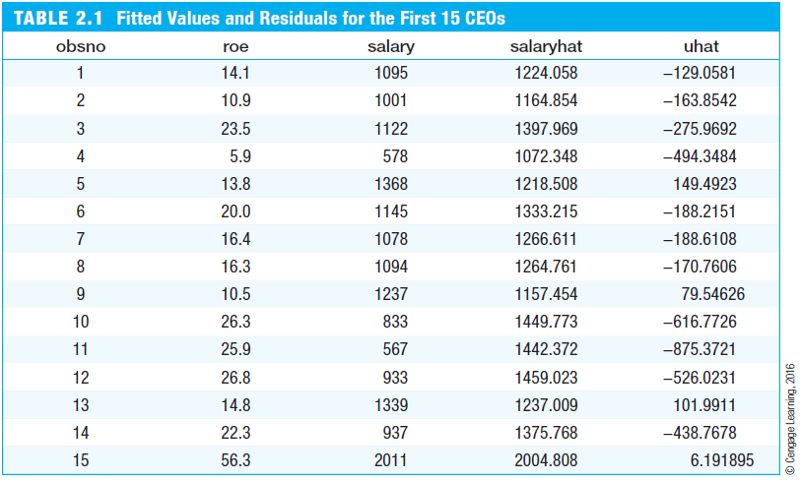



The Simple
Regression Model
For example, CEO number 12‘s salary was
$526,023 lower than predicted using the
the information on his firm‘s return on equity

Slide 25
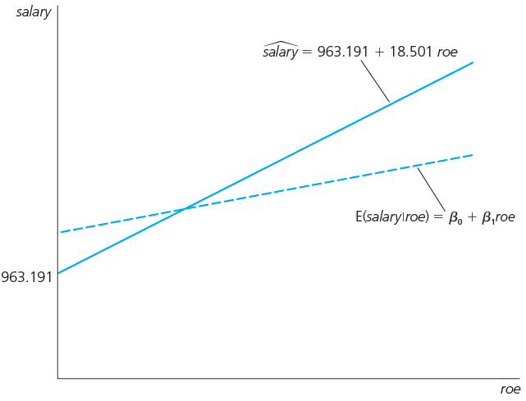
The Simple
Regression Model
Fitted regression line
(depends on sample)
Unknown population regression line

Slide 26
The Simple
Regression Model
Wage and education
Fitted regression
Causal interpretation?
Hourly wage in dollars
Years of education
Intercept
In the sample, one more year of education was
associated with an increase in hourly wage by $0.54

Slide 27
The Simple
Regression Model
Voting outcomes and campaign expenditures (two parties)
Fitted regression
Causal interpretation?
Percentage of vote for candidate A
Percentage of campaign expenditures candidate A
Intercept
If candidate A‘s share of spending increases by one
percentage point, he or she receives 0.464 percen-
tage points more of the total vote

Slide 28
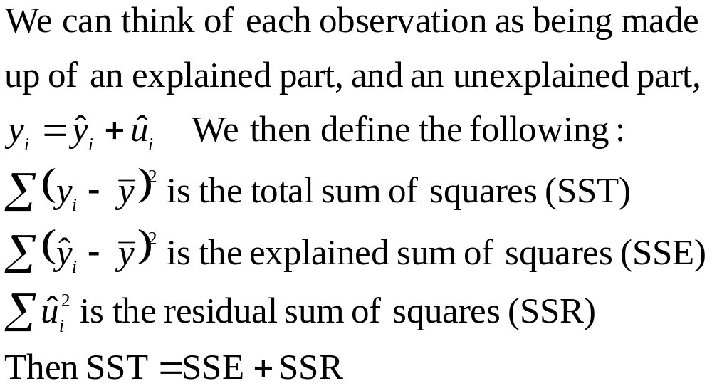
More terminology

Slide 29
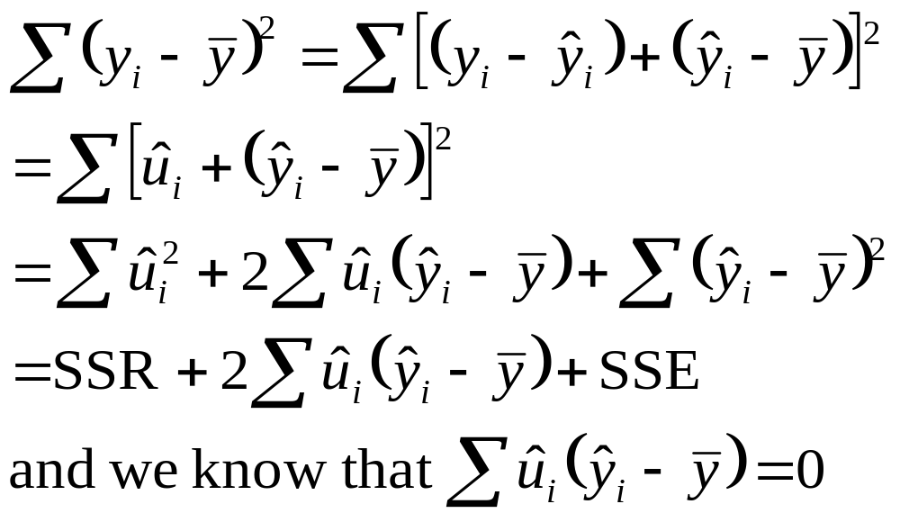
Proof that SST = SSE + SSR

Slide 30
Goodness-of-Fit
How do we think about how well our sample regression line fits our sample data?
We can compute the fraction of the total sum of squares (SST) that is explained by the model, call this the R-squared of regression
R² = SSE/SST = 1 – SSR/SST

Slide 31
R² is the fraction of the sample variation in y that is explained by x.
Two examples
Low R²
High R²
It is worth emphasizing now that a seemingly low R² does not necessarily mean that an OLS regression equation is useless.

Slide 32


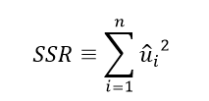
The Simple
Regression Model
Goodness-of-Fit
Measures of Variation
“How well does the explanatory variable explain the dependent variable?”
Total sum of squares,
represents total variation
in the dependent variable
Explained sum of squares,
represents variation
explained by regression
Residual sum of squares,
represents variation not
explained by regression

Slide 33

The Simple
Regression Model
Decomposition of total variation
Goodness-of-fit measure (R-squared)
Total variation
Explained part
Unexplained part
R-squared measures the fraction of the total variation that is explained by the regression

Slide 34

The Simple
Regression Model
CEO Salary and return on equity
Voting outcomes and campaign expenditures
Caution: A high R-squared does not necessarily mean that the regression has a causal interpretation!
The regression explains only 1.3%
of the total variation in salaries
The regression explains 85.6% of the total variation in election outcomes

Slide 35
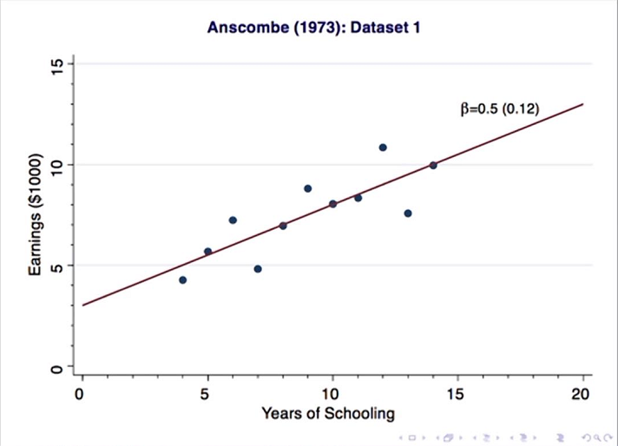

Slide 36
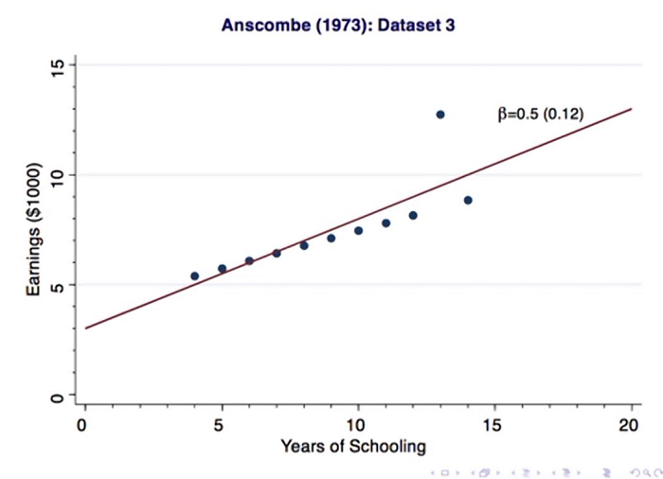

Slide 37
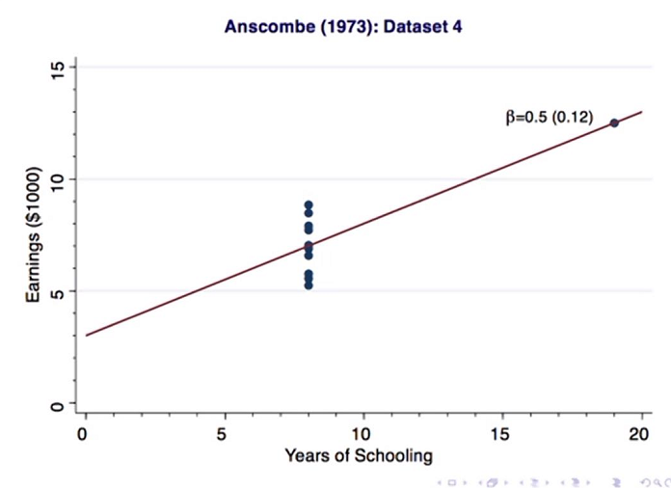

Slide 38
Homework
Try to merge or append two data sets together.
Simulate the PRF and SRF, think about the relationship, and why we need to test if the estimated coefficient is statistically significant.

Slide 39
Homework
Chapter 1： C1.3， C1.4

