Slide 1
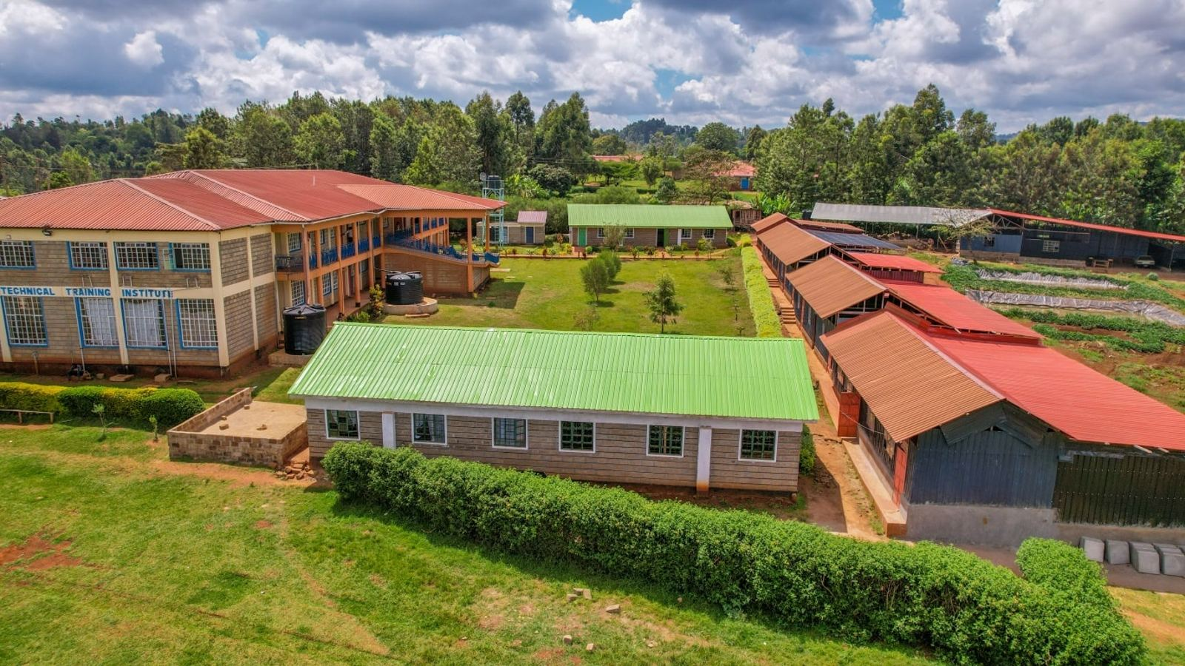

Muraga Technical Training Institute
INNOVATION & EXCELLENCE
Practical skills for employment, enterprise and self-reliance

Slide 2
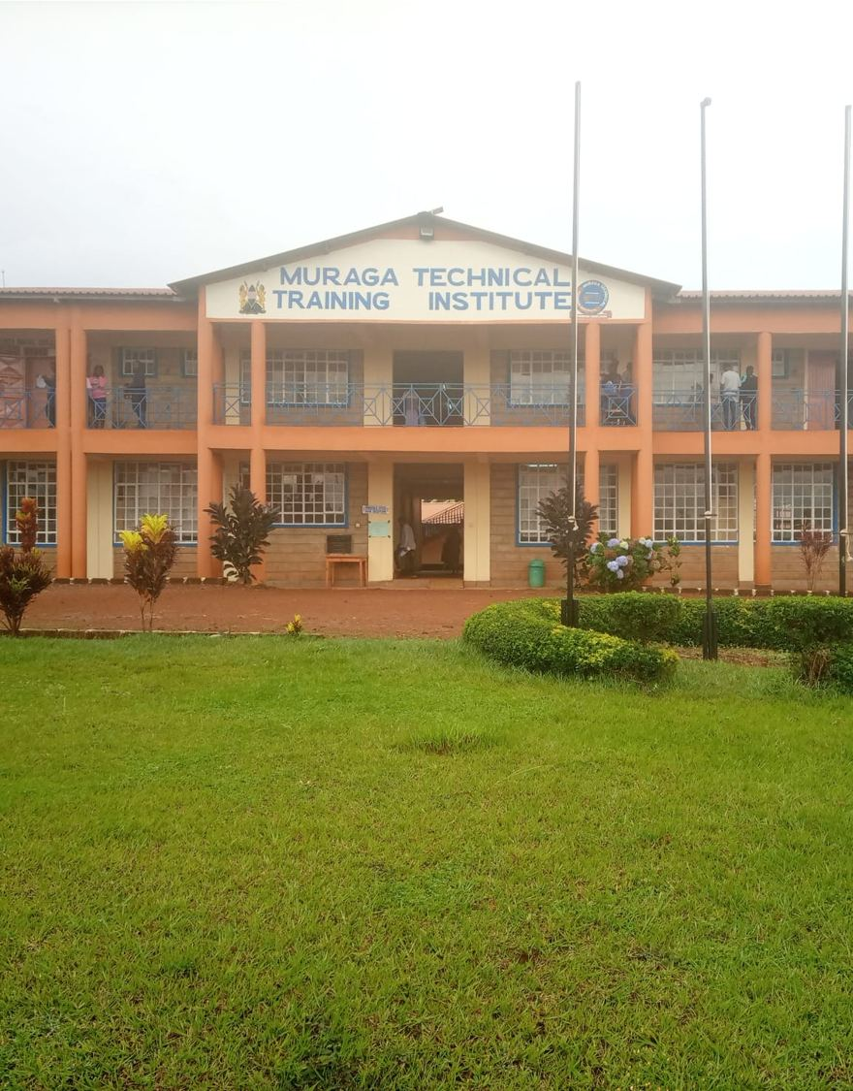
Who We Are
Muraga Technical Training Institute is a TVET institution committed to competence-based training that combines theory with hands-on practice, producing skilled, innovative and self-reliant graduates.
2
6
4-6
Campuses
Departments
Training Levels
Main Campus | Kaare Campus

Slide 3
Vision, Mission & Values
Our Vision
Our Mission
To be a leading institution of excellence in technical and vocational training.
To provide quality, competence-based training that equips learners with practical skills, innovation and values for employment and self-reliance.
Core Values
Guiding Principles
Integrity
Ethics
Accountability
Excellence
Innovation
Professionalism
Corporate Governance
Customer Focus
Teamwork

Slide 4






Our Departments
Building & Civil Engineering
Electrical & Electronics
Mechanical & Automotive
Build the future
Power the nation
Drive innovation
Agriculture & Environment
Information & Communication Technology
Business, Hospitality & Fashion
Grow sustainably
Code your career
Create and serve

Slide 5
Admissions & Entry Requirements
Level 4 | Artisan Certificate
Level 5 | Craft Certificate
Level 6 | Diploma
E
D
C-
KCSE mean grade E and above
KCSE mean grade D (Plain) and above
KCSE mean grade C- (Minus) and above
How to Apply
1
Choose your course and campus
2
Apply online and download your application form
3
Report with your documents and fee payment

Slide 6


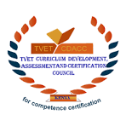


Quality You Can Trust
Competence-based training
Our Partners
Practical, hands-on learning in workshops and labs
Dedicated trainers
Guidance from committed and professional staff
TVETA Kenya | TVET CDACC | Kenya Vision 2030
Digital skills for all
Computer, design, web and online skills for every learner

Slide 7
Join the Muraga Family
Applications are open. Apply online and download your application form.
Main Campus | Kaare Campus
INNOVATION & EXCELLENCE

