Slide 1
Recommendation system
for food warehouse construction

Slide 2
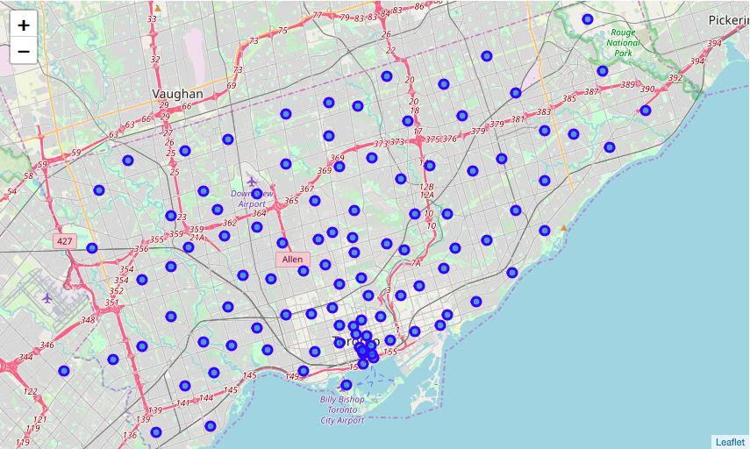
Neighborhoods in Toronto

Slide 3
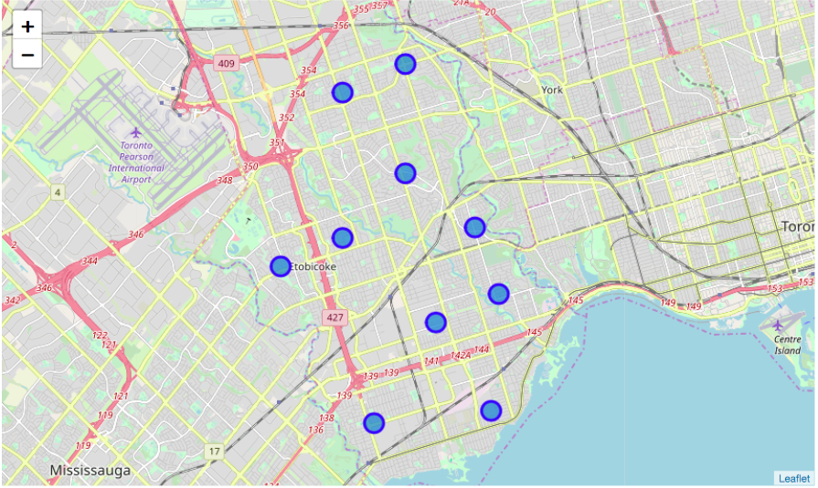
Neighborhoods in Etobicoke

Slide 4
What we care about:
Donut Shop
Sushi Restaurant
French Restaurant
Tapas Restaurant
Seafood Restaurant
Thai Restaurant
Burger Joint
Greek Restaurant
Gourmet Shop
Cupcake Shop
Eastern European Restaurant
Wings Joint
Burrito Place
Middle Eastern Restaurant
BBQ Joint
Comfort Food Restaurant
Asian Restaurant
Buffet
Mediterranean Restaurant
Café
Bakery
Fish & Chips Shop
Restaurant
Pizza Place
Mexican Restaurant
Chinese Restaurant
Sandwich Place
Ice Cream Shop
Breakfast Spot
American Restaurant
Dessert Shop
Italian Restaurant
Indian Restaurant
Fried Chicken Joint
Fast Food Restaurant
Caribbean Restaurant
Moroccan Restaurant

Slide 5
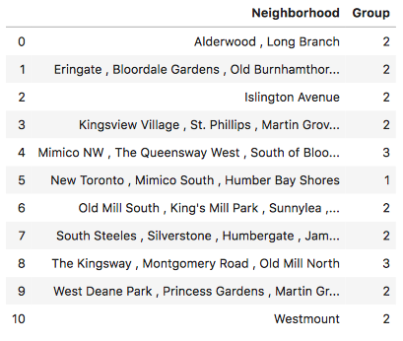
K-means Clustering
3 clusters

Slide 6
Top 3 Neighborhoods
Mimico NW , The Queensway West , South of Bloor , Kingsway Park South West , Royal York South West
2.The Kingsway , Montgomery Road , Old Mill North
3.New Toronto , Mimico South , Humber Bay Shores

