Slide 1
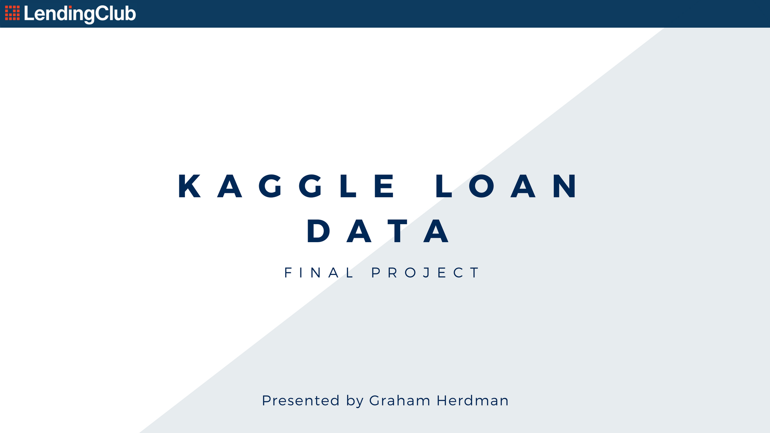

Slide 2

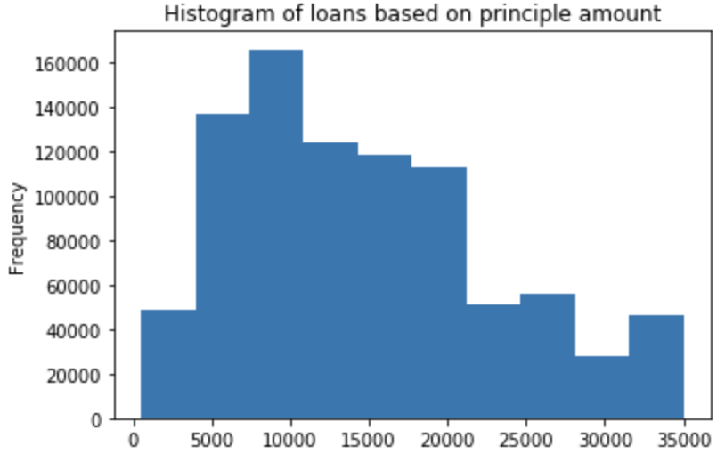
Lending Club Background
Peer to peer loans
Amounts: $1000 - $40 000
Hypothesis:
Top 5 features to use when predicting loan defaults.
Can we predict loan defaults with greater than 80% accuracy?

Slide 3

Assumptions
Dataset is indicative of the entire Australian/American loans market
At least 5 factors in the dataset are highly correlated with loan defaults
Metrics
Was I able to identify 5 factors
Was I able to beat 80% accuracy

Slide 4





Slide 5

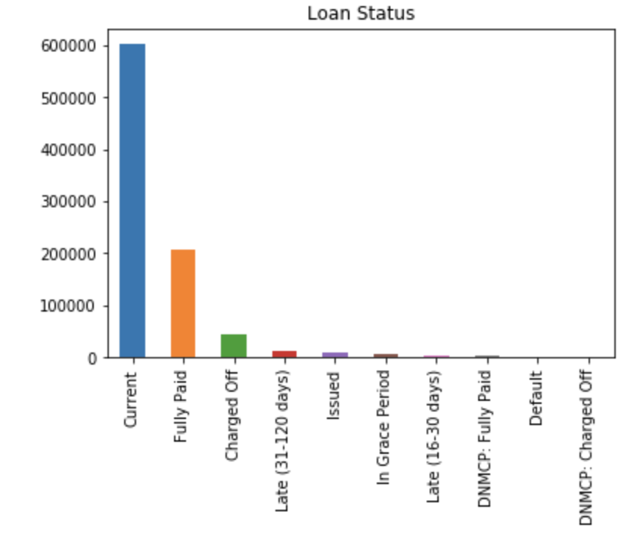
Data Cleaning
Features: 72 |---> 40
Prediction vector: Loan Status
Numeric - Mean imputation
Categorical - ‘other’
Preparing to Model
Removed Highly Correlated Features
Normalized and Standardised
50/50 positive/negative split

Slide 6



Slide 7

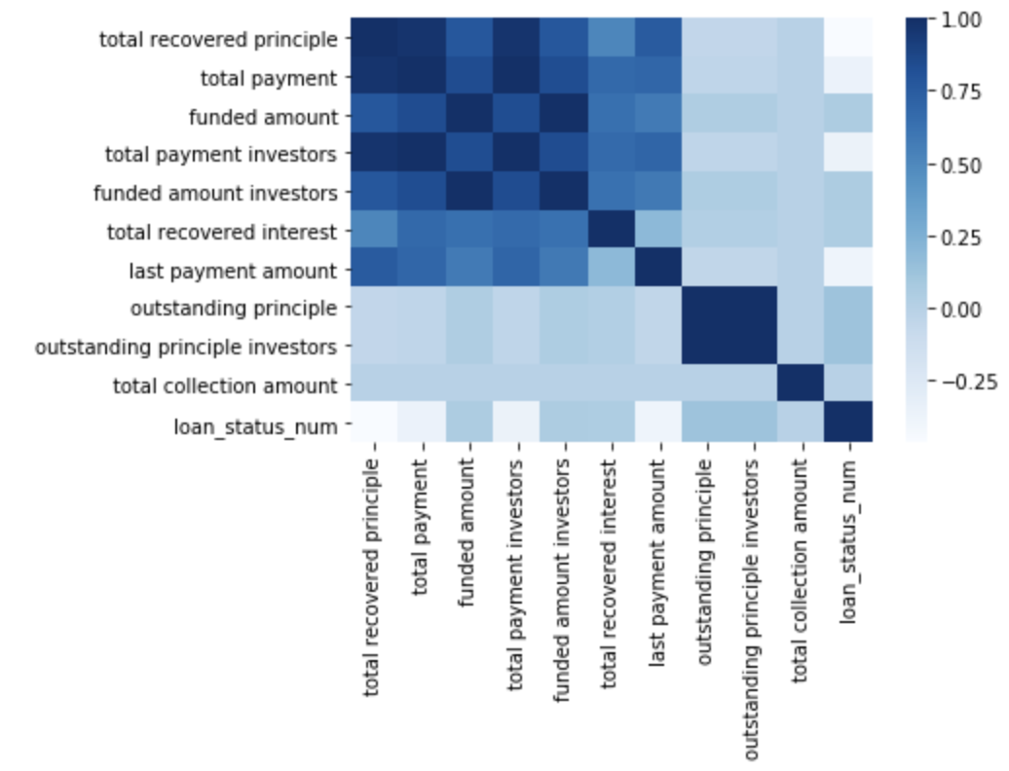
Logistic Regression
L2 regularization
Bias for numeric features
Random Forest
30 estimators
Max depth of 5
Top 10 Logistic Regression Features

Slide 8



Slide 9





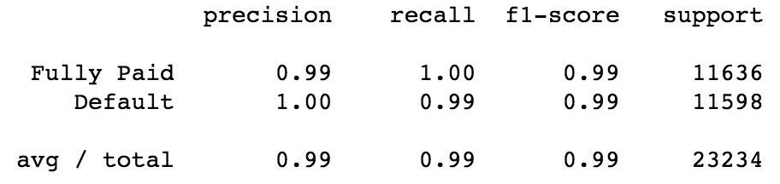
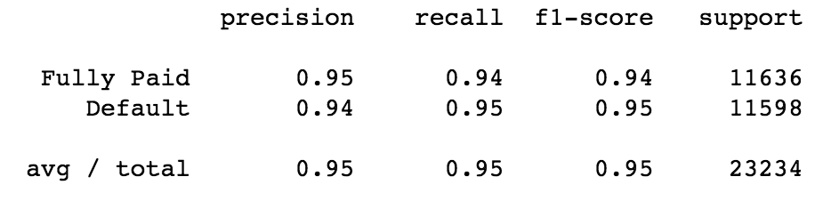
Subset Accuracies
Confusion matrices
F1 scores
Logistic Regression
Random Forest
Logistic Regression
Random Forest
Logistic Regression
Random Forest

Slide 10

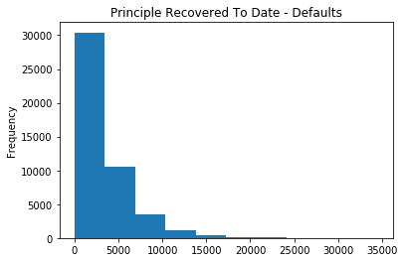
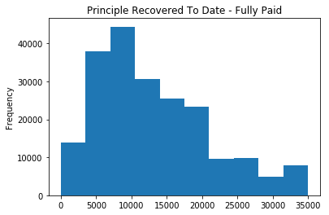
Top 5 Features
80%+ accuracy is easily achievable
Logistic Regression > Random Forest
Feature | Coefficient
total recovered principle | -(100.53)
total payment | 69.25
funded amount | 38.72
total payment investors | 21.65
funded amount investors | -(21.19)

Slide 11

Improvements
Domain expertise
Implementation on fresh data
Random Forest Hyper parameter tuning
Future performance evaluation
Accuracy loss over time
How much money have we lost?

