Slide 1


Introduction to Phishing Attacks
A phishing attack is a type of cybercrime in which attackers pose as a trustworthy institution in order to trick people into submitting sensitive information. This includes usernames, passwords, credit card information, and other sensitive data. Phishing attacks are frequently launched by email, social media messaging, or rogue websites, and they can have serious ramifications for individuals and businesses.

Slide 2
Types of Phishing Attacks
Spear Phishing
Vishing
Smishing
This type of phishing targets specific individuals or organizations, often with personalized information to make the emails or messages appear legitimate.
Also known as voice phishing, this method involves phone calls to trick individuals into revealing sensitive information.
Similar to phishing, smishing uses SMS or text messages to deceive individuals into providing personal information.

Slide 3

Recognizing Phishing Emails
1
Generic Greetings
2
Urgency or Threats
Phishing emails often use generic greetings like "Dear Customer" rather than addressing recipients by their names.
Phishing emails create a sense of urgency or use threats to manipulate individuals into taking quick action.
3
Unknown Sender
Be cautious of emails from unknown senders or email addresses that seem slightly altered from legitimate ones.

Slide 4
Identifying Phishing Websites
1
Mismatched URLs
2
Missing Padlock Symbol
3
Redirections
Check for any discrepancies in website URLs, such as misspelled domain names or extra characters.
Be cautious if the website suddenly redirects to a different and unfamiliar page, especially after entering personal information.
Legitimate websites use SSL encryption and display a padlock symbol in the address bar. Phishing sites may lack this security feature.

Slide 5
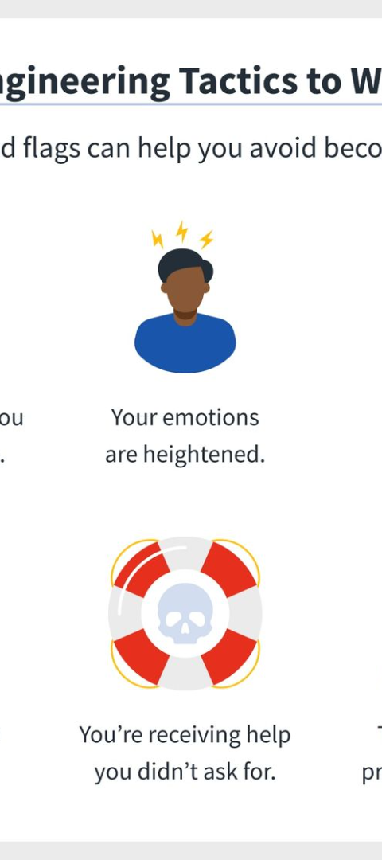



Social Engineering Tactics used in Phishing Attacks
Impersonation
Attackers impersonate individuals or organizations to gain trust and deceive targets into providing sensitive information.
Manipulation of Trust
Phishers exploit trust by pretending to be someone known to the target, such as a colleague, friend, or superior.
Emotional Manipulation
Using emotional triggers like fear, urgency, curiosity, or excitement to prompt recipients to take action.

Slide 6
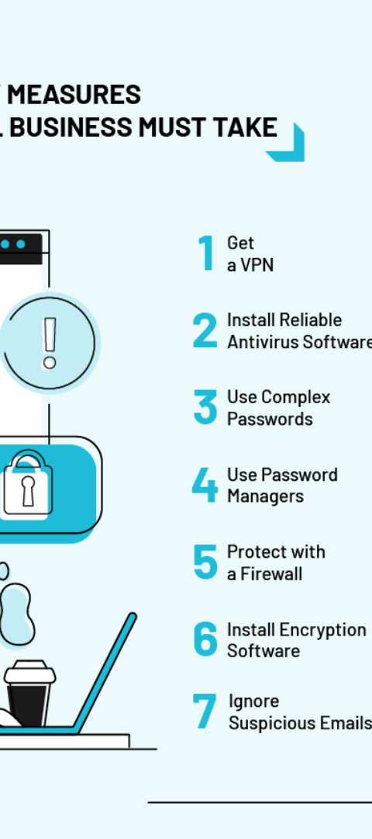
Tips for Avoiding Phishing Attacks
Be Vigilant
Keep Software Updated
Always verify the authenticity of emails, websites, and messages before providing any personal information.
Regularly update operating systems, applications, and security software to prevent vulnerabilities.
Use Multi-factor Authentication
Implement multi-factor authentication to add an extra layer of security for accessing accounts.

Slide 7
Common Targets of Phishing Attacks
Individuals
Businesses
Government Entities
Phishers target individuals to obtain personal information, financial details, and login credentials.
Businesses are targeted for sensitive company data, financial information, and proprietary secrets.
Government organizations are targeted to gain access to confidential information and classified data.

Slide 8

Consequences of Falling for a Phishing Attack
1
Data Breaches
2
Financial Loss
Personal and sensitive information can be compromised, leading to identity theft and financial loss.
Phishing attacks can result in financial fraud, unauthorized transactions, and loss of funds.
3
Reputation Damage
Businesses and individuals may suffer reputational damage due to leaked information or compromised security.

Slide 9

Reporting a Phishing Attack
1
Document Evidence
Record details of the phishing attack, including emails, websites, and any interactions with suspected phishers.
2
Report to Authorities
Inform relevant authorities such as cybersecurity agencies, financial institutions, and platform providers about the attack.
3
Warn Contacts
Notify contacts who may have been affected by the phishing attack to prevent further spread of the threat.

Slide 10

Conclusion and Key Takeaways
1
Stay Informed
2
Education and Training
Keep updated on the latest phishing techniques and security measures to stay vigilant against evolving threats.
Educate individuals and employees about phishing risks and provide regular training on recognizing and avoiding phishing attacks.
3
Collaboration and Communication
Promote open communication and collaboration between cybersecurity experts, organizations, and individuals to combat phishing attacks effectively.

