Slide 1
THE AGENT COST PROBLEM · THE CAPSTONE
Safe to Leave
Running Overnight
One uninstrumented agent. One looping input. Six steps, and every one of them proven by running it.
PRESENTER
RUNTIME
THE CODE
Emmanuel Naweji
~45 min · 6 sections
capstone/ in the course repo
Notes:
Welcome to the capstone.
Everything in the six modules was a piece. This is the assembly. We take the agent you met in module one; the one with no instrumentation and no ceiling; we give it the input that makes it loop, and we make it safe to leave running overnight.
Six steps. And here is the part that matters: at the end, every one of them is proven by running it with the mechanism turned off and then turned on. Not asserted in a comment. Proven.

Slide 2



WHAT THIS SESSION GIVES YOU
Not six ideas. One agent that stops.
A repo you can run
A check that proves it
Two numbers to show
Offline, free, deterministic; the model is simulated so nothing costs money.
verify.py: six steps, six proofs, each one turning a mechanism off.
What the runaway would have cost; what it costs now.
Every proof works by turning the mechanism off first. That is also how you argue for this work to whoever approves it.
Agent Cost Control · The Capstone
2
Notes:
What you walk out with is not six ideas; it is one agent that stops.
A repo you can run today. It is offline, free and deterministic, because nobody should have to spend money to learn cost control. A check that proves it, called verify.py. And two numbers you can show anybody who asks what this work was for.
One line to hold on to all session: every proof in here works by turning the mechanism off first. Run it with the cap disabled, watch what happens, turn it back on. That is not just how the tests work; it is how you get budget approved.

Slide 3
SECTIONS AT A GLANCE
Six sections; one agent at the end
01
~6 min
02
~8 min
03
~7 min
The Before Picture
The Six Steps
Order Matters
04
~8 min
05
~6 min
06
~10 min
Proof by Turning It Off
The Bill That Never Arrived
Build It
Agent Cost Control · The Capstone
3
Notes:
Six sections.
We start by watching the problem again for twenty seconds, because it is worth remembering what it feels like. Then the six steps and what each one actually buys you. Then the order they fire in, which is load-bearing and which almost everybody gets wrong. Then the proofs. Then the two numbers. Then you build it.

Slide 4
BEFORE YOU START
Install what you need
Ten minutes once, and every command in this session will run. Pick your side.
macOS · TERMINAL
WINDOWS · POWERSHELL
# install Homebrew first: brew.sh
$ brew install python git
$ brew install --cask docker
$ brew install --cask visual-studio-code
$ docker --version && python3 --version
# winget ships with Windows 11
> winget install Python.Python.3.12
> winget install Git.Git
> winget install Docker.DockerDesktop
> winget install Microsoft.VisualStudioCode
AND THEN THE REPO
$ git clone https://github.com/Here2ServeU/agent-cost-control && cd agent-cost-control/capstone
Agent Cost Control · The Capstone
4
Notes:
[SETUP]
If your machine is not set up yet, stop here and watch the video for your computer. The Mac one is youtu.be/8ZIiXg4XOY0; the Windows one is youtu.be/3e2-GRBibWc.
Docker Desktop matters for this session because the last section brings up Prometheus and Grafana. Everything else runs with plain Python.
Then clone the course repo and change into the capstone folder. Everything from here happens in there.

Slide 5
BEFORE YOU START
Watch these before you install anything
Two short videos take you from a blank machine to Git, Python and VS Code installed. Pick the one for your computer.
macOS
WINDOWS
Install Git, Python and VS Code on a Mac
Install Git, Python and VS Code on Windows
https://youtu.be/8ZIiXg4XOY0
https://youtu.be/3e2-GRBibWc
THREE COMMANDS AND YOU ARE RUNNING
pip install -r requirements.txt
the only dependency is prometheus_client
python3 verify.py
the capstone check; six proofs
docker compose up -d
Prometheus, Grafana, pushgateway
Agent Cost Control · The Capstone
5
Notes:
[SETUP]
The videos are the same two from every module. Nothing new.
Three commands and you are running. One dependency, prometheus_client, and that is only so the metrics look exactly like they would in production. The model itself is simulated, so nothing in this session costs a cent.

Slide 6
01
The Before Picture
~6 min
Notes:
Twenty seconds with the problem, so the fix means something.

Slide 7
01 · THE BEFORE PICTURE
Nothing in it can stop it
This is the agent you start with. It is honest about nothing.
$ timeout 20 python3 naive_agent.py --input samples/malformed.json
WHAT YOU SEE
WHAT YOU DO NOT SEE
Steps scrolling past. Then more steps. It ends because you killed it, not because it finished.
A single number telling you what those steps cost. Not one. That is the whole problem.
It runs until somebody notices. On a Tuesday night, that means until the morning.
Agent Cost Control · The Capstone
7
Notes:
Run this. Actually run it, for twenty seconds, before you fix anything.
What you see is steps scrolling past. What you do not see is a single number telling you what those steps cost. Not one. There is no cost accounting, no cap, no loop detection, no checkpoint, no definition of success, and no alert.
It ends because you killed it. It did not finish. It cannot finish, because the input makes it bounce between parsing and validating forever, and nothing in the program is watching for that.
It runs until somebody notices. On a Tuesday night, that means until the morning, and the person who notices is usually not you.
→ Next: the six things that change that.

Slide 8
01 · THE BEFORE PICTURE
Three inputs, three ways to lose money
good.json
Finishes in five steps. This is the control; you need one.
converging
malformed.json
Parse, validate, parse, validate. The input that started the course.
bouncing
drifting.json
Never repeats, never finishes. The expensive one, because nothing looks wrong.
drifting
Stuck and bouncing are loud. Drifting is the one that empties an account quietly, because every step looks like progress.
Agent Cost Control · The Capstone
8
Notes:
Three sample inputs, because you need more than one failure shape to test against.
Good JSON converges in five steps. You need a control; without one you cannot tell whether a change made things better.
Malformed bounces. Parse, validate, parse, validate. It is the input from module one and it is the one we use for most of the session.
Drifting never repeats itself and never finishes either. Every single step looks like progress: a new field, a new lookup, something new to explore. That is the one that quietly empties an account, because nothing about it looks wrong until the bill arrives.
→ Next: the six steps.

Slide 9


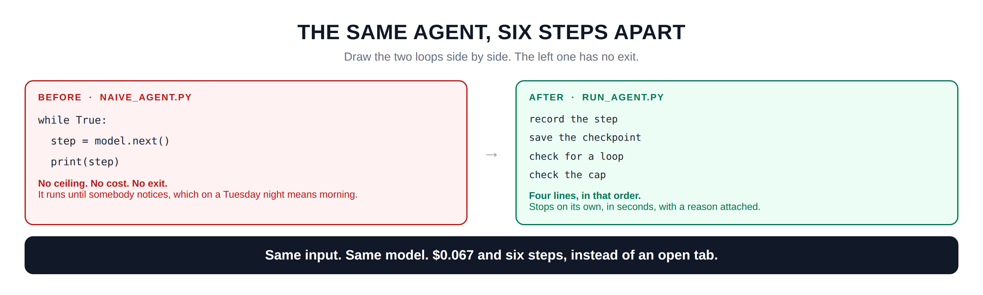
Hidden slide · presenter reference · 01 · The Before Picture
iPAD · DRAW
Draw the two loops
New iPad page. The naive loop on the left, the safe loop on the right, then the line underneath.
Two boxes side by side, the left one red, the right one green
Left, titled BEFORE, naive_agent.py. Write the three lines: while True, step equals model dot next, print step
Underneath in red: no ceiling, no cost, no exit
A fat arrow between the two boxes
Right, titled AFTER, run_agent.py. Four lines stacked: record the step, save the checkpoint, check for a loop, check the cap
Underneath in green: four lines, in that order. Stops on its own, with a reason attached
A dark bar across the bottom: same input, same model, seven cents and six steps instead of an open tab
FINISHED PANEL: WHAT YOURS SHOULD LOOK LIKE
Say: “The difference between these two is four lines, in the right order.”
Agent Cost Control · The Capstone
9
Notes:
[HIDDEN SLIDE — iPad segment. Skip in slideshow.]
Production note: New iPad page. The naive loop on the left, the safe loop on the right, then the line underneath.
SAY:
Let's draw the before and after, because the whole session fits in one picture.
THEN SAY:
Notice what is not on the right-hand side. There is no clever algorithm. There is no new framework. It is four things you already know how to write, in an order that matters. That is genuinely all this is, and that is why it is worth actually doing rather than putting on a roadmap.
→ Next: the six steps and what each one buys.

Slide 10
02
The Six Steps
~8 min
Notes:
What each one costs you to build, and what it buys.

Slide 11
02 · THE SIX STEPS
Each one buys exactly one thing
1
Instrument it
2
Cap it
3
Detect the loop
buys you
buys you
buys you
you can see it
it is bounded
6 steps, not 14
4
Checkpoint
5
Cost per success
6
Alert on the rate
buys you
buys you
buys you
stopping is cheap
the true number
you find out
Each one is useless alone and boring together. Boring is the goal; an agent nobody has to watch is the deliverable.
Agent Cost Control · The Capstone
11
Notes:
Six steps, and each one buys exactly one thing.
Instrument it, and you can see it. Cap it, and it is bounded. Detect the loop, and it stops in six steps instead of fourteen. Checkpoint it, and stopping becomes cheap. Cost per successful task, and you finally have the true number. Alert on the rate, and you find out while it is happening.
Here is the honest bit. Each one of these on its own is close to useless. Instrumentation with no cap just means you get to watch the money leave in high resolution. A cap with no checkpointing means every stop throws away work. They only work together.
And together they are boring. Nothing dramatic happens. That is the goal: an agent nobody has to watch is the deliverable.
→ Next: what it costs to build each one.

Slide 12
02 · THE SIX STEPS
One file each, and none of them are long
agent/metrics.py
step 1
what it cost, and who pays
~60 lines
agent/budget.py
step 2
per run, per day, behaviour chosen
~70 lines
agent/loops.py
step 3
stuck, bouncing, drifting
~60 lines
agent/checkpoint.py
step 4
save after every completed step
~45 lines
report.py
step 5
the arithmetic, with its definition
~60 lines
prometheus/rules/
step 6
fast window and slow window
~50 lines
The whole safety layer is under four hundred lines. It is not hard; it is just never the thing anybody does first.
Agent Cost Control · The Capstone
12
Notes:
One file for each step, and none of them are long.
Metrics, about sixty lines. Budget, seventy. Loop detection, sixty. Checkpointing, forty-five. The report, sixty. The alert rules, fifty.
The whole safety layer is under four hundred lines. I want that number on the screen because of what people assume. They assume cost control is a platform problem; that it needs a team and a quarter and a vendor. It needs an afternoon.
It is not hard. It is just never the thing anybody does first, because it is not the demo.
→ Next: the order they fire in.

Slide 13
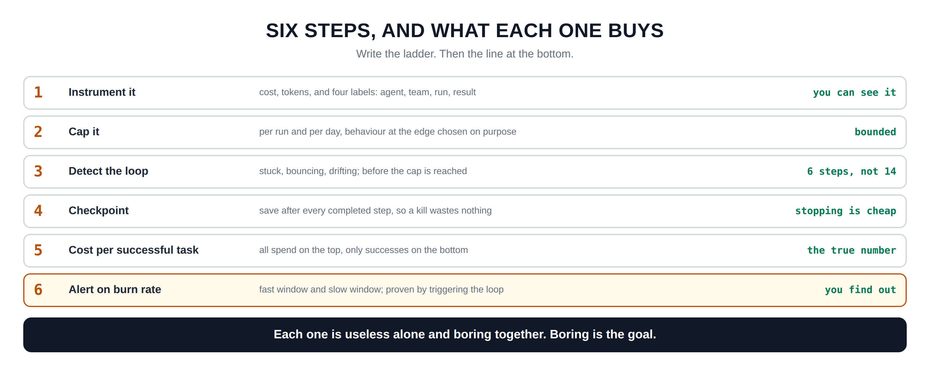
Hidden slide · presenter reference · 02 · The Six Steps
iPAD · DRAW
Draw the ladder
New iPad page. Six rungs, each with what it buys on the right.
Six wide rows down the page, numbered one to six on the left in orange
Row one: INSTRUMENT IT. Middle: cost, tokens, four labels. Right: you can see it
Row two: CAP IT. Middle: per run and per day, behaviour chosen on purpose. Right: bounded
Row three: DETECT THE LOOP. Middle: stuck, bouncing, drifting, before the cap. Right: six steps, not fourteen
Row four: CHECKPOINT. Middle: save after every completed step. Right: stopping is cheap
Row five: COST PER SUCCESSFUL TASK. Middle: all spend on top, only successes on the bottom. Right: the true number
Row six, boxed in amber: ALERT ON BURN RATE. Middle: fast window and slow window. Right: you find out
A dark bar at the bottom: each one is useless alone and boring together. Boring is the goal
FINISHED PANEL: WHAT YOURS SHOULD LOOK LIKE
Say: “Six rungs. Each one buys exactly one thing, and none of them work alone.”
Agent Cost Control · The Capstone
13
Notes:
[HIDDEN SLIDE — iPad segment. Skip in slideshow.]
Production note: New iPad page. Six rungs, each with what it buys on the right.
SAY:
Let's write the ladder, because the right-hand column is the part people skip.
THEN SAY:
If somebody only ever does two of these, make it one and three. Instrumentation and loop detection. Those two together catch most of what actually goes wrong, and they are the cheapest to build. The cap is the seatbelt you hope never to need; loop detection is the thing that stops the crash.
→ Next: the order inside the loop.

Slide 14
03
Order Matters
~7 min
Notes:
Four checks, one order, and two reasons it cannot be any other.

Slide 15
03 · ORDER MATTERS
Record, checkpoint, loop, cap
→
→
→
1
2
3
4
Record the step
Save the checkpoint
Check for a loop
Check the cap
before anything can go wrong
the work that just finished
the cheap stop
the expensive stop
WHY RECORD FIRST
WHY LOOP BEFORE CAP
You want the cost of the step that killed you. A step recorded after the check is money you spent and cannot see.
The cap costs the whole budget to use. Detection costs three or four steps. Fire the cheap one first, every time.
Read agent/runner.py top to bottom. Every mechanism in this course appears exactly once.
Agent Cost Control · The Capstone
15
Notes:
Four checks, and the order is load-bearing.
Record the step. Save the checkpoint. Check for a loop. Check the cap. Every time, in that order.
Why record first? Because you want the cost of the step that killed you. If you record after the check, the step that triggered the stop is money you spent and cannot see; and that is precisely the step somebody will ask you about.
Why loop detection before the cap? Because the cap costs you the entire budget to use. It works, but by the time it fires you have spent everything you were willing to spend. Detection costs three or four steps. Fire the cheap stop first, every single time.
If you read one file in this repo, read runner.py, top to bottom. Every mechanism in this course appears exactly once, in the order it has to fire.
→ Next: what the pre-flight check adds.

Slide 16
03 · ORDER MATTERS
One more check, before the step runs
Charging after the fact is honest but late. A cheap estimate before the step stops you overshooting the cap on the last one.
if budget.would_exceed(0.01):
stop("pre-flight: next step would cross the per-run cap")
Without it
With it
You cross the cap by whatever the last step happened to cost. On an expensive model, that overshoot is the whole point of having a cap.
The run stops just under the line, every time, and the reason says so in words a person can read.
The run that stops at $0.0446 against a $0.05 cap did not get lucky; it declined to start a step it could not afford to finish.
Agent Cost Control · The Capstone
16
Notes:
One more check, and it is the one people leave out.
Charging after the step is honest, but it is late. You have already spent the money. A cheap estimate before the step lets you decline to start something you cannot afford to finish.
Without it, you cross your cap by whatever the last step happened to cost. On an expensive model with a long context, that overshoot can be a meaningful fraction of the cap itself, which rather defeats the point.
With it, the run stops just under the line, every time, and the reason field says so in words a person can read. In the repo you will see a run stop at four and a half cents against a five cent cap. It did not get lucky. It declined to start a step it could not afford.
→ Next: proving all of it.

Slide 17
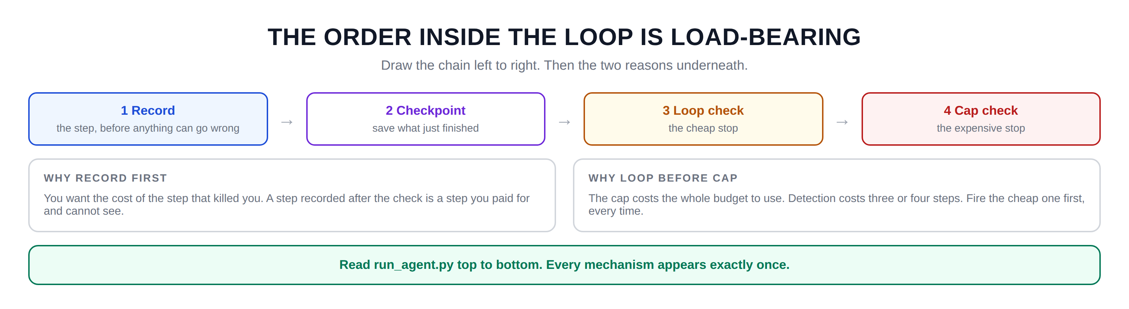
Hidden slide · presenter reference · 03 · Order Matters
iPAD · DRAW
Draw the chain
New iPad page. Four links left to right, then the two reasons underneath.
Four boxes in a row across the page, arrows between them
Box one, blue: RECORD. Underneath: the step, before anything can go wrong
Box two, violet: CHECKPOINT. Underneath: save what just finished
Box three, amber: LOOP CHECK. Underneath: the cheap stop
Box four, red: CAP CHECK. Underneath: the expensive stop
Two wide boxes below. Left, WHY RECORD FIRST: you want the cost of the step that killed you
Right, WHY LOOP BEFORE CAP: the cap costs the whole budget; detection costs four steps
Green bar at the bottom: read runner.py top to bottom, every mechanism appears exactly once
FINISHED PANEL: WHAT YOURS SHOULD LOOK LIKE
Say: “The cheap stop fires before the expensive one. That is the whole ordering rule.”
Agent Cost Control · The Capstone
17
Notes:
[HIDDEN SLIDE — iPad segment. Skip in slideshow.]
Production note: New iPad page. Four links left to right, then the two reasons underneath.
SAY:
Let's draw the chain, because the order is the part that is easy to get wrong and hard to notice.
THEN SAY:
Here is a test for whether you have this right in your own code. Take the run that stopped. Can you say what the last step cost, and can you say which check stopped it, without reading the source? If either answer is no, something is firing in the wrong order or recording too late.
→ Next: proof by turning it off.

Slide 18
04
Proof by Turning It Off
~8 min
Notes:
Six claims, and the only kind of evidence worth anything.

Slide 19
04 · PROOF BY TURNING IT OFF
A comment is not evidence
Every mechanism in this repo can be disabled by a flag. That is not a convenience; it is how each one is proved.
--no-caps
step 2 off
run the runaway and watch the projection climb
--no-loop-detect
step 3 off
the same input, stopped by the cap instead, at twice the cost
--no-checkpoint
step 4 off
kill it and measure what you just threw away
This is also how you get it approved. "Trust me" gets no budget. "Here is the same run with the cap off" does.
Agent Cost Control · The Capstone
19
Notes:
Every mechanism in this repo can be turned off with a flag, and that is not a convenience feature. It is how each one is proved.
No caps: run the runaway and watch the projected monthly spend climb past the budget. No loop detection: the same input, stopped by the cap instead, at roughly twice the cost. No checkpoint: kill it and measure exactly what you threw away.
And this is also how you get the work approved. I want to be direct about this, because it is the difference between doing this and being allowed to do this. Nobody funds a safety layer on the strength of an argument. They fund it when you show them the same run twice; once with the mechanism off, once with it on, and the difference in dollars on the screen.
→ Next: the six proofs.

Slide 20
04 · PROOF BY TURNING IT OFF
Six claims, six proofs
1 Instrumented
run it, assert the counters moved
$0.0671 / 6 steps
2 Capped
loop detection off, $0.05 cap
capped at $0.0446
3 Loop caught first
detector on vs off, same input
6 steps vs 14
4 Checkpointed
kill partway, resume, compare
$0.0291 not re-paid
5 Cost per success
ten runs; six good, four looping
129% above per-request
6 Alerted
runaway with caps off
$9,145/mo vs $300
python3 verify.py; and it exits non-zero if any of the six stops being true.
Agent Cost Control · The Capstone
20
Notes:
Six claims, six proofs. This is verify.py, and it is the capstone check.
Instrumented: run it, assert the counters actually moved, and assert a million input tokens prices out to exactly three dollars.
Capped: turn loop detection off so the cap is the only thing left that can stop it, set a five cent cap, and it stops at four and a half cents.
Loop caught first: the same input twice, detector on and off. Six steps against fourteen.
Checkpointed: kill a good run partway, resume it, and assert the resumed run carries over at least what the killed one spent.
Cost per success: ten runs, six good and four looping, and the per-success number comes out well above per-request.
Alerted: run the runaway with caps off and compute the same projection the Prometheus rule computes.
And it exits non-zero if any of those stops being true. Put it in CI and the safety layer cannot quietly rot.
→ Next: the two numbers.

Slide 21
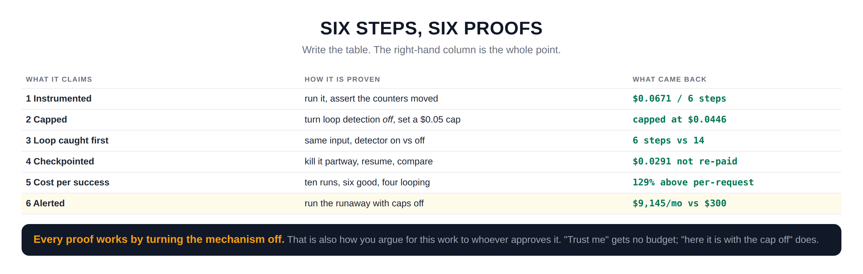
Hidden slide · presenter reference · 04 · Proof by Turning It Off
iPAD · DRAW
Draw the proof table
New iPad page. Three columns; the right-hand one is the takeaway.
Three column headings: WHAT IT CLAIMS, HOW IT IS PROVEN, WHAT CAME BACK
Six rows, numbered. Keep the right column in green and monospaced; those are real numbers
Row one: instrumented; run it and assert the counters moved; $0.0671 over six steps
Row two: capped; turn loop detection OFF and set a five cent cap; capped at $0.0446
Row three: loop caught first; detector on versus off; six steps against fourteen
Row four: checkpointed; kill partway, resume, compare; $0.0291 not re-paid
Row five: cost per success; ten runs, six good and four looping; 129 percent above per-request
Row six, highlighted: alerted; runaway with caps off; $9,145 a month against a $300 budget
A dark bar at the bottom: every proof works by turning the mechanism off
FINISHED PANEL: WHAT YOURS SHOULD LOOK LIKE
Say: “Every proof works by turning the mechanism off. That is also the budget conversation.”
Agent Cost Control · The Capstone
21
Notes:
[HIDDEN SLIDE — iPad segment. Skip in slideshow.]
Production note: New iPad page. Three columns; the right-hand one is the takeaway.
SAY:
Let's write the proof table, and pay attention to the middle column.
THEN SAY:
One practical note. Put verify.py in your CI pipeline. Safety layers rot quietly; somebody refactors the runner, the checkpoint stops being written after every step, and nothing fails until the night it matters. A check that exits non-zero is the only thing that keeps this true six months from now.
→ Next: the bill that never arrived.

Slide 22
05
The Bill That Never Arrived
~6 min
Notes:
Two numbers, one subtraction, and the conversation it starts.

Slide 23
05 · THE BILL THAT NEVER ARRIVED
The number nobody will thank you for
MODULE 1
NOW
what it would have cost
what it actually costs
$1,400+
$0.07
Same agent, same input, nothing in the way. Found in the morning, by somebody else.
Six steps. Stopped by loop detection, with a reason written down. Found in three seconds.
Nobody will ever thank you for this number, because it never appears on an invoice.
Which is exactly why you have to show it to them yourself.
Agent Cost Control · The Capstone
23
Notes:
Two numbers.
The first is what that input would have cost in module one, with nothing in the way, extrapolated across one night. The second is what the same input costs now: six steps, seven cents, stopped by loop detection with a reason written down.
And here is the uncomfortable thing about the difference between them. Nobody will ever thank you for it, because it never appears on an invoice. There is no line item called 'the runaway that did not happen'. The work that prevents an incident is invisible in exactly the way that the incident is not.
Which is why you have to show it to them yourself. Run the uncapped version once, deliberately, in a controlled way, record the number, and put it next to the number you have now. That is the only form this argument takes that anybody acts on.
→ Next: saying it in their words.

Slide 24
05 · THE BILL THAT NEVER ARRIVED
Three sentences, for three different rooms
TO YOUR MANAGER
"The agent that ran away in March now stops itself in six steps. Here is the run with the protection off, and here it is with it on."
TO FINANCE
"Thirty-one cents per resolved ticket, and we can tell you what share of spend goes to work that fails. It is currently nine percent."
TO THE ENGINEER WHO HAS TO KEEP IT
"Four hundred lines, one check that fails in CI if any of it breaks, and every mechanism has a flag so you can measure what it buys."
Same work, three times, in the unit each room already counts in.
Agent Cost Control · The Capstone
24
Notes:
The same work, said three ways, because three different rooms count in three different units.
Your manager wants the incident that will not recur. Show the run with the protection off and the run with it on; that is a before and after they can repeat to their own manager.
Finance wants a unit they already understand. Not tokens, not runs; cents per resolved ticket, and the share of spend going to work that fails.
And the engineer who inherits this wants to know it will not become their problem. Four hundred lines, a check that fails in CI, and a flag on every mechanism so they can measure what each one buys rather than taking your word for it.
Same number. Three units. Say it in the one the room already uses.
→ Last section: build it.

Slide 25
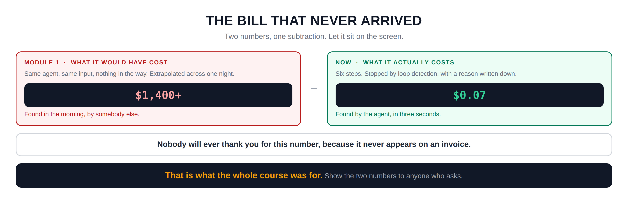
Hidden slide · presenter reference · 05 · The Bill That Never Arrived
iPAD · DRAW
Draw the two numbers
New iPad page. Two boxes, a minus sign between them, then let it sit.
Two large boxes side by side. Left red, right green
Left, MODULE 1: what it would have cost. Big number: $1,400 plus. Underneath: found in the morning, by somebody else
A large minus sign between the boxes
Right, NOW: what it actually costs. Big number: $0.07. Underneath: found by the agent, in three seconds
A wide box underneath: nobody will ever thank you for this number, because it never appears on an invoice
A dark bar at the very bottom in gold: that is what the whole course was for
FINISHED PANEL: WHAT YOURS SHOULD LOOK LIKE
Say: “Fourteen hundred dollars, minus seven cents. Nobody will ever send you that invoice.”
Agent Cost Control · The Capstone
25
Notes:
[HIDDEN SLIDE — iPad segment. Skip in slideshow.]
Production note: New iPad page. Two boxes, a minus sign between them, then let it sit.
SAY:
Let's draw the two numbers, and then leave them on the screen for a second.
THEN SAY:
Do not rush off this slide. Let it sit. This is the one people photograph, and it is the one they repeat in a meeting you are not in.
→ Next: build it, for real this time.

Slide 26
06
Build It: the Whole Thing, in Order
~10 min
Notes:
Six commands, in the order the steps were built. Then the capstone check.

Slide 27
06 · BUILD IT
Six commands, then the check
STEP 1
STEP 2
STEP 3
Watch it fail
Watch it stop
Prove the cap
naive_agent.py, twenty seconds
run_agent.py, same input
loop detection off
STEP 4
STEP 5
STEP 6
Prove the checkpoint
Read the true number
Prove the alert
kill it, resume it
report.py
caps off, then straight back on
Then python3 verify.py. Six PASS lines, and the agent is safe to leave running overnight; not because I said so, but because the thing that would have hurt you was tried and stopped.
Agent Cost Control · The Capstone
27
Notes:
Six commands, in the order the steps were built, and then the check.
Watch it fail. Watch it stop. Prove the cap by turning detection off. Prove the checkpoint by killing it and resuming. Read the true number. Prove the alert by running the runaway with caps off, and then turn them straight back on.
Then verify.py, and six PASS lines.
Do the sixth one carefully. Turning caps off on purpose is the only genuinely dangerous thing in this entire course, and it is dangerous on exactly one input. Do it with the step ceiling set, do it once, and turn them back on before you walk away.

Slide 28
06 · BUILD IT: STEP 1 OF 6
Watch it fail
Twenty seconds with the problem. No cost, no ceiling, no exit.
$ timeout 20 python3 naive_agent.py --input samples/malformed.json
Steps scroll past and stop only because you killed it. Not one number on that screen tells you what it cost.
Agent Cost Control · The Capstone
28
Notes:
[VS CODE / TERMINAL — TYPE THIS]
Step one. Run the naive agent against the looping input, with a timeout so it ends.
Let it run the full twenty seconds on screen. People need to watch it not stop. Point at the output and say: there is no number here. Not one.

Slide 29
06 · BUILD IT: STEP 2 OF 6
Watch it stop
Same input. Same model. Everything switched on.
$ python3 run_agent.py --input samples/malformed.json
run d8d915fa STOPPED: loop detected
why bouncing: 'validate:amount' <-> 'parse:amount' for 3 cycles
steps 6
cost $0.0671
A reason a person can read, attached to a number a person can act on.
Agent Cost Control · The Capstone
29
Notes:
[VS CODE / TERMINAL — TYPE THIS]
Step two. Same input, same model, everything switched on.
Six steps. Seven cents. And look at the 'why' line: bouncing, validate to parse, for three cycles. That is a reason a person can read, attached to a number a person can act on. The naive version gave you neither.

Slide 30
06 · BUILD IT: STEP 3 OF 6
Prove the cap, with the detector off
Turn loop detection off so the cap is the only thing left that can stop it.
$ python3 run_agent.py --input samples/malformed.json --no-loop-detect --per-run-usd 0.05
14 steps and $0.1455, against 6 steps and $0.0671 with the detector on. The cap works. It just costs you the whole budget to find out.
Agent Cost Control · The Capstone
30
Notes:
[VS CODE / TERMINAL — TYPE THIS]
Step three. Turn loop detection off, so the cap is the only thing left that can stop it, and set the cap low so you do not wait.
Fourteen steps and fourteen cents, against six steps and seven cents with the detector on. Both stopped. One cost twice as much to stop.
That is the argument for loop detection in one command, and it is the argument you use when somebody says the cap is enough.

Slide 31
06 · BUILD IT: STEP 4 OF 6
Prove the checkpoint
Kill a good run partway. Then resume it and watch what it does not pay for twice.
$ python3 run_agent.py --input samples/good.json --step-ceiling 3
$ python3 run_agent.py --input samples/good.json --resume
not re-paid $0.0291 ; the finished work the checkpoint kept. Without it, every stop you build costs you a restart.
Agent Cost Control · The Capstone
31
Notes:
[VS CODE / TERMINAL — TYPE THIS]
Step four. Kill a good run partway with a low step ceiling, then resume it.
The resumed run prints a line that says 'not re-paid', and a number. That is the work the checkpoint kept.
This is the step people skip, and skipping it quietly undermines everything else. If stopping is expensive, you will set your caps too loose, because every stop hurts. Make stopping cheap and you can afford to be strict.

Slide 32
06 · BUILD IT: STEP 5 OF 6
Read the true number
Run a batch, good and bad mixed, then ask for the arithmetic.
$ python3 report.py
succeeded 7 <- the denominator
did not 10 <- still counts on top
cost per request $0.2485 (pays by the mile)
cost per SUCCESSFUL $0.6035 (pays for arrival)
failed-run tax $3.7971 (90% of spend)
Agent Cost Control · The Capstone
32
Notes:
[VS CODE / TERMINAL — TYPE THIS]
Step five. Run a batch with good and bad inputs mixed, then ask for the arithmetic.
Successes on the bottom. Failures still counted on the top. And the failed-run tax as a share of spend, which in this deliberately ugly sample is ninety percent.
Notice the report prints the definition of success every single time, right above the number. A number without its definition is not a measurement; it is a rumour.

Slide 33

06 · BUILD IT: STEP 6 OF 6
Prove the alert, then turn the caps back on
Bring the stack up, then run the runaway deliberately, with the ceiling set.
$ docker compose up -d
$ python3 run_agent.py --input samples/malformed.json --no-caps --no-loop-detect --push
This is the only dangerous command in the course. Keep the step ceiling, run it once, and turn the caps back on before you walk away.
Agent Cost Control · The Capstone
33
Notes:
[VS CODE / TERMINAL — TYPE THIS]
Step six. Bring the stack up; Prometheus on 9090, Grafana on 3000, and a pushgateway, because a run that lasts four seconds is never scraped.
Then run the runaway deliberately with caps and detection off, and push the metrics. Watch the fast rule cross its threshold.
And I want to be blunt about this one. This is the only genuinely dangerous command in the entire course. Keep the step ceiling on. Run it once. Turn the caps back on before you walk away from the machine. An alert you have never seen fire is not an alert; but an alert you prove by accident at three in the morning is worse.

Slide 34
06 · BUILD IT: THE CHECK
Six PASS lines
$ python3 verify.py
1. Instrumented: cost, tokens, labels PASS
2. Capped: per run and per day, deliberately PASS
3. Loop caught before the cap is reached PASS
4. Checkpointed: a kill wastes nothing PASS
5. Cost per successful task, failures on top PASS
6. Alerted on burn rate, proven by triggering it PASS
Put it in CI. Safety layers rot quietly, and a check that fails is the only thing that keeps this true in six months.
Agent Cost Control · The Capstone
34
Notes:
[VS CODE / TERMINAL — TYPE THIS]
And then the check. Six PASS lines.
One last practical thing, and it matters more than it sounds. Put verify.py in your CI pipeline. Safety layers rot quietly. Somebody refactors the runner, the checkpoint stops being written after every step, and nothing fails; not until the night it matters.
A check that exits non-zero is the only thing that keeps this true six months from now, when you have moved on to something else and somebody new owns the code.

Slide 35
THE WHOLE COURSE
Seven sessions, one agent
WHERE WE STARTED
WHERE WE ARE
An agent that could spend four figures overnight while every dashboard stayed green.
An agent that stops itself in six steps, at a cost you chose, with a reason written down; and a check that proves it still does.
One number, and a shrug.
Under four hundred lines, and an afternoon. Not a platform, not a quarter, not a vendor.
The runaway that started this course now stops on its own, in seconds, at a cost you chose in advance.
Agent Cost Control · The Capstone
35
Notes:
Seven sessions. One agent.
We started with something that could spend four figures overnight while every dashboard stayed green, and one number, and a shrug.
We end with an agent that stops itself in six steps, at a cost you chose, with a reason written down, and a check that proves it still does that tomorrow.
Under four hundred lines. An afternoon. Not a platform, not a quarter, not a vendor; and I keep saying that because the assumption that this is big is the single most common reason it never gets done.

Slide 36
THE IDEA WORTH KEEPING
Every one of these six
is a decision moved earlier.
A cap
deciding what a task is worth before it runs, instead of after
A step limit
deciding how long is too long while you are calm, rather than during an incident
A definition of success
deciding what you mean before you report a number, rather than in a meeting
A checkpoint
deciding that stopping should be cheap, before you need to stop
None of these are hard in advance. All of them are hard at three in the morning.
Agent Cost Control · The Capstone
36
Notes:
The idea worth keeping, and it is not technical.
Every one of these six is a decision moved earlier. A cap is deciding what a task is worth before it runs instead of after. A step limit is deciding how long is too long while you are calm rather than during an incident. A definition of success is deciding what you mean before you report a number rather than being asked in a meeting. A checkpoint is deciding that stopping should be cheap, before the night you need to stop.
None of those are hard in advance. All of them are hard at three in the morning, which is exactly when you will otherwise be making them.
That is what cost control actually is. Not cleverness. Deciding early, writing it down, and letting a machine enforce it while you sleep.

Slide 37
THE AGENT COST PROBLEM · COURSE COMPLETE
Decide early. Write it down.
Let a machine enforce it.
Go and run verify.py against your own agent. Then show somebody the two numbers.
Thank you for building this with me.
Emmanuel Naweji · github.com/Here2ServeU/agent-cost-control
Notes:
That is the course.
Go and run verify.py against your own agent; not this one, yours. Then show somebody the two numbers.
Thank you for building this with me.

Slide 38
APPENDIX A
Exercises
01
02
03
04
Run the before picture
Break the order
Turn off one mechanism
Add a fourth loop shape
Twenty seconds with naive_agent.py. Watch it not stop.
Move the record call after the cap check. Then try to say what the last step cost.
Any one. Run it. Write down what the number became.
Something your own agent does. Add it to loops.py and to verify.py.
05
06
07
08
Tighten the cap
Put verify.py in CI
Swap in a real model
Record your two numbers
Halve per_run_usd. Find what stops succeeding, and decide whether you care.
Make it fail on purpose once, so you know the failure is visible.
Replace SimulatedModel. Nothing else should need to change.
Uncapped extrapolation, and today's. Keep them where you can find them.
Agent Cost Control · The Capstone
38
Notes:
Eight exercises. Two and three are the ones that teach the most, because they both work by breaking something on purpose and watching what you lose.

Slide 39
APPENDIX B · EVERY WORD WE USED, IN PLAIN ENGLISH
Glossary
01
02
03
04
Capstone
Pre-flight check
Cardinality bomb
The ledger
One agent with all six mechanisms on it, and a check that proves each one.
Estimating a step's cost before running it, so you do not overshoot the cap on the last one.
A metric label with a new value every run. It kills Prometheus long before it kills your agent.
One appended line per run. Prometheus says what is happening; the ledger says what happened.
05
06
07
08
Atomic write
Proof by turning it off
The failed-run tax
The bill that never arrived
Write to a temp file, then rename. A half-written checkpoint is worse than none.
Running with a mechanism disabled to measure what it was buying you.
The share of spend that went to runs which did not succeed.
The difference between the uncapped extrapolation and today's number.
Agent Cost Control · The Capstone
39
Notes:
Eight terms from this session, in plain English. Three and five are the two that bite people in production.

Slide 40
APPENDIX C · THE COMMANDS, IN PLAIN ENGLISH
Everything you typed
python3 naive_agent.py
The before picture. No cost, no ceiling, no exit.
python3 run_agent.py --input X
The safe agent. Same model, six mechanisms on.
--no-loop-detect
Turn step 3 off, so the cap is the only thing that can stop it.
--no-caps
Turn step 2 off. The one dangerous flag; use it once, with the ceiling on.
--resume
Pick up from the last checkpoint instead of paying again.
python3 report.py
Cost per successful task, with its definition printed above it.
python3 verify.py
The capstone check. Six proofs; exits non-zero if any breaks.
docker compose up -d
Prometheus on 9090, Grafana on 3000, pushgateway on 9091.
Agent Cost Control · The Capstone
40
Notes:
Every command from this session in one place, in plain English, so nobody has to scrub back through the video.

