Slide 1
THE AGENT COST PROBLEM · MODULE 1 OF 6
Why Agent Cost
Is Different
Traditional compute cost scales with traffic. Agent cost scales with reasoning.
PRESENTER
RUNTIME
COURSE REPO
Emmanuel Naweji
~45 min · 6 sections
github.com/Here2ServeU/agent-cost-control
Notes:
Why Agent Cost Is Different
Traditional compute cost scales with traffic. Agent cost scales with reasoning — and reasoning is unbounded unless you bound it. This module is the argument for everything that follows: what actually drives the number, why your existing tooling cannot see it, and which unit is the only one worth reporting.
[Presenter: Presenter Emmanuel Naweji · Runtime ~45 min · 6 sections · Course repo github.com/Here2ServeU/agent-cost-control]

Slide 2
THE ARGUMENT FOR EVERYTHING THAT FOLLOWS
Reasoning is unbounded;
you have to bound it.
01
02
03
What drives the number
Why your tools can't see it
The only unit worth reporting
Cost multiplies across four terms; and the work decides three of them.
Bills and consoles have no agents, no runs, no outcomes.
Cost per successful task: failures included.
Agent Cost Control · Module 1
2
Notes:
Traditional compute cost scales with traffic. Agent cost scales with reasoning — and reasoning is unbounded unless you bound it. This module is the argument for everything that follows: what actually drives the number, why your existing tooling cannot see it, and which unit is the only one worth reporting.

Slide 3
SECTIONS AT A GLANCE
Six sections, one argument
01
~8 min
02
~9 min
03
~7 min
The 3am Runaway
The Multiplication Problem
Why Your Cloud Bill Cannot See This
04
~7 min
05
~7 min
06
~8 min
Input vs Output Tokens
What Counts as a Unit
Build It: Price Your Own Agent
Agent Cost Control · Module 1
3
Notes:
Sections at a glance. Sections 1–5 build the argument; section 6 is hands-on — you price your own agent by hand.

Slide 4
BEFORE YOU START
Install what you need
Ten minutes once, and every command in this module will run. Pick your side.
macOS · TERMINAL
WINDOWS · POWERSHELL
# install Homebrew first: brew.sh
$ brew install python git
$ brew install --cask \
visual-studio-code
$ python3 --version && git --version
# winget ships with Windows 11
> winget install Python.Python.3.12
> winget install Git.Git
> winget install \
Microsoft.VisualStudioCode
> py --version; git --version
WHAT MODULE 1 NEEDS
Python 3
Git
A terminal
python3 / py on Windows
to clone the course repo
the one inside VS Code is fine
Agent Cost Control · Module 1
4
Notes:
[SETUP]
Before we type anything, make sure the machine is ready. On a Mac, install Homebrew from brew.sh, then brew install python git, and the VS Code cask. On Windows 11, winget already ships with the operating system: winget install Python.Python.3.12, Git.Git, and Microsoft.VisualStudioCode. Then check the versions print. On Windows the Python command is py; on a Mac it is python3. Everything else in this module assumes those three are installed and that you can open a terminal inside VS Code.

Slide 5
BEFORE YOU START
Watch these before you install anything
Two short videos take you from a blank machine to Git, Python and VS Code installed. Pick the one for your computer.
macOS
WINDOWS
Install Git, Python and VS Code on a Mac
Install Git, Python and VS Code on Windows
https://youtu.be/8ZIiXg4XOY0
https://youtu.be/3e2-GRBibWc
OFFICIAL PAGES, IF YOU PREFER TO READ
Install Python
python.org/downloads
Install Git
git-scm.com/downloads
Official downloads, Mac and Windows
Official downloads, Mac and Windows
VS Code intro videos
code.visualstudio.com/docs/getstarted/introvideos
Git basics videos
git-scm.com/videos
The official video series
Four short official videos
Agent Cost Control · Module 1
5
Notes:
[SETUP]
If your machine is not set up yet, stop here and watch the video for your computer. The Mac one is youtu.be/8ZIiXg4XOY0; the Windows one is youtu.be/3e2-GRBibWc. Both walk you through Git, Python and Visual Studio Code from a blank machine, in order. The official pages underneath are there if you would rather read than watch, or if you hit something the video does not cover.

Slide 6
01
The 3am Runaway
~8 min

Slide 7
01 · THE 3AM RUNAWAY
One malformed record. One long night.
23:40
~400
9.5 hrs
$4,200
a malformed record enters the queue
retries an hour
before anyone noticed
of overnight spend
0 alerts
Every dashboard stayed green.
The agent was working exactly as designed. Cost was the only signal that moved; and nothing was watching it.
Agent Cost Control · Module 1
7
Notes:
I want to start with a failure, because it explains this entire course better than any definition would.
A team puts an agent into production. It processes records from a queue — reads one, reasons about it, calls a few tools, produces a result. It works. It has been working for weeks.
At twenty to midnight, a malformed record enters the queue. The agent reads it, tries to complete the task, fails, and retries. Which is exactly what it was built to do.
It retries again. And again. The record is malformed in a way that means it can never succeed, and nothing in the system knows that, so the agent does the only thing it knows how to do, roughly four hundred times an hour, for nine and a half hours.
At quarter past nine the next morning, somebody opens the provider dashboard for an unrelated reason and finds four thousand two hundred dollars of spend overnight.
Now here is the part I want you to sit with, because it's the part that matters.
Nothing alerted. Not one thing.
CPU was normal — the agent is I/O bound, it's waiting on API calls. Memory was flat. The error rate was zero, because from the service's point of view nothing errored: every API call returned two hundred. Latency looked fine. Uptime was a hundred percent. Every dashboard that team had was green for the entire nine and a half hours.
The agent was working exactly as designed. It was handed a task it could not complete, and it kept trying, because that is the behaviour they asked for.
Cost was the only signal that moved. And nothing was watching it.

Slide 8


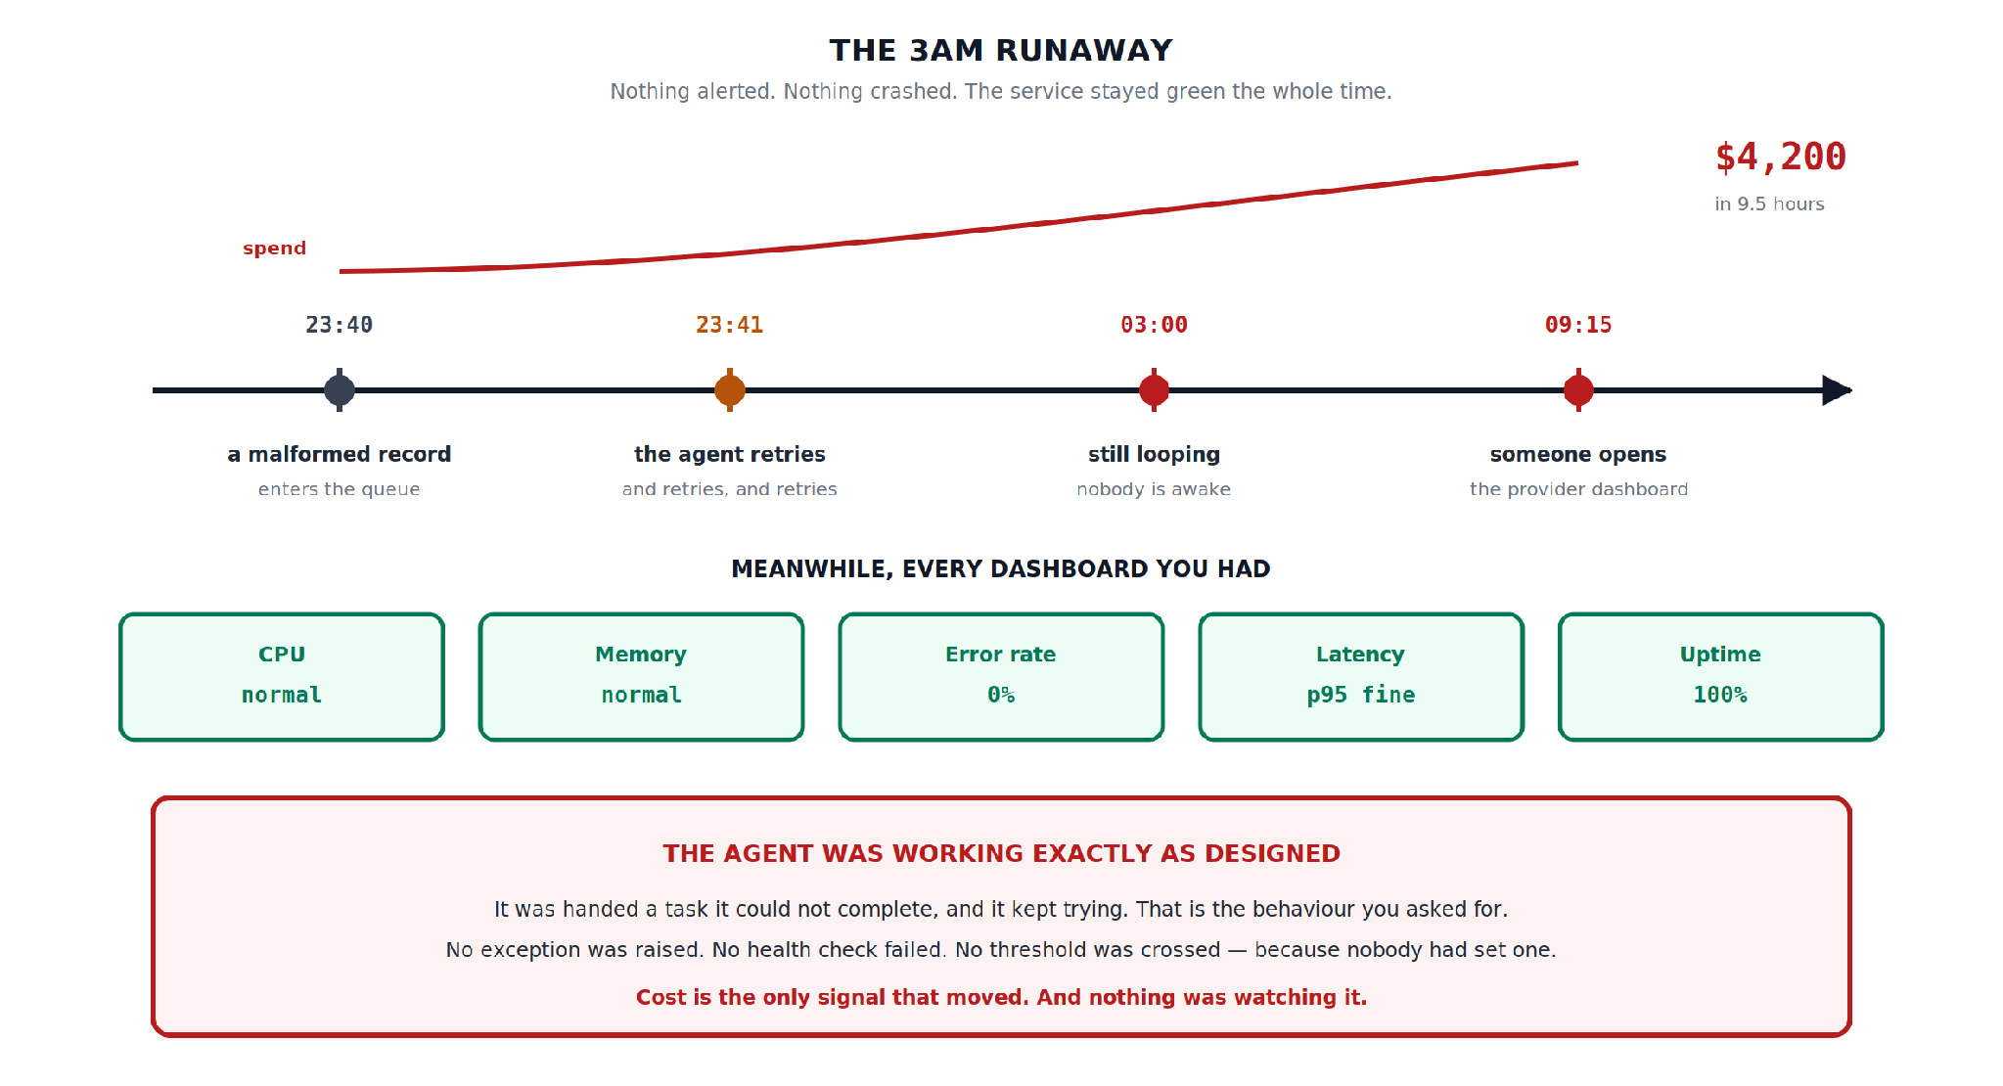
Hidden slide · presenter reference · 01 · The 3am Runaway
iPAD · DRAW
Draw the night
New iPad page. Draw the timeline first, then the green dashboard row underneath; the contrast is the point.
Timeline across the middle: 23:40 · 23:41 · 03:00 · 09:15
Label: record enters queue · agent retries, and retries · still looping, nobody awake · someone opens the dashboard
Above: a spend line climbing left → right. Right end: $4,200 in 9.5 hours
Below: five green panels: CPU normal · Memory normal · Error 0% · p95 fine · Uptime 100%
Bottom, three lines: working as designed · no threshold crossed (none set) · cost is the only signal that moved
FINISHED PANEL
Say: “Every dashboard green. One line climbing. Nothing connecting them.”
Agent Cost Control · Module 1
8
Notes:
[HIDDEN SLIDE — iPad segment. Skip in slideshow.]
Production note — New iPad page. Draw the timeline first, then the green dashboard row underneath — the contrast is the point.
SAY:
Let's draw that night, because the shape of it is the shape of the problem.
Every dashboard green. One line climbing. Nothing connecting them.
DRAW (full steps):
1. Draw a horizontal timeline across the middle of your page with four marked points: 23:40, 23:41, 03:00, and 09:15.
2. Label them in order: a malformed record enters the queue; the agent retries, and retries, and retries; still looping, nobody is awake; someone opens the provider dashboard.
3. Above the timeline, draw a line climbing steadily from left to right, and label it spend. At the right-hand end write the number: four thousand two hundred dollars, in nine and a half hours.
4. Underneath the timeline, draw a row of five small panels and label them CPU, Memory, Error rate, Latency, Uptime. Write a healthy value in each one — normal, normal, zero percent, p95 fine, a hundred percent. Shade all five green.
5. At the bottom of the page write three lines: the agent was working exactly as designed; no exception was raised and no threshold was crossed, because nobody had set one; cost is the only signal that moved.
THEN SAY:
That row of green panels is the honest picture of most agent deployments right now. Every traditional signal is telling you the system is healthy, and every one of them is correct. They are measuring the wrong thing, because agent failure does not look like traditional failure. Traditional failure is loud and stops. Agent failure is quiet and continues.

Slide 9



01 · THE 3AM RUNAWAY
Don't blame the malformed record
Bad input is normal. Queues contain malformed records; that is a permanent condition of running software. The next runaway will come from something you didn't anticipate.
Bounded
A spend ceiling the agent cannot cross.
Visible
Something watching the rate of spend.
The system had no concept of what it was allowed to spend.
Attributable
Every dollar traced to the agent that spent it.
Agent Cost Control · Module 1
9
Notes:
One more thing about that story before we move on. The instinct afterwards is always to blame the malformed record — to say the real problem was bad input validation.
It wasn't. Bad input is normal. Queues contain malformed records; that is a permanent condition of running software. You cannot validate your way out of this, because the next runaway will come from something you didn't anticipate.
The actual problem is that the system had no concept of what it was allowed to spend. There was no ceiling, nothing watching the rate, and no way to attribute the spend to the agent that caused it even after the fact.
That's what we're fixing across these six modules. Not better input handling — bounded, visible, attributable spend.
→ Next: why the number got that large in the first place.

Slide 10
02
The Multiplication Problem
~9 min

Slide 11
02 · THE MULTIPLICATION PROBLEM
Traditional cost adds. Agent cost multiplies.
TRADITIONAL
requests × cost per request
linear · napkin math
AGENT
requests × steps × tokens × retries
YOU CONTROL
THE WORK DECIDES
THE WORK DECIDES
THE WORK DECIDES
Requests
Steps
Tokens
Retries
Your traffic. Same as always.
Reasoning loops per request: set by task difficulty.
Text through the model on every step.
Multiplies everything above it.
Agent Cost Control · Module 1
11
Notes:
Let's look at what actually drives that number, because the arithmetic is genuinely different from anything you've costed before.
For a traditional service, cost is roughly requests times cost-per-request. It's linear. Double the traffic, double the bill. You can capacity-plan it on a napkin, and everyone in this field has done exactly that a hundred times.
For an agent, the formula has four terms, and they multiply: requests, times steps, times tokens, times retries.
Take those one at a time. Requests you control — that's your traffic, same as always. Steps is how many times the agent loops through its reasoning cycle before it produces an answer, and that varies per request depending on how hard the task turns out to be. Tokens is how much text moves through the model on each of those steps. And retries multiplies whatever you had by however many attempts it takes.
The reason this matters isn't that the numbers are bigger. It's that three of those four terms are determined by the work itself rather than by you. You did not decide that this particular record would take nineteen steps instead of four. The agent decided, at runtime, based on input you don't control.
That's the structural difference. In traditional capacity planning, you own every variable. Here you own one of four.
And the retry term is the one that does the real damage, because a retry is not one more API call. It's the entire subtree again. Twelve steps became twenty-four. If it retries three times before giving up, you have paid for forty-eight steps and produced zero successful outcomes.
That last case is worth naming explicitly: you can spend four times the normal cost of a task and get nothing at all. There's no traditional analogue for that. A failed HTTP request costs you almost nothing. A failed agent run can cost you more than a successful one, because failure usually means it tried harder.

Slide 12
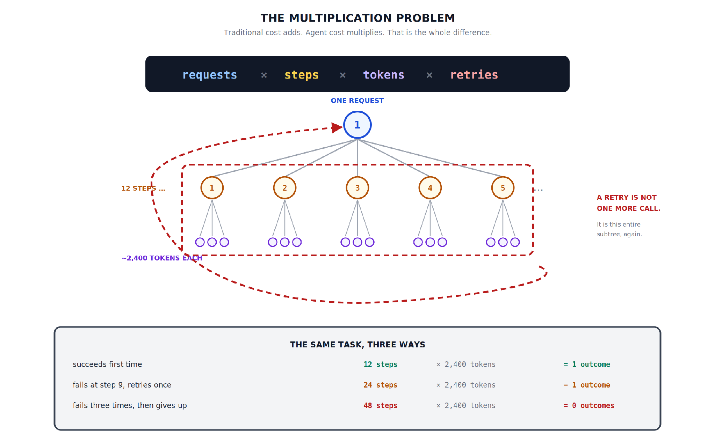
Hidden slide · presenter reference · 02 · The Multiplication Problem
iPAD · DRAW
Draw the multiplication tree
New iPad page. Build the tree downward, then draw the retry boundary around the whole thing last.
Top, large: requests × steps × tokens × retries
One circle: ONE REQUEST
Below: five step circles connected up to it: “12 STEPS …”
Three tiny token circles under each step: “~2,400 tokens each”
Dashed boundary around the whole step-and-token region
Dashed arrow curving back up to the request: “a retry is this entire subtree again”
Bottom, three rows: 12 steps → 1 outcome · 24 steps → 1 outcome · 48 steps → 0 outcomes
FINISHED PANEL
Say: “The dashed boundary is the retry. It encloses everything, and it goes back to the top.”
Agent Cost Control · Module 1
12
Notes:
[HIDDEN SLIDE — iPad segment. Skip in slideshow.]
Production note — New iPad page. Build the tree downward, then draw the retry boundary around the whole thing last.
SAY:
Let's draw the multiplication, because seeing it as a tree makes the retry problem obvious in a way the formula doesn't.
The dashed boundary is the retry. It encloses everything, and it goes back to the top.
DRAW (full steps):
1. At the top of your page, write the formula in large letters: requests, times steps, times tokens, times retries.
2. Underneath, draw a single circle and label it ONE REQUEST.
3. Below that, draw a row of five smaller circles, numbered one to five, with lines connecting each one up to the request circle. Write TWELVE STEPS beside the row with a trailing ellipsis — we're only drawing five of them.
4. Under each step circle, draw three tiny circles with short lines up to it. Label the row roughly two thousand four hundred tokens each.
5. Now draw a dashed boundary around the entire step-and-token region — everything except the original request circle.
6. Draw a dashed arrow from the bottom-right of that boundary, curving all the way around and back up to the request circle at the top. Label it: a retry is not one more call, it is this entire subtree again.
7. At the bottom, draw three rows showing the same task three ways: succeeds first time, twelve steps, one outcome. Fails at step nine and retries once, twenty-four steps, one outcome. Fails three times then gives up, forty-eight steps, zero outcomes.
THEN SAY:
Those three rows are the whole module in miniature. Same task, same tokens per step, and the cost of getting one outcome ranges from twelve step-units to infinity — because the third row produced no outcome at all, so cost per outcome is undefined. We'll come back to that in module five, because it turns out to be the only honest way to report this.

Slide 13
03
Why Your Cloud Bill Cannot See This
~7 min

Slide 14

03 · WHY YOUR CLOUD BILL CANNOT SEE THIS
Three structural blind spots
None of these are fixable by configuration.
The shape of the curve
Attribution
The provider console
Cost tools assume cost tracks traffic. Agent cost tracks reasoning difficulty; every anomaly detector is watching the wrong axis.
Your bill has one line item for the provider. Which agent, team, customer or outcome? That context exists only in your app, at the call.
Tokens by API key and model; but no run boundaries, and no idea whether any of it produced a useful outcome.
Agent Cost Control · Module 1
14
Notes:
Here's a question worth asking before we build anything: you already have cost tooling. Cloud billing dashboards, tagging, maybe an OpenCost or Kubecost deployment. Why doesn't any of it help?
Three reasons, and they're all structural rather than fixable by configuration.
First, the shape of the cost curve. Traditional compute cost correlates with traffic — that's the assumption every cost tool is built on. Agent cost correlates with reasoning difficulty, which does not track traffic at all. You can have a quiet afternoon with three requests that each took forty steps, and a busy one with four hundred requests that each took two. The quiet afternoon costs more. Every anomaly detector you own is watching the wrong axis.
Second, attribution. Your cloud bill shows one line item for the model provider. One. It cannot tell you which agent spent it, which team owns that agent, which customer the work was for, or whether the run succeeded. All of that context exists only inside your application, at the moment of the call, and if you don't capture it there it is gone forever.
Third, the provider console is better but still insufficient. It'll show you total tokens, usually broken down by API key and model. That gives you a crude split if you're disciplined about keys. What it cannot give you is run boundaries — it has no idea that these eleven calls were one logical task and those four were another — and it has no idea whether any of it produced a useful outcome.
So the honest position is: the data you need does not exist anywhere yet. Nobody is withholding it. It has to be created, at the call site, by you. That's module two.

Slide 15
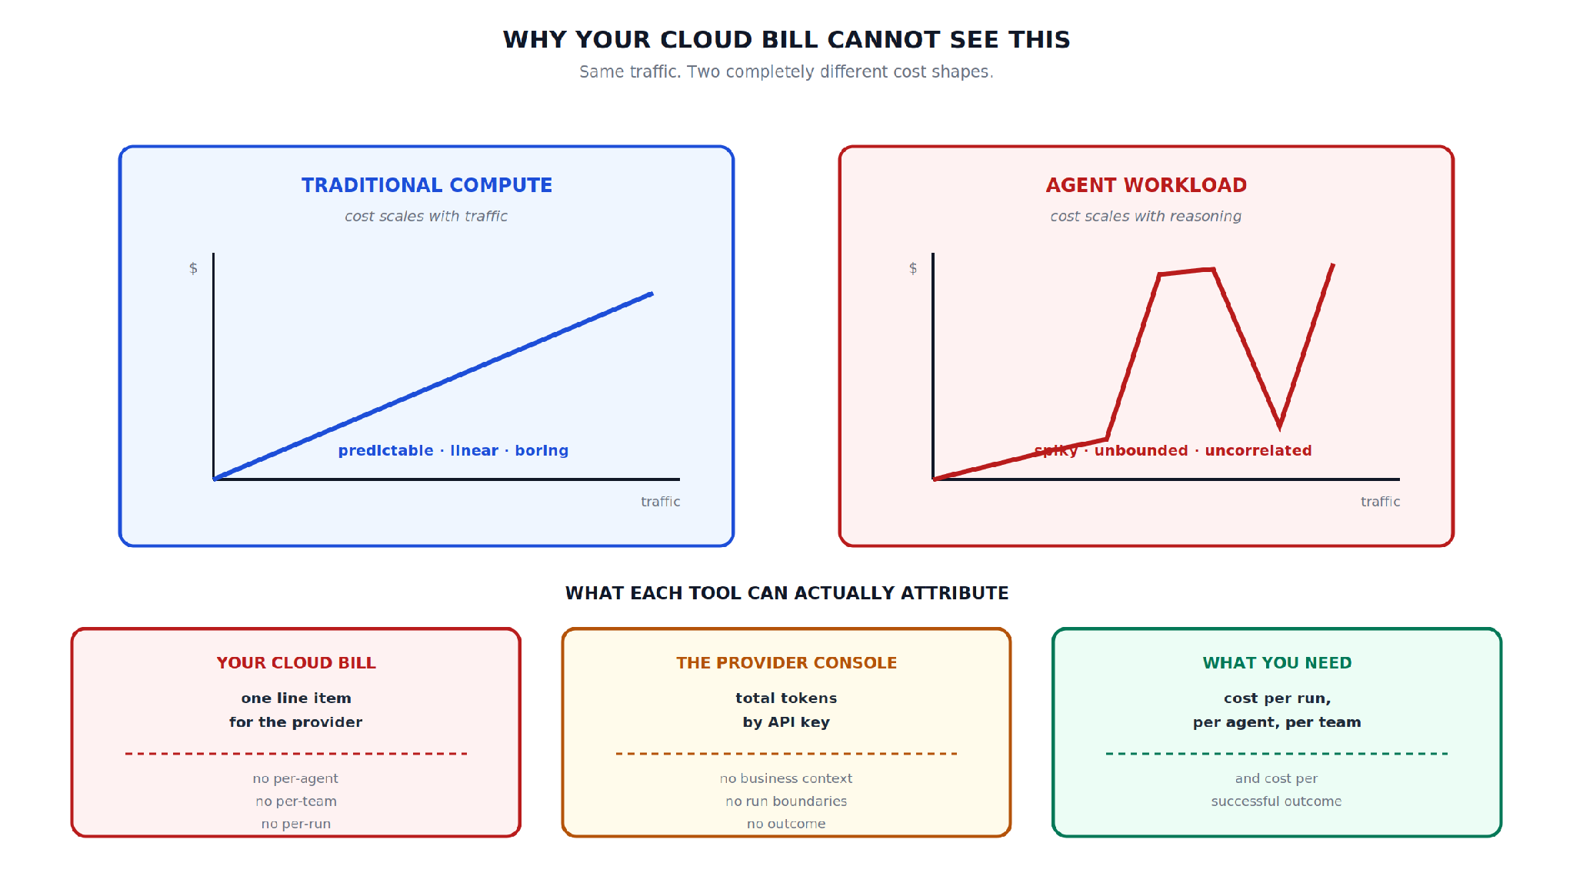
Hidden slide · presenter reference · 03 · Why Your Cloud Bill Cannot See This
iPAD · DRAW
Draw the two curves and three boxes
New iPad page. Two charts side by side, then the three tooling boxes underneath.
Two panels: TRADITIONAL COMPUTE (scales with traffic) · AGENT WORKLOAD (scales with reasoning)
Left: $ vs traffic, straight rising line: “predictable, linear, boring”
Right: same axes, low line with sharp spikes: “spiky, unbounded, uncorrelated”
Below: YOUR CLOUD BILL · THE PROVIDER CONSOLE · WHAT YOU NEED
Bill: one provider line item | no per-agent, per-team, per-run
Console: tokens by API key | no context, no run boundaries, no outcome
What you need (different colour): cost per run, agent, team; and per successful outcome
FINISHED PANEL
Say: “Left is what every cost tool assumes. Right is what you actually have.”
Agent Cost Control · Module 1
15
Notes:
[HIDDEN SLIDE — iPad segment. Skip in slideshow.]
Production note — New iPad page. Two charts side by side, then the three tooling boxes underneath.
SAY:
Let's draw the two cost curves side by side, and then what each tool can actually attribute.
Left is what every cost tool assumes. Right is what you actually have.
DRAW (full steps):
1. Split the top of your page into two panels. Title the left TRADITIONAL COMPUTE, noted: cost scales with traffic. Title the right AGENT WORKLOAD, noted: cost scales with reasoning.
2. In the left panel, draw a simple pair of axes with dollars going up and traffic going across, and draw a straight diagonal line rising steadily. Underneath write: predictable, linear, boring.
3. In the right panel, draw the same axes, but draw a line that is mostly low with several sharp spikes reaching near the top, and no clear relationship to the horizontal axis. Underneath write: spiky, unbounded, uncorrelated.
4. Below both, draw three boxes side by side. Title them YOUR CLOUD BILL, THE PROVIDER CONSOLE, and WHAT YOU NEED.
5. Under the cloud bill write what it has — one line item for the provider — then a dividing line, then what it lacks: no per-agent, no per-team, no per-run.
6. Under the provider console write: total tokens by API key. Then what it lacks: no business context, no run boundaries, no outcome.
7. Under the third write: cost per run, per agent, per team — and cost per successful outcome. Colour this one differently from the other two.
THEN SAY:
That third box is what we're building toward, and I want to be clear that it isn't exotic. It's four labels and a counter. The reason almost nobody has it isn't difficulty — it's that agents arrived faster than the operational practice around them, and most teams are still assuming their existing cost tooling covers this. It doesn't, and the gap is invisible until the morning somebody opens the dashboard.

Slide 16
04
Input vs Output Tokens
~7 min

Slide 17
04 · INPUT VS OUTPUT TOKENS
Most people get this backwards
10 : 1
3–5×
2–3 : 1
input : output tokens in a typical agent step
output price vs input price
the actual cost ratio
Capture both counts, separately
Input grows with every step
Never infer one from the other. A summarisation agent inverts the ratio completely.
Step 12 resends everything from steps 1–11. Long runs are superlinear; a 20-step ceiling is not just 2× a 10-step one.
Agent Cost Control · Module 1
17
Notes:
Quick but consequential section, because this detail changes what you optimise and most people get it backwards.
Every model call has two token counts: input, which is everything you send, and output, which is everything the model generates. They're metered separately and priced differently — output typically costs three to five times the input rate, depending on the provider and model.
Now here's what's specific to agents. Agent calls are unusually input-heavy.
Think about what goes into one step. The system prompt, which for a capable agent is often long. The tool definitions, which are verbose — every tool's schema, every parameter description. The conversation history so far. And the current state of whatever it's working on.
And what comes back? Usually a single tool call. A short structured decision. Maybe two hundred tokens against two thousand two hundred going in.
So you have roughly a ten-to-one token ratio. But because output is priced three to five times higher, that is not a ten-to-one cost ratio — it's closer to two or three to one. Still input-dominated, but nothing like what the token counts alone suggest.
Which is exactly why you capture both counts separately from the very first line of instrumentation. Never infer one from the other, and never assume the ratio holds across different agents. A summarisation agent inverts it completely.
And there's one more thing, which is the piece that surprises people. That input number grows with every step.
Step one sends the system prompt, the tools, and the task. Step twelve sends the system prompt, the tools, the task, and eleven steps of accumulated history. So a twelve-step run does not cost twelve times step one. It costs substantially more, because the input side is growing as you go.
That has a practical consequence worth holding onto: long runs are superlinear. When we get to max-step ceilings in module four, this is the reason a ceiling of twenty is not merely twice as expensive as a ceiling of ten.

Slide 18
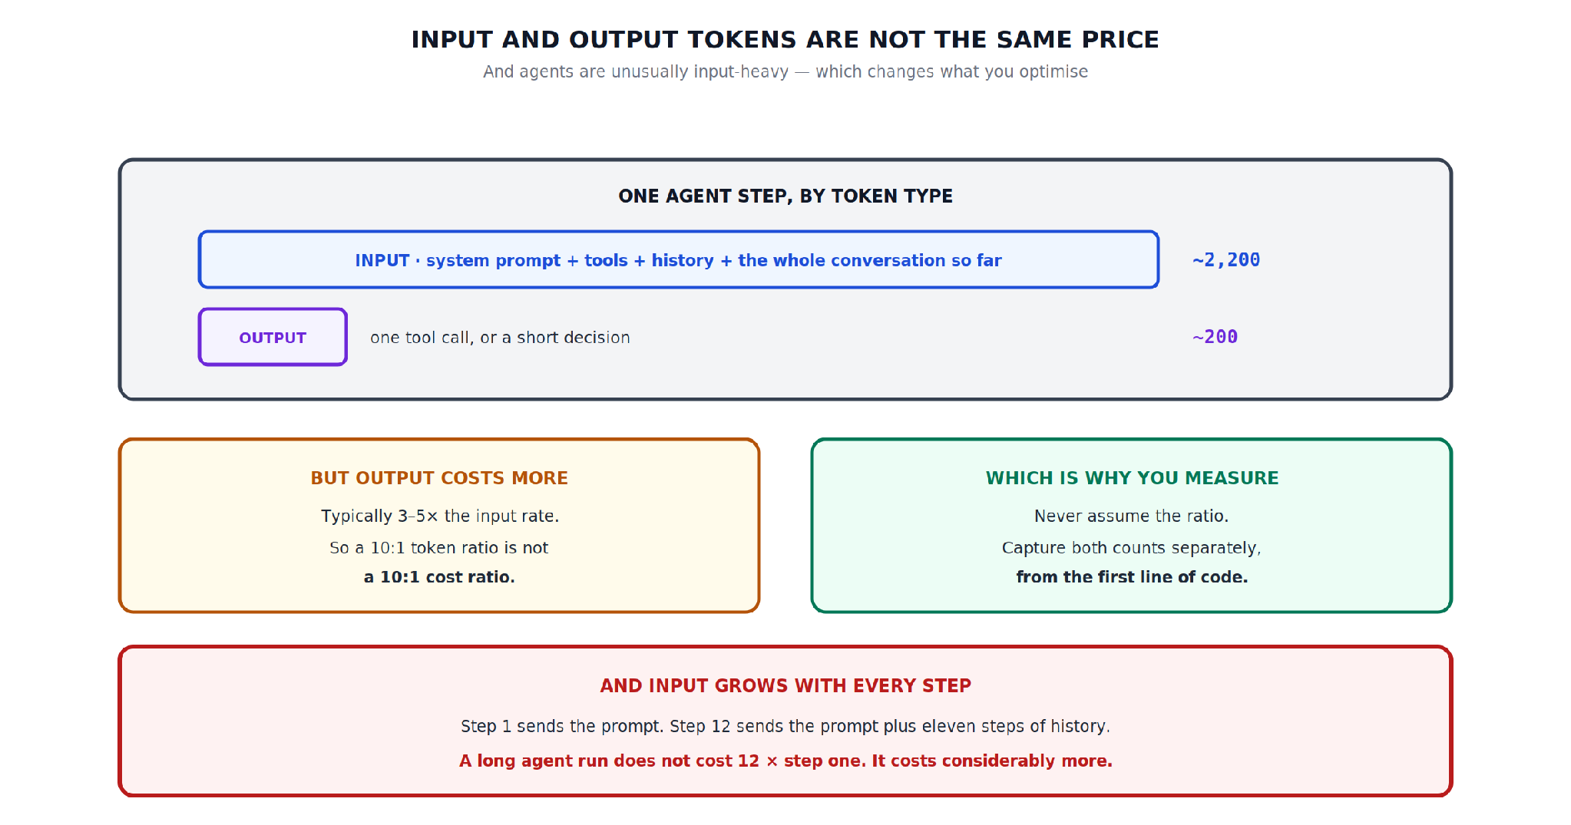
Hidden slide · presenter reference · 04 · Input vs Output Tokens
iPAD · DRAW
Draw one step, by token type
New iPad page. Draw the two bars proportionally; the visual imbalance is the teaching.
Wide panel: “one agent step, by token type”
Long INPUT bar: system prompt, tool definitions, history, conversation: ~2,200
Short OUTPUT bar, ~1/12 the width: one tool call or short decision: ~200
Left box: output costs 3–5× input, so 10:1 tokens ≠ 10:1 cost
Right box: which is why you measure: capture both counts from line one
Bottom: input grows every step; step 12 = prompt + 11 steps of history
FINISHED PANEL
Say: “Draw the bars to scale. The imbalance is the point.”
Agent Cost Control · Module 1
18
Notes:
[HIDDEN SLIDE — iPad segment. Skip in slideshow.]
Production note — New iPad page. Draw the two bars proportionally — the visual imbalance is the teaching.
SAY:
Let's draw one step by token type, and then the thing that makes long runs expensive.
Draw the bars to scale. The imbalance is the point.
DRAW (full steps):
1. Draw a wide panel and title it: one agent step, by token type.
2. Inside it, draw a long horizontal bar taking most of the width. Label it INPUT, and inside write what it contains: system prompt, tool definitions, history, and the conversation so far. Put a token count at the right-hand end — roughly two thousand two hundred.
3. Underneath, draw a much shorter bar, maybe a twelfth of the width. Label it OUTPUT, and beside it write: one tool call, or a short decision. Put its count at the same right-hand position — roughly two hundred.
4. Below that, draw two boxes side by side. In the left write: but output costs more — typically three to five times the input rate — so a ten-to-one token ratio is not a ten-to-one cost ratio.
5. In the right write: which is why you measure — never assume the ratio, capture both counts separately from the first line of code.
6. At the bottom, draw one final wide box and write: input grows with every step. Step one sends the prompt. Step twelve sends the prompt plus eleven steps of history. A long run does not cost twelve times step one — it costs considerably more.
THEN SAY:
That final box is the one to remember when someone proposes raising a step limit to improve success rates. It's often the right call — but it's a superlinear cost decision, not a linear one, and it should be made with that understood rather than discovered afterwards.

Slide 19
05
What Counts as a Unit
~7 min

Slide 20



05 · WHAT COUNTS AS A UNIT
Three candidates. Only one survives finance.
Cost per token
What the provider gives you. Nobody buys tokens; like reporting cost per CPU cycle.
Cost per request
Where most teams stop. It hides retries completely.
Cost per successful task
Failures in the denominator. Maps to a ticket, a document, a decision.
Agent Cost Control · Module 1
20
Notes:
Last conceptual section, and it's the one that determines whether the rest of this course produces anything useful.
You've got a pile of token counts. What number do you actually report? There are three candidates, and only one survives contact with a finance conversation.
Candidate one: cost per token. This is what the provider gives you, and on its own it is close to useless. Nobody buys tokens. It tells you nothing about whether the work was worth doing. Reporting cost per token to a business stakeholder is like reporting cost per CPU cycle — technically true, operationally meaningless.
Candidate two: cost per request. Better, and this is where most teams stop, because it maps onto how they've always thought about services. The problem is that it hides retries completely. Two requests with identical recorded cost might have produced one useful outcome and none at all, and cost per request cannot distinguish them.
Candidate three: cost per successful task. This is the one. It includes the failures in the denominator, and it maps directly onto something a business actually recognises — a resolved ticket, a processed document, a decision made.

Slide 21
05 · WHAT COUNTS AS A UNIT
Same afternoon. Same money. Two stories.
100
requests
COST PER REQUEST
COST PER SUCCESSFUL TASK
4¢
19¢
62
succeeded
$19 ÷ 100 requests
“Sounds fine.”
$19 ÷ 62 successes
Nearly 5× higher; and true.
38
failed after consuming tokens
$19
spent in total
Why it matters: cut your failure rate and cost per successful task falls; even if total spend is unchanged. That's the improvement you can take to someone.
Agent Cost Control · Module 1
21
Notes:
Let me show you why the difference is not academic.
Take one afternoon. A hundred requests. Sixty-two succeeded. Thirty-eight failed, and importantly they failed after consuming tokens — they didn't fail fast, they tried hard and gave up. Nineteen dollars spent in total.
Report cost per request: nineteen dollars over a hundred requests, four cents each. That sounds fine. Nobody in a review is going to blink at four cents.
Report cost per successful task: nineteen dollars over sixty-two successes, about nineteen cents. Nearly five times higher.
Same afternoon. Same money. Two numbers that lead to completely different conversations — and only one of them is true, in the sense of describing what you actually got for the spend.
This is also, incidentally, the number that makes the case for the rest of this course. When you cut your failure rate, cost per successful task falls even if total spend is unchanged. That's the improvement you can actually take to someone.

Slide 22
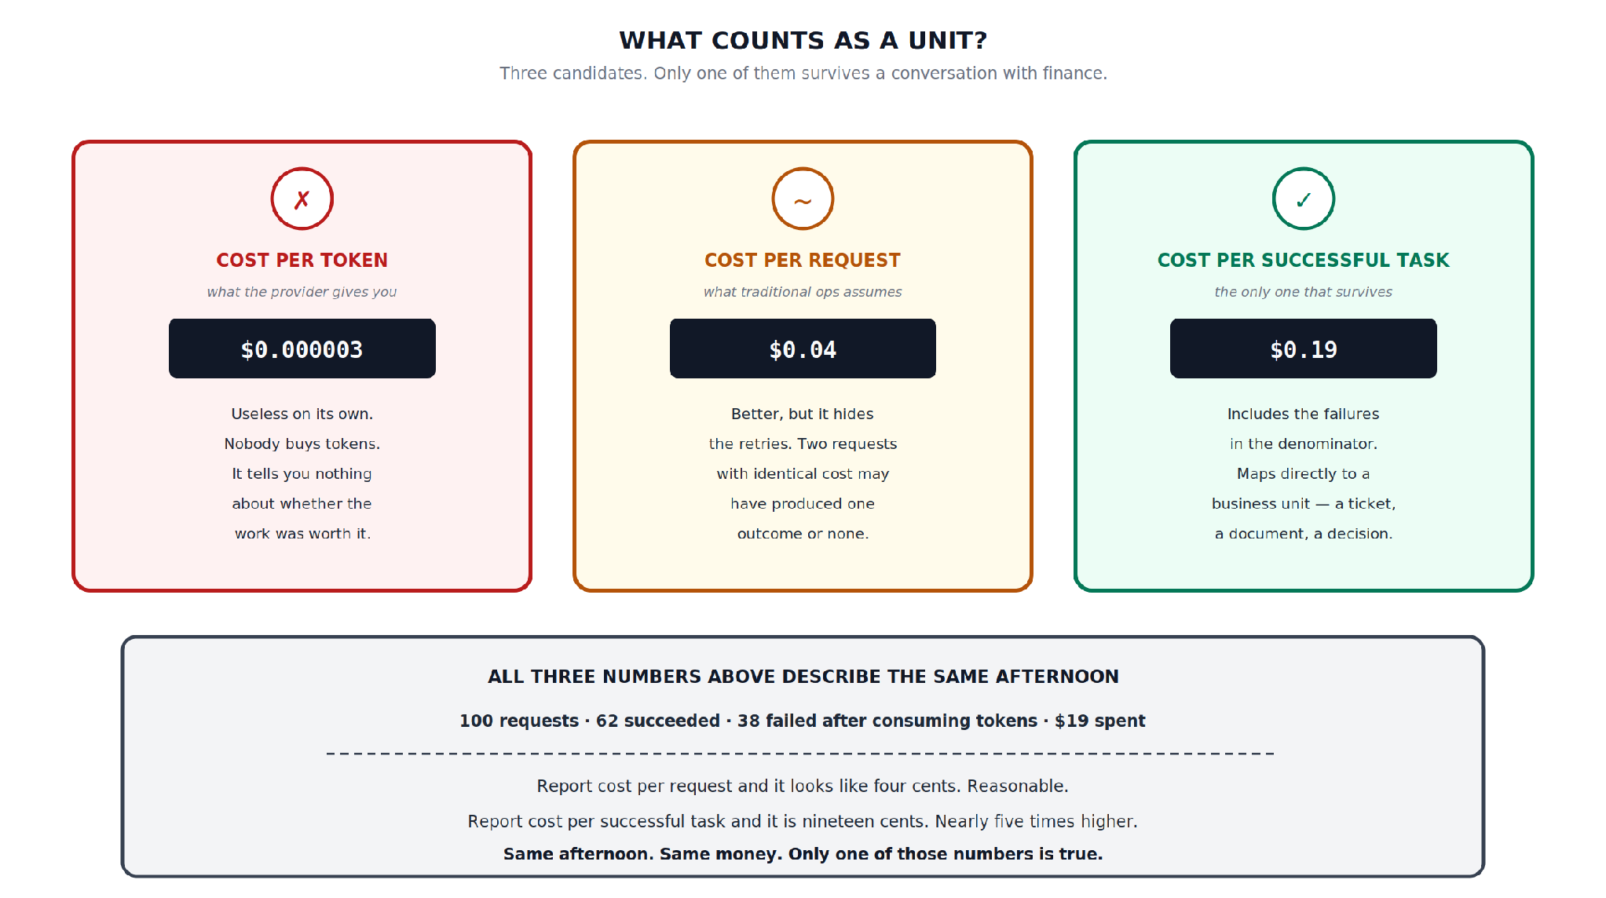
Hidden slide · presenter reference · 05 · What Counts as a Unit
iPAD · DRAW
Draw the three cards and the afternoon
New iPad page. Three cards across the top, then the worked afternoon underneath.
Three tall cards, markers on top: ✗ · ~ · ✓
COST PER TOKEN: $0.000003; useless on its own
COST PER REQUEST: $0.04; hides the retries
COST PER SUCCESSFUL TASK: $0.19; failures in the denominator
Wide box: 100 requests · 62 succeeded · 38 failed · $19 spent
Three lines: 4¢ looks reasonable · 19¢ is ~5× higher · only one is true
FINISHED PANEL
Say: “Three numbers, one afternoon. Only one of them is honest.”
Agent Cost Control · Module 1
22
Notes:
[HIDDEN SLIDE — iPad segment. Skip in slideshow.]
Production note — New iPad page. Three cards across the top, then the worked afternoon underneath.
SAY:
Let's draw all three side by side, and then the same afternoon measured all three ways.
Three numbers, one afternoon. Only one of them is honest.
DRAW (full steps):
1. Draw three tall cards across your page. Put a small marker at the top of each — a cross on the first, a tilde on the second, a tick on the third.
2. Card one: COST PER TOKEN, noted what the provider gives you. Put a tiny figure in a dark box — three millionths of a dollar. Underneath write: useless on its own, nobody buys tokens, it tells you nothing about whether the work was worth it.
3. Card two: COST PER REQUEST, noted what traditional ops assumes. Figure: four cents. Underneath: better, but it hides the retries — two requests with identical cost may have produced one outcome or none.
4. Card three: COST PER SUCCESSFUL TASK, noted the only one that survives. Figure: nineteen cents. Underneath: includes the failures in the denominator, and maps directly to a business unit — a ticket, a document, a decision.
5. Underneath all three, draw a wide box and write the worked example: a hundred requests, sixty-two succeeded, thirty-eight failed after consuming tokens, nineteen dollars spent.
6. Then three lines: report cost per request and it looks like four cents, reasonable. Report cost per successful task and it is nineteen cents, nearly five times higher. Same afternoon, same money — only one of those numbers is true.
THEN SAY:
Keep this page. Module five builds this metric properly, including the genuinely hard part, which is defining what counts as success before you can measure it. But the argument for why it's worth the trouble is right here on this card, and it's the argument you'll need when someone asks why you're instrumenting all this.

Slide 23
06
Build It: Price Your Own Agent
~8 min

Slide 24

06 · BUILD IT: PRICE YOUR OWN AGENT
Do it by hand, once
No instrumentation yet; that's Module 2. The manual calculation is what makes the automated one meaningful later.
github.com/
Here2ServeU/
agent-cost-control
Use your own agent
if you have one
Or clone the course repo
The same agent is used for the whole course.
a deliberately uninstrumented agent, plus an input that sends it into a loop
Agent Cost Control · Module 1
24
Notes:
No instrumentation yet — that's module two. In this module we do it by hand, once, because the manual calculation is what makes the automated one meaningful later.
You need an agent to work with. Use your own if you have one. If not, clone the course repository, which has a deliberately uninstrumented agent with a known input that sends it into a loop — we'll be using that agent for the whole course.

Slide 25
06 · BUILD IT: STEP 1 OF 8
Clone the course agent
$ git clone https://github.com/Here2ServeU/agent-cost-control && cd agent-cost-control
An agent
Look at what's in here before running anything. There's an agent, a handful of sample inputs, and no cost instrumentation of any kind.
used for the whole course
Sample inputs
one normal, one malformed
That's deliberate; it's the state most agents are actually in.
No instrumentation
nothing measures cost yet
Agent Cost Control · Module 1
25
Notes:
[TERMINAL — TYPE THIS] Production note — Two terminals or one — doesn't matter here. The important beat is the pause after the second run, when the learner sees the gap.
Let's price two runs by hand and compare them.
$ git clone https://github.com/Here2ServeU/agent-cost-control && cd agent-cost-control
Look at what's in here before running anything. There's an agent, a handful of sample inputs, and no cost instrumentation of any kind. That's deliberate — it's the state most agents are actually in.

Slide 26
06 · BUILD IT: STEP 2 OF 8
Set your API key
$ export ANTHROPIC_API_KEY=your-key-here
Environment variable, not a config file. Same discipline as any other credential.
Next: one healthy run, priced by hand.
Agent Cost Control · Module 1
26
Notes:
[TERMINAL — TYPE THIS]
$ export ANTHROPIC_API_KEY=your-key-here
Environment variable, not a config file. Same discipline as any other credential.

Slide 27
06 · BUILD IT: STEP 3 OF 8
Run a healthy input
$ python3 run_agent.py --input samples/normal.json --verbose
Verbose mode prints the raw usage block from each API response. Every major provider returns one.
input_tokens
output_tokens
everything sent on that call
everything the model generated
The two numbers we care about; one per call.
Agent Cost Control · Module 1
27
Notes:
[TERMINAL — TYPE THIS]
$ python3 run_agent.py --input samples/normal.json --verbose
Verbose mode prints the raw usage block from each API response. Every major provider returns one, and it contains the two numbers we care about — input tokens and output tokens, per call.

Slide 28
06 · BUILD IT: STEP 4 OF 8
Do the arithmetic by hand
No command for this one. Pen and paper, or a calculator.
1
Add up the input tokens
across every call in that run
2
Add up the output tokens
keep them separate: they're priced differently
3
Multiply each by its rate
from your provider's current pricing page
4
Add the two together
write the number down
Agent Cost Control · Module 1
28
Notes:
[TERMINAL — WORK IT OUT]
Now do the arithmetic by hand. Add up the input tokens across every call in that run. Then the output tokens. Then multiply each by the current per-token rate from your provider's pricing page, and add them together. Write the number down.

Slide 29
06 · BUILD IT: STEP 5 OF 8
Count the model calls
$ python3 run_agent.py --input samples/normal.json --verbose | grep -c 'usage'
That counts how many model calls the run made: your step count. Write that down too.
YOU NOW HAVE THREE NUMBERS FOR A HEALTHY RUN
Steps
Tokens
Cost
Agent Cost Control · Module 1
29
Notes:
[TERMINAL — TYPE THIS]
$ python3 run_agent.py --input samples/normal.json --verbose | grep -c 'usage'
That counts how many model calls the run made — your step count. Write that down too. You now have three numbers for a healthy run: steps, tokens, and cost.

Slide 30

06 · BUILD IT: STEP 6 OF 8
Run the one that cannot finish
$ timeout 120 python3 run_agent.py --input samples/malformed.json --verbose
The samples directory contains a record the agent cannot successfully process. Put a hard timeout on it; the whole point is that it will not stop on its own.
Two minutes. That's all we're giving it. Don't remove the timeout out of curiosity; this is real money.
Agent Cost Control · Module 1
30
Notes:
[TERMINAL — TYPE THIS]
Now the interesting one. The samples directory contains a record that the agent cannot successfully process. Run it — but put a hard timeout on the command, because the whole point is that it will not stop on its own.
$ timeout 120 python3 run_agent.py --input samples/malformed.json --verbose
Two minutes. That's all we're giving it, and I'd strongly encourage you not to remove that timeout out of curiosity — this is real money and the whole premise of the module is that it doesn't stop.

Slide 31
06 · BUILD IT: STEP 7 OF 8
Count the calls it made in two minutes
$ timeout 120 python3 run_agent.py --input samples/malformed.json --verbose | grep -c 'usage'
Same arithmetic as the healthy run: tokens in, tokens out, times the rates. That gives you the cost of two minutes of looping.
Then extrapolate it; that's the next slide.
Agent Cost Control · Module 1
31
Notes:
[TERMINAL — TYPE THIS]
$ timeout 120 python3 run_agent.py --input samples/malformed.json --verbose | grep -c 'usage'
Count the calls it made in two minutes. Do the same arithmetic. Then extrapolate: multiply by thirty to get an hour, and by the number of hours you'd realistically take to notice. Overnight is nine or ten.

Slide 32
06 · BUILD IT: STEP 8 OF 8
Extrapolate your own $4,200
Calls in 2 min
× 30
× 9–10 hrs
= yours
× cost per call
= one hour
time to notice, overnight
cost of one unnoticed loop
Not my $4,200; yours.
Your agent, your model, your environment. Write it down and keep it: every control in the next five modules is measured against this number.
Agent Cost Control · Module 1
32
Notes:
[TERMINAL — WORK IT OUT]
That extrapolated number is the one to write down and keep. It's the cost of one unnoticed loop in your own environment, with your own agent and your own model — not my four thousand two hundred dollars, yours. Every control we build over the next five modules is measured against it.

Slide 33

RECAP
Four things to carry into Module 2
Cost multiplies
Your tooling can't attribute it
Requests × steps × tokens × retries; and the work decides three of the four.
The context only exists at the call site. Capture it there or lose it.
Input dominates; and grows
Report cost per successful task
Output costs more per token, but input grows every step. Long runs are superlinear.
The only unit that survives a real conversation with finance.
Agent Cost Control · Module 1
33
Notes:
That's module one. No code was instrumented and nothing was capped — deliberately. What you have instead is the argument, and your own number attached to it.
To recap: agent cost multiplies rather than adds, and three of its four terms are decided by the work rather than by you. Your existing cost tooling is structurally unable to attribute any of it, because the context only exists at the call site. Input and output are priced differently, input dominates in agent workloads, and it grows with every step so long runs are superlinear. And of the three candidate units, only cost per successful task survives a real conversation.

Slide 34
BEFORE MODULE 2
Take your overnight number to whoever owns the budget. Ask one question:
“Is that an acceptable
worst case?”
The answer is almost always no; and it's usually the first time anyone has framed it that way. That conversation turns an engineering side-project into something with organisational support behind it.
Agent Cost Control · Module 1
34
Notes:
One thing I'd ask you to actually do before module two. Take your extrapolated overnight number to whoever owns the budget for your agent, and ask them a single question: is that an acceptable worst case?
The answer is almost always no, and it's usually the first time anyone has framed it that way. That conversation is what turns this from an engineering side-project into something with organisational support behind it — and support is what you'll want when module three starts adding limits that can block production work.

Slide 35
NEXT · MODULE 2 OF 6
Make it visible.
Instrument the agent so every run emits cost, tokens, and identity as a metric you can actually query.
Bounded · Visible · Attributable
Emmanuel Naweji · github.com/Here2ServeU/agent-cost-control
Notes:
Module two makes all of this visible: instrumenting the agent so every run emits cost, tokens, and identity as a metric you can actually query. See you there.

Slide 36
APPENDIX A
Exercises: do these before Module 2
01
02
03
04
Price one healthy run
Count the steps
Measure the ratio
Watch input grow
Sum input and output tokens separately; multiply by current rates.
Divide total cost by model calls for cost per step. Module 4 uses it.
Input:output tokens vs input:output cost. Note the gap.
Plot input tokens per step. See the superlinear effect yourself.
05
06
07
08
Run the loop; timed
Extrapolate your number
Compute all three units
Ask the budget question
Malformed input, hard 120 s limit. Count the calls.
Cost of one unnoticed overnight loop in your environment.
Per token, per request, per successful task. Expect 2–5× gaps.
Is that an acceptable worst case? Record the answer.
Agent Cost Control · Module 1
36
Notes:
Appendix A — Exercises. Full text:
1. Price one healthy run, by hand — Run the agent on a normal input with verbose output. Sum input and output tokens separately, multiply by current rates, and write down the total. Doing this manually once is what makes the automated version meaningful.
2. Count the steps — Count how many model calls that single run made. Divide your total cost by that number to get cost per step. Keep it — module 4 compares against it.
3. Measure the input/output ratio — For your own agent, compute the ratio of input to output tokens. Then compute the ratio of input COST to output cost. Note how different those two ratios are.
4. Watch input grow — Print the input token count for each step of a multi-step run. Plot them. Confirm for yourself that step twelve sends far more than step one — this is the superlinear effect, in your own data.
5. Run the loop, with a timeout — Run the malformed input under a hard 120-second timeout. Count the calls. Do not remove the timeout — that is real money and the point is already made.
6. Extrapolate your own number — From the two-minute sample, calculate the cost of an unnoticed overnight loop in YOUR environment. This number is the baseline for the entire course.
7. Compute all three units — Take any batch of runs you have. Compute cost per token, cost per request, and cost per successful task. Write down how different the last one is — for most agents it is 2–5× the cost per request.
8. Ask the budget question — Take your overnight number to whoever owns the spend and ask: is that an acceptable worst case? Record the answer. It is the organisational mandate for everything in modules 3 and 4.

Slide 37
APPENDIX B · EVERY TERM WE USED
Glossary: how agent cost behaves
01
02
03
The multiplication problem
Step
Retry as a subtree
Requests × steps × tokens × retries. Traditional cost adds; agent cost multiplies.
One pass through the reasoning cycle: typically one model call plus the tools it triggers.
A retry re-executes the whole step-and-token tree, not one more call.
04
05
06
Input tokens
Output tokens
Superlinear run cost
Everything sent: system prompt, tools, history, state. Often 10:1 against output.
Everything generated. Priced 3–5× input, so 10:1 tokens ≈ 2–3:1 cost.
Each step resends accumulated history, so a 12-step run costs far more than 12× step one.
Agent Cost Control · Module 1
37
Notes:
01 The multiplication problem — Agent cost = requests × steps × tokens × retries. Traditional cost adds; agent cost multiplies. Three of those four terms are determined by the work rather than by you.
02 Step — One pass through the agent's reasoning cycle — typically one model call plus any tool invocations it triggers. Step count varies per request based on task difficulty.
03 Retry as a subtree — A retry is not one additional call. It re-executes the entire step-and-token tree. Three retries on a twelve-step task is forty-eight steps for a possible zero outcomes.
04 Input tokens — Everything sent to the model: system prompt, tool definitions, conversation history, current state. In agent workloads this dominates — often 10:1 against output.
05 Output tokens — Everything the model generates. Typically priced 3–5× higher than input, so a 10:1 token ratio is closer to a 2–3:1 cost ratio.
06 Superlinear run cost — Input grows with every step, because each step resends the accumulated history. A twelve-step run costs considerably more than twelve times step one.

Slide 38
APPENDIX B · EVERY TERM WE USED
Glossary: how to measure it
07
08
09
The usage block
Cost per token
Cost per request
Per-call token counts every provider returns; and they are discarded by default.
What the provider reports. Useless in isolation.
Where most teams stop. Hides retries completely.
10
11
12
Cost per successful task
The attribution gap
The quiet failure
Total spend ÷ successful outcomes. The only unit that survives finance.
Agent, team, run, outcome: context that exists only at the call site.
Every health signal stays green while spend climbs.
Agent Cost Control · Module 1
38
Notes:
07 The usage block — The per-call token counts returned by every major provider's API response. The raw material for all cost instrumentation — and it is discarded by default.
08 Cost per token — What the provider reports. Useless in isolation — nobody buys tokens, and it says nothing about whether the work was worth doing.
09 Cost per request — Where most teams stop. Hides retries completely: two requests with identical cost may have produced one outcome or none.
10 Cost per successful task — Total spend divided by successful outcomes, with failures included in the numerator. The only unit that survives a finance conversation.
11 The attribution gap — Which agent, which team, which run, which outcome — this context exists only at the call site. If you do not capture it there it is permanently unrecoverable.
12 The quiet failure — Traditional failure is loud and stops. Agent failure is quiet and continues — every conventional health signal stays green while spend climbs.

