Slide 1
THE AGENT COST PROBLEM · MODULE 5 OF 6
Cost Per
Successful Task
The only cost number worth reporting, and the one almost nobody calculates.
PRESENTER
RUNTIME
COURSE REPO
Emmanuel Naweji
~45 min · 6 sections
github.com/Here2ServeU/agent-cost-control
Notes:
The only cost number worth reporting, and the one almost nobody calculates. This module sets the result label we left as unknown back in module 2, does the arithmetic, and turns a technical figure into something a finance team can actually compare against something else.
[Presenter: Emmanuel Naweji · Runtime ~45 min · 6 sections · Course repo github.com/Here2ServeU/agent-cost-control]

Slide 2



WHAT THIS MODULE GIVES YOU
The failures go on the top,
not the bottom.
A definition of success
The result label, set
A number finance can use
Written down, so the number means the same thing every time you report it.
The one we left as unknown in module 2 is finally filled in properly.
Stated in their unit, next to something they can compare it against.
Agent Cost Control · Module 5
2
Notes:
This is the metric that finally uses the result label we set to unknown back in module two. Everything else in this course has worked without it. This does not.

Slide 3
SECTIONS AT A GLANCE
Six sections; one number worth reporting
01
~7 min
02
~9 min
03
~6 min
The Taxi
What Is Success
The Arithmetic
04
~8 min
05
~7 min
06
~10 min
What It Reveals
Telling Finance
Build It
Agent Cost Control · Module 5
3
Notes:
Sections 1 to 5 settle what the number means and what it shows; section 6 sets the result label and calculates it.

Slide 4
BEFORE YOU START
Install what you need
Ten minutes once, and every command in this module will run. Pick your side.
macOS · TERMINAL
WINDOWS · POWERSHELL
# install Homebrew first: brew.sh
$ brew install python git
$ brew install --cask \
visual-studio-code
$ python3 --version && git --version
# winget ships with Windows 11
> winget install Python.Python.3.12
> winget install Git.Git
> winget install \
Microsoft.VisualStudioCode
> py --version; git --version
WHAT MODULE 5 ADDS
A file called SUCCESS.md
Prometheus running
curl
your definition, written down first
from module 2, for the PromQL query
already on Mac and Windows
Agent Cost Control · Module 5
4
Notes:
[SETUP]
Module five adds no new tools. You need the machine from module one, the envelope and recorded runs from module two, and Prometheus running so the PromQL query in stage four has something to answer from. The only new file is SUCCESS.md, and you write that yourself before any code.

Slide 5
BEFORE YOU START
Watch these before you install anything
Two short videos take you from a blank machine to Git, Python and VS Code installed. Pick the one for your computer.
macOS
WINDOWS
Install Git, Python and VS Code on a Mac
Install Git, Python and VS Code on Windows
https://youtu.be/8ZIiXg4XOY0
https://youtu.be/3e2-GRBibWc
OFFICIAL PAGES, IF YOU PREFER TO READ
Install Python
python.org/downloads
PromQL basics
prometheus.io/docs/prometheus/latest/querying/basics
Official downloads, Mac and Windows
The official query language docs
Recording rules
prometheus.io/docs/prometheus/latest/configuration/recording_rules
Alerting rules
prometheus.io/docs/prometheus/latest/configuration/alerting_rules
Official guide to pre-computed queries
Official guide to alerts
Agent Cost Control · Module 5
5
Notes:
[SETUP]
If your machine is not set up yet, stop here and watch the video for your computer. The Mac one is youtu.be/8ZIiXg4XOY0; the Windows one is youtu.be/3e2-GRBibWc. The Prometheus pages are there for stage four, where the same calculation becomes a query.

Slide 6
01
Would You Pay a Taxi by the Mile It Drove?
~7 min
Notes:
Two taxis. Both drive exactly four miles. Both charge you twelve dollars.

Slide 7
01 · THE TAXI
Same distance. Same fare. Same cost?
TAXI A
TAXI B
drove four miles, straight to your door
drove four miles, in circles, gave up
$12.00
$12.00
You arrived.
You are still here.
Cost per request is paying by the mile: how much the machine did, and nothing about whether you got anywhere.
Cost per successful task is paying for arrival. Taxi B counts in the top, not the bottom.
Agent Cost Control · Module 5
7
Notes:
Two taxis. Both drive exactly four miles. Both charge you twelve dollars. The first one drives straight to your door. You get out, you are where you wanted to be. The second one drives four miles in circles, gets lost, gives up, and drops you back where you started.
Same distance. Same fare. Would you say those two taxis cost the same? Technically yes. Obviously no.
That is the difference between cost per request and cost per successful task. Cost per request is paying by the mile; it measures how much the machine did and says nothing about whether you got anywhere. Cost per successful task is paying for arrival: everything you spent, including the four miles the second taxi wasted, divided by the journeys that actually finished.
Notice what happens to taxi B in that calculation. Its cost still counts; it goes on the top of the fraction, because you really did spend that money. But it does not count as a successful journey, so it does not go on the bottom. If that is the only thing you take away it is enough: the failures go on the top and not the bottom. That is what makes the number honest.

Slide 8


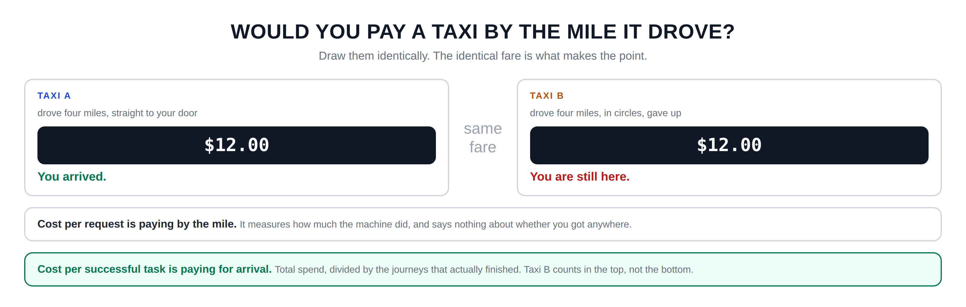
Hidden slide · presenter reference · 01 · The Taxi
iPAD · DRAW
Draw the two taxis
New iPad page. Draw the two taxis identically; the sameness is the point.
Two boxes side by side, the same size. TAXI A on the left, TAXI B on the right
Under A: drove four miles, straight to your door. Under B: drove four miles, in circles, gave up
In each box, a dark rectangle with the fare inside: twelve dollars. Make them identical
Between the boxes, small: same fare
Under A: you arrived. Under B: you are still here. Different colours for these two
Wide box underneath: cost per request is paying by the mile · it measures how much the machine did, and says nothing about whether you got anywhere
One more box: cost per successful task is paying for arrival · total spend divided by the journeys that finished · taxi B counts in the top, not the bottom
FINISHED PANEL: WHAT YOURS SHOULD LOOK LIKE
Say: “Draw them identically. The identical fare is what makes the point.”
Agent Cost Control · Module 5
8
Notes:
[HIDDEN SLIDE — iPad segment. Skip in slideshow.]
Production note — New iPad page. Draw the two taxis identically; the sameness is the point.
SAY:
Let's draw the two taxis, and make them look as similar as possible.
THEN SAY:
Keep that last line. When you build the calculation later, the mistake people make is to quietly drop the failures out of the sum entirely, which makes the number look much better and makes it meaningless. The failed runs cost real money. They belong on the top.
→ Next: the hard part; what counts as arriving.

Slide 9
02
What Counts as Success?
~9 min
Notes:
Not the arithmetic, which is a division, but deciding what the word means.

Slide 10
02 · WHAT IS SUCCESS
Four answers, four different numbers
1
2
3
4
It didn't crash
It produced something
It passed a check
A human accepted it
the program finished
an answer came out
the answer looked right
someone used it
98%
91%
74%
62%
Far too generous
Better, still generous
Usually the right choice
The honest number
All four describe the same hundred runs. Nothing about the agent changed; only the question changed.
Agent Cost Control · Module 5
10
Notes:
The first: it did not crash. The program ran to the end without throwing an error. Easiest thing in the world to measure, and almost always true; on a hundred runs you might get ninety-eight. Far too generous; an agent that returns complete nonsense without crashing counts as a success here.
The second: it produced something. An answer came out the other end. Still easy, slightly better, still generous, because the answer might be wrong. Maybe ninety-one.
The third: it passed a check. You write a rule that catches obvious rubbish. If the agent was supposed to return a number between zero and a hundred, check that it did. Now maybe seventy-four pass.
The fourth: a human accepted it. Someone looked at the output and used it, or clicked approve, or did not send it back. This is the real truth. It is also slow and expensive to collect, and you usually only get it for a sample. Maybe sixty-two.
For most people starting out, the third option is the right choice. A check you write is cheap, runs on every task, and is dramatically more honest than the first two. And you can always add human feedback later as a sample to see how far your check is drifting from the truth.

Slide 11
02 · WHAT IS SUCCESS
A number without its definition
is not a measurement.
It is a rumour.
Your cost per successful task could be twenty cents or thirty-two cents depending entirely on a definition you chose. Both are arithmetically correct. So choose one, write it down, and put the definition next to the number every single time you report it.
If you later tighten your check, the metric moves even though nothing about the agent changed. Say so loudly, or it looks like the system got worse overnight.
Agent Cost Control · Module 5
11
Notes:
Look at those four numbers again: ninety-eight, ninety-one, seventy-four, sixty-two. All four describe exactly the same hundred runs. Nothing about the agent changed at all. Only the question changed. Which means your cost per successful task could be twenty cents or thirty-two cents depending entirely on a definition you chose. Both are arithmetically correct.
So here is the rule, and it matters more than which one you pick: choose one, write it down, and put the definition next to the number every single time you report it. A number without its definition is not a measurement. It is a rumour.
One practical warning. Once you publish a number, people build expectations on it. If you later change the definition, say you tighten your check, your metric will move even though nothing about the agent changed. When that happens, say so loudly, or it looks like the system got worse overnight.

Slide 12
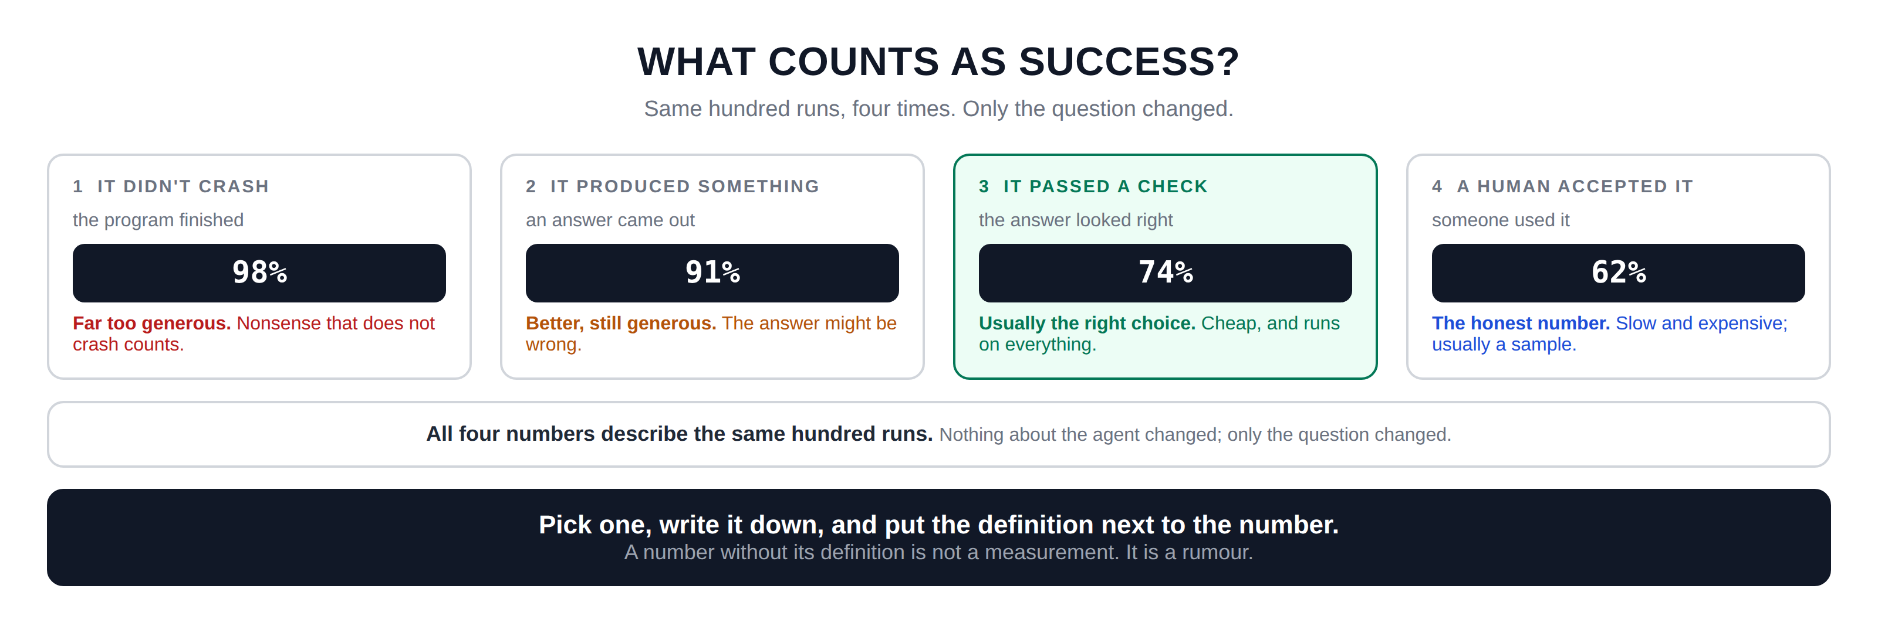
Hidden slide · presenter reference · 02 · What Is Success
iPAD · DRAW
Draw the four definitions
New iPad page. Four cards with the percentages prominent; the spread is the teaching.
Four tall cards across the page, numbered one to four
Card one IT DIDN'T CRASH: the program finished · easy, almost always true · figure in a dark box: 98% · verdict: far too generous
Card two IT PRODUCED SOMETHING: an answer came out · still easy, might be nonsense · 91% · verdict: better, still generous
Card three IT PASSED A CHECK: the answer looked right · a rule you write catches obvious rubbish · 74% · verdict: usually the right choice
Card four A HUMAN ACCEPTED IT: someone used it · the real truth, slow and expensive · 62% · verdict: the honest number
Wide box underneath: all four numbers describe the same hundred runs. Nothing about the agent changed; only the question changed
One last box with the rule: pick one, write it down, put it next to the number. A number without its definition is not a measurement, it is a rumour
FINISHED PANEL: WHAT YOURS SHOULD LOOK LIKE
Say: “Same hundred runs, four times. Only the question changed.”
Agent Cost Control · Module 5
12
Notes:
[HIDDEN SLIDE — iPad segment. Skip in slideshow.]
Production note — New iPad page. Four cards with the percentages prominent; the spread is the teaching.
SAY:
Let's draw all four definitions with the number each one produces.
THEN SAY:
One practical warning. Once you publish a number, people build expectations on it. If you later change the definition, say you tighten your check, your metric will move even though nothing about the agent changed. When that happens, say so loudly, or it looks like the system got worse overnight.
→ Next: the arithmetic, which is the easy part.

Slide 13
03
The Arithmetic
~6 min
Notes:
After all that, the sum itself is a single division.

Slide 14
03 · THE ARITHMETIC
Everything you spent, over the runs that succeeded
Everything you spent
ONE AFTERNOON
(including the failures)
100 runs started
62 succeeded
the denominator
The runs that succeeded
38 failed, after spending money
these still count on top
(only those)
$19 spent in total
the numerator
COST PER REQUEST
COST PER SUCCESSFUL TASK
$19 ÷ 100 = $0.19
$19 ÷ 62 = $0.31
Sounds fine. Nobody would question it.
Sixty percent higher, and it is the true number.
Agent Cost Control · Module 5
14
Notes:
Everything you spent, on the top. The runs that succeeded, on the bottom. That is it. But let me say the top line more carefully, because this is where people go wrong: everything you spent means everything. Including the failures. Including the retries. Including the runs that looped for nine hours and produced nothing.
The temptation is to only count the money spent on successful runs, because it feels more like a fair comparison. It is not. That number tells you what a success costs when everything goes well, which is a fact about a world you do not live in.
A hundred runs started. Sixty-two succeeded. Thirty-eight failed, after spending money. Nineteen dollars spent in total. Cost per request: nineteen cents, and nobody in a meeting would question it. Cost per successful task: thirty-one cents. Sixty percent higher. Same afternoon, same money, same agent. And thirty-one cents is the number you should report.
One small practical point about time windows. Do this over a period long enough to include a normal amount of failure; a week is usually sensible. If you calculate it over one hour and that hour happened to have no failures, you will get a lovely number that means nothing.

Slide 15
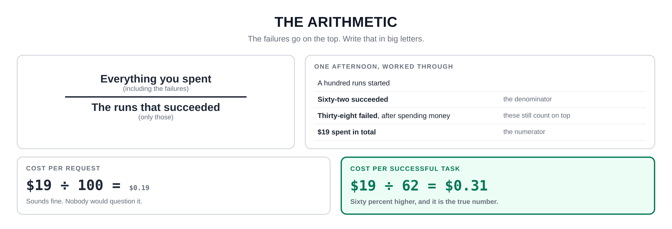
Hidden slide · presenter reference · 03 · The Arithmetic
iPAD · DRAW
Draw the fraction
New iPad page. Draw the fraction large, then the worked rows, then the two answers side by side.
Upper part of the page: a large fraction. On the top line: everything you spent, and in brackets: including the failures
A horizontal line under it
Below the line: the runs that succeeded, and in brackets: only those
Heading underneath: one afternoon, worked through. Then four rows
A hundred runs started · sixty-two succeeded (the denominator) · thirty-eight failed after spending money (these still count on top) · nineteen dollars spent in total (the numerator)
Two boxes at the bottom. Left COST PER REQUEST: 19 ÷ 100 = nineteen cents. Underneath: sounds fine
Right COST PER SUCCESSFUL TASK: 19 ÷ 62 = thirty-one cents. Underneath: the true number. Draw this box heavier than the left one
FINISHED PANEL: WHAT YOURS SHOULD LOOK LIKE
Say: “The failures go on the top. Write that in big letters.”
Agent Cost Control · Module 5
15
Notes:
[HIDDEN SLIDE — iPad segment. Skip in slideshow.]
Production note — New iPad page. Draw the fraction large, then the worked rows, then the two answers side by side.
SAY:
Let's draw the fraction, and then work one afternoon through it.
THEN SAY:
One small practical point about time windows. Do this over a period long enough to include a normal amount of failure; a week is usually sensible. If you calculate it over one hour and that hour happened to have no failures, you will get a lovely number that means nothing.
→ Next: what this number shows you that others cannot.

Slide 16
04
What This Number Reveals
~8 min
Notes:
It moves when nothing else does, and sometimes in the opposite direction to what you would expect.

Slide 17
04 · WHAT IT REVEALS
Three changes; watch spend and value part company
WHAT YOU CHANGED
SPEND
SUCCESSES
THE METRIC
VERDICT
$19 → $14
62 → 41
$0.31 → $0.34
WORSE
Switch to a cheaper model
less capable, so more failures and retries
$19 → $13
62 → 62
$0.31 → $0.21
BETTER
Add checkpoints (module 4)
stop paying twice; answers identical
$19 → $24
62 → 84
$0.31 → $0.29
BETTER
Raise the step limit
more real tasks get to finish
Row one: you spent less and it got worse. Row three: you spent more and it got better.
Agent Cost Control · Module 5
17
Notes:
Scenario one: you switch to a cheaper model. Spending falls from nineteen dollars to fourteen. Anyone looking at the bill would call that a win. But the cheaper model is less capable, so more tasks fail and more get retried. Successes drop from sixty-two to forty-one. Do the division: thirty-four cents. The metric got worse. You spent less money and made the system worse, and total spend told you the opposite.
Scenario two: you add checkpoints, from module four. Spending falls from nineteen to thirteen, because you stopped paying twice for the same work. Successes are unchanged at sixty-two; the answers are identical. Twenty-one cents. Clearly better, and the bill agrees.
Scenario three is the interesting one. You raise the step limit, because you noticed some real tasks were being stopped just short of finishing. Spending goes up: nineteen becomes twenty-four. On the bill, that looks like a failure. But successes go from sixty-two to eighty-four. Twenty-nine cents. Better than where you started.
You spent more and got better value, and there is no other number in this course that would have told you that. Total spend would have called it a regression and somebody would have reverted it.

Slide 18
04 · WHAT IT REVEALS
The only number here that can
tell the difference between
spending less and being worth more.
At some point someone will ask you to cut agent spending by a fixed percentage. This metric is how you find out whether that request makes the business better or worse; and occasionally how you make the case that the right move is to spend a bit more.
Agent Cost Control · Module 5
18
Notes:
That is the case for this metric in one sentence: it is the only number here that can tell the difference between spending less and being worth more.
Row three is worth remembering for a specific reason. At some point someone will ask you to cut agent spending by a fixed percentage. This metric is how you find out whether that request makes the business better or worse; and occasionally how you make the case that the right move is to spend a bit more.

Slide 19
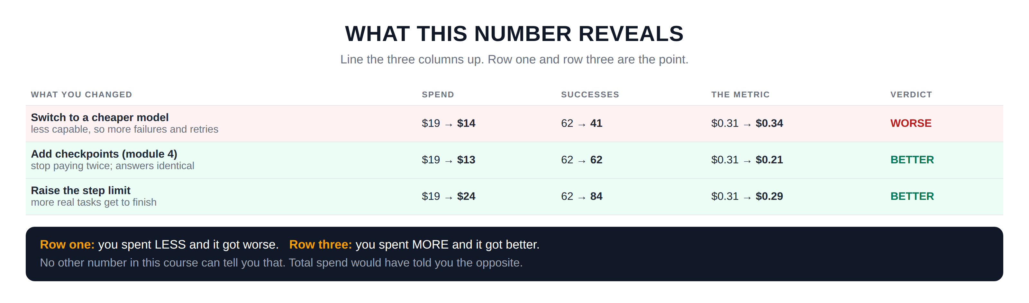
Hidden slide · presenter reference · 04 · What It Reveals
iPAD · DRAW
Draw the three scenarios
New iPad page. Three scenario rows with the three columns aligned, then the punchline.
Three wide rows down the page. Description on the left, three columns of figures on the right headed SPEND, SUCCESSES, THE METRIC
Row one, cheaper model: spend 19 to 14 · successes 62 to 41 · metric 31 cents to 34 cents · verdict WORSE
Row two, checkpoints from module four: spend 19 to 13 · successes 62 to 62 · metric 31 to 21 cents · verdict BETTER
Row three, raise the step limit: spend 19 to 24 · successes 62 to 84 · metric 31 to 29 cents · verdict BETTER
Shade row one differently from rows two and three so the verdicts read at a glance
Wide box at the bottom: look at row one and row three. Row one, you spent LESS and it got worse. Row three, you spent MORE and it got better
Underneath: no other number in this course can tell you that. Total spend would have told you the opposite
FINISHED PANEL: WHAT YOURS SHOULD LOOK LIKE
Say: “Line the three columns up. Row one and row three are the point.”
Agent Cost Control · Module 5
19
Notes:
[HIDDEN SLIDE — iPad segment. Skip in slideshow.]
Production note — New iPad page. Three scenario rows with the three columns aligned, then the punchline.
SAY:
Let's draw three changes you might make, and what each does to the number.
THEN SAY:
Row three is worth remembering for a specific reason. At some point someone will ask you to cut agent spending by a fixed percentage. This metric is how you find out whether that request makes the business better or worse; and occasionally how you make the case that the right move is to spend a bit more.
→ Next: saying it so a non-engineer can use it.

Slide 20
05
Saying It in Their Words
~7 min
Notes:
One more step, and it is not technical at all. It is translation.

Slide 21

05 · TELLING FINANCE
Same number, in the unit they already count
WHAT YOU MEASURED
WHAT THEY ALREADY COUNT
$0.31
per successful task
31¢ per resolved support ticket
31¢ per invoice processed
31¢ per document summarised
AND THEN THEY CAN COMPARE IT TO SOMETHING
A human doing the same ticket
$4.20
Your agent
31¢
The old rules-based system
2¢, but only 40% of tickets
Agent Cost Control · Module 5
21
Notes:
Nobody outside engineering buys tasks. If you tell a finance director that your agent costs thirty-one cents per successful task, they will nod politely and it will mean nothing to them, because they do not know what a task is or whether thirty-one cents is good.
So translate it once, into the unit their world already uses. Thirty-one cents per successful task becomes thirty-one cents per resolved support ticket. Or per invoice processed. Or per document summarised. Whatever the agent is actually for. It is the same number, but now it is attached to something they already count, already budget for, and already have opinions about.
And the moment it is in their unit, something useful happens: they can compare it to something else. A human doing the same ticket might cost four dollars and twenty cents. Your agent does it for thirty-one cents. That is a conversation worth having. And you should include the honest comparison too: the old rules-based system did it for two cents a ticket, but only handled forty percent of them. Now the trade-off is visible, and somebody can make a real decision.

Slide 22
05 · TELLING FINANCE
Report all three, every time
The number, its definition, and the comparison.
The number
$0.31 per resolved ticket, over the last seven days.
The definition
Success means it passed our check: required fields present, value in range.
The comparison
A human costs $4.20. The old system costs 2¢ but handles 40%.
A number on its own invites people to invent their own context, and it is rarely the one you wanted.
Agent Cost Control · Module 5
22
Notes:
That is the entire reason this metric exists. Not so engineers can optimise. So that the people who decide whether the agent continues to exist can understand what they are buying.
One last piece of advice about reporting it. Give the number, give its definition, and give the comparison. All three, every time. A number on its own invites people to invent their own context for it, and the context they invent is rarely the one you want.
Notice that the third comparison is not flattering to the agent on cost alone. Include it anyway. If you only ever present comparisons that make your work look good, people eventually stop believing the ones that do, and the honest version is the one that gets you listened to when it matters.

Slide 23
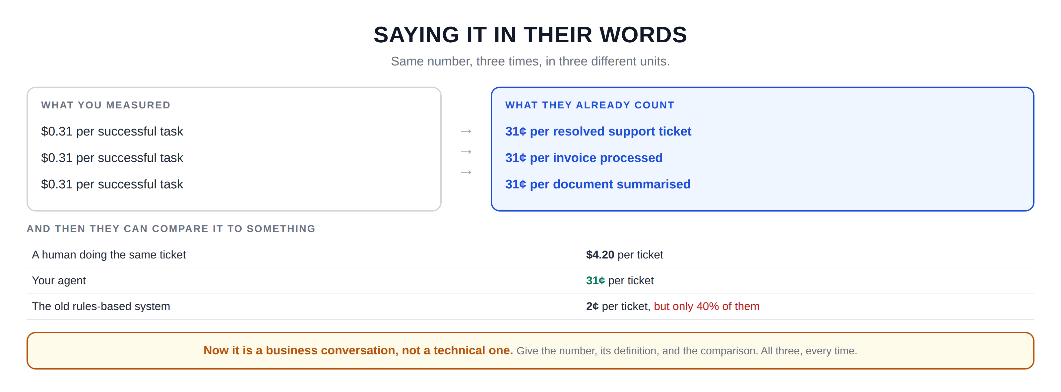
Hidden slide · presenter reference · 05 · Telling Finance
iPAD · DRAW
Draw the translation
New iPad page. Translations at the top, comparisons underneath.
Three rows across the top. On the left of each, the same thing: thirty-one cents per successful task. Make all three identical and plain
An arrow from each one pointing right
Right of row one: 31¢ per resolved support ticket. Row two: 31¢ per invoice processed. Row three: 31¢ per document summarised. Colour these differently from the left
Heading underneath: and then they can compare it to something
Three more rows: a human doing it, four dollars and twenty cents per ticket · your agent, thirty-one cents · the old rules-based system, two cents but only forty percent of the time
A box at the bottom: now it is a business conversation, not a technical one. That is the entire reason this metric exists
FINISHED PANEL: WHAT YOURS SHOULD LOOK LIKE
Say: “Same number, three times, in three different units.”
Agent Cost Control · Module 5
23
Notes:
[HIDDEN SLIDE — iPad segment. Skip in slideshow.]
Production note — New iPad page. Translations at the top, comparisons underneath.
SAY:
Let's draw the translation, and then what it lets someone compare against.
THEN SAY:
Notice that the third comparison is not flattering to the agent on cost alone. Include it anyway. If you only ever present comparisons that make your work look good, people eventually stop believing the ones that do, and the honest version is the one that gets you listened to when it matters.
→ Last section: build it.

Slide 24
06
Build It: Set the Result Label
~10 min
Notes:
Five stages. We are finally setting that result label, then calculating the metric, then alerting on it.

Slide 25
06 · BUILD IT
Five stages; run after every one
STAGE 1
STAGE 2
STAGE 3
Write your definition
Write the check
The metric
SUCCESS.md, before you touch any code.
A function returning true or false; set the result label from it.
A script that sums spend, counts successes, divides.
Everything still lives in the envelope from module two.
STAGE 4
STAGE 5
The same thing in PromQL
Alert on the ratio
So it can live on a dashboard in module 6.
Not on spend. This catches quality problems.
Agent Cost Control · Module 5
25
Notes:
Five stages. We are finally setting that result label, then calculating the metric, then alerting on it. Everything still lives in the envelope from module two.
Production note — Build in an editor with a terminal beside it. Stage 3 is the moment the whole course pays off; let the number sit on screen.

Slide 26
06 · BUILD IT: STAGE 1 OF 5
Write down your definition first
Before touching any code, open a file called SUCCESS.md and write a paragraph saying what counts as success for your agent, and why. This sounds like a formality. It is the most important stage, and it is the one people skip.
$ cat SUCCESS.md
Read it back and ask one question: could a colleague apply your definition to ten runs and get the same answers you would? If not, it is not specific enough yet.
Agent Cost Control · Module 5
26
Notes:
[VS CODE / TERMINAL — TYPE THIS]
Stage one: write down your definition. Before touching any code, open a file called SUCCESS.md and write a paragraph saying what counts as success for your agent and why. This sounds like a formality. It is the most important stage, and it is the one people skip.
Read it back and ask whether a colleague could apply your definition to ten runs and get the same answers you would. If not, it is not specific enough yet.

Slide 27
06 · BUILD IT: STAGE 2 OF 5
Write the check, and set the label
Turn that paragraph into a function that takes a run's output and returns true or false. Keep it simple: does the output have the right shape, are the required fields present, is the number in a plausible range. Then set the result label from it, replacing the unknown we have carried since module two.
$ python3 run_agent.py --input samples/normal.json && curl -s localhost:8000/metrics | grep result=
The result label should now say success or failure, not unknown. Run a few tasks, including the malformed one, and confirm both values appear.
Agent Cost Control · Module 5
27
Notes:
[VS CODE / TERMINAL — TYPE THIS]
Stage two: write the check. Turn that paragraph into a function that takes a run's output and returns true or false. Keep it simple; does the output have the right shape, are the required fields present, is the number in a plausible range. Then set the result label from it, replacing the unknown we have been carrying since module two.
Look at the metrics output. The result label should now say success or failure rather than unknown. Run a few tasks, including the malformed one, and confirm both values appear.

Slide 28
06 · BUILD IT: STAGE 3 OF 5
The metric; this is the moment
Write a script that reads your recorded runs over a window, sums all spend, counts successful runs, and divides. Print all three numbers: spend, successes, and the result. Not just the answer.
$ python3 cost_per_success.py --since 7d
Sit with that number, and compare it against your cost per request.
For most agents at this stage the gap is between fifty and a hundred percent, and it is the first time most people see what their work actually costs.
Agent Cost Control · Module 5
28
Notes:
[VS CODE / TERMINAL — TYPE THIS]
Stage three: the metric. Write a script that reads your recorded runs over a window, sums all spend, counts successful runs, and divides. Print all three numbers; spend, successes, and the result; not just the answer.
There it is. Sit with that number for a moment and compare it against your cost per request. For most agents at this stage the gap is somewhere between fifty and a hundred percent, and it is the first time most people see what their work actually costs.

Slide 29
06 · BUILD IT: STAGE 4 OF 5
The same calculation, in PromQL
Total cost divided by the count of runs where the result label is success, over the same window. Add it as a recording rule so the dashboard does not recompute it constantly.
$ curl -s 'localhost:9090/api/v1/query?query=sum(increase(agent_cost_usd_total[7d]))/sum(increase(agent_runs_total{result="success"}[7d]))'
That should roughly match what your script printed.
If it does not, the usual cause is the two calculations covering different time windows; check both before assuming something is broken.
Agent Cost Control · Module 5
29
Notes:
[VS CODE / TERMINAL — TYPE THIS]
Stage four: the same thing in PromQL, so it can live on a dashboard. You want total cost divided by the count of runs where the result label is success, over the same window. Add it as a recording rule so the dashboard does not recompute it constantly.
That should roughly match what your script printed. If it does not, the usual cause is the two calculations covering different time windows; check both before assuming something is broken.

Slide 30
06 · BUILD IT: STAGE 5 OF 5
Alert on the ratio, not on spend
Set an alert for when cost per successful task rises above a threshold you choose from your own data. This is the alert that catches quality problems disguised as cost problems.
$ python3 cost_per_success.py --since 7d --compare-previous
Comparing against the previous window is what makes it actionable.
A number in isolation tells you little; a number that moved fifteen percent since last week tells you to go and look.
Agent Cost Control · Module 5
30
Notes:
[VS CODE / TERMINAL — TYPE THIS]
Stage five: alert on the ratio, not on spend. Set an alert for when cost per successful task rises above a threshold you choose from your own data. This is the alert that catches quality problems disguised as cost problems.
Comparing against the previous window is what makes it actionable. A number in isolation tells you little; a number that moved fifteen percent since last week tells you to go and look.

Slide 31
RECAP
The course is now functionally complete
You can see what you spend
Caps stop a runaway by itself
With four labels attached, from module 2.
And a switch anyone can flip, from module 3.
You stop paying twice
You know what it is worth
Step limits, loop detection and save points, from module 4.
Cost per successful task, with the result label finally set.
Every calculation that depends on success is now real rather than an estimate.
Agent Cost Control · Module 5
31
Notes:
That is module five, and the course is now functionally complete. You can see what you spend, with four labels attached. You have caps that stop a runaway by themselves, and a switch anyone can flip. You stop paying twice for repeated work. And you now have the one number that tells you whether any of it is actually worth the money.
The result label we set to unknown back in module two is finally set properly, which means every calculation that depends on success is now real rather than an estimate.

Slide 32
ONE HONEST THING
Your definition of success is
almost certainly imperfect.
A check you wrote will pass some outputs a human would reject, and probably fail a few that are fine. That is normal, and it does not make the number useless; it makes it a good approximation that you can improve.
What would make it useless is not writing the definition down at all, so that nobody knows what the number means.
Agent Cost Control · Module 5
32
Notes:
I want to name one thing honestly before the last module. Your definition of success is almost certainly imperfect. A check you wrote will pass some outputs that a human would reject, and probably fail a few that are fine. That is normal, and it does not make the number useless; it makes it a good approximation that you can improve.
The thing that would make it useless is not writing the definition down at all, so that nobody knows what the number means.

Slide 33
NEXT · MODULE 6 OF 6
Make it run without you.
The dashboard, burn-rate alerts, model routing for the cheap steps, and the weekly review that makes this somebody's job rather than a project you did once.
Definition · The label · The number · The comparison
Emmanuel Naweji · github.com/Here2ServeU/agent-cost-control
Notes:
Module six pulls everything together into something that runs without you watching it. The dashboard, burn-rate alerts, model routing for the cheap steps, and the weekly review that makes this somebody's actual job rather than a project you did once. See you there.

Slide 34
APPENDIX A
Exercises: do these before Module 6
01
02
03
04
Write SUCCESS.md first
Score the same runs four ways
Build the check
Calculate it by hand
Before any code. Could a colleague apply it to ten runs and agree with you?
Fifty real runs, four definitions. Write down all four numbers and look at the spread.
A function returning true or false. Confirm the metrics no longer say unknown.
One week: total spend ÷ successful runs. In a spreadsheet, before you automate it.
05
06
07
08
Automate it
Put it in PromQL
Run the three scenarios
Translate it, and compare it
cost_per_success.py. Print spend, successes and the result; never just the answer.
Confirm the query matches your script. If it differs, check the time windows first.
Cheaper model, checkpoints, higher step limit. Estimates are fine; watch them part company.
Your unit: per ticket, per invoice. Include one comparison that does not flatter the agent.
Agent Cost Control · Module 5
34
Notes:
Appendix A; exercises before module 6.
1. Write SUCCESS.md first. Before any code, write a paragraph defining success for your agent. Test it: could a colleague apply it to ten runs and get the same answers you would?
2. Score the same runs four ways. Take fifty real runs and count how many pass each of the four definitions. Write down all four numbers and look at the spread.
3. Build the check. Turn your definition into a function returning true or false. Set the result label from it. Confirm the metrics output no longer says unknown.
4. Calculate the metric by hand. For one week of runs: total spend divided by successful runs. Do it in a spreadsheet first. Compare against cost per request and note the gap.
5. Automate it. Write cost_per_success.py. Print spend, successes and the result; all three, never just the answer.
6. Put it in PromQL. Write the same calculation as a query and confirm it matches your script. If they differ, check the time windows before assuming a bug.
7. Run the three scenarios. Model what happens if you switch to a cheaper model, add checkpoints, or raise the step limit. Estimates are fine; the point is seeing spend and value move in opposite directions.
8. Translate it, and compare it. Write your number in the business unit, then find one honest comparison, including one that does not flatter the agent.

Slide 35
APPENDIX B · EVERY WORD WE USED, IN PLAIN ENGLISH
Glossary: the number
01
02
03
Cost per successful task
Numerator and denominator
The taxi test
Total spend divided by the runs that succeeded. Failures count on the top, not the bottom.
The top and bottom of a fraction: everything you spent on top, successful runs underneath.
Two taxis drive four miles for the same fare; one arrives. Cost per request cannot tell them apart.
04
05
06
The four definitions
Definition beats precision
A check
Didn't crash (~98%), produced something (~91%), passed a check (~74%), a human accepted it (~62%).
Your number can be $0.20 or $0.32 purely by definition. Publish the definition with the number.
A simple rule catching obvious rubbish: right shape, required fields, plausible range. Usually the right choice.
Agent Cost Control · Module 5
35
Notes:
01 Cost per successful task : Total spend divided by the runs that succeeded. Failures count on the top, not the bottom.
02 Numerator and denominator : The top and bottom of a fraction: everything you spent on top, successful runs underneath.
03 The taxi test : Two taxis drive four miles for the same fare; one arrives. Cost per request cannot tell them apart.
04 The four definitions : Didn't crash (~98%), produced something (~91%), passed a check (~74%), a human accepted it (~62%).
05 Definition beats precision : Your number can be $0.20 or $0.32 purely by definition. Publish the definition with the number.
06 A check : A simple rule catching obvious rubbish: right shape, required fields, plausible range. Usually the right choice.

Slide 36
APPENDIX B · EVERY WORD WE USED, IN PLAIN ENGLISH
Glossary: reporting it
07
08
09
The result label
Spending less vs worth more
Recording rule
The fourth label from module 2, unknown until now. Everything that depends on success needs it set.
A cheaper model can lower spend and raise this metric. Only this number tells them apart.
A pre-calculated query stored by Prometheus, so a dashboard does not recompute an expensive sum.
10
11
12
Alerting on the ratio
Translation
Number, definition, comparison
Alert when cost per successful task rises, not when spend rises. Catches quality problems in disguise.
Restating the number in the unit the business counts: per ticket, per invoice, per document.
Report all three, every time. A number alone invites context you did not choose.
Agent Cost Control · Module 5
36
Notes:
07 The result label : The fourth label from module 2, unknown until now. Everything that depends on success needs it set.
08 Spending less vs worth more : A cheaper model can lower spend and raise this metric. Only this number tells them apart.
09 Recording rule : A pre-calculated query stored by Prometheus, so a dashboard does not recompute an expensive sum.
10 Alerting on the ratio : Alert when cost per successful task rises, not when spend rises. Catches quality problems in disguise.
11 Translation : Restating the number in the unit the business counts: per ticket, per invoice, per document.
12 Number, definition, comparison : Report all three, every time. A number alone invites context you did not choose.

Slide 37
APPENDIX C: THE COMMANDS, IN PLAIN ENGLISH
Setting the label
cat SUCCESS.md / Get-Content SUCCESS.md
Print your definition back. The first on Mac and Linux, the second in PowerShell.
python3 run_agent.py … && curl -s localhost:8000/metrics
Run one task, then read the metrics your program is serving.
| grep result=
Keep only the lines mentioning the result label, so you can see success or failure.
python3 cost_per_success.py --since 7d
Your own script: spend, successes and the division, over the last seven days.
--compare-previous
A flag on your script: show the same figure for the window before, so you can see movement.
Agent Cost Control · Module 5
37
Notes:
cat SUCCESS.md / Get-Content SUCCESS.md : Print your definition back. The first on Mac and Linux, the second in PowerShell.
python3 run_agent.py … && curl -s localhost:8000/metrics : Run one task, then read the metrics your program is serving.
| grep result= : Keep only the lines mentioning the result label, so you can see success or failure.
python3 cost_per_success.py --since 7d : Your own script: spend, successes and the division, over the last seven days.
--compare-previous : A flag on your script: show the same figure for the window before, so you can see movement.

Slide 38
APPENDIX C: THE COMMANDS, IN PLAIN ENGLISH
Reading it back from Prometheus
localhost:9090
Where Prometheus answers queries; 8000 is your own program's metrics page.
/api/v1/query?query=…
Ask Prometheus a question over HTTP and get the answer as JSON.
sum(increase(agent_cost_usd_total[7d]))
How much that counter grew over seven days, added up across all labels.
agent_runs_total{result="success"}
Only the runs whose result label says success; this is the denominator.
Recording rule
Not a command: a query Prometheus computes on a schedule, so dashboards load quickly.
Agent Cost Control · Module 5
38
Notes:
localhost:9090 : Where Prometheus answers queries; 8000 is your own program's metrics page.
/api/v1/query?query=… : Ask Prometheus a question over HTTP and get the answer as JSON.
sum(increase(agent_cost_usd_total[7d])) : How much that counter grew over seven days, added up across all labels.
agent_runs_total{result="success"} : Only the runs whose result label says success; this is the denominator.
Recording rule : Not a command: a query Prometheus computes on a schedule, so dashboards load quickly.

