Slide 1
THE AGENT COST PROBLEM · MODULE 6 OF 6
Operating It
The last hour. Everything you have built needs to keep working when you are not looking at it.
PRESENTER
RUNTIME
COURSE REPO
Emmanuel Naweji
~50 min · 6 sections
github.com/Here2ServeU/agent-cost-control
Notes:
The last hour. Everything you have built so far needs to keep working when you are not looking at it. A dashboard with four panels, alerts that fire on the rate rather than the total, two ways to spend less without spending worse, and a fifteen-minute habit that keeps all of it alive.
[Presenter: Emmanuel Naweji · Runtime ~50 min · 6 sections · Course repo github.com/Here2ServeU/agent-cost-control]

Slide 2



WHAT THIS MODULE GIVES YOU
Everything works. The problem now is
keeping it working.
A dashboard of four panels
Two alerts on the rate
A fifteen-minute habit
Each one answering a question a real person asks out loud.
One fast enough to catch a runaway, one quiet enough to be believed.
Four questions, once a week, with one person's name against it.
Agent Cost Control · Module 6
2
Notes:
Welcome to the last module. Everything we have built so far works. The problem now is keeping it working when nobody is thinking about it.

Slide 3
SECTIONS AT A GLANCE
Six sections; one habit that outlives you
01
~8 min
02
~9 min
03
~9 min
Four Panels
Burn Rate
Routing
04
~7 min
05
~8 min
06
~9 min
Caching
The Review
Build It
Agent Cost Control · Module 6
3
Notes:
Sections 1 and 2 are how you watch it. Sections 3 and 4 are two ways to spend less without spending worse. Section 5 keeps all of it alive; section 6 builds it, and ends with the capstone.

Slide 4
BEFORE YOU START
Install what you need
Ten minutes once, and every command in this module will run. Pick your side.
macOS · TERMINAL
WINDOWS · POWERSHELL
# install Homebrew first: brew.sh
$ brew install python git
$ brew install --cask docker \
visual-studio-code
$ docker --version && python3 --version
# winget ships with Windows 11
> winget install Python.Python.3.12
> winget install Git.Git
> winget install Docker.DockerDesktop
> winget install \
Microsoft.VisualStudioCode
WHAT MODULE 6 ADDS
Docker Desktop
Grafana
A calendar invite
to run Prometheus and Grafana
for the four panels
for the weekly review
Agent Cost Control · Module 6
4
Notes:
[SETUP]
This is the one module that adds a tool: Docker Desktop, so you can run Prometheus and Grafana locally with one command. Everything else is what you already have from modules one to five. And one thing that is not software: a calendar invite for the weekly review in section five.

Slide 5
BEFORE YOU START
Watch these before you install anything
Two short videos take you from a blank machine to Git, Python and VS Code installed. Pick the one for your computer.
macOS
WINDOWS
Install Git, Python and VS Code on a Mac
Install Git, Python and VS Code on Windows
https://youtu.be/8ZIiXg4XOY0
https://youtu.be/3e2-GRBibWc
OFFICIAL PAGES, IF YOU PREFER TO READ
Docker Desktop
docs.docker.com/desktop
Grafana with Prometheus
grafana.com · basics
Install for Mac and Windows
Official getting-started guide
Alerting rules
prometheus.io · alerts
Grafana panels
grafana.com · panels
Official Prometheus guide
How to build and title a panel
Agent Cost Control · Module 6
5
Notes:
[SETUP]
If your machine is not set up yet, stop here and watch the video for your computer. The Mac one is youtu.be/8ZIiXg4XOY0; the Windows one is youtu.be/3e2-GRBibWc. The Docker and Grafana pages are for this module specifically.

Slide 6
01
Four Panels. Not Fourteen.
~8 min
Notes:
A dashboard nobody can read in ten seconds is a dashboard nobody reads.

Slide 7
01 · FOUR PANELS
Each panel answers a question somebody asks
What are we spending?
What is it buying us?
cost per hour, this week
cost per successful task
Is that normal for a Tuesday?
Module 5's number; the one that matters.
Who is spending it?
How much is wasted?
cost by team, this month
the failed-run tax over time
So the bill has somewhere to go.
Module 4's number, watched weekly.
If you cannot say out loud what question a panel answers, delete the panel.
Agent Cost Control · Module 6
7
Notes:
Panel one: what are we spending? Cost per hour, over this week. Somebody glances at this and asks themselves one thing: is that normal for a Tuesday?
Panel two: what is it buying us? Cost per successful task, the number we built in module five. This is the one that matters most, and I would put it second only because people look for total spend first out of habit.
Panel three: who is spending it? Cost by team, this month. Not so you can blame anyone; so the bill has somewhere to go, and so a new agent nobody mentioned shows up as a new bar.
Panel four: how much is wasted? The failed-run tax from module four, tracked over time. If this starts climbing, something is failing more than it used to, and you want to know before anyone else notices.
Here is the test for any panel you are tempted to add. Say out loud what question it answers. If you cannot, delete it. If two panels answer the same question, delete one. Four is genuinely enough. Add a fifth when somebody asks you a question these four cannot answer, and not before.

Slide 8
01 · FOUR PANELS
Title it with the question, not the metric name
ONLY READABLE BY ITS AUTHOR
READABLE BY YOUR MANAGER
agent_cost_usd_total rate 1h
What are we spending?
A query with a name. Nobody else opens it twice.
The entire point of a dashboard rather than a query.
Every extra chart makes the important ones harder to find.
Twenty panels feels thorough; after two weeks people stop opening it.
Agent Cost Control · Module 6
8
Notes:
One small thing that makes a real difference: title each panel with the question, not the metric name. A panel called 'agent_cost_usd_total rate 1h' is only readable by the person who built it. A panel called 'What are we spending?' is readable by your manager, which is the entire point of having a dashboard rather than a query.
The temptation, once you have all this lovely data, is to put all of it on a screen. Twenty panels. Every metric you collected. It feels thorough. It is actually the opposite, because every extra chart makes the important ones harder to find, and after two weeks people stop opening it.

Slide 9


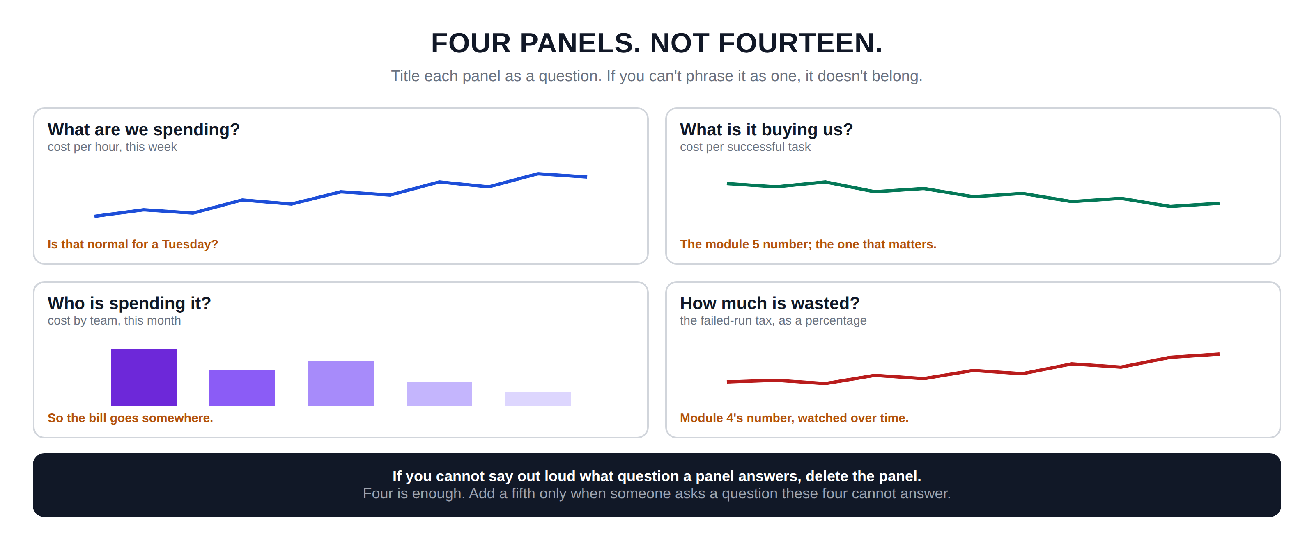
Hidden slide · presenter reference · 01 · Four Panels
iPAD · DRAW
Draw the dashboard
New iPad page. Draw the four panels as a two-by-two grid with rough sketch charts inside each.
Four boxes in a two-by-two grid, taking up most of the page
Top left WHAT ARE WE SPENDING? Smaller: cost per hour, this week. Sketch a wobbly rising line. At the bottom: is it normal for a Tuesday?
Top right WHAT IS IT BUYING US? Smaller: cost per successful task. Another line. At the bottom: the module five number, the one that matters
Bottom left WHO IS SPENDING IT? Smaller: cost by team, this month. Five bars of different heights. At the bottom: so the bill goes somewhere
Bottom right HOW MUCH IS WASTED? Smaller: the failed-run tax, as a percentage. A line. At the bottom: module four's number, watched over time
Wide box underneath: each panel answers one question a person actually asks. If you cannot say out loud what question a panel answers, delete the panel
Add underneath: four is enough; add a fifth only when someone asks a question these four cannot answer
FINISHED PANEL: WHAT YOURS SHOULD LOOK LIKE
Say: “Title each panel as a question. If you can't phrase it as one, it doesn't belong.”
Agent Cost Control · Module 6
9
Notes:
[HIDDEN SLIDE — iPad segment. Skip in slideshow.]
Production note — New iPad page. Draw the four panels as a two-by-two grid with rough sketch charts inside each.
SAY:
Let's draw the dashboard, with each panel titled as a question rather than a metric name.
THEN SAY:
One small thing that makes a real difference: title each panel with the question, not the metric name. A panel called 'agent_cost_usd_total rate 1h' is only readable by the person who built it. A panel called 'What are we spending?' is readable by your manager, which is the entire point of having a dashboard rather than a query.
→ Next: alerts that fire while it is still happening.

Slide 10
02
Alert on the Rate, Not the Total
~9 min
Notes:
A dashboard only helps when somebody is looking at it. Alerts are for when nobody is.

Slide 11
02 · BURN RATE
How fast, not how much
ALERT ON THE TOTAL
ALERT ON THE RATE
"Tell me when we have spent $500 this month." By the time it fires, you have already spent $500. It is a report on something finished.
"At this rate we will hit the budget in two days." Nothing has gone wrong yet; the slope is telling you something is wrong right now.
NORMAL
SLOW BURN
FAST BURN
a gentle slope that reaches the top at the end of the month
steeper; gone in a week if nothing changes
very steep; gone in two days, and it has spent almost nothing yet
Burn rate: how fast the budget is being consumed, compared with how fast it should be. The runaway from module one would have tripped it within minutes.
Agent Cost Control · Module 6
11
Notes:
The obvious alert is on the total. Tell me when we have spent five hundred dollars this month. The problem is that by the time it fires, you have already spent five hundred dollars. It is a report on something finished, arriving too late to change anything.
The better alert is on the rate. Not how much have we spent, but how fast are we spending it. Picture a month's budget as a line you are climbing towards. Normal spending is a gentle slope that reaches the top at roughly the end of the month, which is exactly what a budget is for. Now picture a steeper line. Same budget, but at this rate you will hit the top in two days. Nothing has gone wrong yet; you have spent barely anything. But the slope is telling you something is wrong right now.
That is burn rate. How fast the budget is being consumed, compared to how fast it should be. And the reason it works is that it fires early. The runaway from module one would have tripped a burn-rate alert within minutes, long before the total looked alarming.

Slide 12
02 · BURN RATE
Two windows; two speeds of response
FAST WINDOW · LAST 1 HOUR
SLOW WINDOW · LAST 24 HOURS
Fires within minutes. Catches the sharp problems: a runaway loop, an agent gone mad.
Fires in hours. Catches the quiet drift: slightly too high every hour, adding up to a bad month.
Worth waking someone up for.
Mention it at standup.
One alert cannot do both. Fast enough to catch the runaway means waking you for every busy afternoon.
The cap is the seatbelt; the alert is the dashboard light. Module 3's cap stops the bleeding whether anyone answers the page or not.
Agent Cost Control · Module 6
12
Notes:
You want two of these, watching different windows.
The fast window looks at the last hour. It fires within minutes and it catches the sharp problems: a runaway loop, an agent gone mad. This one is worth waking someone up for.
The slow window looks at the last twenty-four hours. It fires in hours and catches the quiet drift: spending that is slightly too high every hour, never dramatic, adding up to a bad month. This one is not worth waking anyone up for. Mention it at standup.
Different speeds of problem need different speeds of response, and one alert genuinely cannot do both. Set it fast enough to catch the runaway and it will wake you for every busy afternoon. Set it slow enough to be quiet and it will miss the thing you built it for.
One thing worth saying about the fast alert. Because you already have caps from module three, this alert is not your only protection; the cap will stop the bleeding whether anyone answers the page or not. That means you can set the alert to be genuinely informative rather than panicked. The cap is the seatbelt. The alert is the dashboard light.

Slide 13
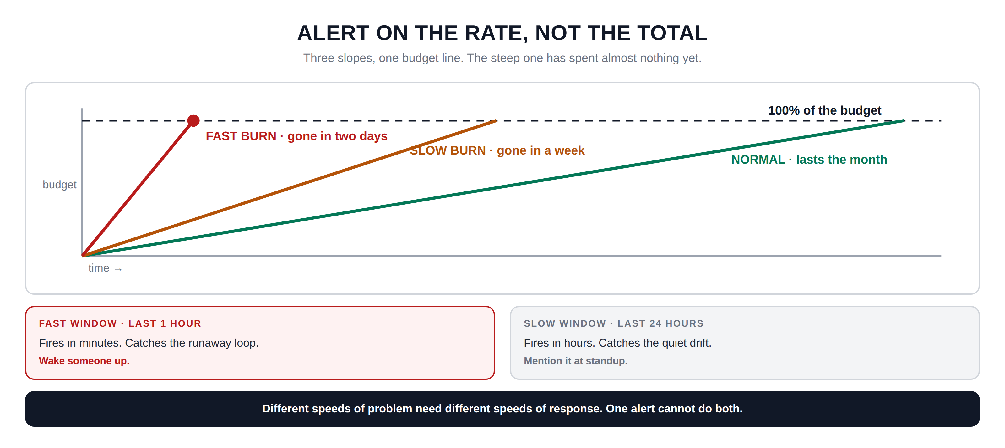
Hidden slide · presenter reference · 02 · Burn Rate
iPAD · DRAW
Draw the three slopes
New iPad page. Draw the three slopes against one budget line, then the two windows underneath.
A pair of axes. Up the left: budget used. Along the bottom: time
A horizontal dashed line near the top, labelled one hundred percent; that is the whole budget
From the bottom-left corner, three straight lines at different angles
A gentle one reaching the dashed line at the far right: NORMAL, budget lasts the month
A steeper middle one reaching it about halfway: SLOW BURN, gone in a week
A very steep one hitting it near the left: FAST BURN, gone in two days. Put a dot where it crosses
Heading underneath: so you watch two windows at once. Then two boxes
Left FAST WINDOW, last one hour: fires in minutes, catches the runaway loop; underneath, wake someone up
Right SLOW WINDOW, last twenty-four hours: fires in hours, catches the quiet drift; underneath, mention it at standup. At the very bottom: one alert cannot do both
FINISHED PANEL: WHAT YOURS SHOULD LOOK LIKE
Say: “Three slopes, one budget line. The steep one has spent almost nothing yet.”
Agent Cost Control · Module 6
13
Notes:
[HIDDEN SLIDE — iPad segment. Skip in slideshow.]
Production note — New iPad page. Draw the three slopes against one budget line, then the two windows underneath.
SAY:
Let's draw the slopes, because burn rate is much easier to see than to explain.
THEN SAY:
One thing worth saying about the fast alert. Because you already have caps from module three, this alert is not your only protection; the cap will stop the bleeding whether anyone answers the page or not. That means you can set the alert to be genuinely informative rather than panicked. The cap is the seatbelt. The alert is the dashboard light.
→ Next: spending less without spending worse.

Slide 14
03
Not Every Step Needs the Expensive Model
~9 min
Notes:
You would not send a senior engineer to reset somebody's password. Same idea.

Slide 15
03 · ROUTING
Send the easy steps to the cheaper model
A twelve-step agent task is not twelve equally difficult steps. Most of them are ordinary; two or three are the actual hard part.
THE EXPENSIVE MODEL
THE CHEAP MODEL
reason · decide · write · judge
classify · extract · format · route
The reasoning and the judgement; the bit that needed a capable model.
The ordinary steps that would be boring for a person to do.
Everything on the expensive model
12 steps
$0.31
Nine cheap steps and three expensive ones
12 steps
$0.11
Same answer, same quality, about sixty-five percent less.
Agent Cost Control · Module 6
15
Notes:
Routing means sending the easy steps to a cheaper model and keeping the expensive one for the steps that need it. A twelve-step agent task is not twelve equally difficult steps. Most of them are ordinary: classify this, pull the date out of that, decide which of three categories this falls into, format the output. Two or three of them are the actual hard part.
The numbers are substantial. In the example on screen, running everything on the expensive model costs thirty-one cents. Nine cheap steps and three expensive ones costs eleven cents. Same answer, same quality, about sixty-five percent less.
One practical note on how to decide. Do not guess which steps are easy. Look at your data from module two. The steps that always produce the same shape of output, that never need much history, that would be boring for a person to do; those are your candidates.

Slide 16
03 · ROUTING
Do routing last, not first.
Routing is the only change in this entire course that can make your answers worse. Caps, loop detection and checkpoints cost you nothing in quality; you are simply not buying things twice. Routing genuinely trades quality for money, even if only a little.
People get this backwards constantly: switching models is the first thing everyone reaches for, and then they spend weeks arguing about whether quality dropped.
Fix the waste first. It is free. Then route, one step type at a time, checking as you go.
Agent Cost Control · Module 6
16
Notes:
Now the important warning, and I want to be firm about this. Do routing last, not first.
Routing is the only change in this entire course that can make your answers worse. Everything in modules three and four; caps, loop detection, checkpoints; costs you nothing in quality. You are simply not buying things twice. Routing genuinely trades quality for money, even if only a little, and even if only on the steps you judged to be easy.
And people get this backwards constantly. Switching models is the first thing everyone reaches for, because it feels like the obvious lever. Then they spend weeks arguing about whether quality dropped. Fix the waste first. It is free. Then, when the waste is gone and you still need to spend less, route, and route carefully, one step type at a time, checking the results as you go.
If you want a rule for where to start, it is this: route the step types where you would be comfortable showing a colleague both answers side by side and saying 'can you tell which one was the cheap model?' If you would not be comfortable with that question, leave that step on the expensive model.

Slide 17
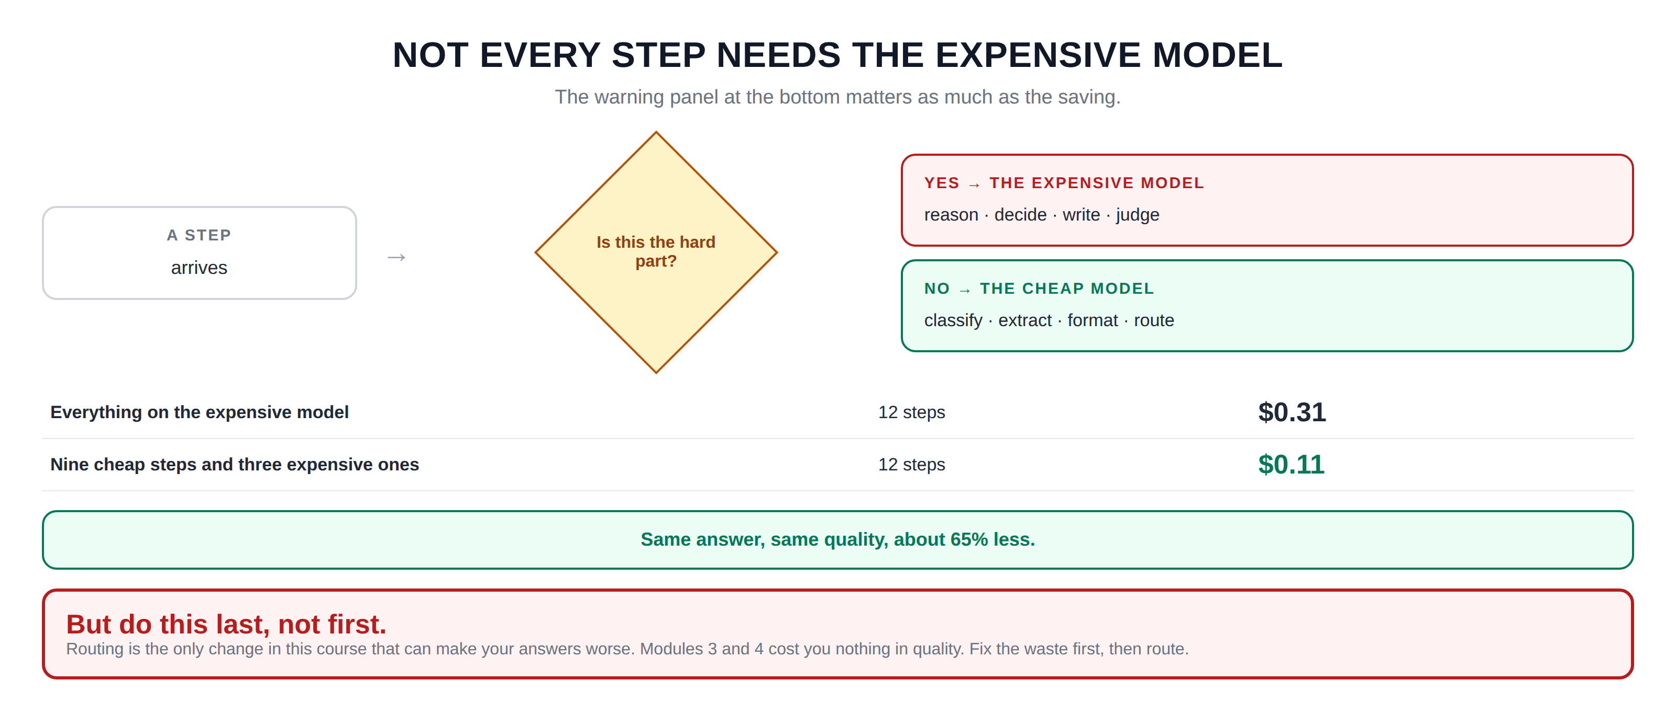
Hidden slide · presenter reference · 03 · Routing
iPAD · DRAW
Draw the sorting
New iPad page. A decision diamond splitting to two models, then the cost comparison, then the warning.
Left of the page: a small box labelled A STEP, with 'arrives' underneath
An arrow right into a diamond. Inside the diamond: is this the hard part?
From the right point, an arrow labelled yes to a box THE EXPENSIVE MODEL: reason, decide, write, judge
From the bottom point, an arrow labelled no curving to a box THE CHEAP MODEL: classify, extract, format, route
Heading below: a twelve-step task, sorted. Then two rows
Row one: everything on the expensive model, twelve steps, thirty-one cents. Row two: nine cheap and three expensive, twelve steps, eleven cents
Underneath: same answer, same quality, sixty-five percent less
At the bottom, a warning box: but do this last, not first. Routing is the only change in this course that can make your answers worse. Fix the waste first, then route.
FINISHED PANEL: WHAT YOURS SHOULD LOOK LIKE
Say: “The warning panel at the bottom matters as much as the saving.”
Agent Cost Control · Module 6
17
Notes:
[HIDDEN SLIDE — iPad segment. Skip in slideshow.]
Production note — New iPad page. A decision diamond splitting to two models, then the cost comparison, then the warning.
SAY:
Let's draw the sorting, and then the numbers, and then the warning that goes with it.
THEN SAY:
If you want a rule for where to start, it is this: route the step types where you would be comfortable showing a colleague both answers side by side and saying 'can you tell which one was the cheap model?' If you would not be comfortable with that question, leave that step on the expensive model.
→ Next: the free money, and its one danger.

Slide 18
04
What Is Safe to Remember?
~7 min
Notes:
If you have already answered this exact question, do not pay to answer it again.

Slide 19

04 · CACHING
Three categories, and one danger
Always safe
Safe for a while
Never cache
the answer cannot change
the answer changes slowly
the answer is personal or live
the same document summarised
a fixed lookup table
last month's closed figures
product descriptions
policy documents
help articles, with an expiry
anything about one customer
prices that move, stock levels
anything with a name in it
A cached answer leaking between customers is not a cost incident. It is a data breach, and no saving is worth that.
Agent Cost Control · Module 6
19
Notes:
Caching means: if you have already answered this exact question, do not pay to answer it again; just give back what you said last time. When it applies, it is the closest thing to free money in this whole course.
But caching has one real danger, and it is worse than spending money: serving somebody an answer that was correct yesterday and is wrong today. Or worse, serving one person an answer that belonged to somebody else.
Always safe: the answer genuinely cannot change. The same document summarised. A fixed lookup table. Last month's closed figures, which are closed.
Safe for a while: the answer changes, but slowly. Product descriptions. Policy documents. Help articles. Cache these, but give them an expiry that matches how often they actually change.
Never cache: the answer is personal or live. Anything about one specific customer. Prices that move. Stock levels. And a good catch-all: anything with somebody's name in it.

Slide 20
04 · CACHING
If two different people ask this,
should they get the same answer?
YES · safe to cache
NO · never cache it
That question catches the staleness problems and the privacy ones too. When you are unsure: do not cache it. The saving from one more case is small; the cost of getting it wrong is not.
Agent Cost Control · Module 6
20
Notes:
Now, one question that catches almost every dangerous case, and I would use it as your only test if you remember nothing else. If two different people ask this, should they get the same answer? Yes means it is safe to cache. No means never cache it.
That question catches the obvious staleness problems, and it catches the privacy ones too, which are far more serious. A cached answer leaking between customers is not a cost incident, it is a data breach, and no saving is worth that. So when you are unsure: do not cache it.
One implementation note. Cache on the whole question, not part of it. If you cache on just the user's words but the system prompt has changed, you will serve answers generated under the old instructions and never know. Include everything that went into the call when you decide whether two requests are really the same request.

Slide 21
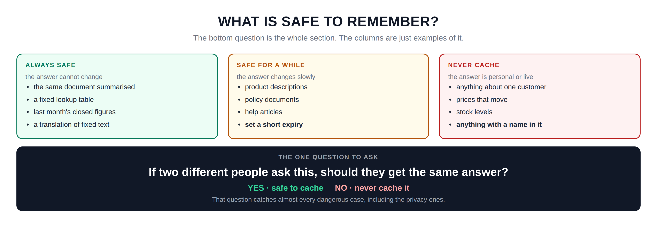
Hidden slide · presenter reference · 04 · Caching
iPAD · DRAW
Draw the three categories
New iPad page. Three columns, then the single test question at the bottom; that question is the takeaway.
Three tall columns: ALWAYS SAFE · SAFE FOR A WHILE · NEVER CACHE
ALWAYS SAFE: the answer cannot change. The same document summarised · a fixed lookup table · last month's closed figures · a translation of fixed text
SAFE FOR A WHILE: the answer changes slowly. Product descriptions · policy documents · help articles · set a short expiry
NEVER CACHE: the answer is personal or live. Anything about one customer · prices that move · stock levels · anything with a name in it
Wide box underneath with a heading: the one question to ask
Inside, in large letters: if two different people ask this, should they get the same answer?
A line underneath; on the left YES, safe to cache; on the right NO, never cache it
At the very bottom, small: that question catches almost every dangerous case, including the privacy ones
FINISHED PANEL: WHAT YOURS SHOULD LOOK LIKE
Say: “The bottom question is the whole section. The columns are just examples of it.”
Agent Cost Control · Module 6
21
Notes:
[HIDDEN SLIDE — iPad segment. Skip in slideshow.]
Production note — New iPad page. Three columns, then the single test question at the bottom; that question is the takeaway.
SAY:
Let's draw the three categories, and then the one question that decides all of it.
THEN SAY:
One implementation note. Cache on the whole question, not part of it. If you cache on just the user's words but the system prompt has changed, you will serve answers generated under the old instructions and never know. Include everything that went into the call when you decide whether two requests are really the same request.
→ Next: keeping all of it alive.

Slide 22
05
Make It Somebody's Job
~8 min
Notes:
Everything you have built quietly stops working the week nobody looks at it.

Slide 23
05 · THE REVIEW
Four questions. Fifteen minutes. Once a week.
1
Did anything change?
cost per successful task, this week vs last
Moved more than 10%? Find out why first.
2
Who is spending most?
cost by team, this month
A new bar usually means an agent nobody mentioned.
3
How much was wasted?
the failed-run tax, this week
Climbing means something is failing more than it used to.
4
Did any alert fire?
and did anyone actually do anything
An alert nobody acts on should be fixed or deleted.
Down is as worth understanding as up; a sudden drop often means something stopped working rather than something got better.
Agent Cost Control · Module 6
23
Notes:
Question one: did anything change? Compare cost per successful task this week against last week. If it moved more than about ten percent in either direction, find out why before you do anything else. Down is as worth understanding as up; a sudden drop often means something stopped working rather than something got better.
Question two: who is spending most? Look at cost by team this month. This is not about blame. It is about noticing a bar that was not there last month, which usually means somebody deployed an agent nobody told you about.
Question three: how much was wasted? The failed-run tax this week. If it is climbing, something is failing more often than it used to, and that is worth a look while it is small.
Question four: did any alert fire, and did anyone actually do anything? An alert that fires regularly and gets ignored is worse than no alert, because it teaches everyone that alerts do not matter. Either fix it so it only fires when action is needed, or delete it.

Slide 24
05 · THE REVIEW
It needs a name against it.
Not the team; the team owns nothing. A rota is fine. One person per week, same slot, in the calendar.
A habit with an owner survives people leaving, reorganisations, and busy months. A habit that belongs to everybody survives about three weeks.
Put it in a calendar before you finish this module, with a name on it and the dashboard link in the invite. A habit that requires somebody to remember it is not a habit yet.
Agent Cost Control · Module 6
24
Notes:
And the part people skip: it needs a name against it. Not the team; the team owns nothing. A rota is fine. One person per week, same slot, in the calendar.
Because a habit with an owner survives people leaving, reorganisations, and busy months. A habit that belongs to everybody survives about three weeks.
If you want this to actually happen, put it in a calendar before you finish this module, with a name on it, and paste the dashboard link into the invite. A habit that requires somebody to remember it is not a habit yet.

Slide 25
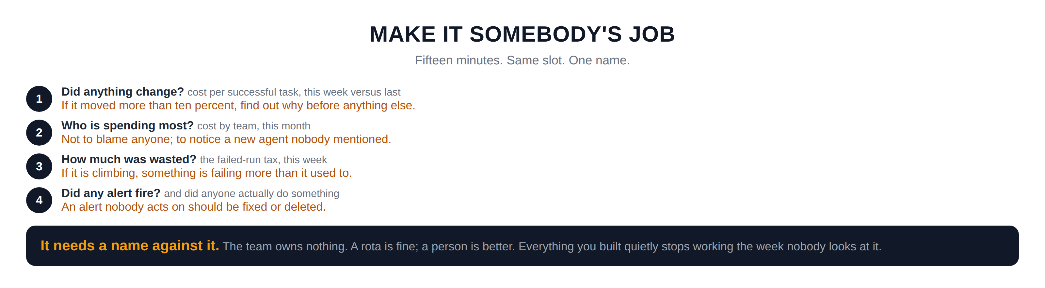
Hidden slide · presenter reference · 05 · The Review
iPAD · DRAW
Draw the four questions
New iPad page. Four numbered questions, then the ownership panel.
Four wide rows, each with a numbered circle on the left
Row one DID ANYTHING CHANGE? Under it: cost per successful task, this week versus last. On the right: if it moved more than ten percent, find out why before anything else
Row two WHO IS SPENDING MOST? Under it: cost by team, this month. On the right: not to blame anyone, but to notice a new agent nobody mentioned
Row three HOW MUCH WAS WASTED? Under it: the failed-run tax, this week. On the right: if it is climbing, something is failing more than it used to
Row four DID ANY ALERT FIRE? Under it: and did anyone actually do something. On the right: an alert nobody acts on should be deleted or fixed
A box underneath: it needs a name against it. The team owns nothing. A rota is fine, a person is better
Then: everything you built in this course quietly stops working the week nobody looks at it. Fifteen minutes, same slot every week, one person
FINISHED PANEL: WHAT YOURS SHOULD LOOK LIKE
Say: “Fifteen minutes. Same slot. One name.”
Agent Cost Control · Module 6
25
Notes:
[HIDDEN SLIDE — iPad segment. Skip in slideshow.]
Production note — New iPad page. Four numbered questions, then the ownership panel.
SAY:
Let's write down the four questions, and then the thing that makes them stick.
THEN SAY:
If you want this to actually happen, put it in a calendar before you finish this module, with a name on it, and paste the dashboard link into the invite. A habit that requires somebody to remember it is not a habit yet.
→ Last section: build it, and finish the course.

Slide 26
06
Build It: and the Bill That Never Arrived
~9 min
Notes:
Four things to build, and then the capstone that ties the whole course together.

Slide 27
06 · BUILD IT
Four stages, then the capstone
STAGE 1
STAGE 2
The four panels
The two alerts
In Grafana, titled with the question each one answers.
Fast on 1 hour, slow on 24 hours, routed differently.
STAGE 3
STAGE 4
Routing
The capstone
One step type to a cheaper model; compare cost and quality.
Module 1's runaway against your fully built agent.
Prometheus and Grafana run locally; everything else is the agent you have been building since module two.
Agent Cost Control · Module 6
27
Notes:
Four things to build, and then the capstone that ties the whole course together.
Production note — Grafana and Prometheus running locally. The capstone at the end is the moment; let the final output sit on screen.

Slide 28
06 · BUILD IT: SETUP
Start Prometheus and Grafana
$ docker compose up -d prometheus grafana
Two containers, one command. Prometheus answers on port 9090; Grafana opens on port 3000.
Test every query in the terminal before pasting it into a Grafana panel. Debugging PromQL inside a panel is miserable.
Agent Cost Control · Module 6
28
Notes:
[VS CODE / TERMINAL — TYPE THIS]
Start Prometheus and Grafana if they are not already running. Two containers, one command.
Always test a query in the terminal first; debugging PromQL inside a Grafana panel is miserable.

Slide 29
06 · BUILD IT: STAGE 1 OF 4
The four panels
In Grafana, create a dashboard with exactly four panels: cost per hour, cost per successful task, cost by team, failed-run tax. Title each one with the question, not the metric.
$ curl -s localhost:9090/api/v1/query --data-urlencode 'query=sum(rate(agent_cost_usd_total[1h]))*3600'
Panel one's query. Rate gives spend per second; multiplying by 3,600 gives spend per hour.
$ curl -s localhost:9090/api/v1/query --data-urlencode 'query=sum(increase(agent_cost_usd_total[24h])) / sum(increase(agent_runs_total{result="success"}[24h]))'
Agent Cost Control · Module 6
29
Notes:
[VS CODE / TERMINAL — TYPE THIS]
Stage one: the four panels. In Grafana, create a dashboard with exactly four panels. Cost per hour. Cost per successful task. Cost by team. Failed-run tax. Title each one with the question, not the metric.
That is the first panel's query, checked from the terminal before you paste it into Grafana. Rate gives you spend per second; multiplying by thirty-six hundred gives you per hour. Always test a query here first; debugging PromQL inside a Grafana panel is miserable.
And the second is cost per successful task; module five's formula, in PromQL. All spend on the top, only successes on the bottom, same window on both. Check that it returns a number in the range you expect.

Slide 30
06 · BUILD IT: STAGE 2 OF 4
The two alerts, and proving one fires
Write a fast rule on a one-hour window that fires when projected monthly spend exceeds your budget by a wide margin. Then a slow rule on twenty-four hours with a tighter threshold. Route the fast one somewhere noisy and the slow one somewhere quiet.
$ python3 run_agent.py --input samples/malformed.json --no-caps &
Run the runaway with caps disabled, deliberately, to prove the alert fires. Watch your fast alert go off within a couple of minutes. Then stop it, and turn the caps back on immediately.
Agent Cost Control · Module 6
30
Notes:
[VS CODE / TERMINAL — TYPE THIS]
Stage two: the two alerts. Write a fast rule on a one-hour window that fires when the projected monthly spend exceeds your budget by a wide margin. Then a slow rule on a twenty-four-hour window with a tighter threshold. Route the fast one somewhere noisy and the slow one somewhere quiet.
Run the runaway with caps disabled, deliberately, to prove the alert fires. Watch your fast alert go off within a couple of minutes. Then stop it, and turn the caps back on immediately.

Slide 31
06 · BUILD IT: STAGE 3 OF 4
Route one step type
Pick the one step type in your agent that is most obviously mechanical. Send only that step to a cheaper model. Run twenty tasks and compare both cost and output quality against the previous twenty.
$ python3 compare_runs.py --before baseline --after routed
Two numbers: how much you saved, and whether anything got worse.
If quality moved at all, put that step back on the expensive model. The saving is not worth an argument about quality.
Agent Cost Control · Module 6
31
Notes:
[VS CODE / TERMINAL — TYPE THIS]
Stage three: routing. Pick the one step type in your agent that is most obviously mechanical. Send only that step to a cheaper model. Run twenty tasks and compare both cost and output quality against the previous twenty.
Two numbers: how much you saved, and whether anything got worse. If quality moved at all, put that step back on the expensive model. The saving is not worth an argument about quality.

Slide 32
06 · BUILD IT: STAGE 4 OF 4
The capstone: the bill that never arrived
Take the malformed input from module one and run it against everything you have built.
$ python3 run_agent.py --input samples/malformed.json
Instrumented
Ceiling and detection
Capped
you can see the cost
it stops in seconds
the spend is bounded anyway
Checkpointed
Labelled
Alerted
nothing finished is wasted
it counts correctly in your metrics
it would have fired if it had not stopped
$ curl localhost:9090/api/v1/query --data-urlencode 'query=sum(increase(agent_cost_usd_total[1h]))'
Agent Cost Control · Module 6
32
Notes:
[VS CODE / TERMINAL — TYPE THIS]
Stage four, the capstone. Take the original uninstrumented agent and the malformed input from module one, and put everything together.
Watch what happens. It is instrumented, so you can see the cost. It has a step ceiling and loop detection, so it stops in seconds. It has a cap, so even if detection missed it, the spend is bounded. It checkpoints, so nothing completed is wasted. Its result is labelled, so it counts correctly in your metrics. And your alert would have fired if it had not stopped.
There is the total cost of that runaway. Compare it to the number you extrapolated in module one, before any of this existed. That difference is the bill that never arrived, and it is the thing to show anyone who asks what this work was for.

Slide 33
THE WHOLE COURSE
Six modules ago, and now
SIX MODULES AGO
NOW
An agent that could spend four figures overnight while every dashboard stayed green.
Receipts with four labels
Caps per run and per day
A switch anyone can flip
Loops caught, work saved
Cost per successful task
A dashboard, alerts and a weekly habit
One number, and a shrug.
The runaway that started this course now stops on its own, in seconds, at a cost you chose in advance.
Agent Cost Control · Module 6
33
Notes:
That is the course.
Six modules ago you had an agent that could spend four figures overnight while every dashboard stayed green. Now every run writes a receipt with four labels. Spending is capped per run and per day, with a behaviour you chose deliberately. A switch anyone can flip stops new work while letting current work finish. Loops are detected, steps are limited, and completed work is saved so a retry does not start from zero. You know what a successful task actually costs, including the failures. And there is a dashboard, two alerts, and a fifteen-minute weekly habit with somebody's name on it.

Slide 34
THE IDEA WORTH KEEPING
Almost everything in this course
is a decision moved earlier.
A cap
deciding what a task is worth before it runs, instead of after
A step limit
deciding how long is too long while you are calm, rather than during an incident
A definition of success
deciding what you mean before you report a number, rather than being asked in a meeting
None of these are hard in advance. All of them are hard at three in the morning.
Agent Cost Control · Module 6
34
Notes:
I want to leave you with the idea I think is most worth keeping, and it is not technical.
Almost everything in this course is a decision moved earlier. A cap is deciding what a task is worth before it runs instead of after. A step limit is deciding how long is too long while you are calm rather than during an incident. A definition of success is deciding what you mean before you report a number rather than being asked in a meeting.
None of those decisions are hard when you make them in advance. All of them are hard at three in the morning, or in front of a finance director, which is exactly when you will otherwise be making them.
That is really what cost control is. Not cleverness; just deciding early, writing it down, and letting a machine enforce it while you sleep.

Slide 35
THE AGENT COST PROBLEM · COURSE COMPLETE
Decide early. Write it down.
Let a machine enforce it.
Go and run the capstone on your own agent. Then show somebody the two numbers.
Thank you for spending six modules with me.
Emmanuel Naweji · github.com/Here2ServeU/agent-cost-control
Notes:
That is really what cost control is. Not cleverness; just deciding early, writing it down, and letting a machine enforce it while you sleep.
Go and run the capstone on your own agent. Then show somebody the two numbers.
Thank you for spending six modules with me.

Slide 36
APPENDIX A
Exercises, and the capstone
01
02
03
04
Build exactly four panels
Test every query in the terminal
Build both alerts
Prove the fast alert fires
No more. Title each with the question it answers, not the metric name.
Use the Prometheus API before pasting anything into Grafana.
Fast on 1 hour routed somewhere noisy; slow on 24 hours routed somewhere quiet.
Run the runaway with caps disabled, then stop it and turn caps back on.
05
06
07
08
Route one step type
Do the caching test
Put the review in a calendar
THE CAPSTONE
Your most mechanical step. Twenty tasks, compare cost AND quality. If quality moved, revert.
For each candidate: should two different people get the same answer? Unsure means do not cache.
Weekly, same slot, one name, dashboard link in the invite. Do it before you finish.
Module 1's malformed input against your finished agent. Record cost and time to stop; put it beside your module 1 extrapolation.
Agent Cost Control · Module 6
36
Notes:
Appendix A; exercises and the capstone.
1. Build exactly four panels. No more. Title each one with the question it answers, not the metric name.
2. Test every query in the terminal first, using the Prometheus API, before pasting anything into Grafana.
3. Build both alerts: a fast one on a 1-hour window routed somewhere noisy, and a slow one on 24 hours routed somewhere quiet.
4. Prove the fast alert fires: run the runaway with caps disabled and confirm the alert goes off within minutes. Then stop it and turn caps back on immediately.
5. Route one step type: your most mechanical step. Run twenty tasks and compare cost and quality. If quality moved at all, put it back.
6. Do the caching test for each cacheable-looking thing: if two different people ask this, should they get the same answer? When unsure, do not cache.
7. Put the review in a calendar: fifteen minutes, weekly, same slot, one name on it, dashboard link in the invite. Do this before you finish the module or it will not happen.
8. The capstone, the bill that never arrived: run the module 1 malformed input against your fully built agent. Record what it cost and how long it took to stop. Put that number beside your module 1 extrapolation. Those two numbers are what this course was for; show them to someone.

Slide 37
APPENDIX B · EVERY WORD WE USED, IN PLAIN ENGLISH
Glossary: watching it
01
02
03
04
The four-panel rule
Burn rate
Fast and slow windows
The cap is the seatbelt
A dashboard nobody can read in ten seconds is a dashboard nobody reads. One question per panel.
How fast the budget is being consumed compared with how fast it should be. Fires while it is happening.
1 hour catches runaways and is worth waking someone for; 24 hours catches drift and belongs at standup.
Module 3's caps stop the bleeding regardless, so the alert can inform rather than panic.
05
06
07
Model routing
Why routing goes last
Caching
Easy steps to a cheaper model, the hard part on the expensive one. Around 65% less in the worked example.
It is the only change here that can make answers worse. Fix the free waste first, then route carefully.
If you already answered this exact question, give back the previous answer. The closest thing to free money.
Agent Cost Control · Module 6
37
Notes:
01 The four-panel rule : A dashboard nobody can read in ten seconds is a dashboard nobody reads. One question per panel.
02 Burn rate : How fast the budget is being consumed compared with how fast it should be. Fires while it is happening.
03 Fast and slow windows : 1 hour catches runaways and is worth waking someone for; 24 hours catches drift and belongs at standup.
04 The cap is the seatbelt : Module 3's caps stop the bleeding regardless, so the alert can inform rather than panic.
05 Model routing : Easy steps to a cheaper model, the hard part on the expensive one. Around 65% less in the worked example.
06 Why routing goes last : It is the only change here that can make answers worse. Fix the free waste first, then route carefully.
07 Caching : If you already answered this exact question, give back the previous answer. The closest thing to free money.

Slide 38
APPENDIX B · EVERY WORD WE USED, IN PLAIN ENGLISH
Glossary: keeping it alive
08
09
10
11
The caching test
Cache on the whole call
The weekly review
An ignored alert
If two different people ask this, should they get the same answer? Yes is safe; no is never.
Include the system prompt and everything else, or you serve answers made under old instructions.
Four questions, fifteen minutes: what changed, who spent, what was wasted, did an alert fire.
Worse than no alert: it teaches everyone that alerts do not matter. Fix it or delete it.
12
13
It needs a name
The whole course in one idea
The team owns nothing. A rota is fine, a person is better. A shared habit lasts about three weeks.
Almost everything here is a decision moved earlier: made calmly, written down, enforced by a machine.
Agent Cost Control · Module 6
38
Notes:
08 The caching test : If two different people ask this, should they get the same answer? Yes is safe; no is never.
09 Cache on the whole call : Include the system prompt and everything else, or you serve answers made under old instructions.
10 The weekly review : Four questions, fifteen minutes: what changed, who spent, what was wasted, did an alert fire.
11 An ignored alert : Worse than no alert: it teaches everyone that alerts do not matter. Fix it or delete it.
12 It needs a name : The team owns nothing. A rota is fine, a person is better. A shared habit lasts about three weeks.
13 The whole course in one idea : Almost everything here is a decision moved earlier: made calmly, written down, enforced by a machine.

Slide 39
APPENDIX C: THE COMMANDS, IN PLAIN ENGLISH
Running the stack
docker compose up -d prometheus grafana
Start both containers in the background. Prometheus on 9090, Grafana on 3000.
curl -s localhost:9090/api/v1/query
Ask Prometheus a question from the terminal, before you build the panel.
--data-urlencode 'query=…'
Send the query safely, so characters like { } and " are not mangled by the shell.
sum(rate(agent_cost_usd_total[1h]))*3600
Spend per second over the last hour, added up, multiplied into spend per hour.
sum(increase(...[24h]))
How much a counter grew over 24 hours; the form you use for both halves of the metric.
Agent Cost Control · Module 6
39
Notes:
docker compose up -d prometheus grafana : Start both containers in the background. Prometheus on 9090, Grafana on 3000.
curl -s localhost:9090/api/v1/query : Ask Prometheus a question from the terminal, before you build the panel.
--data-urlencode 'query=…' : Send the query safely, so characters like { } and " are not mangled by the shell.
sum(rate(agent_cost_usd_total[1h]))*3600 : Spend per second over the last hour, added up, multiplied into spend per hour.
sum(increase(...[24h])) : How much a counter grew over 24 hours; the form you use for both halves of the metric.

Slide 40
APPENDIX C: THE COMMANDS, IN PLAIN ENGLISH
Testing and finishing
--no-caps
A flag on the course script: run with the module 3 caps turned off, to prove the alert fires.
&
At the end of a line: run it in the background so you keep your prompt while it runs.
compare_runs.py --before baseline --after routed
Your own script: two batches of runs, compared on cost and on quality.
docker compose down
Stop the containers when you are finished for the day.
localhost:3000
Where Grafana opens in your browser. The dashboard link you paste into the calendar invite.
Agent Cost Control · Module 6
40
Notes:
--no-caps : A flag on the course script: run with the module 3 caps turned off, to prove the alert fires.
& : At the end of a line: run it in the background so you keep your prompt while it runs.
compare_runs.py --before baseline --after routed : Your own script: two batches of runs, compared on cost and on quality.
docker compose down : Stop the containers when you are finished for the day.
localhost:3000 : Where Grafana opens in your browser. The dashboard link you paste into the calendar invite.

