Slide 1
THE AGENT COST PROBLEM · MODULE 2 OF 6
Making Cost
Visible
Right now your agent spends money and nobody writes down what it was for. This module fixes that.
PRESENTER
RUNTIME
COURSE REPO
Emmanuel Naweji
~45 min · 6 sections
github.com/Here2ServeU/agent-cost-control
Notes:
Right now your agent spends money and nobody writes down what it was for. This module fixes that. We will not stop anything or limit anything yet — we will only start keeping receipts, because you cannot control something you cannot see.
[Presenter: Emmanuel Naweji · Runtime ~45 min · 6 sections · Course repo github.com/Here2ServeU/agent-cost-control]

Slide 2



WHAT THIS MODULE DOES; AND DOESN'T
You cannot control something
you cannot see.
We keep receipts
Nothing is stopped yet
Seeing comes first
Every model call writes down what it cost and what it was for.
No limits, no blocking, no kill switch. Your agent behaves exactly as before.
You cannot sensibly choose a limit until you can see what normal looks like.
Agent Cost Control · Module 2
2
Notes:
This module is about writing receipts. Nothing gets blocked, nothing gets limited, nothing gets stopped. We only start writing things down — because in module three we start putting limits on spending, and you cannot sensibly decide what a limit should be until you can see what normal looks like. Seeing comes first. Always.

Slide 3
SECTIONS AT A GLANCE
Six sections, one habit: write it down
01
~7 min
02
~7 min
03
~8 min
No Receipts
The Usage Note
Wrap, Don't Rewrite
04
~8 min
05
~7 min
06
~10 min
Four Labels
Number to Picture
Build It
Agent Cost Control · Module 2
3
Notes:
Sections 1–5 build the idea; section 6 is hands-on — you build the envelope and write your first receipt.

Slide 4
BEFORE YOU START
Install what you need
Ten minutes once, and every command in this module will run. Pick your side.
macOS · TERMINAL
WINDOWS · POWERSHELL
# install Homebrew first: brew.sh
$ brew install python git
$ brew install --cask \
visual-studio-code
$ python3 --version && git --version
# winget ships with Windows 11
> winget install Python.Python.3.12
> winget install Git.Git
> winget install \
Microsoft.VisualStudioCode
> py --version; git --version
WHAT MODULE 2 ADDS
venv
prometheus-client
curl
built into Python 3
one pip install, in section 6
already on Mac and Windows
Agent Cost Control · Module 2
4
Notes:
[SETUP]
Before we type anything, make sure the machine is ready. On a Mac, install Homebrew from brew.sh, then brew install python git, and the VS Code cask. On Windows 11, winget already ships with the operating system: winget install Python.Python.3.12, Git.Git, and Microsoft.VisualStudioCode. Then check the versions print. On Windows the Python command is py; on a Mac it is python3. Everything else in this module assumes those three are installed and that you can open a terminal inside VS Code.

Slide 5
BEFORE YOU START
Watch these before you install anything
Two short videos take you from a blank machine to Git, Python and VS Code installed. Pick the one for your computer.
macOS
WINDOWS
Install Git, Python and VS Code on a Mac
Install Git, Python and VS Code on Windows
https://youtu.be/8ZIiXg4XOY0
https://youtu.be/3e2-GRBibWc
OFFICIAL PAGES, IF YOU PREFER TO READ
Install Python
python.org/downloads
Virtual environments
docs.python.org/3/library/venv.html
Official downloads, Mac and Windows
The official venv how-to
WinGet on Windows
learn.microsoft.com/windows/package-manager/winget
Grafana with Prometheus
grafana.com/docs/grafana/latest/fundamentals
Official package manager docs
Official getting-started guide
Agent Cost Control · Module 2
5
Notes:
[SETUP]
If your machine is not set up yet, stop here and watch the video for your computer. The Mac one is youtu.be/8ZIiXg4XOY0; the Windows one is youtu.be/3e2-GRBibWc. Both walk you through Git, Python and Visual Studio Code from a blank machine, in order. The official pages underneath are there if you would rather read than watch, or if you hit something the video does not cover.

Slide 6
01
A Shop That Keeps No Receipts
~7 min
Notes:
Let me start with a picture that has nothing to do with computers.

Slide 7
01 · NO RECEIPTS
One number a month. Nothing else.
Imagine you own a small shop. At the end of every month the bank sends you one number: how much money came in. No till roll. No receipts. No record of which items sold.
WHAT YOU CAN SEE
monthly total
$4,218
You could keep the shop open. You could never answer the questions that matter.
One number, once a month.
And nothing else at all.
That is exactly where you are with your agent today.
Agent Cost Control · Module 2
7
Notes:
Imagine you own a small shop. At the end of every month, the bank sends you one number: how much money came in. That is all you get. No till roll. No receipts. No record of which items sold or which shelf made money.
Could you run that shop well? You could keep it open. But you could never answer the questions that actually matter. Which product is losing money? Which customer is worth keeping? Should I order more of this or less?
That is exactly where you are with your agent today. At the end of the month, the model provider sends you one number. In module one we saw it: four thousand two hundred dollars. True, and almost useless, because you cannot ask it anything.

Slide 8
01 · NO RECEIPTS
Four questions you cannot answer
Which agent spent it?
Which team should pay?
You do not know.
You do not know.
Which customer was it for?
Did the work even succeed?
You do not know.
No idea at all.
The fix is not a better bill. You are not waiting for the provider to build you a nicer dashboard; you start writing a receipt yourself, every time the agent spends money.
Agent Cost Control · Module 2
8
Notes:
Which agent spent it? You do not know. Which team should pay for it? You do not know. Which customer was the work for? You do not know. And the most important one: did any of that work actually succeed? You have no idea at all.
Now here is the good news, and it is genuinely good news. The fix is not a better bill. You are not waiting for the provider to build you a nicer dashboard. The fix is that you start writing a receipt yourself, every time the agent spends money.
That is the whole of this module. We write receipts. Nothing gets blocked, nothing gets limited, nothing gets stopped. We only start writing things down.
And I want to say clearly why we do this before we do anything else. In module three we start putting limits on spending. You cannot sensibly decide what a limit should be until you can see what normal looks like. Seeing comes first. Always.

Slide 9


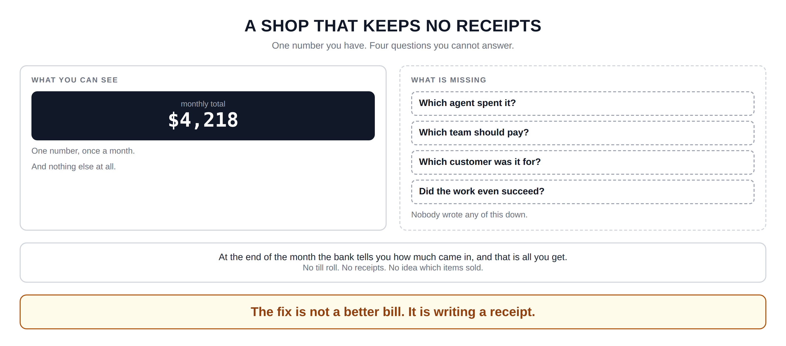
Hidden slide · presenter reference · 01 · No Receipts
iPAD · DRAW
Draw the problem
New iPad page. Draw the two boxes first, then the analogy and the fix underneath.
Left box: WHAT YOU CAN SEE. Inside, a dark rectangle with one number: $4,218, labelled “monthly total”
Under the number, two lines: one number, once a month · nothing else at all
Right box, same size but dashed outline: WHAT IS MISSING
Inside it, four questions in small dashed rectangles: Which agent spent it? Which team should pay? Which customer was it for? Did the work even succeed?
Under those four, small: nobody wrote any of this down
Wide box across the bottom: the shop story: the bank tells you how much came in, and that is all. No till roll, no receipts, no idea which items sold.
One last box, big letters: the fix is not a better bill, it is writing a receipt
FINISHED PANEL: WHAT YOURS SHOULD LOOK LIKE
Say: “One number you have. Four questions you cannot answer.”
Agent Cost Control · Module 2
9
Notes:
[HIDDEN SLIDE — iPad segment. Skip in slideshow.]
Production note — New iPad page. Draw the two boxes first, then the analogy and the fix underneath.
SAY:
Let's draw the problem, because the picture stays with you better than the explanation does. One number you have. Four questions you cannot answer.
THEN SAY:
Keep this page where you can see it while you work through the rest of the module. Every single thing we build from here is one of those four dashed boxes turning solid. That is all instrumentation ever is — turning a question you cannot answer into one you can.
→ Next: the surprising part — the receipt already exists.

Slide 10
02
The Receipt Is Already in the Box
~7 min
Notes:
Here is the part that surprises almost everyone: you do not have to count anything yourself. The counting is already done.

Slide 11

02 · THE USAGE NOTE
What actually comes back
YOUR AGENT
THE MODEL
WHAT COMES BACK
asks a question
thinks, answers
{
"text": "…the answer…",
"usage": {
"input_tokens": 2214,
"output_tokens": 187
}
}
The usage block
A small note attached to every response. Every major provider returns one, on every call, whether you asked for it or not.
A token ≈ four characters of English. Input is what you sent; output is what it wrote back.
The green lines are the receipt. They arrive whether you read them or not.
Agent Cost Control · Module 2
11
Notes:
You do not have to count anything yourself. The counting is already done.
Your agent sends a question. The model thinks about it and sends back an answer. But the answer does not arrive on its own. It arrives with a small note attached, and that note contains exactly two numbers we care about: how many tokens went in, and how many came out.
A token is roughly a piece of a word; about four characters of English. Input tokens are everything you sent it. Output tokens are everything it wrote back.
That little note has a name in the documentation: the usage block. Every major provider returns one, on every single call, whether you asked for it or not. It is already there, in every response, right now, in your agent today.

Slide 12
02 · THE USAGE NOTE
The change is one extra line
What most programs do
What we will do
Read the answer
Use the answer
Ignore the usage part completely
Read the answer
Use the answer
AND keep the two numbers
The receipt is thrown in the bin.
That is the entire change.
Agent Cost Control · Module 2
12
Notes:
So what happens to it? Almost every program throws it away. The code reads the answer, uses the answer, and quietly ignores the usage part completely. The receipt goes straight in the bin, thousands of times a day.
That is the whole problem. Not that the data is missing — the data is arriving and being discarded. We are not building a counting system. We are going to stop throwing away a receipt that is already being handed to us.
The only difference between those two boxes is one extra line. That is genuinely the size of the change we are making.

Slide 13
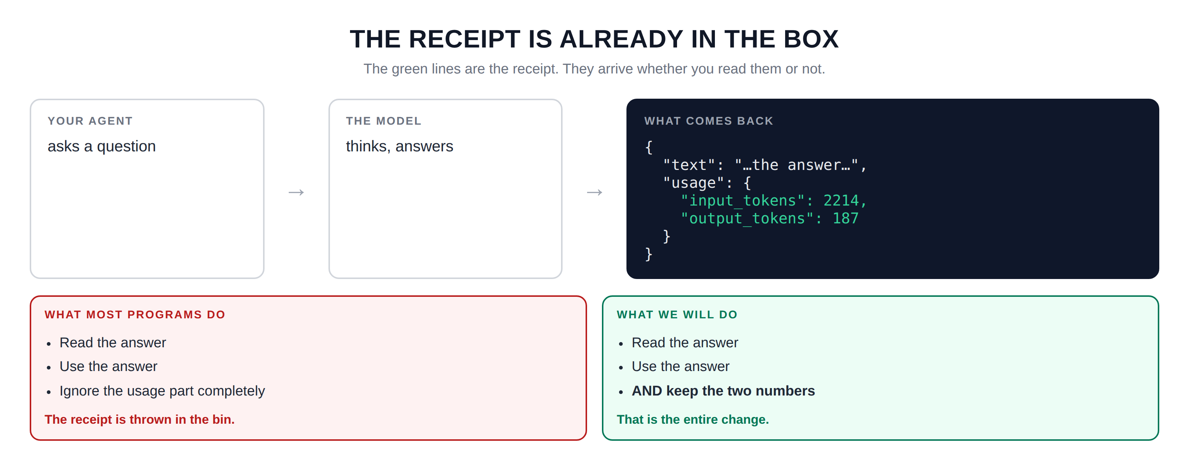
Hidden slide · presenter reference · 02 · The Usage Note
iPAD · DRAW
Draw what comes back
New iPad page. Draw the flow left to right, then the two contrasting boxes underneath.
Left: box labelled YOUR AGENT: “asks a question”
Arrow right into THE MODEL: “thinks, answers”
Arrow right into a larger dark rectangle: WHAT COMES BACK
Inside it, write it like a document: open brace · text: … · usage: { · input tokens: 2214 · output tokens: 187 · }
Colour those last two lines differently; under the rectangle write: the coloured lines are the receipt
Below, left box WHAT MOST PROGRAMS DO: read the answer · use the answer · ignore the usage part completely → the receipt is thrown in the bin
Right box WHAT WE WILL DO: read the answer · use the answer · AND keep the two numbers → that is the entire change
FINISHED PANEL: WHAT YOURS SHOULD LOOK LIKE
Say: “The green lines are the receipt. They arrive whether you read them or not.”
Agent Cost Control · Module 2
13
Notes:
[HIDDEN SLIDE — iPad segment. Skip in slideshow.]
Production note — New iPad page. Draw the flow left to right, then the two contrasting boxes underneath.
SAY:
Let's draw what actually comes back, so you can see the receipt sitting there.
THEN SAY:
Look at those two boxes side by side for a moment. The only difference between them is one extra line. That is genuinely the size of the change we are making. Everything else in this module is about what we do with those two numbers once we have stopped throwing them away.
→ Next: where to put that extra line.

Slide 14
03
Wrap, Don't Rewrite
~8 min
Notes:
So we need to catch that receipt. Where do we put the code that does it?

Slide 15
03 · WRAP, DON'T REWRITE
Put an envelope around the call
BEFORE
AFTER: THE ENVELOPE
note the time, note who is asking
ask the model
use the answer
ask the model
use the answer
wrap it →
read the receipt, write it down
If you remember one sentence from this module: wrap, do not rewrite.
identical code; the middle is untouched
Agent Cost Control · Module 2
15
Notes:
The wrong answer is to go through your agent and edit every place it talks to the model. A real agent might do that in ten or fifteen different places. You would have to change all of them, remember to change any new one somebody adds next month, and you would touch a lot of working code to do it.
The right answer is to put a small envelope around the call instead. Just before the call it notes the time and who is asking. Just after the call it reads the receipt and writes it down. The middle stays exactly the same. The line that asks the model is untouched. The line that uses the answer is untouched. We put something around them, not inside them.
This has a name in programming — a wrapper.

Slide 16



03 · WRAP, DON'T REWRITE
Three reasons this is the right shape
Nothing breaks
One place to change
It outlives tools
Your agent behaves precisely as it did before, because you did not change how it works; you added two lines around the outside.
Every model call goes through the same envelope. Fix it once and every agent is covered, including ones you write next year.
Agent frameworks change constantly. An envelope around a function call works in all of them, because they all call the model the same way.
Wrap, do not rewrite.
Agent Cost Control · Module 2
16
Notes:
First, nothing breaks. Second, there is one place to change. Third, and this one matters more than it sounds: it outlives tools. The frameworks people use to build agents change constantly. New ones appear every few months. But an envelope around a function call works in all of them, because every one of them eventually calls the model the same way.
If you remember only one sentence from this module, make it this one: wrap, do not rewrite.

Slide 17
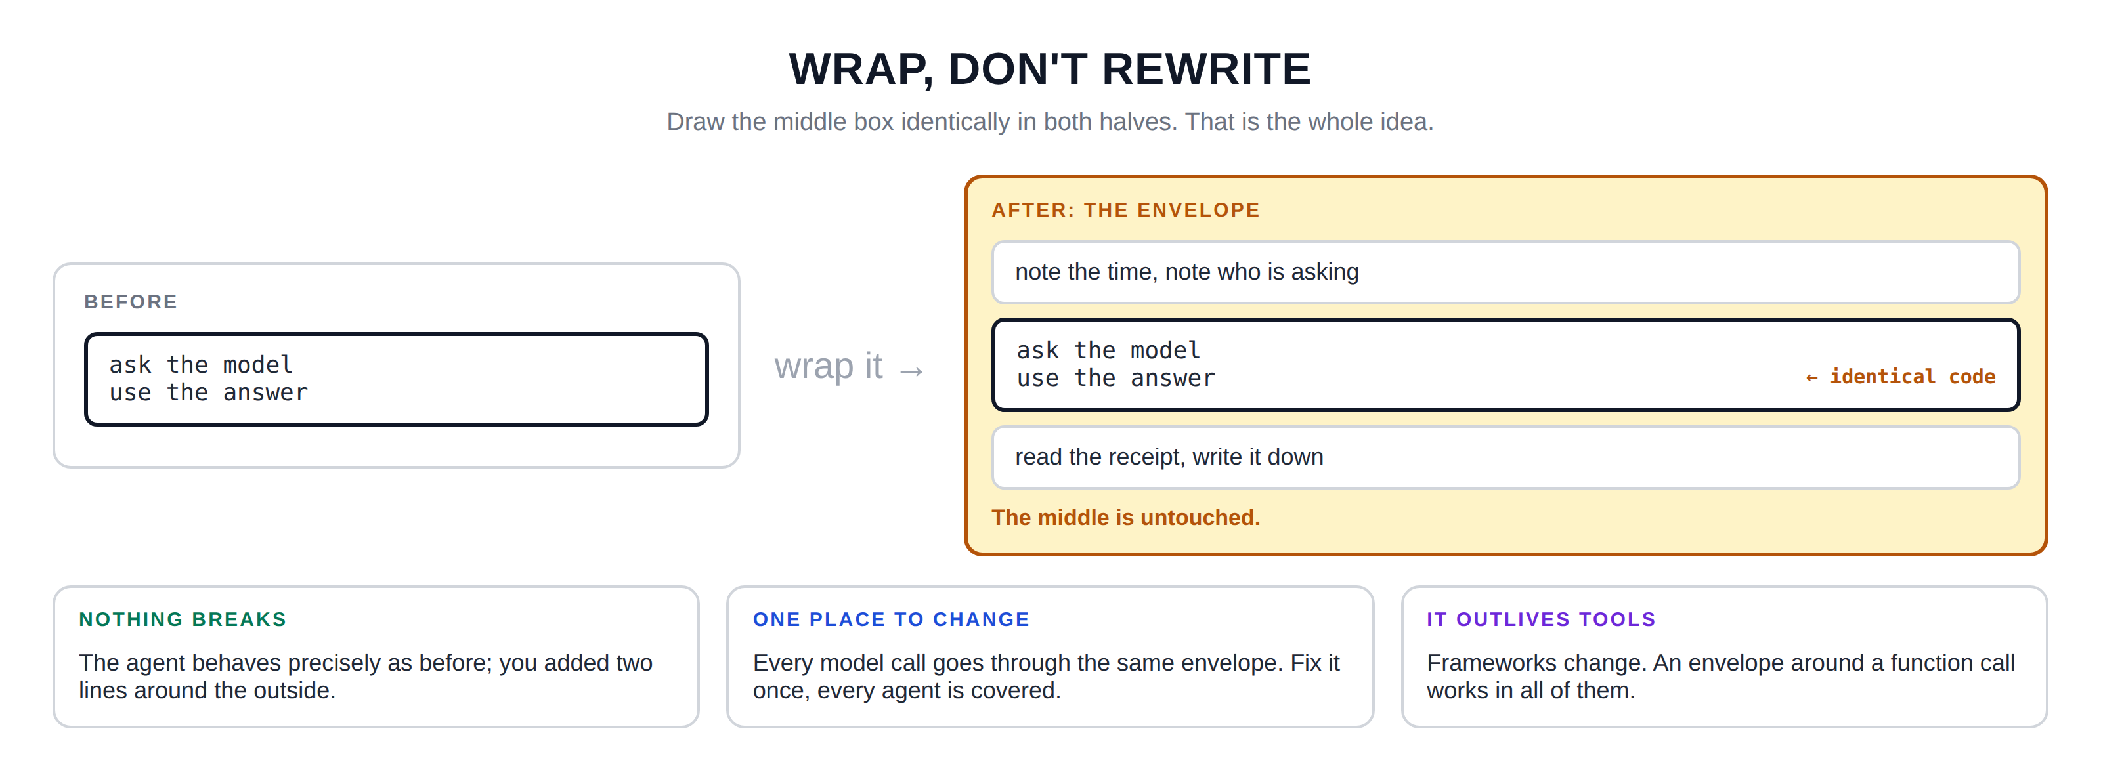
Hidden slide · presenter reference · 03 · Wrap, Don't Rewrite
iPAD · DRAW
Draw the envelope
New iPad page. Draw before on the left, after on the right, and make the unchanged middle visually identical in both.
Left: heading BEFORE, a box, and inside it a smaller box with two lines: ask the model · use the answer
Arrow pointing right, labelled: wrap it
Right: heading AFTER, a taller box titled THE ENVELOPE
Inside, stacked: thin strip “note the time, note who is asking” · the exact same small box, drawn identically · thin strip “read the receipt, write it down”
Small arrow into the middle box labelled: identical code. Under the envelope: the middle is untouched
Across the bottom, three boxes: NOTHING BREAKS · ONE PLACE TO CHANGE · IT OUTLIVES TOOLS, with a line or two under each
FINISHED PANEL: WHAT YOURS SHOULD LOOK LIKE
Say: “Draw the middle box identically in both halves. That's the whole idea.”
Agent Cost Control · Module 2
17
Notes:
[HIDDEN SLIDE — iPad segment. Skip in slideshow.]
Production note — New iPad page. Draw before on the left, after on the right, and make the unchanged middle visually identical in both.
SAY:
Let's draw the envelope, because seeing what stays the same is as important as seeing what gets added.
THEN SAY:
That middle box, drawn identically on both sides, is the thing to notice. People expect instrumentation to mean rewriting their agent, and they put it off for months because it sounds like a big job. It is not a big job. It is two strips of code around something you already have.
→ Next: making the number mean something.

Slide 18
04
Four Labels
~8 min
Notes:
We can now catch the receipt. But a receipt with only a price on it is still not very useful.

Slide 19
04 · FOUR LABELS
The same four cents, twice
WITHOUT LABELS
WITH LABELS
$0.04
$0.04
agent = invoice-reader
team = finance
run = a41f…
result = success
True, and useless.
You cannot ask it a single question.
Now it can answer things.
A label is just a word attached to the number saying what it was about; like writing on the back of a photograph.
Agent Cost Control · Module 2
19
Notes:
Say you write down that one run cost four cents. That is a true fact, and you cannot ask it a single question. Four cents of what? Spent by whom? For which customer? Did it even work?
So alongside the number we write down four labels. A label is just a word we attach to the number to say what it was about; like writing on the back of a photograph.

Slide 20
04 · FOUR LABELS
Four labels, four questions
agent
team
run
result
WHICH ONE SPENT IT?
WHO SHOULD PAY?
WHICH ATTEMPT?
DID IT WORK?
So you can find the expensive agent.
So the bill goes to the right budget.
So you can add up one whole task: twelve calls, one number.
So you can separate money well spent from money burned.
Add a label today and you can ask that question forever. Miss it today and the runs that already happened are gone.
Agent Cost Control · Module 2
20
Notes:
Label one: which agent. Your system probably has several — one reading invoices, one answering support questions, one summarising documents.
Label two: which team. Somebody owns the budget this comes out of. If you never write this down, every cost conversation ends with people guessing.
Label three: which run. A single task might make twelve calls. Without a run label you have twelve unrelated four-cent charges. With it, you can add them up. This is what makes module four possible at all.
Label four: the result. Did this work succeed or not? Write it down the moment you know.
You can add a label today and ask that question forever afterwards. If you miss it today, you can never ask about the runs that already happened — that information is gone permanently. So when you are unsure whether a label is worth adding, add it. Storage is cheap. Regret is not.

Slide 21

04 · FOUR LABELS
One warning: never label something that changes constantly
Don't do this
Do this
customer email address
document ID
timestamp
agent name: a handful of values
team name: a handful of values
result: success or failure
Labels with unlimited possible values make your monitoring system slow and expensive; an unfortunate way to end a course about cost. Keep labels to small, fixed sets of values.
Agent Cost Control · Module 2
21
Notes:
A word of warning on one label in particular, because it is the one people get wrong. Do not put anything into a label that changes constantly — a customer's email address, a document ID, a timestamp. Labels with unlimited possible values will make your monitoring system very slow and very expensive, which would be an unfortunate way to end a course about cost. Keep labels to things with a small, fixed set of values.
(The run ID is the exception people ask about: it belongs in the receipt, but it is not a good Prometheus label — we keep it on the printed line and in logs.)

Slide 22
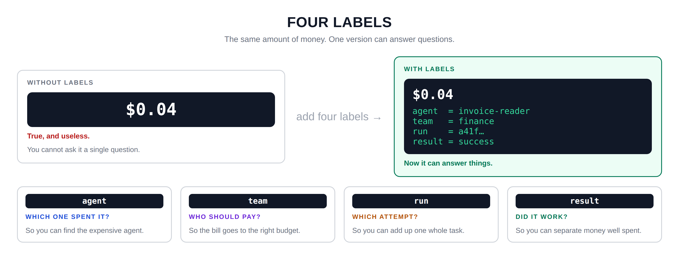
Hidden slide · presenter reference · 04 · Four Labels
iPAD · DRAW
Draw the same four cents twice
New iPad page. The before-and-after at the top, then the four labels as separate cards.
Left box WITHOUT LABELS: a dark rectangle with just “four cents”. Under it: true, and useless · you cannot ask it a single question
Arrow right, labelled: add four labels
Right box WITH LABELS: the same four cents at the top, then agent = invoice-reader · team = finance · run = a41f… · result = success
Under that box: now it can answer things
Across the bottom, four cards. Label name in a small dark rectangle at the top of each: agent · team · run · result
Under each name, the question in capitals: WHICH ONE SPENT IT? WHO SHOULD PAY? WHICH ATTEMPT? DID IT WORK?
Under each question, why, in small letters: find the expensive agent · the right budget · add up one whole task · separate money well spent
FINISHED PANEL: WHAT YOURS SHOULD LOOK LIKE
Say: “The same amount of money. One version can answer questions.”
Agent Cost Control · Module 2
22
Notes:
[HIDDEN SLIDE — iPad segment. Skip in slideshow.]
Production note — New iPad page. The before-and-after at the top, then the four labels as separate cards.
SAY:
Let's draw the same four cents twice — once bare, once with labels — and then what each label buys you.
THEN SAY:
A word of warning on one label in particular, because it is the one people get wrong. Do not put anything into a label that changes constantly — a customer's email address, a document ID, a timestamp. Labels with unlimited possible values will make your monitoring system very slow and very expensive. Keep labels to things with a small, fixed set of values.
→ Next: turning a number into something you can look at.

Slide 23
05
From a Number to a Picture
~7 min
Notes:
We have a number and four labels. There is one more step before a human can use any of it, and it happens in three stages.

Slide 24
05 · NUMBER TO PICTURE
Three stages
1
2
3
A NUMBER
A COUNTER
A PICTURE
One run just cost four cents.
Add it to a running total that never resets.
A line on a screen you can look at.
It exists for a moment, then it is gone.
A tally on the wall that only goes up.
Now a human can see it at a glance.
Why a tally that never resets? To find what one hour cost, look at the mark now and the mark an hour ago, and subtract. Any window you like, from one number.
Agent Cost Control · Module 2
24
Notes:
Stage one is what we have now: a number. One run just cost four cents. The problem is that this number exists for a moment and then it is gone.
Stage two is a counter — a running total that only ever goes up. Think of marks on a wall, a tally. It would seem more useful for it to reset at midnight. It is not, because you would lose everything. With a tally that never resets, you can work out spending for any period you like: look at the mark now, look at the mark an hour ago, and subtract.
Stage three is a picture. A line on a screen — where a human can finally glance at it and know something without doing arithmetic.

Slide 25
05 · NUMBER TO PICTURE
Two tools, set up today, used in module 6
Prometheus
Grafana
Remembers numbers over time. It periodically reads the tallies your program keeps and stores them with a timestamp. The industry standard.
Asks Prometheus for numbers and draws them as lines on a screen, so a human can see at a glance.
At the end of this module, nothing is stopped or limited yet.
You can only see. And seeing comes first; you cannot bound what you cannot measure.
Agent Cost Control · Module 2
25
Notes:
The tool that stores these tallies for us is called Prometheus. All you need to know today: it is a program that remembers numbers over time, and it is the standard way of doing this across the industry. The tool that draws the picture is called Grafana.
We are only setting these up today. We will not really use them properly until module six, where we build the dashboard and the alerts.
People finish this module and feel slightly underwhelmed. Nothing is protected yet. Your agent can still run away overnight exactly as it did in module one. What has changed is that you would now be able to see it happening, and say afterwards exactly which agent, which team, and which runs. That is the foundation everything else sits on.

Slide 26
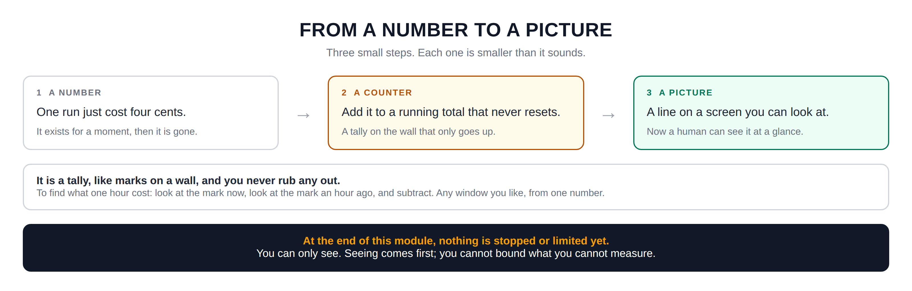
Hidden slide · presenter reference · 05 · Number to Picture
iPAD · DRAW
Draw the three stages
New iPad page. Three stages across the top, then the tally explanation, then the ending state.
Three boxes across the top, connected by arrows, numbered 1, 2, 3
Box one A NUMBER: one run just cost four cents · smaller: it exists for a moment, then it is gone
Box two A COUNTER: add it to a running total that never resets · smaller: a tally on the wall that only goes up
Box three A PICTURE: a line on a screen you can look at · smaller: now a human can see it at a glance
Wide box below: it is a tally, like marks on a wall, and you never rub any out. To find what one hour cost, look at the mark now and the mark an hour ago, and subtract.
Final box: at the end of this module, nothing is stopped or limited yet. You can only see. Seeing comes first; you cannot bound what you cannot measure.
FINISHED PANEL: WHAT YOURS SHOULD LOOK LIKE
Say: “Three small steps. Each one is smaller than it sounds.”
Agent Cost Control · Module 2
26
Notes:
[HIDDEN SLIDE — iPad segment. Skip in slideshow.]
Production note — New iPad page. Three stages across the top, then the tally explanation, then the ending state.
SAY:
Let's draw the three stages, and then I want to draw the tally idea specifically because it catches people out.
THEN SAY:
That last box matters, because people finish this module and feel slightly underwhelmed. Nothing is protected yet. Your agent can still run away overnight exactly as it did in module one. What has changed is that you would now be able to see it happening, and you would be able to say afterwards exactly which agent, which team, and which runs.
→ Last section: build the envelope.

Slide 27
06
Build It: Write Your First Receipt
~10 min
Notes:
Let's build the envelope. We will do it in four small stages and run it after each one, so you always know that the last thing you added is what broke it, if anything does.

Slide 28
06 · BUILD IT
Four stages: run after every one
STAGE 1
STAGE 2
Catch the receipt
Turn tokens into money
Wrap the model call. Read the two token counts and print them.
Add the two rates. Multiply, add, print the cost.
STAGE 3
STAGE 4
Add the four labels
Make the counter
agent, team, run, result. One run ID for the whole run.
Prometheus counters, plus the /metrics endpoint.
Same agent as module one; the uninstrumented one from the course repository. Setup first: a virtual environment, then one package.
Agent Cost Control · Module 2
28
Notes:
Let's build the envelope. We will do it in four small stages and run it after each one, so you always know that the last thing you added is what broke it, if anything does. We are using the same agent from module one — the uninstrumented one from the course repository.
Production note — Build in an editor with a terminal beside it. Run after every stage. Pause on the /metrics output — that is the moment it becomes real for most people.

Slide 29
06 · BUILD IT: SETUP, STEP 1 OF 2
Work inside a virtual environment
A virtual environment is a private box of Python packages that belongs to this project only. Nothing you install here touches the rest of your computer, and you can throw it away and rebuild it in seconds.
macOS · Linux
WINDOWS · POWERSHELL
$ cd agent-cost-control
$ python3 -m venv .venv
$ source .venv/bin/activate
> cd agent-cost-control
> py -m venv .venv
> .venv\Scripts\Activate.ps1
Your prompt now starts with (.venv). That is how you know you are inside the box.
Agent Cost Control · Module 2
29
Notes:
[VS CODE / TERMINAL — TYPE THIS]
Before we install anything, we make a virtual environment. A virtual environment is a private box of Python packages that belongs to this project only. Nothing you install goes near the rest of your computer, and if it ever gets into a mess you delete the folder and build it again in about ten seconds.
On a Mac or on Linux: change into the repository, then python3 -m venv .venv, then source .venv/bin/activate.
On Windows in PowerShell: py -m venv .venv, then .venv backslash Scripts backslash Activate.ps1. If Windows refuses to run the activate script, that is the execution policy; run Set-ExecutionPolicy -Scope Process -ExecutionPolicy Bypass in that window and activate again. In the old Command Prompt the line is .venv backslash Scripts backslash activate.bat.
Either way, look at your prompt. It now starts with (.venv) in brackets. That is how you know you are inside the box. You do this every time you open a new terminal for this project.

Slide 30
06 · BUILD IT: SETUP, STEP 2 OF 2
Install the library that keeps the tallies
$ pip install prometheus-client
Check you are in the right place
When you are finished for the day
$ which python
> where python
$ deactivate
One package, and it is the standard one. It lands inside .venv, not on your system Python; that is the whole point of the box.
Agent Cost Control · Module 2
30
Notes:
[VS CODE / TERMINAL — TYPE THIS]
With the environment active, install the small library that keeps the tallies for us. One package, and it is the standard one. Because the environment is active, plain pip is the right command on both platforms, and the package lands inside .venv rather than on your system Python.
If you want to prove it to yourself: which python on a Mac, or where python on Windows. The path it prints should point inside your .venv folder.
When you are finished for the day, deactivate. Next time you come back, activate again before you run anything.
Add .venv to your .gitignore if it is not there already; you never commit a virtual environment.
Next: stage one, catch the receipt.

Slide 31
06 · BUILD IT: STAGE 1 OF 4
Catch the receipt
Find where the agent calls the model. Don't edit it; write a new function around it. Inside, call the model exactly as before, read the two token counts out of the response's usage block, and print them.
$ python3 run_agent.py --input samples/normal.json
You should see two numbers printed for every step. That is the receipt, caught for the first time. The agent behaved identically; you only added printing.
Agent Cost Control · Module 2
31
Notes:
[VS CODE / TERMINAL — TYPE THIS]
Stage one: catch the receipt. Find the place where the agent calls the model. Instead of editing it, write a new function around it — your envelope. Inside, call the model exactly as before, then read the two token counts out of the response's usage block, and print them. Run the agent.
You should see two numbers printed for every step. That is the receipt, caught for the first time. The agent behaved identically; you only added printing.

Slide 32
06 · BUILD IT: STAGE 2 OF 4
Turn tokens into money
Add two constants near the top of the file for the input and output rates from your provider's pricing page. In the envelope, multiply each count by its rate and add them. Print the cost alongside the tokens.
$ python3 run_agent.py --input samples/normal.json
Add these up by hand and compare with your module 1 figure. If they don't match, you have a rate wrong; and finding that now is better than finding it in a report.
Agent Cost Control · Module 2
32
Notes:
[VS CODE / TERMINAL — TYPE THIS]
Stage two: turn tokens into money. Add two constants near the top of the file for the input and output rates from your provider's pricing page. In your envelope, multiply each count by its rate and add them. Print the cost alongside the tokens.
Now every step prints what it actually cost. Add those up by hand and compare against the figure you calculated manually in module one — they should match. If they do not, you have a rate wrong, and finding that now is better than finding it in a report.

Slide 33
06 · BUILD IT: STAGE 3 OF 4
Add the four labels
Give the agent a name and a team as constants. Generate a run ID once when the run starts; a short random string is fine. Pass it into every call. Set result to unknown for now; module five sets it properly.
$ python3 run_agent.py --input samples/normal.json
Check the run ID is the same on every line. If it changes between steps, you generated it in the wrong place; it belongs at the start of the run, not inside the envelope.
Agent Cost Control · Module 2
33
Notes:
[VS CODE / TERMINAL — TYPE THIS]
Stage three: the four labels. Give the agent a name and a team as constants. Generate a run ID once when the run starts; a short random string is fine. Pass it into every call. For now set result to unknown; we will set it properly in module five. Print all four alongside the cost.
Look carefully at that output and confirm one thing: the run ID is the same on every line. If it changes between steps, you generated it in the wrong place; it belongs at the start of the run, not inside the envelope.

Slide 34
06 · BUILD IT: STAGE 4 OF 4
Make the counter
Import Counter from the prometheus client, create two: one for cost, one for tokens. Each carries your four label names. In the envelope, add the cost to the counter instead of only printing. Then start the metrics server.
$ python3 run_agent.py --input samples/normal.json &
$ curl http://localhost:8000/metrics | grep agent_cost
There it is; your cost, with all four labels attached, in the format the monitoring world reads. That output is what Prometheus will collect from you.
Agent Cost Control · Module 2
34
Notes:
[VS CODE / TERMINAL — TYPE THIS]
Stage four: the counter. Import Counter from the prometheus client library and create two: one for cost, one for tokens. Each carries your four label names. In the envelope, instead of just printing, add the cost to the counter with the labels filled in. Then start the metrics server so the numbers can be read.
There it is. Your cost, with all four labels attached, in the format the monitoring world reads. That output is what Prometheus will collect from you.

Slide 35
06 · BUILD IT: CONFIRM
Watch the tally grow
$ python3 run_agent.py --input samples/normal.json && curl -s http://localhost:8000/metrics | grep agent_cost_total
Run the agent three more times and curl it again after each one.
Watch the number grow rather than reset.
That is the tally behaving exactly as it should; and it is why you can measure any window you like later.
Agent Cost Control · Module 2
35
Notes:
[VS CODE / TERMINAL — TYPE THIS]
Now run the agent three more times and curl it again. Watch the number grow rather than reset. That is the tally behaving exactly as it should.

Slide 36
RECAP
What changed; and what didn't
WHAT CHANGED
WHAT DID NOT
Every model call writes a receipt
The receipt carries cost and tokens
Four labels: agent, team, run, result
The receipts add up into tallies a monitoring system can read
Your agent's behaviour: unchanged
Nothing is limited
It can still run away overnight, exactly as in module one
In module one you had one number and a shrug.
Agent Cost Control · Module 2
36
Notes:
That is module two. What changed: every model call now writes a receipt. That receipt has the cost, the tokens, and four labels saying which agent, which team, which run, and eventually whether it worked. Those receipts add up into tallies that a monitoring system can read.
What did not change: your agent's behaviour, at all. And nothing is limited. It can still run away overnight exactly as it did in module one.

Slide 37
BEFORE MODULE 3
If it ran away tonight, tomorrow morning you could say exactly which agent, which team, how many runs, and what each one cost.
Instrument the runaway.
Run the malformed input again, under a timeout, with your new instrumentation switched on. Then watch the cost climb in real time, with your own labels on it.
That is the moment most people feel this rather than just understand it.
Agent Cost Control · Module 2
37
Notes:
One exercise I would particularly ask you to do before module three. Run the malformed input again, under a timeout, with your new instrumentation switched on. Then look at the metrics.
You will see the cost climbing in real time, with your own labels on it. That is the first time most people genuinely feel this rather than just understanding it — and it makes the limits we build in module three feel obviously necessary rather than like extra work.

Slide 38
NEXT · MODULE 3 OF 6
Stop it.
Budget caps and kill switches: a hard limit that fires by itself at three in the morning without waking anyone.
Receipts · Labels · Tallies
Emmanuel Naweji · github.com/Here2ServeU/agent-cost-control
Notes:
Module three is where we stop it. Budget caps and kill switches: a hard limit that fires by itself at three in the morning without waking anyone. See you there.

Slide 39
APPENDIX A
Exercises: do these before Module 3
01
02
03
04
05
Set up the venv
Prove you are inside it
Find the receipt
Build the envelope
Turn tokens into money
Create and activate .venv on your own machine; install prometheus-client inside it.
which python on Mac, where python on Windows. The path must point into .venv.
Print a whole response object and find the usage block with your own eyes.
Wrap the call; print the two counts. Same answers, same speed as before.
Add the rates. Compare one run against your module 1 hand calculation.
06
07
08
09
10
Add the four labels
Make the counter
Watch a tally grow
Instrument the runaway
Try a bad label
agent, team, run, result. Check the run ID stays the same across one run.
Create the counters, add to them in the envelope, expose /metrics, curl it.
Run five times, curl between each. Write the number down. It only goes up.
Malformed input, 120-second timeout, instrumentation on. Watch cost climb.
Add a timestamp label on purpose, run twenty times, watch the output grow. Then remove it.
Agent Cost Control · Module 2
39
Notes:
Appendix A; exercises before module 3.
1. Set up the venv: create and activate .venv, install prometheus-client inside it.
2. Prove you are inside it: which python (Mac) or where python (Windows) should print a path inside .venv.
3. Find the receipt in your own agent: print the whole response object and read it.
4. Build the envelope: confirm the agent behaves exactly as before.
5. Turn tokens into money: sum one run, compare against module 1. They must match.
6. Add the four labels: check the run ID stays the same across steps and changes between runs. Most common mistake.
7. Make the counter: create the Prometheus counters, expose the endpoint, curl it.
8. Watch a tally grow: run five times, write the number each time, confirm it only goes up.
9. Instrument the runaway: malformed input, 120-second timeout, instrumentation on. This is the exercise that makes module 3 feel necessary.
10. Try a bad label, on purpose: a timestamp label, twenty runs, watch the metrics output grow. Then remove it and never do it again.

Slide 40
APPENDIX B · EVERY WORD WE USED, IN PLAIN ENGLISH
Glossary: the receipt
01
02
03
04
Instrumentation
Token
Input / output tokens
The usage block
Code that records facts about your program's own behaviour; here, a receipt each time money is spent.
Roughly a piece of a word; about four characters of English. The model charges by how many it handles.
Input is everything you sent; output is everything it wrote back. Counted separately, priced differently.
The small note on every response holding the two token counts. Most programs throw it away.
05
06
07
Wrapper (the envelope)
Label
Run ID
Code placed around an existing call, adding behaviour before and after. Wrap, do not rewrite.
A word attached to a number saying what it was about. Four matter: agent, team, run, result.
A short unique string made once at the start of a task and attached to every call it makes.
Agent Cost Control · Module 2
40
Notes:
01 Instrumentation — Code that records facts about your program's own behaviour; here, a receipt each time money is spent.
02 Token — Roughly a piece of a word; about four characters of English. The model charges by how many it handles.
03 Input / output tokens — Input is everything you sent; output is everything it wrote back. Counted separately, priced differently.
04 The usage block — The small note on every response holding the two token counts. Most programs throw it away.
05 Wrapper (the envelope) — Code placed around an existing call, adding behaviour before and after. Wrap, do not rewrite.
06 Label — A word attached to a number saying what it was about. Four matter: agent, team, run, result.
07 Run ID — A short unique string made once at the start of a task and attached to every call it makes.

Slide 41
APPENDIX B · EVERY WORD WE USED, IN PLAIN ENGLISH
Glossary: the tally
08
09
10
11
High-cardinality label
Counter
Prometheus
Grafana
A label with unlimited values: an email, a timestamp. Makes monitoring slow and expensive.
A running total that only goes up. Never resets, so any window is two readings subtracted.
The standard program for remembering numbers over time, with timestamps.
Asks Prometheus for numbers and draws them as lines a human can read at a glance.
12
13
14
The /metrics endpoint
Seeing comes first
Virtual environment (venv)
A web address your program exposes where its current tallies can be read.
Why this module precedes the limits in module 3; you cannot choose a limit blind.
A private box of Python packages for one project. Activate it before you work; deactivate when done.
Agent Cost Control · Module 2
41
Notes:
08 High-cardinality label — A label with unlimited values: an email, a timestamp. Makes monitoring slow and expensive.
09 Counter — A running total that only goes up. Never resets, so any window is two readings subtracted.
10 Prometheus — The standard program for remembering numbers over time, with timestamps.
11 Grafana — Asks Prometheus for numbers and draws them as lines a human can read at a glance.
12 The /metrics endpoint — A web address your program exposes where its current tallies can be read.
13 Seeing comes first — Why this module precedes the limits in module 3; you cannot choose a limit blind.
14 Virtual environment (venv) — A private box of Python packages for one project. Activate it before you work; deactivate when done.

Slide 42
APPENDIX C: THE COMMANDS, IN PLAIN ENGLISH
Setting up
cd agent-cost-control
Move into the project folder. Every later command assumes you are in it.
python3 -m venv .venv
Mac and Linux: build the private package box, in a folder called .venv.
py -m venv .venv
Windows: the same thing. py is the Python launcher that ships with Windows.
source .venv/bin/activate
Mac and Linux: step into the box. Your prompt gains a (.venv) marker.
.venv\Scripts\Activate.ps1
Windows PowerShell: step into the box. In Command Prompt it is .venv\Scripts\activate.bat.
pip install prometheus-client
Install the counter library. It lands inside .venv, not on the system Python.
which python / where python
Print which Python you are using. The path should sit inside .venv.
deactivate
Step back out of the box when you are done for the day.
Agent Cost Control · Module 2
42
Notes:
cd agent-cost-control : Move into the project folder. Every later command assumes you are in it.
python3 -m venv .venv : Mac and Linux: build the private package box, in a folder called .venv.
py -m venv .venv : Windows: the same thing. py is the Python launcher that ships with Windows.
source .venv/bin/activate : Mac and Linux: step into the box. Your prompt gains a (.venv) marker.
.venv\Scripts\Activate.ps1 : Windows PowerShell: step into the box. In Command Prompt it is .venv\Scripts\activate.bat.
pip install prometheus-client : Install the counter library. It lands inside .venv, not on the system Python.
which python / where python : Print which Python you are using. The path should sit inside .venv.
deactivate : Step back out of the box when you are done for the day.

Slide 43
APPENDIX C: THE COMMANDS, IN PLAIN ENGLISH
Running and reading
python3 run_agent.py --input samples/normal.json
Run the agent once on a well-formed record. This is the script you are instrumenting.
--verbose
A flag on that script: print the raw usage block from each API response.
| grep agent_cost
Send the output into grep, which keeps only the lines containing that text.
| grep -c 'usage'
Same idea, but -c counts the matching lines instead of showing them.
&
At the end of a line: run it in the background so you get your prompt back.
curl http://localhost:8000/metrics
Fetch the page your own program is now serving, and print it.
curl -s
The -s flag: silent, so curl does not print its progress meter.
A && B
Run A, and only if it succeeds, run B.
Agent Cost Control · Module 2
43
Notes:
python3 run_agent.py --input samples/normal.json : Run the agent once on a well-formed record. This is the script you are instrumenting.
--verbose : A flag on that script: print the raw usage block from each API response.
| grep agent_cost : Send the output into grep, which keeps only the lines containing that text.
| grep -c 'usage' : Same idea, but -c counts the matching lines instead of showing them.
& : At the end of a line: run it in the background so you get your prompt back.
curl http://localhost:8000/metrics : Fetch the page your own program is now serving, and print it.
curl -s : The -s flag: silent, so curl does not print its progress meter.
A && B : Run A, and only if it succeeds, run B.

