Slide 1
THE AGENT COST PROBLEM · MODULE 3 OF 6
Budget Caps and
Kill Switches
Module 2 let you see the money leaving. This one stops it.
PRESENTER
RUNTIME
COURSE REPO
Emmanuel Naweji
~50 min · 6 sections
github.com/Here2ServeU/agent-cost-control
Notes:
Module 2 let you see the money leaving. This one stops it. A hard limit that fires by itself at three in the morning, a switch you can flip in seconds, and a decision about what should happen when the money runs out; made now, while you are calm.
[Presenter: Emmanuel Naweji · Runtime ~50 min · 6 sections · Course repo github.com/Here2ServeU/agent-cost-control]

Slide 2



WHAT THIS MODULE GIVES YOU
Seeing something happen is not
the same as stopping it.
A hard limit
A switch anyone can flip
A decision made calmly
A cap that fires by itself at three in the morning, with nobody watching.
One setting, changed by hand in seconds, with no deployment.
What happens when the money runs out, chosen now rather than in a panic.
Agent Cost Control · Module 3
2
Notes:
In module two we started writing receipts. You can now see the money leaving. That is genuinely useful, and it is not enough, because seeing something happen is not the same as stopping it. Today we stop it.

Slide 3
SECTIONS AT A GLANCE
Six sections; one habit: decide in advance
01
~8 min
02
~9 min
03
~9 min
A Coin Meter
Three Gates
What Happens
04
~8 min
05
~8 min
06
~10 min
The Switch
Fire Drill
Build It
Agent Cost Control · Module 3
3
Notes:
Sections 1 to 5 make the decisions; section 6 builds all of it into the envelope from module two.

Slide 4
BEFORE YOU START
Install what you need
Ten minutes once, and every command in this module will run. Pick your side.
macOS · TERMINAL
WINDOWS · POWERSHELL
# install Homebrew first: brew.sh
$ brew install python git
$ brew install --cask \
visual-studio-code
$ python3 --version && git --version
# winget ships with Windows 11
> winget install Python.Python.3.12
> winget install Git.Git
> winget install \
Microsoft.VisualStudioCode
> py --version; git --version
WHAT MODULE 3 ADDS
Your module 2 envelope
Environment variables
A small file or Redis
everything is added inside it
the caps and the switch
so the daily total survives
Agent Cost Control · Module 3
4
Notes:
[SETUP]
Module three adds no new tools. You need the same machine you set up for module one, the virtual environment from module two, and the envelope you built there; everything today goes inside that envelope. The caps and the switch are environment variables to start with, and the daily total needs somewhere that survives between runs: a small file is enough, or Redis if you already run it.

Slide 5
BEFORE YOU START
Watch these before you install anything
Two short videos take you from a blank machine to Git, Python and VS Code installed. Pick the one for your computer.
macOS
WINDOWS
Install Git, Python and VS Code on a Mac
Install Git, Python and VS Code on Windows
https://youtu.be/8ZIiXg4XOY0
https://youtu.be/3e2-GRBibWc
OFFICIAL PAGES, IF YOU PREFER TO READ
Install Python
python.org/downloads
Virtual environments
docs.python.org/3/library/venv.html
Official downloads, Mac and Windows
The official venv how-to
Environment variables
code.visualstudio.com/docs/python/environments
Redis, if you use it
redis.io/docs/latest/get-started
How env vars work in VS Code
Official quick start
Agent Cost Control · Module 3
5
Notes:
[SETUP]
If your machine is not set up yet, stop here and watch the video for your computer. The Mac one is youtu.be/8ZIiXg4XOY0; the Windows one is youtu.be/3e2-GRBibWc. Both walk you through Git, Python and Visual Studio Code from a blank machine.

Slide 6
01
A Cap Is a Coin Meter
~8 min
Notes:
Here is the idea, and there is nothing clever about it. A cap is a coin meter.

Slide 7
01 · A COIN METER
Put in what you are willing to spend
If you have ever used an old electricity meter, you know how this works. You put in what you are willing to spend. The meter counts down. When it reaches zero, the power stops. It does not ask you.
THE METER
$2.00
remaining
That is exactly what we are building. You decide in advance how much one task may cost. When it runs out, the agent stops.
EMPTY?
STOP
At three in the morning. With nobody watching. Which is precisely when you need it.
The agent stops, by itself, with nobody watching.
Agent Cost Control · Module 3
7
Notes:
Here is the idea, and there is nothing clever about it. A cap is a coin meter.
If you have ever used an old electricity meter, you know how this works. You put in what you are willing to spend. The meter counts down as you use it. When it reaches zero, the power stops. It does not ask you. It does not wait for you to notice. It just stops.
That is exactly what we are building for your agent. You decide in advance how much one task is allowed to cost. The agent spends against that number. When it runs out, the agent stops. At three in the morning. With nobody watching. Which is precisely when you need it.

Slide 8
01 · A COIN METER
You already have a limit; it is just not written down
DECIDE NOW
OR DECIDE AT 3AM
You are calm. You have time to think. Nothing is on fire. You can look at your own numbers from module 2 and pick a sensible figure.
The same question: how much is this worth? Asked in a panic, after the money has already gone.
You already have a limit.
It is whatever your company can afford before somebody gets very upset. You just have not written it down, and nothing is enforcing it.
Agent Cost Control · Module 3
8
Notes:
A cap is a decision you make once, in advance, while you are calm. You have time to think about it. Nothing is on fire. You can talk to someone about it, look at your own numbers from module two, and pick a sensible figure.
The alternative is making the same decision at three in the morning, in a panic, after the money has already gone. It is the same decision either way; how much is this worth? But the conditions are very different.
Some people resist caps because they worry about blocking real work. That is a fair worry, and it is why we spend a whole section later on what should happen when the limit is reached. But here is the thing to hold onto: you already have a limit. It is whatever your company can afford before somebody gets very upset. You just have not written it down, and nothing is enforcing it.

Slide 9


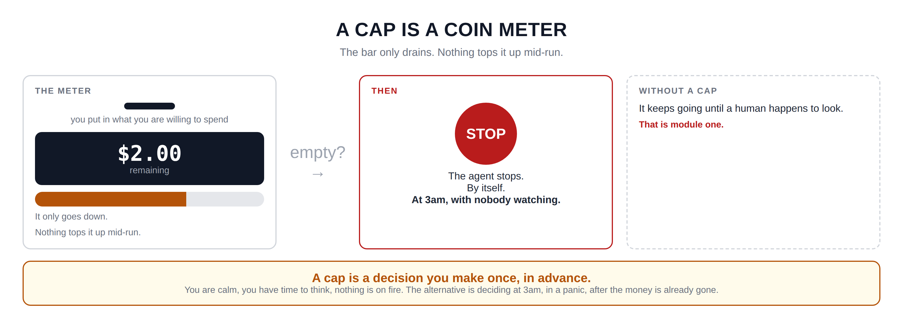
Hidden slide · presenter reference · 01 · A Coin Meter
iPAD · DRAW
Draw the meter
New iPad page. Draw the meter with the draining bar, then the stop, then the contrast panel.
Tall box on the left: THE METER. A coin slot at the top; under it: you put in what you are willing to spend
In the middle, a dark rectangle with an amount inside: two dollars. Under it: remaining
Below, a long thin bar with rounded ends, shaded about two thirds from the left. Under it: it only goes down · nothing tops it up mid-run
Arrow from the meter pointing right, labelled: empty?
At the end of the arrow, a box with a large filled circle reading STOP. Under it: the agent stops · by itself · at 3am with nobody watching
To the right, a smaller dashed box: WITHOUT A CAP. Inside: it keeps going until a human happens to look. In another colour: that is module one
Wide box across the bottom: a cap is a decision you make once, in advance. Calm, time to think, nothing on fire. The alternative is 3am, in a panic, after the money is gone.
FINISHED PANEL: WHAT YOURS SHOULD LOOK LIKE
Say: “The bar only drains. Nothing tops it up mid-run.”
Agent Cost Control · Module 3
9
Notes:
[HIDDEN SLIDE — iPad segment. Skip in slideshow.]
Production note — New iPad page. Draw the meter with the draining bar, then the stop, then the contrast panel.
SAY:
Let's draw the meter, because it makes the shape of this obvious. The bar only drains. Nothing tops it up mid-run.
THEN SAY:
That last box is the one I would keep. Every argument you will have about caps, and you will have some, comes back to it. Nobody is against limits in principle. They are against limits chosen badly. So choose them carefully now, with the numbers you collected in module two in front of you, and the conversation is much easier.
→ Next: where to put the gate.

Slide 10
02
Three Places to Put the Gate
~9 min
Notes:
So we want a limit. Where does it actually live? There are three places, and each one can see something the others cannot.

Slide 11
02 · THREE GATES
What each gate sees, and what it misses
Inside the agent
At the gateway
At the provider
closest to the work
the shared front door
the account itself
SEES
SEES
SEES
This one task, step by step. It knows the run is on step eleven and has spent eighty cents.
Every agent, every team, today. This team has spent ninety dollars across eleven agents.
The whole bill, the whole month. It is the outermost wall.
CANNOT SEE
CANNOT SEE
CANNOT SEE
The other agents, or yesterday.
What a single run is trying to do.
Anything about your business at all.
Good for: One run
Good for: One day, one team
Good for: The last resort
Agent Cost Control · Module 3
11
Notes:
The first place is inside the agent itself. This is the closest to the work. As the agent runs, it keeps a tally of what it has spent so far on this one task, and checks it before each step. What it sees: this task, step by step, in detail. What it cannot see: anything else; it has no idea what the other agents are doing right now, or what this agent spent yesterday.
The second place is the gateway. A gateway is a shared front door; one service that all your agents send their model calls through. If you do not have one, that is fine, it is a thing you can add later. What it sees: every agent, every team, and the whole day. What it cannot see: what any single run is trying to do.
The third place is the provider itself. Most model providers let you set a spending limit on the account or the API key. What it sees: the whole bill, the whole month. What it cannot see: anything about your business at all.

Slide 12

02 · THREE GATES
Each gate catches a failure the others miss
One task goes mad and loops forever
caught inside the agent
Fifty tasks each behave, but together they blow the budget
caught at the gateway
Someone deploys a new agent that nobody capped
caught at the provider
One gate is better than none. Three gates is how you sleep.
Agent Cost Control · Module 3
12
Notes:
Why use more than one? Because each catches a failure the others miss.
One task goes mad and loops forever; the agent's own cap catches that, because it can see the steps piling up. But fifty tasks that each behave perfectly well, and together blow the monthly budget; the agent cap never fires, because no individual run did anything wrong. That needs the gateway. And then somebody deploys a new agent that nobody remembered to cap. Only the provider limit catches that one, because it is the only thing that does not need to know the agent exists.
One gate is much better than none. Three gates is how you sleep.
If you only have time to build one, build the first: the cap inside the agent. It is the easiest, it needs no new infrastructure, and it catches the runaway loop, which is the failure that costs the most and happens most often.

Slide 13
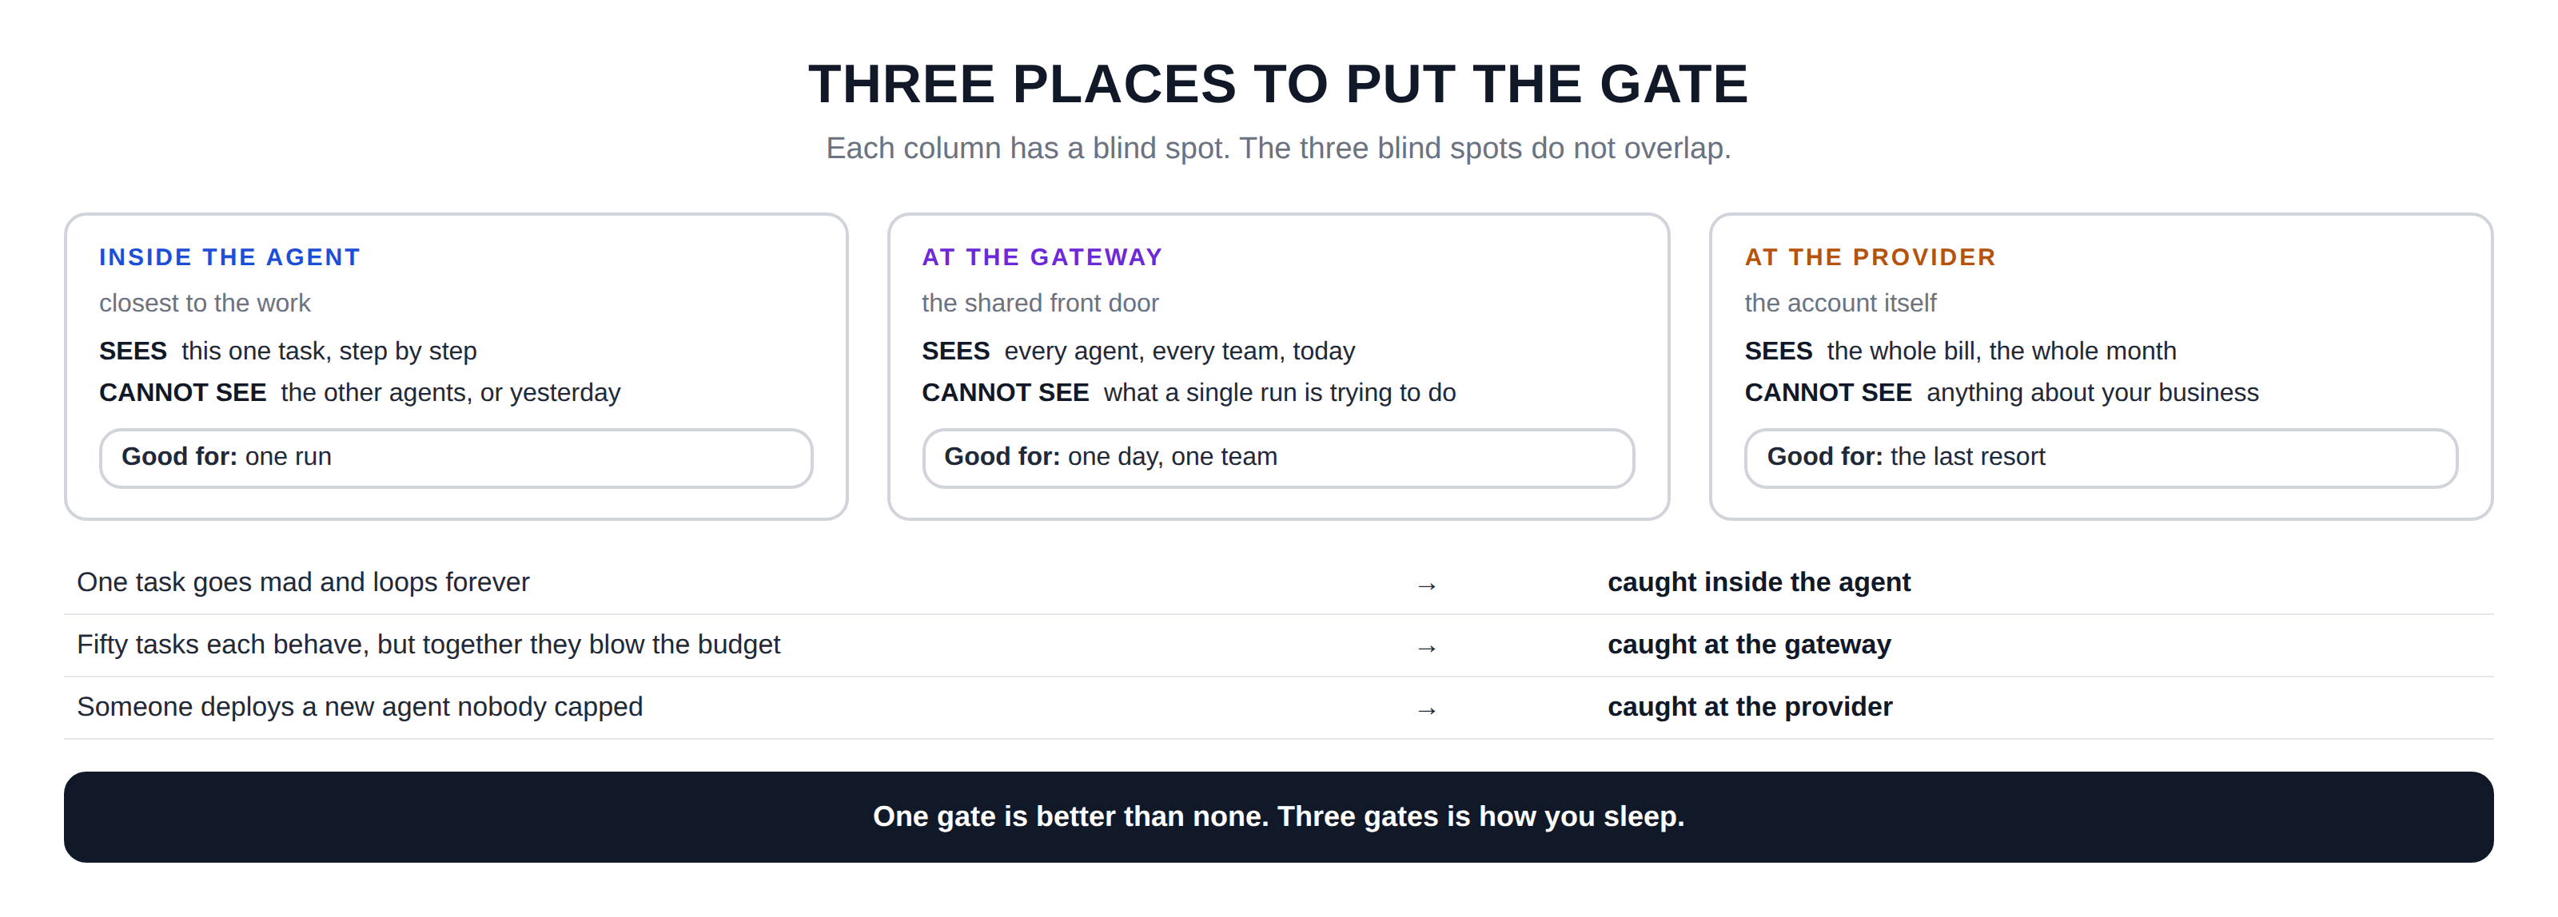
Hidden slide · presenter reference · 02 · Three Gates
iPAD · DRAW
Draw the three gates
New iPad page. Three columns at the top, then the three failure cases underneath.
Three tall columns: INSIDE THE AGENT · AT THE GATEWAY · AT THE PROVIDER
Under each title a short note: closest to the work · the shared front door · the account itself
In each column write SEES: this one task step by step · every agent, every team, today · the whole bill, the whole month
Then CANNOT SEE: the other agents or yesterday · what a single run is trying to do · anything about your business
At the bottom of each column a small GOOD FOR box: one run · one day, one team · the last resort
Underneath, three wide rows: failure on the left, arrow, the gate that catches it on the right
Rows: one task goes mad → the agent · fifty tasks together blow the budget → the gateway · a new agent nobody capped → the provider
At the very bottom: one gate is better than none, three gates is how you sleep
FINISHED PANEL: WHAT YOURS SHOULD LOOK LIKE
Say: “Each column has a blind spot. The three blind spots do not overlap.”
Agent Cost Control · Module 3
13
Notes:
[HIDDEN SLIDE — iPad segment. Skip in slideshow.]
Production note — New iPad page. Three columns at the top, then the three failure cases underneath.
SAY:
Let's draw all three, with what each one can and cannot see. Each column has a blind spot. The three blind spots do not overlap.
THEN SAY:
If you only have time to build one of these, build the first, the cap inside the agent. It is the easiest, it needs no new infrastructure, and it catches the runaway loop, which is the failure that costs the most and happens most often. The other two are worth adding, and they can wait.
→ Next: the decision most people forget to make.

Slide 14
03
What Should Happen When It Runs Out?
~9 min
Notes:
Here is the question people skip, and skipping it causes real problems. The budget runs out. Now what?

Slide 15
03 · WHAT HAPPENS
Three sensible answers; pick one deliberately
STOP
DEGRADE
QUEUE
refuse, and say why
give a cheaper answer
try again later
The task fails; the caller gets a clear message saying the budget ran out.
Switch to a smaller model, return a simpler result, or serve one from cache.
Put the task aside and run it when the budget refills, usually at midnight.
USE IT WHEN
USE IT WHEN
USE IT WHEN
A wrong answer is worse than no answer.
Something is better than nothing.
The work matters but the timing does not.
fraud checks · medical · legal
search · summaries · suggestions
reports · batch jobs · backfills
Agent Cost Control · Module 3
15
Notes:
The first is stop. The task fails, and the caller gets a clear message saying the budget ran out. Not a crash, not a timeout; a proper message explaining exactly what happened. Use this when a wrong answer is worse than no answer: fraud, medical notes, contracts. Half an answer is dangerous.
The second is degrade. Instead of failing, give a cheaper answer. Switch to a smaller model, return a simpler result, or serve something from a cache. Use this when something is better than nothing: search results, summaries, suggestions.
The third is queue. Put the task aside and run it later, when the budget refills, usually at midnight. Use this when the work genuinely matters but the timing does not: overnight reports, batch jobs, backfills.
One practical note: you can use different answers in different places. A run-level cap might degrade while a daily team cap stops. That is completely fine, and often correct; just make each choice deliberately.

Slide 16

03 · WHAT HAPPENS
The fourth option, which you get by not choosing
The agent runs out of budget in the middle of a thought, crashes in some way nobody planned for, and leaves half-finished work behind with no message explaining anything.
Somebody then spends an afternoon working out why; and the honest answer is that you added a limit and never decided what it should do.
Pick one of the three. On purpose. Before you ship it.
Write down which one you picked and why, because the next person will want to know.
Agent Cost Control · Module 3
16
Notes:
There is a fourth thing that can happen, and you get it by not choosing.
If you add a cap without deciding what it does, then what happens is: the agent runs out of budget in the middle of a thought, crashes in some way nobody planned for, and leaves half-finished work behind with no message explaining anything. Somebody then spends an afternoon working out why. And the honest answer, that you added a limit and never decided what it should do, is a bad answer to have to give.
So pick one of the three. On purpose. Before you ship it. And write down which one you picked and why, because the next person will want to know.

Slide 17
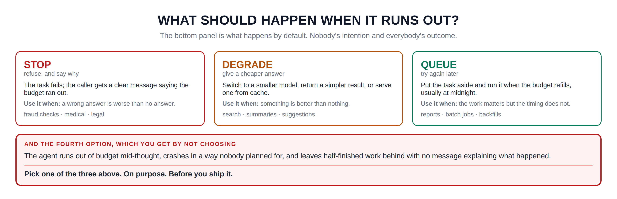
Hidden slide · presenter reference · 03 · What Happens
iPAD · DRAW
Draw the three choices, and the fourth
New iPad page. Three option cards, then the fourth-option panel underneath; that panel is the point of the section.
Three tall cards, large titles: STOP · DEGRADE · QUEUE
Under each title a short description: refuse and say why · give a cheaper answer · try again later
STOP: the task fails, the caller gets a clear message. USE IT WHEN a wrong answer is worse than no answer. Examples: fraud, medical, legal
DEGRADE: smaller model, simpler result, or cached. USE IT WHEN something is better than nothing. Examples: search, summaries, suggestions
QUEUE: set it aside, run it when the budget refills at midnight. USE IT WHEN the work matters but the timing does not. Examples: reports, batch jobs, backfills
Underneath, a wide box with a heavy outline: AND THE FOURTH OPTION, WHICH YOU GET BY NOT CHOOSING
Inside: runs out mid-thought, crashes in a way nobody planned for, half-finished work, no message
Then a line, and under it: pick one of the three above. On purpose. Before you ship it.
FINISHED PANEL: WHAT YOURS SHOULD LOOK LIKE
Say: “The bottom panel is what happens by default. It is nobody's intention and everybody's outcome.”
Agent Cost Control · Module 3
17
Notes:
[HIDDEN SLIDE — iPad segment. Skip in slideshow.]
Production note — New iPad page. Three option cards, then the fourth-option panel underneath; that panel is the point of the section.
SAY:
Let's draw the three choices, and then the fourth one that you get for free if you do not choose.
THEN SAY:
I have seen that fourth box happen more often than any of the three deliberate ones, and always for the same reason. Somebody adds a limit late on a Friday, it works in testing because testing never hits the limit, and then three weeks later it fires in production and behaves in a way nobody has thought about. Ten minutes of deciding now prevents all of it.
→ Next: the switch you flip by hand.

Slide 18
04
The Kill Switch
~8 min
Notes:
Caps handle the problems you predicted. Now we need something for the ones you did not.

Slide 19
04 · THE SWITCH
One setting, flipped by hand, in seconds
Not a code change. Not a deployment. One setting the agent checks, so flipping it takes effect within seconds.
ONE SETTING
WHAT HAPPENS IMMEDIATELY
ON
New work
is refused, politely
Work already running
is allowed to finish
OFF
Nothing
needs redeploying
flip it
Someone with no context can turn it off and ask questions afterwards. That is the point.
Agent Cost Control · Module 3
19
Notes:
A kill switch is one setting you can change by hand, in seconds, that stops the agent taking new work. Not a code change. Not a deployment. One setting.
Why does that matter so much? Because when something is going wrong, the slowest part is almost never deciding what to do. It is doing it. If turning an agent off means editing code, getting a review, waiting for a build and a deploy, that is twenty minutes on a good day. On a bad day the person who knows how is asleep. A switch you can flip removes all of that.
One practical suggestion about where the switch lives. Put it somewhere a person can reach without needing your help: an environment variable they can change, a row in a small table, a feature flag if you already have that system. The whole value is that someone other than you can use it, at a time when you are not available.

Slide 20

04 · THE SWITCH
Let running work finish; it is called draining
KILL EVERYTHING AT ONCE
DRAIN INSTEAD
Nine runs were ninety percent done. You paid for all of that work and threw every bit of it away; you pay for it again when you restart.
Stop taking new work, let the nine finish. It costs you the last ten percent, and the bleeding stops either way.
A kill switch you have never tested is not a kill switch. It is a hope. The first time you flip it must not be during an actual incident; we test it in section five, deliberately, while everything is calm.
Agent Cost Control · Module 3
20
Notes:
Work already running is allowed to finish. This one surprises people, so let me explain it properly. Say nine tasks are in flight and each is ninety percent done. If you kill everything instantly, you have paid for all of that work and thrown every bit of it away. You will pay for it again when you restart, because they all have to begin from the beginning. Letting them finish costs you the last ten percent. Killing them costs you the whole hundred, twice.
Stopping new work while letting current work finish has a name: draining. You will hear it constantly around deployments and shutdowns, and it means exactly this.
One caution, and it is a real one. A kill switch you have never tested is not a kill switch; it is a hope. The first time you flip it must not be during an actual incident. We test it in section five, deliberately, while everything is calm.

Slide 21
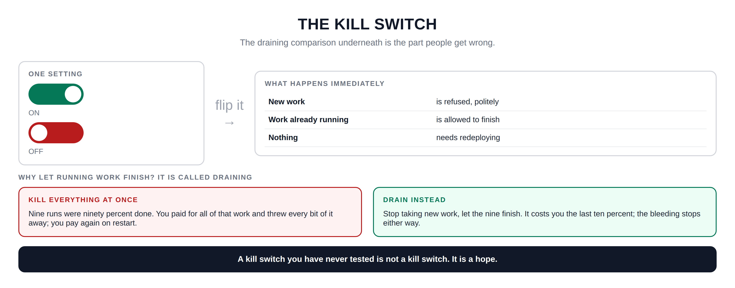
Hidden slide · presenter reference · 04 · The Switch
iPAD · DRAW
Draw the switch and the draining
New iPad page. Switch on the left, effects on the right, then the draining comparison underneath.
Left: a box titled ONE SETTING with two rounded toggles stacked; ON with its circle to the right, OFF with its circle to the left, shaded differently
Arrow pointing right, labelled: flip it
Right: a wider box titled WHAT HAPPENS IMMEDIATELY, with three rows
Rows: new work is refused politely · work already running is allowed to finish · nothing needs redeploying
Heading underneath: why let running work finish? It is called draining
Left box KILL EVERYTHING AT ONCE: nine runs were ninety percent done; you paid for all of it and threw it away
Right box DRAIN INSTEAD: stop taking new work, let the nine finish; the bleeding stops either way
At the very bottom: a kill switch you have never tested is not a kill switch, it is a hope
FINISHED PANEL: WHAT YOURS SHOULD LOOK LIKE
Say: “The draining comparison underneath is the part people get wrong.”
Agent Cost Control · Module 3
21
Notes:
[HIDDEN SLIDE — iPad segment. Skip in slideshow.]
Production note — New iPad page. Switch on the left, effects on the right, then the draining comparison underneath.
SAY:
Let's draw the switch and, more importantly, what it does to work that is already running.
THEN SAY:
One practical suggestion about where the switch lives. Put it somewhere a person can reach without needing your help: an environment variable they can change, a row in a small table, a feature flag if you already have that system. The whole value is that someone other than you can use it, at a time when you are not available.
→ Next: break it all, on purpose, today.

Slide 22
05
The Fire Drill
~8 min
Notes:
Everything we have built today is safety equipment. And safety equipment that has never been tested is just decoration.

Slide 23
05 · FIRE DRILL
Four tests, today, while nothing is wrong
1
Spend past the run cap
Set the cap very low, run one normal task.
It stops, says why, and does not crash.
2
Spend past the day cap
Run enough tasks to exhaust the daily budget.
The next task is refused clearly, not queued silently.
3
Flip the switch mid-run
Turn it off while several tasks are in flight.
Running work finishes; new work is refused.
4
Run the runaway, capped
The malformed input from module one.
It stops in seconds instead of hours.
Write down what actually happened in each test, not what you expected.
Agent Cost Control · Module 3
23
Notes:
Test one: spend past the run cap. Set the cap very low and run one normal task. Three things should happen. It should stop. It should tell you why. And it should not crash. That last one matters; a cap that stops the agent with a stack trace is barely better than no cap.
Test two: spend past the daily cap. Run enough tasks to exhaust a whole day's budget. The next task should be refused clearly; not silently queued, not hung waiting, not passed through anyway. Whatever you chose in section three should be what actually happens.
Test three: flip the kill switch while work is running. Start several tasks, and while they are in flight, turn the switch off. The running tasks should finish. New ones should be refused. If running tasks die instead, your draining is not working, and you have just learned that at zero cost.
Test four: take the malformed input from module one and run it now, with the caps in place.
Write down what actually happened in each test, not what you expected. If any of the four behaved differently from the plan, that is the most valuable thing you will learn all week, and you learned it on a quiet afternoon rather than during an incident.

Slide 24
05 · FIRE DRILL
Same input. Same agent. Same model.
It stops in seconds.
In module one it was a number that made you uncomfortable. Now it stops by itself, immediately, and tells you why. That is the whole course working, in front of you, in about ten seconds.
Record it. It is the best thing you can show someone when you explain why this work mattered.
Agent Cost Control · Module 3
24
Notes:
And test four, which is the one I most want you to actually run. Take the malformed input from module one, the one you extrapolated an overnight cost for, and run it now, with the caps in place. It should stop in seconds.
Same input. Same agent. Same model. In module one it was a number that made you uncomfortable. Now it stops by itself, immediately, and tells you why. That is the whole course working, in front of you, in about ten seconds. I would genuinely encourage you to record it, because it is also the single best thing you can show someone when you are explaining why this work mattered.

Slide 25
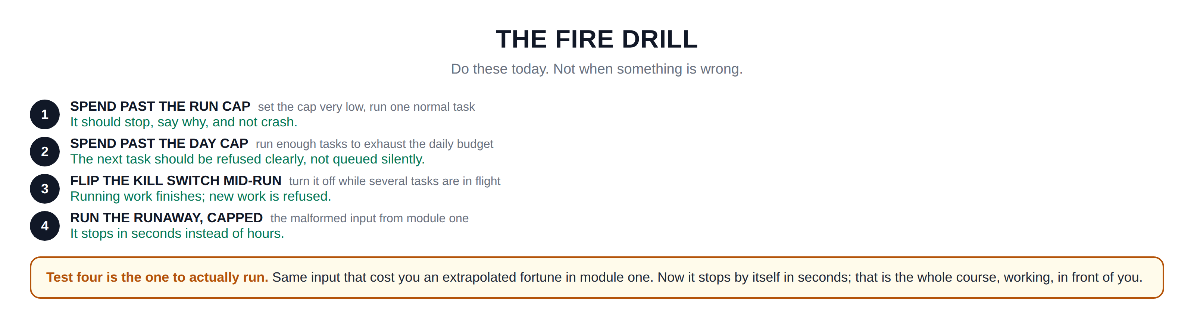
Hidden slide · presenter reference · 05 · Fire Drill
iPAD · DRAW
Draw the four tests
New iPad page. Four numbered rows, then the payoff panel for test four.
Four wide rows down the page, each with a numbered circle on the left
Row one SPEND PAST THE RUN CAP: set the cap very low, run one normal task. It should stop, say why, and not crash
Row two SPEND PAST THE DAY CAP: run enough tasks to exhaust the daily budget. The next task is refused, not queued silently
Row three FLIP THE KILL SWITCH MID-RUN: turn it off while several tasks are in flight. Running work finishes, new work is refused
Row four RUN THE RUNAWAY, CAPPED: the malformed input from module one. It stops in seconds instead of hours
Underneath, a wide box: test four is the one to actually run. Same input that cost you an extrapolated fortune in module one; now it stops by itself in seconds. That is the whole course, working, in front of you.
FINISHED PANEL: WHAT YOURS SHOULD LOOK LIKE
Say: “Do these today. Not when something is wrong.”
Agent Cost Control · Module 3
25
Notes:
[HIDDEN SLIDE — iPad segment. Skip in slideshow.]
Production note — New iPad page. Four numbered rows, then the payoff panel for test four.
SAY:
Let's write down the four tests, with what should happen in each. Do these today. Not when something is wrong.
THEN SAY:
Write down what actually happened in each test, not what you expected. If any of the four behaved differently from the plan, that is the most valuable thing you will learn all week, and you learned it on a quiet afternoon rather than during an incident.
→ Last section: build all of it.

Slide 26
06
Build It: Caps That Actually Fire
~10 min
Notes:
We are adding three things to the envelope we built in module two: a per-run cap, a daily cap, and a kill switch.

Slide 27
06 · BUILD IT
Five stages; run after every one
STAGE 1
STAGE 2
STAGE 3
The per-run cap
Decide what happens
The daily cap
A running total inside the envelope, checked before each call.
Catch the exception and do what you chose in section 3.
A total that survives between runs, checked before any work.
Everything goes in the envelope. We are still not touching the agent's own logic.
STAGE 4
STAGE 5
Cap the runaway
The kill switch
The malformed input from module one, with caps on.
One setting checked before starting any new run.
Agent Cost Control · Module 3
27
Notes:
We are adding three things to the envelope we built in module two: a per-run cap, a daily cap, and a kill switch. Five stages, running after each one. Everything goes in the envelope. We are still not touching the agent's own logic.
Production note — Build in an editor with a terminal beside it. Stage 4 is the payoff; let the output sit on screen before narrating it.

Slide 28
06 · BUILD IT: STAGE 1 OF 5
The per-run cap
In your envelope, keep a running total of what this run has spent. Before each model call, check it against a limit. If the run is already over, raise a clear named exception; call it something like BudgetExceeded rather than a generic error.
$ RUN_BUDGET_USD=0.02 python3 run_agent.py --input samples/normal.json
Two cents is deliberately too low, so a normal task trips it. Read your own message as if you were someone else finding it in a log: does it say what happened and what to do? If not, rewrite it now.
Agent Cost Control · Module 3
28
Notes:
[VS CODE / TERMINAL — TYPE THIS]
Stage one: the per-run cap. In your envelope, keep a running total of what this run has spent so far. Before each model call, check it against a limit you set as a constant. If the run has already spent more than the limit, raise a clear custom exception; give it a name like BudgetExceeded rather than a generic error.
Two cents is deliberately too low, so a normal task trips it. You should see the run stop partway through with your own message. Read that message as if you were someone else finding it in a log: does it tell you what happened and what to do? If not, rewrite it now.

Slide 29
06 · BUILD IT: STAGE 2 OF 5
Decide what happens
Right now it just raises an exception. Catch it at the top of your agent and implement the behaviour you chose in section three. For most learners, stop is the right first choice: return a clear result saying the task could not be completed because the budget was reached.
$ RUN_BUDGET_USD=0.02 python3 run_agent.py --input samples/normal.json
Same trip, but now it is a controlled stop with a proper result. That difference is the whole of section three, in code.
Agent Cost Control · Module 3
29
Notes:
[VS CODE / TERMINAL — TYPE THIS]
Stage two: decide what happens. Right now it just raises an exception. Catch it at the top of your agent and implement the behaviour you chose in section three. For most learners, stop is the right first choice; return a clear result saying the task could not be completed because the budget was reached.
Same trip, but now it is a controlled stop with a proper result rather than an exception escaping. That difference is the whole of section three, in code.

Slide 30
06 · BUILD IT: STAGE 3 OF 5
The daily cap
This one needs memory that survives between runs, because a single run does not know what happened earlier today. Use a small file, or Redis if you already have it. Before starting a run, read today's total; if it is over the limit, refuse before doing any work at all.
$ DAILY_BUDGET_USD=0.10 python3 run_agent.py --input samples/normal.json
Run that four or five times in a row. The first few should work. Then one should be refused before it makes a single model call, which is the point: refusing early costs nothing.
Agent Cost Control · Module 3
30
Notes:
[VS CODE / TERMINAL — TYPE THIS]
Stage three: the daily cap. This one needs memory that survives between runs, because a single run does not know what happened earlier today. Use a small file, or Redis if you already have it. Before starting a run, read today's total; if it is over the daily limit, refuse before doing any work at all.
Run that four or five times in a row. The first few should work. Then one should be refused before it makes a single model call, which is the point, because refusing early costs nothing.

Slide 31
06 · BUILD IT: STAGE 4 OF 5
Cap the runaway; this is the one to watch
Run the malformed input, capped. Keep the timeout on as a backstop, but it should not be needed.
$ RUN_BUDGET_USD=0.50 timeout 120 python3 run_agent.py --input samples/malformed.json
It stopped. By itself, in seconds, at a cost you chose in advance.
Compare that with the number you extrapolated in module one and sit with the difference for a moment; that gap is what you built.
Agent Cost Control · Module 3
31
Notes:
[VS CODE / TERMINAL — TYPE THIS]
Stage four, and this is the one to watch. Run the malformed input, capped. Keep the timeout on as a backstop, but it should not be needed.
It stopped. By itself, in seconds, at a cost you chose in advance. Compare that to the number you extrapolated in module one and sit with the difference for a moment; that gap is what you built.

Slide 32
06 · BUILD IT: STAGE 5 OF 5
The kill switch
Add a setting the envelope checks before starting any new run; an environment variable is fine to start with. If it is off, refuse new work immediately, but let anything already running continue to completion.
$ AGENT_ENABLED=false python3 run_agent.py --input samples/normal.json
Refused instantly, with a clear message, having spent nothing.
Now start several runs in the background, flip the setting while they are in flight, and confirm the running ones finish while new ones are refused. That is draining, tested.
Agent Cost Control · Module 3
32
Notes:
[VS CODE / TERMINAL — TYPE THIS]
Stage five: the kill switch. Add a setting the envelope checks before starting any new run; an environment variable is fine to start with. If it is off, refuse new work immediately, but let anything already running continue to completion.
Refused instantly, with a clear message, having spent nothing. Now start several runs in the background, flip the setting while they are in flight, and confirm the running ones finish while new ones are refused. That is draining, tested.

Slide 33
RECAP
The biggest change in the course
A limit on one task
A limit on one day
Your per-run cap stops a single runaway before it becomes a number.
Your daily cap catches the case where every run behaved but the total did not.
A switch anyone can flip
All of it tested
New work refused, running work drained, nothing redeployed.
You ran the fire drill while nothing was wrong.
The runaway from module one now stops on its own, in seconds.
Agent Cost Control · Module 3
33
Notes:
That is module three, and it is the biggest change in the course.
Your agent now has a limit on what one task may cost, a limit on what a whole day may cost, and a switch anyone can flip to stop it taking new work. Each of those behaves in a way you chose deliberately rather than by accident. And you have tested all of them while nothing was wrong.
The runaway from module one, the one with the number attached that made you uncomfortable, now stops on its own in seconds.

Slide 34
WHAT IS STILL MISSING
The cap stopped the bleeding.
It did not save the work.
When a run hits its cap, everything it had done is thrown away. On step eleven of twelve, you paid for eleven steps and got nothing. And a run that fails and is retried starts again from the beginning. Every time.
That is module four: loops, retries, and the cost of failure; where the largest savings in this course are, and they do not come from a cheaper model.
Agent Cost Control · Module 3
34
Notes:
I want to name what is still missing, though, because it is genuinely the next most valuable thing.
Right now, when a run hits its cap, everything it had done is thrown away. If it was on step eleven of twelve, you paid for eleven steps and got nothing. The cap stopped the bleeding, but it did not save any of the work. And a run that fails and gets retried starts again from the beginning. Every time.
That is module four: loops, retries, and the cost of failure. It is where the largest savings in this entire course are, and they do not come from a cheaper model. They come from not paying twice for the same work.

Slide 35
NEXT · MODULE 4 OF 6
Stop paying twice.
Loops, retries, and the cost of failure; the largest savings in the course, and none of them come from a cheaper model.
Caps · Behaviour · The switch
Emmanuel Naweji · github.com/Here2ServeU/agent-cost-control
Notes:
That is module four: loops, retries, and the cost of failure. It is where the largest savings in this entire course are, and they do not come from a cheaper model. They come from not paying twice for the same work. See you there.

Slide 36
APPENDIX A
Exercises: do these before Module 4
01
02
03
04
Choose your numbers
Build the per-run cap
Read your own message
Pick a behaviour
A per-run cap and a daily cap from your own module 2 data, with one sentence of why for each.
Running total plus the check. A named exception, not a generic one.
Trip the cap; read the message as a stranger would at 3am. Rewrite until it is clear.
Stop, degrade or queue. Write down which and why, then implement it properly.
05
06
07
08
Build the daily cap
Run the fire drill
Cap the runaway
Hand over the switch
A total that survives between runs. A refused run must make zero model calls.
All four tests. Write down what actually happened, not what you expected.
Record how long it takes to stop and what it cost. Compare with module 1.
A three-line note; a colleague turns the agent off without your help.
Agent Cost Control · Module 3
36
Notes:
Appendix A; exercises before module 4.
1. Choose your numbers, with reasons. Using your own data from module 2, write down a per-run cap and a daily cap. Beside each, one sentence saying why that number. If you cannot justify it, it is a guess.
2. Build the per-run cap. Running total and the check in the envelope. A named exception, not a generic one. Test with a deliberately tiny limit.
3. Read your own error message. Trip the cap, then read the message as a stranger finding it in a log at 3am. Rewrite until it says what happened and what to do.
4. Pick a behaviour and implement it: stop, degrade or queue. Write down which and why before you code it. A controlled result, not an escaping exception.
5. Build the daily cap. Store today's total somewhere that survives between runs. Confirm a refused run makes zero model calls.
6. Run the fire drill: all four tests from section 5. Write down what actually happened.
7. Cap the runaway. Record how long it takes to stop and what it cost; compare with your module 1 extrapolation. Keep both numbers.
8. Hand the switch to someone else. Write a three-line note telling a colleague how to turn the agent off, and have them do it without your help.

Slide 37
APPENDIX B · EVERY WORD WE USED, IN PLAIN ENGLISH
Glossary: the caps
01
02
03
Cap (budget limit)
Per-run cap
Daily cap
A maximum decided in advance. Like a coin meter: when it runs out, things stop, with no human needed.
The most one single task may cost. Catches the runaway loop, because it sees steps piling up.
The most a whole day may cost across all runs. Catches many well-behaved runs that add up.
04
05
06
The three gates
Gateway
Stop / degrade / queue
Inside the agent, at the gateway, at the provider. Each has a blind spot the others cover.
A shared front door all agents send model calls through. The only place that sees everything now.
The three deliberate answers at the cap: refuse clearly, answer cheaply, or set it aside.
Agent Cost Control · Module 3
37
Notes:
01 Cap (budget limit) — A maximum decided in advance. Like a coin meter: when it runs out, things stop, with no human needed.
02 Per-run cap — The most one single task may cost. Catches the runaway loop, because it sees steps piling up.
03 Daily cap — The most a whole day may cost across all runs. Catches many well-behaved runs that add up.
04 The three gates — Inside the agent, at the gateway, at the provider. Each has a blind spot the others cover.
05 Gateway — A shared front door all agents send model calls through. The only place that sees everything now.
06 Stop / degrade / queue — The three deliberate answers at the cap: refuse clearly, answer cheaply, or set it aside.

Slide 38
APPENDIX B · EVERY WORD WE USED, IN PLAIN ENGLISH
Glossary: the switch
07
08
09
The fourth option
Kill switch
Draining
What you get by not choosing: a crash mid-thought, half-finished work, no explanation.
One setting changed by hand, in seconds, with no deployment, that stops new work.
Stopping new work while current work finishes. Killing nine 90% runs means paying twice.
10
11
12
Named exception
Refusing early
Fire drill
An error with its own name, like BudgetExceeded, so your code can handle that exact case.
Checking the daily cap before any model call, so a refused run costs nothing at all.
Testing safety equipment deliberately while nothing is wrong. Untested equipment is decoration.
Agent Cost Control · Module 3
38
Notes:
07 The fourth option — What you get by not choosing: a crash mid-thought, half-finished work, no explanation.
08 Kill switch — One setting changed by hand, in seconds, with no deployment, that stops new work.
09 Draining — Stopping new work while current work finishes. Killing nine 90% runs means paying twice.
10 Named exception — An error with its own name, like BudgetExceeded, so your code can handle that exact case.
11 Refusing early — Checking the daily cap before any model call, so a refused run costs nothing at all.
12 Fire drill — Testing safety equipment deliberately while nothing is wrong. Untested equipment is decoration.

Slide 39
APPENDIX C: THE COMMANDS, IN PLAIN ENGLISH
Setting the caps
RUN_BUDGET_USD=0.02 python3 run_agent.py …
Set an environment variable for one command only, then run the agent. The variable is gone afterwards.
DAILY_BUDGET_USD=0.10 python3 run_agent.py …
The same trick for the daily cap. Your envelope reads it when the run starts.
AGENT_ENABLED=false python3 run_agent.py …
The kill switch as an environment variable. Your envelope checks it before taking new work.
timeout 120 …
Stop the command after 120 seconds. Here it is only a backstop; the cap should fire first.
--input samples/malformed.json
A flag on the course script: the record the agent cannot process. Module 1's runaway.
Agent Cost Control · Module 3
39
Notes:
RUN_BUDGET_USD=0.02 python3 run_agent.py … : Set an environment variable for one command only, then run the agent. The variable is gone afterwards.
DAILY_BUDGET_USD=0.10 python3 run_agent.py … : The same trick for the daily cap. Your envelope reads it when the run starts.
AGENT_ENABLED=false python3 run_agent.py … : The kill switch as an environment variable. Your envelope checks it before taking new work.
timeout 120 … : Stop the command after 120 seconds. Here it is only a backstop; the cap should fire first.
--input samples/malformed.json : A flag on the course script: the record the agent cannot process. Module 1's runaway.

Slide 40
APPENDIX C: THE COMMANDS, IN PLAIN ENGLISH
Shell helpers for the fire drill
export NAME=value / $env:NAME="value"
Set a variable for the whole session: the first on Mac and Linux, the second in PowerShell.
echo $RUN_BUDGET_USD / echo $env:RUN_BUDGET_USD
Print a variable back, to check it is really set in this shell.
python3 run_agent.py … &
A trailing ampersand runs it in the background, so you can start several and flip the switch.
jobs / Get-Job
List what you started in the background, to confirm the running ones finished.
BudgetExceeded
Not a command: the name you give your own exception, so your code can catch this exact case.
Agent Cost Control · Module 3
40
Notes:
export NAME=value / $env:NAME="value" : Set a variable for the whole session: the first on Mac and Linux, the second in PowerShell.
echo $RUN_BUDGET_USD / echo $env:RUN_BUDGET_USD : Print a variable back, to check it is really set in this shell.
python3 run_agent.py … & : A trailing ampersand runs it in the background, so you can start several and flip the switch.
jobs / Get-Job : List what you started in the background, to confirm the running ones finished.
BudgetExceeded : Not a command: the name you give your own exception, so your code can catch this exact case.

