Slide 1
THE AGENT COST PROBLEM · MODULE 4 OF 6
Loops, Retries, and
the Cost of Failure
The biggest saving in this whole course is not a cheaper model. It is not paying twice for work you already did.
PRESENTER
RUNTIME
COURSE REPO
Emmanuel Naweji
~45 min · 6 sections
github.com/Here2ServeU/agent-cost-control
Notes:
The biggest saving in this whole course is not a cheaper model. It is not paying twice for work you already did. This module is about step limits, spotting loops, save points, and finding out what share of your money buys nothing at all.
[Presenter: Emmanuel Naweji · Runtime ~45 min · 6 sections · Course repo github.com/Here2ServeU/agent-cost-control]

Slide 2



WHAT THIS MODULE GIVES YOU
Caps stopped the bleeding.
They did not save the work.
A ceiling from your data
Save points
A number for the waste
A step limit chosen from your own successful runs, not from a feeling.
Finished work written down, so a restart does not begin at zero.
The share of your spending that bought nothing at all.
Agent Cost Control · Module 4
2
Notes:
At the end of module three I said something was still missing, and here it is. Your caps now stop the bleeding. But they do not save any of the work. If a run hits its limit on step eleven of twelve, you paid for eleven steps and got nothing back at all.

Slide 3
SECTIONS AT A GLANCE
Six sections; one habit: stop buying it twice
01
~8 min
02
~8 min
03
~7 min
Paying Twice
Loop Shapes
How Many Steps
04
~8 min
05
~7 min
06
~10 min
Save Points
The Tax
Build It
Agent Cost Control · Module 4
3
Notes:
Sections 1 to 5 build the case and the numbers; section 6 adds all four controls to the envelope from module two.

Slide 4
BEFORE YOU START
Install what you need
Ten minutes once, and every command in this module will run. Pick your side.
macOS · TERMINAL
WINDOWS · POWERSHELL
# install Homebrew first: brew.sh
$ brew install python git
$ brew install --cask \
visual-studio-code
$ python3 --version && git --version
# winget ships with Windows 11
> winget install Python.Python.3.12
> winget install Git.Git
> winget install \
Microsoft.VisualStudioCode
> py --version; git --version
WHAT MODULE 4 ADDS
Your module 2 records
A file for checkpoints
One small script
the step counts and the costs
or Redis, if you already run it
to calculate your tax
Agent Cost Control · Module 4
4
Notes:
[SETUP]
Module four adds no new tools either. You need the machine from module one, the virtual environment and envelope from module two, and the recorded runs from module two, because this module picks its numbers from your own data. Checkpoints need somewhere to write: a small file is enough, or Redis if you already run it.

Slide 5
BEFORE YOU START
Watch these before you install anything
Two short videos take you from a blank machine to Git, Python and VS Code installed. Pick the one for your computer.
macOS
WINDOWS
Install Git, Python and VS Code on a Mac
Install Git, Python and VS Code on Windows
https://youtu.be/8ZIiXg4XOY0
https://youtu.be/3e2-GRBibWc
OFFICIAL PAGES, IF YOU PREFER TO READ
Install Python
python.org/downloads
Virtual environments
docs.python.org/3/library/venv.html
Official downloads, Mac and Windows
The official venv how-to
Reading and writing files
docs.python.org/3/tutorial/inputoutput.html
Redis, if you use it
redis.io/docs/latest/get-started
The official file how-to
Official quick start
Agent Cost Control · Module 4
5
Notes:
[SETUP]
If your machine is not set up yet, stop here and watch the video for your computer. The Mac one is youtu.be/8ZIiXg4XOY0; the Windows one is youtu.be/3e2-GRBibWc.

Slide 6
01
Paying Twice for the Same Work
~8 min
Notes:
A retry does not continue from where it stopped. It starts again from the very beginning.

Slide 7
01 · PAYING TWICE
Thirty steps to get twelve steps of work
Attempt one
runs steps 1 to 9, fails
paid for 9, got nothing
Attempt two
starts at step 1 again, fails at 9
paid for 9 again
Attempt three
runs all 12, succeeds
paid for 12, succeeded
You paid for 30 steps to get 12 steps of work. Eighteen steps produced nothing. The agent did nothing wrong; it retried, which is exactly what you asked.
Agent Cost Control · Module 4
7
Notes:
A task needs twelve steps. On the first attempt it gets to step nine and something goes wrong; a tool times out, an external service is briefly down, anything. It fails. You have paid for nine steps and received nothing.
It retries. Attempt two starts at step one. Steps one through nine run again, doing exactly the same work they did five minutes ago, costing exactly the same money. And it fails at step nine again, because whatever was wrong is still wrong.
It retries once more. Attempt three runs all twelve steps and succeeds. Add it up. You paid for thirty steps. You received twelve steps of useful work. Eighteen steps produced nothing at all; they were done, paid for, and thrown away.
And here is the part worth sitting with: the agent did nothing wrong. It retried, which is exactly what you asked it to do. The retry logic is correct. The cost is a consequence of how retrying works, not a bug anybody introduced.

Slide 8
01 · PAYING TWICE
The same thing, with a save point
WITHOUT SAVE POINTS
WITH SAVE POINTS
30 steps
12 steps
Three attempts, each starting from zero.
Attempt two skips the nine already done and runs 10, 11, 12.
Same outcome. Same answer. Same quality.
This is the rare kind of saving that costs you nothing at all, which is why I would do it before touching model choice or prompt size.
Agent Cost Control · Module 4
8
Notes:
Now imagine the same thing with a save point. Attempt one still fails at step nine, but this time the work is written down as it goes. Attempt two skips the first nine steps; they are already done; and runs steps ten, eleven, twelve.
Thirty steps becomes twelve. Same outcome, same answer, same quality. You just stopped buying the same thing three times. That is this module.

Slide 9


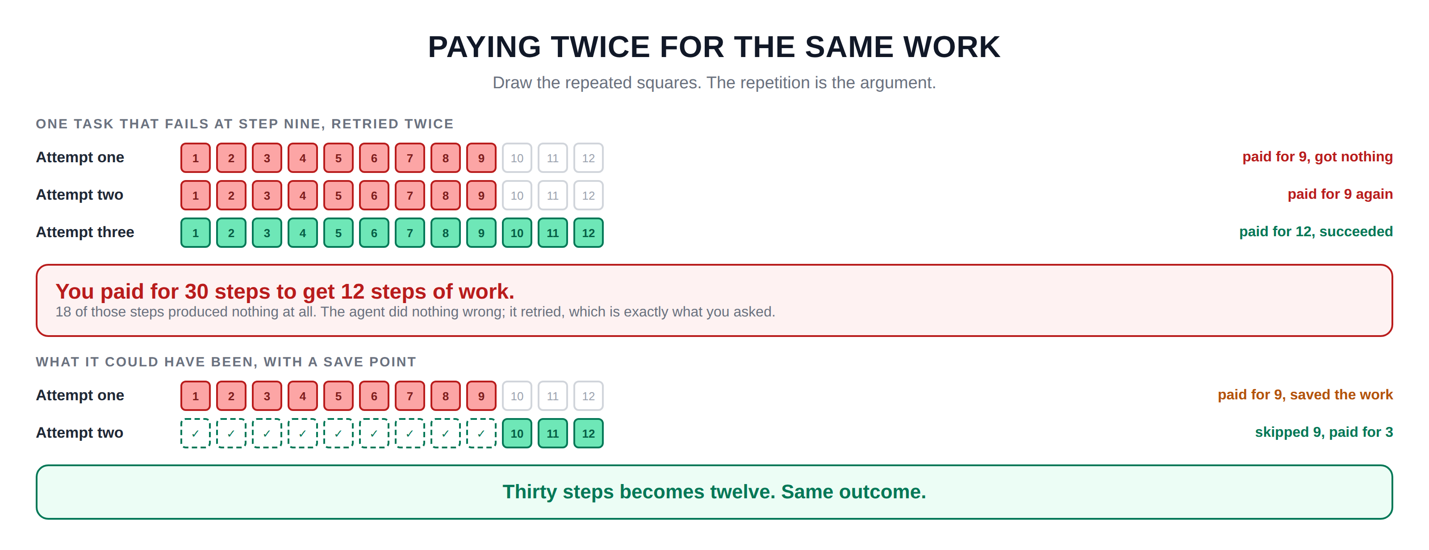
Hidden slide · presenter reference · 01 · Paying Twice
iPAD · DRAW
Draw the three attempts
New iPad page. Draw the step rows as small numbered squares; the visual repetition is the argument.
Heading: one task that fails at step nine, retried twice
A row of twelve small numbered squares. Shade the first nine, leave three empty. Label it attempt one; on the right: paid for nine, got nothing
An identical second row, same nine shaded. Attempt two; on the right: paid for nine again
A third row with all twelve shaded in another colour. Attempt three; on the right: paid for twelve, succeeded
Wide box underneath, large: you paid for thirty steps to get twelve steps of work. Then: eighteen produced nothing · the agent did nothing wrong, it retried
Second heading lower down: what it could have been
The first attempt row again, nine of twelve shaded; on the right: paid for nine, saved the work
Second row: the first nine squares dashed with a tick inside, only the last three shaded. Attempt two; on the right: skipped nine, paid for three
At the very bottom: thirty steps becomes twelve, same outcome
FINISHED PANEL: WHAT YOURS SHOULD LOOK LIKE
Say: “Draw the repeated squares. The repetition is the argument.”
Agent Cost Control · Module 4
9
Notes:
[HIDDEN SLIDE — iPad segment. Skip in slideshow.]
Production note — New iPad page. Draw the step rows as small numbered squares; the visual repetition is the argument.
SAY:
Let's draw the three attempts, because seeing the same steps repeat makes the waste obvious.
THEN SAY:
Those two pictures side by side are the entire business case for this module. And notice what did not change: the answer the user gets is identical. This is the rare kind of saving that costs you nothing in quality, which is why I would do it before touching model choice or prompt size.
→ Next: the loops that never finish at all.

Slide 10
02
Three Shapes a Loop Can Take
~8 min
Notes:
Retries waste money on work that could have succeeded. Loops waste money on work that was never going to.

Slide 11
02 · LOOP SHAPES
Only the first one is obvious
STUCK
BOUNCING
DRIFTING
the same thing, over and over
flipping between two things
always something slightly new
search("invoice")
search("invoice")
search("invoice")
read_file("a.csv")
parse_file("a.csv")
read_file("a.csv")
search("invoice 1")
search("invoice 2")
search("invoice 3")
Identical calls; easy to spot.
Looks like progress; a two-step circle.
No repetition at all; the hardest.
Agent Cost Control · Module 4
11
Notes:
The first shape is stuck. The agent does exactly the same thing over and over. It searches for the same phrase, gets the same unhelpful result, and searches again, identically. This is the easy one; the calls are identical, so you can spot it by remembering the last few and checking whether this one matches.
The second shape is bouncing. The agent flips between two things, forever. It reads a file, tries to parse it, fails, decides it should read the file again, parses it again, and round it goes. No single call repeats immediately. Every step looks different from the one before it. It looks like progress. It is not; it is a two-step circle.
The third shape is drifting, and it is the hardest. The agent always does something slightly new. It searches for invoice one, then invoice two, then invoice three. Nothing ever repeats. You cannot catch that by looking for repetition, because there is no repetition. It just never finishes.

Slide 12
02 · LOOP SHAPES
How you catch each one
STUCK
Remember the last few calls; if this one matches, stop.
BOUNCING
Remember more of them; if you have seen this pair before, stop.
DRIFTING
You cannot spot the pattern, so a step limit catches it instead.
This is why you need a step limit even after you build loop detection. Detection catches the patterns you can describe; a ceiling catches everything else.
Agent Cost Control · Module 4
12
Notes:
That is exactly why you need a step limit even after you have built loop detection. Loop detection catches the patterns you can describe. A step limit catches everything else, including the shapes you have not thought of yet. Those two together, a detector for the obvious cases and a hard ceiling for everything else, is the complete answer.
Start with the first one. Detecting identical repeated calls takes about ten lines of code and catches the most common loop by a wide margin. The bouncing case is worth adding later. Drifting you do not try to detect at all; you let the ceiling handle it.

Slide 13
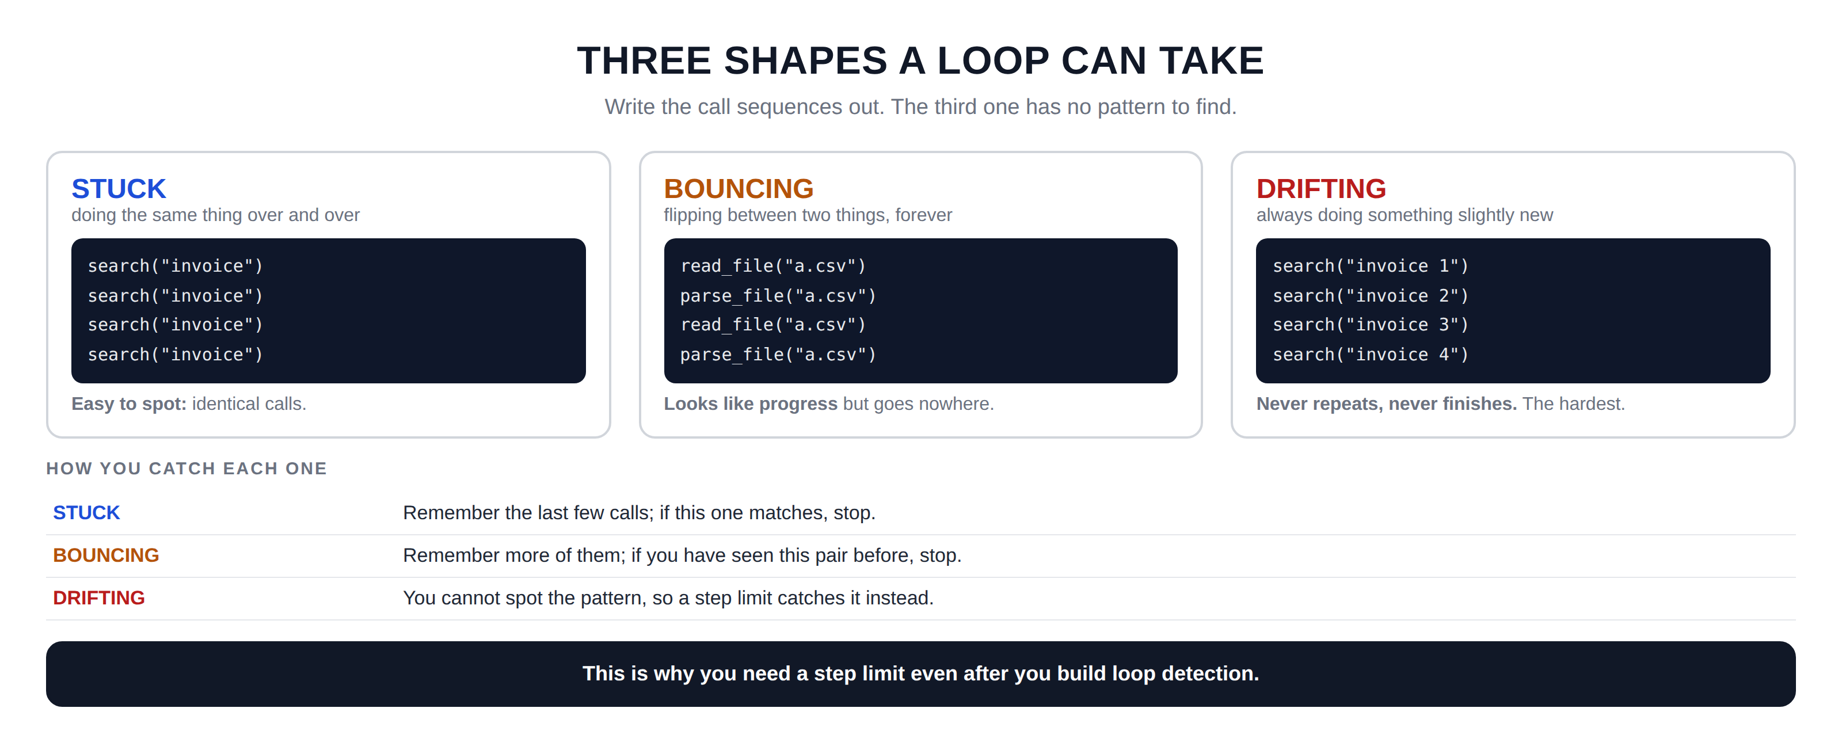
Hidden slide · presenter reference · 02 · Loop Shapes
iPAD · DRAW
Draw the three shapes
New iPad page. Write out the actual call sequences; seeing the pattern is what teaches it.
Three tall cards: STUCK · BOUNCING · DRIFTING
STUCK: doing the same thing over and over. In a dark box, the same call four times: search("invoice"). Under it: easy to spot, identical calls
BOUNCING: flipping between two things forever. Four calls alternating: read_file, parse_file, read_file, parse_file. Under it: looks like progress but goes nowhere
DRIFTING: always something slightly new. Four different calls: search invoice 1, 2, 3, 4. Under it: never repeats, never finishes; the hardest
Below the cards, a heading: how you catch each one, then three rows
STUCK: remember the last few calls, and if this one matches, stop
BOUNCING: remember more of them, and if you have seen this pair before, stop
DRIFTING: you cannot spot the pattern, so a step limit catches it instead. At the very bottom: this is why you need a step limit even after you build loop detection
FINISHED PANEL: WHAT YOURS SHOULD LOOK LIKE
Say: “Write the call sequences out. The third one has no pattern to find.”
Agent Cost Control · Module 4
13
Notes:
[HIDDEN SLIDE — iPad segment. Skip in slideshow.]
Production note — New iPad page. Write out the actual call sequences; seeing the pattern is what teaches it.
SAY:
Let's draw all three shapes with real call sequences, so you can see why two of them hide.
THEN SAY:
Start with the first one. Detecting identical repeated calls takes about ten lines of code and catches the most common loop by a wide margin. The bouncing case is worth adding later. Drifting you do not try to detect at all; you let the ceiling handle it, which is the next section.
→ Next: choosing the ceiling.

Slide 14
03
How Many Steps Is Too Many?
~7 min
Notes:
A step limit is the simplest control in this course. The only real question is what number to use.

Slide 15
03 · HOW MANY STEPS
Do not guess; you already have the data
In module two you started recording every run. Go and look at your successful runs and ask one question: how many steps did they actually use?
1
Look at your successful runs
From module 2. Count the steps each one used.
2
Find the number that covers almost all
Say 95 out of every 100.
3
Add a little headroom
Your data is from the past; next month may be harder.
4
Write down what it would have blocked
And if that number is not zero, say so out loud.
A step limit and a cost cap are not the same thing, and you want both.
Agent Cost Control · Module 4
15
Notes:
There is a temptation to guess; to pick twenty because it sounds generous, or fifty because you do not want to block anything. Do not guess. You already have the data.
In module two you started recording every run. Go and look at your successful runs and ask a simple question: how many steps did they actually use? What you will almost certainly find is that most tasks finish quickly. A big cluster around three, four, five steps. Then a tail stretching out to the right.
Find the number that covers nearly all of your successful runs, say ninety-five out of a hundred. Then add a bit of headroom, because your data is from the past and next month might be slightly harder. That is your ceiling. It came from your own system rather than from a feeling.
One last thing: a step limit and a cost cap are not the same thing and you want both. A run can use very few steps and still be expensive if each step carries a huge amount of history. And a run can take many cheap steps. They catch different failures.

Slide 16
03 · HOW MANY STEPS
Whatever number you pick,
some real tasks will hit it.
If your ceiling covers ninety-five percent of successful runs, then five percent of the work that would have succeeded is now going to be stopped.
Write that number down. Say it out loud to whoever owns the work.
The alternative is having no ceiling at all, and we already know what that costs; that was module one.
Agent Cost Control · Module 4
16
Notes:
Now the honest part, and I want to be clear about it because this is where people quietly fool themselves.
Whatever number you pick, some real tasks will hit it. If your ceiling covers ninety-five percent of successful runs, then five percent of the work that would have succeeded is now going to be stopped. Write that number down. Say it out loud to whoever owns the work. Because the alternative to blocking five percent of tasks is having no ceiling at all, and we already know what that costs; that was module one.
There is a real trade being made here, and it is much better made openly than discovered later by someone whose task got stopped.

Slide 17
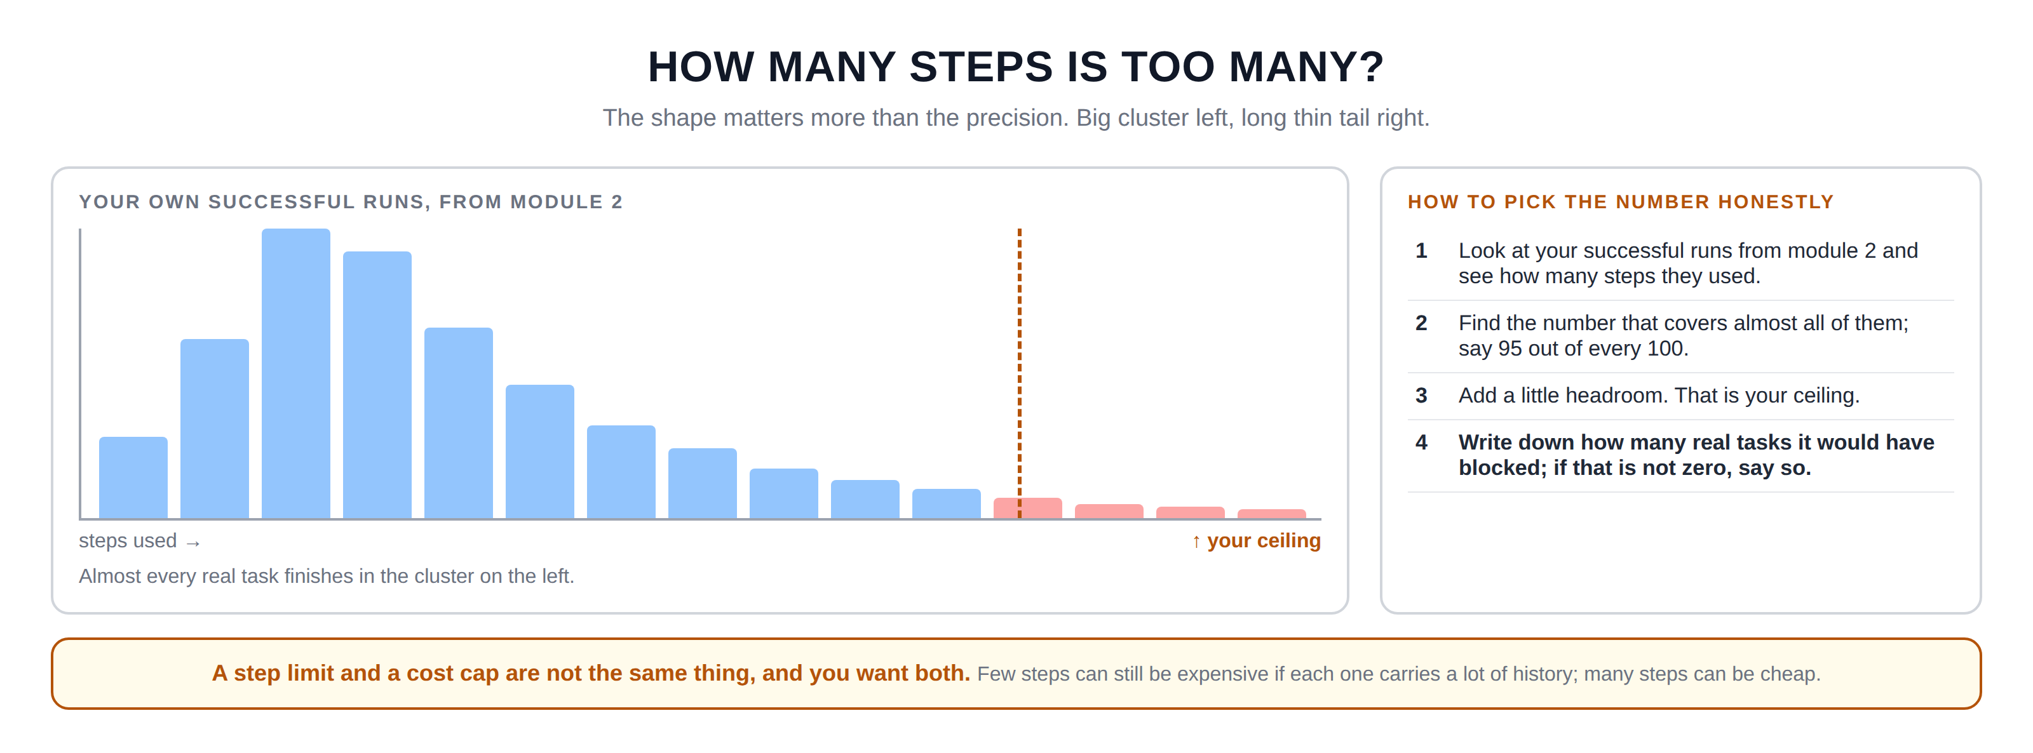
Hidden slide · presenter reference · 03 · How Many Steps
iPAD · DRAW
Draw your own step distribution
New iPad page. Draw the histogram shape roughly; the long tail is the point, not precision.
A pair of axes. Up the left: how many runs. Along the bottom: steps used
A row of bars: short at one step, taller at two, tallest around three or four, then shorter and shorter to the right; a long thin tail out to fifteen
A vertical dashed line in the tail, around twelve, labelled: your ceiling
Shade the bars left of that line one colour and the few to the right in another
An arrow pointing at the big cluster: almost every real task finishes in here
Wide box underneath titled: how to pick the number honestly, with four numbered lines
One: look at your successful runs from module two. Two: find the number that covers 95 of every 100. Three: add a little headroom; that is your ceiling. Four: write down how many real tasks it would have blocked, and if it is not zero, say so
FINISHED PANEL: WHAT YOURS SHOULD LOOK LIKE
Say: “The shape matters more than the precision. Big cluster left, long thin tail right.”
Agent Cost Control · Module 4
17
Notes:
[HIDDEN SLIDE — iPad segment. Skip in slideshow.]
Production note — New iPad page. Draw the histogram shape roughly; the long tail is the point, not precision.
SAY:
Let's draw what your own data will look like, and pick the number off it.
THEN SAY:
That fourth line is the one people skip, and it is the one that matters when someone comes to you in three weeks saying their task was stopped. If you already knew and already said so, that is a conversation about the trade-off. If you did not, it looks like your control broke their work.
→ Next: not starting from zero.

Slide 18
04
A Checkpoint Is a Save Point
~8 min
Notes:
If you have ever played a video game, you already understand this completely.

Slide 19
04 · SAVE POINTS
Without save points, every death costs everything
You die, and you start again from the last save point; not from the very beginning of the game. Agents work exactly the same way, and by default they have no save points at all.
WITHOUT CHECKPOINTS
WITH CHECKPOINTS
Nine steps finish. All of it is held in memory, inside the running program. The run stops, memory clears, and all nine steps are gone.
Each finished step is written down outside the program. The run stops, something restarts it, and it picks up at step ten.
A file on disk, a row in a small table, or Redis. This does not need special software.
Agent Cost Control · Module 4
19
Notes:
Here is what actually happens without them. A run gets through nine steps. All the results from those nine steps are held in memory, inside that running program. Then the run stops; it hits a cap, it crashes, the machine restarts, whatever. The program ends, memory is cleared, and all nine steps are simply gone.
With checkpoints, each finished step gets written down somewhere outside the program. When the run stops and something restarts it, it reads what was already done and picks up at step ten.
Where do you put it? Almost anywhere. A file on disk. A row in a small table. Redis if you already have it. This genuinely does not need special software, and I want to say that clearly because checkpointing sounds like a big infrastructure topic and for most agents it is a small file.

Slide 20
04 · SAVE POINTS
What to write down, and what is safe to resume
Which step
What you found
The run ID
just a number
results from the steps that finished
from module 2, so you find the right save point
ALWAYS SAFE TO RESUME
NEEDS THOUGHT
Steps that only read: a search, a lookup, a calculation.
Steps that send, write, charge or delete. Resume from step five and you may send that email twice.
Writing a checkpoint costs a little time on every step. For twelve steps that is nothing; for thousands, checkpoint every tenth.
Agent Cost Control · Module 4
20
Notes:
What do you actually write down? Three things. Which step you got to; just a number. What you found; the results from the steps that finished. And the run ID from module two, so you can find the right save point when you come back.
Two honest cautions before you build it. First, writing a checkpoint costs something; a little time on every step. For a twelve-step task that is nothing. For a task with thousands of tiny steps it might matter, and you would checkpoint every tenth step instead of every one.
Second, and more important: not everything is safe to resume. If step seven sent an email, and you resume from step five, you might send it twice. So before you resume, ask what each step actually did. Steps that only read things are always safe. Steps that change something in the outside world need thought.

Slide 21
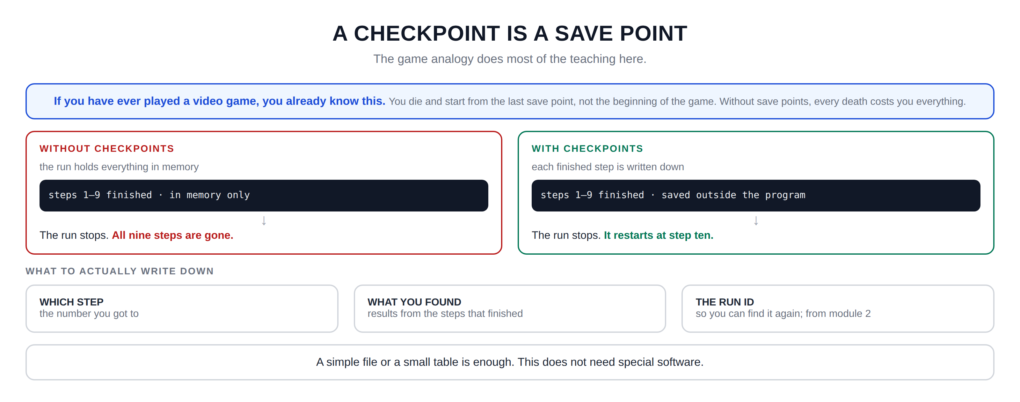
Hidden slide · presenter reference · 04 · Save Points
iPAD · DRAW
Draw the save points
New iPad page. Game analogy at the top, then the two-column comparison, then what to save.
Wide box at the top with the analogy: you die and start from the last save point, not the beginning. Without save points, every death costs you everything
Two boxes side by side. Left: WITHOUT CHECKPOINTS, noted: the run holds everything in memory
Inside it, a small box: steps one to nine finished, in memory only. Arrow down to: the run stops, and all nine steps are gone
Right: WITH CHECKPOINTS, noted: each finished step is written down. Inside: steps one to nine finished, and saved. Arrow down to: the run stops, and it restarts at step ten
Heading underneath: what to actually write down, then three small boxes
WHICH STEP: the number you got to. WHAT YOU FOUND: results from the steps that finished. THE RUN ID: so you can find it again, from module two
At the bottom: a simple file or a small table is enough; this does not need special software
FINISHED PANEL: WHAT YOURS SHOULD LOOK LIKE
Say: “The game analogy does most of the teaching here.”
Agent Cost Control · Module 4
21
Notes:
[HIDDEN SLIDE — iPad segment. Skip in slideshow.]
Production note — New iPad page. Game analogy at the top, then the two-column comparison, then what to save.
SAY:
Let's draw the difference between having save points and not.
THEN SAY:
Before you build this, write down one sentence for each step of your agent saying whether it is safe to run twice. Steps that only read something, a search, a lookup, a calculation, are always safe. Steps that send, write, charge, or delete are not. That list takes ten minutes and it is what stops resuming from causing a much worse problem than it solved.
→ Next: measuring how much this is costing you.

Slide 22
05
The Failed-Run Tax
~7 min
Notes:
There is a number, and you can calculate it today from what you recorded in module two.

Slide 23
05 · THE TAX
The share of your spending that bought nothing
61% work that succeeded
39% burned
A real month, from a real agent, before any of this was fixed. Total spend, minus spend on runs that succeeded.
Retries
Loops
Abandoned runs
the same work, paid for more than once
work that was never going to finish
stopped partway, with nothing saved
Thirty to forty percent is common for an agent nobody has tuned. Measure your own number before you optimise anything.
Agent Cost Control · Module 4
23
Notes:
I call it the failed-run tax. It is the share of your spending that bought nothing at all. Take a month of runs. Add up everything you spent. Then add up what you spent on runs that succeeded. The difference is the tax.
The first time people calculate this, the number is usually higher than they expect. Thirty to forty percent is common for an agent nobody has tuned. In the example on screen it is thirty-nine percent, meaning nearly four in every ten bought precisely nothing.
That tax is made of three things, all of which we have now covered. Retries, the same work paid for more than once, from section one. Loops, work that was never going to finish, from section two. And abandoned runs, runs stopped partway with nothing saved, which is the problem checkpoints solve.

Slide 24

05 · THE TAX
Why fix this before switching models
A CHEAPER MODEL
FIXING THE FAILED-RUN TAX
~30%
up to 39%
And your answers usually get worse, followed by weeks of arguing about whether that is acceptable.
And the answers do not get worse at all. Not even slightly. You are simply not buying the same thing twice.
You need the result label from module two. The one we set to unknown and promised to come back to. Until it is set properly you cannot compute this; that is module five's job.
Agent Cost Control · Module 4
24
Notes:
Here is why I wanted you to measure this specifically, rather than just improving things and hoping. The obvious way to reduce agent cost is to switch to a cheaper model. That might save you thirty percent. It will also usually make your answers worse, and you will spend weeks arguing about whether the quality drop is acceptable.
Fixing the failed-run tax saves you up to thirty-nine percent in this example, and the answers do not get worse at all. Not even slightly. You are simply not buying the same thing twice. That is a genuinely rare kind of improvement.
One practical note on calculating this. You need the result label from module two, the one we set to unknown and promised to come back to. If you have not set it properly yet, you cannot compute this number. That is module five's job, and it is the last piece before the dashboard.

Slide 25
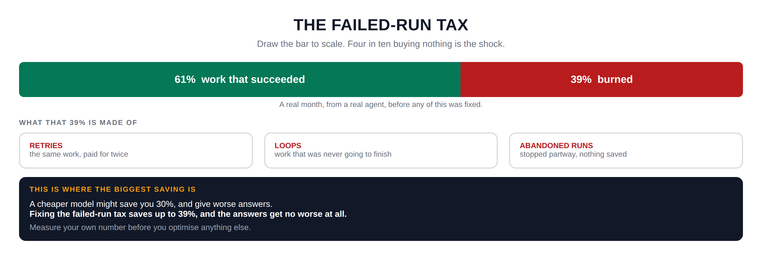
Hidden slide · presenter reference · 05 · The Tax
iPAD · DRAW
Draw the tax
New iPad page. Draw the split bar to scale; the visual proportion is the shock.
One long horizontal bar across the top of the page
Shade about sixty percent from the left in one colour: work that succeeded. The remaining forty percent in a contrasting colour: burned
Put the percentages inside each part, sixty-one and thirty-nine. Underneath: a real month, from a real agent, before any of this was fixed
Heading below the bar: what that thirty-nine percent is made of, then three boxes
RETRIES: the same work, paid for twice. LOOPS: work that was never going to finish. ABANDONED RUNS: stopped partway, nothing saved
A final wide box titled: this is where the biggest saving is
Inside: a cheaper model might save thirty percent, and give worse answers · fixing the failed-run tax saves up to thirty-nine percent, and the answers get no worse
At the bottom: measure your own number before you optimise anything else
FINISHED PANEL: WHAT YOURS SHOULD LOOK LIKE
Say: “Draw the bar to scale. Four in ten buying nothing is the shock.”
Agent Cost Control · Module 4
25
Notes:
[HIDDEN SLIDE — iPad segment. Skip in slideshow.]
Production note — New iPad page. Draw the split bar to scale; the visual proportion is the shock.
SAY:
Let's draw the tax, and then what it is made of.
THEN SAY:
One practical note on calculating this. You need the result label from module two, the one we set to unknown and promised to come back to. If you have not set it properly yet, you cannot compute this number. That is module five's job, and it is the last piece before the dashboard.
→ Last section: build all of it.

Slide 26
06
Build It: Stop Paying Twice
~10 min
Notes:
Four things to add: a step limit, loop detection, checkpoints, and the failed-run tax calculation.

Slide 27
06 · BUILD IT
Five stages; run after every one
STAGE 1
STAGE 2
STAGE 3
The step limit
Loop detection
Checkpoints
A counter in the envelope, checked before each call.
The last few tool calls, checked for a repeat.
A record after each step; skip ahead on restart.
Everything still goes in the envelope from module two.
STAGE 4
STAGE 5
Prove the saving
Calculate your tax
The same failing task with checkpoints off, then on.
A small script over your recorded runs.
Agent Cost Control · Module 4
27
Notes:
Four things to add: a step limit, loop detection, checkpoints, and the failed-run tax calculation. Five stages, running after each. Everything still goes in the envelope from module two.
Production note — Build in an editor with a terminal beside it. Stage 4 is the payoff; let the before-and-after numbers sit on screen.

Slide 28
06 · BUILD IT: STAGE 1 OF 5
The step limit
Keep a count of steps in the run and check it before each model call. At the ceiling, stop the same controlled way your budget cap does: a clear result, not a crash. Read the ceiling from an environment variable so you can change it without editing code.
$ MAX_STEPS=3 python3 run_agent.py --input samples/normal.json
Three is deliberately too low, so a normal task trips it. The message must say which limit it hit: a step limit is not a budget cap, and you will need to tell them apart in a log.
Agent Cost Control · Module 4
28
Notes:
[VS CODE / TERMINAL — TYPE THIS]
Stage one: the step limit. Keep a count of steps in the run, and check it before each model call. If the count is at the ceiling, stop the run the same controlled way your budget cap does; a clear result, not a crash. Set the ceiling from an environment variable so you can change it without editing code.
Three is deliberately too low, so a normal task trips it. Confirm it stops cleanly and says which limit it hit; the message must distinguish a step limit from a budget cap, or you will confuse yourself later.

Slide 29
06 · BUILD IT: STAGE 2 OF 5
Loop detection, the simple kind
Keep a short list of the last few tool calls the agent made, the name and the arguments together as one string. Before making a new call, check whether it is already in that list. If it is, stop.
$ python3 run_agent.py --input samples/loop.json
Your detector should catch it well before the step ceiling fires. Note which one caught it: that tells you the detector is doing real work rather than the ceiling covering for it.
Agent Cost Control · Module 4
29
Notes:
[VS CODE / TERMINAL — TYPE THIS]
Stage two: loop detection, the simple kind. Keep a short list of the last few tool calls the agent made; the name and the arguments together as one string. Before making a new call, check whether it is already in that list. If it is, stop.
The loop sample repeats the same call. Your detector should catch it within a handful of steps, well before the step ceiling fires. Note which one caught it; that tells you the detector is doing real work rather than the ceiling covering for it.

Slide 30
06 · BUILD IT: STAGE 3 OF 5
Checkpoints; stop it, then resume it
After each step completes, write a small record to a file: the run ID, the step number, and the result. At the start of a run, look for an existing checkpoint for that run ID, and if you find one, skip ahead.
$ python3 run_agent.py --input samples/normal.json --run-id test-resume
Let it run partway, then stop it with Control-C. Open the checkpoint file and confirm the finished steps are in it. Then run exactly the same command again:
$ python3 run_agent.py --input samples/normal.json --run-id test-resume
Same run ID, second time. It should skip what it already did and pick up where it left off; count the model calls, and the difference is money you did not spend twice.
Agent Cost Control · Module 4
30
Notes:
[VS CODE / TERMINAL — TYPE THIS]
Stage three: checkpoints. After each step completes, write a small record to a file; the run ID, the step number, and the result of that step. At the start of a run, look for an existing checkpoint for that run ID, and if you find one, skip ahead.
Let that run partway, then stop it with control-C. Look at the checkpoint file and confirm the finished steps are in it.
Same run ID, second time. Watch the output. It should skip the steps it already did and pick up where it left off. Count the model calls it made; fewer than the first attempt. That difference is money you did not spend twice.

Slide 31
06 · BUILD IT: STAGE 4 OF 5
Prove the saving
Run the same failing task twice: once with checkpoints turned off, once with them on. Compare total cost.
$ CHECKPOINTS=off python3 run_agent.py --input samples/flaky.json --retries 3
$ CHECKPOINTS=on python3 run_agent.py --input samples/flaky.json --retries 3
Two numbers. Same task, same retries, same answer. Write both down; that pair is the clearest thing you can show anyone to explain what this module was for.
Agent Cost Control · Module 4
31
Notes:
[VS CODE / TERMINAL — TYPE THIS]
Stage four: prove the saving. Run the same failing task twice; once with checkpoints turned off, once with them on; and compare total cost.
Two numbers. Same task, same retries, same answer. The second one costs substantially less. Write both down, because that pair of numbers is the clearest thing you can show anyone to explain what this module was for.

Slide 32
06 · BUILD IT: STAGE 5 OF 5
Calculate your tax
Write a small script that reads your recorded runs, sums total spend, sums spend on successful runs, and prints the difference as a percentage.
$ python3 failed_run_tax.py --since 30d
That percentage is your number. Keep it.
In module six you will put it on a dashboard, and it becomes the thing you watch to know whether any of this is still working.
Agent Cost Control · Module 4
32
Notes:
[VS CODE / TERMINAL — TYPE THIS]
Stage five: calculate your tax. Write a small script that reads your recorded runs, sums total spend, sums spend on successful runs, and prints the difference as a percentage.
That percentage is your number. Keep it. In module six you will put it on a dashboard, and it becomes the thing you watch to know whether any of this is still working.

Slide 33

RECAP
The module with the biggest saving in it
A ceiling from your data
It notices repetition
It stops after a number of steps you chose from your own successful runs.
The simple loop detector stops it early, before the ceiling has to.
Finished work is written down
You know the waste
A restart does not begin at zero any more.
You have a percentage for the money that bought nothing.
None of it made a single answer worse.
Agent Cost Control · Module 4
33
Notes:
That is module four, and it is the one with the biggest saving in it.
Your agent now stops after a number of steps you chose from your own data. It notices when it is repeating itself and stops early. It writes down finished work so a restart does not begin at zero. And you know what share of your spending has been buying nothing.

Slide 34
WHAT IS STILL MISSING
Every number that depends on
success is still an estimate.
You have been calculating the failed-run tax using whatever you have for a result. But in module two we set that label to unknown and promised to come back to it.
What counts as success? A run that finished without crashing? One that produced an answer? One that produced a correct answer? Three different questions, three different numbers.
Agent Cost Control · Module 4
34
Notes:
I want to flag one thing that is still missing, because it is the last real gap.
You have been calculating the failed-run tax using whatever you have for a result. But back in module two we set that result label to unknown and promised to come back to it. Until that label is set properly, until your system actually knows whether a run succeeded, every number that depends on success is an estimate.
And that turns out to be harder than it sounds. What counts as success? A run that finished without crashing? One that produced an answer? One that produced a correct answer? Those are three different questions and they give three different numbers.

Slide 35
NEXT · MODULE 5 OF 6
What counts as success?
Cost per successful task, and the genuinely difficult part: defining what successful means.
Ceiling · Detection · Save points · The tax
Emmanuel Naweji · github.com/Here2ServeU/agent-cost-control
Notes:
That is module five: cost per successful task, and the genuinely difficult part of defining what successful means. See you there.

Slide 36
APPENDIX A
Exercises: do these before Module 5
01
02
03
04
Find your step distribution
Pick a ceiling, name the cost
Build the step limit
Detect the simple loop
Count the steps each successful run used. Find the number covering 95 of every 100.
Then write down how many real tasks it would have blocked last month, and say it out loud.
Counter plus check. The stop message must distinguish a step limit from a budget cap.
Keep the last few calls as strings. Confirm your detector catches the loop before the ceiling does.
05
06
07
08
List what is safe to resume
Build checkpoints
Prove the saving
Calculate your failed-run tax
One line per step. Reading is safe; sending, writing, charging, deleting are not.
Run ID, step number, results. Stop partway, restart with the same run ID, confirm it skips ahead.
The same flaky task with checkpoints off and on. Keep both costs.
Total spend minus spend on successful runs, as a percentage. Write it down.
Agent Cost Control · Module 4
36
Notes:
Appendix A; exercises before module 5.
1. Find your step distribution. From your module 2 records, count how many steps each successful run used. Sketch the shape. Find the number that covers 95 of every 100 successful runs.
2. Pick a ceiling, and name the cost. Then write down how many real tasks it would have blocked last month, and say that number out loud to whoever owns the work.
3. Build the step limit. Add the counter and the check. Make the stop message clearly distinguish a step limit from a budget cap.
4. Detect the simple loop. Keep the last few tool calls as strings and check for a repeat. Confirm your detector catches the loop sample before the step ceiling does.
5. List what is safe to resume. One line per step of your agent. Reading is safe; sending, writing, charging, deleting are not. Ten minutes, and it prevents a much worse bug.
6. Build checkpoints. Write the run ID, step number and results after each step. Stop a run partway, restart it with the same run ID, and confirm it skips ahead.
7. Prove the saving. Run the same flaky task with checkpoints off and on. Record both costs; that pair of numbers is the most persuasive thing you have.
8. Calculate your failed-run tax. Total spend minus spend on successful runs, as a percentage. Most people are surprised, and it tells you how much is actually available here.

Slide 37
APPENDIX B · EVERY WORD WE USED, IN PLAIN ENGLISH
Glossary: the waste
01
02
03
Paying twice
Loop
Stuck loop
A retry starts from the beginning, not where it stopped. Three attempts at a 12-step task can cost 30 steps.
The agent keeps going without getting closer to finishing; money spent on work that was never going to succeed.
The same call, over and over, identically. The easy one: catch it by remembering the last few calls.
04
05
06
Bouncing loop
Drifting loop
Step limit (ceiling)
Flipping between two things forever. Looks like progress because no single call repeats.
Always something slightly new, never finishing. No pattern to detect; only a step limit catches it.
Stop after this many steps, regardless. Pick it from your own data, and state what it would block.
Agent Cost Control · Module 4
37
Notes:
01 Paying twice : A retry starts from the beginning, not where it stopped. Three attempts at a 12-step task can cost 30 steps.
02 Loop : The agent keeps going without getting closer to finishing; money spent on work that was never going to succeed.
03 Stuck loop : The same call, over and over, identically. The easy one: catch it by remembering the last few calls.
04 Bouncing loop : Flipping between two things forever. Looks like progress because no single call repeats.
05 Drifting loop : Always something slightly new, never finishing. No pattern to detect; only a step limit catches it.
06 Step limit (ceiling) : Stop after this many steps, regardless. Pick it from your own data, and state what it would block.

Slide 38
APPENDIX B · EVERY WORD WE USED, IN PLAIN ENGLISH
Glossary: the fixes
07
08
09
Why you need both
Checkpoint (save point)
What to checkpoint
Detection catches patterns you can describe. A ceiling catches everything else, including shapes you have not met.
Finished work written down outside the program, so a restart does not begin at zero.
Which step you reached, what you found, and the run ID. A file or a small table is enough.
10
11
12
Safe to resume
The failed-run tax
Fix this before models
Steps that only read can run twice safely. Steps that send, write, charge or delete cannot.
The share of spending that bought nothing: total spend minus spend on successful runs. Often 30 to 40 percent.
A cheaper model saves money and makes answers worse. Fixing the tax saves as much and makes them no worse.
Agent Cost Control · Module 4
38
Notes:
07 Why you need both : Detection catches patterns you can describe. A ceiling catches everything else, including shapes you have not met.
08 Checkpoint (save point) : Finished work written down outside the program, so a restart does not begin at zero.
09 What to checkpoint : Which step you reached, what you found, and the run ID. A file or a small table is enough.
10 Safe to resume : Steps that only read can run twice safely. Steps that send, write, charge or delete cannot.
11 The failed-run tax : The share of spending that bought nothing: total spend minus spend on successful runs. Often 30 to 40 percent.
12 Fix this before models : A cheaper model saves money and makes answers worse. Fixing the tax saves as much and makes them no worse.

Slide 39
APPENDIX C: THE COMMANDS, IN PLAIN ENGLISH
Running the samples
MAX_STEPS=3 python3 run_agent.py …
Set the step ceiling for one command only, then run the agent.
--input samples/loop.json
A sample input that makes the agent repeat the same call, to test your detector.
--input samples/flaky.json
A sample that fails partway, so retries and checkpoints have something to work with.
--retries 3
A flag on the course script: try the task up to three times before giving up.
--run-id test-resume
Give the run a fixed name, so the second run finds the first run's checkpoint.
Agent Cost Control · Module 4
39
Notes:
MAX_STEPS=3 python3 run_agent.py … : Set the step ceiling for one command only, then run the agent.
--input samples/loop.json : A sample input that makes the agent repeat the same call, to test your detector.
--input samples/flaky.json : A sample that fails partway, so retries and checkpoints have something to work with.
--retries 3 : A flag on the course script: try the task up to three times before giving up.
--run-id test-resume : Give the run a fixed name, so the second run finds the first run's checkpoint.

Slide 40
APPENDIX C: THE COMMANDS, IN PLAIN ENGLISH
Checking your work
Control-C
Stop the running command by hand. Here it is how you interrupt a run partway through.
CHECKPOINTS=off / CHECKPOINTS=on
The same task, twice, with save points disabled and enabled, so you can compare the cost.
python3 failed_run_tax.py --since 30d
Your own small script: read the last 30 days of runs and print the wasted percentage.
cat checkpoints.json / Get-Content
Print the checkpoint file to confirm the finished steps really were written down.
grep -c 'usage'
From module 1: count model calls, so you can compare the first run with the resumed one.
Agent Cost Control · Module 4
40
Notes:
Control-C : Stop the running command by hand. Here it is how you interrupt a run partway through.
CHECKPOINTS=off / CHECKPOINTS=on : The same task, twice, with save points disabled and enabled, so you can compare the cost.
python3 failed_run_tax.py --since 30d : Your own small script: read the last 30 days of runs and print the wasted percentage.
cat checkpoints.json / Get-Content : Print the checkpoint file to confirm the finished steps really were written down.
grep -c 'usage' : From module 1: count model calls, so you can compare the first run with the resumed one.

