Slide 1


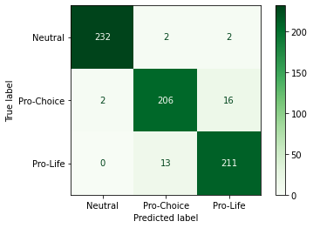


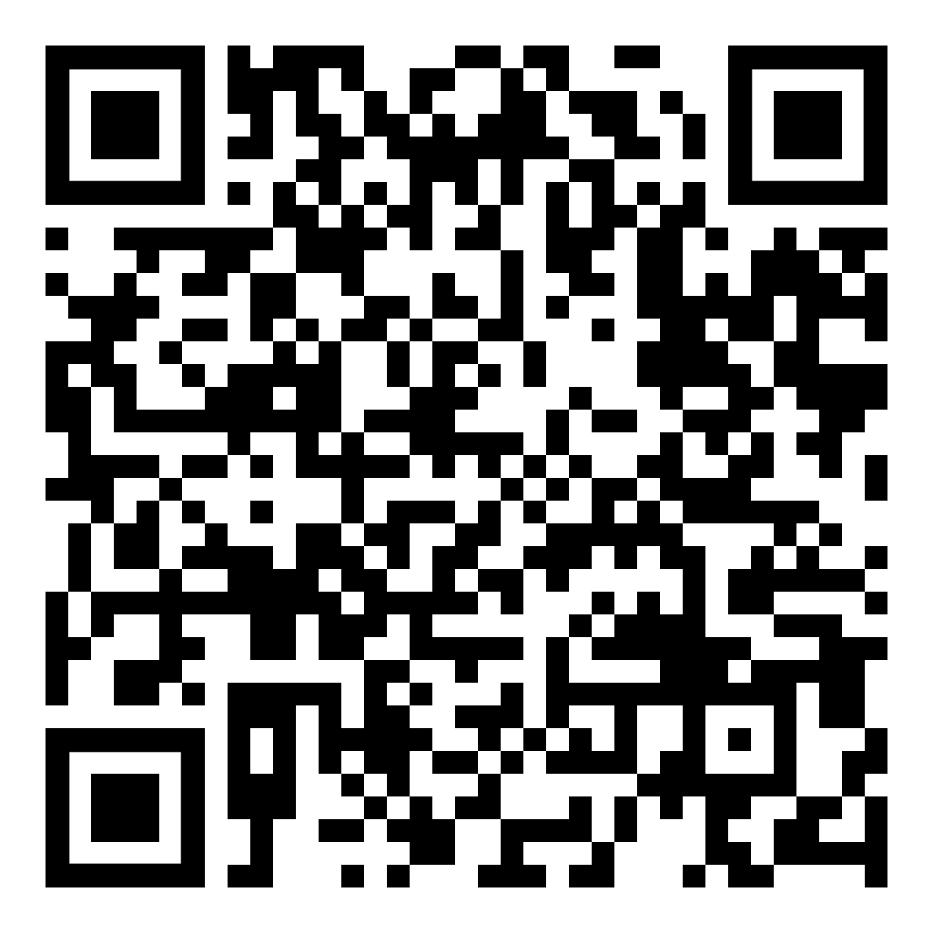

Stance Detection in YouTube Comments
Mark Stowell and Dr. Adita Kulkarni
Department of Computing Sciences, SUNY Brockport, Brockport NY
Abstract
Examples of Annotated YouTube Comments
Results
Confirmation bias is the tendency of humans to favor information that confirms one’s previously existing beliefs. Contemporary debatable issues usually carry some political weight and controversy. Such information is widely available on social media which is one of the primary sources of news across the world. This information is persuasive and promotes conformation bias, which enables internet debates spreading discrimination, misinformation, and hate speech, all of which are crucial problems on social media that need to be addressed. Stance detection focuses on identifying a person’s opinion, either in favor of or against an idea. This work aims to use machine learning for detecting stance of users on social media platform(s) for contemporary controversial issues. In turn, this work will help identify the origin of misinformation and enable the spread of unbiased information. This iteration focuses on social media comments pertaining to abortion from the YouTube platform. Supervised machine learning models were developed using classic machine learning and deep learning architectures with comparable metrics.
Table 1: Examples of Annotated YouTube Comments
Comment | Stance
Its no ones damn business other than the people involved in the situation. This is not political and should not be. | Pro-Choice (in-favor)
I’m pro choice because in many countries where abortion is illegal, I’d be in prison for my natural miscarriages. Want less abortions? Fix the foster care system. Promote better sex education and support better research for pregnancy prevention. | Pro-Choice (in-favor)
If you really don’t want a kid, give it up for adoption. You don’t have to straight up kill it. | Pro-Life (against)
Thank God the baby was born and no one will blame her. She is a beautiful person and deserves her life as all infants deserve life and love. Please pray for those who have been hurt by this horrendous genocide. | Pro-Life (against)
My views are that in a case of incest, rape, or any other case like that it should be a choice but if a woman made a decision to go sleep with someone and where fully aware of the chance of pregnancy and can support a life or give it up for adoption or to a family member then they shouldn’t really have the option of abortion just because they “don’t what a baby” | Neutral
I think if you don’t want the child you can do adoption but if your say in school or the pregnancy is going to make you lose your job then it’s ok. Other than that do adoption so the child can have a life | Neutral
Table 4: Statistical Analysis of Models
Model | Accuracy | Precision | Recall | F1 Score
Non-Transformer Models
SVM | 87.62% | 87.53% | 87.72% | 87.55%
BiLSTM | 80.70% | 81.18% | 80.73% | 80.75%
Transformer Models (Fine-Tuned from Pre-Trained Models)
BERT | 93.12% | 93.09% | 93.07% | 93.08%
DistilBERT | 91.52% | 91.51% | 91.47% | 91.48%
RoBERTa | 94.15% | 94.13% | 94.09% | 94.09%
DeBERTa | 94.88% | 94.83% | 94.82% | 94.82%
Error Analysis (DeBERTa Model)
Table 5: Stance Determination Samples from DeBERTa Model Testing
No. | Comment | Label | Prediction
1 | i think the main problem with the pro life vs pro choice debate is that pro life people only have empathy for the zygotes that are questionably alive at best and the pro choice people only have empathy for the women who are definitely alive and that's why pro choice people win this debate. | Pro-choice | Pro-choice
2 | i hate pro life people | Pro-choice | Pro-life
3 | what about even the fact that making abortions illegal does not reduce the number of abortions. i don’t lean either way but at the end of the day we can’t control what people do and if legalizing abortion at the very least saves the lives of women who they will otherwise risk giving their lives to have them... then they should be legal. | Pro-choice | Neutral
4 | just to put it out there. i’m 16 and for sure pro-life. if you see someone pro-choice, they’ll say they have a fetus or a blob or a mass, not a baby. would you go up to a pregnant woman and say “oh you’re pregnant with a blob or a mass or just a fetus with no function”. absolutely not. | Pro-life | Pro-life
5 | abortion is celebrated in this country! ever hear of adoption? if you don’t want the baby then allow someone who does want the child to raise them. you want sex than you accept the consequences. | Pro-life | Pro-choice
6 | why are there unwanted pregnancies? i am buying you any kind of birth control you want, use several different types if you want. rape, incest, or health of woman, i get. unprotected sex is a choice and can have many undesirable consequences. | Neutral | Neutral
7 | is anyone out there conflicted and not polarized? science says life starts at conception (very early at least), and it’s wrong to tell other women what to do with their bodies and take away their choice. | Neutral | Positive
8 | abortion is always sad. i'm not pro choice or pro life. but this celebration of abortion as a rite of passage for womanhood is demonic. and i'm not christian but even i can see it! | Neutral | Negative
Data Collection
Dataset Statistics
YouTube videos related to abortion were identified using the following queries within the search bar on YouTube:
Query results were sorted by view count and selected arbitrarily through analysis of the video’s title. Examples of selected and ignored videos:
User comments were gathered for selected videos through the YouTube API, accessible via the Google Developers Console.
Dataset was balanced using natural language processing (NLP) augmentation via the nlpaug module.
Dataset elements were randomly assigned to train, validation, or test datasets for model training, validation, and testing (ratio 80:10:10) using train_test_split in the sklearn.model_selection module.
“abortion”
“abortion middle ground”
“abortion compromise”
“pro choice versus pro life”
Table 2: Dataset Breakdown and train/test/validation Split Compositions |  |  | Dataset Breakdown
Partition | Pro-Choice | Pro-Life | Neutral | Total
Train | 1,816 | 1833 | 1818 | 5,467
Validation | 238 | 221 | 224 | 683
Test | 224 | 224 | 236 | 684
Total | 2,278 | 2,278 | 2,278 | 6,834
Selected: “Pro-Choice vs. Pro-Life: Can They See Eye to Eye?”
Ignored: “Praise Abort” (song/music video)
Original and balanced datasets available at: https://github.com/HereBeCode/StanceDetectionML-Brockport
Annotating The Dataset
Models
Figure 1: Confusion Matrix Generated From DeBERTa Model Predictions
Rules and procedures for determining Pro-Choice (in-favor), Pro-Life (against), and neutral stances were established to assist in annotating the dataset, as described below.
Note: Ambiguous or irrelevant comments were discarded.
Non-transformer based models were developed and established as baseline comparators for the transformer based models, the current gold standard for natural language processing tasks. The HuggingFace hub (https://huggingface.co/models) provided pre-trained transformer models for fine-tuning.
Conclusion and Future Direction
Among the models developed, trained, and tested, the DeBERTa fine-tuned model provided the greatest performance in abortion stance prediction with a test accuracy of 94.88%.
Future work includes fine-tuning the abortion model with supplementary dataset samples and building additional stance detection models for other contemporary issues such as universal healthcare, climate change, etc.
Stance | Criteria | Example
Pro-Choice (in-favor) | Explicitly expresses strict pro-choice stance or able to infer implicitly. | “Women should be allowed to decide…”
Pro-Life (against) | Explicitly expresses strict pro-life stance or able to infer implicitly | “Abortion is murder, it should never be allowed…”
Neutral | Expresses either pro-choice or pro-life stance with some exception. | “I believe in choice for the woman up until the second trimester…” “I am pro-life, but agree with abortion in the case of rape or incest…”
Table 3: Models Developed for Training and Testing
Non-Transformer Models
SVM: Support Vector Machine
BiLSTM: Bidirectional Long-Short-Term-Memory Networks
Transformer Models (Fine-Tuned from Pre-Trained Models)
BERT: Bidirectional encoder representations from transformers
DistilBERT: Distilled version of BERT model.
RoBERTa: Robustly Optimized BERT Pretraining Approach
DeBERTa: Decoding-enhanced BERT with Disentangled Attention
/deberta-fine-tuned-abortion-stance-detect
Left: HuggingFace repository containing fine-tuned DeBERTa model for abortion stance detection. Available at: https://huggingface.co/HereBeCode/deberta-fine-tuned-abortion-stance-detect
Right: GitHub repository with all code from project and instructions for future work. Available at: https://github.com/HereBeCode/YouTube-Stance-Detection

