Slide 1
Capstone Project - 4
Netflix Movies and TV Shows Clustering
Submitted by
Praveen Pal

Slide 2

Agenda
Problem Statement
Data Summary
Data Cleaning
Exploratory Data Analysis (EDA)
Feature Engineering
Dimensionality Reduction
Clustering
Word cloud on Clusters
Content Based Recommender System
Challenges Faced
Conclusions

Slide 3

Abstract
Netflix is a popular streaming service and
production firm.
According to approximately
Statista,
220.67
Netflix million
had paid second
subscribers worldwide as of the
quarter of 2022.
It is crucial that they effectively cluster the shows that are hosted on their platform in order to enhance the user experience for its subscribers.

Slide 4

Problem Statement
The goal of this project is to cluster the shows on Netflix such that the shows within a cluster are similar to each other and the shows in different clusters are dissimilar to each other.
These clusters may be later leveraged to offer the consumers personalized show recommendations based on their interests.
The dataset contains 7787 records, and
11 attributes

Slide 5

Data Summary
Show ID
Type – Movie / TV show
Title – Show title
Director – Name of the director
Cast – Name of the cast
Country – Production country
Date added
Release year
Rating – Show age rating
Duration – Minutes / seasons
Listed in - Genre
Description

Slide 6

Data Cleaning
Handling missing values:
  Director (2389), cast (718), and country (507) –
replace with 'Unknown’
  Date added (10) - dropped.
  Rating (7) – mode imputation.
Only primary genre and country were
selected to simplify the EDA
The dataset contained separate age ratings for movies and TV shows, and were replaced with values of: 'Adults', 'Teens', 'Young Adults', 'Older Kids', 'Kids'

Slide 7
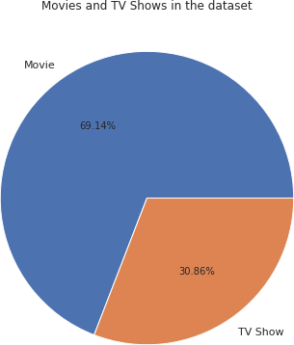
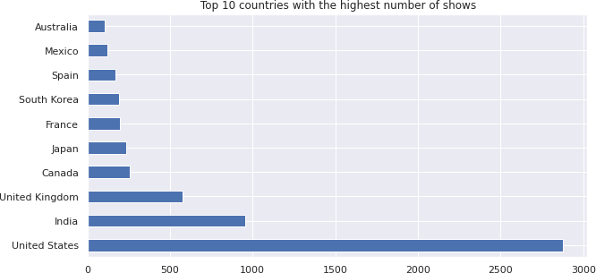
Exploratory Data Analysis (EDA)
69.14% of the shows on Netflix are movies, and 30.86% TV shows.
The top 3 countries together
account for about 56% of all movies and TV shows in the dataset.
This value increases to about
78% for top ten countries.

Slide 8
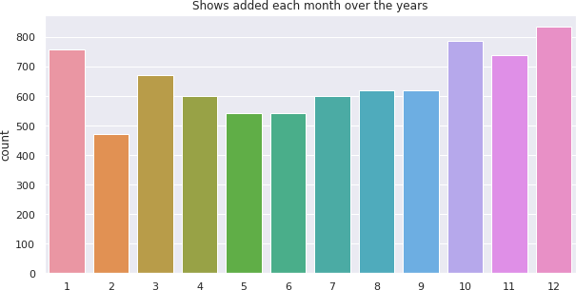
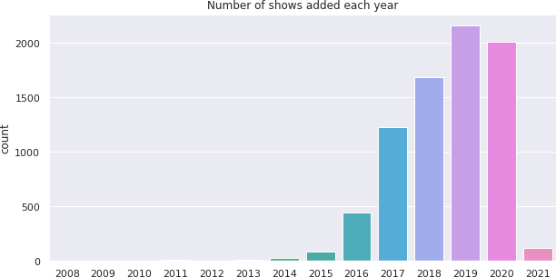
EDA (Contd.)
More shows are added in the months of October, November, December, and January.
There is a decrease in the
number of shows added in the year 2020, which might be attributed to the Covid-induced lockdowns, which halted the creation of shows.
There are very few shows added
in the year 2021, since the data is
available only up to 16th January.

Slide 9
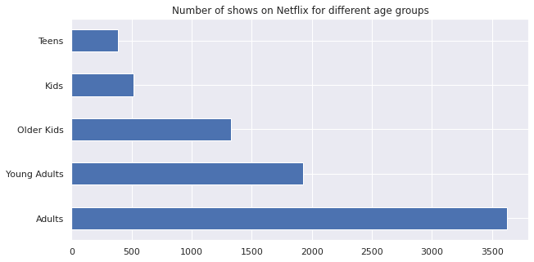
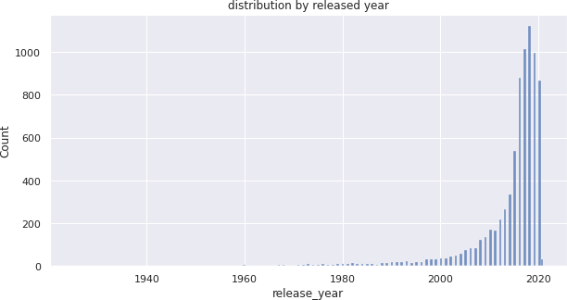
EDA (Contd.)
The majority of the shows on Netflix are catered to the needs of adult and young adult population.
Netflix has greater number of new movies / TV shows than the old ones.

Slide 10
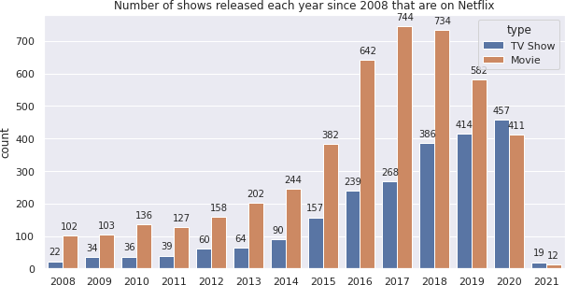
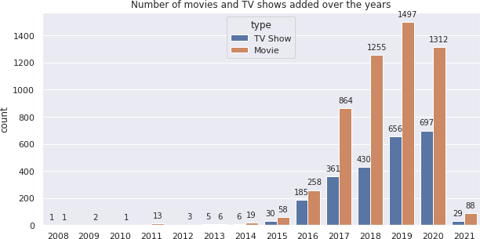
EDA (Contd.)
Though there was a decrease in the number of movies added in 2020, this pattern did not exist in the number of TV shows added in the same year.
This might signal that Netflix is increasingly concentrating on introducing more TV series to its platform rather than movies.

Slide 11
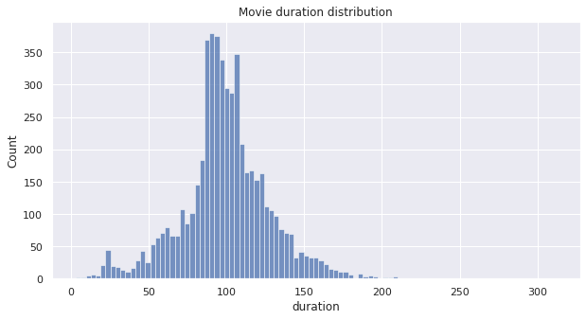
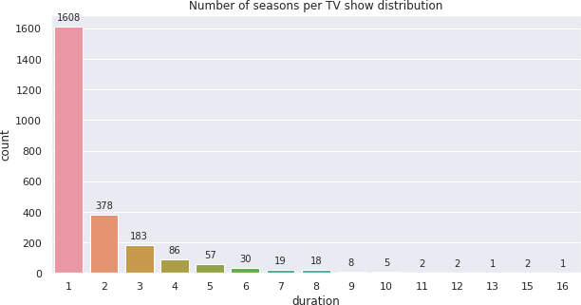
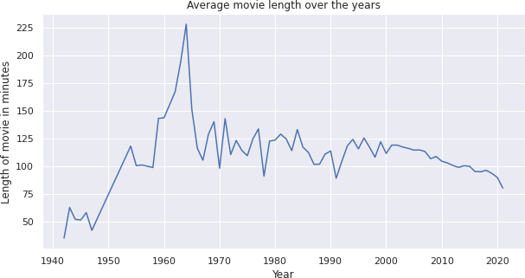
EDA (Contd.)
The length of movies in the are
almost normally distributed.
Majority of the TV shows are still in the 1st season.

Slide 12
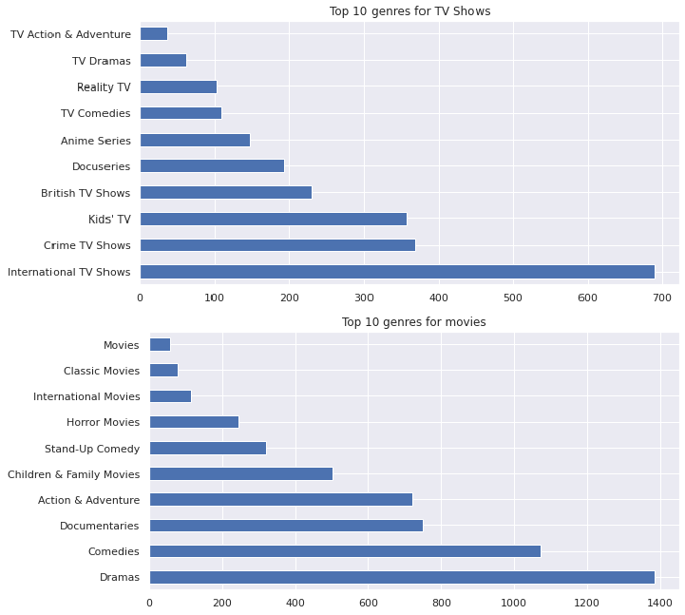
EDA (Contd.)
Dramas, comedies, and documentaries are the most popular genre for the movies on Netflix.
International, crime, and kids are the most popular genre for TV shows on Netflix.

Slide 13
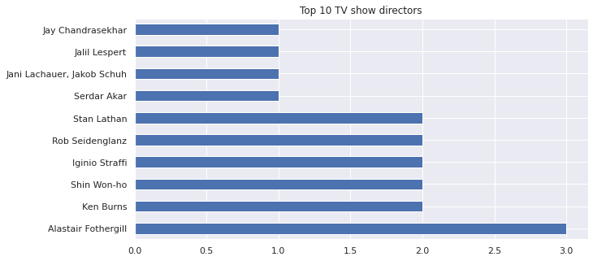
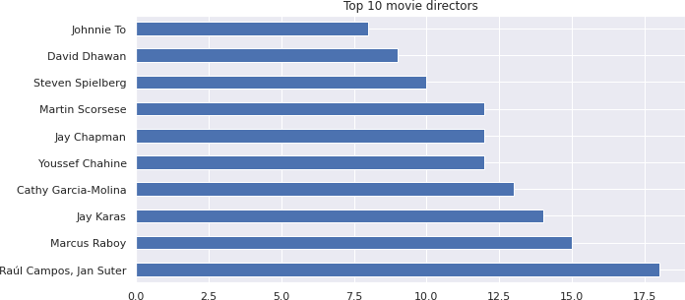
EDA (Contd.)
Raul Campos and Jan Suter have directed 18 movies, higher than anyone yet.
Alastair Fothergill
directed three TV
has shows,
higher than anyone yet.
Only six directors have directed more than one television show.

Slide 14
Feature Engineering
Clusters are built based on the attributes: Director, Cast, Country,
Listed in (genres), and Description
Steps involved in data pre-processing:
  Removing non-ascii characters
  Removing stop words and converting to lowercase
  Removing punctuation marks
  Lemmatization, tokenization and text vectorization
  Dimensionality reduction using PCA

Slide 15
Feature Engineering (Contd.)
TFIDF (Term Frequency Inverse Document Frequency) vectorizer
was used to vectorize the corpus.
Number of times term t appears in a document
𝑻𝑭 =
Total number of terms in the document
Total number of documents Number of documents with term t in it
𝑰𝑫𝑭 = 𝐥𝐨𝐠_{𝒆}
𝑻𝑭𝑰𝑫𝑭 = 𝑻𝑭 × 𝑰𝑫𝑭
Maximum number of features were taken as 20000.

Slide 16
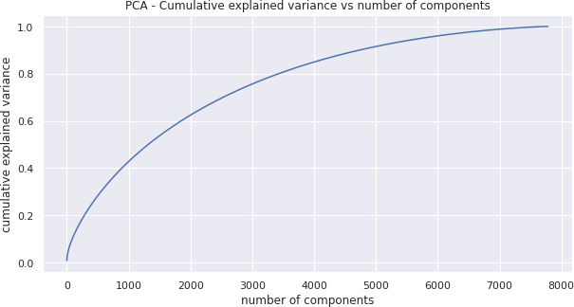
Dimensionality Reduction
100% of the variance in data is explained by about ~7500 components.
To reduce dimensionality, only
the top 4000 components were taken, which will still be able to capture more than 80% of variance in the data.

Slide 17
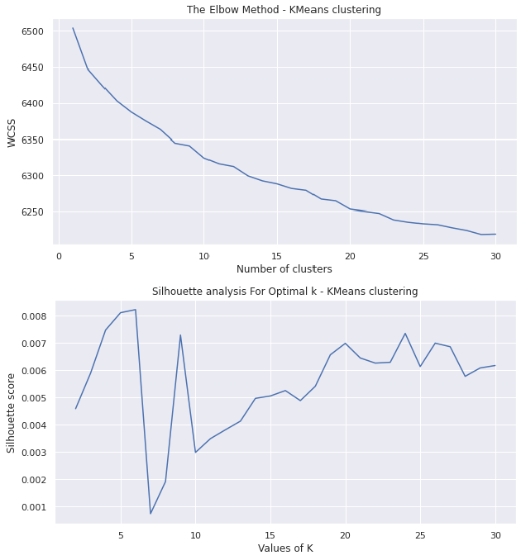
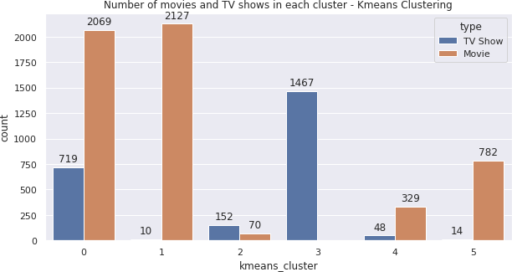
K Means Clustering
Distortion: 6374.78
Silhouette score: 0.0082
Number of clusters: 6

Slide 18
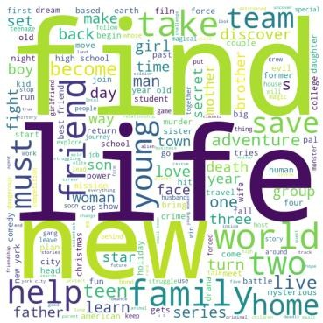
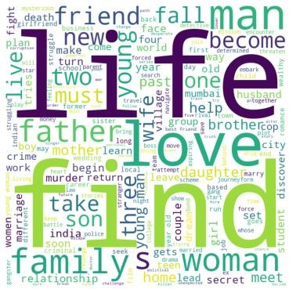
Word Clouds: K Means Clusters
K Means Cluster - 0
K Means Cluster - 1

Slide 19
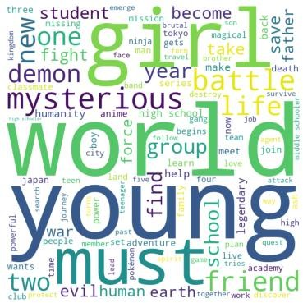
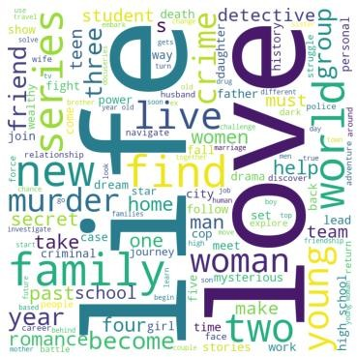
Word Clouds: K Means Clusters (Contd.)
K Means Cluster - 2
K Means Cluster - 3

Slide 20
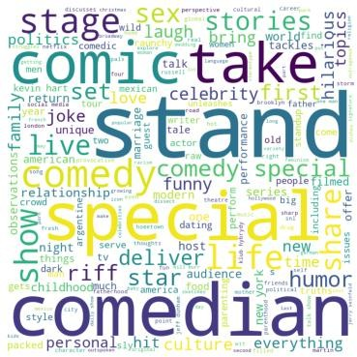
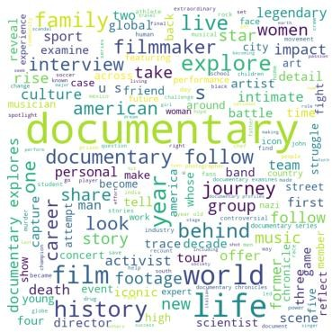
Word Clouds: K Means Clusters (Contd.)
K Means Cluster - 4
K Means Cluster - 5

Slide 21
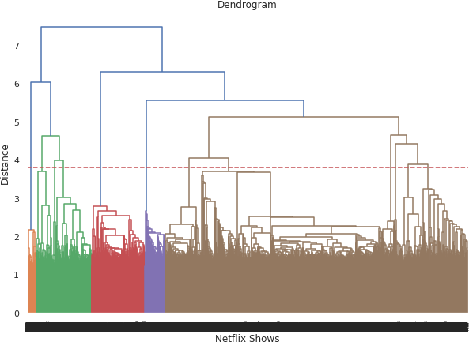
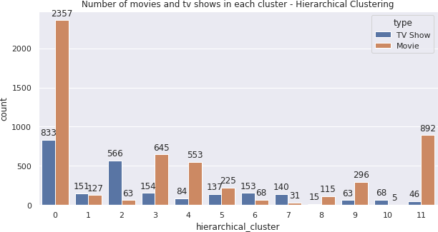
Hierarchical Clustering
Agglomerative clustering.
Distance: Euclidean
Linkage: Ward
Number of clusters: 12

Slide 22
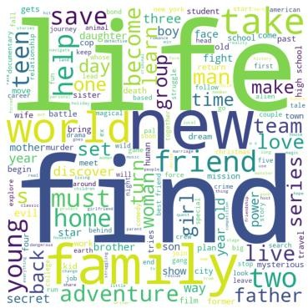
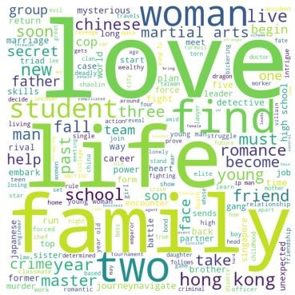
Word Clouds: Hierarchical Clusters
Hierarchical Cluster - 0
Hierarchical Cluster - 1

Slide 23
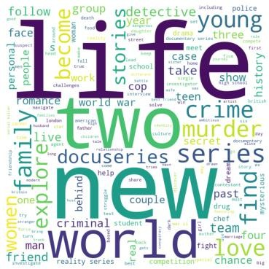
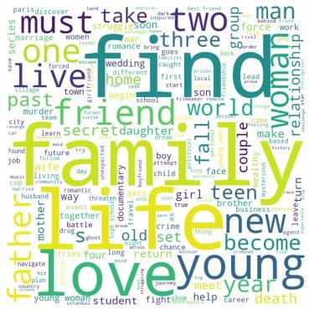
Word Clouds: Hierarchical Clusters (Contd.)
Hierarchical Cluster - 2
Hierarchical Cluster - 3

Slide 24
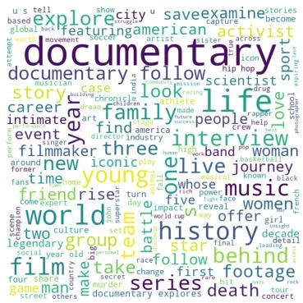
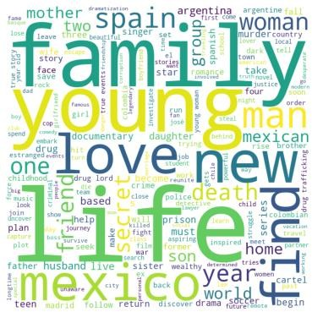
Word Clouds: Hierarchical Clusters (Contd.)
Hierarchical Cluster - 4
Hierarchical Cluster - 5

Slide 25
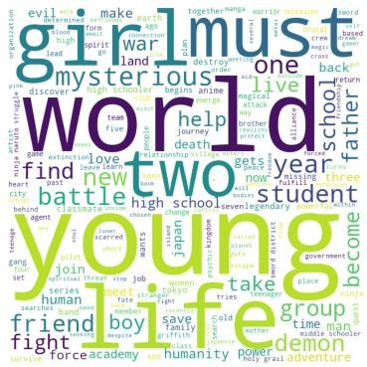
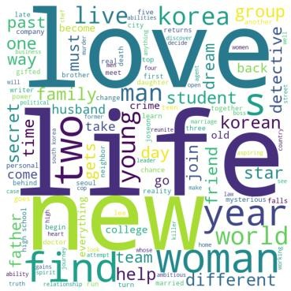
Word Clouds: Hierarchical Clusters (Contd.)
Hierarchical Cluster - 6
Hierarchical Cluster - 7

Slide 26
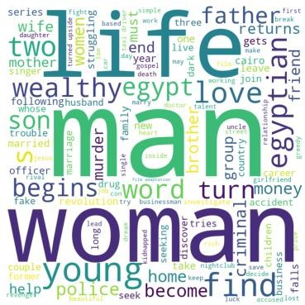
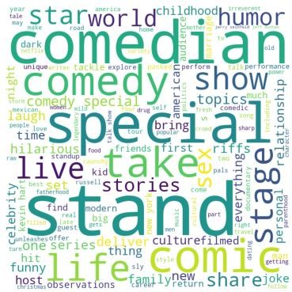
Word Clouds: Hierarchical Clusters (Contd.)
Hierarchical Cluster - 8
Hierarchical Cluster - 9

Slide 27
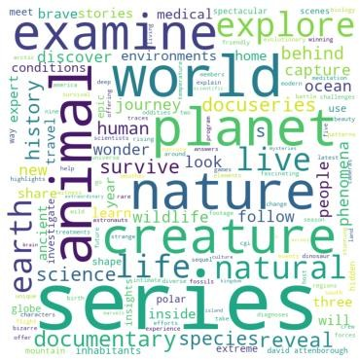
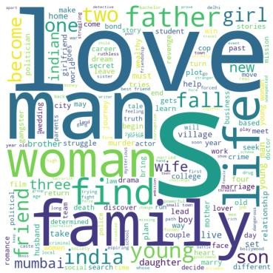
Word Clouds: Hierarchical Clusters (Contd.)
Hierarchical Cluster - 10
Hierarchical Cluster - 11

Slide 28
Content Based Recommender System
We can build a simple content based recommender system based
on the similarity of the shows.
If a person has watched a show on Netflix, the recommender system must be able to recommend a list of similar shows that s/he likes.
To get the similarity score of the shows, we can use cosine similarity
The Cosine Similarity score of two vectors increases as the angle between them decreases.
𝑨 . 𝑩
𝐂𝐨𝐬 𝜽 =
𝑨 . |𝑩|

Slide 29
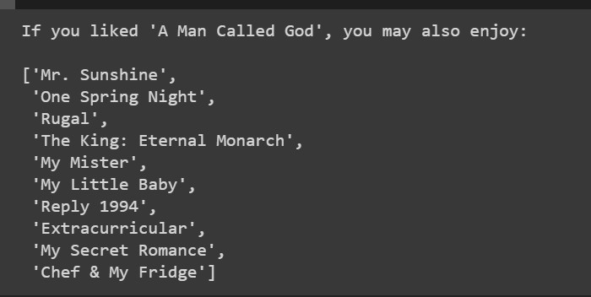
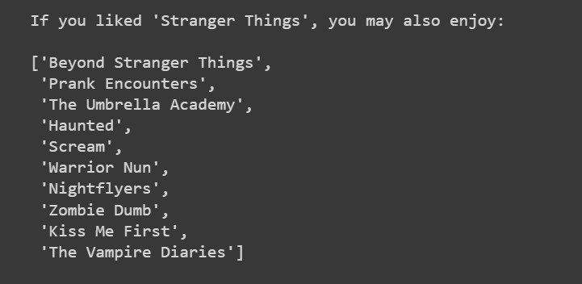
Content Based Recommender System (Contd.)
10 recommendations for the show “A Man Called
“Stranger Things”
God” and

Slide 30
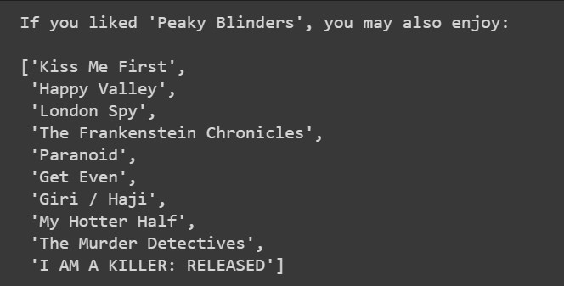
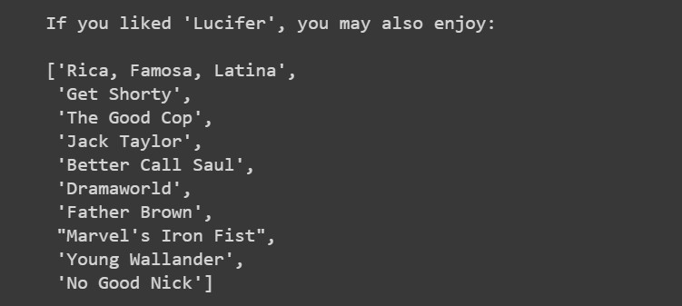
Content Based Recommender System (Contd.)
10 recommendations for the show “Peaky Blinders” and “Lucifer”

Slide 31
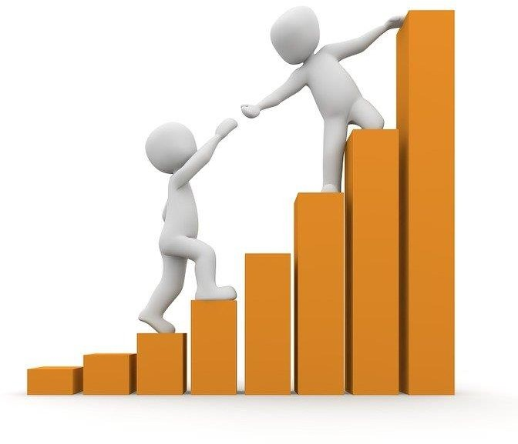
Challenges Faced
Deciding the attributes on which we can
build the clusters
Feature engineering – deciding on the features to be dropped/kept/transformed
Choosing the best visualization to show the trends clearly in the EDA phase
Deciding on ways to handle the missing
values
Deciding on the attributes to be considered for clustering the dataset
High computation time

Slide 32
Conclusions
In this project, we worked on a text clustering problem wherein we had to cluster the Netflix shows such that the shows within a cluster are similar to each other and the shows in different clusters are dissimilar to each other.
The dataset contained about 7787 records, and 11 attributes.
We began by dealing with the dataset's missing values and doing exploratory data analysis (EDA).
It was found that Netflix hosts more movies than TV shows on its platform, and the total number of shows added on Netflix is growing exponentially. Also, majority of the shows were produced in the United States, and the majority of the shows on Netflix were
created for adults and young adults age group.

Slide 33
Conclusions (Contd.)
It was decided to cluster the data based on the attributes: director, cast, country, genre, and description. The values in these attributes were pre-processed, tokenized and then vectorized using TFIDF vectorizer.
Through TFIDF Vectorization, we created a total of 20000 attributes.
We used Principal Component Analysis (PCA) to handle the curse of dimensionality. 4000 components were able to capture more than 80% of variance, and hence, the number of components were restricted to 4000.
We first built clusters using the k-means clustering algorithm, and
the optimal number of clusters came out to be 6. This was obtained
through the elbow method and Silhouette score analysis.

Slide 34
Conclusions (Contd.)
Hierarchical clustering model was built using the Agglomerative clustering algorithm, and the optimal number of clusters came out to be 12. This was obtained after visualizing the dendrogram.
A content-based recommender system was built using the Cosine Similarity score. This recommender system will make 10
recommendations to the user based on the type of show they watch.

Slide 35
Thank You!

