Slide 1
Hotel Summative
By Edgar Daniel L. Moso

Slide 2
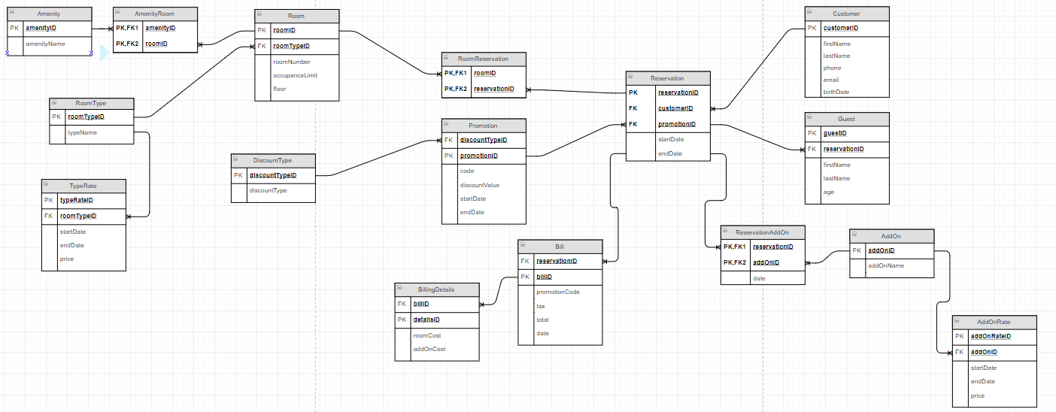
ERD

Slide 3
Problems
Normalization
ERD (Creating Databases)
Kept Messing Up With Table Creations

Slide 4
Queries To Aim
Write a query the returns all rooms for a customer
Write a query that returns room that do not contain a specific amenity
Query all promotion codes & number of times used

