Slide 1
Week Four Summative
By Edgar Daniel L. Moso(Ted)

Slide 2
Assignment
Apply Spring Dependency Injection (DI)
Apply Aspect Oriented Programming (AOP)

Slide 3
Spring DI vs. Regular DI
Dependency Injection:
Allows for loose coupling between DAO, Service Layer (business logic), and View of your application.
With Spring DI
It allows us to externalize our DI
Reduces boilerplate code

Slide 4
Spring Steps
Add Spring Libraries
In pom.xml, we added spring-context dependency
Transitive Dependencies handled by Maven
Configuration files
To externalize our DI (or Constructor Injection)
Modify the App class
Instantiate Application Context object, which we use to get the controller object

Slide 5
Aspect Oriented Programming
Helps us deal with cross cutting concerns, or any other identical code that we end up using repetitively:
With Spring AOP we are able to run methods without adding code to our program
Cross Cutting concerns: logging, security, and transactions

Slide 6
Steps for AOP
Add aspectjtools dependency in our pom.xml file
Create Advice
“what” functionality
Configure Spring AOP in the applicationContext file
Where we set-up our aspect which is associated with the Advice

Slide 7
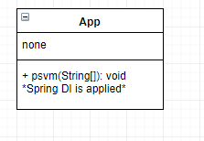
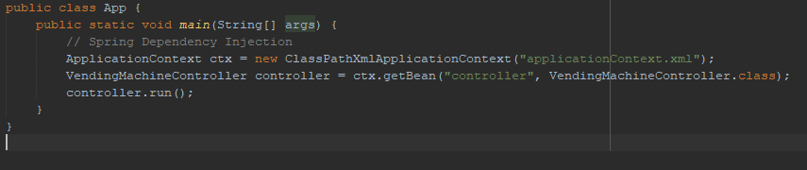
Where Spring DI is Applied

Slide 8
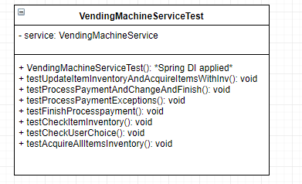
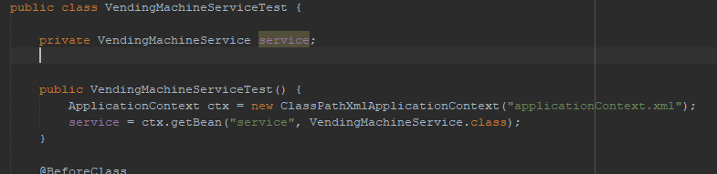

Slide 9
Updated Flow Chart
VendingMachineFlowChart.html

