Slide 1
VENDING MACHINE SUMMATIVE
By Edgar Daniel L. Moso (Ted)

Slide 2
Strategy
List<Items>
Switched to Map<String, Items>

Slide 3
Before And During The Process…
Concerned with Exceptions before the process
But finally understand more about exceptions and how it’s used.
Trouble(s) and Mistake(s) during:
Didn’t read the instructions fully, causing me to prolong the process
Exit Command
BigDecimals
Problem with setting up user input for money in double type
My fix to the problem: Changed to read user input in String type

Slide 4
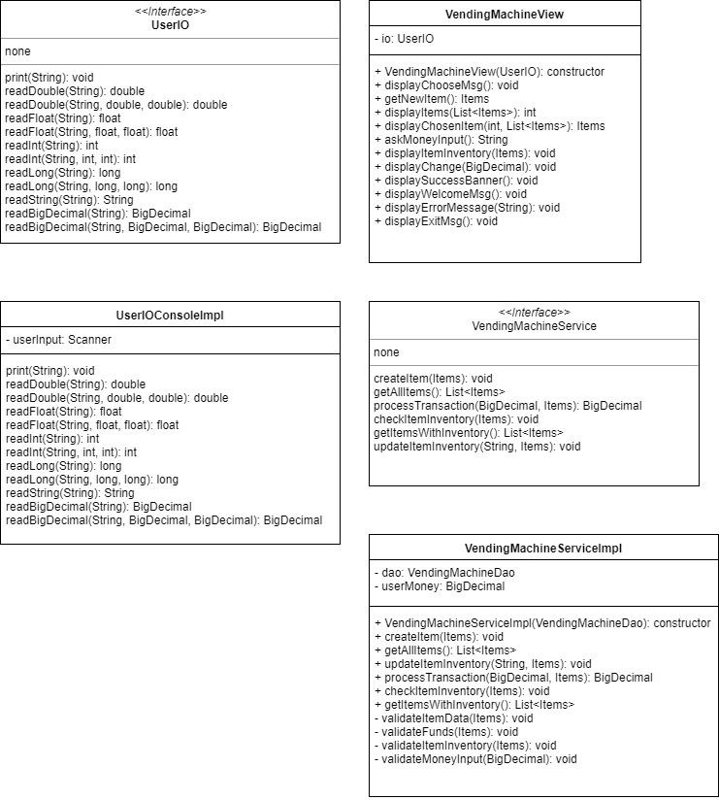
UML
UserIO (Interface)
UserIOConsoleImpl
VendingMachineView
VendingMachineService (Interface)
VendingMachineServiceImpl

Slide 5
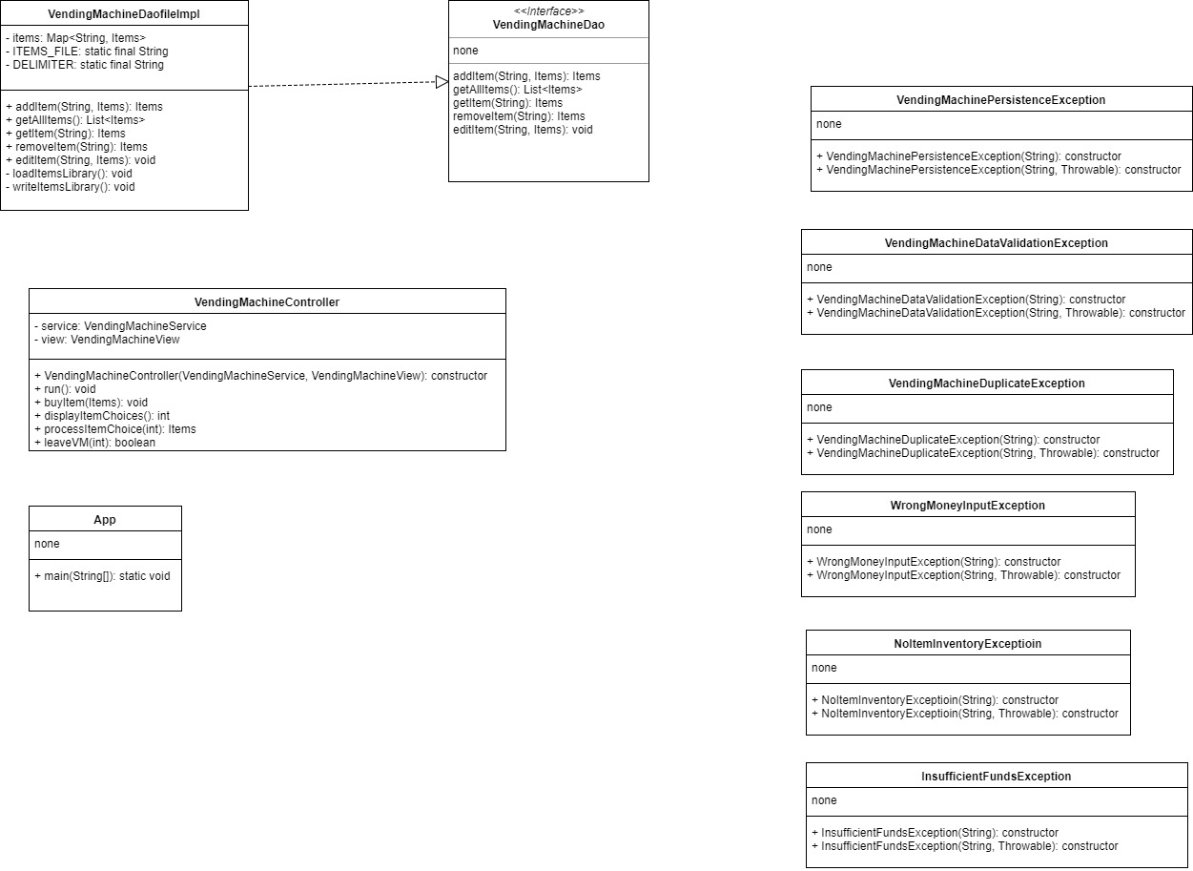
UML cont…
VendingMachineDao (Interface)
VendingMachineDaoFileImpl
VendingMachineController
App
Exceptions

Slide 6
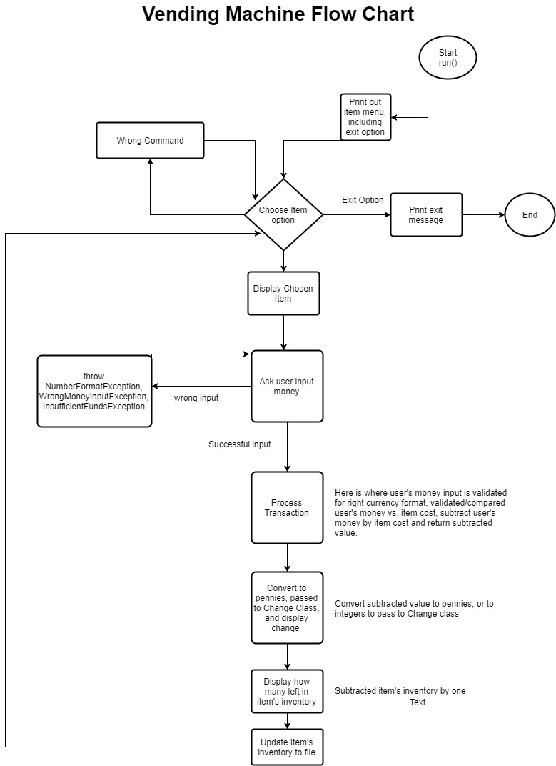
Flow Chart

